Slide 1
News from the GSI test facility SALERNO
D’Agostino D. , Gambardella U., Iannone G., Severino C.
INFN-Sezione di Napoli, Salerno group, Italy.
Ferrentino A., Saggese A.
University of Salerno, Physics Department E.R. Caianiello, Salerno, Italy
Domenico D’Agostino – 3rd Int. Workshop of the Superconducting Magnets Test Stands – Uppsala 11-12 June 2019

Slide 2
Summary
The THor project
System design and preliminary tests
THor Control System
Domenico D’Agostino – 3rd Int. Workshop of the Superconducting Magnets Test Stands – Uppsala 11-12 June 2019

Slide 3
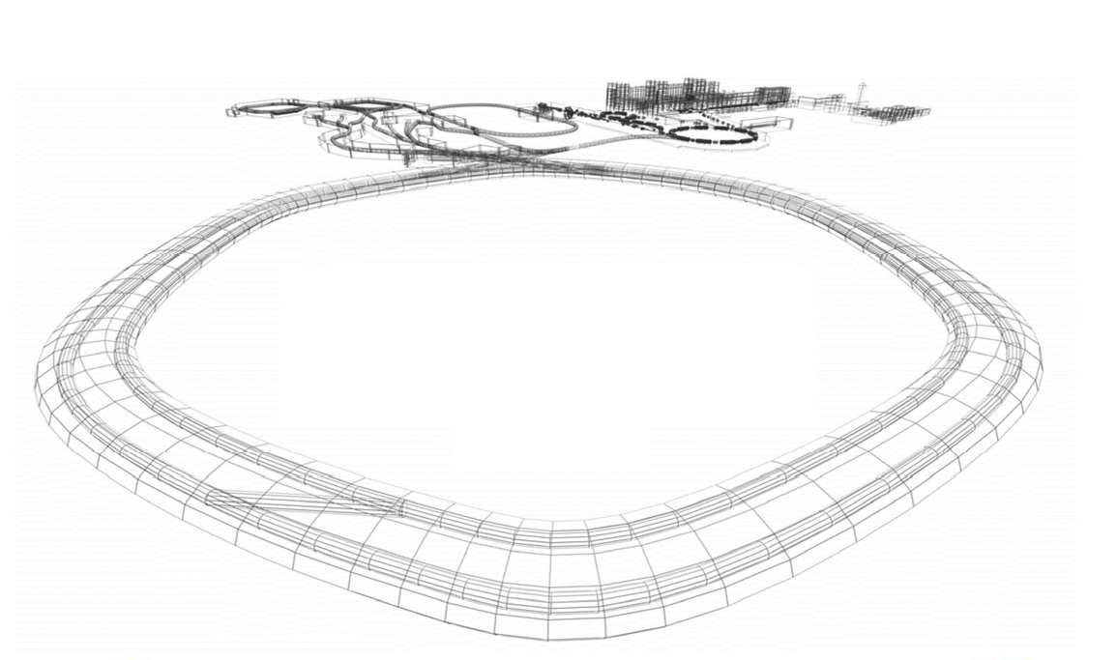
The THor project
THor project (Test in Horizontal) is based on the collaboration with GSI and it is devoted to the test of 81 Quadrupole Doublet Modules (QDM) for SIS-100 synchrotron of FAIR. These QDM are divided in 54 arc type modules, and 27 straight modules.

Slide 4
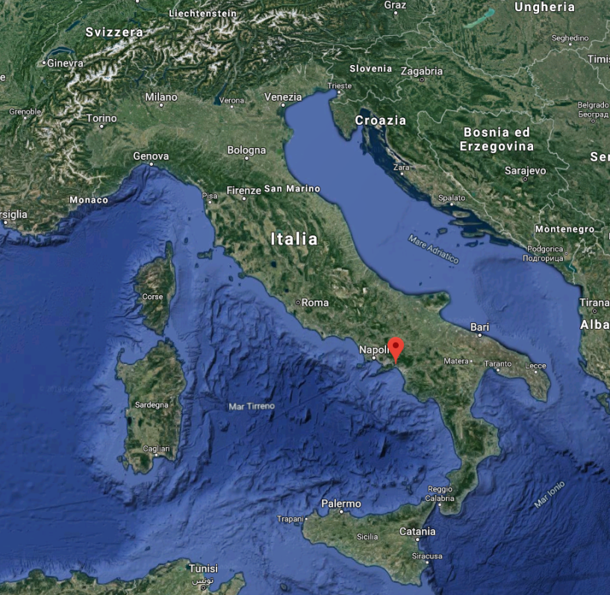
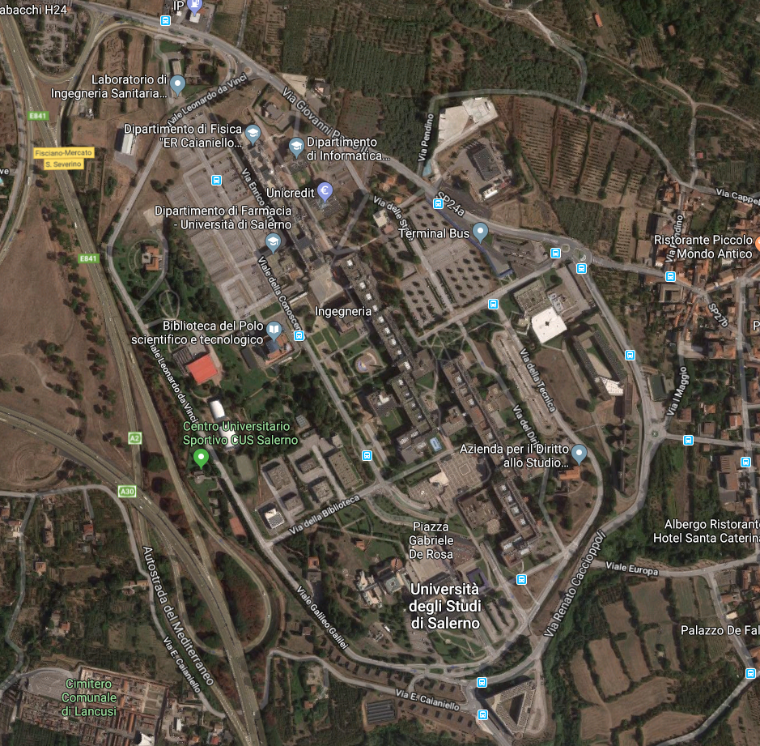
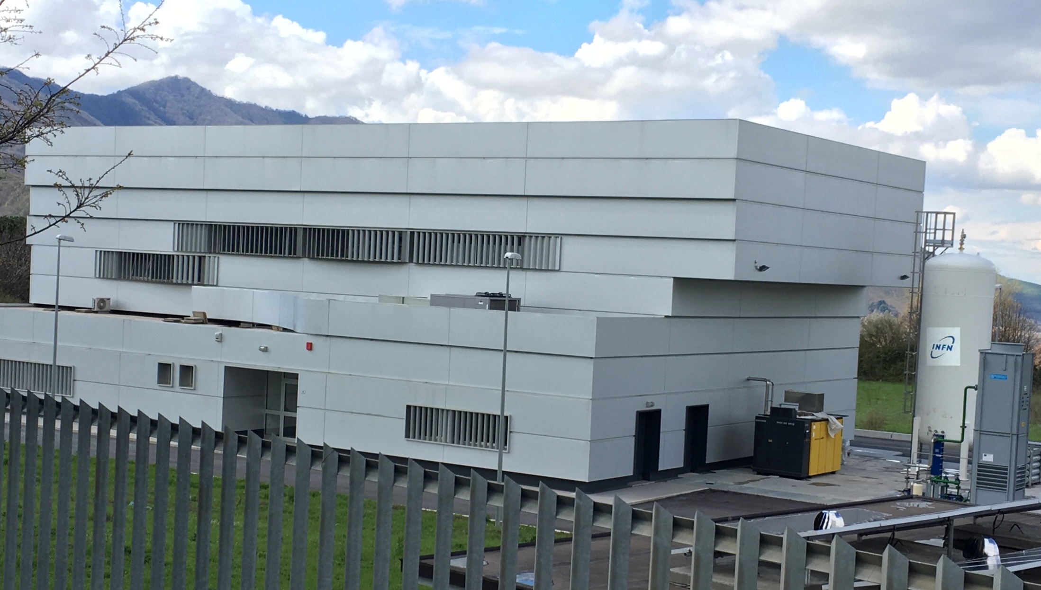
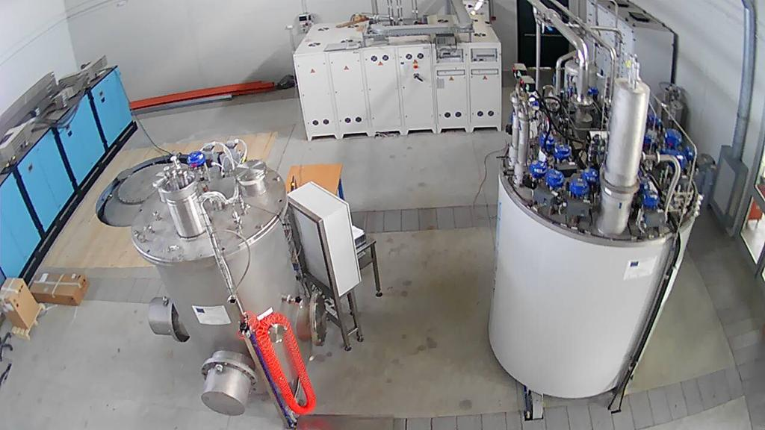
The THor project

Slide 5
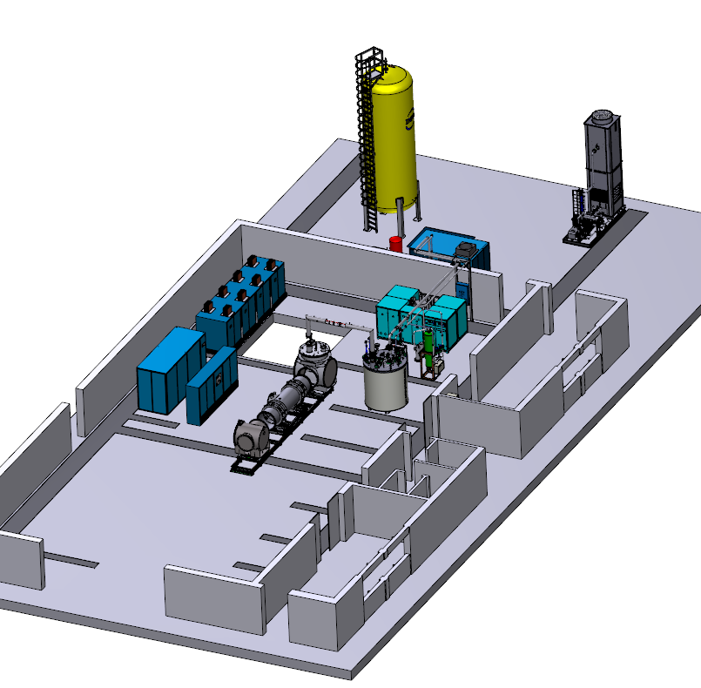
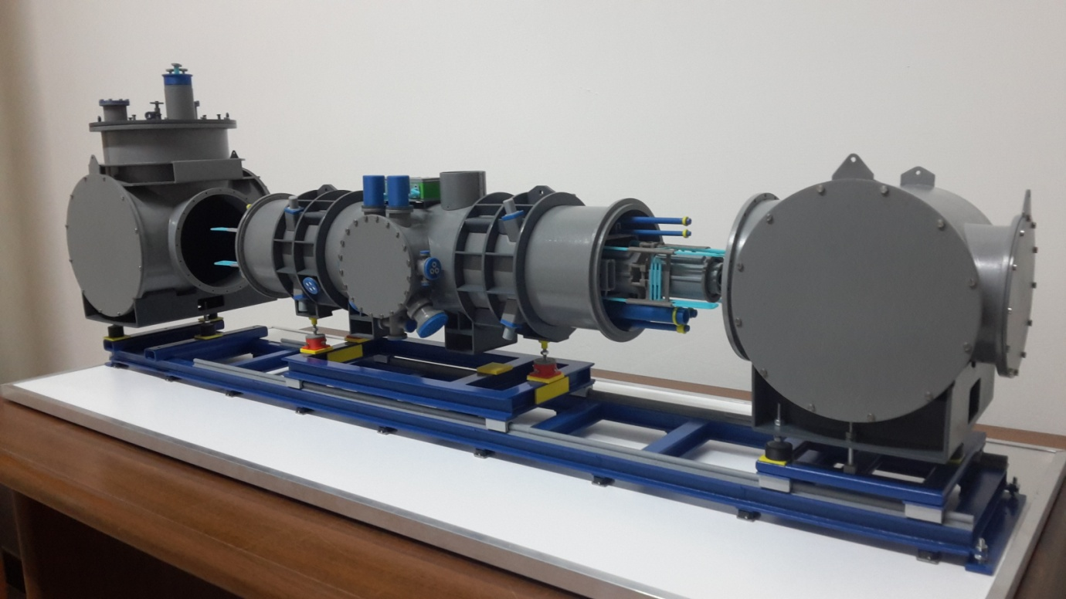
System design
Ready within 6 month
Domenico D’Agostino – 3rd Int. Workshop of the Superconducting Magnets Test Stands – Uppsala 11-12 June 2019

Slide 6
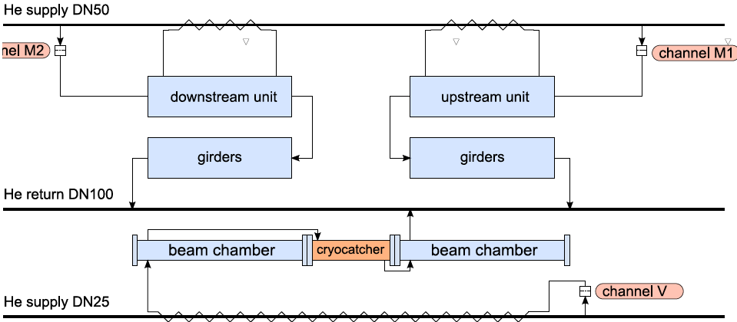
System design
FEED BOX
Transferline
z
z
60° C max
P
ΔP
QUADRUPOLE MODULE
END BOX
heater
V₁
60 K->
V₂
Coriolis
4 K ->
V₅
V₈
V₃
4 K <-
V₆
V₇
WEKA
V₄
80K <-

Slide 7
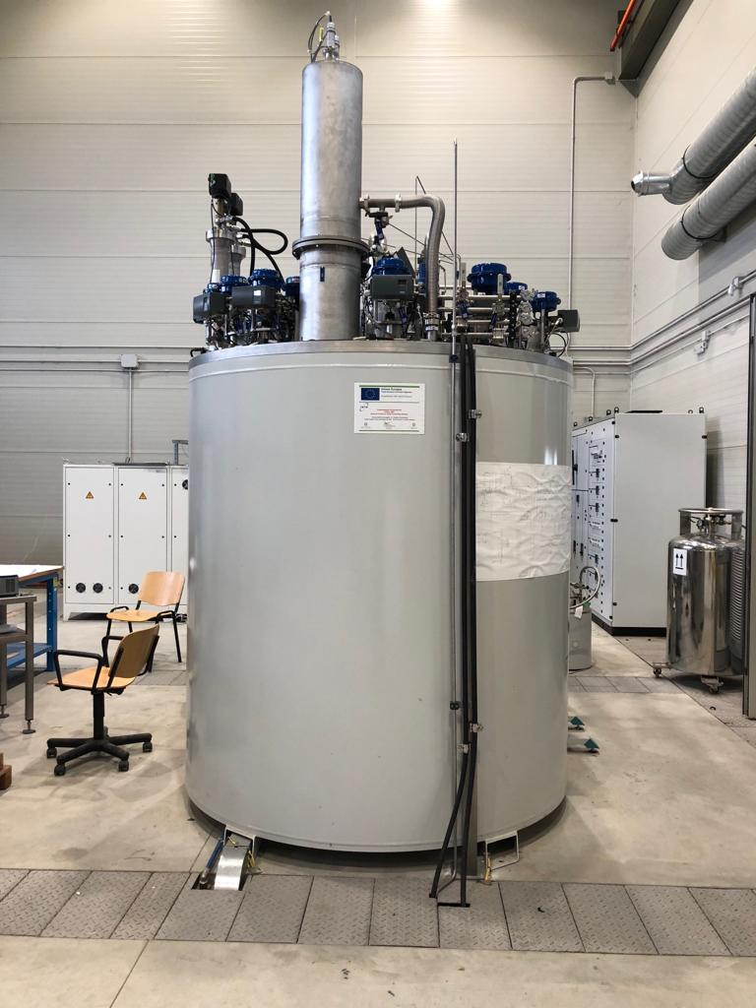
System design
Linde LR280R refrigerator is equipped with He subcooler stage for single phase stream at 4.5 K up to 7 bar, a separate J-T liquid port, an internal purifier and a 80 K adsorber.
In refrigeration mode the maximum 4.5 K flow is about 15 g/s, thus the refrigerator can deliver an isobaric power of 200 W (4.5K-6K), plus additional 500 W (60K-80K) in refrigeration mode.
Domenico D’Agostino – 3rd Int. Workshop of the Superconducting Magnets Test Stands – Uppsala 11-12 June 2019

Slide 8
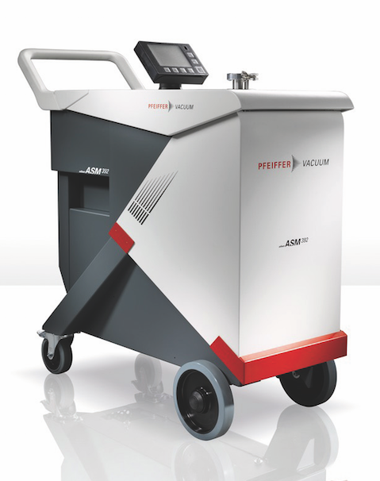
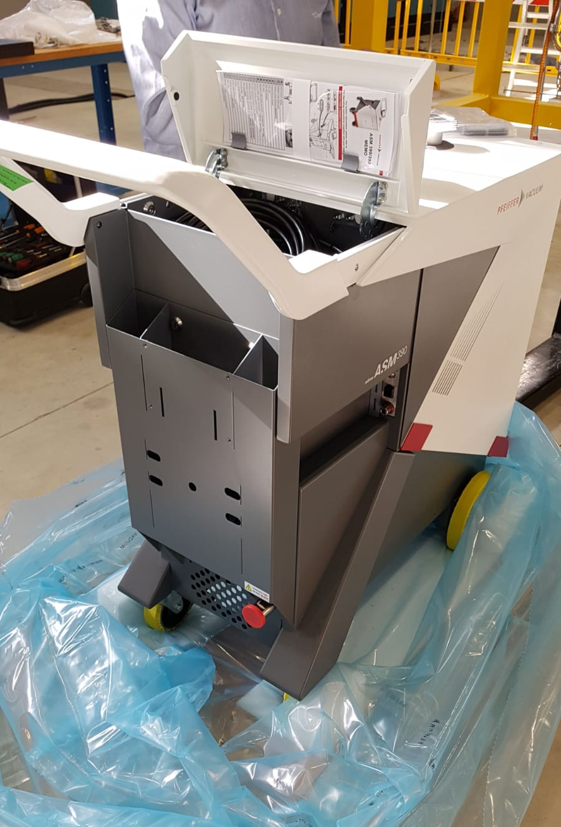
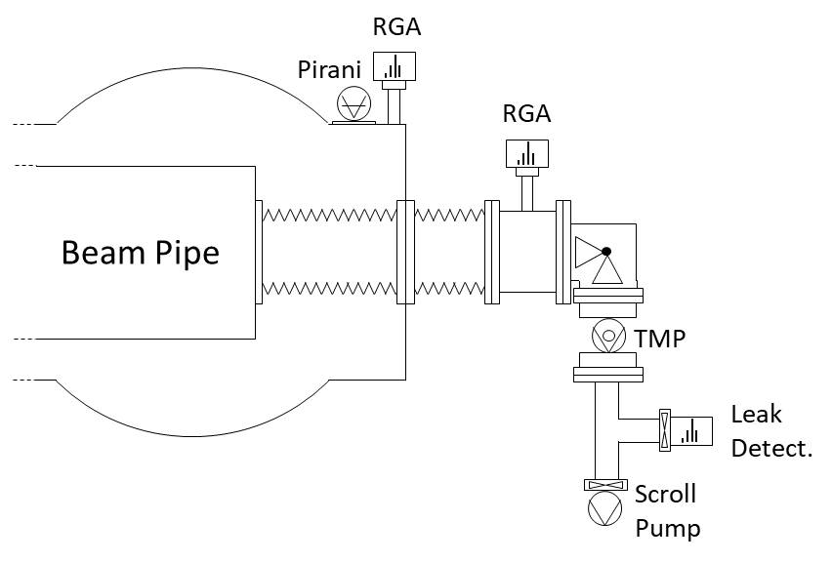
System design
BP vacuum tightness
- Oil free leak detector Pfeiffer ASM 390:
Oil free roots pump/TMP system;
Minimum detectable leak of 5 x 10⁻¹² mbar l/s;
Internal calibrated leak 10⁻⁷ mbar l/s;
ethernet interface
Sniffing probe.
CWT

Slide 9
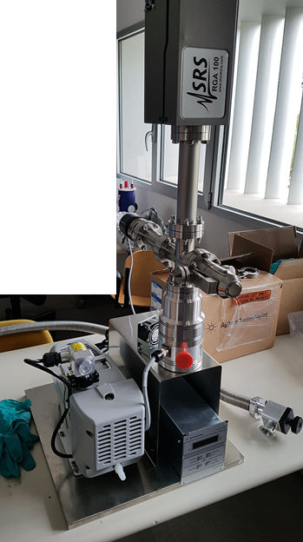
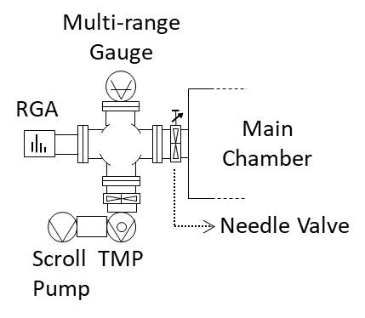
System design
Insulation vacuum tightness
- RGA SRS 100 (Faraday cup):
1 to 100 amu, with resolution better than 0.5 amu @ 10% peak height;
Minimum detectable partial pressure of 5 x 10⁻¹¹ mbar;
Maximum operating pressure 10⁻⁵ mbar.
- Differential vacuum:
Oil free scroll pump Agilent IDP 3 (3 m³/h);
TMP Agilent 74 FS (80 l/s);
Multi-range gauge Agilent FR 700.

Slide 10
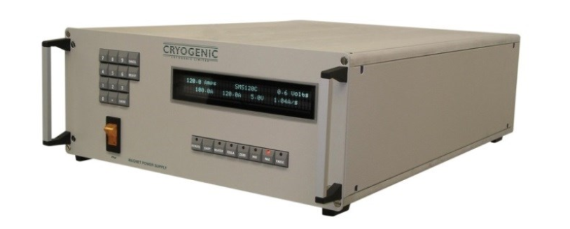
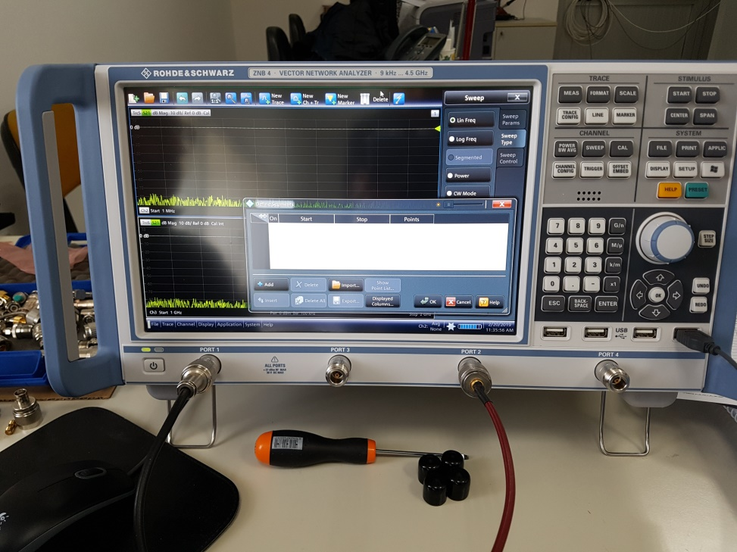
System design
Superconducting Magnets Power Supply
- Cryogenics Q12707
320 A -10 V
4 Quadrant
Quench protections
Vector Network Analyser
- R&S ZNB4
4 Channel
2 Generators
Time Domain Option

Slide 11
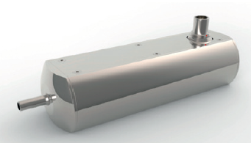
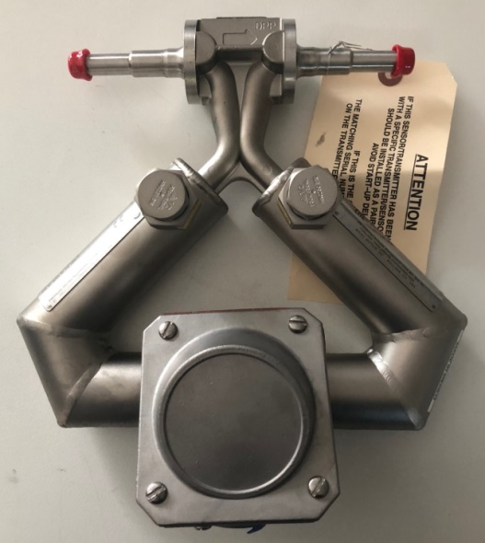
System design
- WEKA Sense Mass Flow Meter
Mass Flow Range 0.2 – 12 g/s;
Temperature range 3- 300 K;
Measurement accuracy <1%;
- EMERSON ELITE Micro Motion Coriolis CMF025
Calibrated for LHe flow;
Volume flow accuracy 0.10%;
Mass flow accuracy 0.35%.
Domenico D’Agostino – 3rd Int. Workshop of the Superconducting Magnets Test Stands – Uppsala 11-12 June 2019

Slide 12
Preliminary tests
COLD BOX
FEED BOX
z
z
P
60 K fwd
5 K ret
Emerson
MFM
heater
Weka
MFM
4 K fwd
80 K ret
z
z
Domenico D’Agostino – 3rd Int. Workshop of the Superconducting Magnets Test Stands – Uppsala 11-12 June 2019

Slide 13
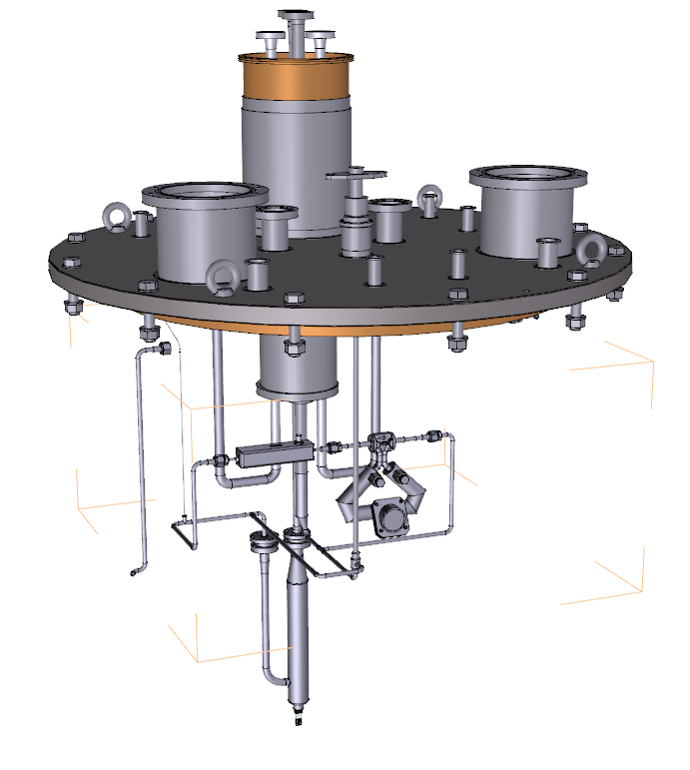
Preliminary tests
Feed-box Top Flange
WEKA Sense MFM
Emerson Coriolis MFM
heater
Domenico D’Agostino – 3rd Int. Workshop of the Superconducting Magnets Test Stands – Uppsala 11-12 June 2019

Slide 14
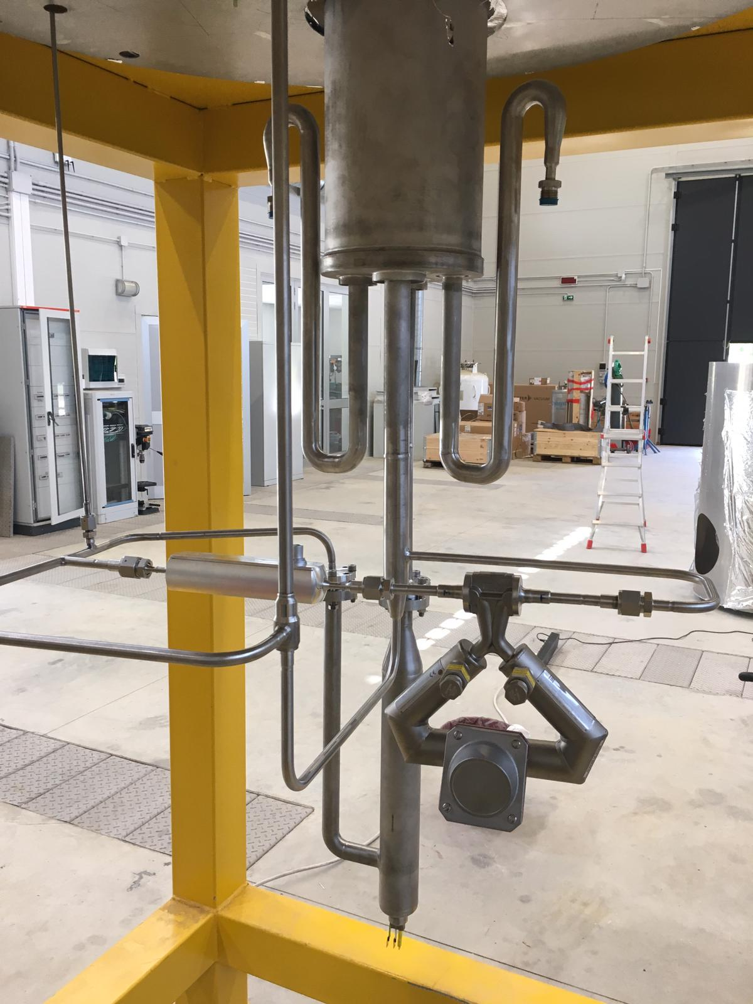
Preliminary tests
Feed-box Top Flange
Domenico D’Agostino – 3rd Int. Workshop of the Superconducting Magnets Test Stands – Uppsala 11-12 June 2019

Slide 15
THor control system
Main tests:
Local Current Leads heaters
Vacuum tightness
Electrical Insulation/sensor integrity
In order to:
Increase reliability during operation
Speed up test procedure
Increase productivity
Format reports, data storage
…
a control system has been designed.

Slide 16
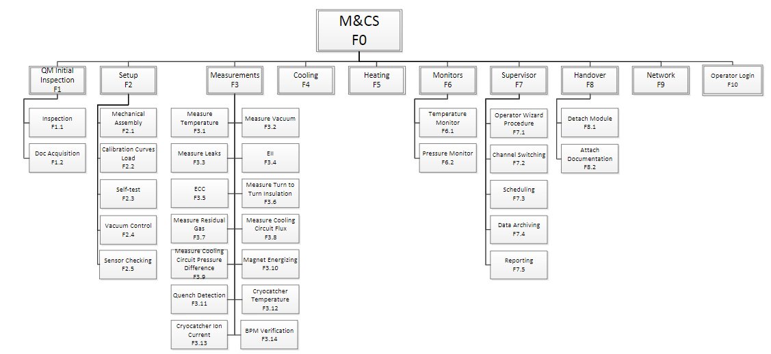
THor control system
Structure of the control system
Domenico D’Agostino – 3rd Int. Workshop of the Superconducting Magnets Test Stands – Uppsala 11-12 June 2019

Slide 17
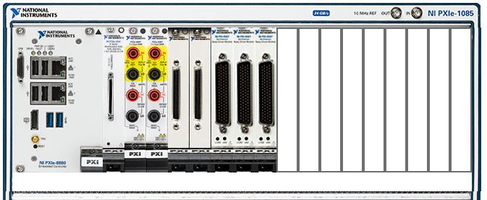
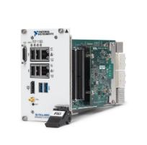
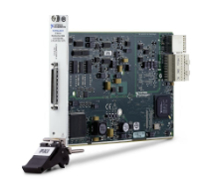
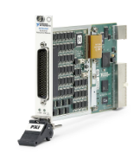
THor control system
Controller H/W by NI
PXIe-8880
Controller PXI Intel Xeon 8 core- bandwith 24GB/s
PXIe-6341
Multifunctional I/O module 24 Ch, max freq 500 kS/s, 16 bit
PXI-6512
I/O industrial 64 Channels
Domenico D’Agostino – 3rd Int. Workshop of the Superconducting Magnets Test Stands – Uppsala 11-12 June 2019

Slide 18
THor control system
Electrical tests
High Voltage (up to 3 kV)
Middle Voltage
(up to 1.1 kV)
Low Voltage (up to 100 V)
Main bus-bars
QP coils
Related voltage taps
Corrector bus-bars
Related voltage taps
Temperature sensors
Cryo-heater
LCL-heaters
Isolation
Integrity
Isolation
Integrity
Isolation
Integrity
Functionality
Domenico D’Agostino – 3rd Int. Workshop of the Superconducting Magnets Test Stands – Uppsala 11-12 June 2019

Slide 19
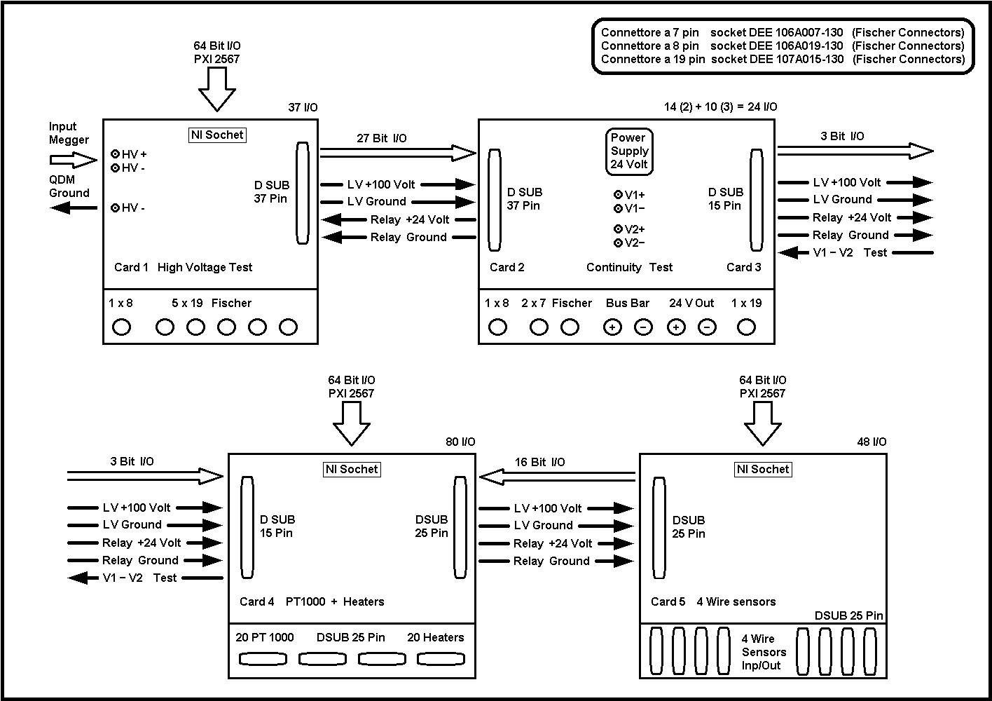
THor control system
Switch boxes schema
Domenico D’Agostino – 3rd Int. Workshop of the Superconducting Magnets Test Stands – Uppsala 11-12 June 2019

Slide 20
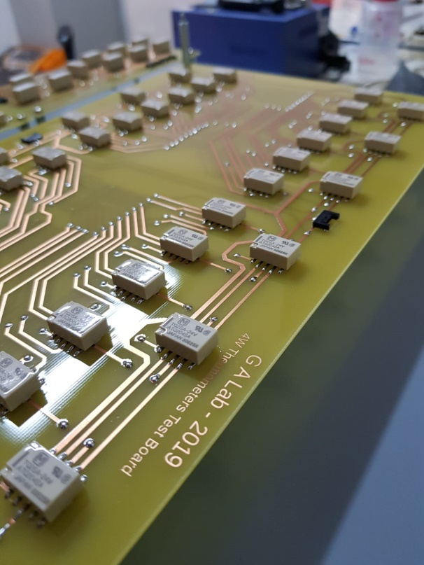
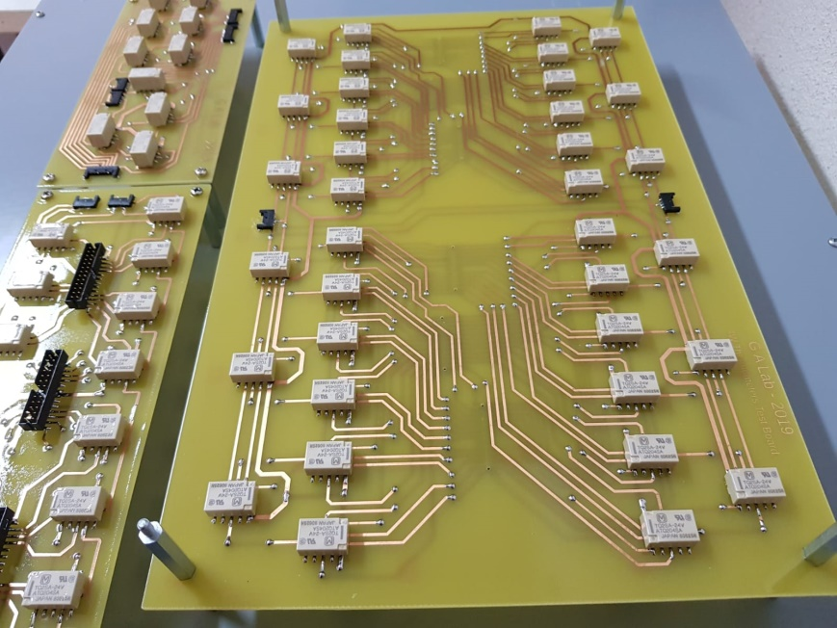
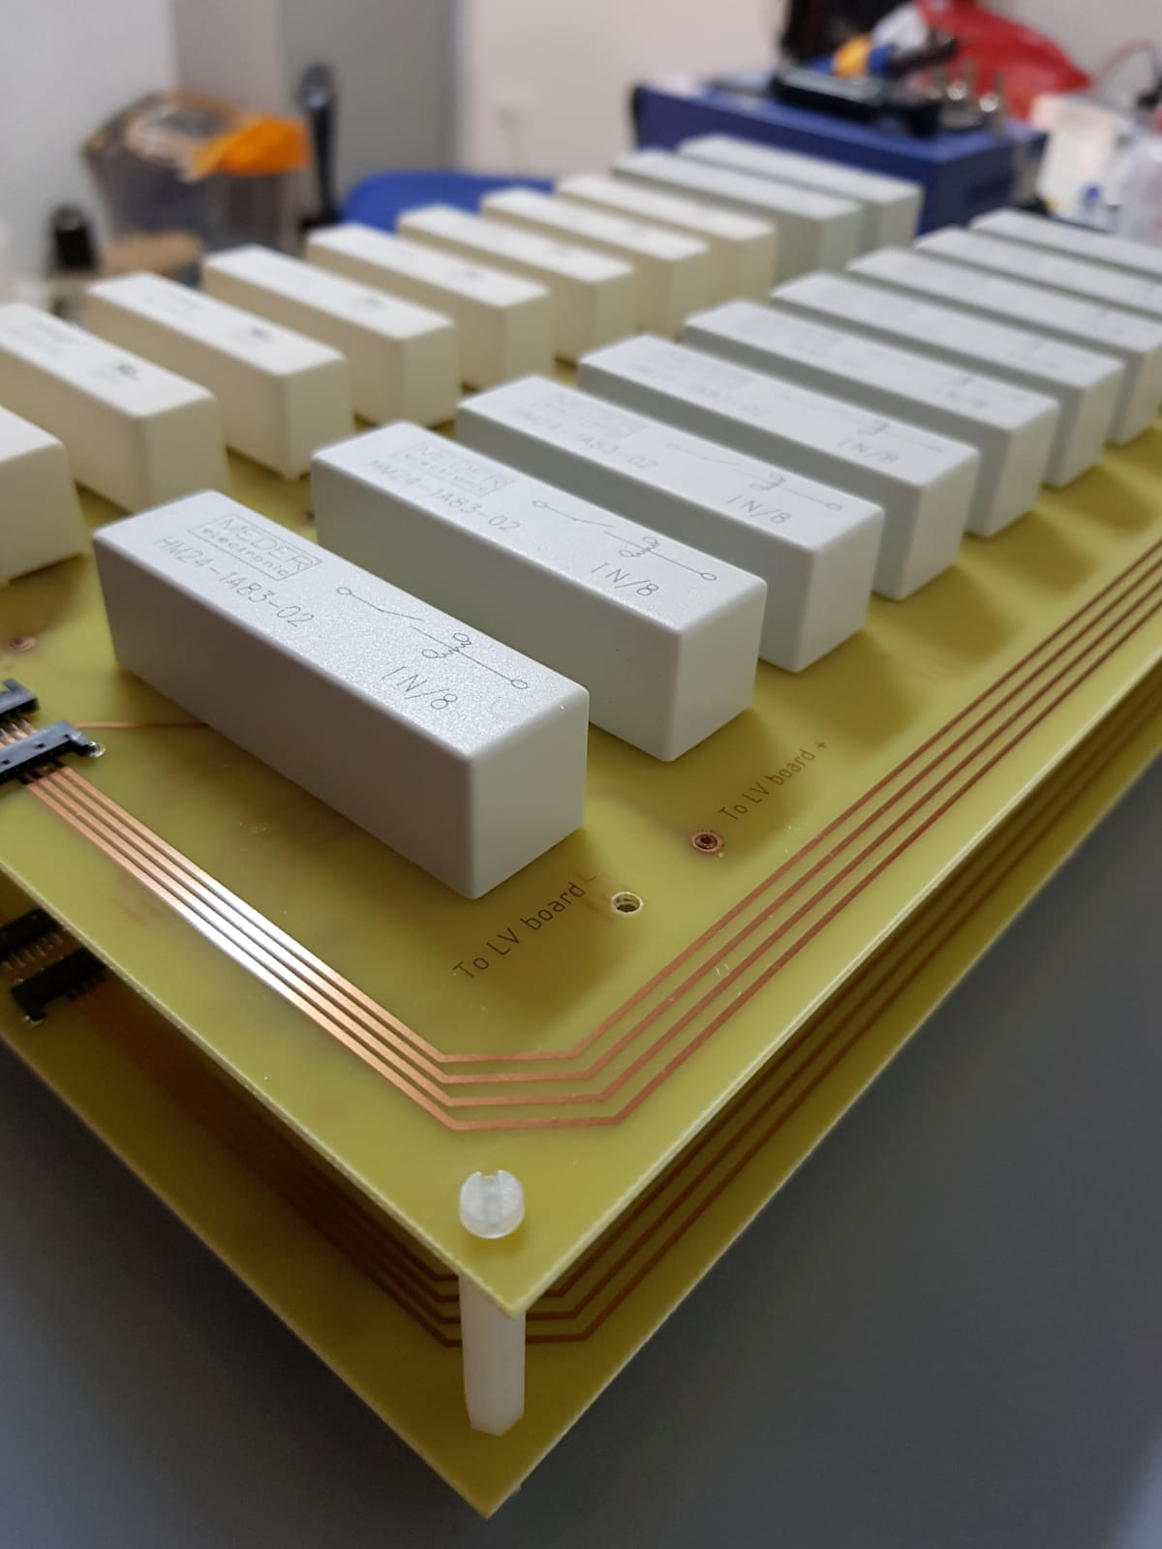
THor control system
Switch boxes boards

Slide 21
…thank you for your time!

