Slide 1


News From IMP Magnet Test Stand
Dongsheng Ni, Wenjie Yang, Xudong Wang
Superconducting magnet Group,
Magnet Division,
Institute of Modern Physics, Chinese Academy of Sciences
3rd International Magnet Test Stand Workshop, Uppsala University, 11-12 June 2019
Notes:
Good noon everyone. I come from the superconducting magnet group of IMP, CAS. We are part of the HL-LHC Chinese team which is steered by IHEP, CAS. Today I would like to introduce the General information of the IMP test stand and the upgrade project for MCBRD testing .

Slide 2
Outline
Overview of the test stand
Test requirements of the MCBRD in China
Upgrade project of the test station
Field measurement & Data acquisition & Quench protection
Test stand for HIAF project
Summary
Notes:
I will begin by giving you an overview of the test stand. Then I will summarize the test requirements of the MCBRD. After that I will introduce the upgrade project and show you the measurement and data systems. In the end I will give you a short message of the test stand for our HIAF project and a short summary.

Slide 3
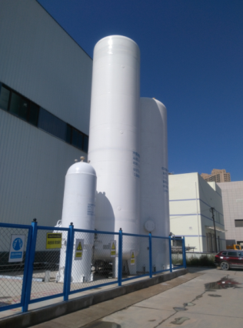
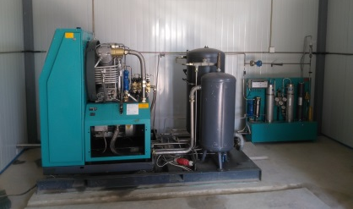
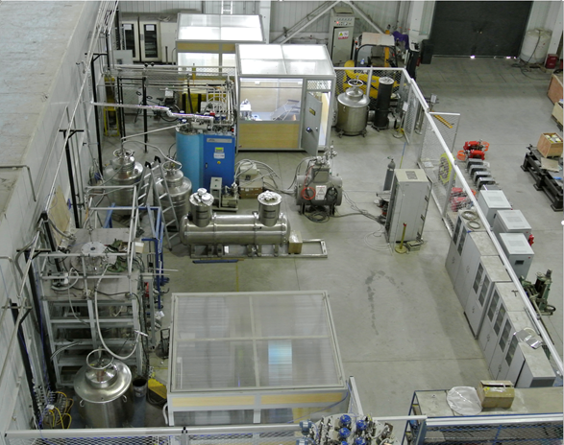
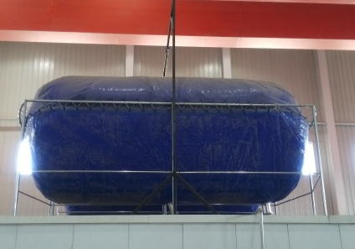
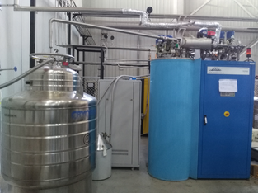
Overview of the IMP Magnet Test Stand
Helium Liquefier | 39L/h
Helium Dewar | 500L
Buffer Tank | 100m³
Liquid Nitrogen Tank | 50m³
Recovery Compressor | 23m³/h
Gas Bag | 100m³
Impure Helium Tank | 5m³@15MPa
Buffer Tank & Impure Gas Tank & Liquid Nitrogen
300mm Test Cryostat
23m³/h Recovery Compressor
Control room
2×50m³ Gas Bag
TCF10 Liquefier Unit
700mm Test Cryostat
Notes:
In 2015 we started to build the test stand systematically by moving an old TCF10 liquefier to a new magnet testing building. The test stand is working in an open loop. The helium gas produced in the testing process is recovered by a piston compressor. Then the gas will be purified and liquefied again by TCF10 unit. There are three vertical test cryostats in this test station. The diameters of the cryostats are 300,500,700mm. The useful depths of the cryostats are all about 1 meter.

Slide 4
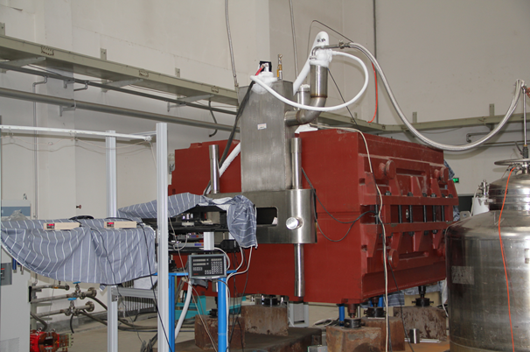
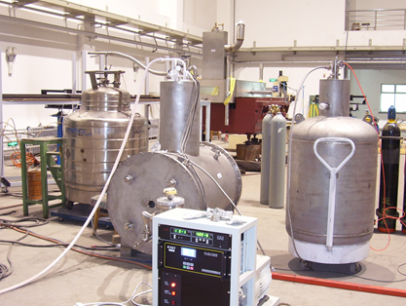
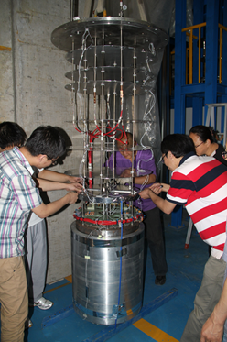
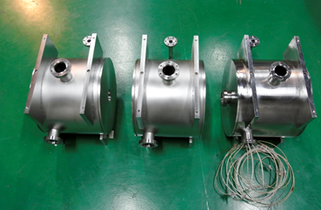
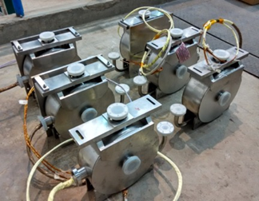
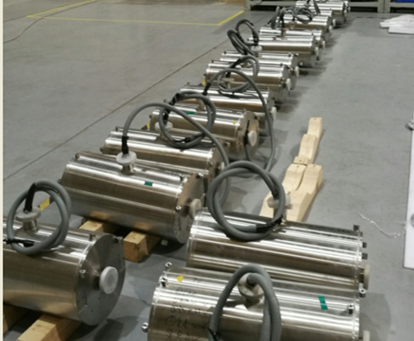
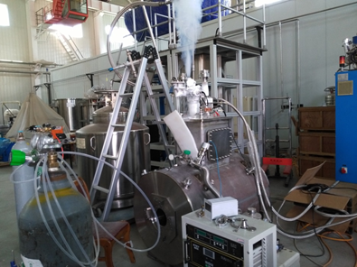
Magnets Tested at IMP
3T Solenoid
SECRAL II
SuperFRS
Type | Quantity
SuperFRS Dipole Prototype | 1
CIADS solenoids | 31
FRIB Solenoids | 37
Others | ＞10
CIADS Solenoids
FRIB Solenoids
7T Penning Trap
Notes:
Up to now, almost 100 magnets has been tested at IMP. About half of them was tested at this test stand or with the TCF10 liquefier earlier. As you seen from the table on the previous page , the capability of the test stand is limited. It is only suitable for small magnet or magnet with a small energy storage.

Slide 5

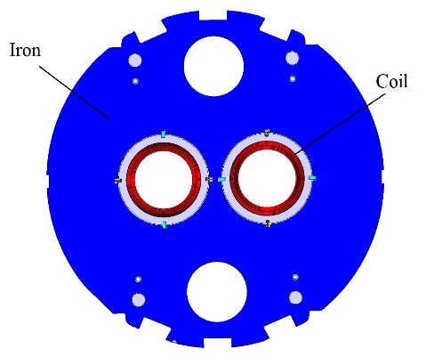
Test Plan of the MCBRD
China will provide 12 units of MCBRD before 2022.
First two magnets for integration in D2 series are needed for mid 2021.
China makes a 0.5m long prototype and a full size prototype.
The full size prototype is needed for integration in the prototype D2 cold mass in mid 2020.
Training and the integral multipoles measurement of the magnets will be processed at 4.5K in China.
E. Todesco
Notes:
The MCBRDs must be tested to ensure that they are up to standard before shipping to CERN. There are 14 magnets need to be tested totally. The main test tasks are the training and the integral multipoles measurement at 4.5K. The detailed test will be processed at 1.9K when they arrive CERN.

Slide 6
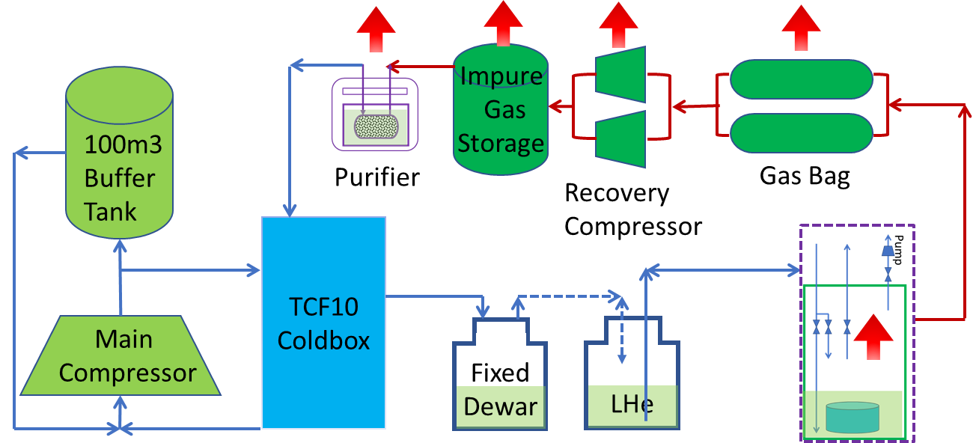
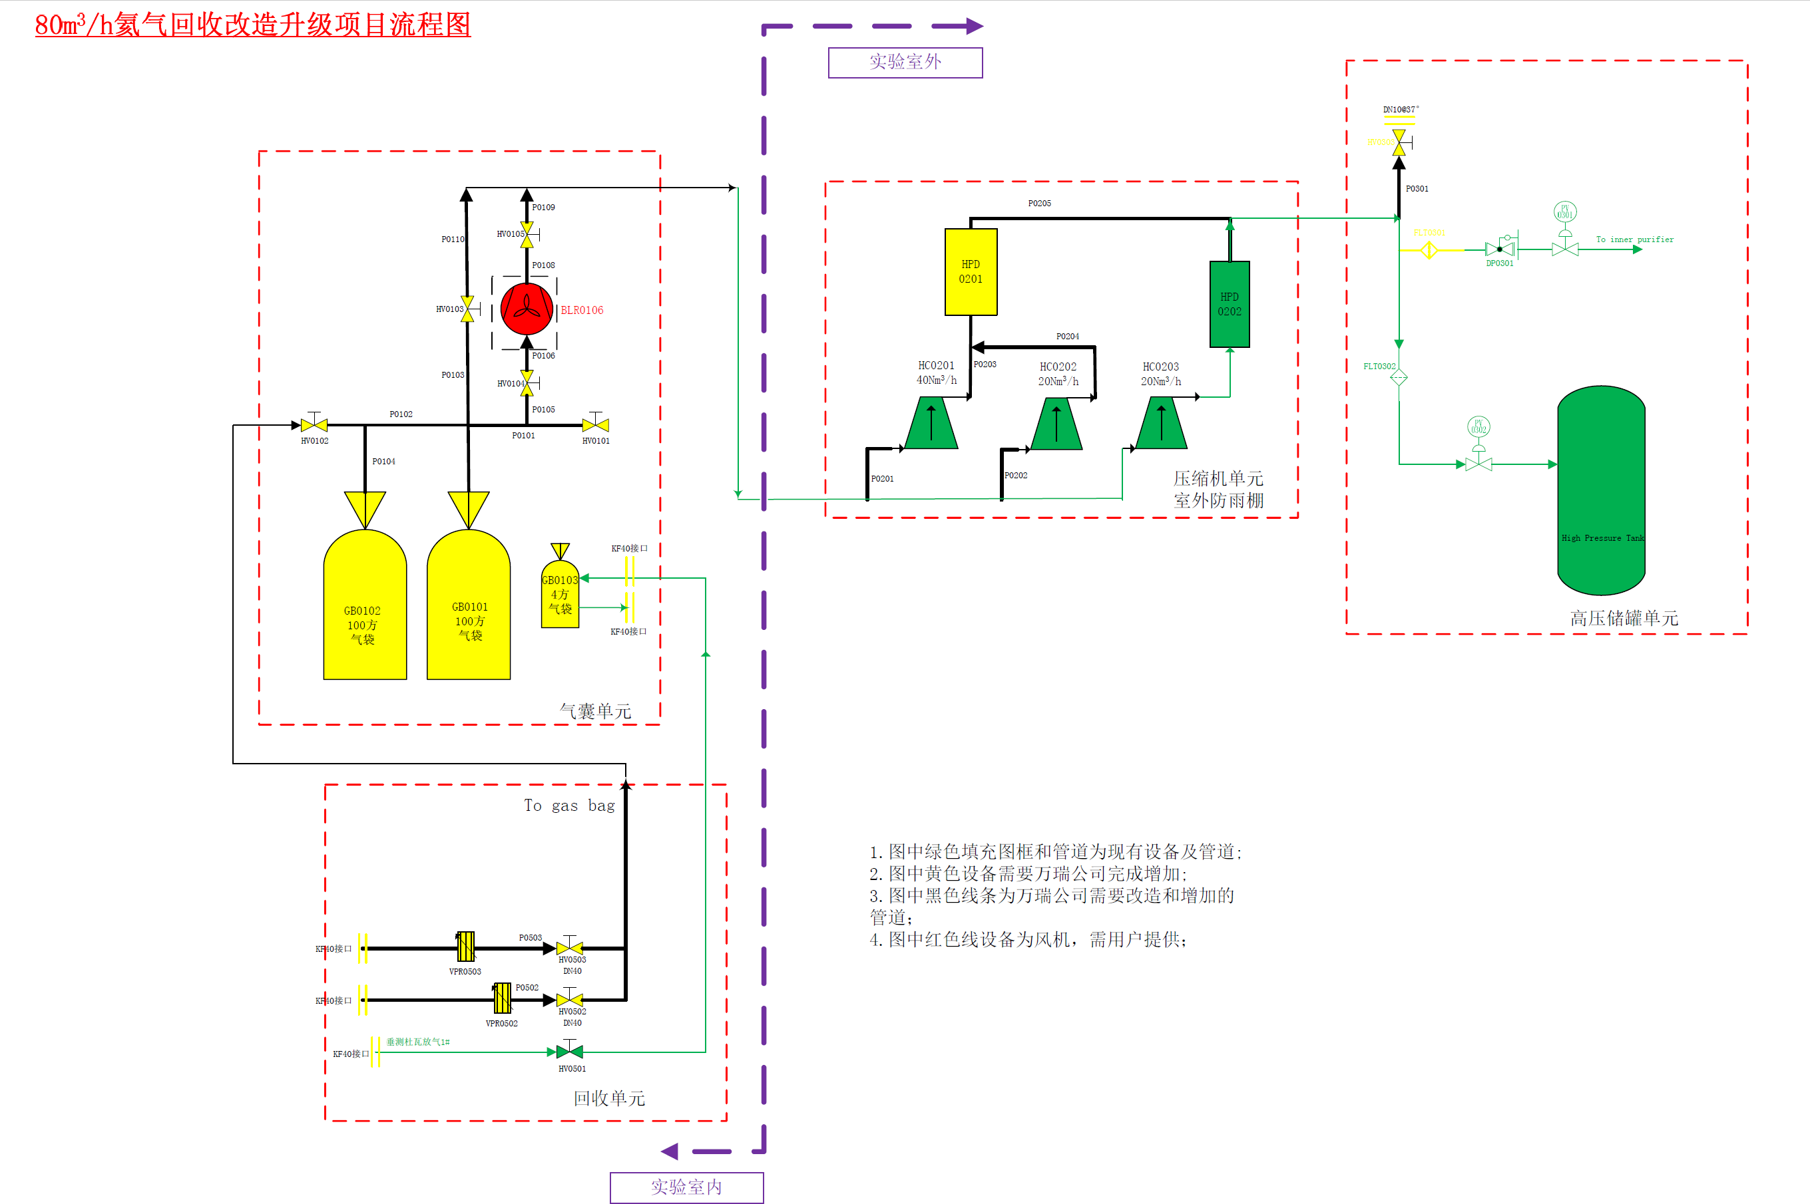
Upgrade Project
First Stage
  Gas bag → 200m³
  Recovery compressor →80m³/h
  Impure Gas Storage→＞10m³@15MPa
  External Purifier→35m³/h
  Vertical Test Dewar→Φ800mm L3800mm
Second Stage
  + Valve box for Vertical Test Dewar
  + Pre-cooler system for cooling down & warm up
Scheme of the purifier
Scheme of the Recovery System
Notes:
Because the MCBRD has relatively large cold mass and large dimensions, we made an upgrade plan for the test stand which is divided into two stages. First, we upgrade the helium recovery system , add an external purifier and an 800mm dewar/ˈdju:ə/. After the first stage, the test stand will satisfy the requirement for cooling down the MCBRD. At the second stage we will install a valve box and a pre-cooler to the test dewar to improve efficiency. The first stage has been started in January 2019.

Slide 7
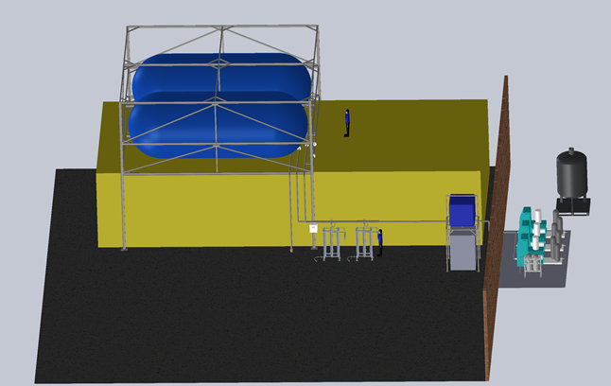
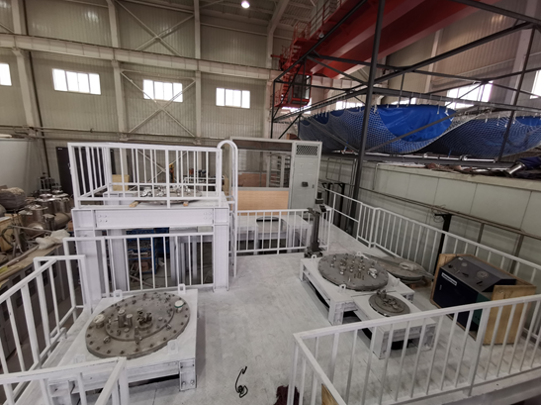
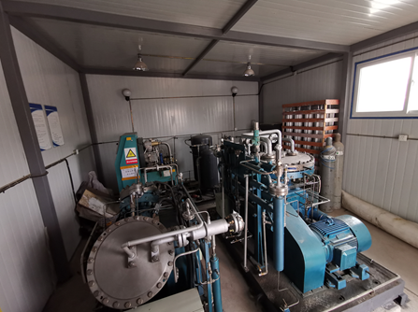
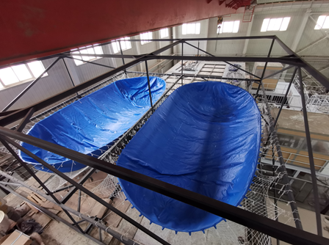
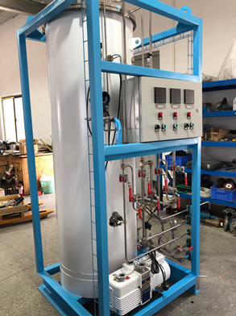
Status of the Upgrade
The Helium Recovery System is under construction, will finished in two weeks.
External purifier is waiting for Factory Acceptance Tests.
800mm dewar has been installed, hanging system is under manufacture.
All upgrades in stage 1 will be finished before July.
Notes:
Now most of the works are in the final steps. All upgrades in stage 1 will be finished before July, then the 0.5meter prototype will be tested.

Slide 8
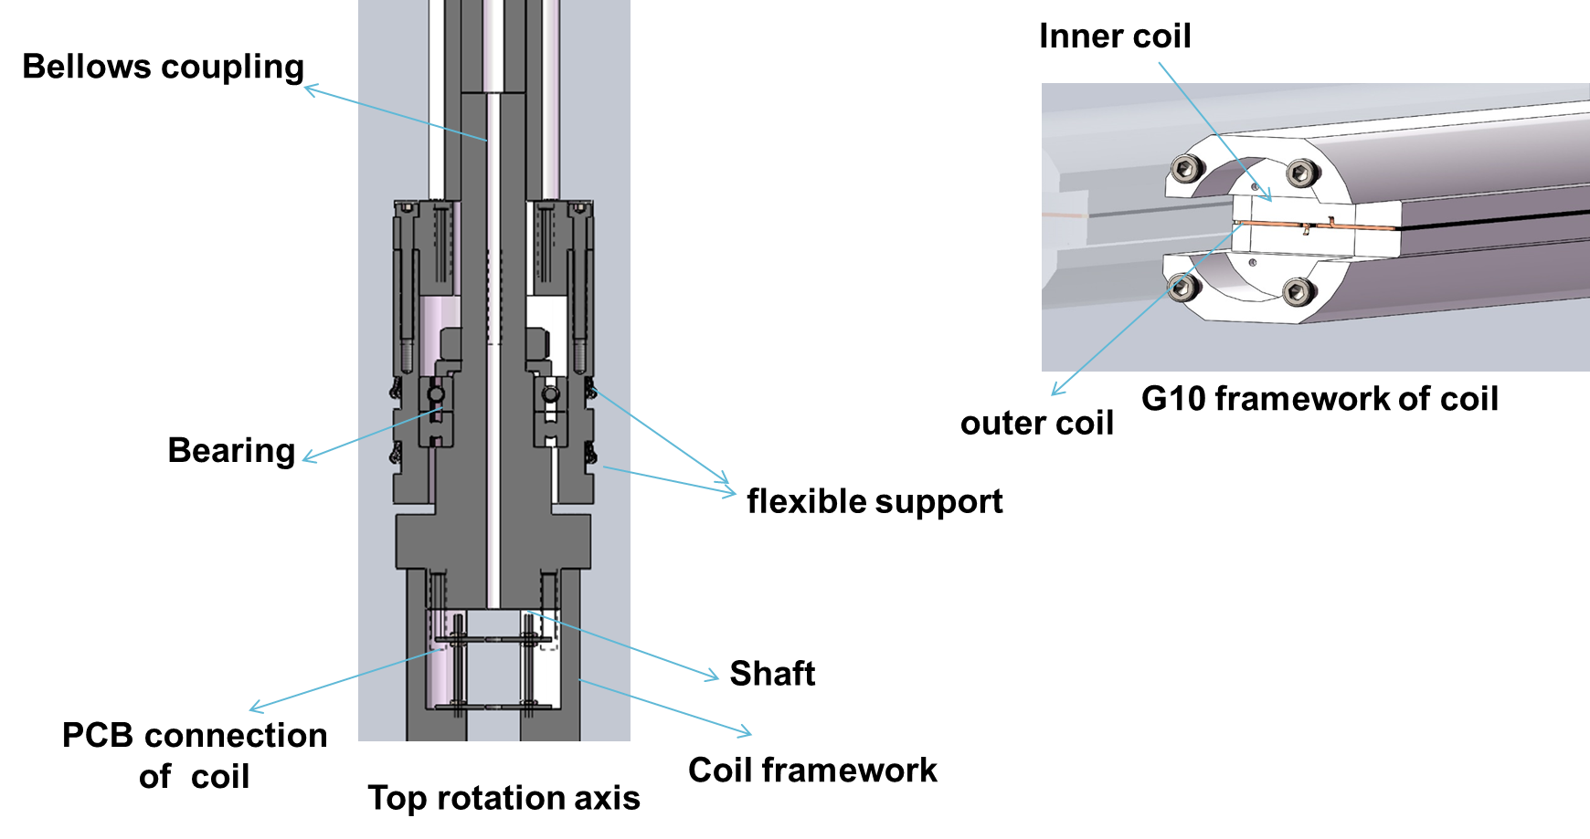
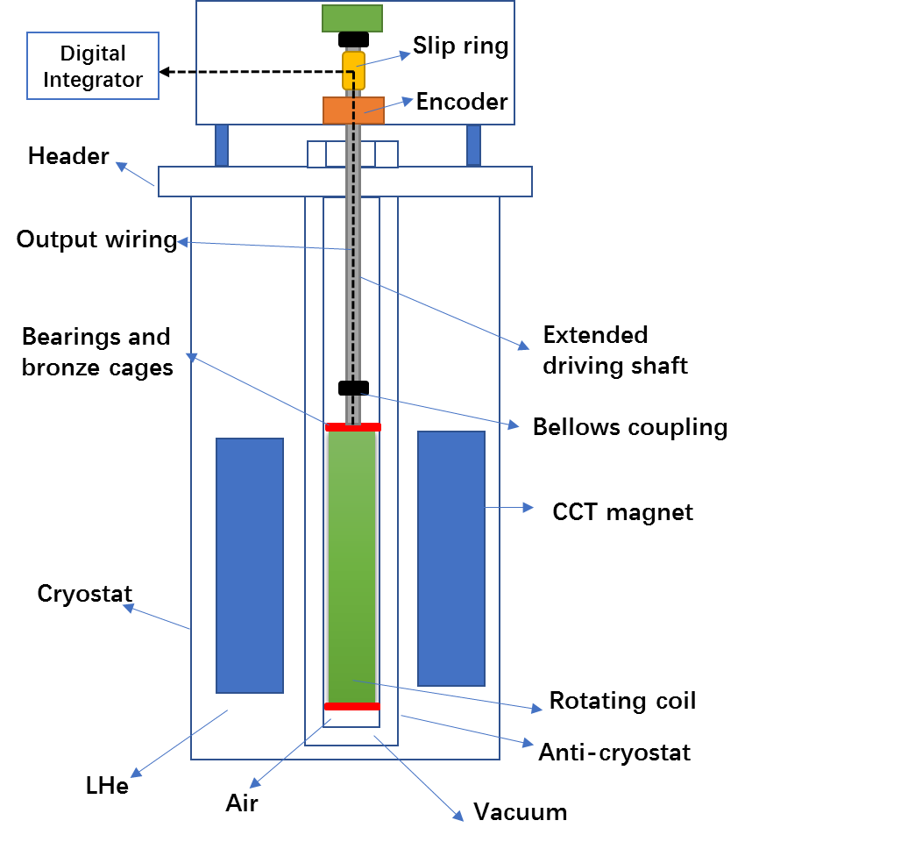
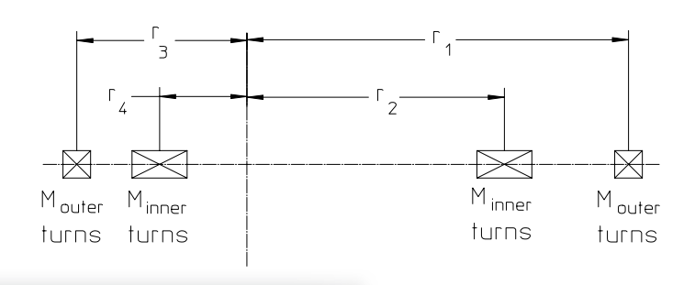
Field Measurement
Magnetic field measurements are performed by the rotating coil.
The rotating coil contains two radius coils, the outer one measures the main component and the inner one for bucking improves the sensitivity for the high-order multipole components.
Typical accuracy of the system :10⁻⁴.
The rotating coil is positioned in the Anti-cryostat.
The rotating coil is connected via a long stainless steel shaft to a rotation motor.
The rotating shaft of the coil is coupled to an angular encoder and a slip ring.
Notes:
We also tailor made or improve the measurement and date systems. The magnetic field is measured by a rotating coil. The coil works in a warm bore. The field measurement devices are under fabrication in the factory and will be finished at the end of June.

Slide 9
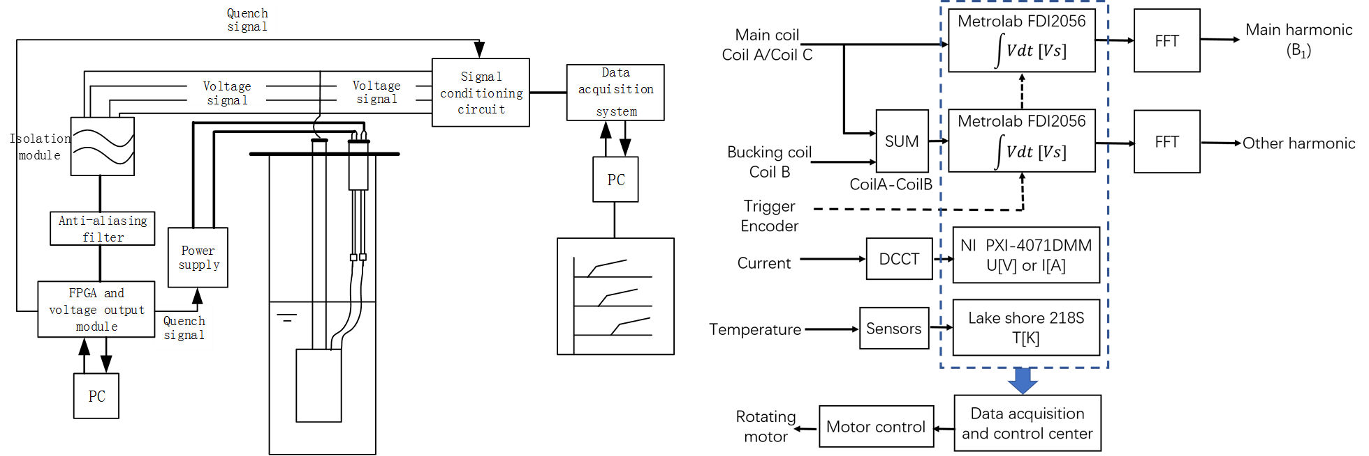
Data Acquisition
The inductive voltage of the rotating coil is fed into digital integrator (MetroLab, FDI2056).
The integrators are triggered by the angular encoders.
Results are obtained from the average of the forward and backward revolutions.
The harmonic amplitudes and phases are calculated by a Fast Fourier Transform (FFT) of the acquired data.
The magnet current is measured in real-time by a digital multimeter (NI PXI-4071).
Notes:
The data acquisition system has been successfully applied to the test of many different magnets in recent years. This time we purchased some new equipment and build a new system for exclusive use.

Slide 10
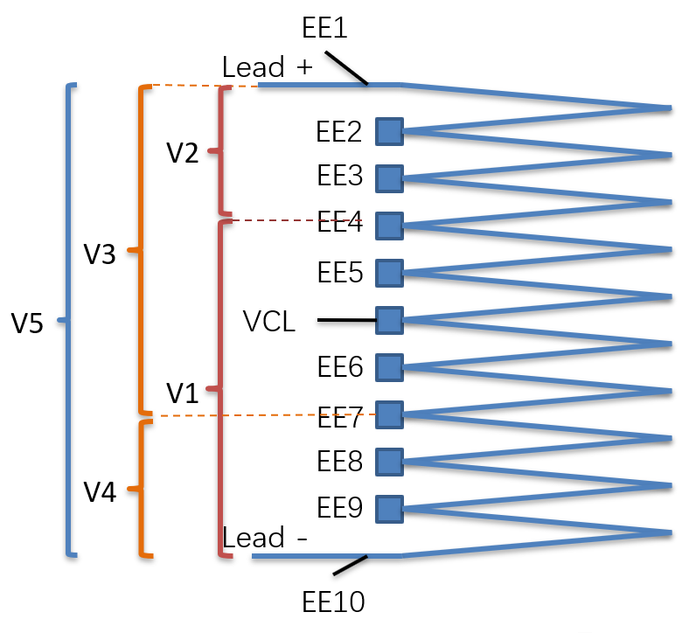
Quench detection
The quench detection system is based on the NI-cRIO platform.
The outlet voltages of SC coils are used as judgement signal.
The logical calculus is carried out by FPGA.
The isolation module is used to protect the electronic equipment.
When the quench is detected, a 24V quench signal will be sent to the power supply and the data acquisition system.
Notes:
We design the quench protection circuit and the system based on our experience with referring to CERN’s test results. We will check and debug the system during the test of the 0.5m prototype.

Slide 11
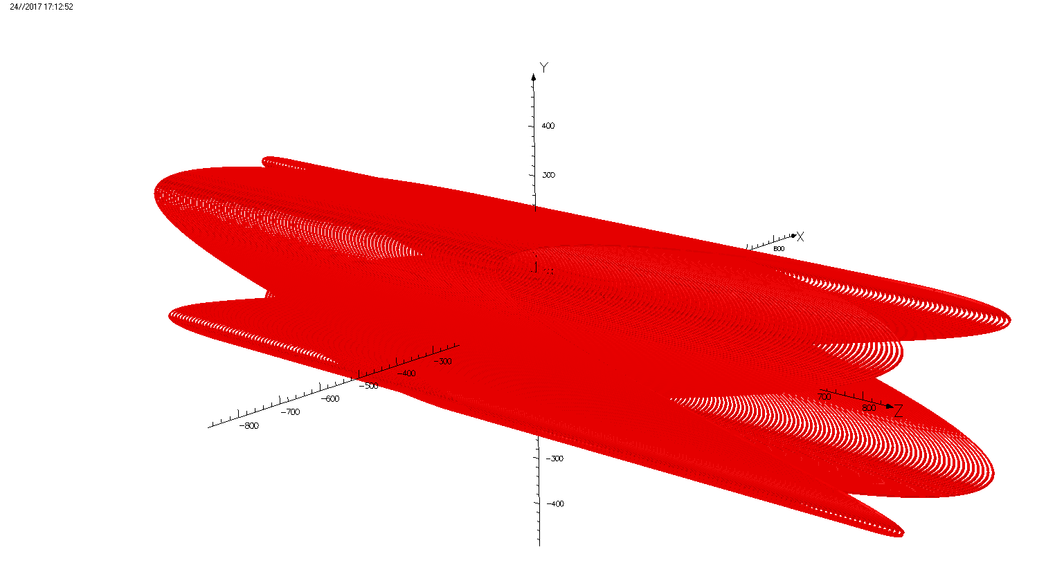
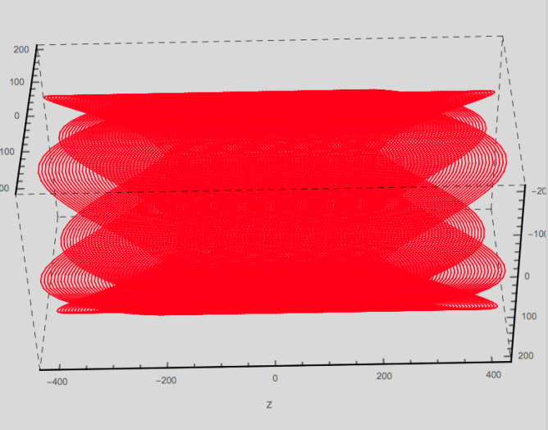
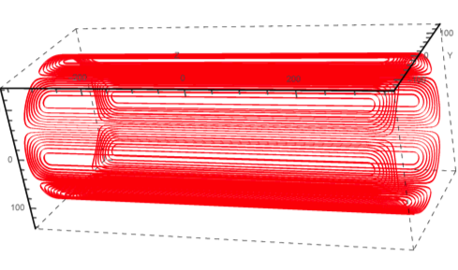
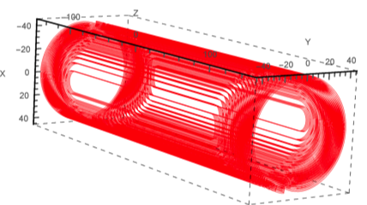
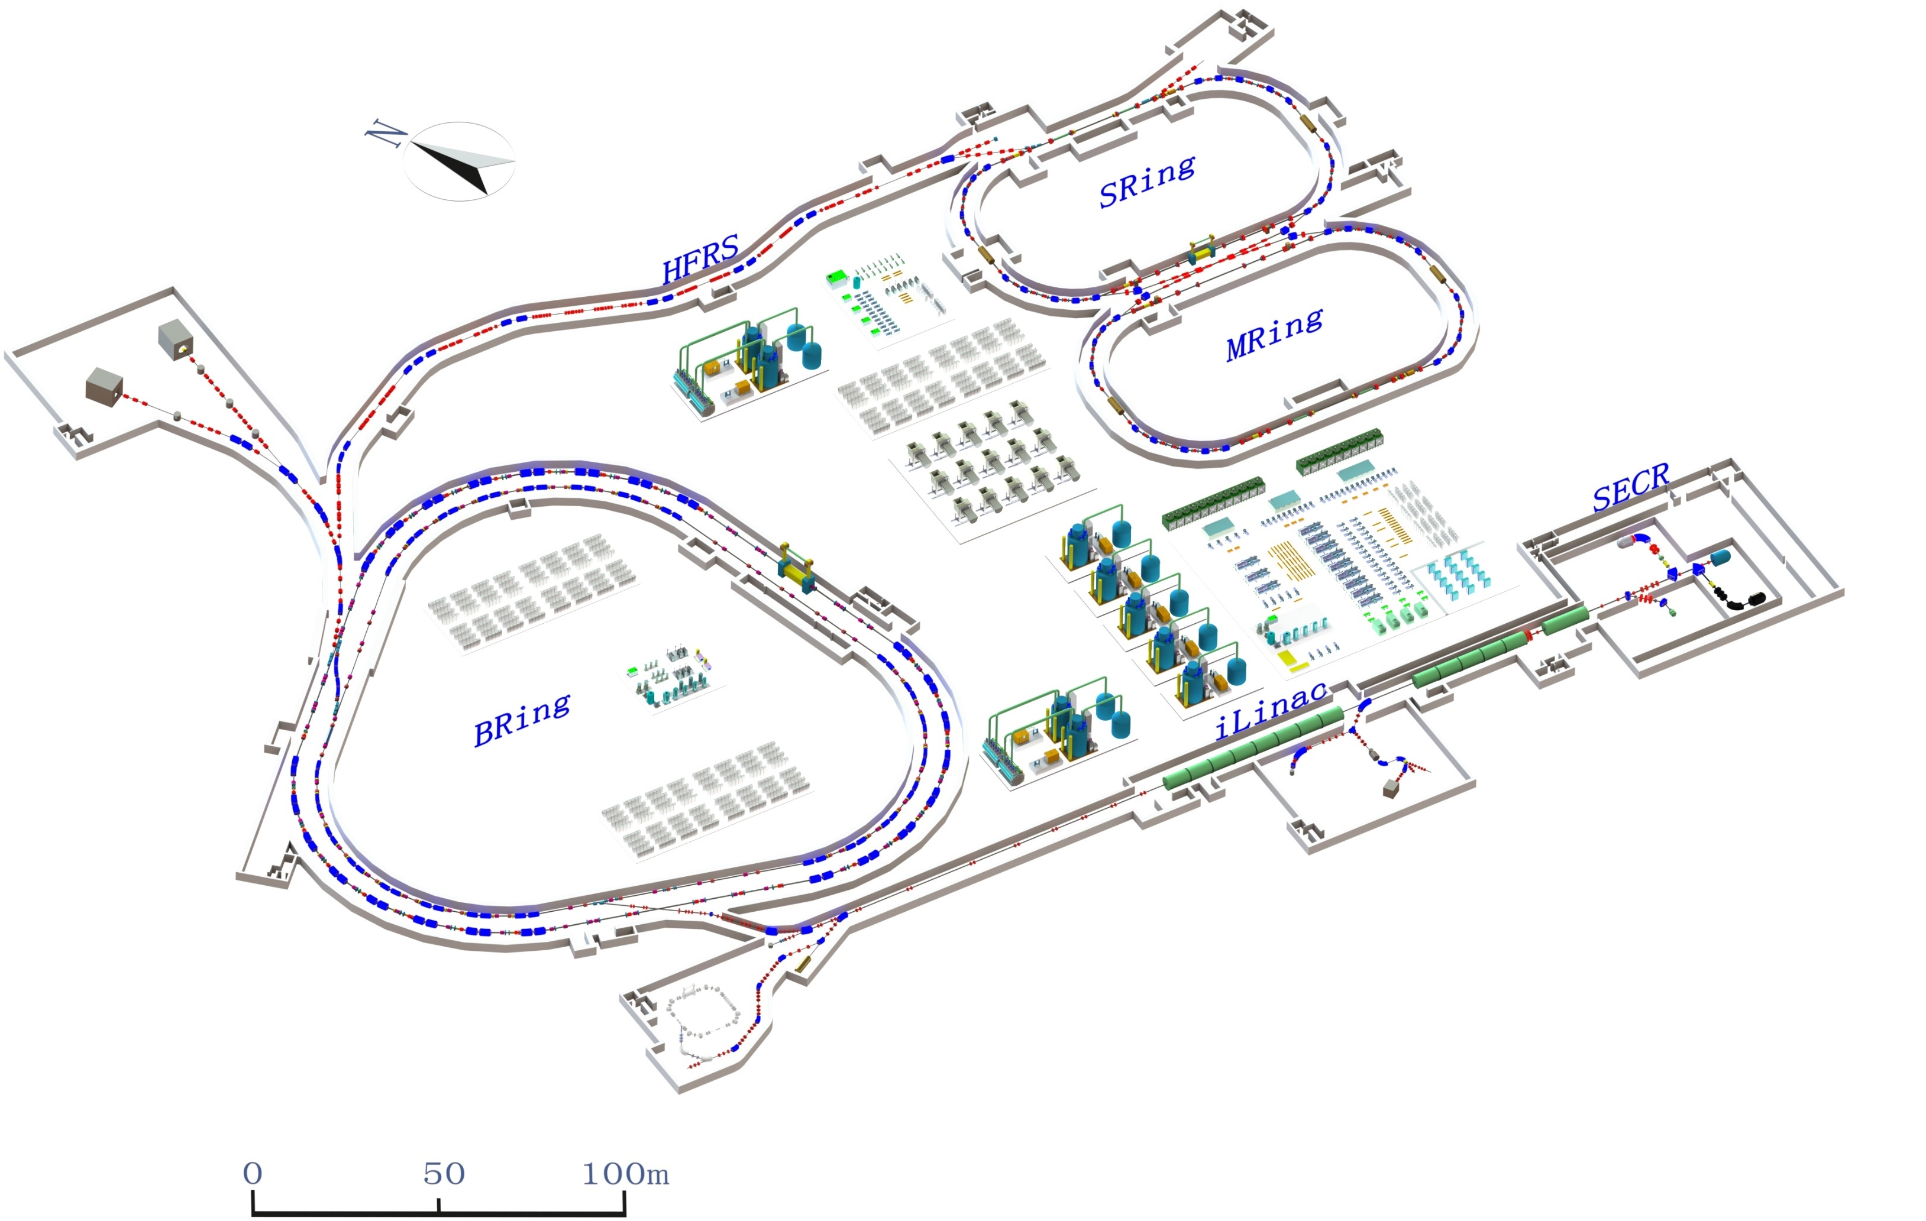
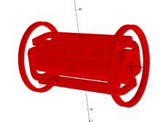
Future plan for HIAF project
Total coldmass ~100 tons.
Dipole | 11
Quadrupole | 39
Sextupole | 21
Total | 71
300-500W refrigerator is required.
1 horizontal test bench is required.
2 vertical test bench
10g/s recovery and purifier system
Plan to start testing in 2022.
Quadrupole
Sextupole
Octupole
dipole
Dipole Module | 11
Multipole Module | 13
Octupoles and Correctors are integrated with other magnets.
45 SC Solenoids
Notes:
Besides the existing magnet test stand we also plan a new one for the HIAF（High Intensity Heavy-ion Accelerator Facility） project which is a new heavy ion accelerator facility in China. The HFRS（HIAF Fragmentation Separator）is a fragmentation separator like the SuperFRS. Unlike the SuperFRS, the HFRS employs coil dominated CCT magnets. All the CCTs need to be vertical tested alone and horizontal tested after integrated into modules. That means we need a much larger test stand.

Slide 12
Summary
Cryogenic system: Capability will be improved.
  The capability of helium recovery system will be improved.
  The vertical dewar for MCBRD has been installed.
Measurement and data system: Has been modified or tailor made.
  Quench detection system and data acquisition system are available.
  Magnetic field measurement system is under construction.
The whole system will be ready in July and then the 0.5m prototype will be tested.
Wish we will perform the test of MCBRDs with high quality.
Wish the test stand for HIAF project will go on well step by step.
Notes:
In Summary, after we upgrade the whole test system, it will satisfy the requirement of the MCBRDs. And the whole system will be available in July, then the 0.5 meter prototype will be tested to debug the system.

Slide 13
THANKS FOR YOUR ATTENTION

Slide 14
Slides For Reference
Conceptual design of the Anti-Cryostat
FORCE FROM BOLTS
SUPPORT BOLT (ADJUST LOAD)
Install the anti-cryostat;
Install the magnet;
Fix the bottom of the anti-cryostat to the magnet coaxially;
Tighten the support bolt on the top of the anti-cryostat to pull the inner and outer tube.
The bend of the tube will be minimized.
The main support rods for magnet is not shown here.
BELLOWS
FLANGE OF CRYOSTAT
ASSISTANT SUPPORT
COAXIAL FLANGE
MAGNET
BOLT TO MAGNET
WEIGHT OF MAGNET
COAXIAL SUPPORT
BOLT TO ANTI-CRYOSTAT

Slide 15
Test Circuit
Slides For Reference
Five voltages,
V1 between EE4 and EE10,
V2 between EE1 and EE4,
V3 between EE1 and EE7,
V4 between EE7 and EE10,
V5 between EE1 and EE10
are used for the quench detection.
Three threshold voltages, Vth1, Vth2 and Vth3 are applied to the quench judgement,
when V1 – λ1 * V2＞Vth1 or V3 – λ2 * V4＞Vth2 or V5>Vth3 with three times respectively, the coil is considered quench and the power supply will be turned off.
λ1 and λ2 are adjustment coefficients. Vth1 and Vth2 are usually set for 20~50 mV. V5 is not used during charging and discharging since the inductance is uncertain and Vth3 is usually set for 50~100 mV. V5 is also monitored by the quench detection system built in the power supply.
All the voltage taps are connected to the voltage data acquisition device to obtain the wire voltage on each layer.

