Slide 1

News from the LASA test facility
Marco Statera
on behalf of the LASA team
INFN Milano - LASA
Uppsala, June 11th 2019

Slide 2
Outline
LASA cryogenic system
SC cavities test facility
SC magnets test area
  High current and variable temperature
  HL-LHC HO corrector magnets
  FCC activity
conclusion

Slide 3
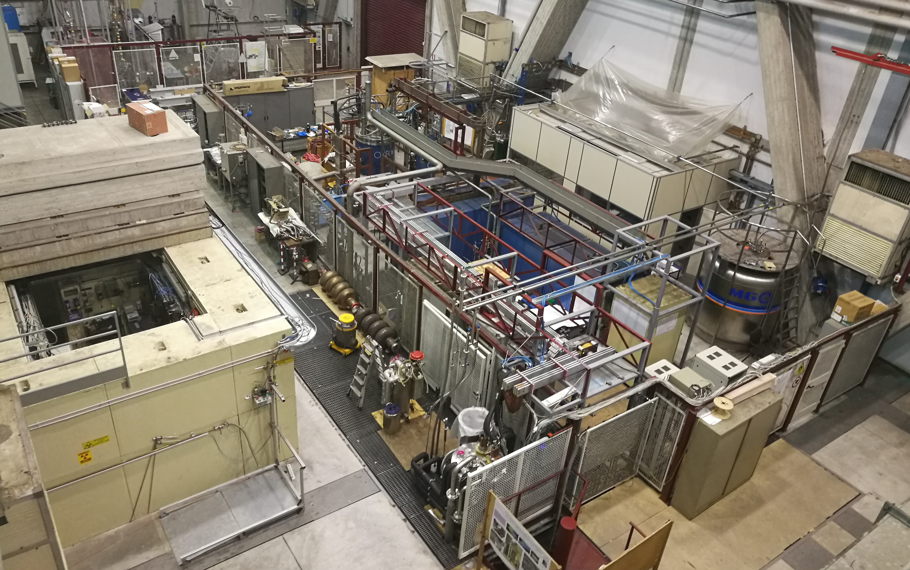
LASA overview
high field solenoids
Neutron test area
30 kA line
SC cavities
Test area
aaa
power supplies
fast DAQ and slow control
vertical cryostats
10 kA line

Slide 4
Cryoplant layout
a
DISCORAP cryostat
3000l
450 l dewar
DISCORAP
constraints
100 Nm³/h compressors
100 m³ recovery balloon
operation 1-2 k h/year

Slide 5
Cryoplant Upgrades
a
SC magnets
HL-LHC correctors
HTS @ variable T
SC cavities
HeII refiller
study ongoing
warm helium
Automation ongoing
2019
He liquefier
Update or
New machine

Slide 6
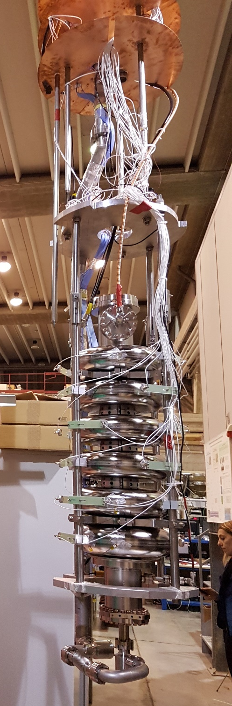
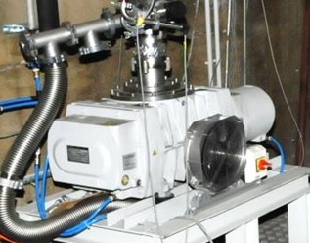
SC Cavities Testing Facility
Bunker with vertical cryostat, φ 700 mm, 4500 mm depth, can hold large SC cavities as 500 MHz
Sub-cooling system for superfluid helium, up to 1.5 K. Cooling power 41 W a 2.0 K
2 Cold inserts for cavity testing
RF generators: 700 MHz, 1.3 and 3.9 GHz
  European Spallation Source – ESS
  Proton Improvement Plan II – PIP-II FNAL
Associated infrastructures
ISO4 clean room (9 m²)
High Pressure Rinsing facility
Slow pumping Slow venting system
UP water production plant (100 l/h)
Courtesy of R. Paparella

Slide 7
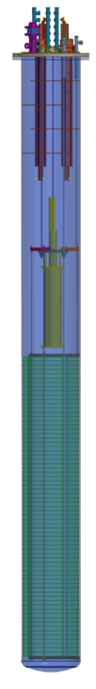
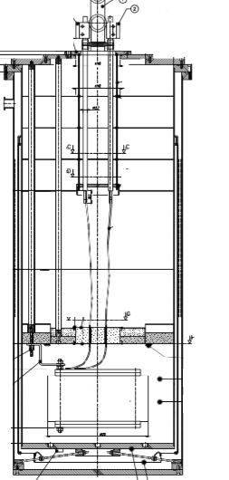
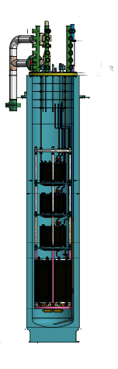
SC Magnet Test Area
Small Magnets test cryostat
  HO correctors protoypes
    6P MCSXFP (MCSXF/MCSSXF)
    8P MCOXFP (MCOXF/MCOSXF)
    10P MCDXFP (MCDXF/MCDSXF)
High Current Test Station
  DISCORAP and HTS magnets
  HO correctors
    12P MCTXFP
    4P MQSXFP
  HiLumi HO correctors series
MAGIX
D 480 mm
h 1200 mm
4.2 K and 2.17 K
500 A
DISCORAP
D 695 mm
h 7200 mm
4.2 K
10 kA
HiLumi
D 515 mm
H 2950 mm
4.2 K
500 A

Slide 8
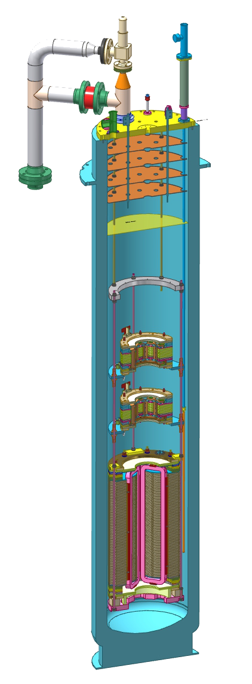
HL-LHC HO Correctors
Mag.meas.
Safety
Valve and disk
He inlet
Cryostat for testing MCTXFP1 (12P), MCQSXFP1 (4P) and series magnets
4 K operation
515 mm inner diameter
Hosted within DISCORAP cryostat (which acts as a support)
About 3 m high
Up to 4 magnets (3 possible configurations)
New power supply and IGBT switch
Ordered end 2017
Delivery April 2018
Test MCTXFP1 (12P) 2018/09
Test MCQSXFP1-01 (4P) 2019/02
Test MCQSXFP1-02 (4P) 2019/06 ongoing
Mechanical interface with dicorap cryostat
CL
2+4

Slide 9
Measurements
HO correctors’ measurements at 4 K
Stability 1h @ ultimate
One magnet at a time
Field quality at 4K (1 magnet per cooldown)
Data Acquisition Architecture
QDS (MSS Magnet Safety System)
Initiates a fast discharge or switches off the power supply incase some voltage thresholds on the magnet or on its electrical connection are exceeded. Includes a capacitor bank for firing quench heaters.
Fast Acquisition
Records voltages across the magnet under test with 1 kHz sampling frequence, in coincidence with a fast discharge
Current Control & Slow Control
Two different functions, implemented in the same hardware & software system.
Slow acquisition monitors and records most important data (temperatures, current, voltage along critical items) from the cooldown to the operation. Data are avalilable to the operator and recorded at about 1 Hz

Slide 10
Quench Protection
Each HO corrector
1 common CL + bus bar
1 dedicated CL + bus bar
3 voltage taps
Cross check magnet connection before powering by AC signal

Slide 11
Test configurations
Prototypes
Single magnet test
Series production
3 batches
  18 magnets
  2X12P 2X4P
  5 cooldowns
Automatization of the cooldown and warmup by a Nitrogen heat exchanger 2019
600
LHe max
2350
4P
12P

Slide 12
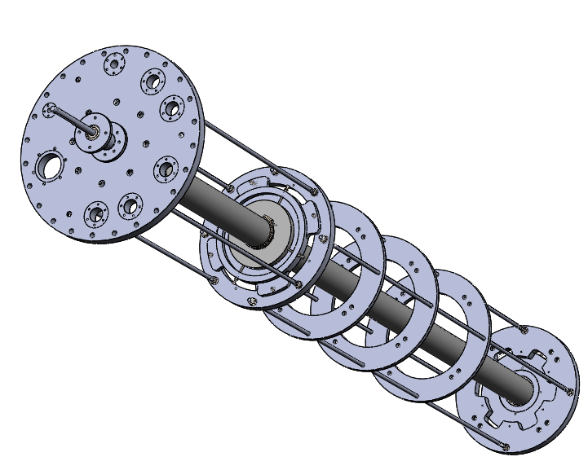
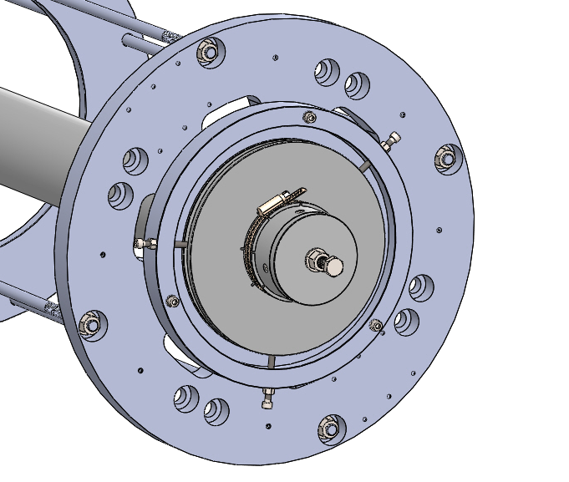
Magnetic Measurement
Shaft from CERN (at LASA)
Measurement at LASA
Dedicated shaft for series HO correctors
MCQSXFP1 magnetic measurement in collaboration with CERN (L. Fiscarelli) 2019
feedthrough
CERN design
machined at LASA
designed and machined at LASA
designed and machined at LASA
by N. Lusa

Slide 13
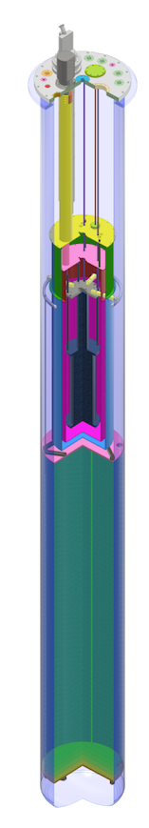
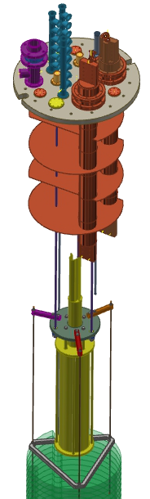
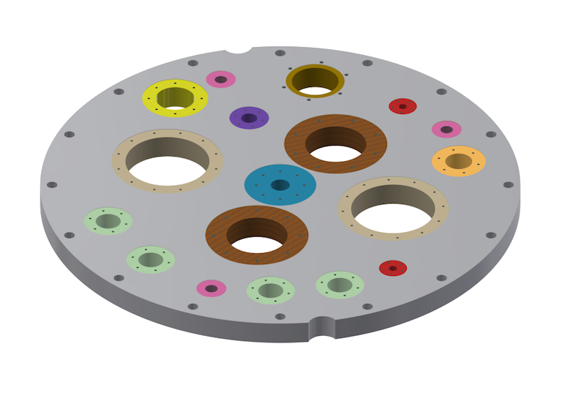
LASA High Current Test Station
10 kA test station
Three 6V 10 kA power supplies
10 kA current leads
7.2 m cryostat
3.4 m
10 kA leads
7.2 m
DISCORAP cryostat for HTS magnets test
Mechanical interface redesign ongoing
Zero uplift filler delivered
Fast switch commissioned
Electrical connections integration ongoing
Temperature control design ongoing
Cryocooler procurement ongoing
Magnetic field measurement integration designed
HTS magnet
1.4 m³ ethylene-vinil acetate disks
HTS magnet
ballast
φ 0.695 m

Slide 14
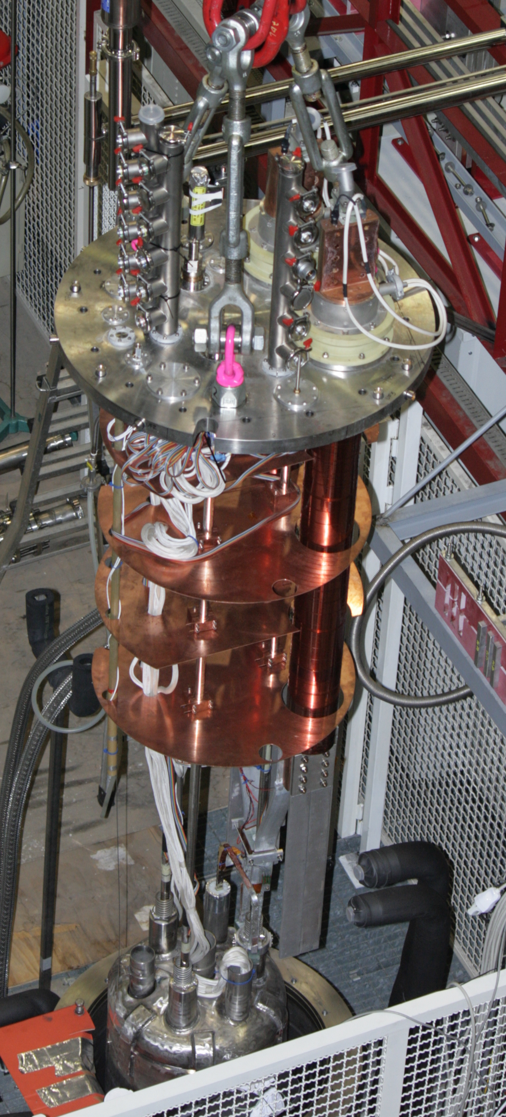
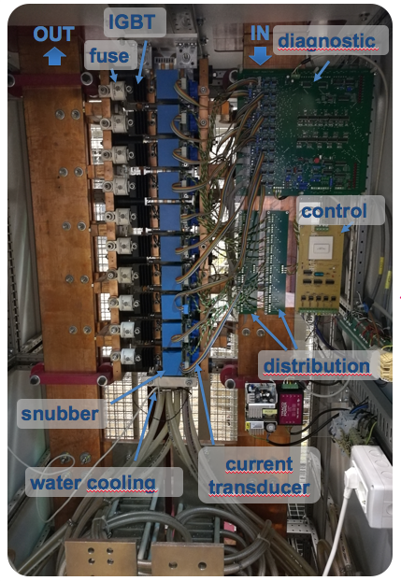
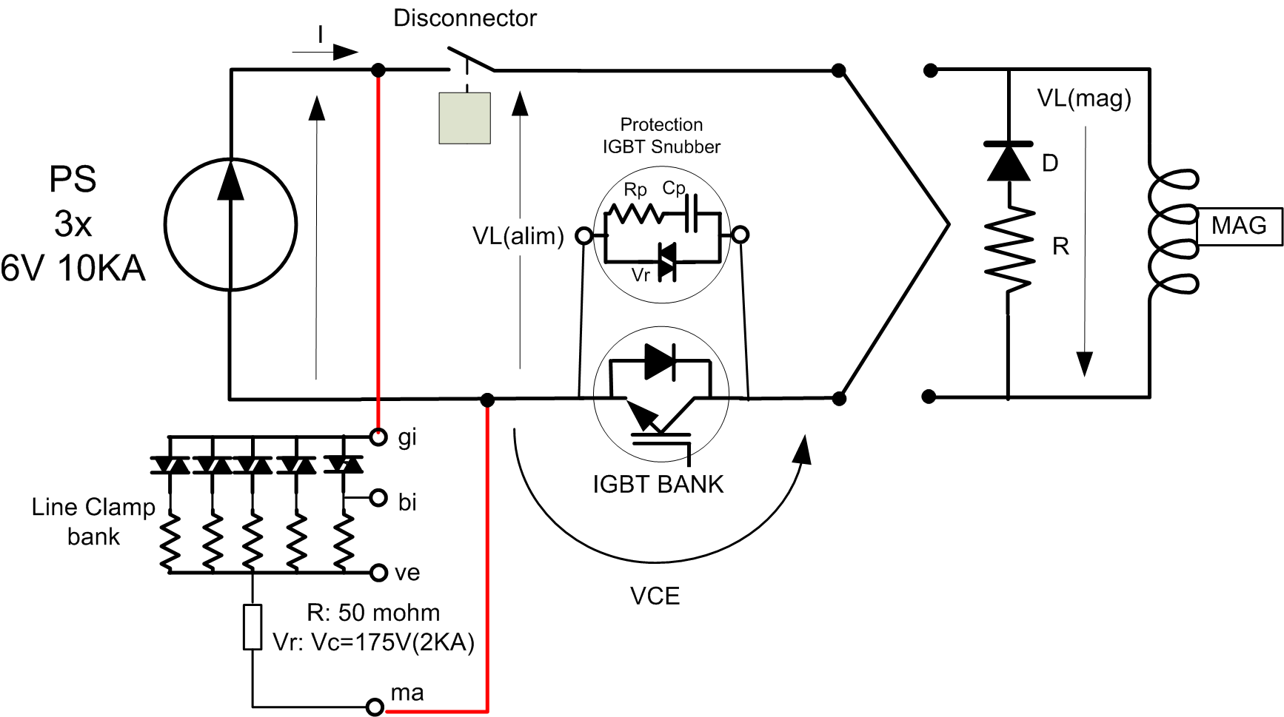
10 kA Protection
Discorap test
10 kA lead
M. Quadrio and A. Paccalini
Power supply 10kA – 30 kA
Power line 10 kA
Disconnector/fast switch 10 kA 1.2 ms
Line clamp
Dump resistor
1.2 ms to open
220 μs opening time
water cooling 17 kW

Slide 15
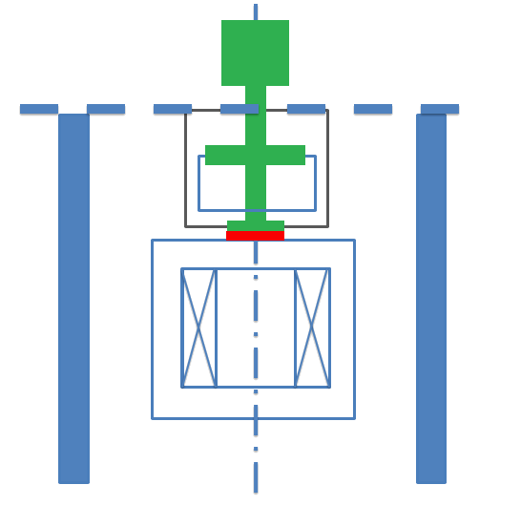
Working Principle
Vacuum
AIR
Low helium consuption
Good temperature control
Low temperature gradient (Ghe)
30-100 K
Shell design by R. Pengo
We introduce the cryocooler
10-50 K
GAS He
HEATER
Note
The cryostat is not in vacuum
The vessels have to allow the gas to flow in/out for cleaning
Liquid He
(optional)
Vacuum insulation
+ LN2

Slide 16
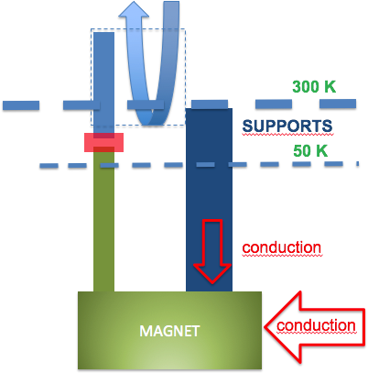
Thermal Balance Scheme
Current leads
  Gas He from a 450 l Dewar
  Updated CL design (no UHV welding on Cu)
  1-2 W @ I=0 and 7 W @ 10 kA
Mechanical support
Integration ongoing
CURRENT LEADS
G He
CRYOCOOLER
FIRST STAGE 20W @ 30K and 120 W @100 K
SECOND STAGE 9W @ 10 K

Slide 17
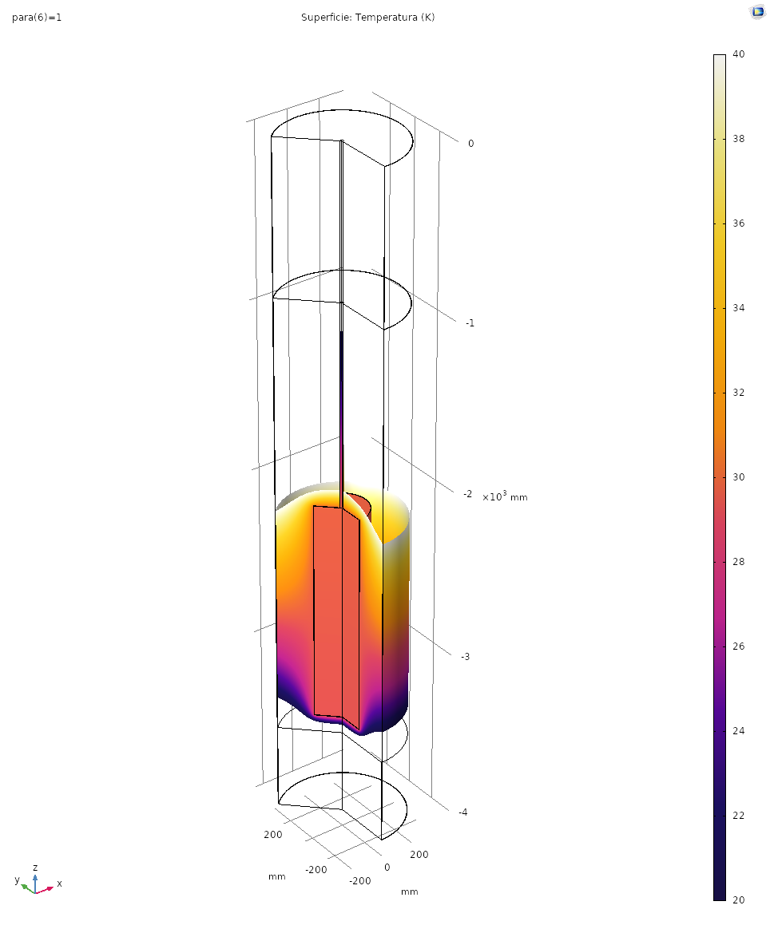
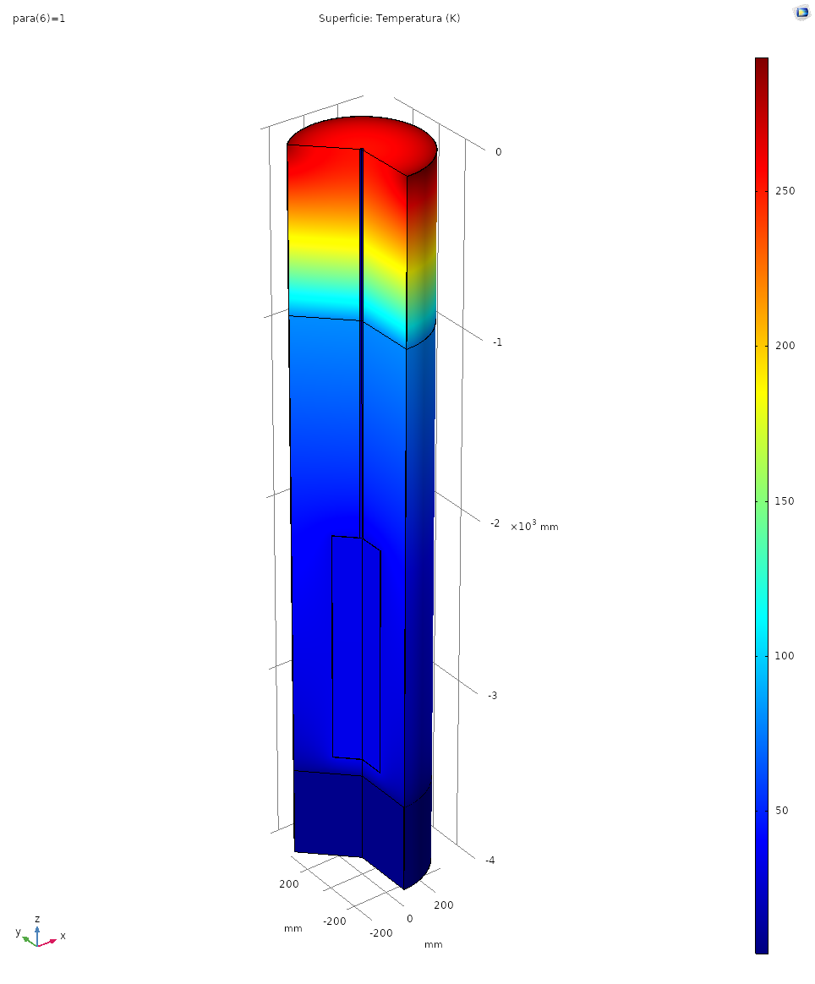
Magnet Temperature
40 K
300 K
Simplified model
Additional L-He consuption 1-10 l/h
Temperature homogeneity 1K
3.4 m
77 K
Magnet screen
LHe
20 K
4 K

Slide 18

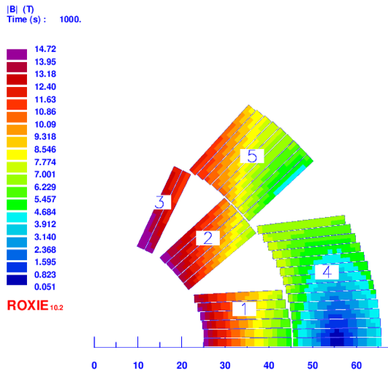
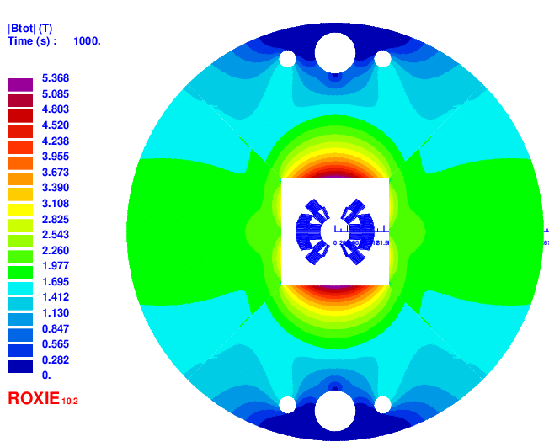
FalconD
INFN activity, co-founded by CERN, to develop a Nb₃Sn cos-theta dipole demostrator for 14 T (2 m long)
Magnet Parameter | Value
Bore field (T) | 14
Operation on Load Line | 86% (block 3)
Current (A) | 22975
J_{cu} (A/mm²) | 1540
Cable Parameter | Value
Cu/SC | 1
Strand number | 2x19
Strand diameter (mm) | 1
Height (mm) | 20
Inner width (mm) | 1.72
Outer width (mm) | 1.895
Keystone angle | 0.5°
Twist pitch (mm) | 100

Slide 19
INFN-LASA furnace for Nb3Sn winding heat treatment
The activity will require an investment to puchase a furnace for Nb3Sn reaction
Financial support already obtained, the activity to launch the tender in starting
Geometry and load: | 3 m with option for extension
Commissioning | 2020/2021
Installation area | 9 x 3.5 m
Length (uniform Temp/total) | 3 m
Performance
Max. operation temperature | 900°C
Temperature uniformity | ±3°C
Circulation fan / turbulent flow | 1 Fan/vertical axis
Process atmosphere | Argon
Vacuum level | 10⁻² hPa
Oxygen monitoring | down to 1 ppm

Slide 20
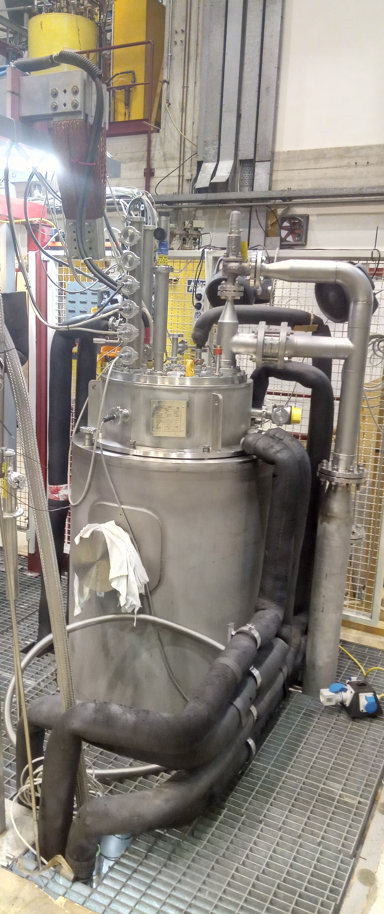
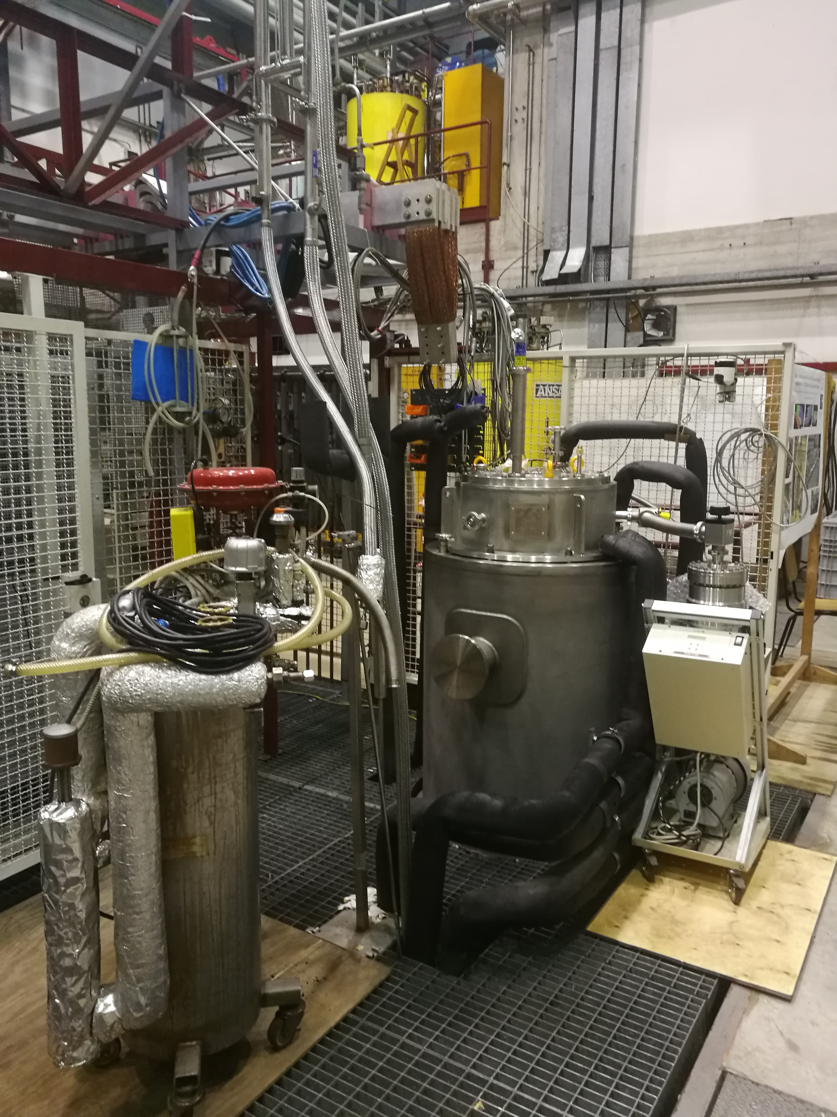
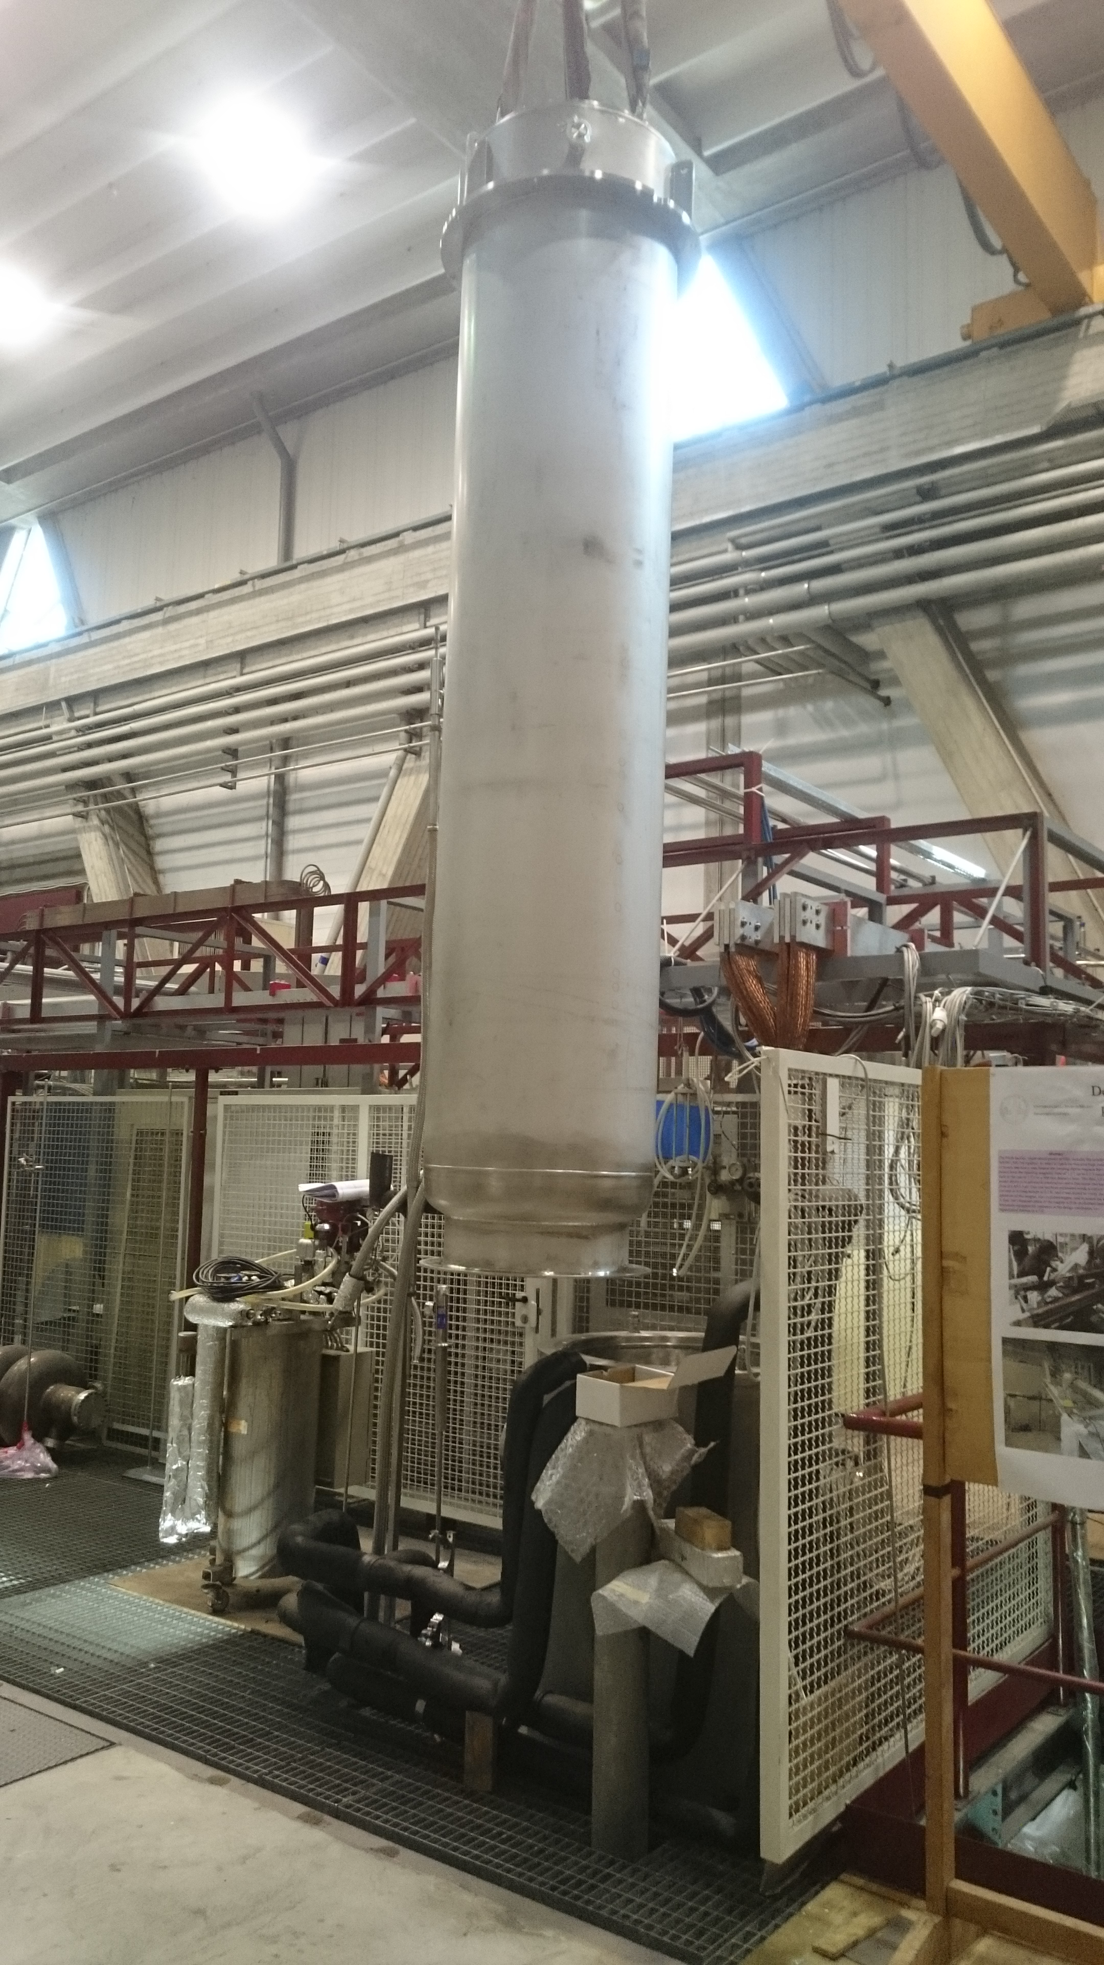
Status of Installation
4pole test
AAA
HiLumi cryostat
10 kA line
pumping station
Discorap cryostat
Nitrogen
heat exchanger

Slide 21
Conclusion
Updates on the activity of the LASA magnet test station
Updating cryoplant
Commissioning of the system for HiLumi HO correctors
  Test the ‘long’ HO prototypes
  Test the HO corrector series magnets
HTS magnets at variable temperature
Furnace for Nb3Sn reaction for a 14T demonstrator: FalconD

Slide 22
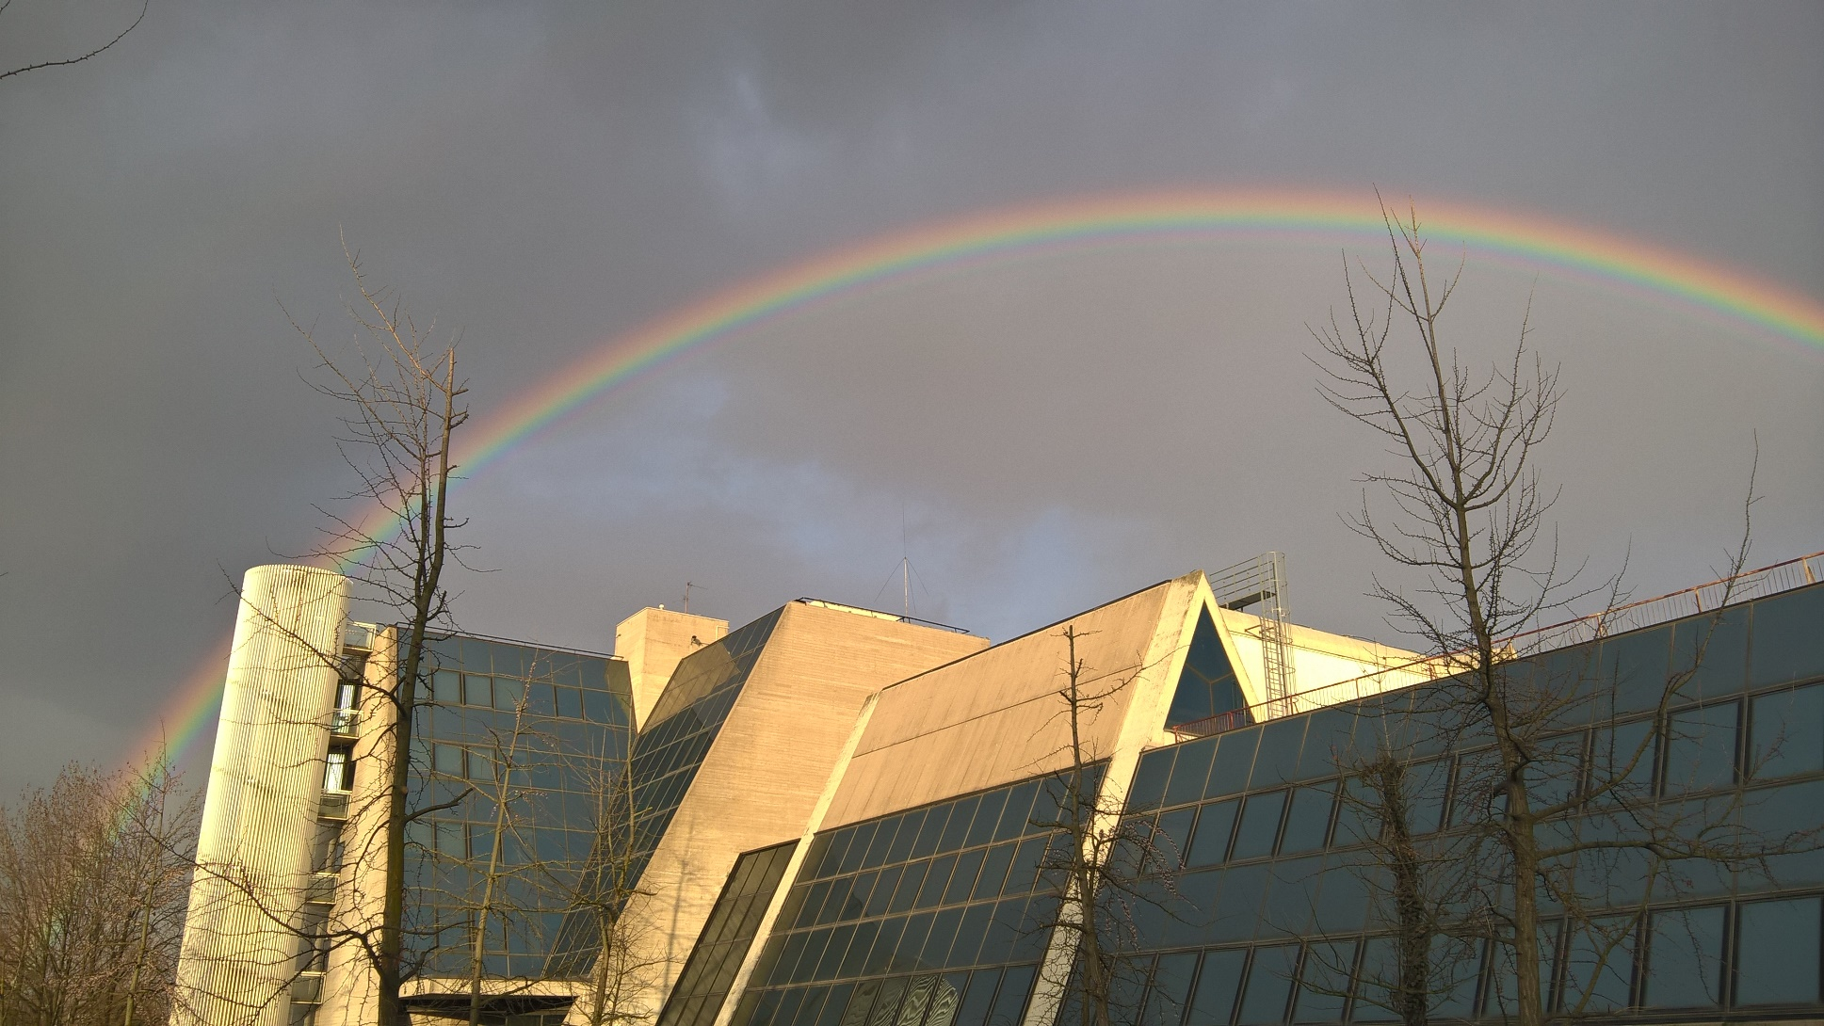
THANK YOU
Ph. by G. Fornasier
LASA team
F. Alessandria, G. Bellomo, F. Broggi, N. Lusa, S. Mariotto, A. Paccalini, D. Pedrini, A. Leone, M. Quadrio, A. Pasini, M. Prioli, M. Sorbi, M. Statera, M. Todero, C. Uva

