Slide 1
Challenges of a 1.9 K vertical cryostat design
Rocío Santiago Kern
On behalf of the FREIA team

Slide 2
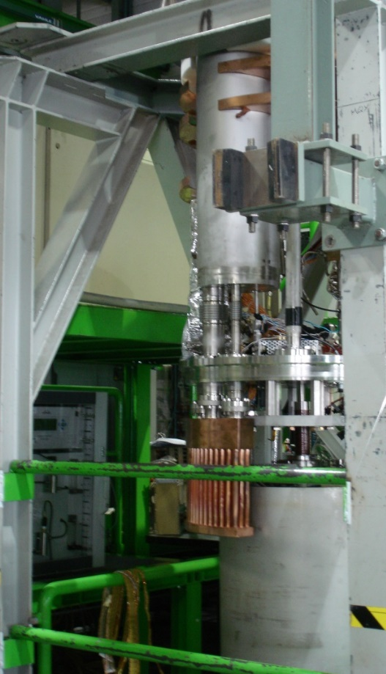
Challenges for the design and manufacturing of FREIA’s vertical cryostat ”Gersemi” were minimal thanks to the discussions held with
CERN
IPN Orsay
Design and sizing done by Accelerator and Cryogenic Systems

Slide 3
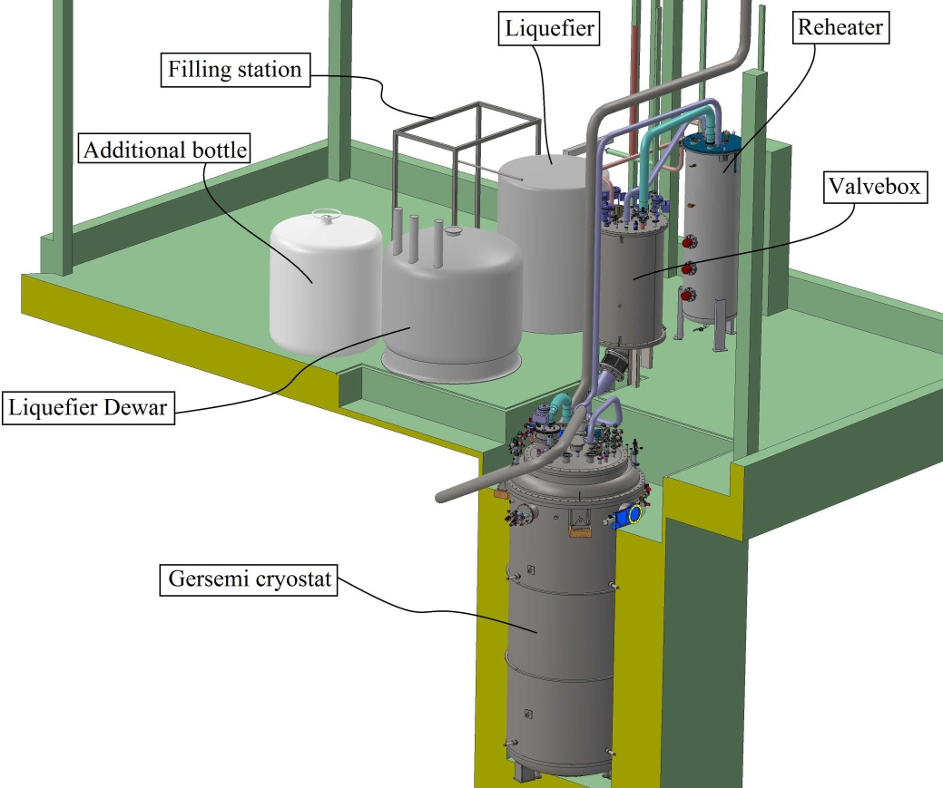
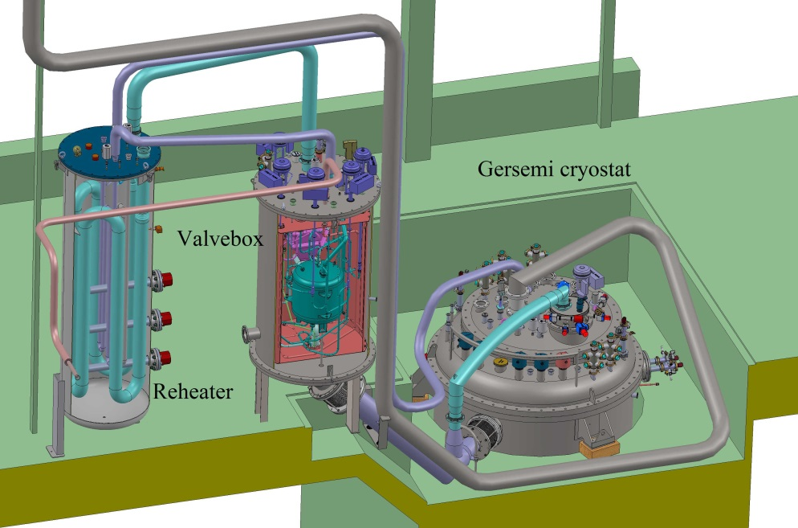
Gersemi’s General Layout

Slide 4
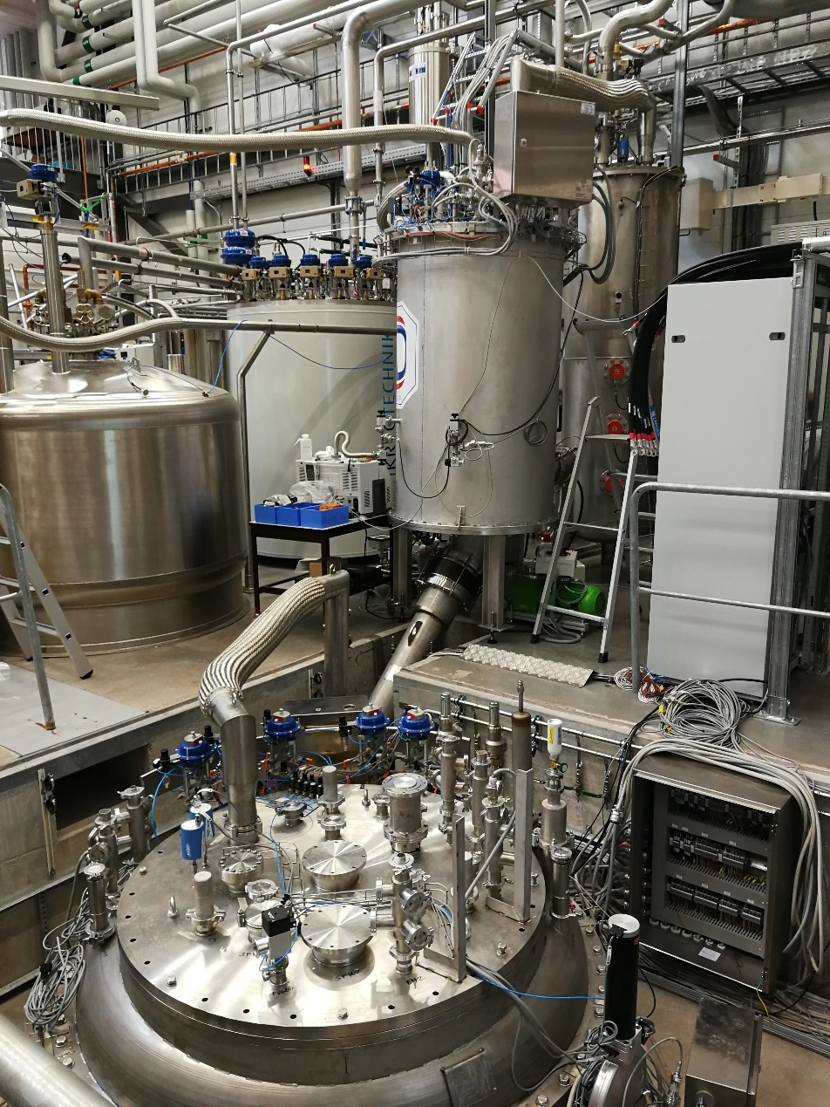
Gersemi’s General Layout

Slide 5
Cryogenic Scheme (magnet insert)

Slide 6
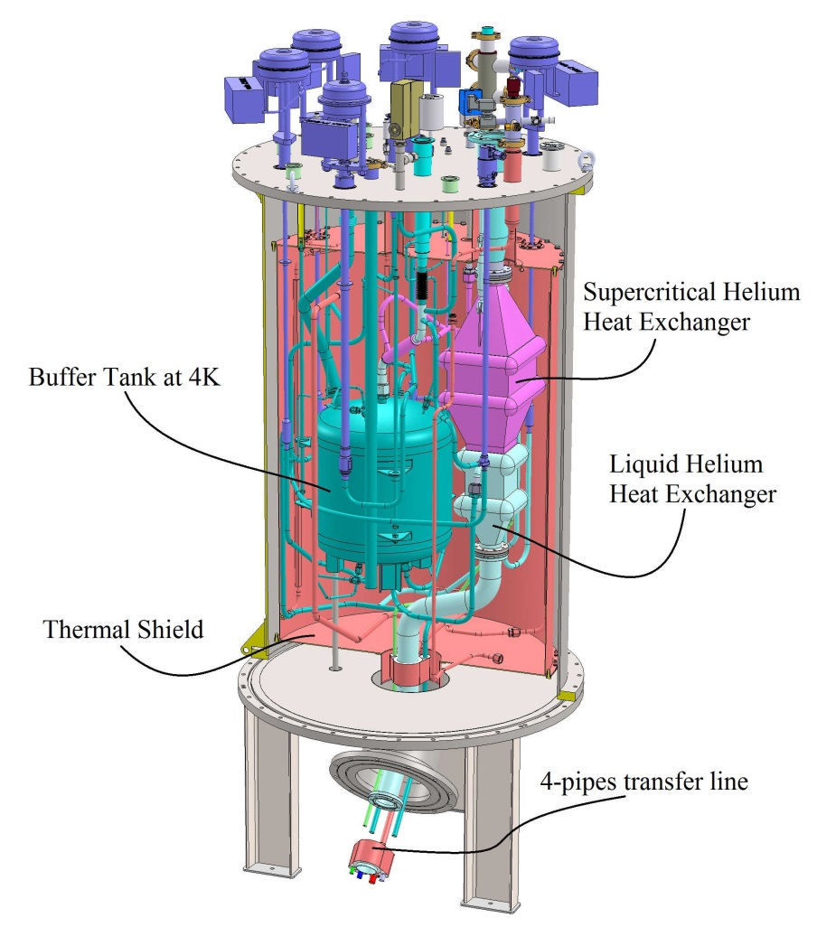
Components: Valvebox (VB)
Valves to direct LN2 and LHe where needed
Buffer tank at 4.5 K
Double Heat exchanger
Cooling of the LHe before expansion through the Joule-Thomson valve
Cooling of supercritical helium for the nexk of the vertical cryostat (VCS)
Transfer line (from below) to send cryogens to the cryostat
Height = 2330 mm
Diameter = 1016 mm

Slide 7
Components: Valvebox (VB)

Slide 8
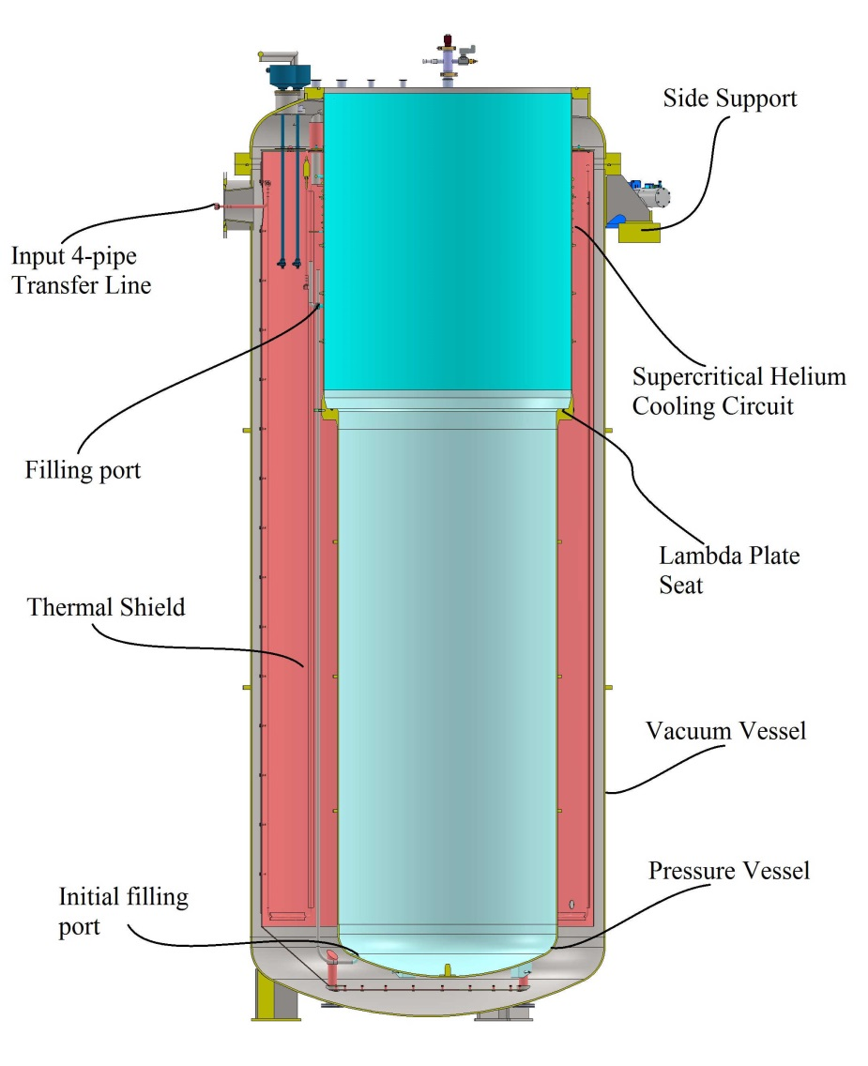
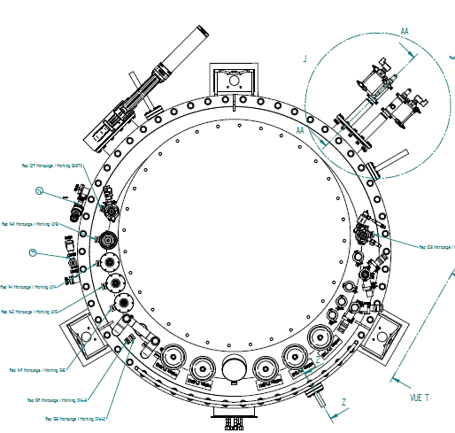
Components: Cryostat
Vacuum vessel:
To isolate the system from the surroundings
Has a thermal shield actively cooled with LN2
The feeding line comes from the side
Hangs on the pit by three side supports
Height = 4330 mm
Diameter = 1960 mm

Slide 9
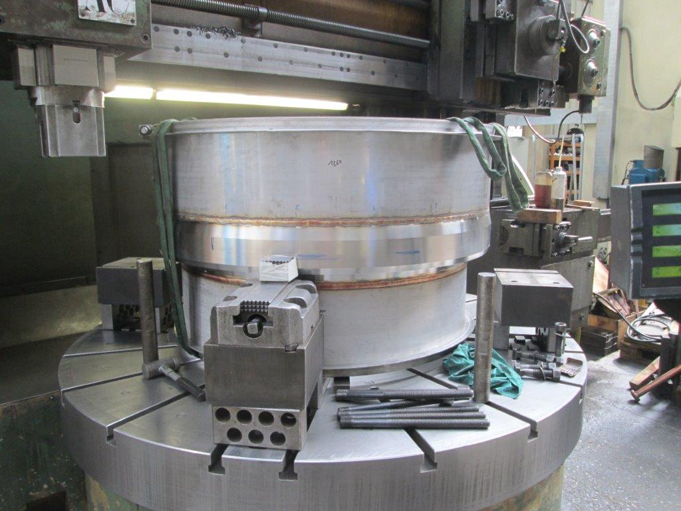
Components: Cryostat
Pressure vessel:
To use the cryostat in different modes of operation
It is categorized as a pressure vessel cat. III
It is off-center to accommodate for valves, instrumentation
towers, etc. that are common to all inserts
Height = 4770 mm
Diameter (below lambda plate) = 1120 mm

Slide 10
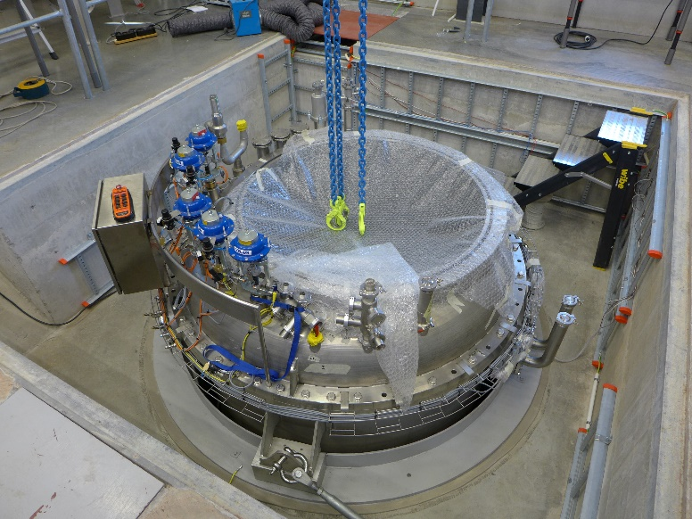
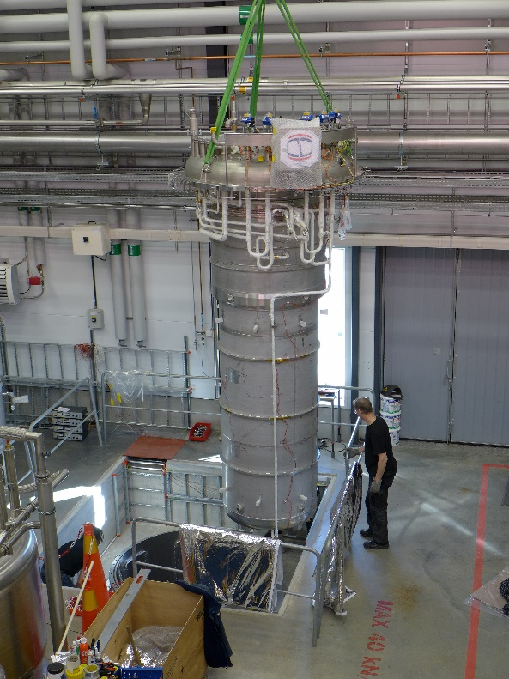
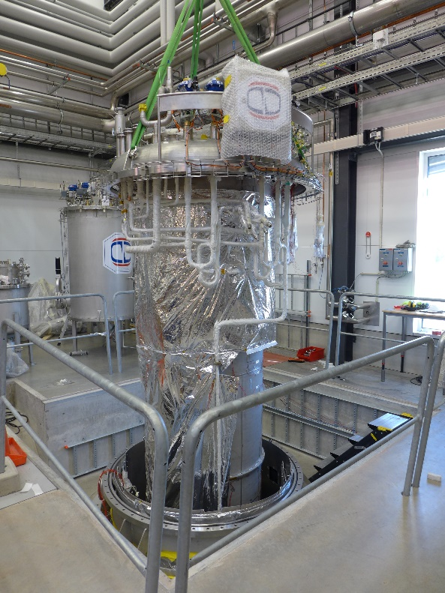
Components: Cryostat

Slide 11
Components: Inserts
To be able to test different devices with one cryostat, several inserts are needed
These inserts are independent from each other: they share sensors, heaters, etc but they are stand-alone units
They are lowered into the pressure vessel and fastened to its top flange
Feeding and collection of cryogens is through the top of the insert
All inserts can operate between 4.5K and 1.8K
Gersemi can have three different insert types
Vacuum insert: for devices with helium tank (not available)
Bath insert/Liquid insert: for devices without helium tank
Magnet insert/Lamda Insert: for magnets
None of the inserts has a power coupler port: only low power tests are possible

Slide 12
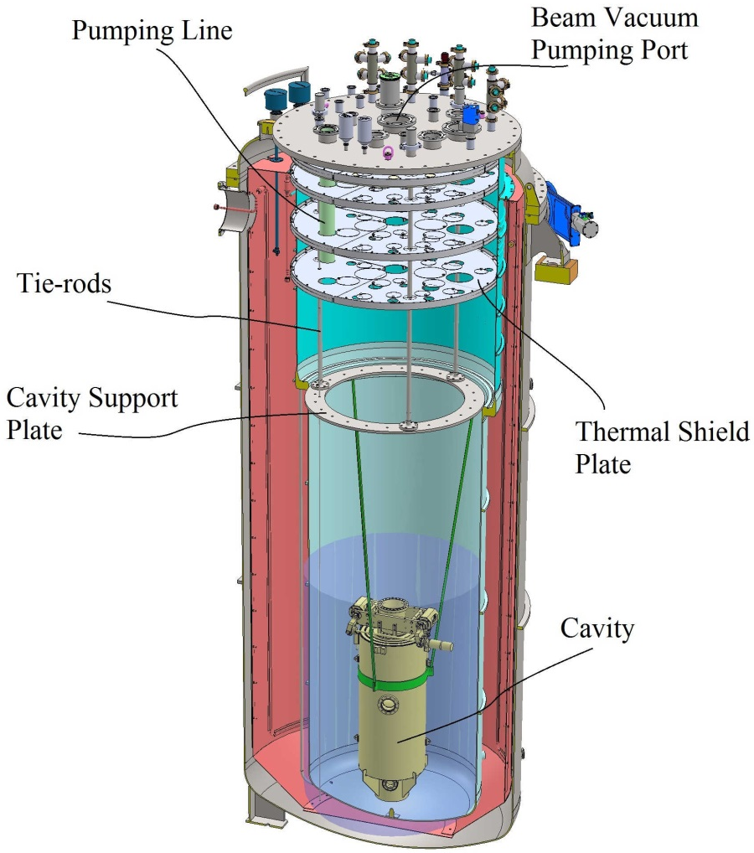
Bath/Liquid Insert
The device under test (DUT) does not have a helium tank
The pressure vessel is then filled with liquid helium to a suitable level (note: more liquid helium means need of higher production rates and heat losses)
To reduce heat inleaks from the top flange (at room temperature), several circular screems are stacked below
Depending on the DUT size one or more units can be tested at the same time
If needed, the beam vacuum can be pumped
Most of the instrumentation (heaters, temperature sensors, etc) is in direct contact with liquid helium
When operating below 4.5K, the volume to be pumped is the complete bath were the DUT is inmersed in

Slide 13
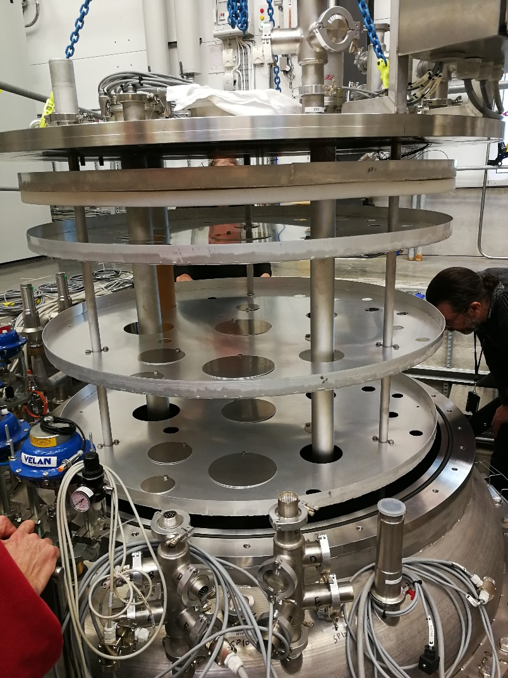
Bath/Liquid Insert

Slide 14
Magnet Insert
The lambda plate sits 1/3 way down the pressure vessel
(where the diameter changes)
To reduce heat inleaks from the top flange (at room
temperature), several circular screems are stacked
below
Depending on the DUT size one por more units
can be tested at the same time
Most of the instrumentation (heaters, temperature
sensors, etc) is in direct contact with liquid helium
Because of working above atmospheric pressure, the
vessel has been designed to sustain a pressure of 7 bara if
something goes wrong
Thermal Shields
Lambda Plate
Heat Exchanger

Slide 15
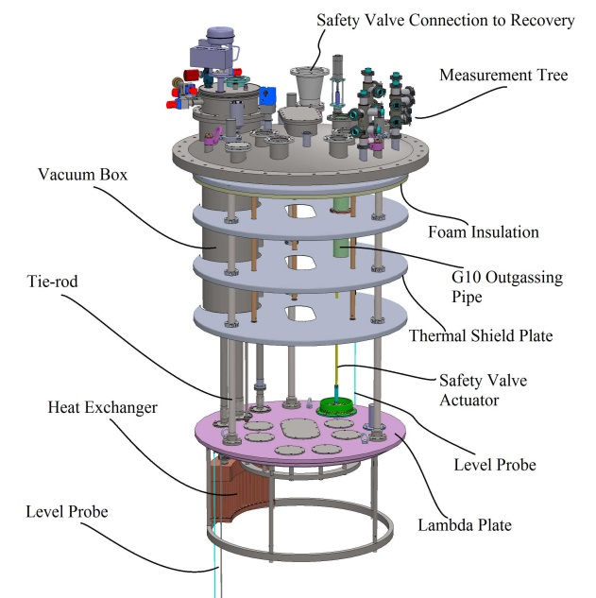
Magnet Insert
Available space below lambda-plate is 2.65 m in length and 1.1 m in diamater
When operating below 4.5K, the volume to be pumped is small but the heat load of the complete lower bath is taken by the heat exchanger (Inner surface 1m³)
Current Leads
4 gas-cooled current leads designed for max 2 kA
Heat inleak max 2.4 W at 2 kA
Current lead cold isolation
(courtesy of M&W)
Current lead cold terminal (courtesy of M&W)

Slide 16
Experience and schedule
Experience gathered from HNOSS:
VAT butterfly valves instead of MKS type
In the future, exchange the actual volumetric flow meters for mass flow meters
Cryogenic behaviour under different conditions
Experience to be gathered
Cooling times for magnets
LHe requirements (available Lhe rate of 150 l/h, cooling power 90 w at 1.8 K)
Sequences for cooling and powering magnets
Schedule:
VB with simulator: to test VB performance and some sequences
Done
VB with VCS + bath insert: to test VCS performance and other sequences
Before and after summer
VB with VCS + magnet insert with magnet: to test magnet sequences and overall behaviour
Mid Autumn

Slide 17
Thank you for listening
Doubts/requests/inquiries?

