Slide 2


3rd International Workshop on Superconducting Magnet Test Stands
Uppsala - Sweden
2019, June 11 – 12
Ångström laboratory
SM18 CRYO UPGRADE
Nicolas GUILLOTIN (CERN)
on behalf of TE-CRG
And major contribution of : F. DHALLA, J-P. LAMBOY, R. LAMY, , J. MOULEYRE, A. PERIN, M. PEZZETTI,

Slide 3
OUTLOOK
I | INTRODUCTION & CONTEXT
II | SM18 SIMPLIFIED CRYO DEVICES : BEFORE & AFTER UPGRADE
III | KEY FIGURES
IV | UPGRADE HANDOVER & RESTART PROTOCOL
V | OVERVIEW
2019 JUNE, 11
3

Slide 4
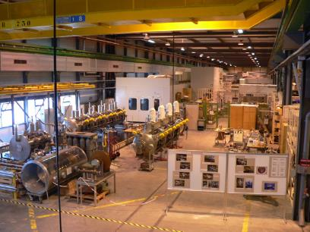
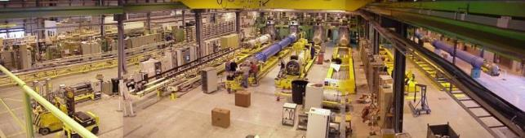
SM18 : CERN main facility for testing SC accelerator magnets and SC RF cavities
SM18 cryo infrastructure is being significantly upgraded (starting in 2019) to meet requirements for :
LHC High Luminosity project (HL LHC)
R&D program for SC magnets
RF equipment until 2023 and beyond
RF cavities & Cryomodules
Horizontal test benches
2019 JUNE, 11
4

Slide 5
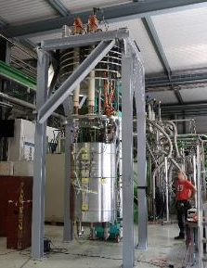
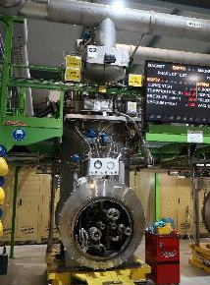
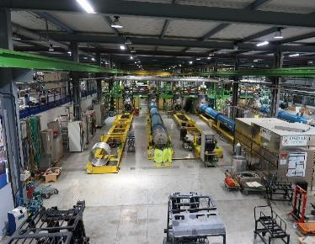
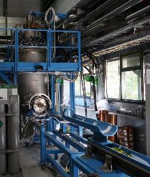
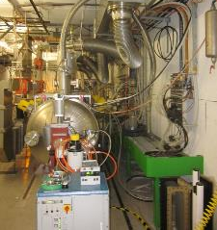
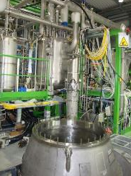
SOME OF THE SYSTEMS CURRENTLY IN OPERATION IN SM18
5 vertical magnet cryostats :
HFM, CLUSTER D, SIEGTAL,
LONG, DIODES
10 Horizontal test benches for magnets
1 test bench for SC Link :
4 test benches for RF cavities : V3, V4, V5, V6
2 test benches for Cryomodules : M7, M9
1 independent test Bench :
Eu HIT GReC
(80K, 4.5 K, 1.9 K)
(80K, 4.5 K, 1.9 K)
(30 - 4.5 K, 2 ∼ 15g/s)
Vertical magnet tests
Hor. Magn, feed box
Horizontal magnets test benches
(4.5 K, 1.9 K)
(80K, 4.5 K, 1.9 K)
(10 - 4.5K)
SC links tests
RF cavities & CM tests
Vertical magnet tests
In Operation
2019 JUNE, 11
5

Slide 6
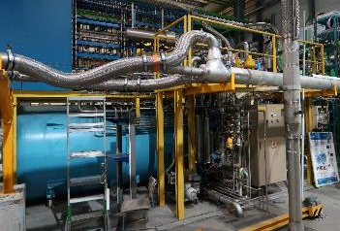
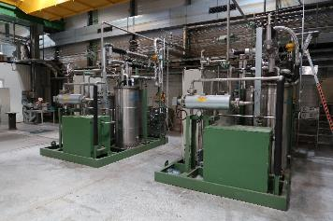
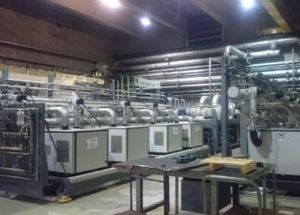
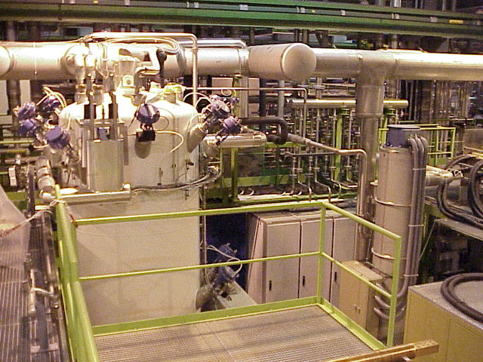
SOME DEVICE OF THE CRYOGENIC INFRASTRUCTURE CURRENTLY IN OPERATION
6kW Linde Cold Box
27g/s (∼700L/h) @4.5K
Purification units
3 x 130 Nm3/h Burckardt recovery compressors +
2 Purifiers 200 Nm³/h at 180 bars
In Operation
Very Low Pressure compressors (WPU)
Cool down - warm up unit (CWU)
  Values per WPU unit :
  6 g/s @ 10 mbar
  12 g/s @ 20 mbar
  18 g/s @ 30 mbar (max)
2 x CWU 80g/s –
2 x 120kW @80K
With 3 Kaesers compressors
2019 JUNE, 11
6

Slide 7
FACING THE HL LHC PROGRAM
New SC devices for the HL-LHC project require the SM18 cryostructure upgrade
Partial installation
Installation
11T dipoles
Standalone magnets
SC link
(Cables & current leads)
Crab RF cavities
Inner Triplet magnets
Project
Low-β magnets - Nb3Sn technology - peak field of 11.4 T
With : 2 outer quadrupoles, Q1 & Q3 +
a central one divided into 2 identical magnets, Q2a and Q2b
HL LHC String will be a new test stand to validate the collective behaviour of a structure including IT magnets
Project
‘’HL-LHC IT STRING TEST’’, M. Bajko,
LHC Performance Workshop 2018 Chamonix

Slide 8
I | INTRODUCTION & CONTEXT
II | SM18 SIMPLIFIED CRYO DEVICES : BEFORE & AFTER UPGRADE
III | KEY FIGURES
IV | UPGRADE HANDOVER & RESTART PROTOCOL
V | OVERVIEW
2019 JUNE, 11
8

Slide 9
REQUIREMENTS FOR THE UPGRADE OF THE CRYOGENICS INFRASTRUCTURE
BASED ON TEST PROGRAM - ASSUMPTIONS FOR COVERING THE MAIN TEST BENCHES
Magnet test benches: 2 vertical & 2 horiz. magnets at cold / month with 2 magnets powered simultaneously
Superconducting cavities: 1 cavity /2 weeks & 1 cryomodule test every 6 months
Parallel test of a superconducting link (SC Link) and/or the IT string (String)
Possibility of additional individual systems tests on dedicated facilities

Slide 10
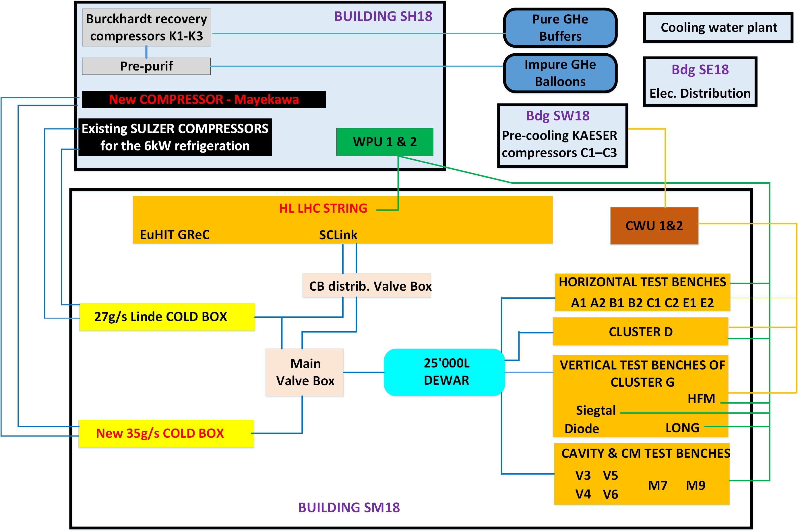
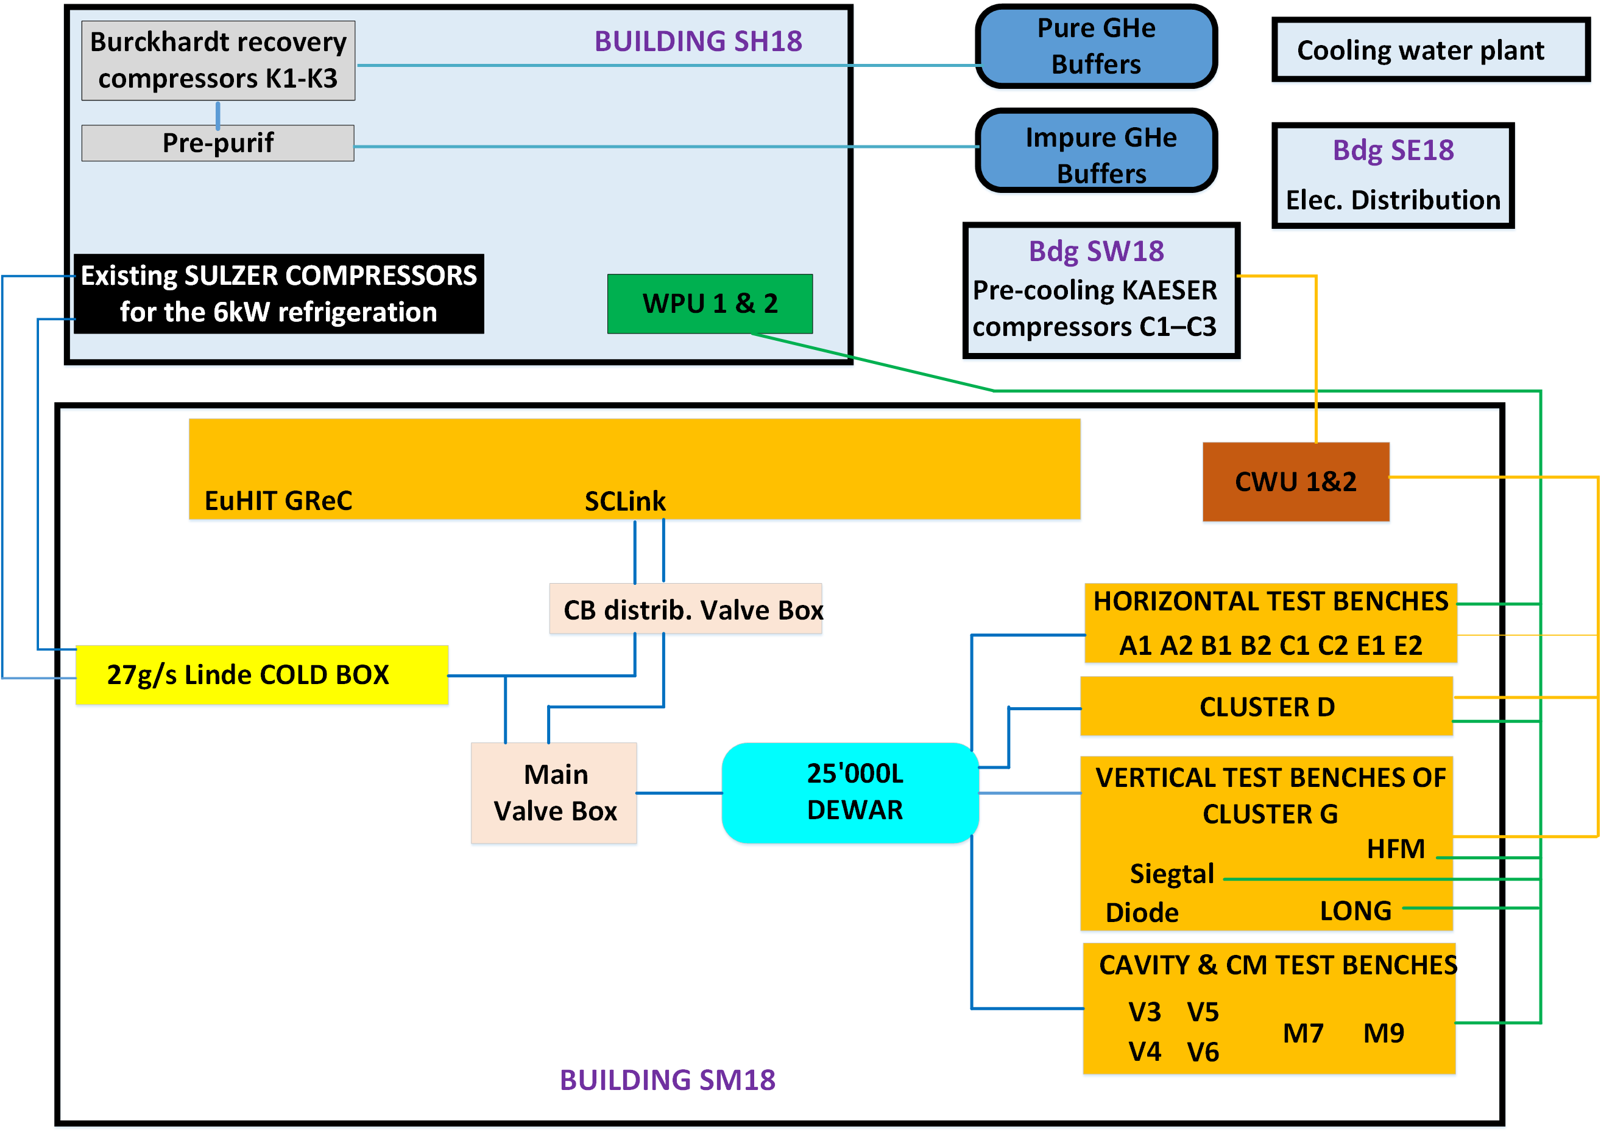
AFTER UPGRADE
SCHEMATIC LAYOUT OF THE SM18 CRYO INFRASTRUCTURE
Infra
Test benches
Cold Boxes
LHe dewar
GHe stock
Distribution

Slide 11
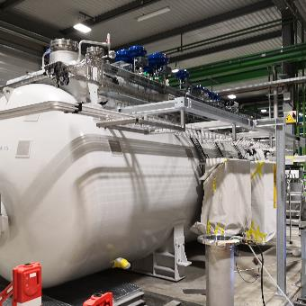
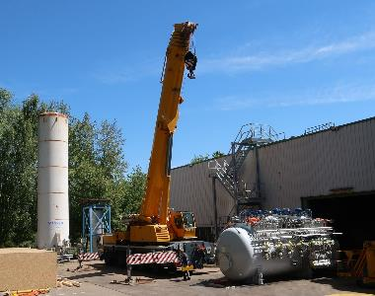
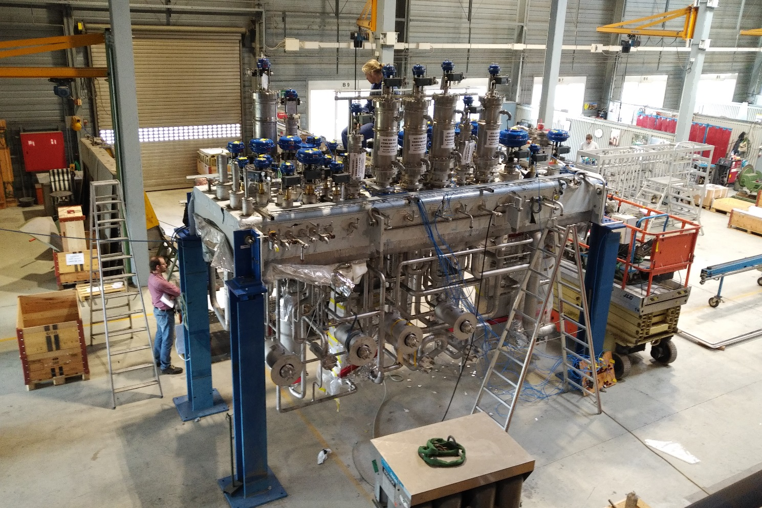
SM18 NEW COLD BOX
Cold Box installed in the SM18
2019 MAY, 15
Transport and arrival at the SM18
2019 MAY, 14
Mechanical Integration, Electrical and Control System review held at Linde Kryotechnik AG (LKT) in 2018 and beginning of 2019
2019 JUNE, 11
11

Slide 12
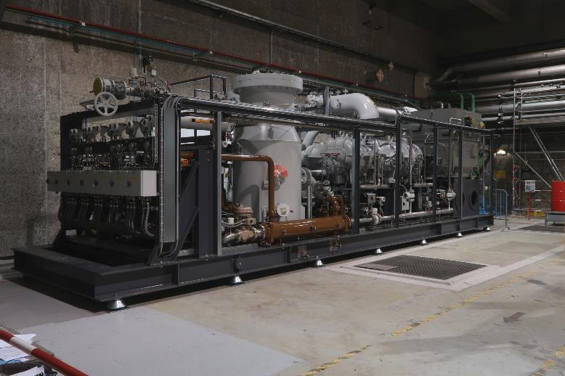
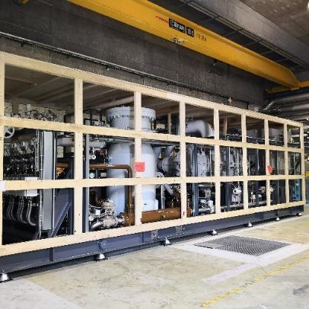
SH18 NEW MAYEKAWA COMPRESSOR
Reception March, 26

Slide 13
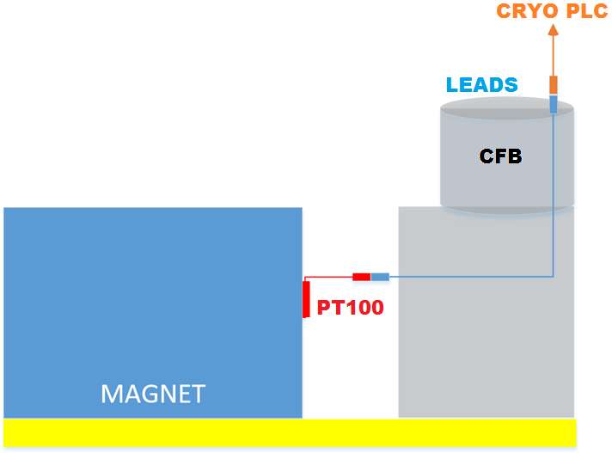
PROCESS UPGRADE FOR Nb3Sn MAGNETS
Nb3Sn SC magnet tests at the SM18 need a control of the ΔT during cool down and warm up, in the 80 – 300K range
⇒ Automated ΔT control during cool down / warm up of Nb3Sn magnets has been implemented and need to be evaluated in real conditions
Installation of a new PT100 close to the magnet cold mass
Measurement of the ΔT between CFB Temp_inlet – CFB Temp_outlet = value A
Measurement of the ΔT between CFB Temp_inlet – Magnet new PT100 = value B
Continuous regulation of the ΔT based on the max value : A or B
Redundancy for the PT100 is necessary
Particular case for the reconnexion after a trip

Slide 14
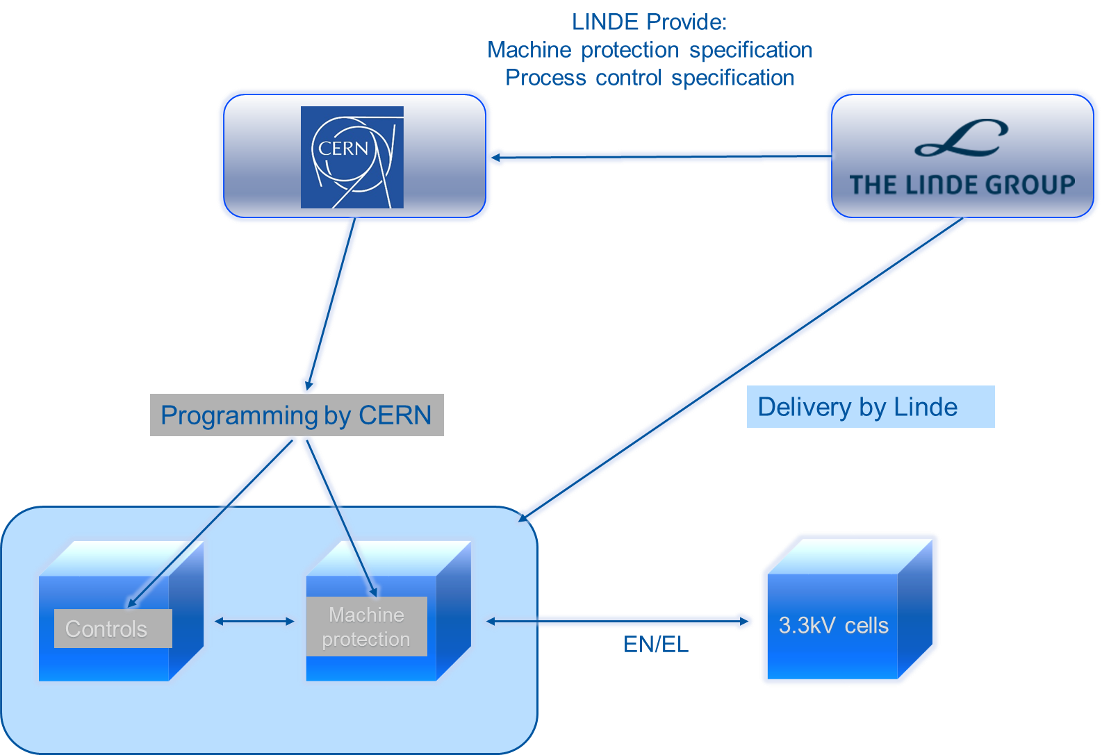
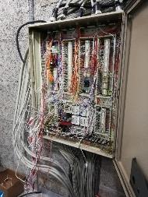
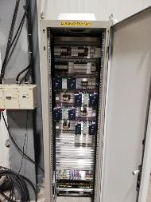
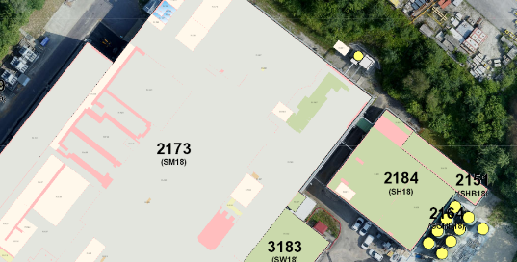
CONTROL & ELECTRIC UPGRADE
For the 35g/s Cold Box & Mayekawa compressor :
Electrical cabinet installation for the 35g/s CB & Mayekawa CP
CP logic document sent to LKT, ready to be commissioned
CB logic sent to LKT
Control & Elec upgrade for the SH18 :
2019 : New rack with independent M580 PLC + RIO (Remote I/O)
Buffers and Burkhardt controlled by an independent system
Done
to allow independent maintenance and debugging
2020 : M580 PLC moved to Infra Cabinet and RIO linked with fiber optic
Done
SM18
PLC
2020
SH18
RIO

Slide 15
I | INTRODUCTION & CONTEXT
II | SM18 SIMPLIFIED CRYO DEVICES : BEFORE & AFTER UPGRADE
III | KEY FIGURES
IV | UPGRADE HANDOVER & RESTART PROTOCOL
V | OVERVIEW
2019 JUNE, 11
15

Slide 16
SM18 CRYOPLANT GENERAL KEY FIGURES : AFTER UPGRADE
Sytem | Characteristics
EXISTING 6kW CB – ‘’LINDE A’’ | 27g/s (∼700L/h) @4.5K
NEW Linde CB – ‘’LINDE B’’ | 35g/s (∼1000L/h) @4.5K
Process compression station | 3 Stal He compressors (350 g/s @19 bar), 1.6 MW elec. power + ORS + new MAYEKAWA compressor (main drive motor of 1.4 MW)
Very Low Pressure Pumping (WPU) | 2 warm pumping units, each one : 6 g/s @ 10 mbar 12 g/s @ 20 mbar 18 g/s @ 30 mbar (max) To each WPU is dedicated a very low pressure heater of 32 kW (20g/s)
Pre-cooling to 80K | 2 x CWU (80g/s - 2 x 120kW @80K) - With 3 Kaesers compressors
GHe Purification | 5 x 80 m³ Balloons at 1 bar (3 Burckardt recovery compressors + 2 Purifiers 200 Nm³/h at 180 bars)
Pure GHe storage | 8 x 75m3 @18 bars
LHe storage | 1 x 25 m³ LHe storage at 1.6 bar (+ 1x 10 m³ mobile)
LN2 storage | 50’000L Dewar
2019 JUNE, 11
16

Slide 17
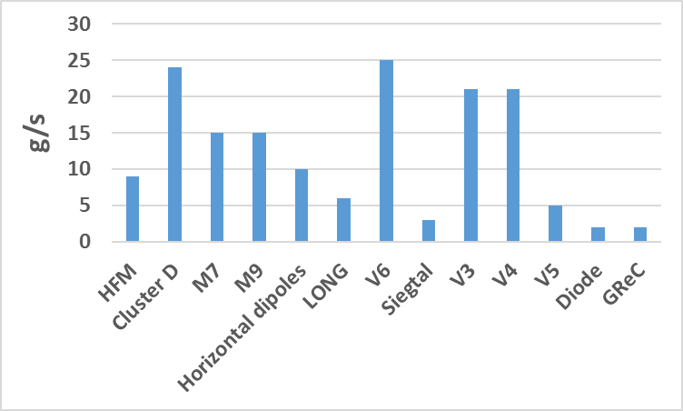
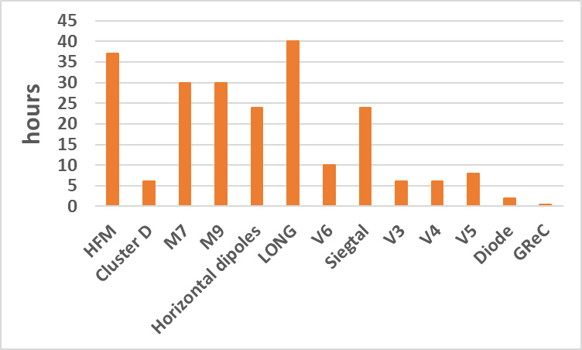
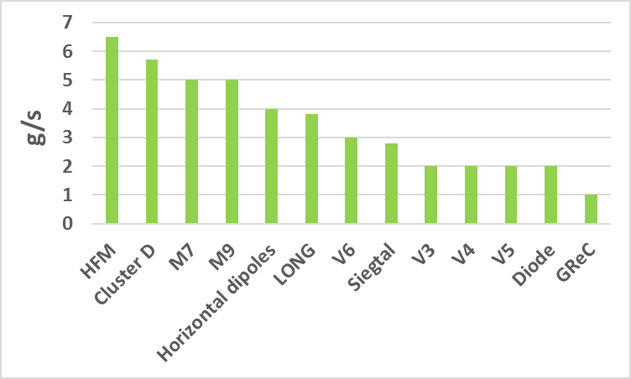
LHe CONSUMPTION FOR COOL DOWN TO 4.2K - COOL DOWN DURATION – STEADY STATE
Cool down consumption
The 27g/s cold box will be dedicated to the HL LHC String and could complement the Dewar for the other test benches
Cool down duration
The new 35g/s cold box will directly and significantly increase the LHe capacity for :
The cool down
The steady state
The Quench recovery
Test benches
Test benches
Steady state consumption
EQUIPMENT | LHe FLOW FOR QUENCH RECOVERY | QUENCH RECOVERY TIME
 | [g/s] | [h]
HFM | 12 | 4
Cluster D | 12 | 4
Horizontal dipoles | 14 | 2.25
LONG | 6.8 | 2
Test benches
2019 JUNE, 11
17

Slide 18
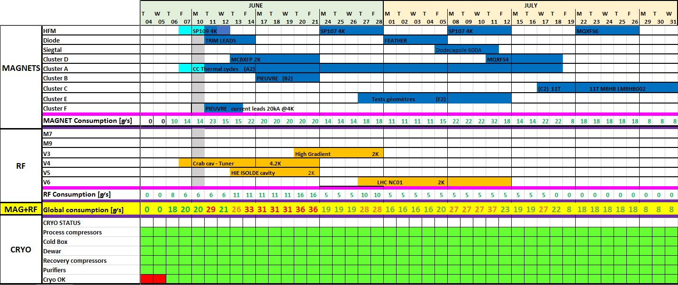
SM18 TYPICAL CURRENT PLANNING : LHe DISTRIBUTION FOR THE TESTS
A priority management is currently essential for the cool down organisation (capacity limited to 27 g/s)
The 35g/s cold box will be mandatory to operate HL LHC String in parallel of the current tests and reduce Quench recovery time
2019 JUNE, 11
18

Slide 19
I | INTRODUCTION & CONTEXT
II | SM18 SIMPLIFIED CRYO DEVICES : BEFORE & AFTER UPGRADE
III | UPGRADE KEY FIGURES
IV | OPERATIONAL PROTOCOL & TOOLS AFTER THE UPGRADE
V | OVERVIEW
2019 JUNE, 11
19

Slide 20
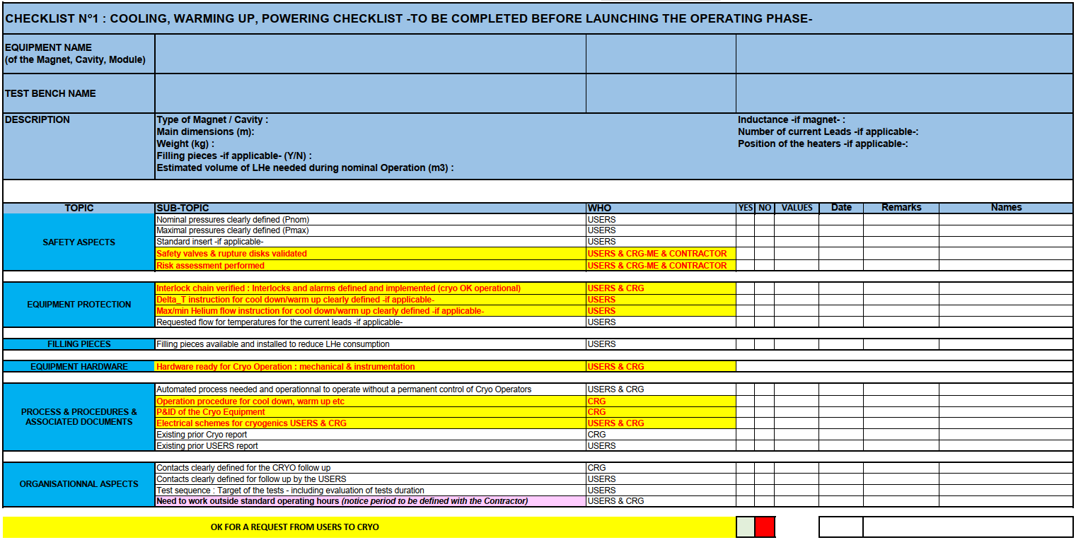

RESTART PROTOCOL : CHECKLISTS
SAFETY
ORGANIZATION
OPIMIZATION & TOOLS
COMMUNICATION
Could be implemented with CARPENTER

Slide 21
OPERATIONAL PROTOCOLS
SAFETY
Human safety ⇒ respect of rules and best practices for Operation
Equipment safety ⇒ preventive maintenance, follow up with INFOR
ORGANIZATION
OPIMIZATION & TOOLS
Excel forecast tool to anticipate and simulate LHe consumptions
COMMUNICATION
‘’Weekly’’ general Coordination meetings for the tests (priority definitions)
Weekly Technical meetings
Reports on activities

Slide 22
SUMMARY
The upgrade of the cryogenic system at the SM18 gives the possibility to :
Increase the global LHe capacity for the Magnets and RF cavity tests
Ease Quenches recovery for Magnet tests
Allow the operation of the SM18 test benches while also running the test program of the HL-LHC String
Allow one CB/Compressor system to be under maintenance while the LHe supply to dewar can continue
⇒ Operation flexibility & Redudancy in case of major issue
2019 JUNE, 11
22

