Slide 2
Power Converters and Room Temperature Connections in SM18
Samer Yammine
3rd International Magnet Test Stand Workshop
2019-06-11

Slide 3
Contents
Circuits for HL-LHC Magnet Tests at CERN
SM18 Cluster F Powering Upgrade
Room Temperature Connections
Conclusion

Slide 4
1
Circuits for HL-LHC Magnet Tests at CERN

Slide 5
HL-LHC Circuits at SM18
Power Converters for HL-LHC (in the Tunnel)
Type of Circuits for HL-LHC:
18 kA without EES
14 kA without EES
2 kA without EES
2 kA with EES
600 A with EES
200 A with EES
120 A without EES

Slide 6
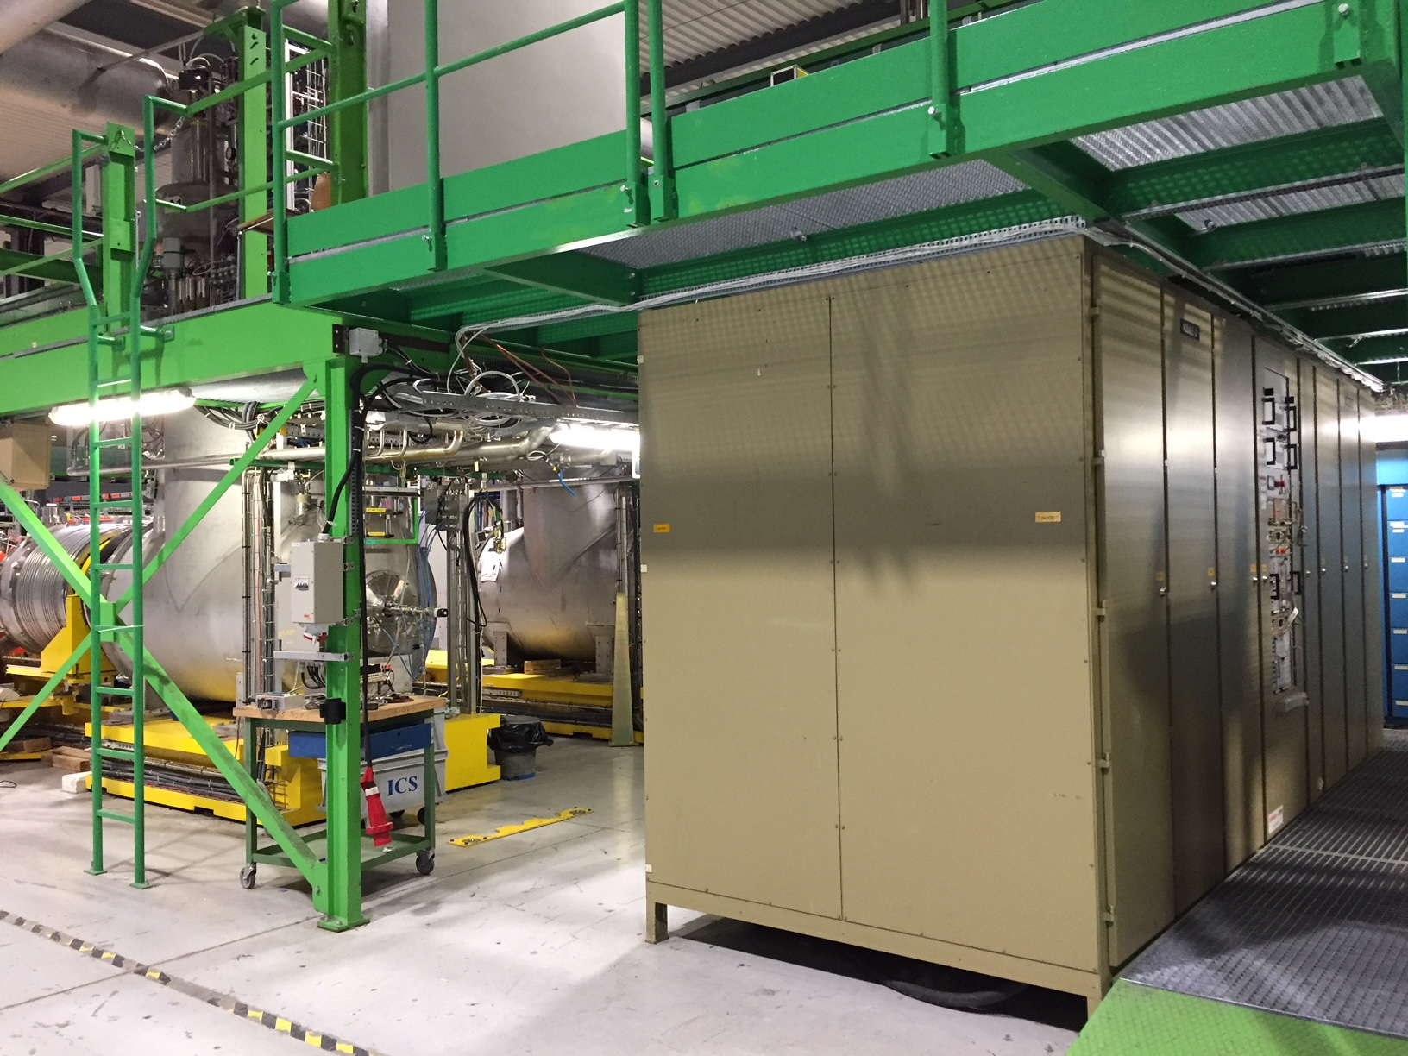
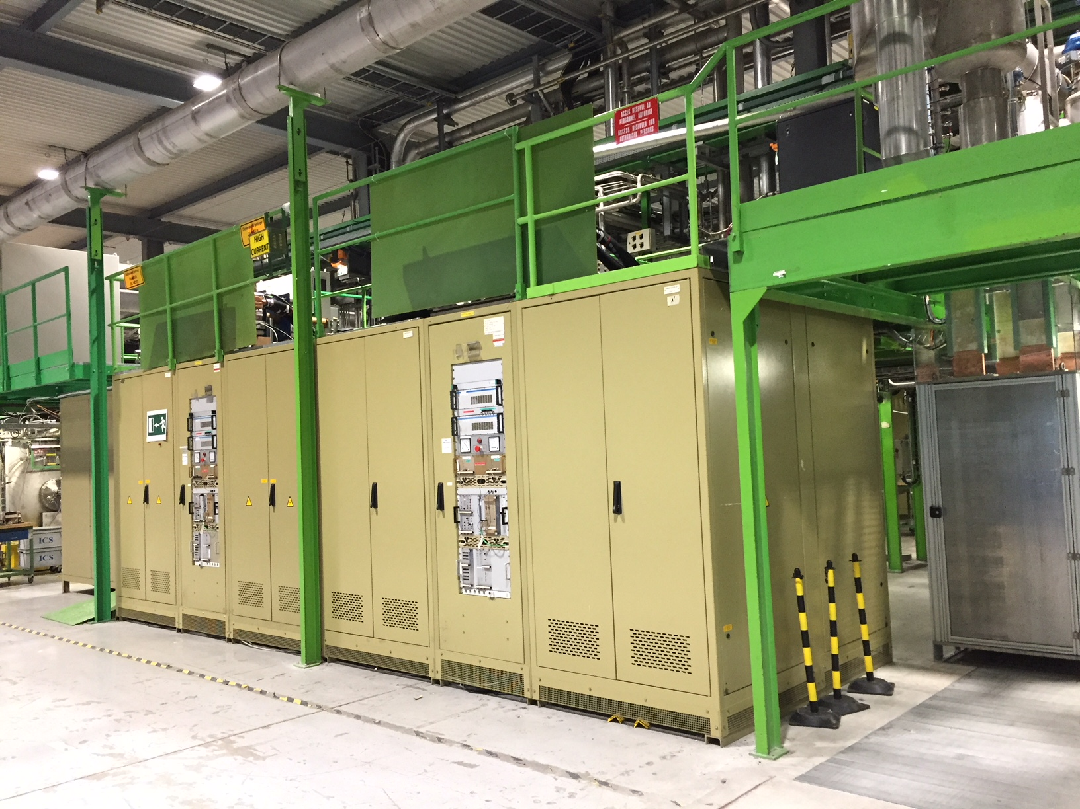
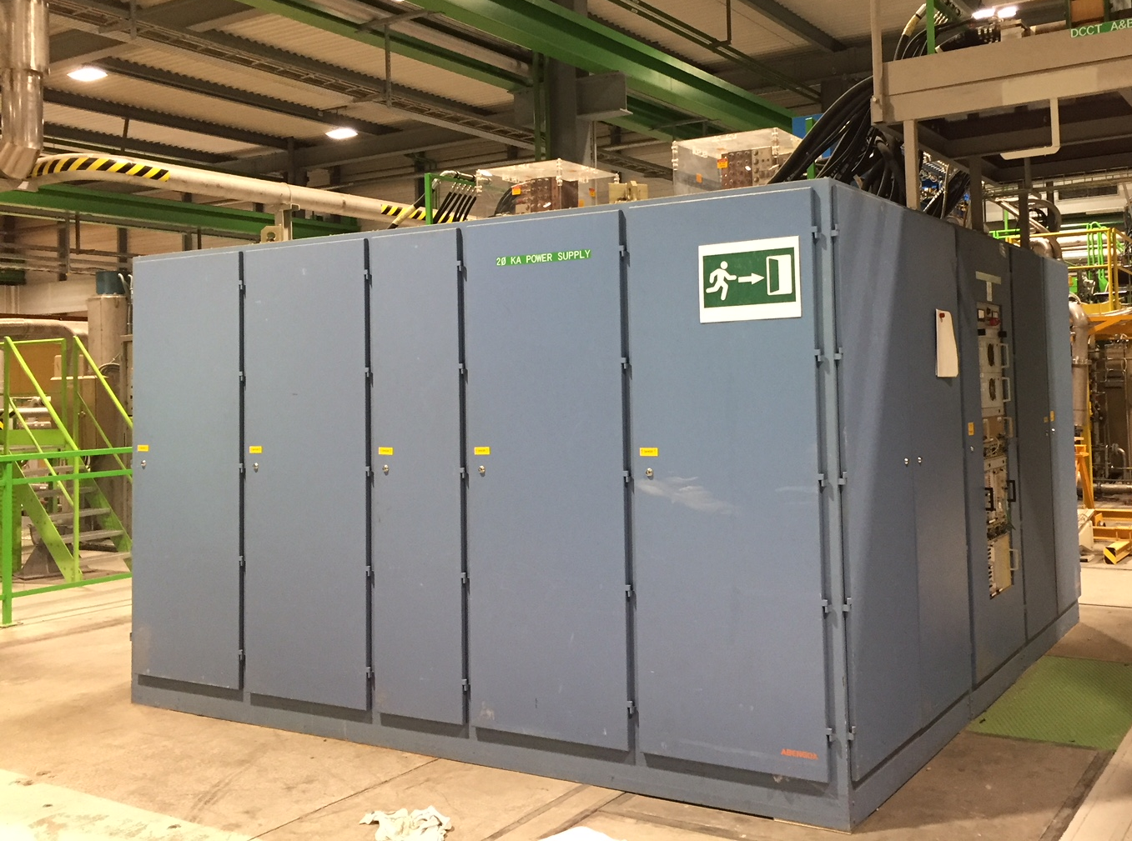
HL-LHC Circuits at SM18
Power Converters for Magnet Tests – High Current Converters
Upgrade in 2017
For Horizontal Tests (without EES)
Cluster A
20kA-61V
Upgrade in 2016-2017
Cluster D
30kA-16V
IN PLACE
For Vertical Tests (with EES)
Cluster G
20kA-25V
For Vertical Tests (with EES)

Slide 7
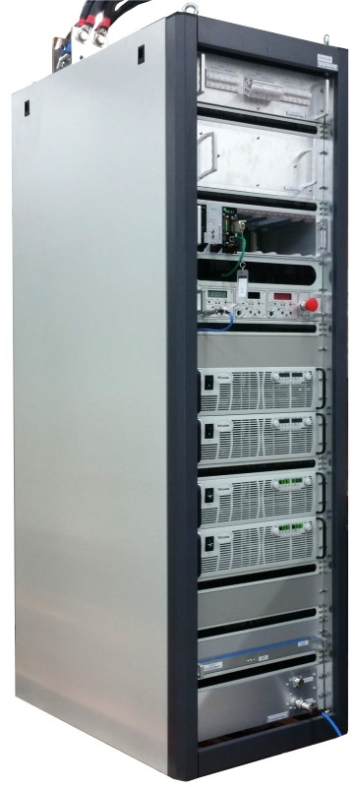
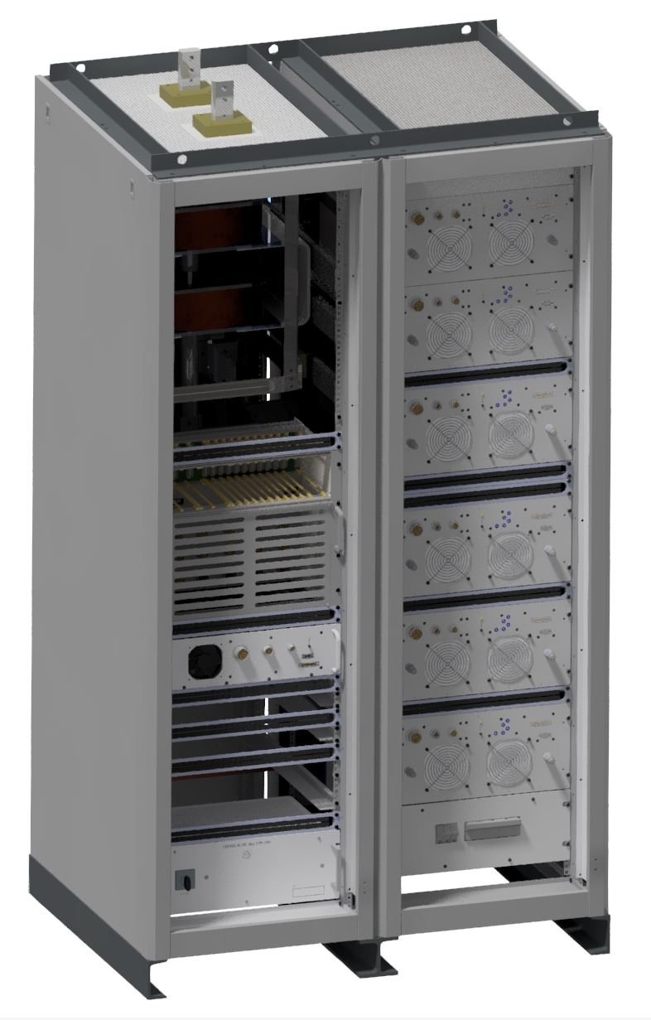
HL-LHC Circuits at SM18
New Power Converter for 2 kA Corrector Circuits
Upgrade in 2017
Upgrade in 2016-2017
COMBO 2kA-10V
1 Quadrant
Cluster A (Without EES)
Cluster F (With EES)
HL-LHC2kA-10V
4 Quadrants
Cluster D (With EES)
Installed in SM18 and first tests done on MCBXFB
Delivery Date: 12-2019

Slide 8
HL-LHC Circuits at SM18
All SM18 Circuits after Powering Upgrade
Upgrade in 2016-2017

Slide 9
2
SM18 Cluster F Powering Upgrade

Slide 10
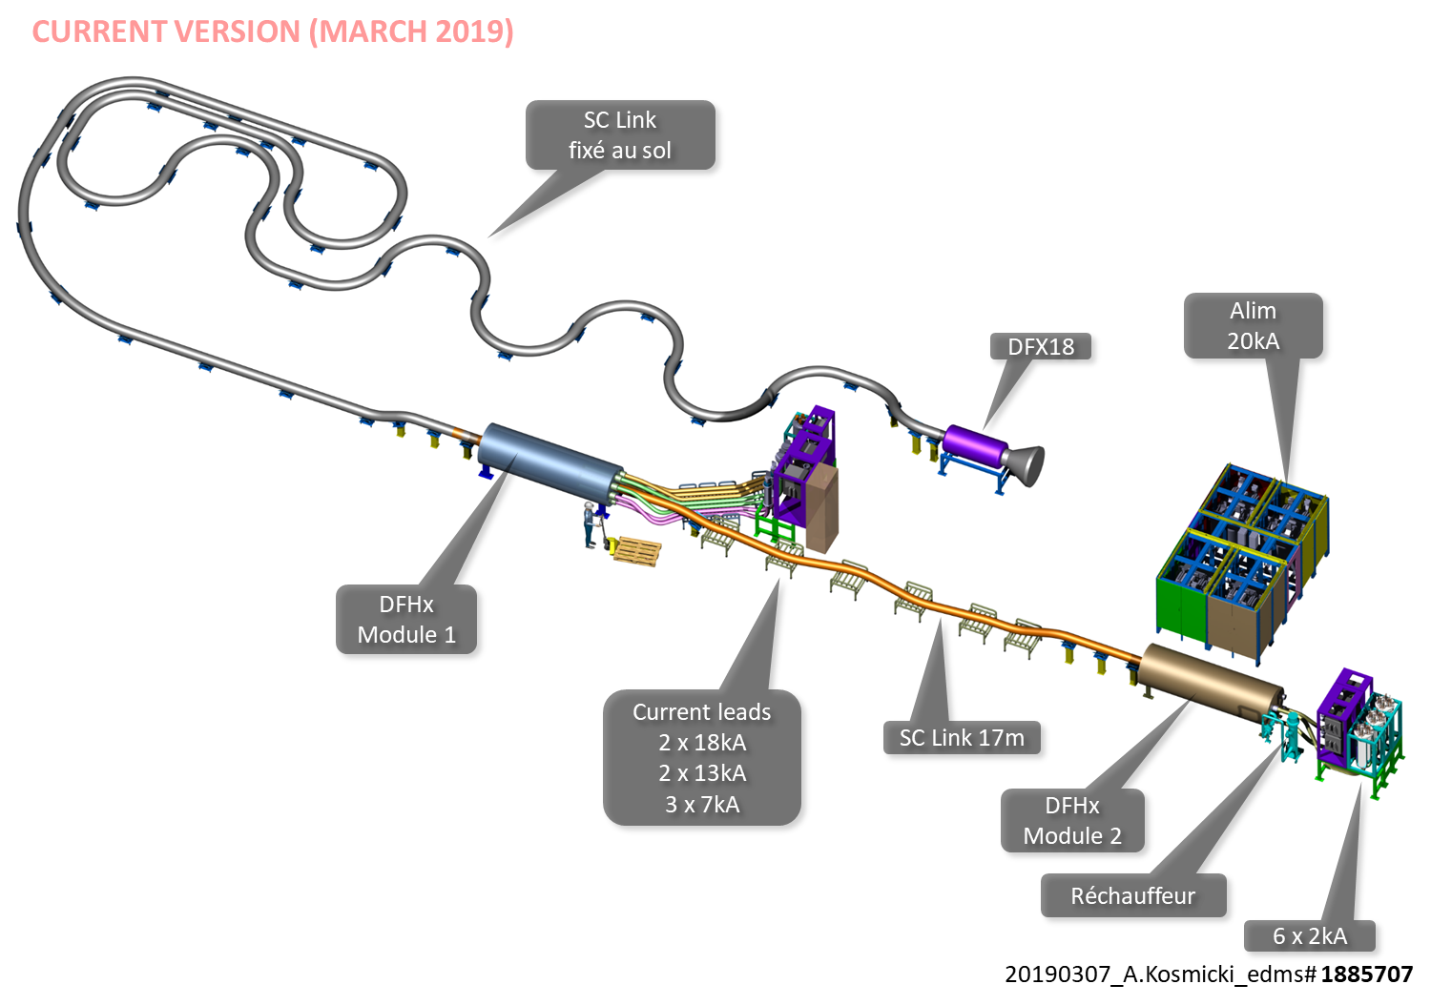
SM18 Cluster F Powering Upgrade
New High Current Power Converter : Cluster F 20kA-26V
For SC Link and MQXF series tests

Slide 11
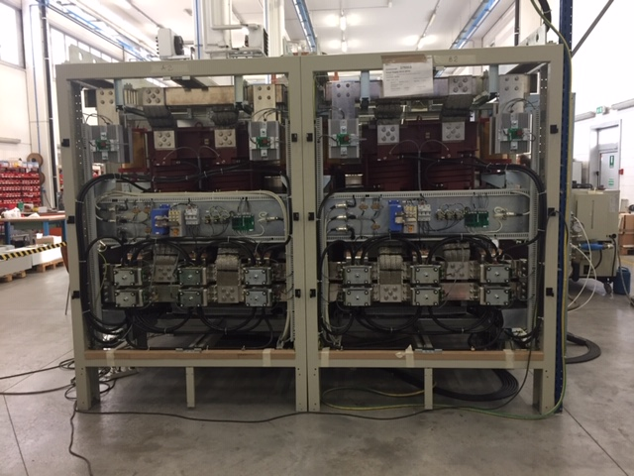
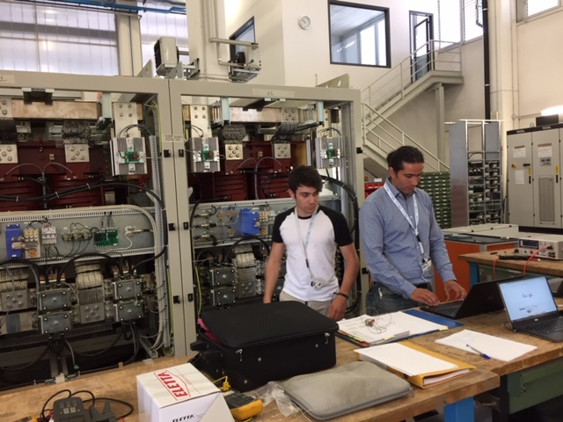
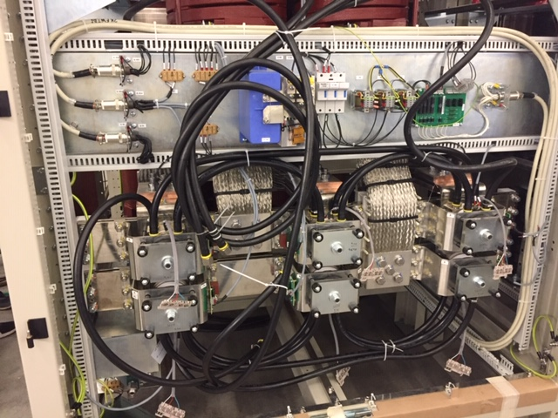
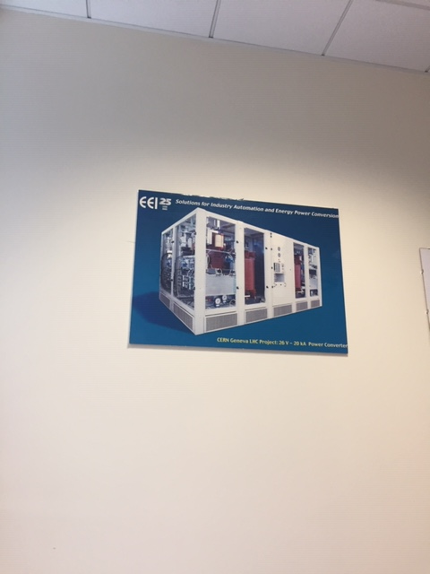
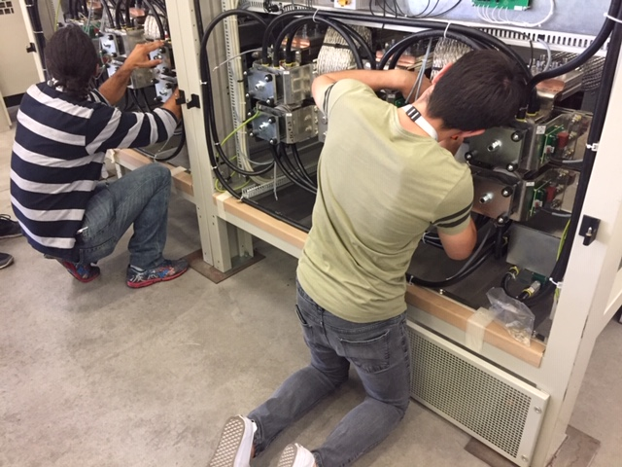
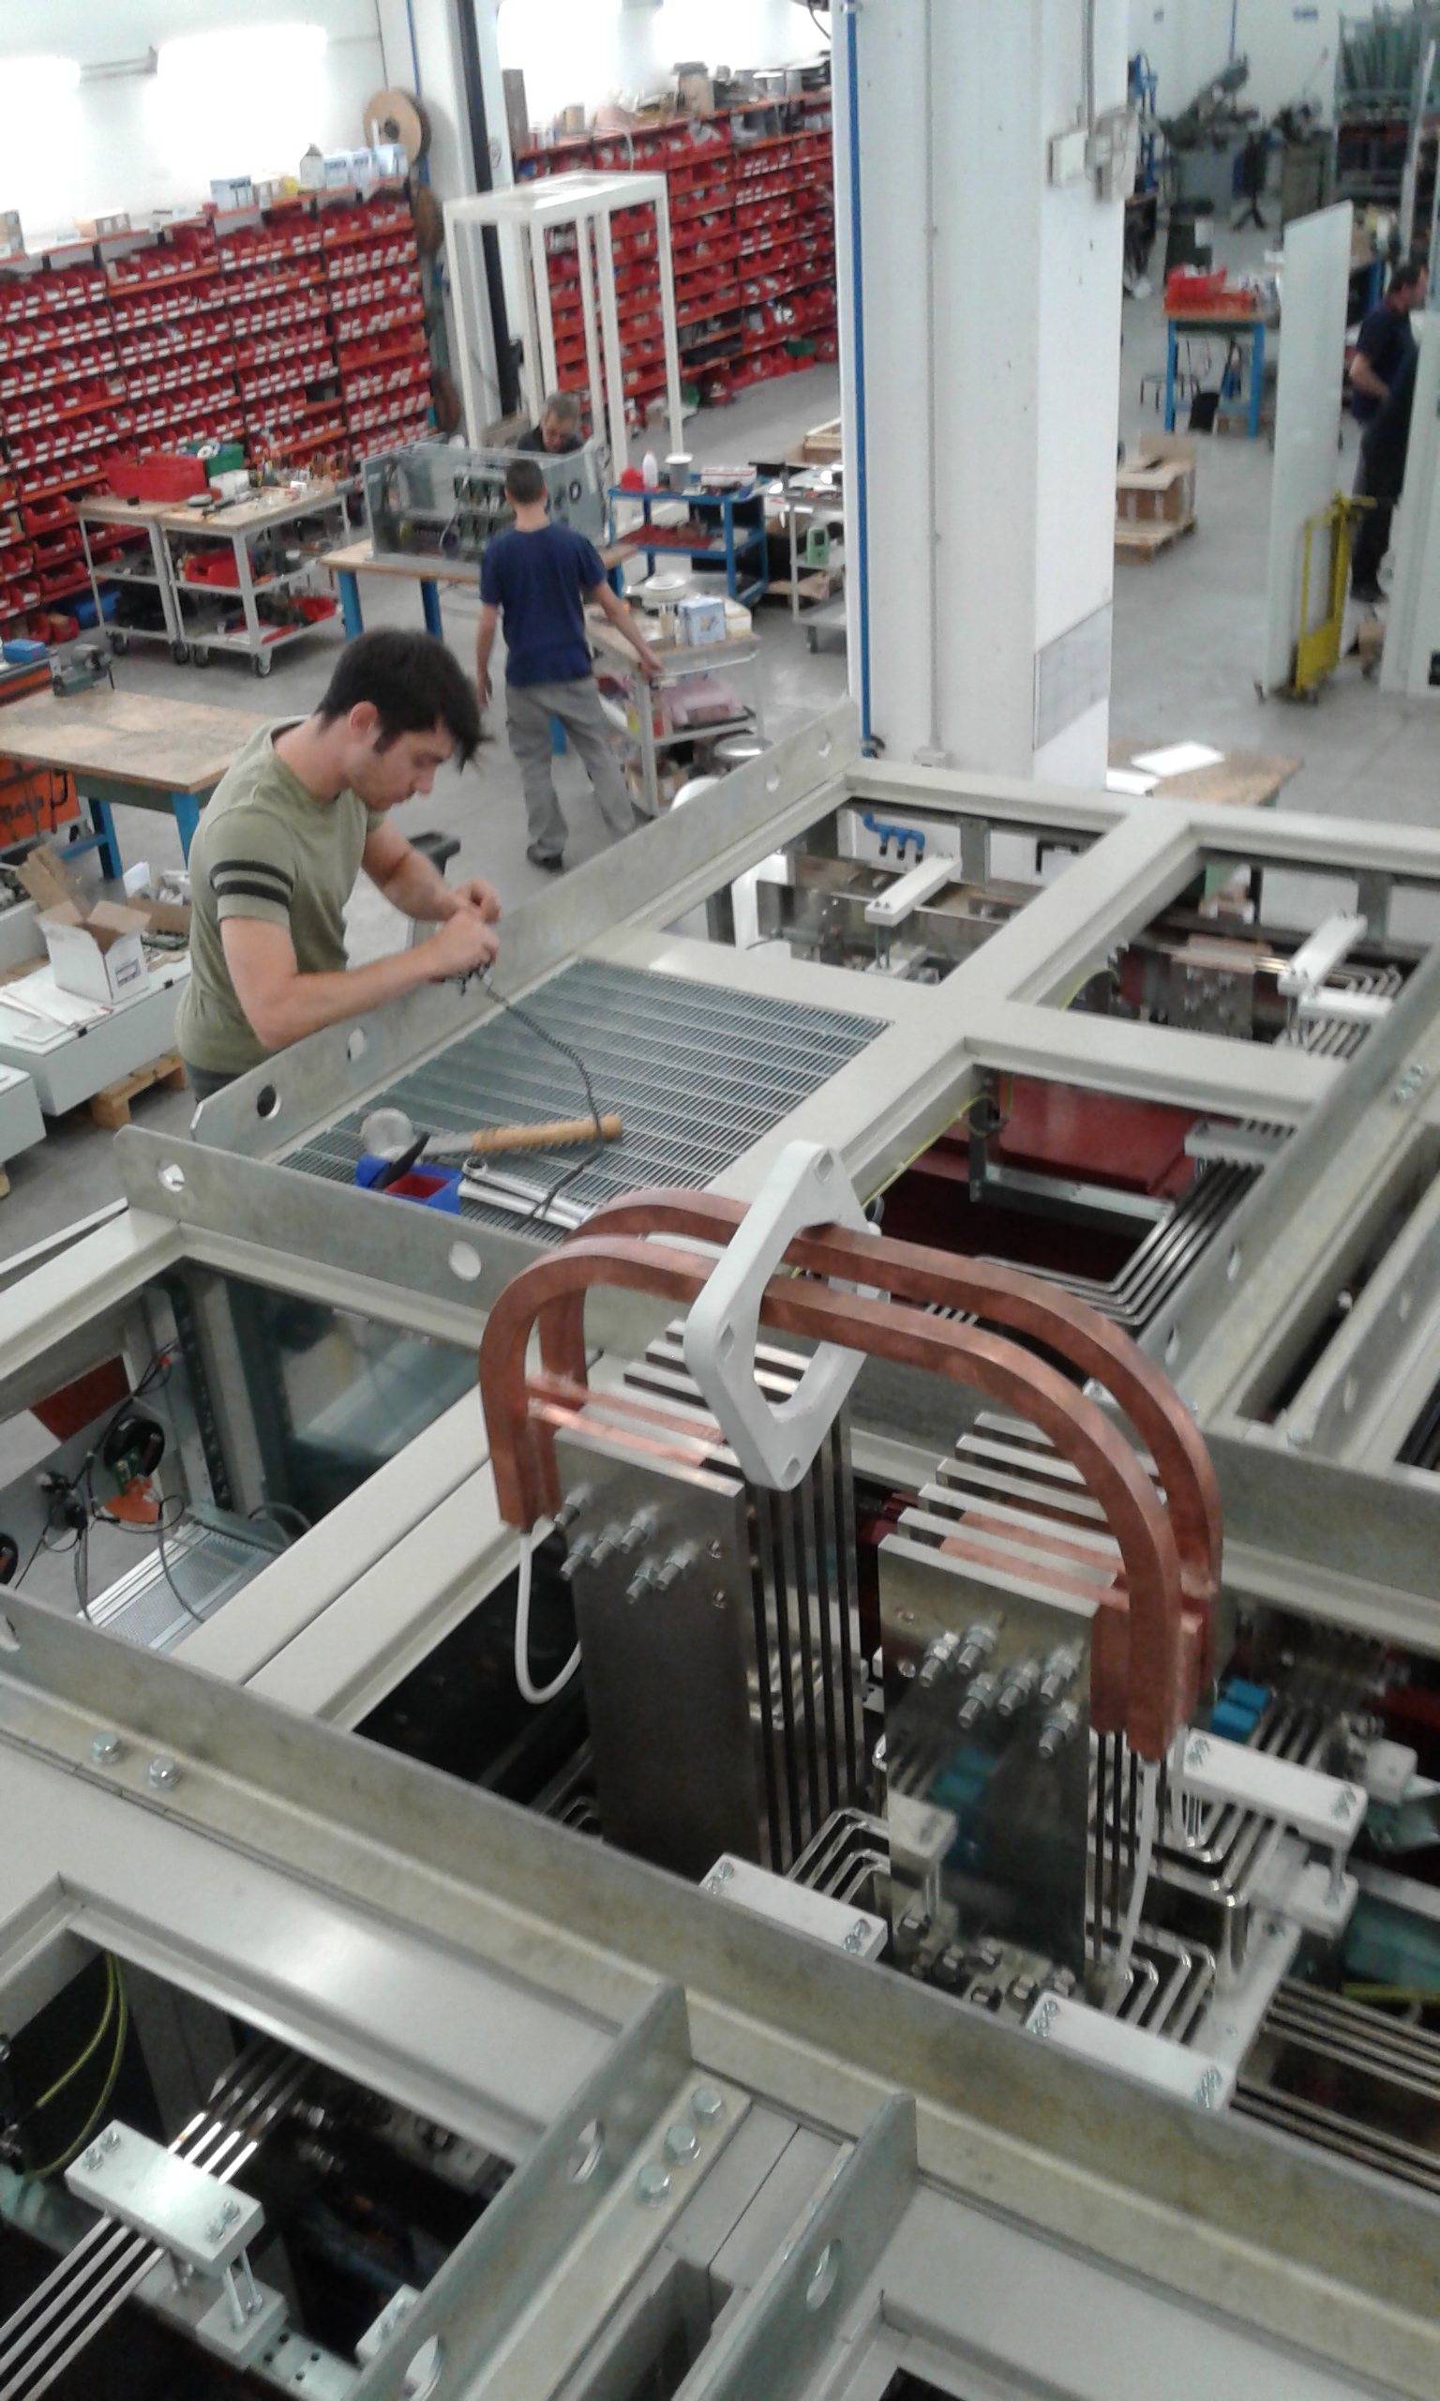
SM18 Cluster F Powering Upgrade
New High Current Power Converter : Cluster F 20kA-26V
Factory Acceptance Test - Italy 2018
Quoting the company’s salesman: “The power converter that discovered the Higgs Boson”

Slide 12
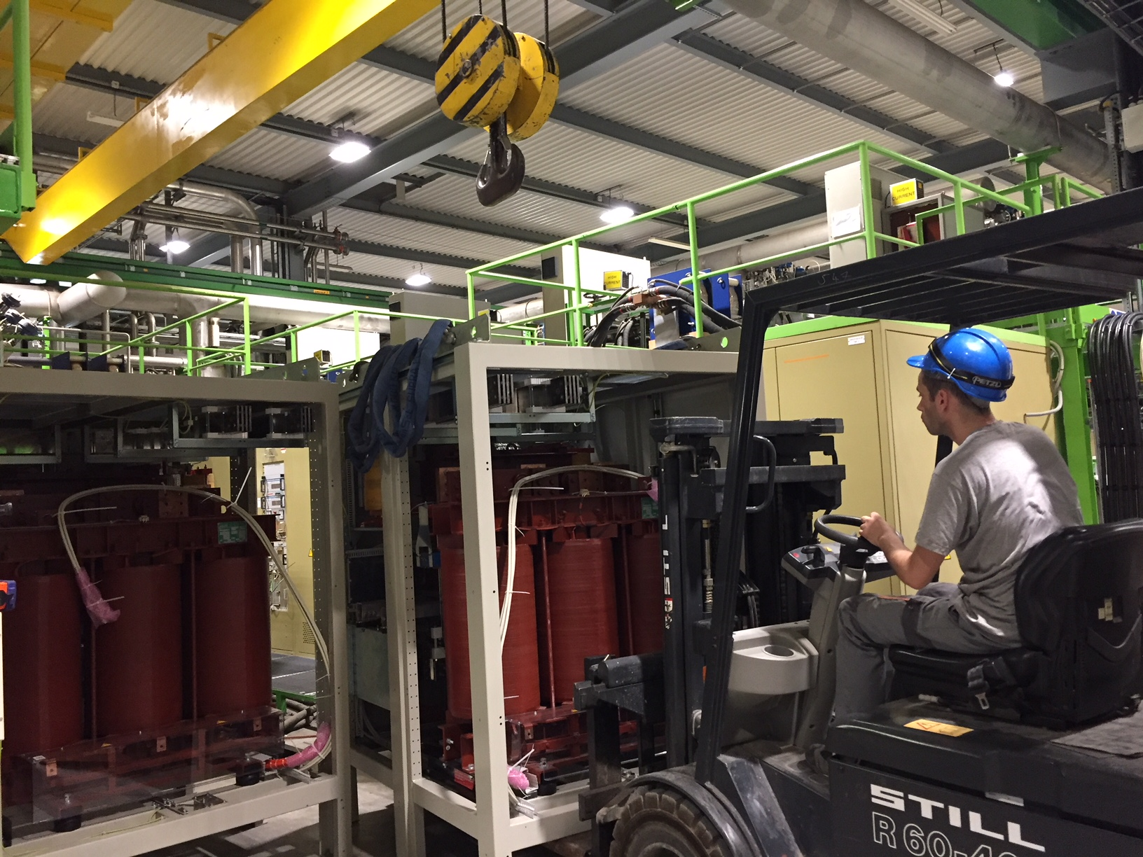
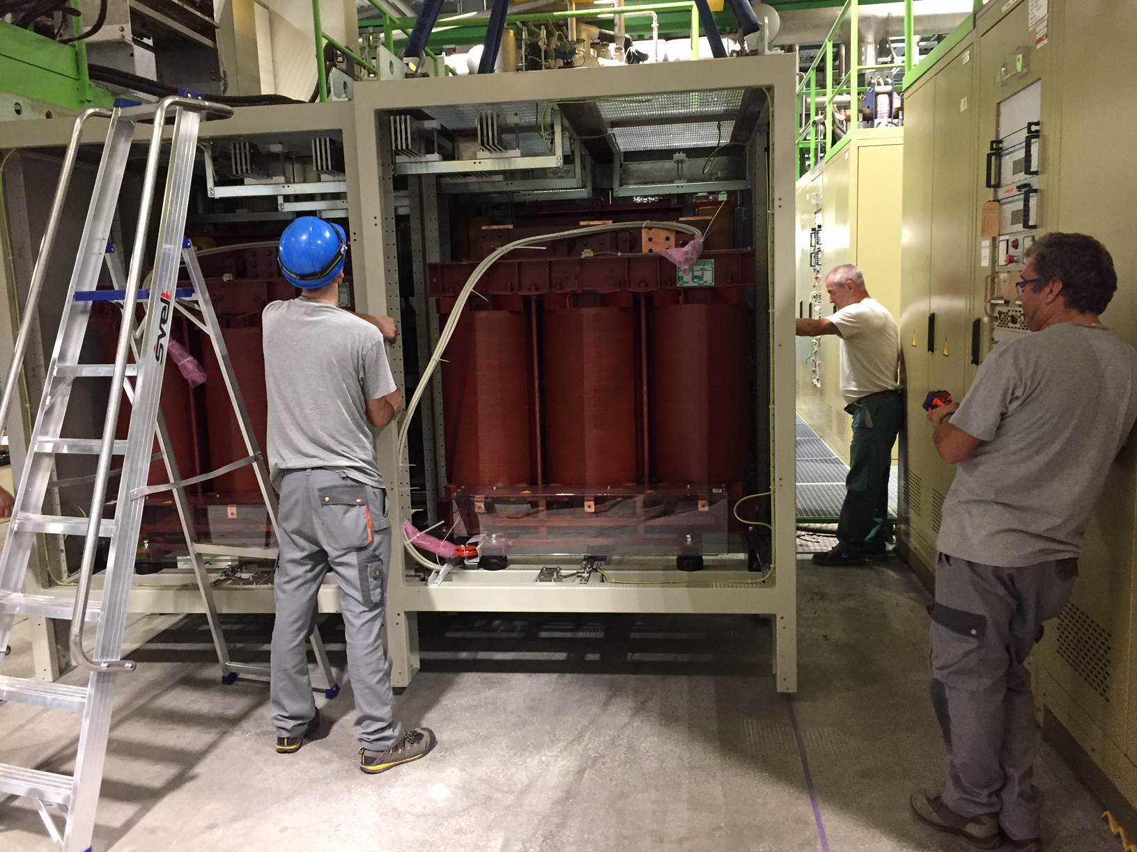
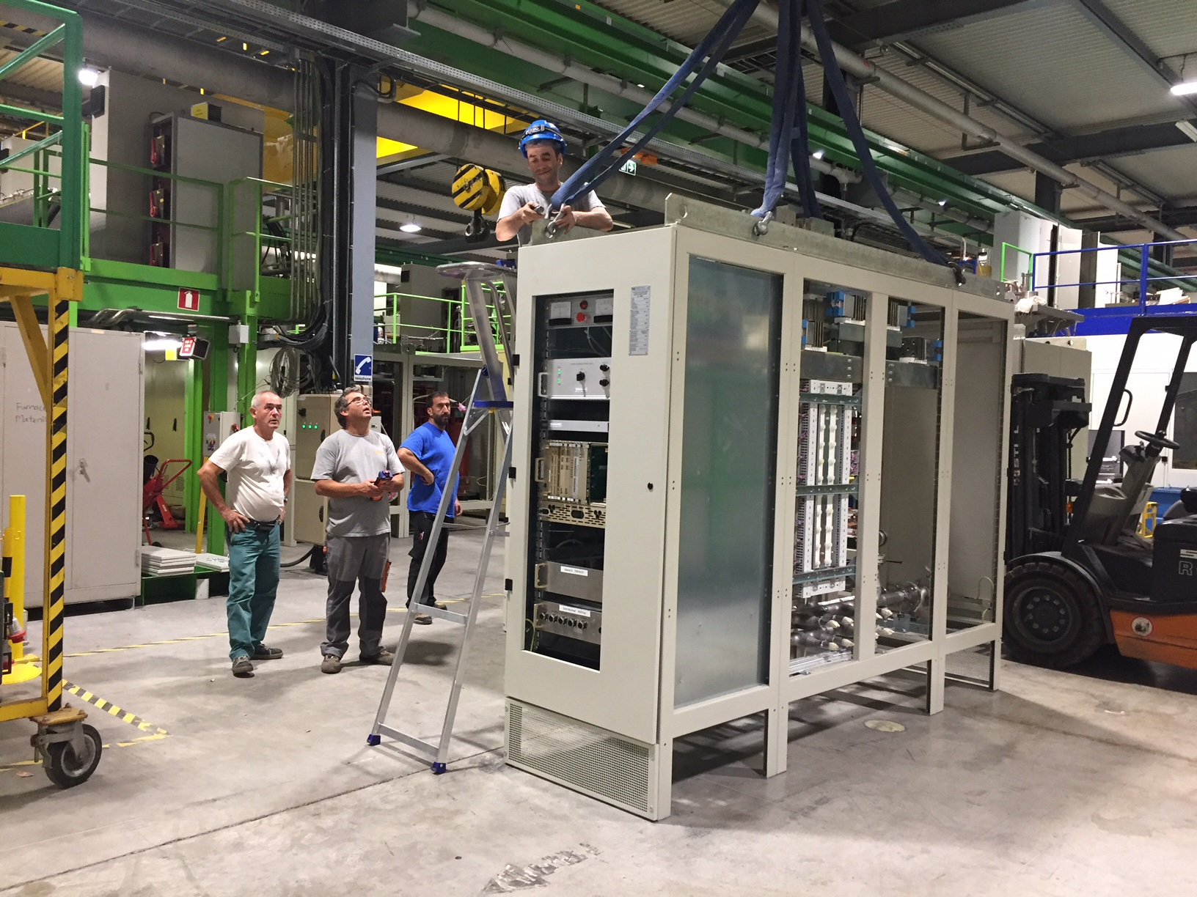
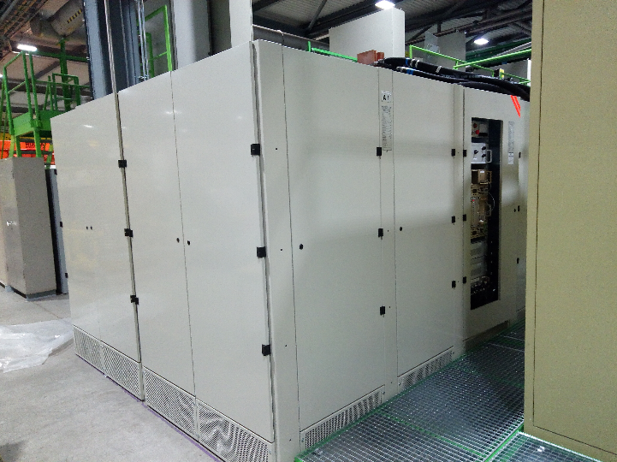
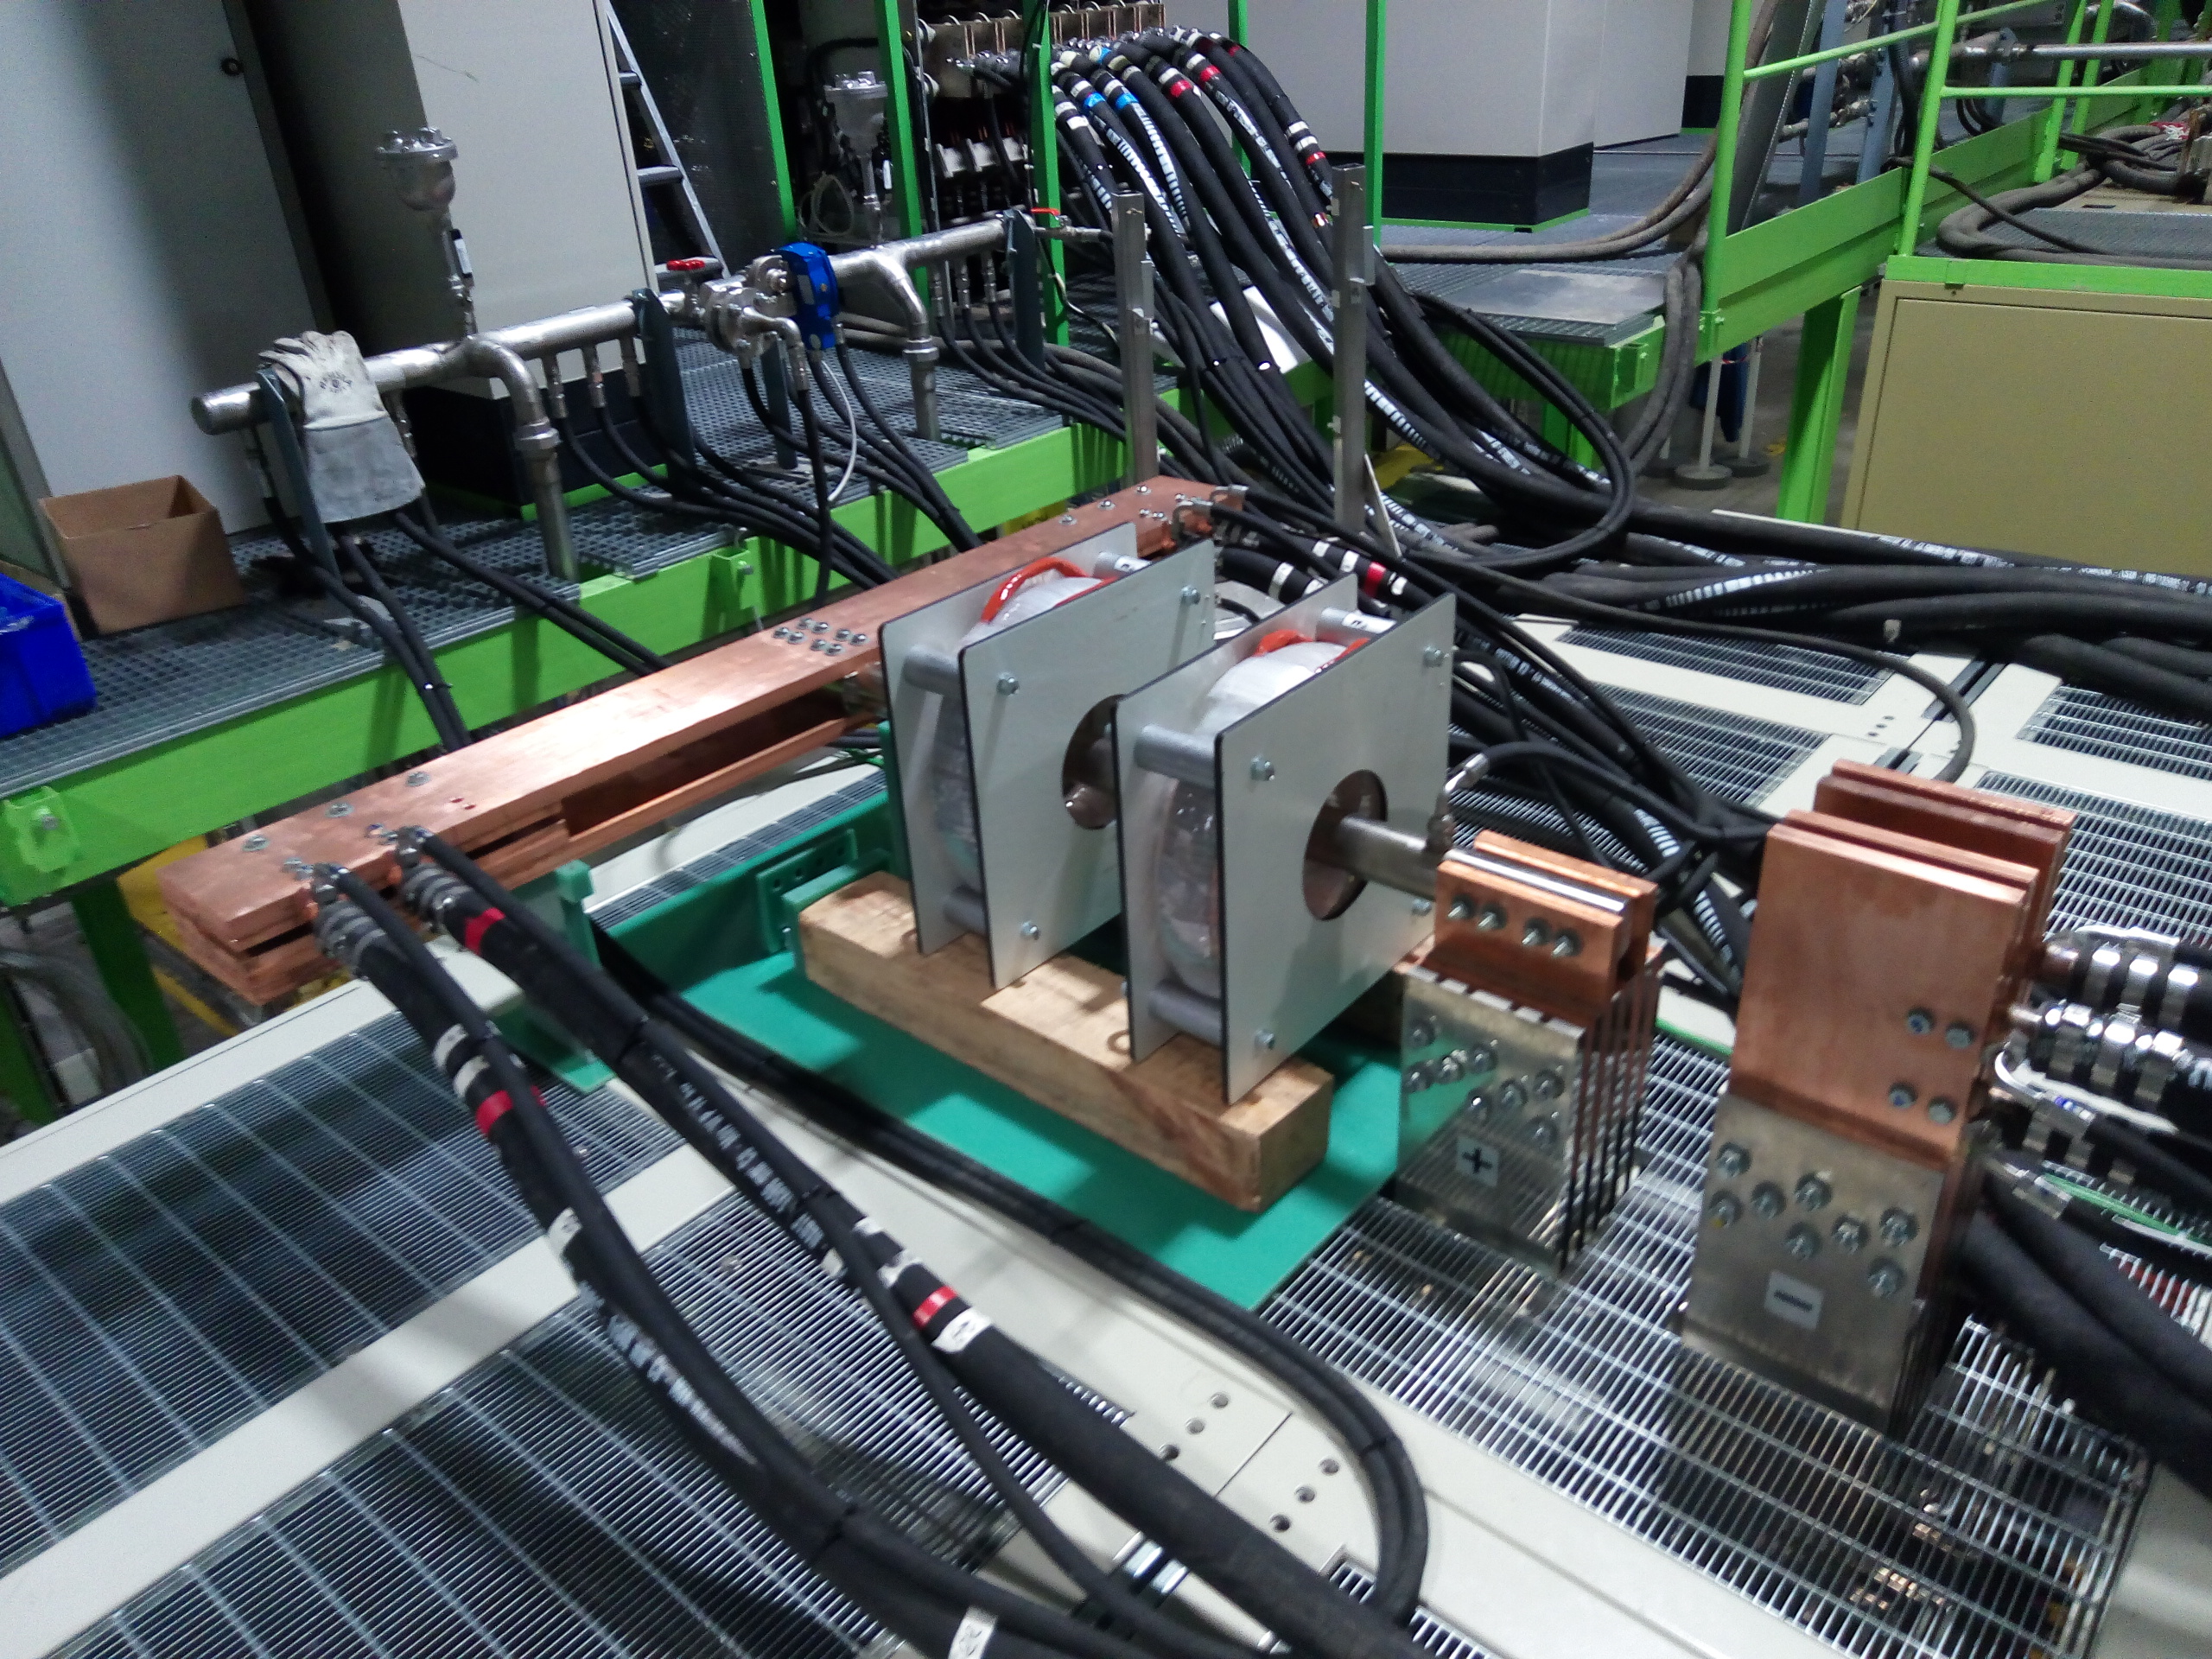
SM18 Cluster F Powering Upgrade
New High Current Power Converter : Cluster F 20kA-26V
Installation in SM18 - 2018

Slide 13
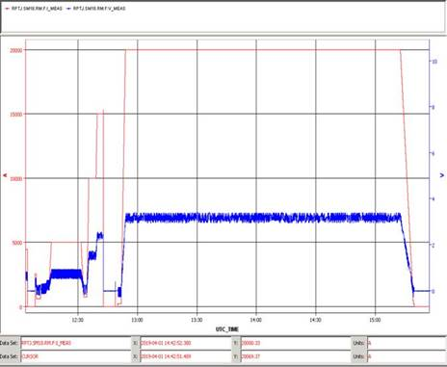
SM18 Cluster F Powering Upgrade
New High Current Power Converter : Cluster F 20kA-26V
Successful Tests on Short Circuit till 20 kA
in beginning of 2019
The 20 kA powering tests (in short circuit) will end in S3 2019

Slide 14
3
Room Temperature Connections

Slide 15
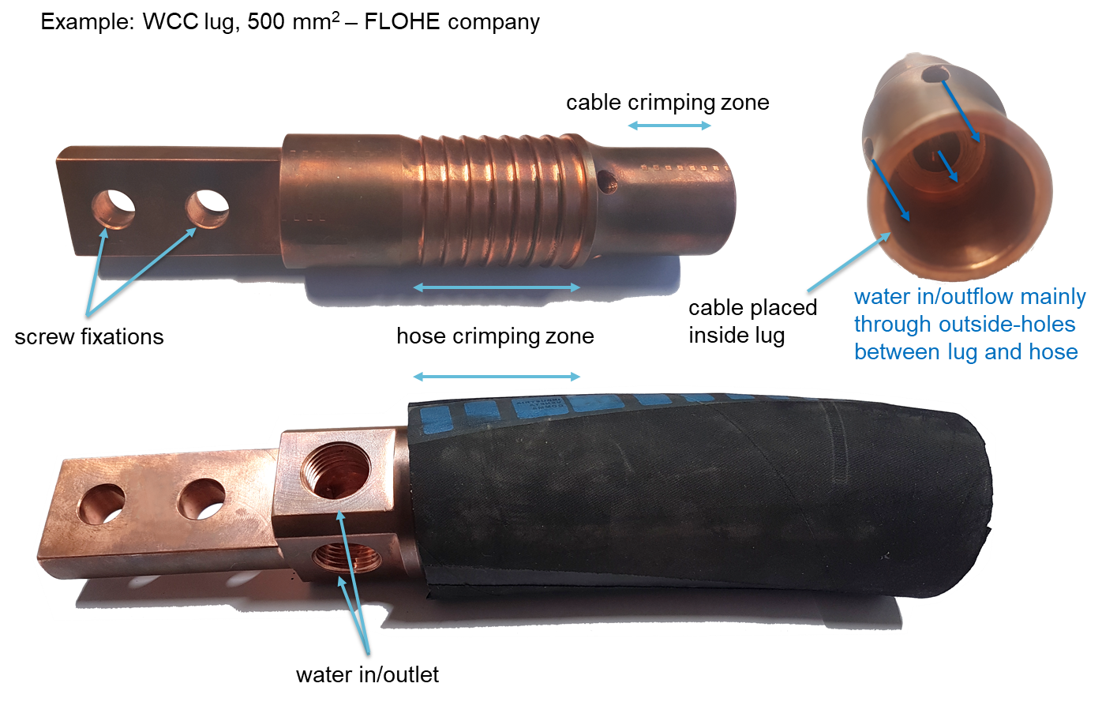
Room Temperature Connections
Cables for High Current Connections in SM18
Courtesy of EN-EL

Slide 16
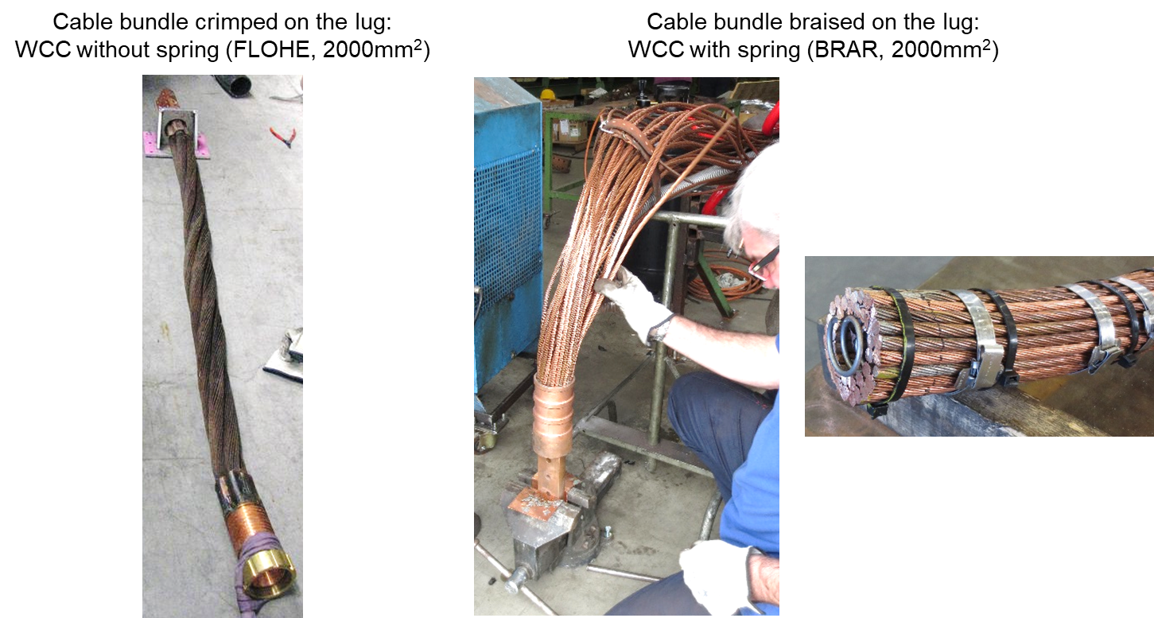
Room Temperature Connections
Cables for High Current Connections in SM18
Courtesy of EN-EL

Slide 17
Room Temperature Connections
Dimensional Constraints
Cables for circuits:
Cable trays
13 kA & 18 kA
Area reserved
for cable supports
6 kA
r
2 kA
Intensity | Section [mm²] | h [mm] | r [mm] | Ext. Diam. [mm]
18 kA | 2x1300 | 500 | 800 | 2x95
13 kA | 2000 | 500 | 800 | 115
6 kA | 1000 | 500 | 700 | 95
2 kA | 500 | 500 | 500 | 70
600 A | 400 | 300 | 300 | 36
200 A | 95 | 200 | 200 | 25
120 A | 70 | 150 | 150 | 22
200 A & 120 A
1200 mm
600 A
1300 mm
1000 mm
h
600 mm
400 mm
most significant constraints
Courtesy of EN-EL

Slide 18
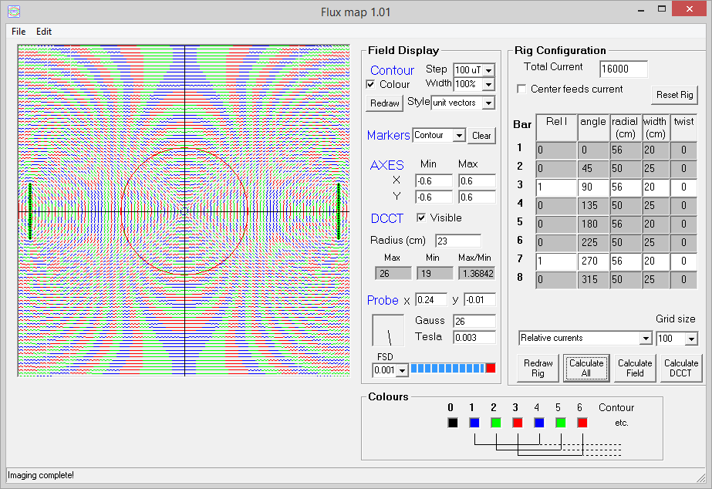
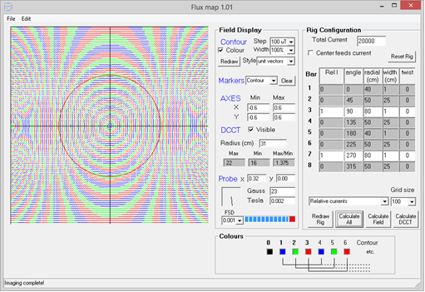
Room Temperature Connections
Magnetic DCCT Constraints on Cable Distances
DCCT current (A) | 16000
DCCT radius (mm) | 230
Type of return | double
Distance to centre bar (mm) | 580 | 560
Results | 10mm bar | 200mm bar
Field @centre (mT) | 0.1 | 0.1
Field @DCCT edge (mT) | 2.5 | 2.5
DCCT current (A) | 20000
DCCT radius (mm) | 310
Type of return | double
Distance to centre bar (mm) | 800 | 750
Results | 10mm bar | 200mm bar
Field @centre (mT) | 0.1 | 0.1
Field @DCCT edge (mT) | 2.4 | 2.5

Slide 19
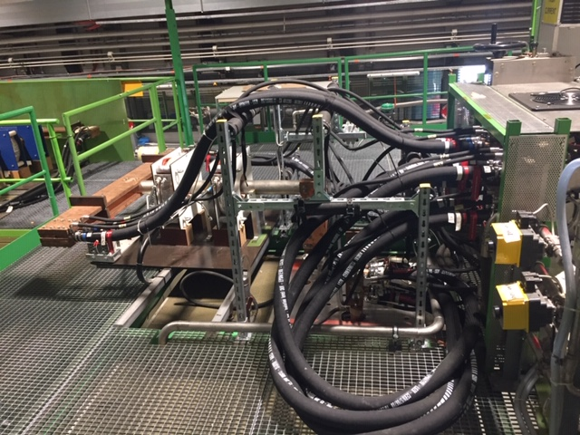
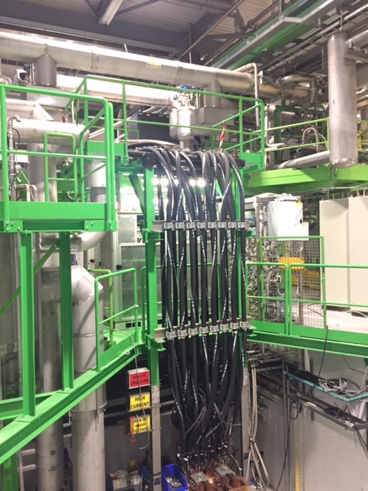
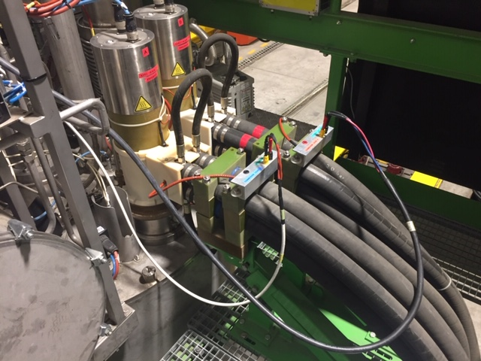
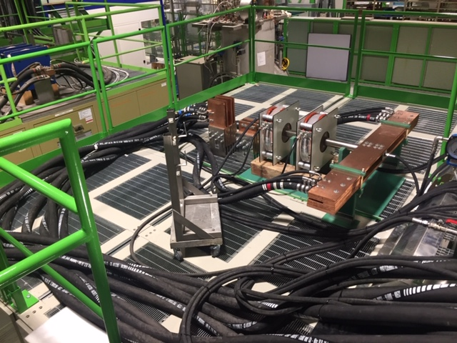
Room Temperature Connections
Cluster A – 20 kA
Cluster D – 30 kA
Cluster F – 20 kA
Cables to Leads Connection

Slide 20
4
Conclusion

Slide 21
Conclusion
Power converters family vary from 120 A to 30 kA to test HL-LHC magnets vertically and horizontally
Major work has been done in 2016-2019 for the upgrade of the power converters in SM18
Power converters will be completely installed by 2020
Parallel 500 mm² water cooled cables are used for high current connections in SM18

Slide 22
Thank you for your attention

