Slide 2
Energy Extraction Systems and CLIQ at CERN Test Areas
Bozhidar Panev – 11 June 2019

Slide 3
Outline
EE systems at CERN
Switching technologies involved in the EE systems at CERN
Semiconductor based EE systems in CERN test benches
High current systems (2÷30)kA
Low current systems (up to 2kA)
Vacuum based EE systems (HL-LHC)
CLIQ unit

Slide 4
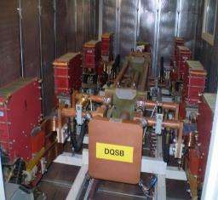
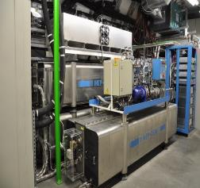
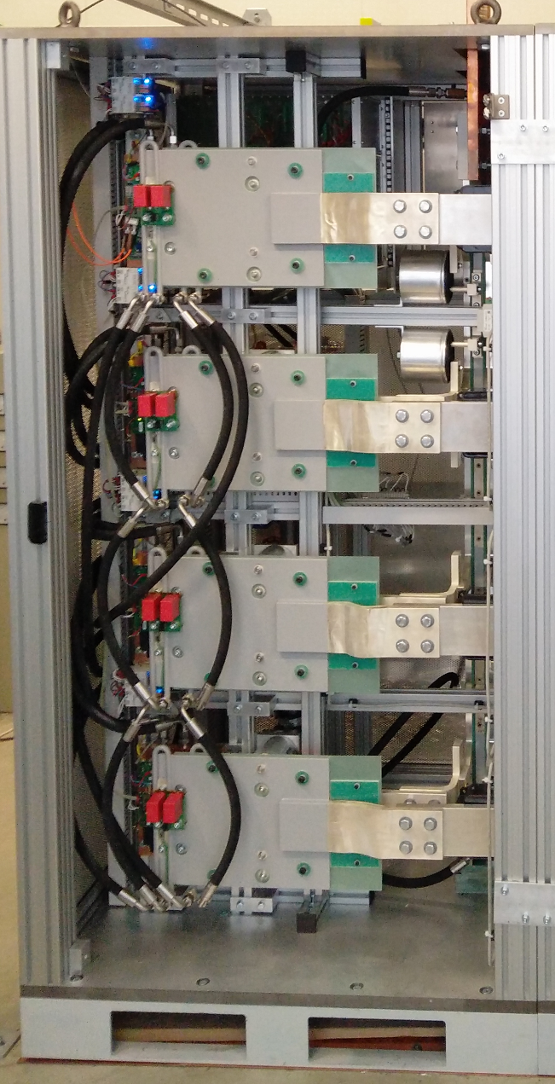
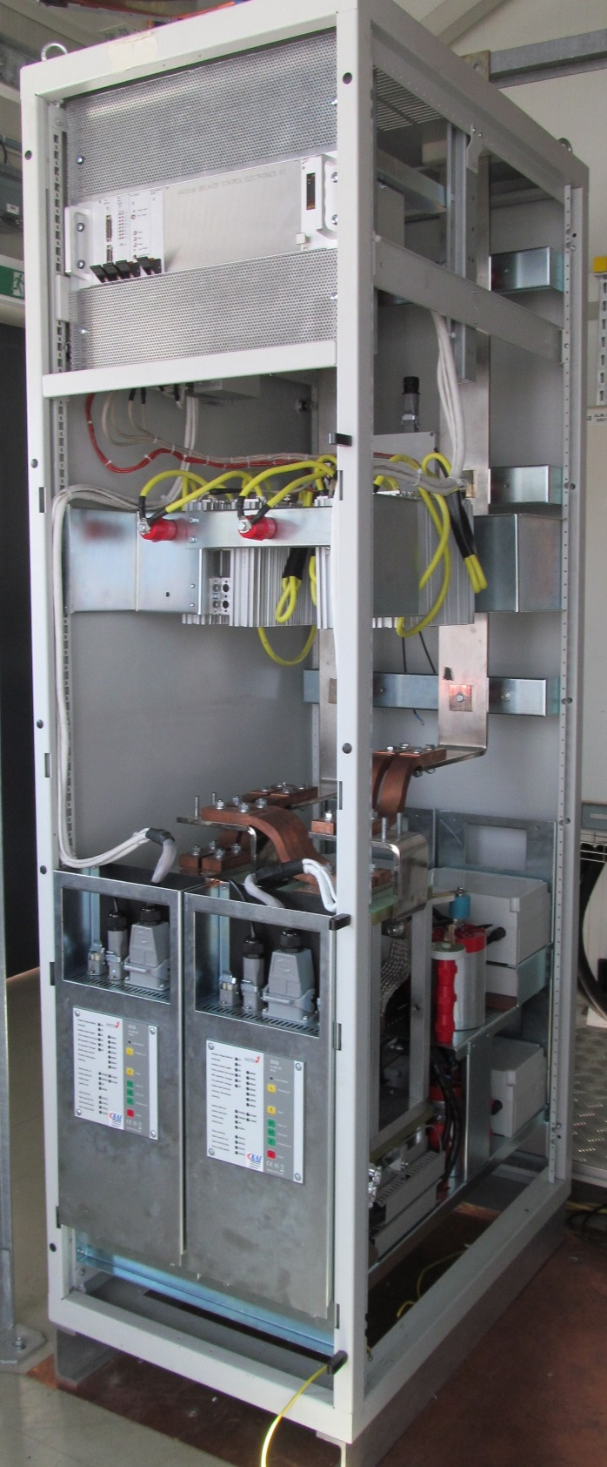
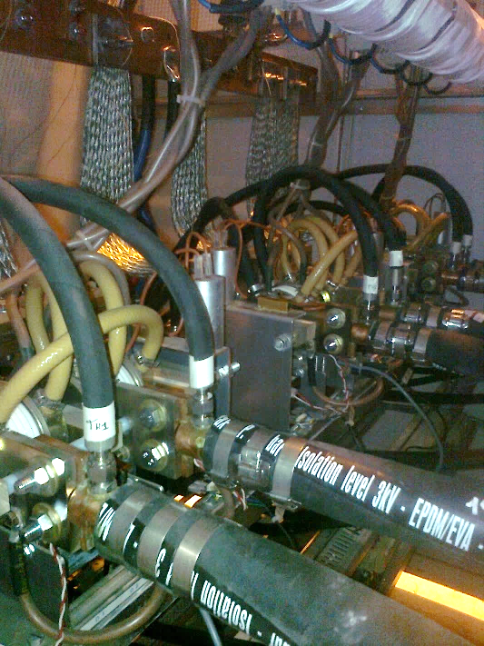
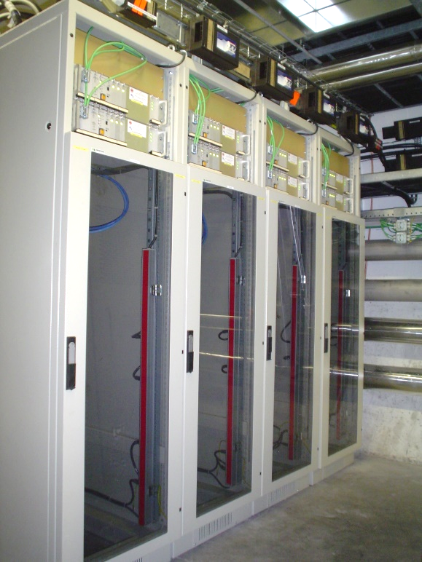
EE systems at CERN
LHC
13kA EE systems (RB/RQ circuits)
600A EE systems (corrector circuits)
Superconducting test benches
EE facilities – (0.6÷30)kA
13kA EE system
2kA vacuum switches
EE system
20kA
thyristor switch
EE system
7.5kA IGBT
EE module
2kA IGBT
EE system
600A EE
systems

Slide 5
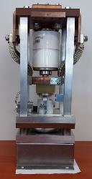
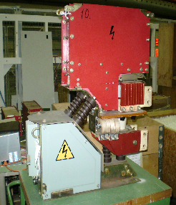
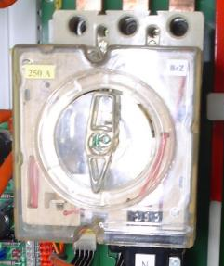
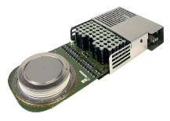
Switching technologies involved in EE systems at CERN
Electromechanical high-speed circuit breakers – up to 20ms opening time
Semiconductors as a solid state switch - up to 1ms opening time
Vacuum interrupters – up to 5ms opening time
IGBT
Electro-mechanical
circuit breakers
Vacuum
interrupter
IGCT

Slide 6
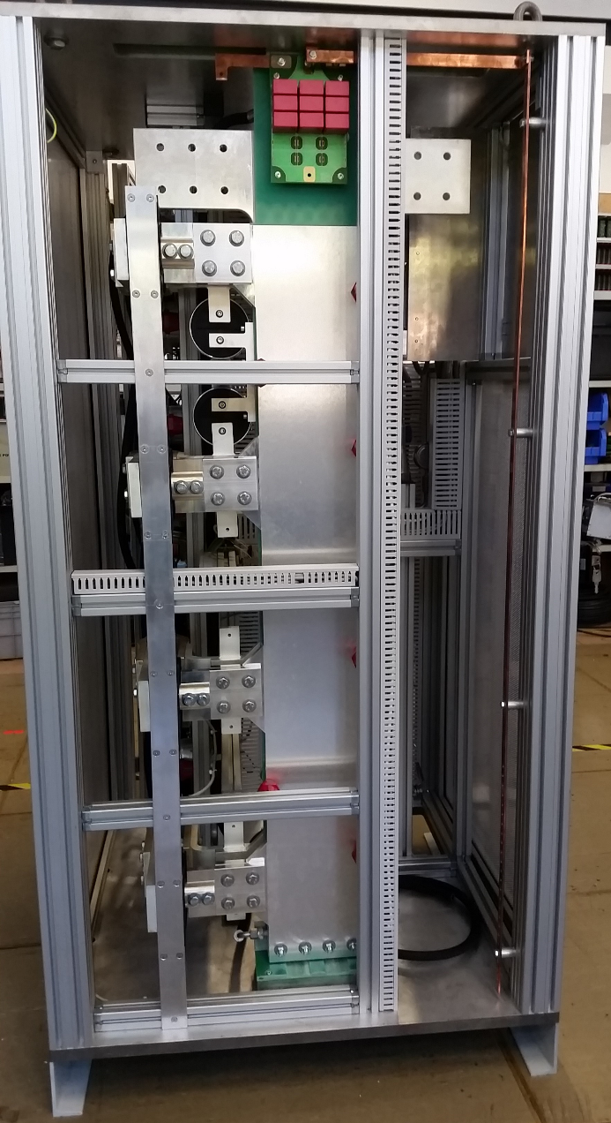
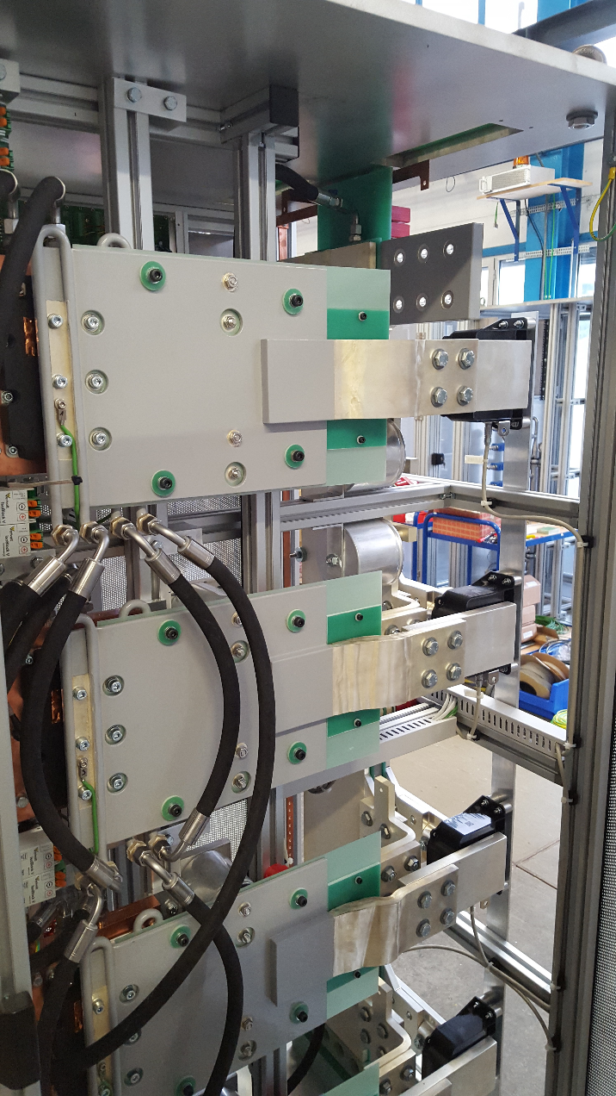
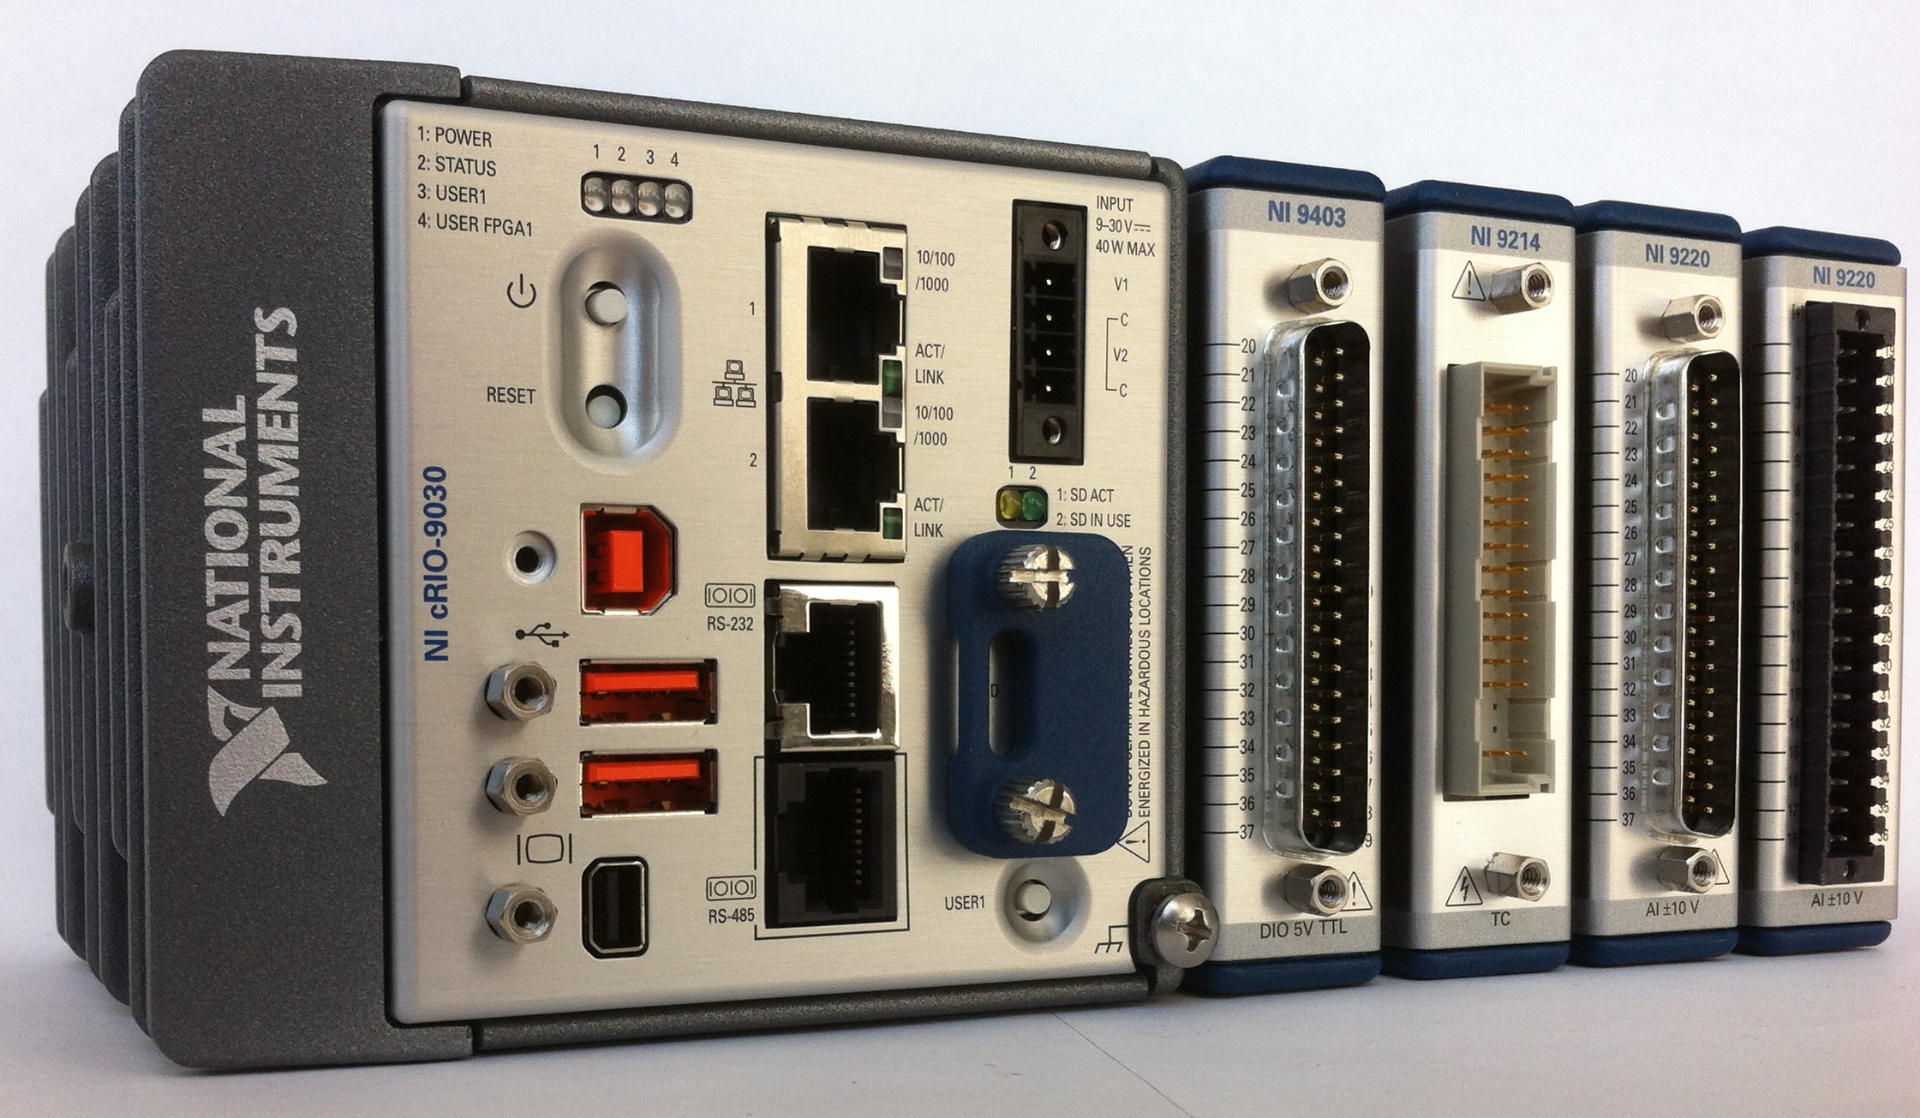
IGBT based EE systems for superconducting test areas at CERN
Solid state switch development project started several years ago
IGBT was selected as a switching device
7.5kA module was developed, produced and installed
Some details:
4 IGBTs share the current of 7.5kA
Special care paid in the busbar and heatsink design
Three snubber capacitor stages
NI-Compact RIO based control system

Slide 7
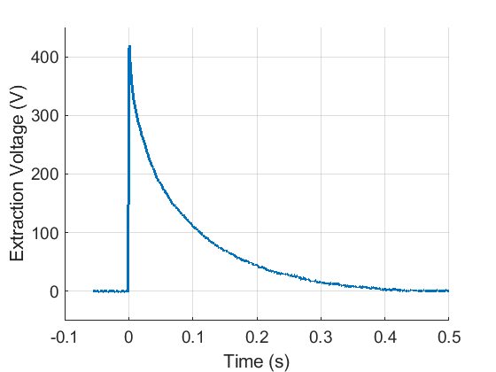
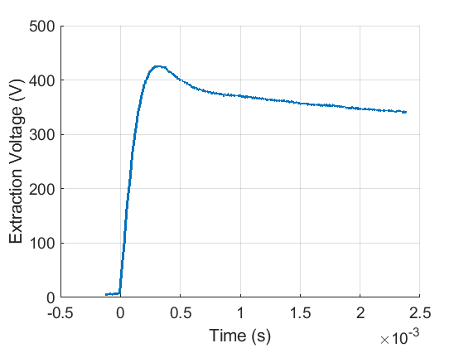
Performance of 7.5kA IGBT based EE system
I=7.5kA
L=3mH
R=60mOhms
Main features:
Compact design
Ultra fast operation
Current transferred in the resistor for less than 1ms
Possibility of paralleling the racks up to 30 kA
Maintenance free

Slide 8
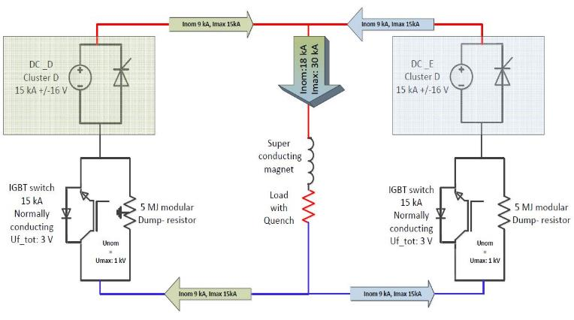
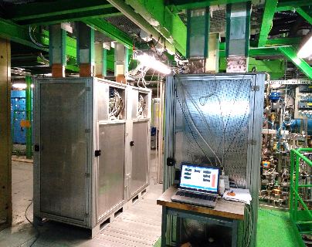
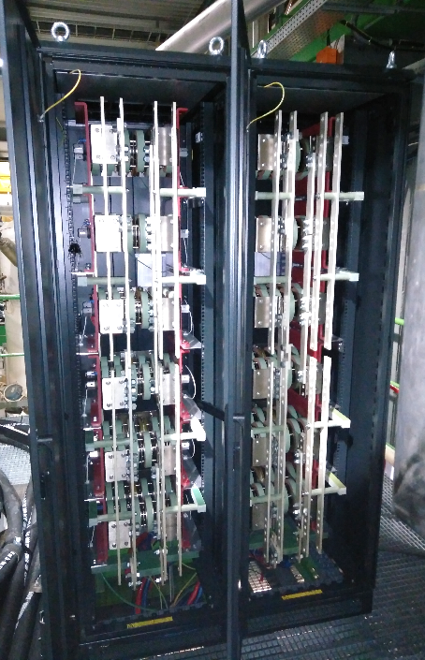
SM18 – EE systems at cluster-D
Two IGBT based EE systems (15kA each) installed and commissioned in 2016
Each system consist of 2 modules 7.5kA each
Maximum current: Imax = 30kA
Resistors: modular design allowing different configurations: (6.67$÷$240)mΩ
Rated energy: 6MJ
Successful operation is registered
Expected service life: 20 years
IGBT switch modules
Resistors

Slide 9
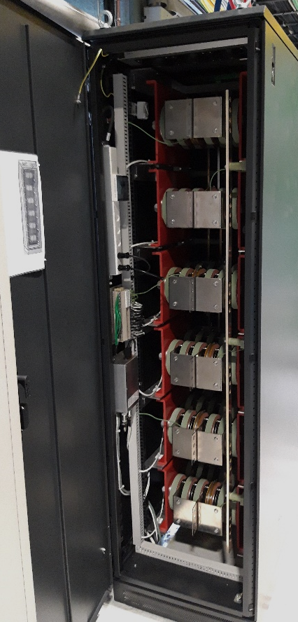
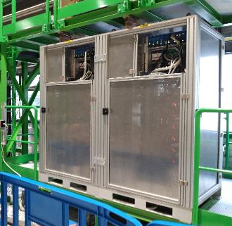
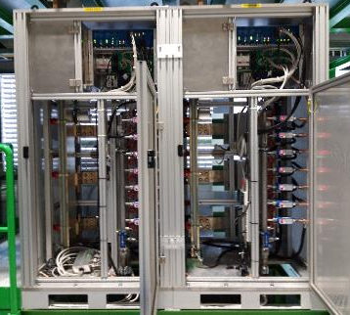
SM18 – EE systems at cluster-G (HFM)
Two IGBT based modules compose the EE system (the same as for cluster-D)
Each module rated to 7.5kA
Maximum current: Imax = 15kA
Resistors: modular design allowing different configurations →(6.67$÷$240)mΩ
Rated energy: 6MJ
Commissioning planned for summer 2019
Expected service life → 20 years
IGBT EE system for 15kA (2 x 7.5kA)
Dump Resistor

Slide 10
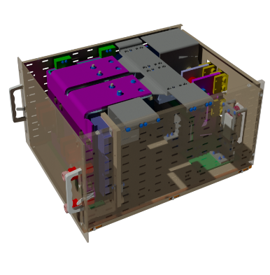
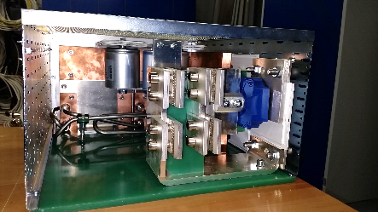
2kA IGBT based EE systems for HL-LHC (1)
Design and development started in 2017
A modular approach is applied in the design
A single module commutates bidirectionally 1000 A
Two modules connected in parallel for 2kA operation
1kA module
housed in a 6U chassis
2 modules
In parallel

Slide 11
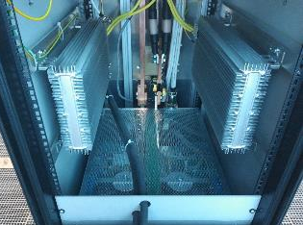
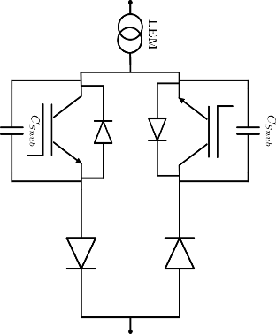
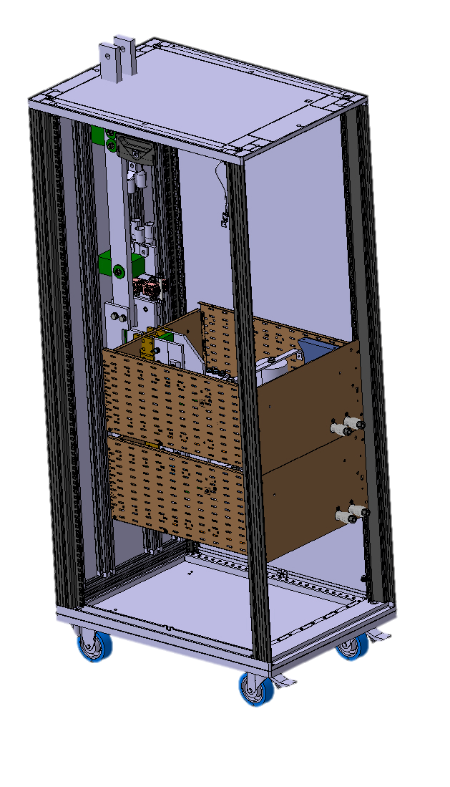
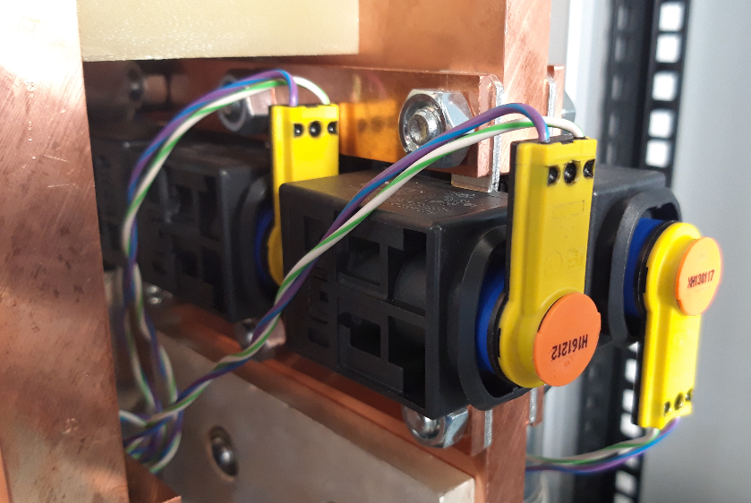
2kA IGBT based EE systems for HL-LHC (2)
Details from the design:
Dump resistor 300mΩ (2 x 600mΩ in parallel)
Bipolar operation of each 1kA module
~2.5V voltage drop (still significant)
Redundancy achieved through 2kA triggerable fuse
250us reaction
Low ohmic losses (200uOhms)
Dump resistors
180 cm
triggerable fuse
Back up protection
with triggerable fuse
1kA module
configuration
90 cm
60 cm

Slide 12
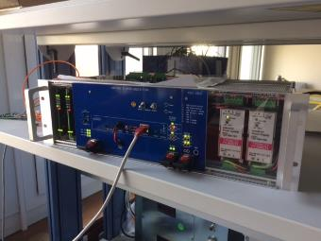
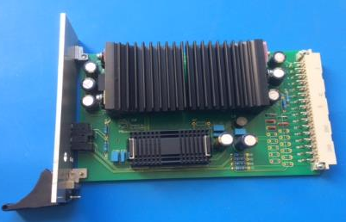
Control electronics of IGBT based EE system
Some details of the control electronics
sbRIO controller
Two FPA boards
Hardware interlock board
Power supply board
NI – sbRIO controller
(single-board)
28 digital I/O
16 analogue inputs
etc.
3U control chassis
housed the electronic boards
FPA and PSU boards

Slide 13
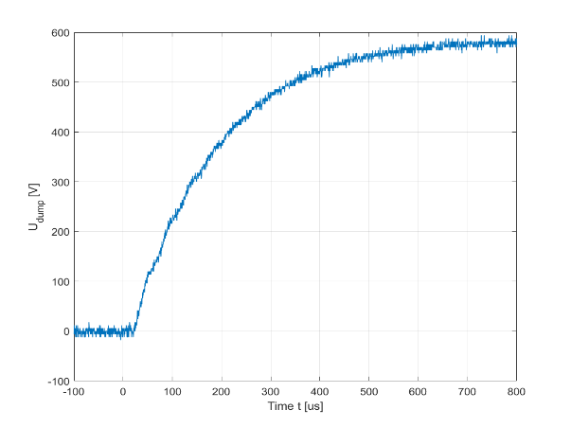
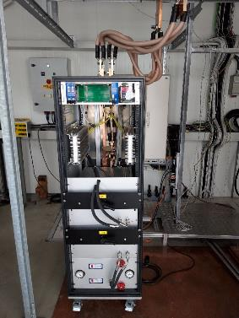
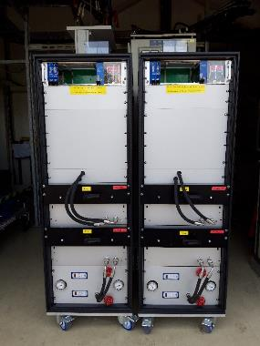
2kA IGBT based EE systems for HL-LHC (3)
Semiconductor based (IGBT) bipolar, compact and complete EE system to be used with the Hi-Lumi corrector magnets (MCBXFA & MCBXFB) at the vertical test bench in SM18
Two systems (final version) fully tested were send for installation in SM18
Two more systems ordered in the industry – expected in Sep19
730 μs
Performance at 2kA – U_DUMP
System under test
In SM18

Slide 14
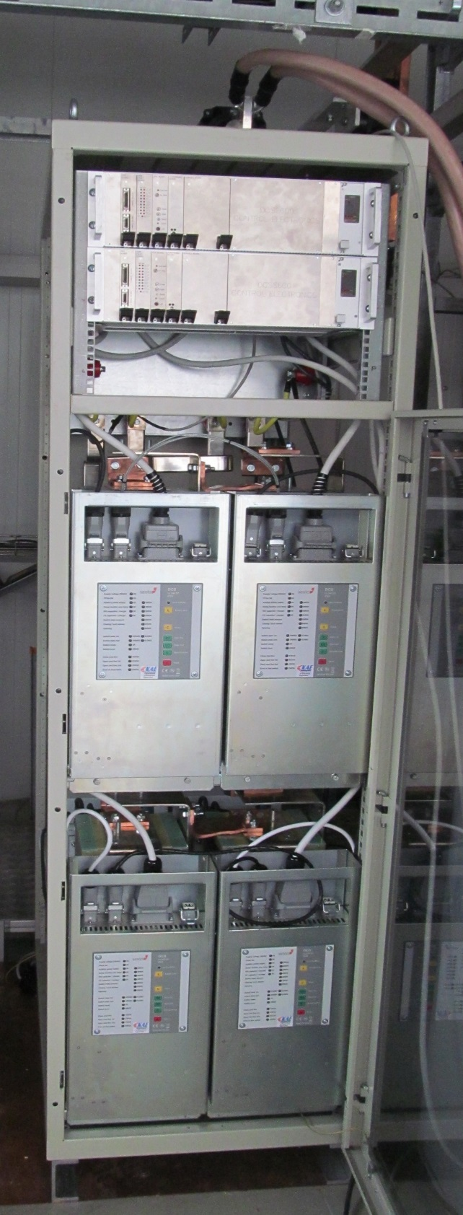
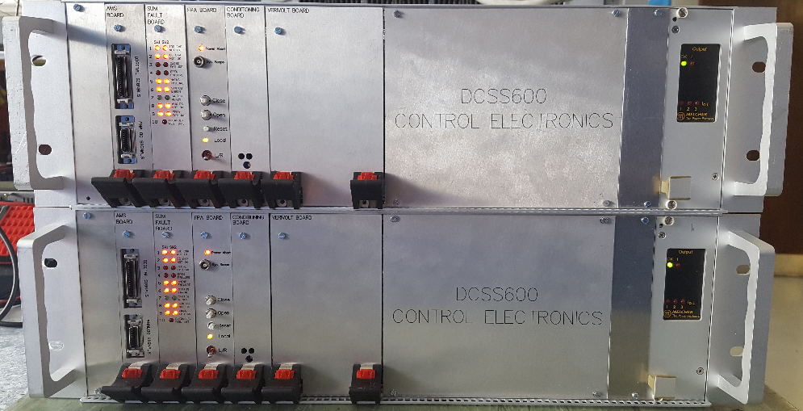
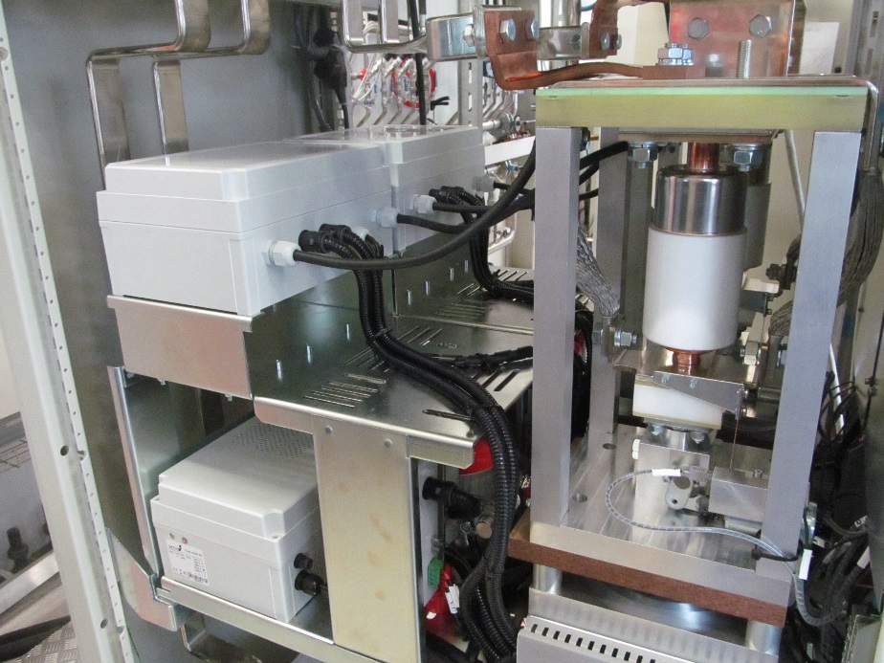
Vacuum switches based EE systems
New development for HL-LHC
28 EE systems required
8 for 2kA
20 for 600A
Prototypes fully tested
Control electronics
Long service life vacuum switch
2kA EE system
2 system for 600A

Slide 15
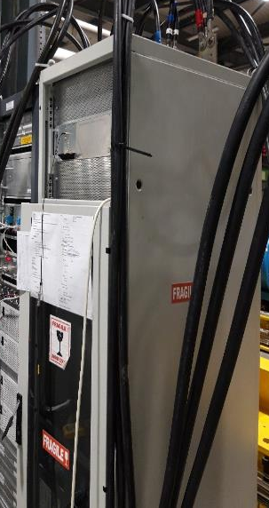
Performance of vacuum switches based EE systems
2kA system installed and commissioned in SM18 for protection of MCBXFB – 15.03.19
2kA vacuum switches EE system in real operation
Pre-series → ordered
4 systems for 2kA
4 systems for 600A
EE operation during a training quench of MCBXFB at 1.5kA (15.03.2019) SM18
Circuit current transferred to resistor for ≈1.8ms
Vacuum switches EE systems are selected to be used for HL-LHC magnet circuits protection
MCBXFA: 8 systems (2 kA)
MCQSXF: 4 systems (600 A)
MCBRD: 16 systems (600 A)

Slide 16
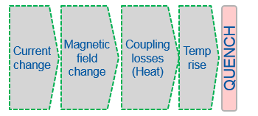
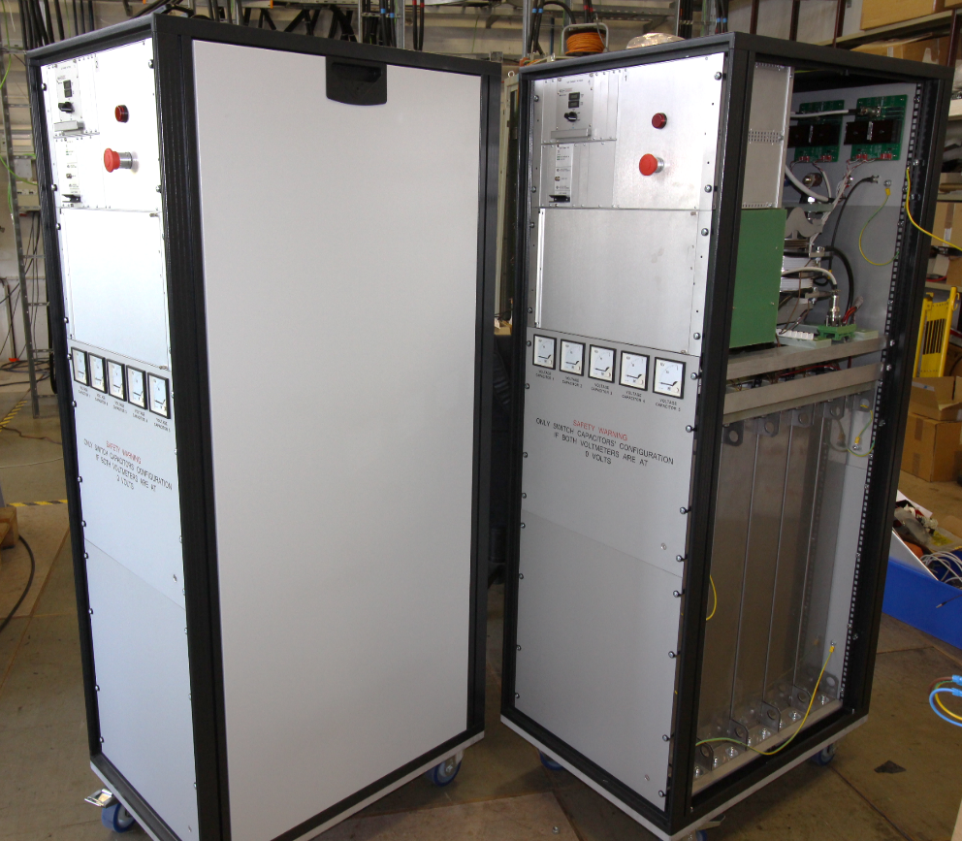
CLIQ
Coupling-Loss Induced Quench (CLIQ) is an innovative quench protection method based on a capacitor discharge resulting in high inter-filament and inter-strand coupling losses
Complement of the Quench Heater systems for the HL-LHC new Inner Triplet magnets protection
Two prototype versions designed at CERN
CLIQ v2 successfully manufactured and tested by the industry
CLIQ v3 prototype ongoing (1000 VDC, 40 mF capacitors)
CLIQ v2 units
Courtesy to David Carrillo

Slide 17
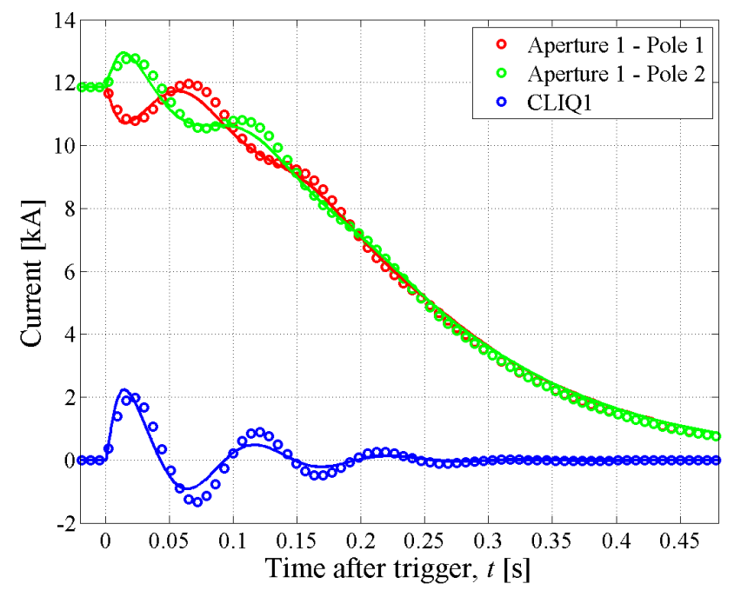
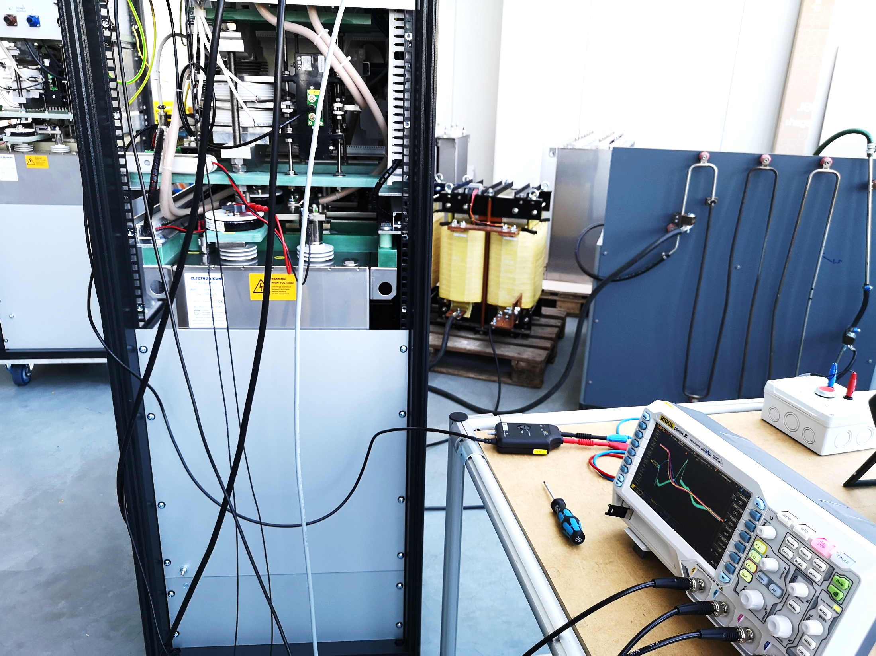
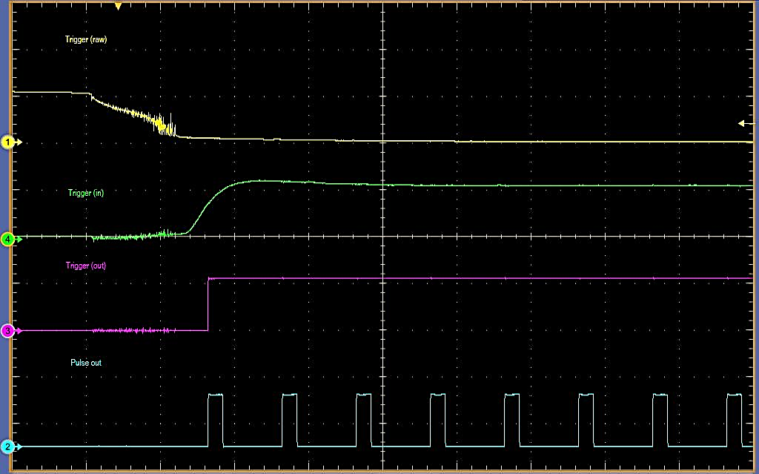
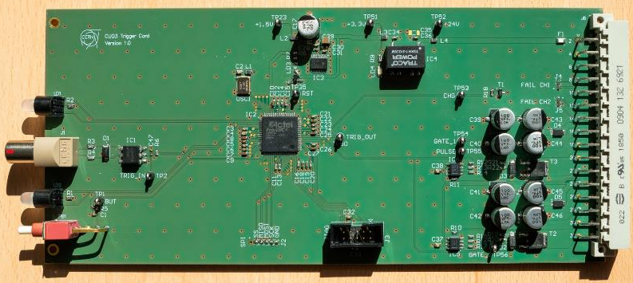
CLIQ
CLIQ v1 used on a 14-m-Long Full-Scale LHC dipole magnet. E. Ravaioli et al.
CLIQ v2 units manufactured and tested by the industry
Testing of new trigger card for CLIQ v3
Courtesy to David Carrillo

Slide 18
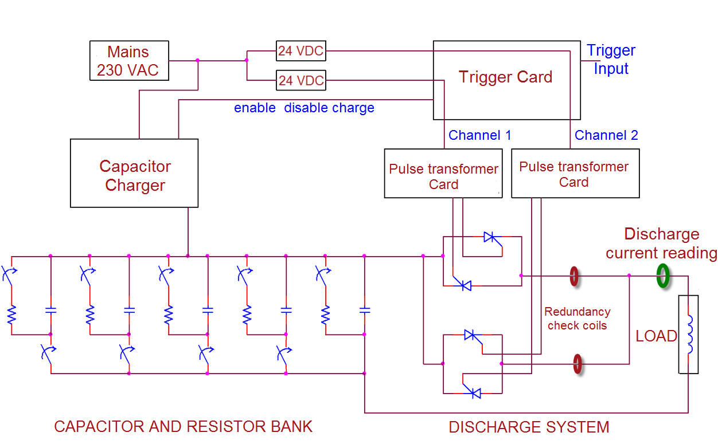
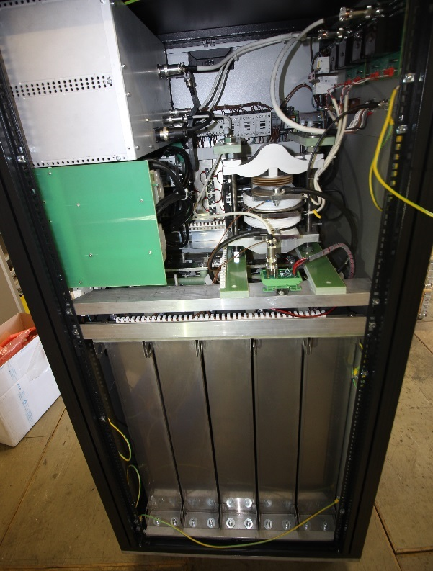
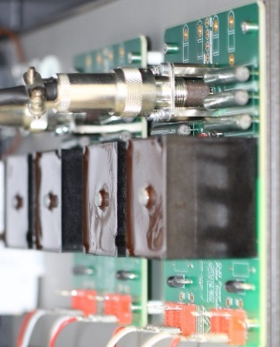
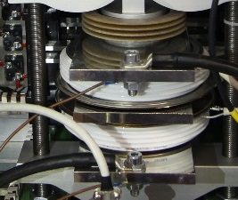
A glimpse into the CLIQ v2 unit
Courtesy to David Carrillo

Slide 19
Thank you!

