Slide 1
Power Leads for Test Stands
S. Feher
3rd International Workshop on Superconducting Magnet Test Stands
June 11-12, 2019, Uppsala

Slide 2
Outline
Overview
Test stand requirements with respect to Power Leads
HTS vs Convectional PL
What can go wrong?
Summary

Slide 3
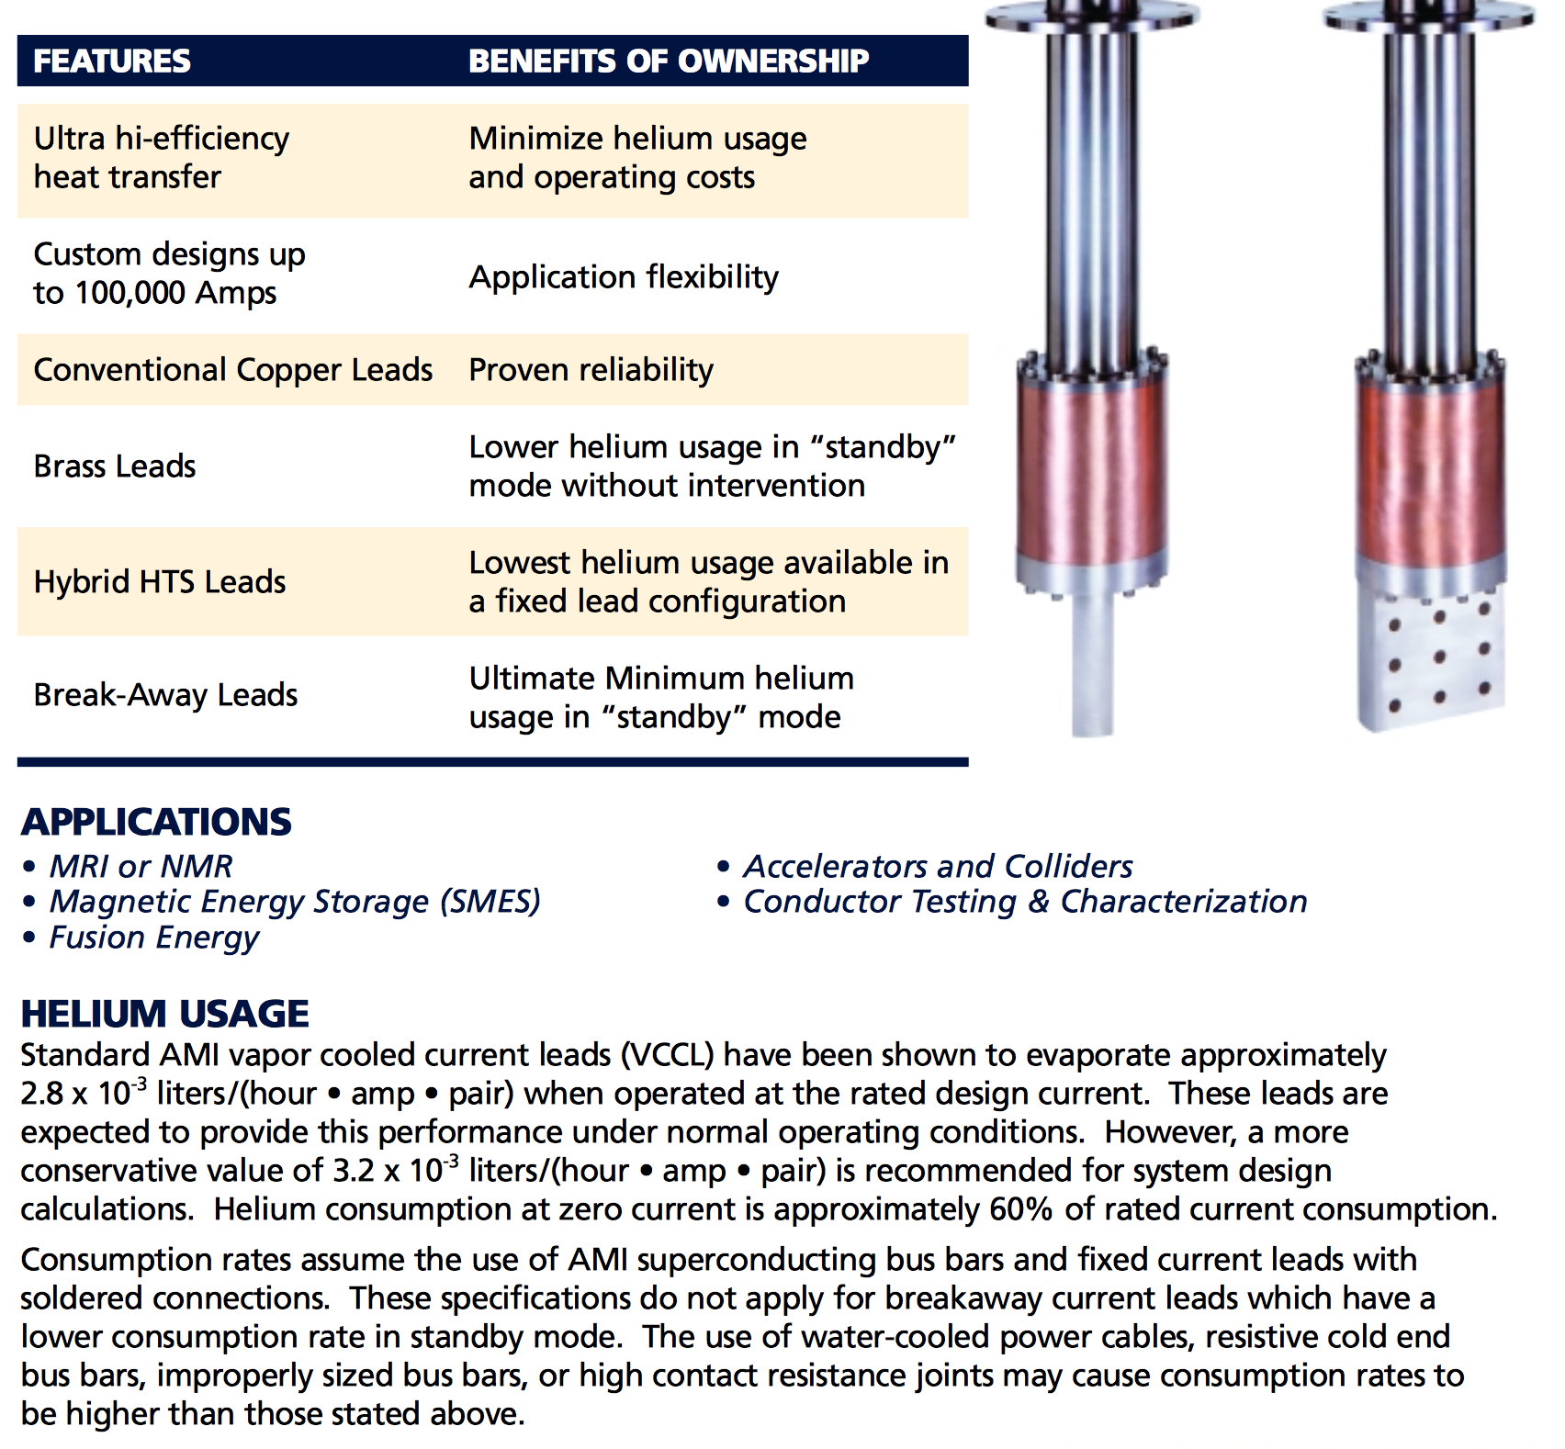
Power leads are commercially available

Slide 4
Magnet Test Stands Requirements – Power Leads
Magnet test stands primary purpose is to validate magnet designs by testing R&D, Prototype and Production magnets.
Test stands should be capable of simulating operational environments and requirements for multiple designs for similar but different magnet types:
Dipole, Quadrupole, Multipoles
Current and future accelerators (LHC, HL-LHC, FCC etc.)
Operational environment might be different (pressure, temperature range, magnetic field, voltage and electrical current rating, etc.)
Power leads are part of the magnet test stand so they need to follow the same approach with respect to operational environment and providing current to different magnet designs:
Current
Voltage
Pressure
Cooling scheme - heat load at the cold end
Protection

Slide 5
Current Rating and Range
Test stands are designed to be able to test at least one magnet type but in mind that the stand will be used for multiple purposes. Choosing the power leads for test stands are not obvious since PLs are optimized for one operational current.
Current rating can be up to 100 kA – Pipetron magnets
In general low current considered up to 1-2 kA
”Regular” rating is up to 30 kA – low inductance high current
Ramp rate up to 500 A/s – Eddy current issues are negligible but still need to be designed to withstand high ramp rates

Slide 6
Voltage Rating
HV test of the magnets also means we are HV testing the leads
Can be as high as 3 kV
Leakage current is as low as < 1uA
Running the power leads at different current than the designed (optimum) current value leads overcooling the upper end of the leads
Condensation at the insulating surface is probably the most problematic issue with the current leads

Slide 7
Pressure Rating
It is usually not an issue however sometimes in special test cases the power leads need to be robust
Pressure rating can be up to 4-5 bars
Insulation scheme has to be appropriate with most likely metal sealing surfaces
Other extreme case is when the power leads need to operate in vacuum
Conduction cooled leads – cryo-cooler is used at the cold end
Bi-functional vapor cooled lead lower end is conduction cooled
Testing feed boxes – pressure rating is higher
Testing the power leads itself
Paschen test can be challenging – p*d has the minumum

Slide 8
Cooling Scheme - Heat Load at the Cold End
Optimizing the cooling consumption of the leads are not the primary goal for test stands, since they are not operating all the time; saving money is not the driving force, but cooling capacity sometimes can be an issue.
Heat load at the cold end to be minimized
Power leads are coming in several different cooling solutions:
LHe vapor cooled leads – most common solution to minimize coolant consumption
Conduction cooled leads – most useful for cryo-cooler solutions or small current applications
Bifunctional leads can use different cooling type – LHe vapor, LN2 and LN2 vapor

Slide 9
Regulation and Protection
Vapor cooled leads cooling depends on the operating electrical current value, even if the leads are optimized to one current value
Current dependent flow rate
Usual solution is a stand by current and operating current flow rate adjustment
It is possible to use voltage drop as a feedback to regulate the flow rate
Optimized power leads are using optimized copper cross section and length
Leads can be unstable at not sufficient cooling – coolant loss case
Protection is based on voltage threshold
Simple fixed threshold value – maximum allowable voltage drop value for the current lead
Resistance deviation based: Voltage drop value is bucked against the current (traditionally used at FNAL)

Slide 10
HTS vs Conventional Current Leads
In a case the cooling capacity is limited HTS leads are excellent choice
LHe liquefaction is limited
Cryo-coolers are in use – low current applications
Bi-functional power lead solution
Upper section is a conventional vapor cooled copper lead
LHe vapor – re-utilized helium gas at higher temperature 20-50 K - CERN Leads by Amalia
LN2 is used at 80 - 82 K – FNAL leads; LN2 is cheap
Pros
Less power consumption
Cons
HTS needs special protection scheme
1 mV threshold value

Slide 11
What Can Go Wrong?
HV withstand test is compromised by power leads
Overcooled uppers section – wet insulation, high leakage current
Multiple solutions to prevent it:
Dry nitrogen cover
Active temperature control
Passive thermal insulation
Special coating to prevent moisture to be absorbed into the current leads
Special power lead design that is not sensitive to excessive cold gas trough the lead
Copper flag joint compromised and too much heat generated at the upper end
Lower joint is compromised and too much heat transferred to the liquid
Improper protection and lead burn out
HTS proper protection 1 mV threshold value

Slide 12
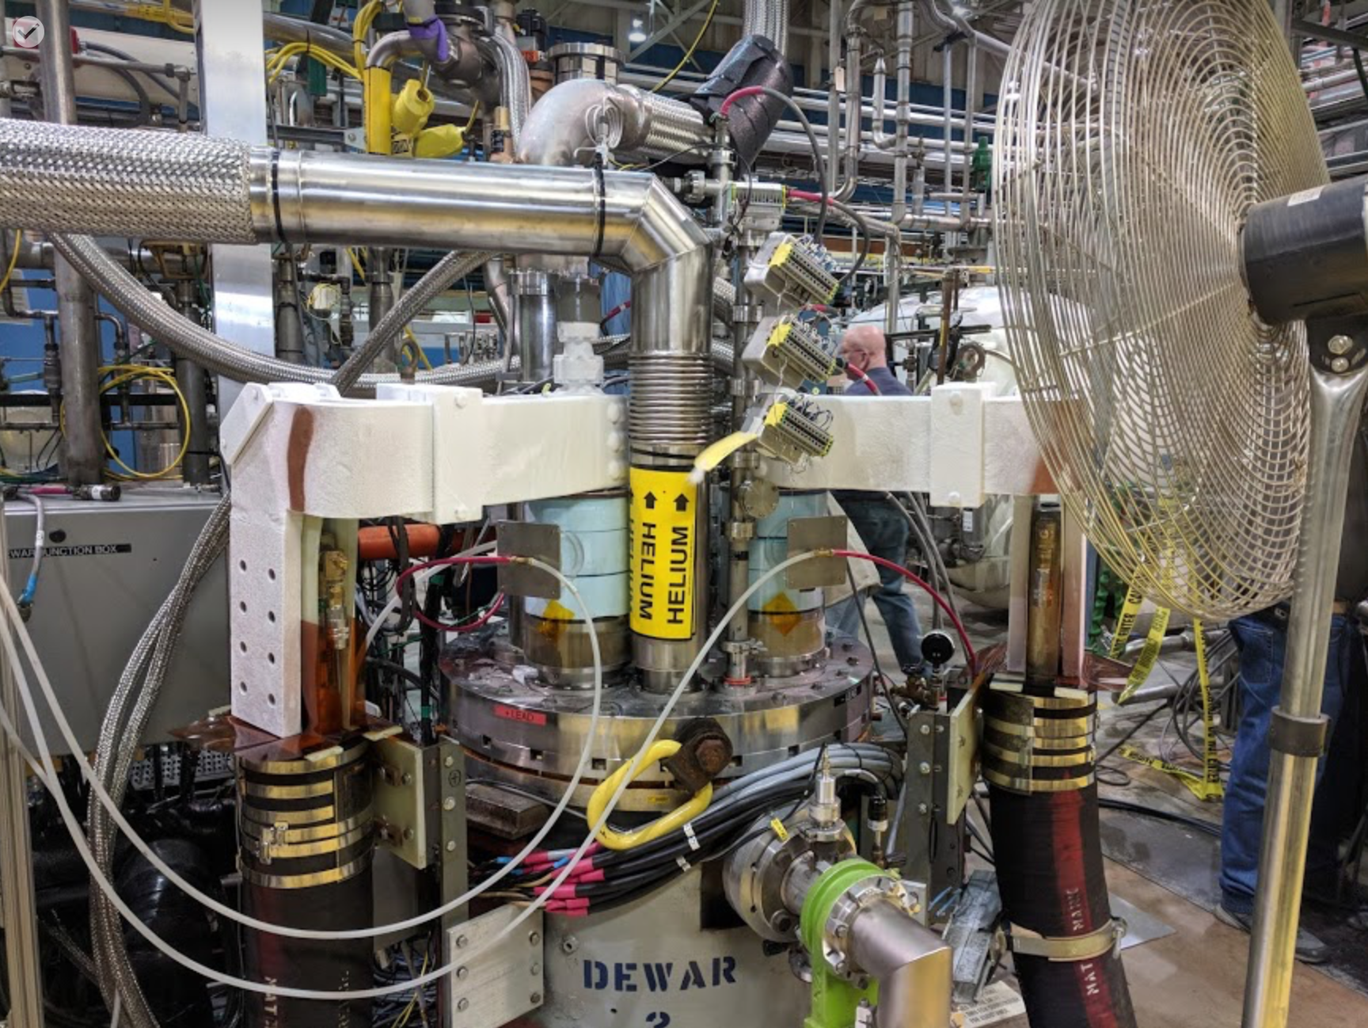

Slide 13
Summary
Power leads are test stand specific
Magnet specifications will influence choosing the leads
Vapor cooled leads are common but conduction cooled leads are also used for test stands with low current < 2000 A
Bi-functional HTS leads are not common for test stands but occasionally are used if cooling capacity is limited to save liquid or cryo-coolers are used
Magnet HV withstand tests can be limited by improper power leads insulation scheme

