Slide 1
Magnet safety system and supervision in FREIA
3rd International Workshop of the Superconducting Magnets Test Stand
Kévin Pepitone
Uppsala, June 11-12, 2019

Slide 2
Outline
Magnet safety
  Equipment connected to the magnets
  Acquisition systems
  Magnet protection at FREIA
Supervision
  Control system architecture
  Subsystems
  Services and user interfaces
  Safety system – PLC
  Cryogenics supervision software
  Power converters EPICS interface

Slide 3
Magnet safety
Equipment connected to the magnets
Acquisition systems
Magnet protection at FREIA
Supervision
Control system architecture
Subsystems
Services and user interfaces
Safety system – PLC
Cryogenics supervision software
Power converters EPICS interface
Magnet safety

Slide 4
Equipment connected to the magnets

Slide 5
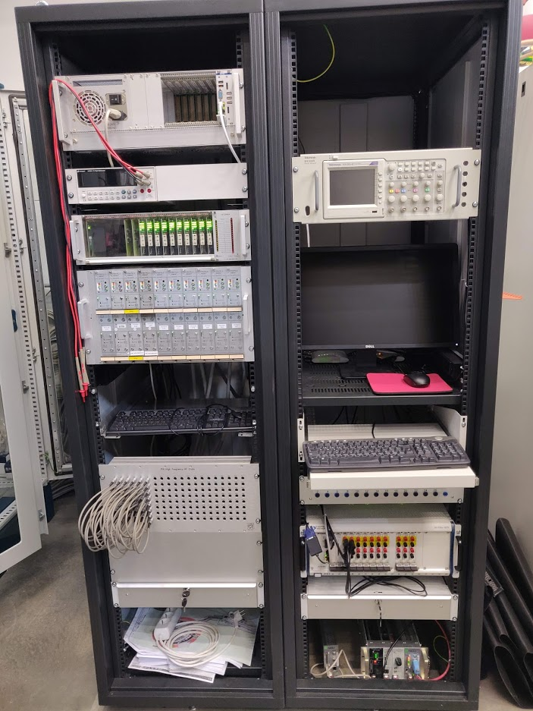
Equipment connected to the magnets
PLC
Computers for interlocks and acquisition
Measurements: 4-wires multimeter
oscilloscope (200 MHz BW and 2GS/s)
Safety systems: Matrix and PotAim cards 1kVdc insulation
Patch panels
Acquisition systems:
DAQ (16 bits) | HF | MF | LF
Maximum number of channels to be recorded | 48 | 48 | 72
Maximum differential input voltage | 1 kVdc | 1 kVdc | 1 kVdc
Acquisition frequency | 5 - 200 kHz | 1 - 5 kHz | 1 kHz
Bandwidth of the system | 600 Hz
Thresholds / delays per signal | 0 – 1 V / 0 – 1 s

Slide 6
Acquisition systems – Fast acquisition
Quench detected by the matrix
=> Triggers fired
Look at the differential voltages to find where is the quench
Find the segment(s) where the quench occurs

Slide 7
Acquisition systems – Long acquisition
“Plateau” -> Splices measurements
Ramp rate -> Inductances measurements
Quench

Slide 8
Magnet protection at FREIA
36 Vtaps that can be connected to the magnets
16 Vtaps on the splices and current leads
Sensors and interlocks:
  GHe flow (current leads to gaz bag)
  Temperature on magnet and insert (49 sensors below the λ_{plate}, 18 above)
  Level (2 sensors below the λ_{plate}, 1 above)
PotAim cards and matrix:
t_{Validation}
System
delay
V_{threshold}

Slide 9
Magnet safety
Equipment connected to the magnets
Acquisition systems
Magnet protection at FREIA
Supervision
Control system architecture
Subsystems
Services and user interfaces
Safety system – PLC
Cryogenics supervision software
Power converters EPICS interface
Supervision
Courtesy Konrad Gajewski

Slide 10

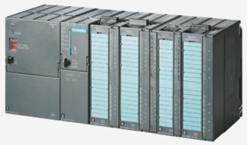
Control system architecture
Internet
EPICS (Experimental Physics and
Industrial Control System) based
3 Layer architecture
Top layer: Application programs (GUI, data browser, alarm manager,…)
Middle layer – Input/Output controllers (IOC)
Front end (PLC, ADCs, intelligent peripherals, etc…)
Archiever
Alarm Manager
ChannelAccess
IOC
IOC
Why EPICS?
Has all features that we need at FREIA
Mature, well maintained system
Will be used at ESS
EPICS drivers and device support for many commercial instrumentation
Easy integration with PLCs
Very wide users base and helpful community
Common services:
Archiver (archive appliance)
Alarm manager (BEAST)

Slide 11

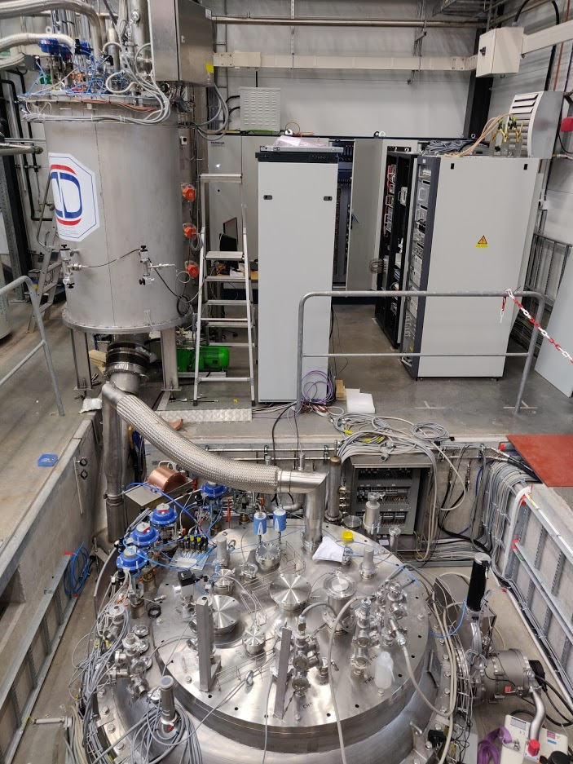

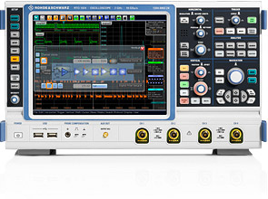

Subsystems @ FREIA connected to EPICS
Services:
Cryogenics (controls based on PLC)
Vacuum (pumps, valves, gauges)
Water cooling (valves, sensors)
Facilities:
RF power stations (anode PS, solid state amplifier...)
Horizontal cryostat
Vertical cryostat (PLC)
Personnel protection system:
RF leak detector
Radiation monitoring
Machine protection system:
Fast interlocks (cRIO via LabView’s Epics IO-Server)
Slow interlocks (Siemens PLC)
Instrumentation:
Laboratory instrumentation (via LabView’s Epics IO-Server)
Timing system
LLRF

Slide 12
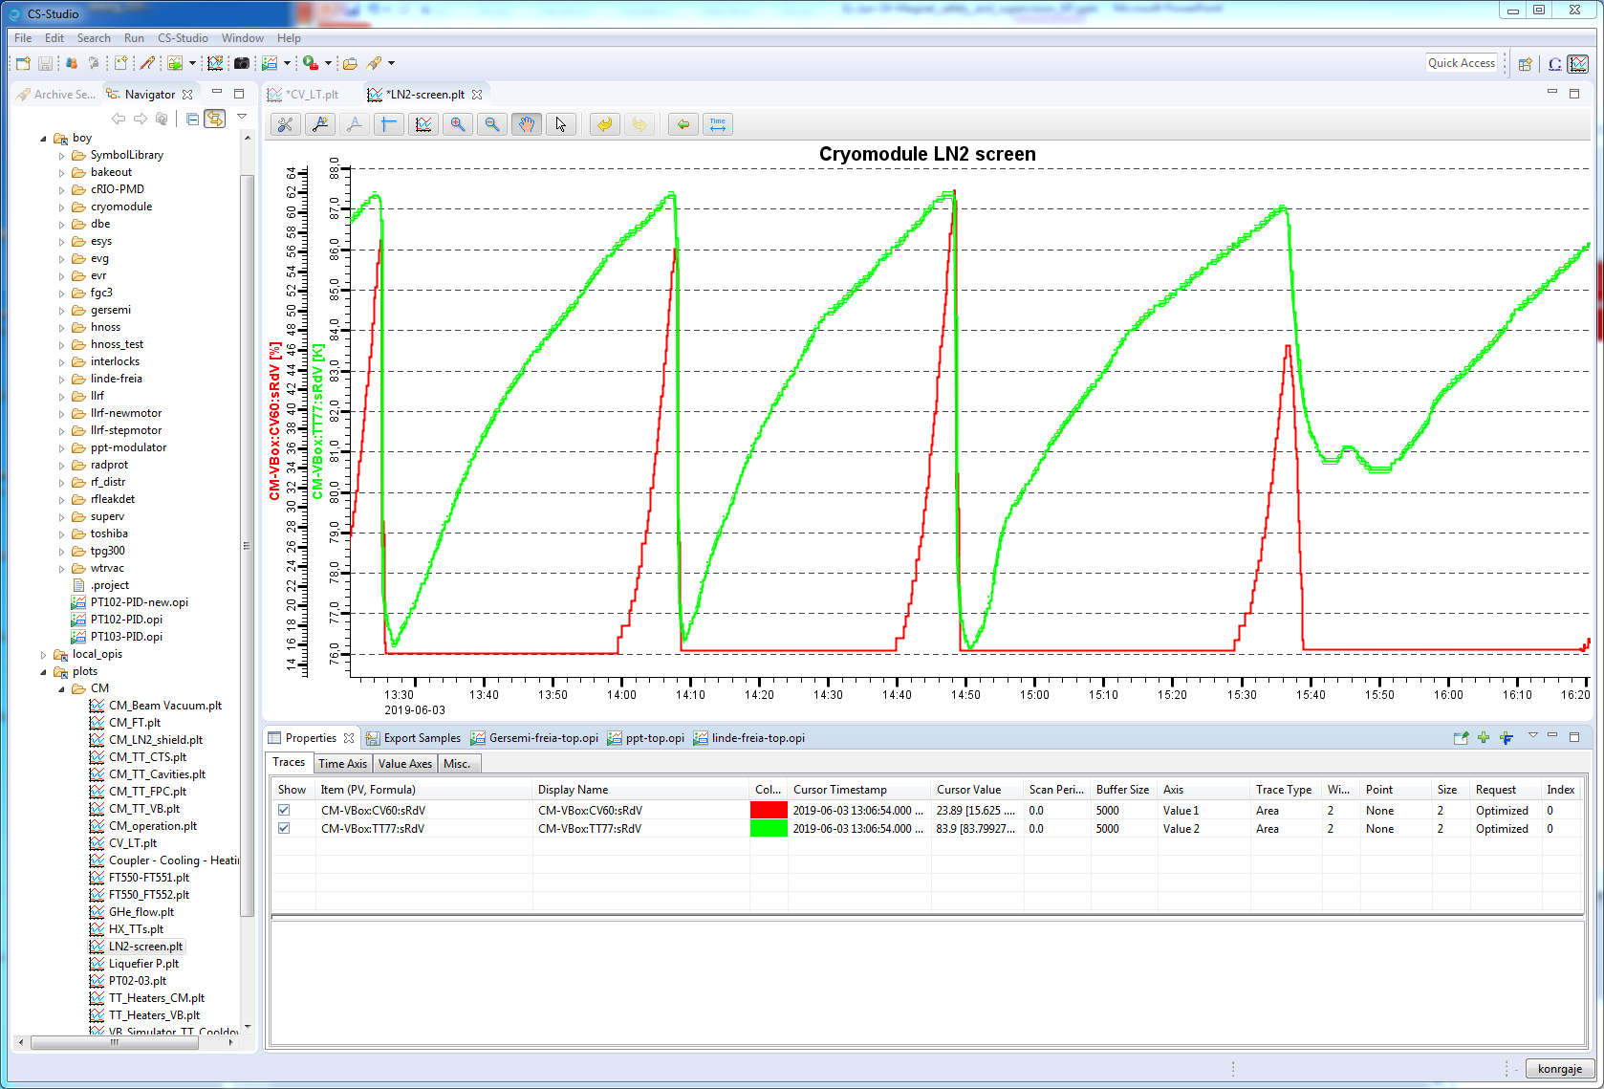
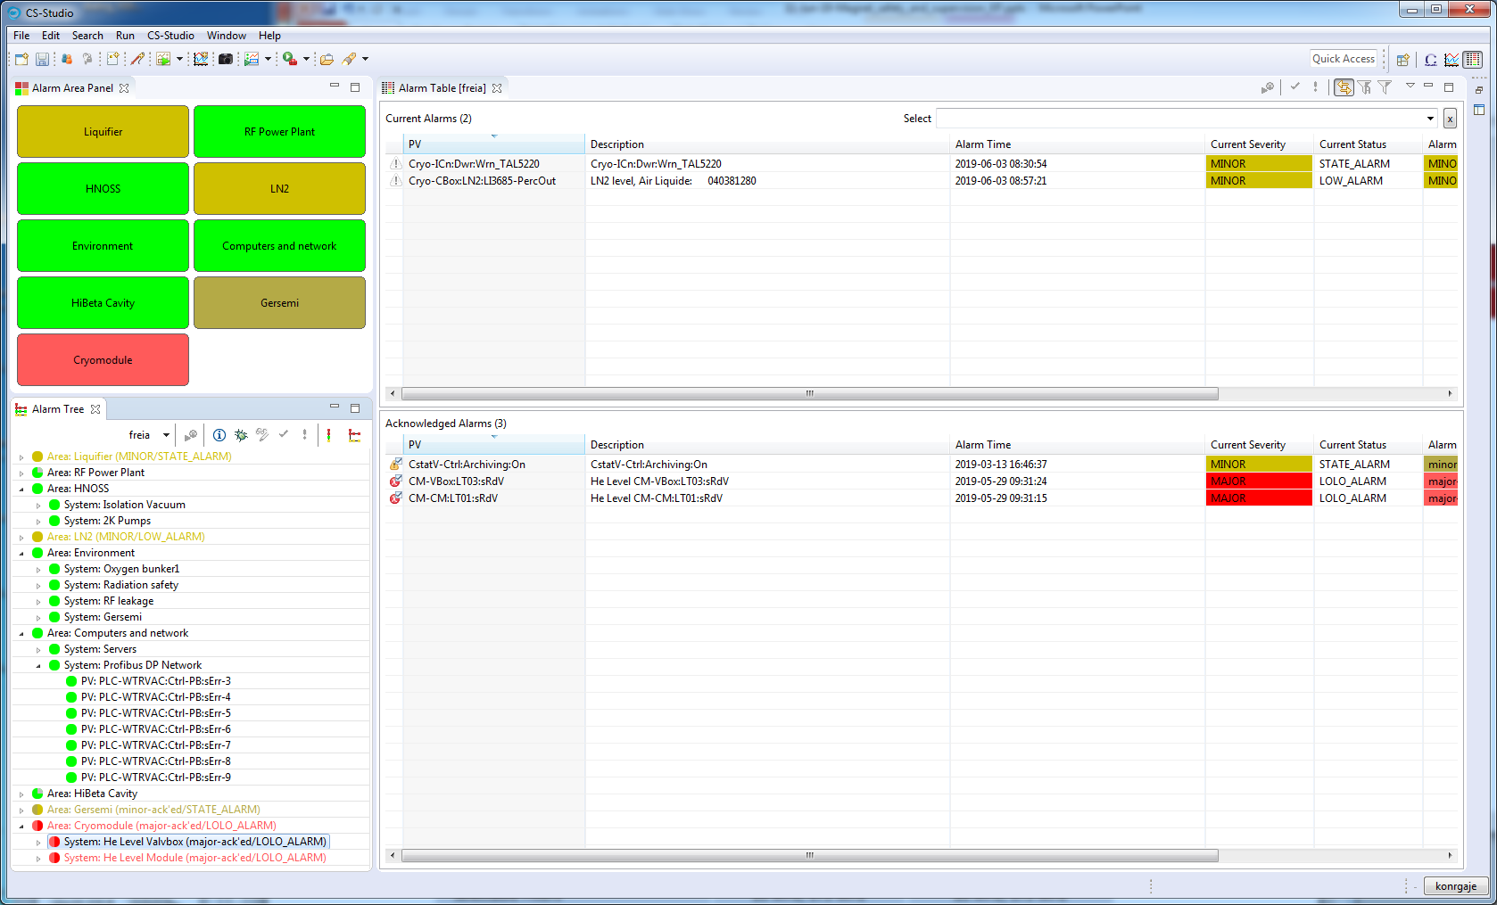
Control system services and user interfaces
User interfaces:
Control System Studio
  OPI builder (BOY)
  Data browser
  Alarm manager
Web browser
  Archive viewer
  FREIA status pages
  Logbooks
Services:
Archiver (archive appliance)
Alarm manager (component of the Control System Studio)
Channel acces gateway
Electronic logbooks

Slide 13
Safety system - PLC
No quench detected (from safety matrix)
DAQ system OK
Power converter status
Energy extraction status
Slow/Fast power abort on power converters
Cables in parking or operation position
Thermo switches on leads
Cryo ok
Minimum current for quench detection
Current of power converters
PLC
Leads voltage
Magnet temperature phase
Power converters
Energy extraction
Flash boxes
Current value (to cryo)
Quench signal (to cryo)

Slide 14
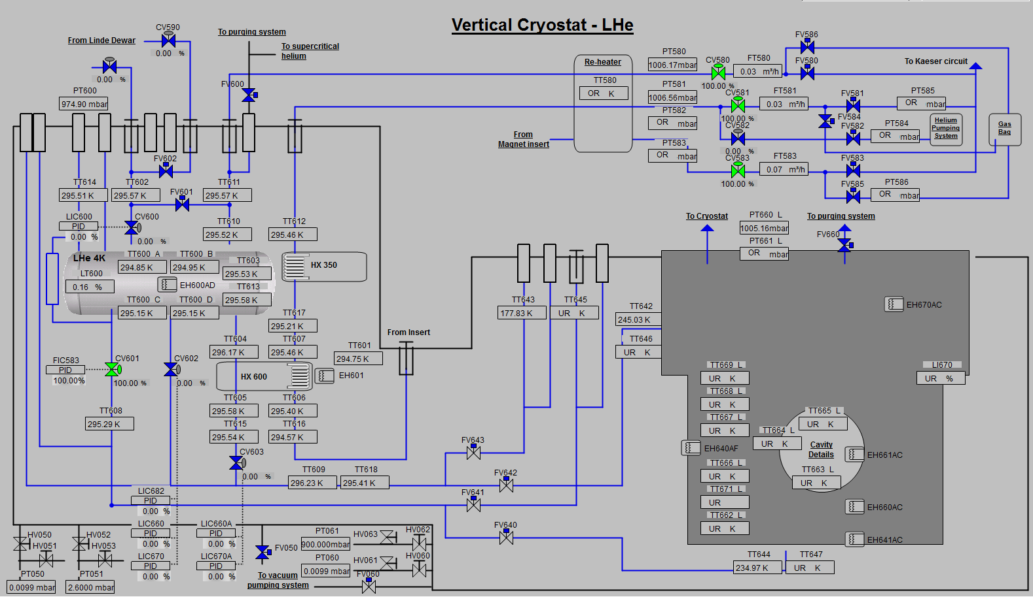
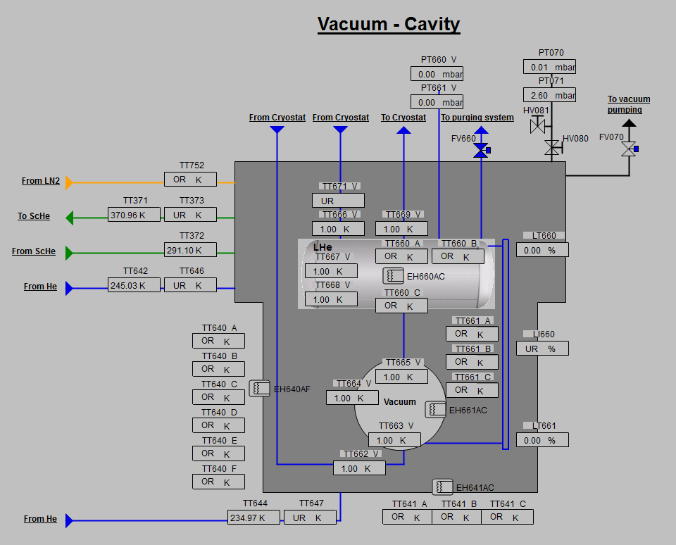
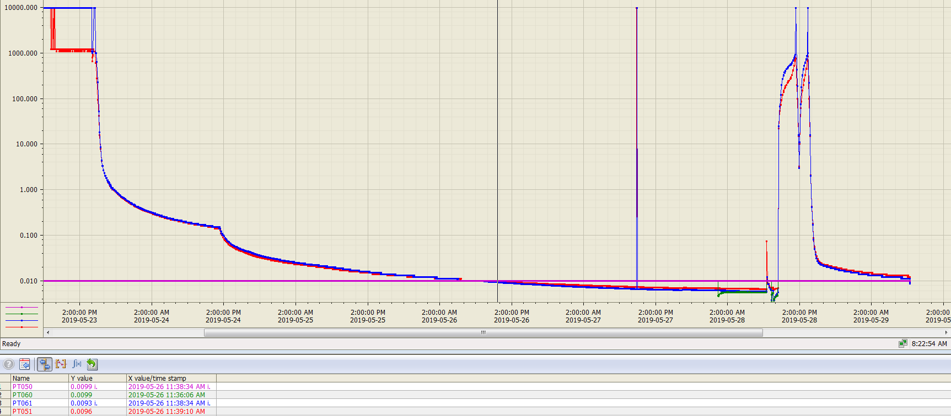
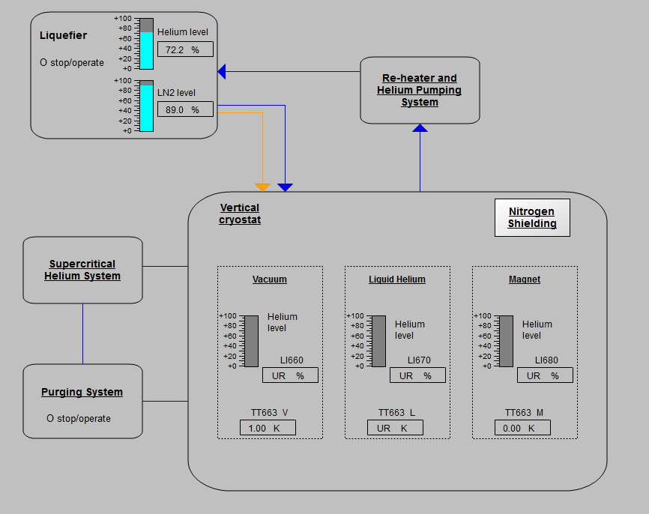
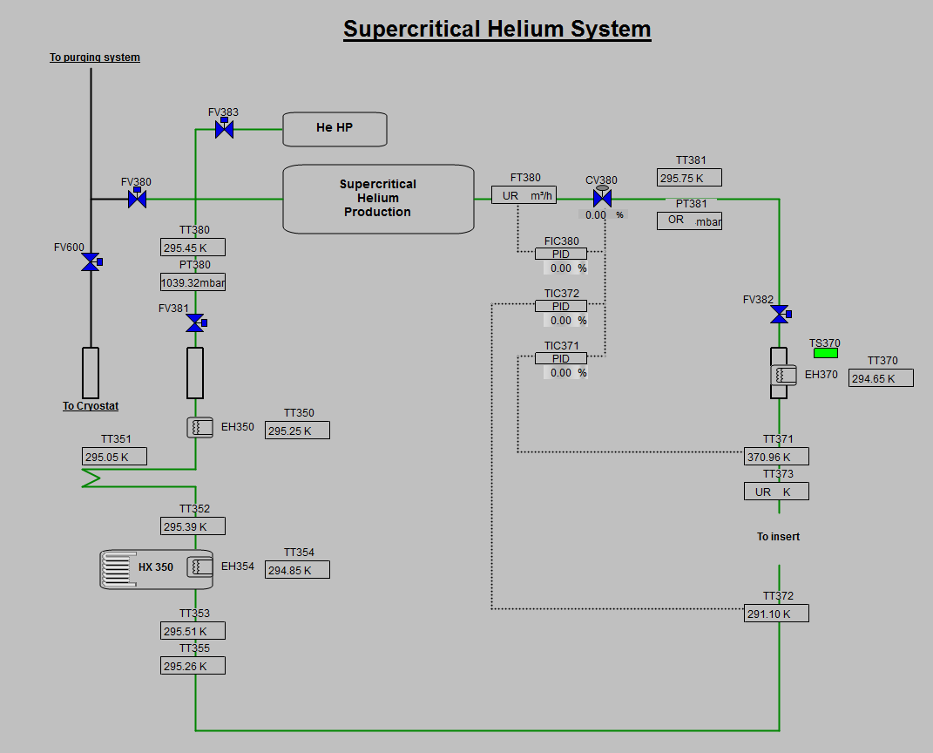
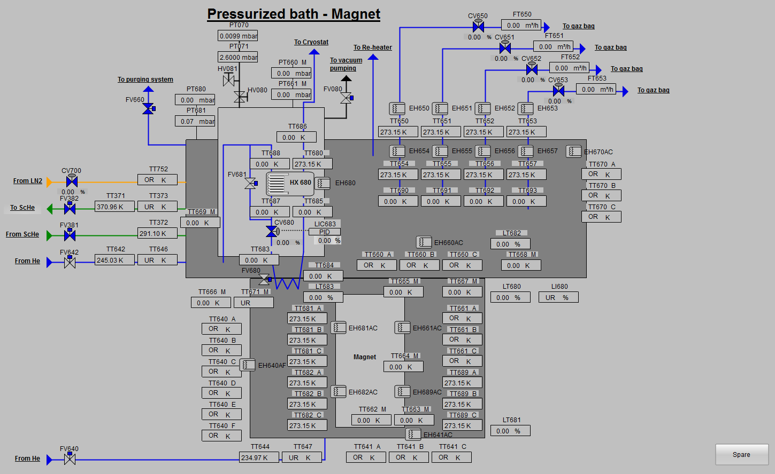
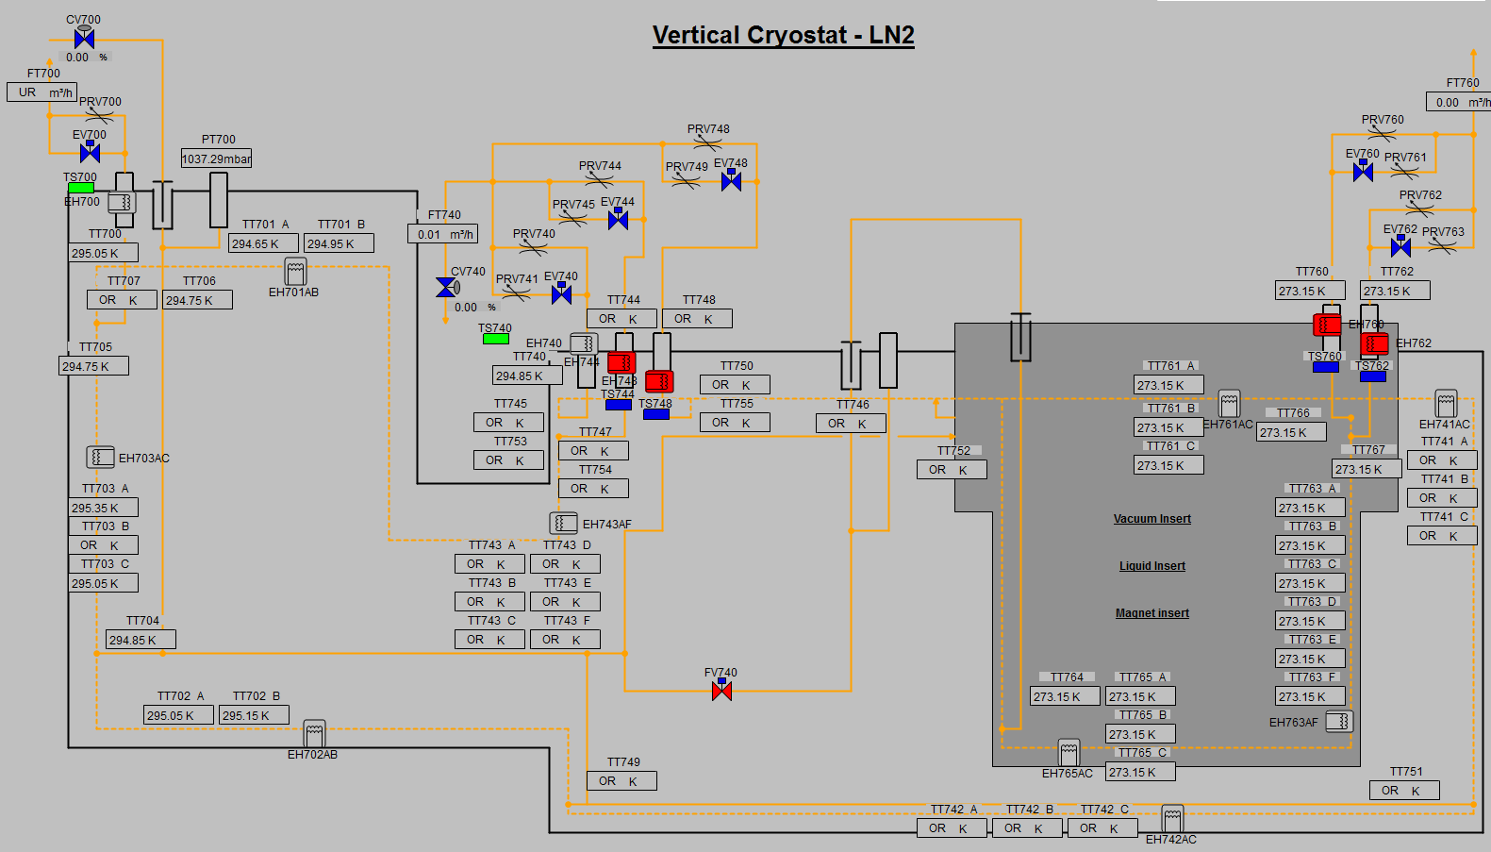
Cryogenics supervision software

Slide 15
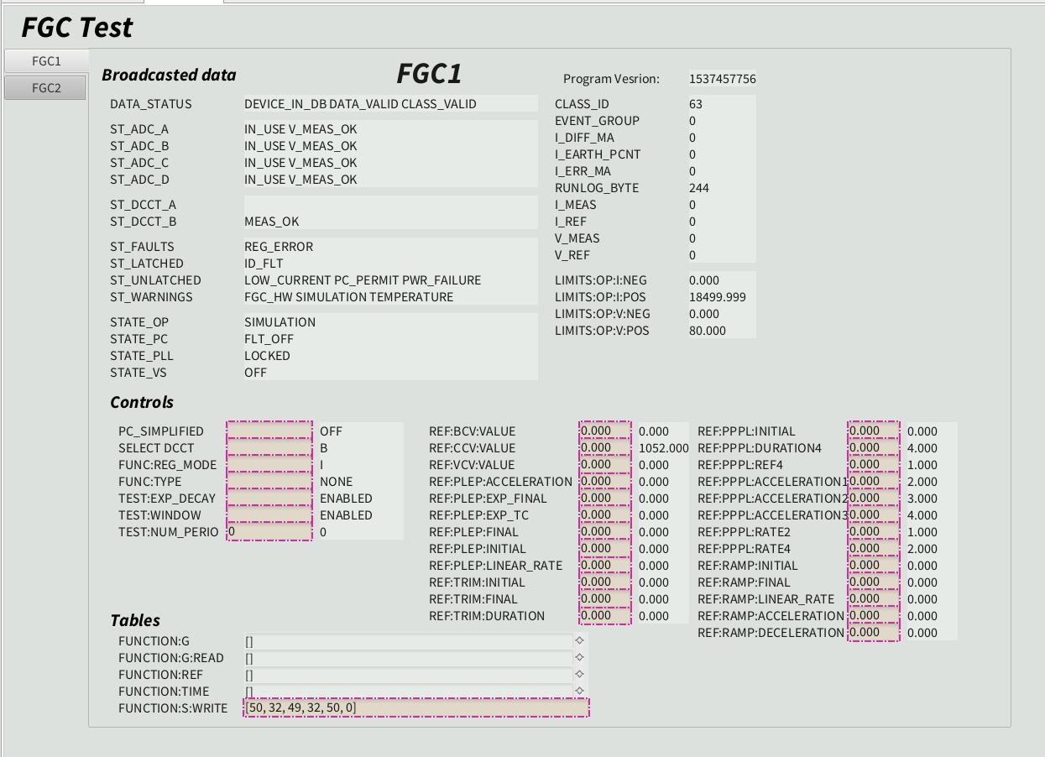
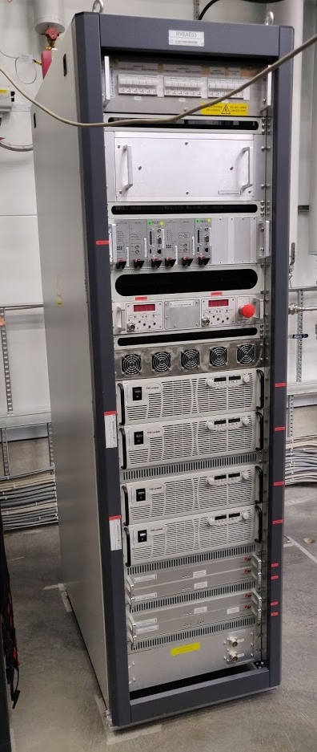
Power converters EPICS interface

Slide 16
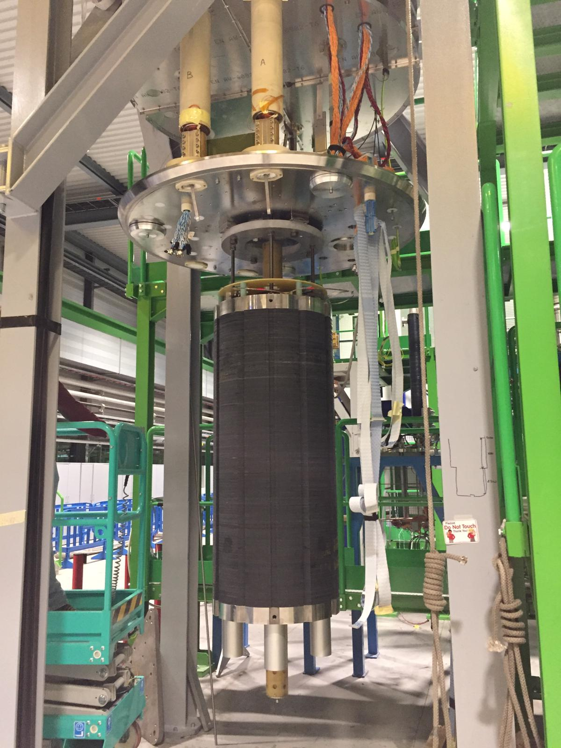
Conclusions
MCBXF prototype
Not to be broken, damaged, during transportation, installation and operation
Expensive
Power converter
Cryogenics
PLC, safety system and many measurements on the magnet to be sure it is powered only when it is superconducting
Supervision and sensors to control pressure, temperature

Slide 17
Thank you for your attention

Slide 18
Safety system - PLC
Par. (Quench to cryo; Magnet Phase)
6 ANALOG INPUTS + SPARES
(PC current; V leads)
27 DIGITAL INPUTS + SPARES
(DAQ OK; EE Status; PC Status; Leads Temperature)
17 DIGITAL OUTPUTS + SPARES
(PC Permit; Flash Boxes; Current to cryo; Quench to cryo)

