Slide 1
Electrical integrity of magnets and coils
Vittorio Marinozzi
3rd International Workshop of the Superconducting Magnets Test Stands
June 11th, 2019

Slide 2
Introduction
Before operating magnets and coils, it is important to verify electrical integrity
Presence of short circuits can damage magnet, coils, equipment, and can be a safety hazard
After construction and before operation of coils/magnets, it is important to verify electrical integrity with dedicated electrical tests

Slide 3
Introduction (2)
Coils are subject to risk of different kind of short circuits
To ground
Turn-to-turn
Layer-layer
To floating parts (pole...)
Diagnostic wires (ground)
…
Several tests can be performed to mitigate the risk of having shorts during operation
High-voltage hipotting
Impulse test
Electrical measurements

Slide 4
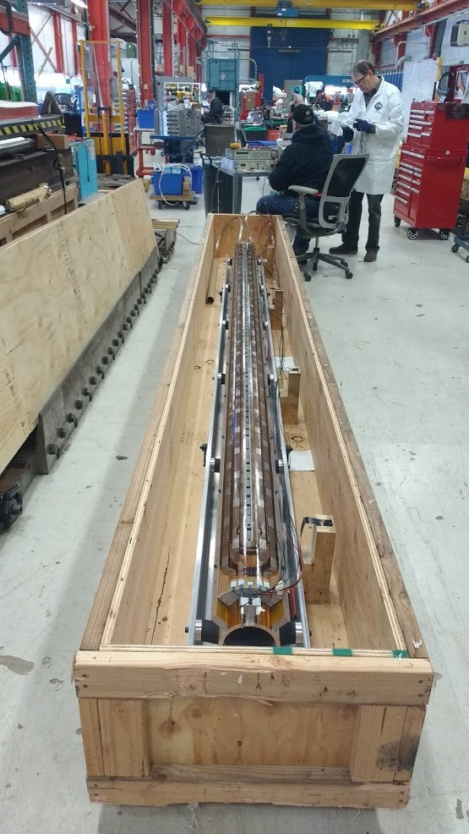
AUP HiLumi experience
During production of the AUP / HiLumi MQXFA coils, we perform several electrical checkouts, in order to mitigate electrical risks

Slide 5
Reference document

Slide 6
Coil electrical design

Slide 7
Coil in the magnet

Slide 8
Tests that we perform on QXFA coils
Impulse test
To verify absence of turn-turn shorts
Both polarities
From 1 kV to 2.5 kV, 500 V steps
High voltage Hipots
Details later
Electrical measurements
Inductance (20 Hz , 100 Hz, 1000 Hz), resistance, voltage taps
Repeated at each stage of the coil fabrication
We have ranges based on past coils measurements

Slide 9
Test sequence during coil/magnet fabrication
Pre-fabrication: heater traces tested at 3700 V
After winding, curing, reaction, trace installation, impregnation: electrical measurements
After impregnation: HiPot, impulse test
After shipping: HiPot, impulse test, electrical measurements
After magnet assembly: HiPot, impulse test, electrical measurements
The sequence of tests with details is referenced on US-HiLumi-doc-956 and US-HiLumi-doc-521

Slide 10
Impulse test example (QXFA115)

Slide 11
Impulse test example (QXFA108)
High frequency, sign of intermittent short

Slide 12
Hipot values
Golden rule:
V_{hi-pot} (4.2 K) = 2 * V_{peak} + 500 V
V_{hi-pot} (warm) = 2 * V_{hi-pot} (4.2 K)
V_{peak} from simulations in nominal conditions

Slide 13
Hipot values (2)
Warm:
Coil to ground: 3680 V
QH to coil: 3680 V
Coil to pole: 500 V
Coil to end-shoe: 1000 V
QH to end-shoe (OL): 2500 V
IL End-shoe to OL end-shoe: 1000 V
Cold (in the test station):
Coil to ground: 1840 V
QH to coil: 2300 V
Max leakage current: 1 μA

Slide 14
Discussion on heater-to-coil voltage
MQXFAP1 (first MQXFA 4 m long prototype) test has been interrupted, due to a short to-ground caused by a short heater-to-coil
This is a single event, due to a weakness of the coil. However, we want to improve our QC in order to mitigate risks

Slide 15
Peak heater to coil voltages
Peak heater to coil voltages occur after a quench event
Coil become resistive
Dump resistor circuit is opened
Heaters are fired
CLIQ unit is fired
We should design the electrical tests in order to reproduce as close as possible the conditions that occur during a quench

Slide 16
What happens during a quench?
Both coil and heaters become hot
If heater-to-coil insulation is damaged, helium superfluid that filled the crack becomes hot as well
Temperature increase → Pressure increase
Worst situation for the peak voltage could occur at temperature different than liquid helium or room temperature
We would gain from test stations able to test magnets/coils at different sets of temperature and helium pressure

Slide 17
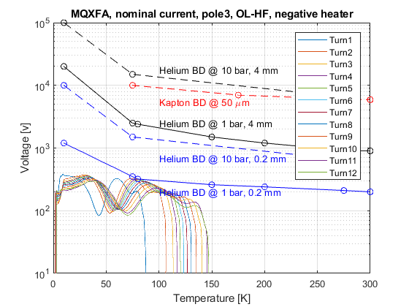
Example: MQXFA peak heater-to-coil voltages
MQXFA Peak Heater-to-Coil Voltage
Worst situation, interesting to test coils in this condition, at different helium pressures

Slide 18
Proposal for heater to coil hipot (under discussion)
Take worst combination voltage/temperature, and make a test at 20% higher value
450 V MQXFA @ 100 K
800 V MQXFB @ 100 K
Scale values at room temperature (250 V MQXFA, 450 V MQXFB)
Helium pressure: 1 bar
Provides margin at 100 K
Expected pressure at 100 K: > 10 bar (HiLumi-doc-921)

Slide 19
Conclusions
Checking electrical integrity of coils is important to operate safely magnets and coils, avoiding damages of coils and equipment
During the production of the HiLumi AUP MQXFA coils/magnets, we perform a sequence of electrical checkout to ensure quality
Well referenced QC procedures and, and clear criteria
Improvement of Quality Control on heater-to-coil tests is under discussion
Ability of controlling temperature and pressure of helium in test stations would be helpful to improve coil/magnet QC

