Slide 1
Magnetic measurements techniques for Super-FRS
Giancarlo Golluccio, Magnetic measurement
on behalf of GSI-CERN collaboration on Super-FRS testing
3rd International Workshop of the Superconducting Magnets Test Stands,
Uppsala 11-12 June, 2019
Notes:
Full SAT, acceptance of the magnet for approval, provide information both for installation in the Super-fRS and future operation

Slide 2
Outline
Magnets Overview
  Super-FRS superconducting magnets
  Short/Long multiplet design parameters
  Dipoles design parameters
Magnetic measurements
  Magnetic measurement campaign
  Measurement devices
  Measurement strategy
  Devices
    SSW
    Rotating coils
    Translating fluxmeter
    3D mapper

Slide 3
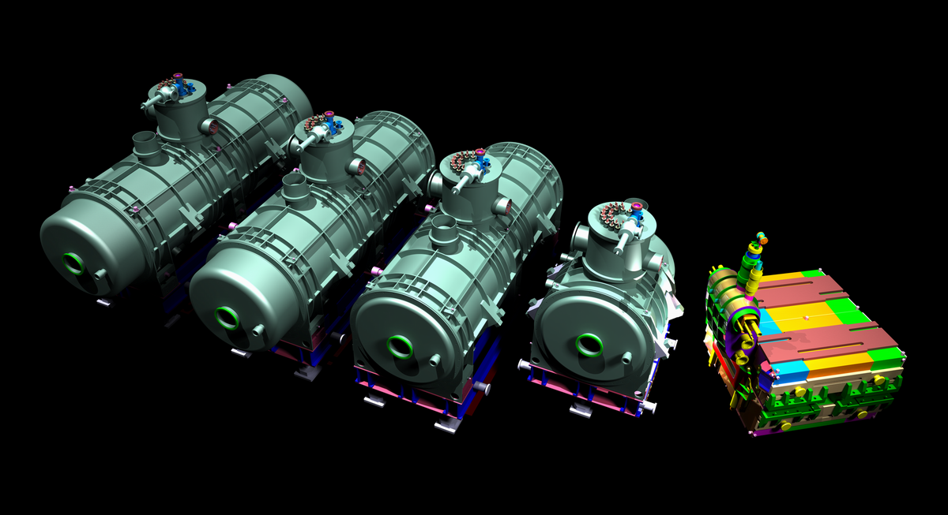
Super-FRS superconducting magnets
32 Multiplets: ASG, Italy
Magnets
Long quadrupole
Short quadrupole
Sextupole
Octupole
Steerer
Dipoles: Elytt, Spain
18 × 9.75° bending magnet
3 × 11° bending magnet
3 × 9.75° bending branch magnet
7000mm
6500mm
2600 mm
6000mm

Slide 4
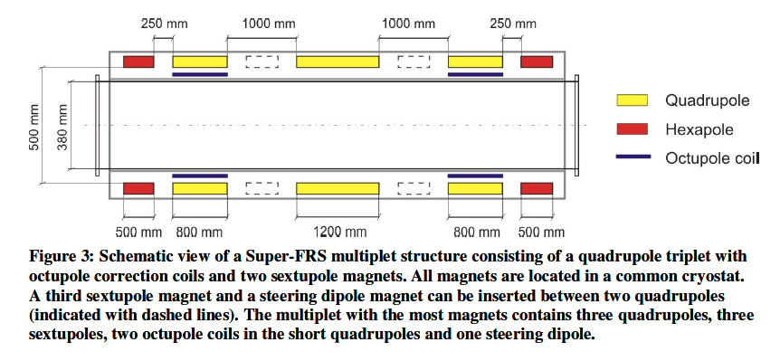
Short/Long multiplet design parameters
Short multiplets composed by: a Quad (plus octupole coils for some of them) and an hexapole (at left or right side of the quad)
Magnets | Parameters | Low excitation level | Hi excitation level
Quads | Local gradient field (T/m) | 0.85 | 9.72
 | integral gradient field (Tm/m) | 1.14 | 11.83
 | Integral field quality | 14.7 ∙10⁻⁴ | 120 ∙10⁻⁴
 | Current (A) | 17 | 300
 | Iron length (mm) | 1200
 | Aperture (pole tip) (mm) | 250
 | GFR (mm) (radius) | 190
Sextupole | Local gradient field (T/m²) | 2.32 | 36.14
 | integral gradient field (Tm/m²) | 1.34 | 2.32
 | Integral field quality | 22.8 ∙10⁻⁴ | 100 ∙10⁻⁴
 | Current (A) | 17 | 291
 | Iron length (mm) | 500
 | Aperture (pole tip) (mm) | 252
 | GFR (mm) (radius) | 190
Steerer dipoles
or hexapoles

Slide 5
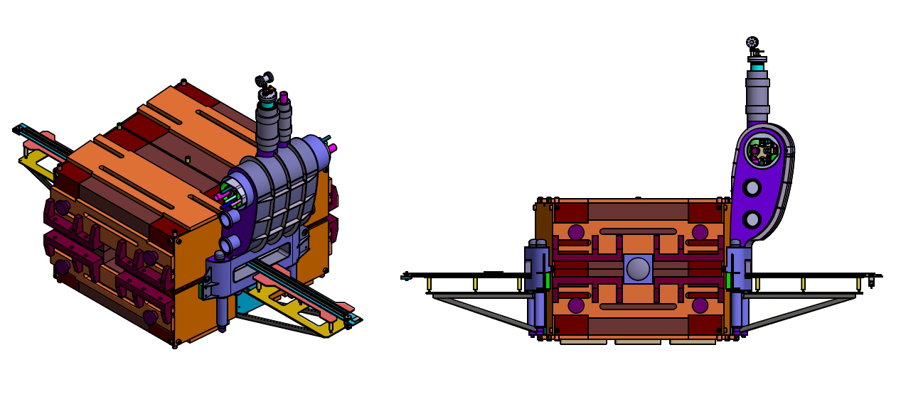
Dipoles design parameters
Magnet parameters
Central field at Inom (T) | 1.6
Integral field at Inom (Tm) | 3.403
Integral field at Imin (Tm) | 0.319
Magnetic length (mm) | 2127
total measurement length (mm) | 4000
Bending angle ° | 9.75
Curvature radius (mm) | 12.5
Aperture width (mm) | +460.85
Aperture height (mm) | +85
Good Field region width (mm) | +190
Good Field region height (mm) | +70
Acceptance criteria of field quality on the GFR boundary (Units of the integral field) | +3
Rise time to Inom (s) | 120

Slide 6
Magnetic measurement campaign
Magnet QA
Data for optics calculation
Magnetic field on line monitor
Model validation
Conformity to QA SAT parameters
Magnet to magnet reproducibility
Localization of the magnetic field for installation purposes (fiducialization)
Requires: reproducible Integral field measurements
Local field information (field roll off)
the 3D magnetic field model can be tuned on the measurements
only for first of series
Provide a feedback during operation in control room
Requires: dedicated measurement campaign for sensors calibration
Not planned yet for super-FRS
Measurement in the 2D region and integral
Only for the first of series
Verify mechanical assembly tolerances
Requires: local measurements and sensitivity to field errors
Notes:
Single pass machine

Slide 7
Magnetic measurement campaign
Magnetic measurement for the Super-FRS
  Requirements from GSI to CERN in the 2014
  Based on that, CERN started the development of four new measurement systems
Challenges:
  Large dimension of the Good Field Region
    190 mm radius for quadrupoles
    380 x 140 mm for dipoles
  Extended fringe field
  No possibility of standard calibration procedures
  Requirements of accuracy and fiducialization

Slide 8
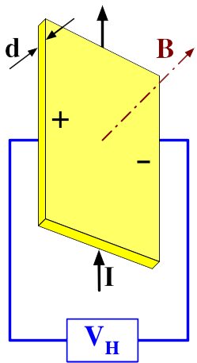
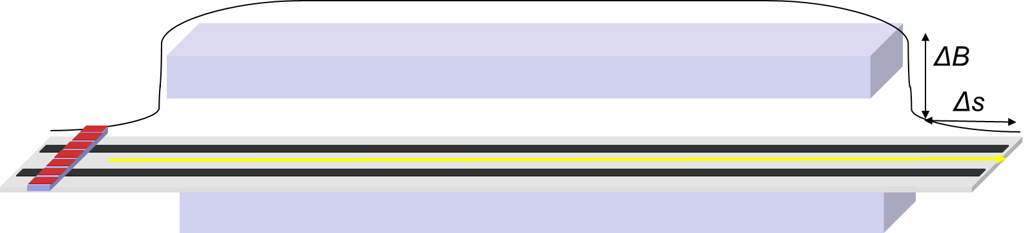
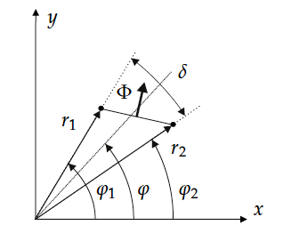
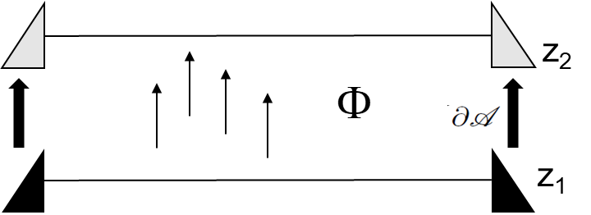
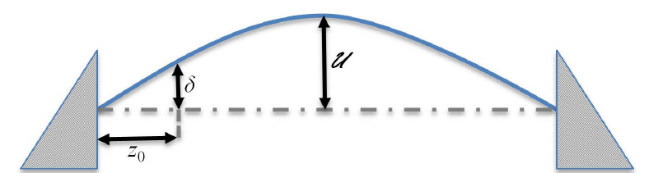
4 measurement devices
3D Hall sensor
Translating fluxmeter
Single stretched wire (SSW)
Vibrating wire (VW)
Rotating coil

Slide 9
Measurement strategy
  The integral field and field quality of each FOS is measured with two independent systems/methods
    Dipoles: Translating fluxmeter, Stretched Wire (Vibrating Wire)
    Multipoles: Rotating coils, Stretched Wire (Vibrating Wire)
  Extended program for FOS
    For dipoles (FOS 9.75°, 11° and each branch dipole): additional local map with a 3D hall probe mapper ( 3m length, top, mid, bottom of GFR boundaries and three current levels)
    For multipoles (quadrupole and sextupole): local field and field harmonics provided with an 100 mm length rotating coil, 100 mm step size over 2.6 m (for long quad)
    An extended measurement plan for the pre-series is needed for guarantee redundancy and flexibility for the series testing phase
  Standard program for the Series
    Only integral measurements
    use of only Stretched Wire measurement is preferable.
    In case of not acceptable divergences w.r.t. FOS measurements, alternative fluxmeter (for dipole) or rotating coil (for multiplet) will be used.
    The magnetic measurement program at cold for the series is 10 days, however, as function of the results of the first of series this schedule can be adjusted
Notes:
In case magnets are fine it provides all required param for SAT

Slide 10
Measurement strategy
Pre-series
  enough time for study and cross-checking both global and local field distribution and homogeneity
Series
  Checking magnet to magnet reproducibility
  No contingency for tracing manufacturing errors and corrective actions for the magnet is foreseen, for the moment.
  Under responsible of the magnet work packages, additional measurements might be discussed and can be arranged.

Slide 11
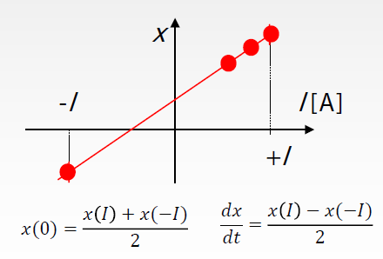
Measurement devices
Accuracy vs testing time
The standard uncertainty of an instrument is a function of the operating conditions (field range/frequency, gradient, temperature etc. … ) that is the way can only be estimated in situ. Testing time and effort are needed to estimate and improve...
Repeat to get rid of random errors
Flip and repeat to estimate systematic effects
either the magnet or the instrument
Inverse polarity (if possible) to remove intrinsic or environmental offsets
e.g. residual field and earth field
Redundancy
Cross-calibrate measurement systems
Covering of all measurement scenarios
Cross-check measurement results
Results confidence
Flexibility

Slide 12
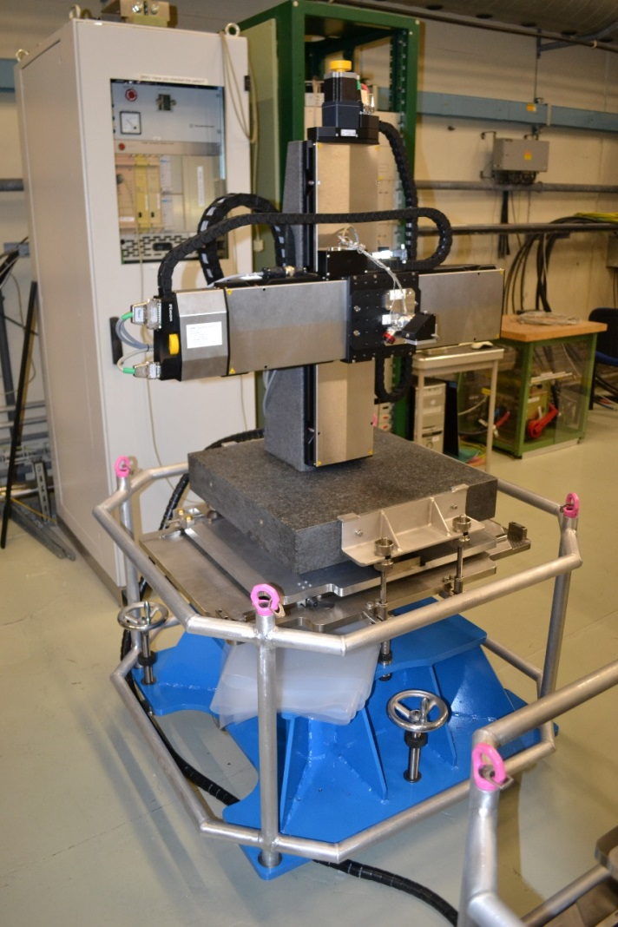
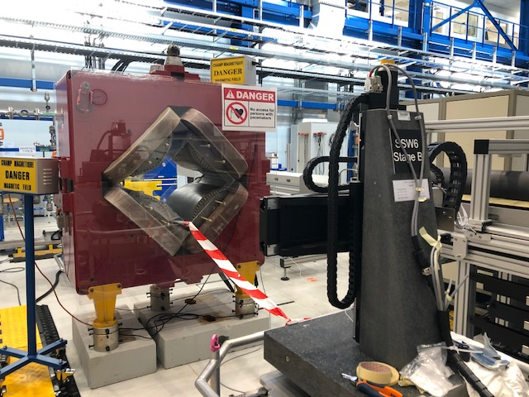
Measurement device: SSW
Stretched wire for multiplets and dipoles
Stages with 400 mm stroke equipped with vibrating wire sensors: Ready for operation

Slide 13
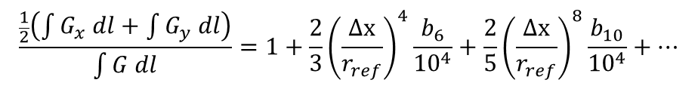
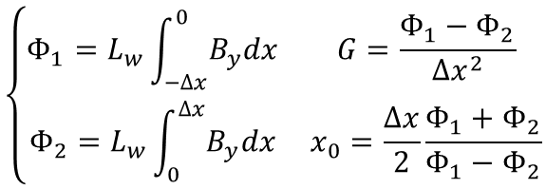
Measurement device: SSW
Wire moved in two steps of width Δx inside a quadrupole of unknown gradient G
Coordinate frame offset from magnetic axis by unknown amount x₀
Flux Φ integrated over the wire length L_{w}
$$\left\{\begin{matrix}Φ_{1}=L_{w}\int_{−Δx}^{0}{B_{y}dx} & G=\frac{Φ_{1}−Φ_{2}}{{Δx}^{2}} \\ Φ_{2}=L_{w}\int_{0}^{Δx}{B_{y}dx} & x_{0}=\frac{Δx}{2}\frac{Φ_{1}+Φ_{2}}{Φ_{1}−Φ_{2}}\end{matrix}\right.$$
Uncertainty depends on the flux measurement and displacements
increasing too much Δx →
get too close to the poles, harmonic
errors perturb the result:
$$\frac{\frac{1}{2}\left(\int{G_{x} dl}+\int{G_{y} dl}\right)}{\int{G dl}}=1+\frac{2}{3}{\left(\frac{Δx}{r_{ref}}\right)}^{4}\frac{b_{6}}{{10}^{4}}+\frac{2}{5}{\left(\frac{Δx}{r_{ref}}\right)}^{8}\frac{b_{10}}{{10}^{4}}+…$$
Measuring the Flux Φ integrated at several angular positions along the GFR allows also to measure the multipoles (polygons)

Slide 14
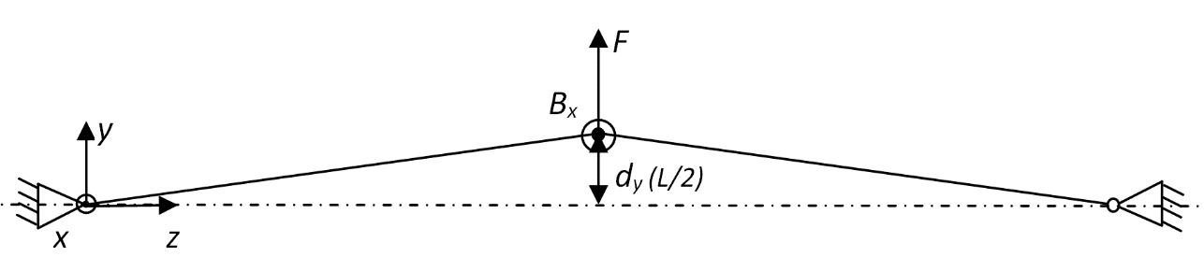
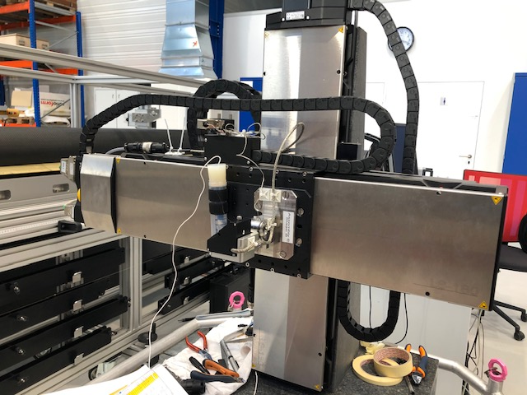
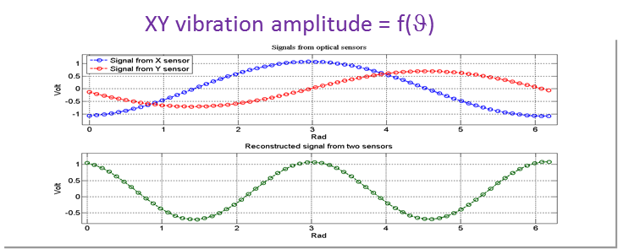
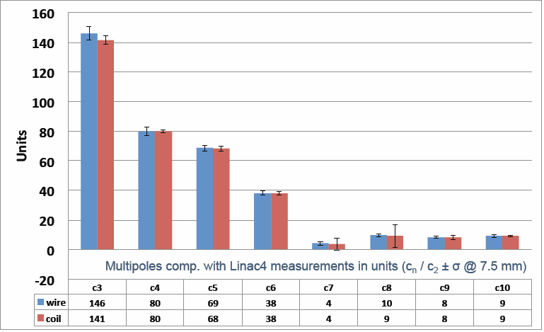
Measurement device: VW
XY micrometric stages
XY long range stages
Stretched-wire system with AC current passed through the wire → Lorentz force → oscillation ∝ BdL
zero amplitude = wire on magnetic axis
integrated harmonics by stepwise scan around a circle
Tuning of the wire detectors required to operate in the linear range
wire
XY optical wire position detectors

Slide 15
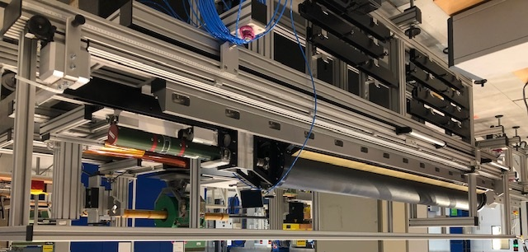
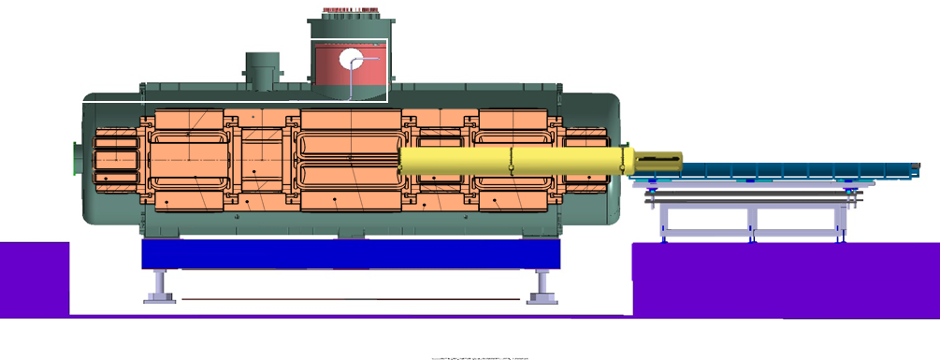
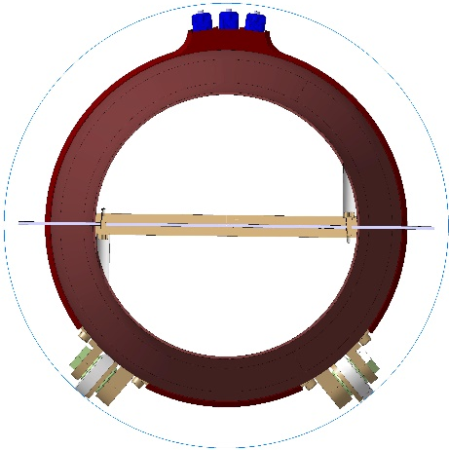
Measurement devices: Rotating coil
Rotating coils for multiplets
2.6 m rotating coil shaft with 350 mm diameter
Carbon Fibre structure
Support structure for PCB
rigidity
Weight reduction
3 PCBs
2 x 1.326 m length
1 x 0.1 m length
5 Radial coils
72 turns 6 layers
External radius 167 mm

Slide 16


Measurement devices: Rotating coil
2D ideal rectangular rotating
coil geometry
integration constant: lost with fixed coil measurements,
irrelevant (unphysical) for rotating coils
integration bounds
set by precise angular encoder
→ rotation speed fluctuations
have negligible effects
measured flux depends
on both the field
and coil geometry
Fourier component of the flux
absolute
$C_{n}=\frac{2}{N}r_{ref}^{n−1}\frac{Ψ_{n+1}}{{ A}_{c}r_{c}^{n−1}}$ [T @ r_{ref} ]
Normalized
(from absolute)
$c_{n}={10}^{4}\frac{C_{n}}{C_{main}}$ [units @ r_{ref}]
Coil area
Coil rotation radius
Area and radius need to be calibrated…

Slide 17
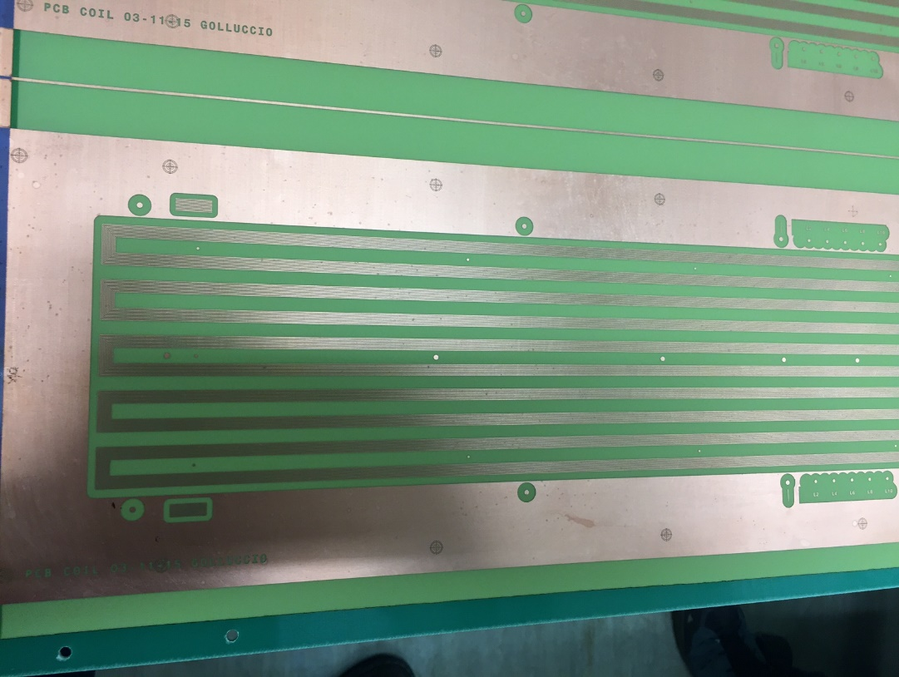
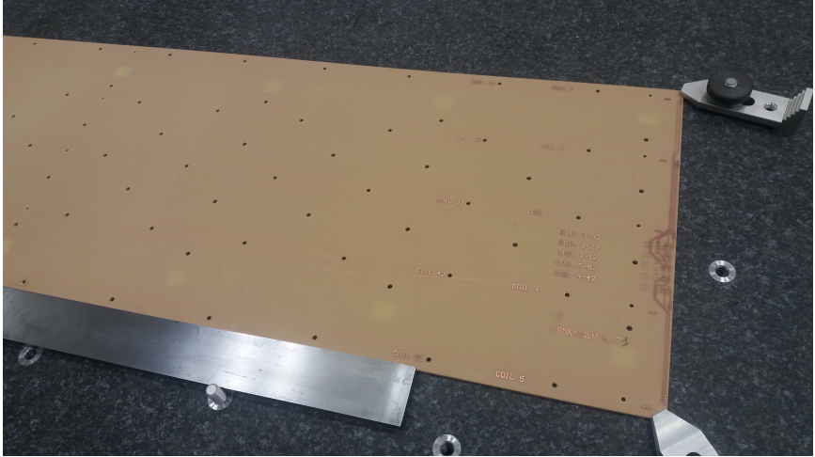
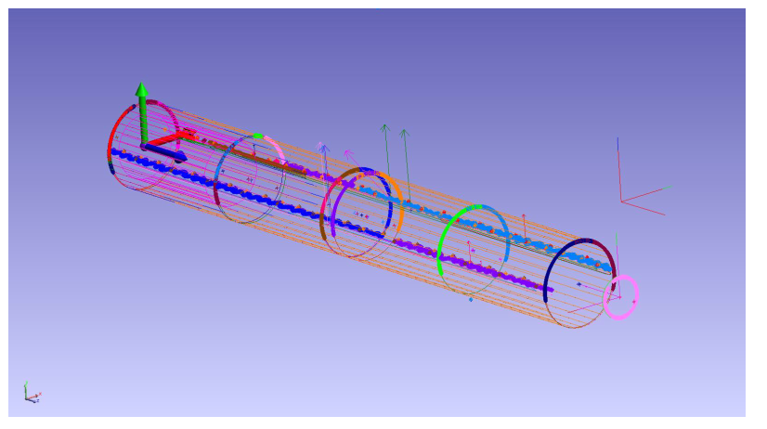
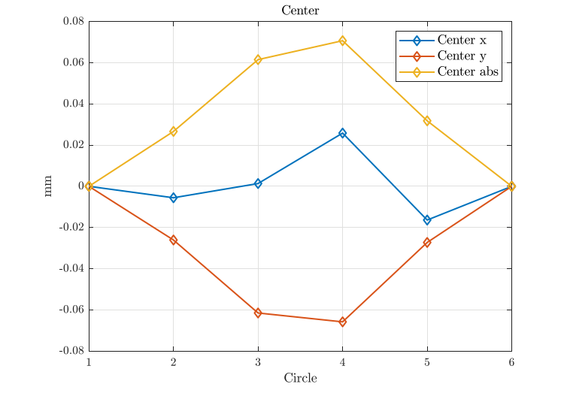
Measurement devices: Rotating coil
Rotational radius calibration:
Not possible with standard procedures:
Average radius calibration will be done in situ calibration with SSW
crosscheck with mechanical measurements (metrology and laser tracker)

Slide 18
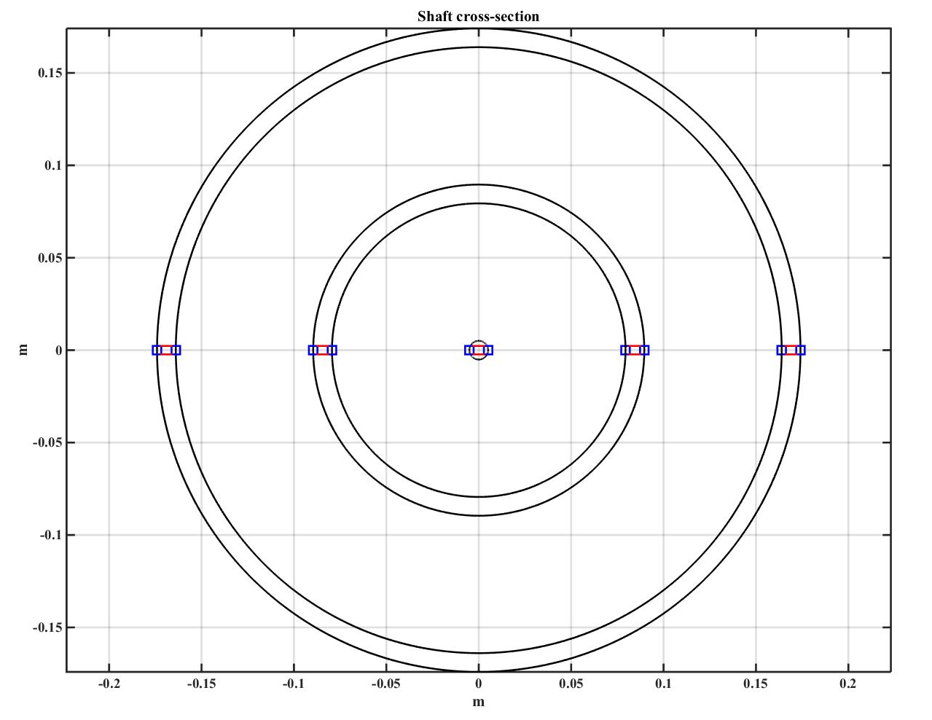
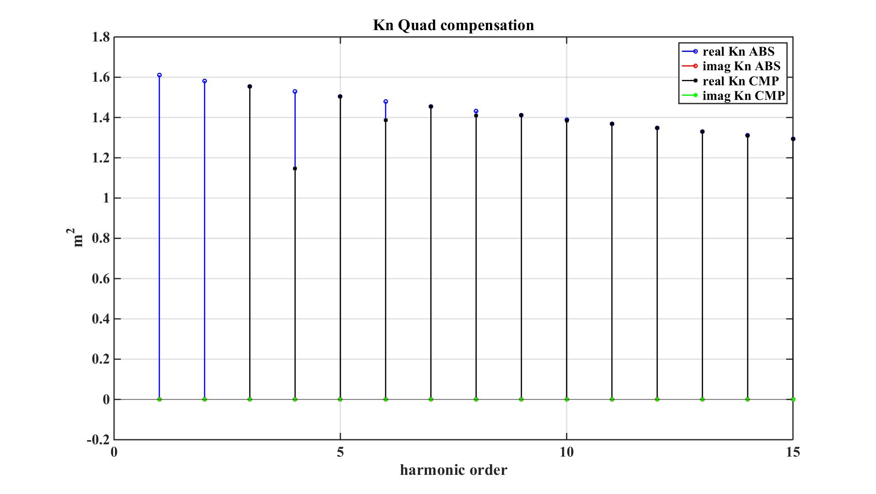
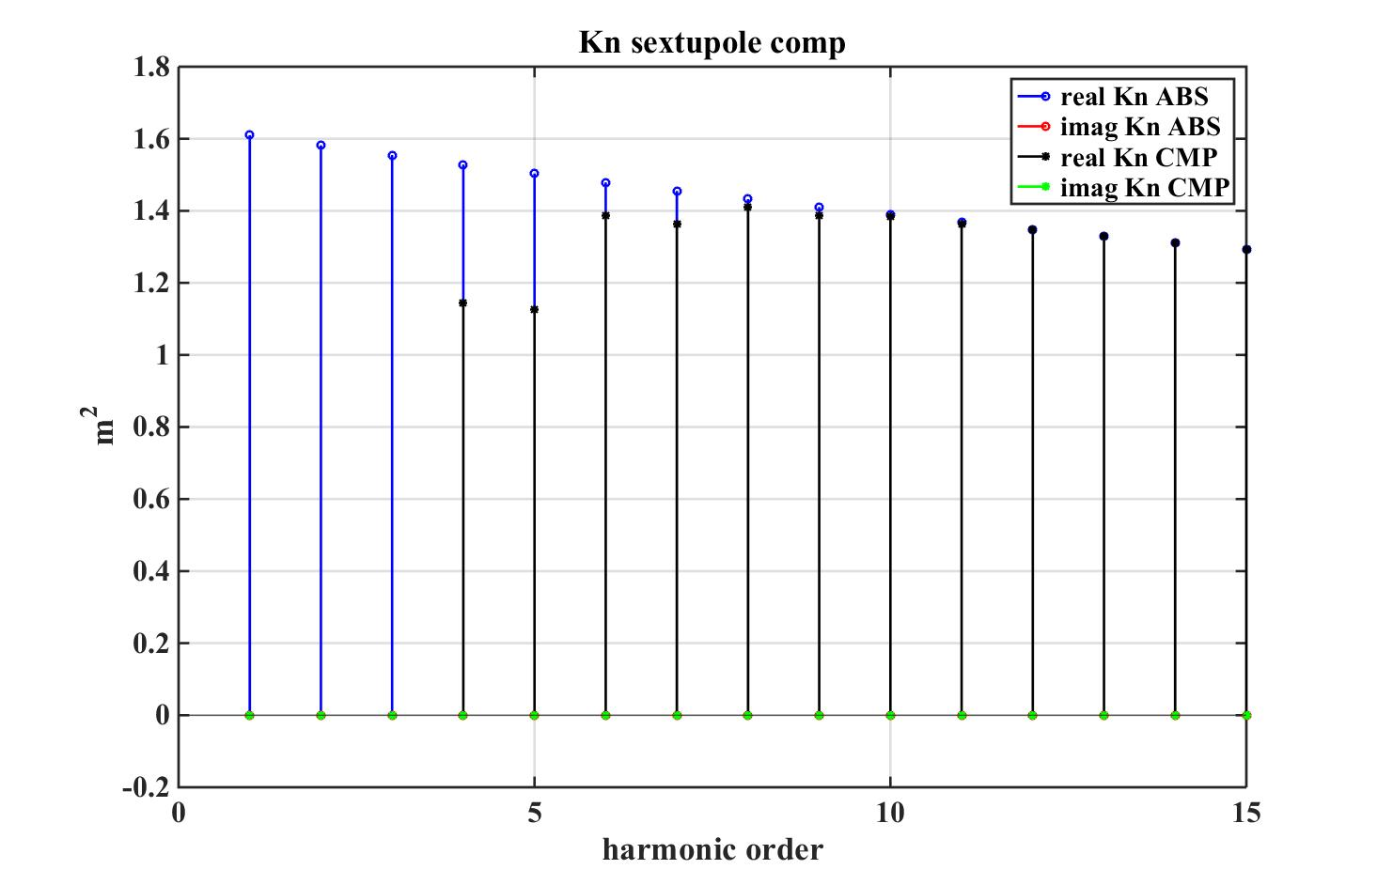
Measurement devices: Rotating coil
Coil bucking for improving sensitivity to higher order harmonics:
A-B-C+D Remove dipole and quadrupole component
A-3B+3C+D Remove dipole, quad and sextupole component
(the factor 3 can be obtained using the inner layer of the pcbs)
E
D
C
B
A
Total surface
1.40203 m²
Two layers
0.46736 m²
Deviation from design values in 10⁻⁴
A (absolute) | -0.5 | 1.3
B | -1.2 | 1.3
C | -0.3 | 0.0
D | -1.4 | 0.6
E(spare) | -1.8 | -2.5

Slide 19
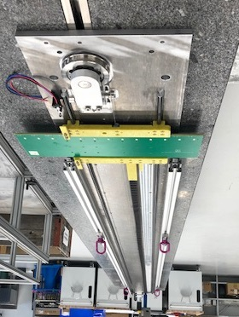
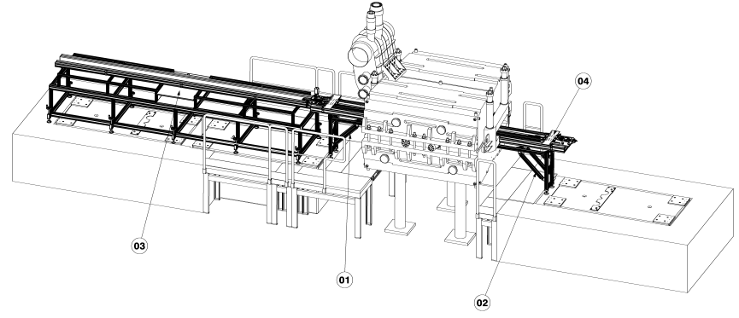
Measurement devices: Translating fluxmeter
4 m measurement length translating fluxmeter for dipoles
PCB plate with
13 coils of 0.6 m²
1D Hall probe for offset adjustment
Aluminium structure
Guiding system
Non magnetic linear encoder (5 um resolution MicroE MII6000)
5 m Aluminium encoder scale tape

Slide 20
Measurement devices: Translating fluxmeter
An array of coils translating along z
Voltage output:
field at the point nΔz :

Slide 21
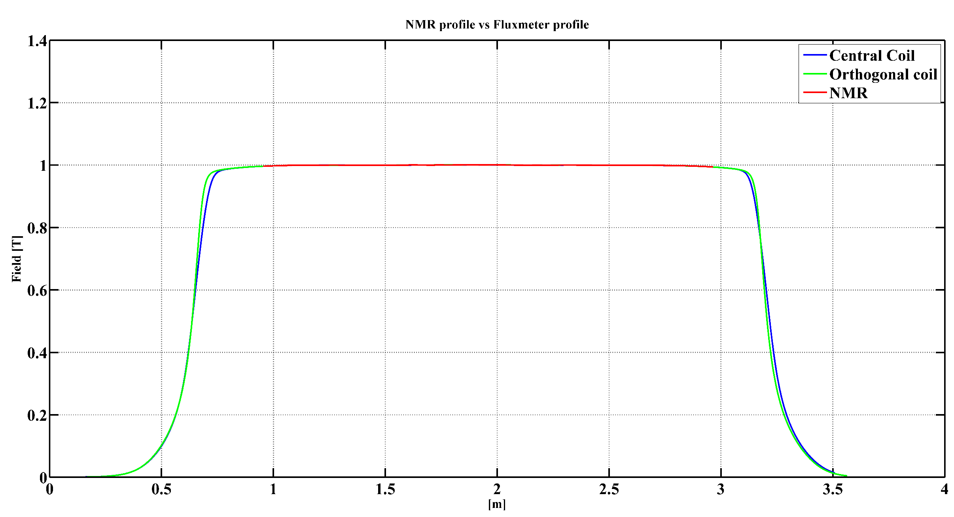
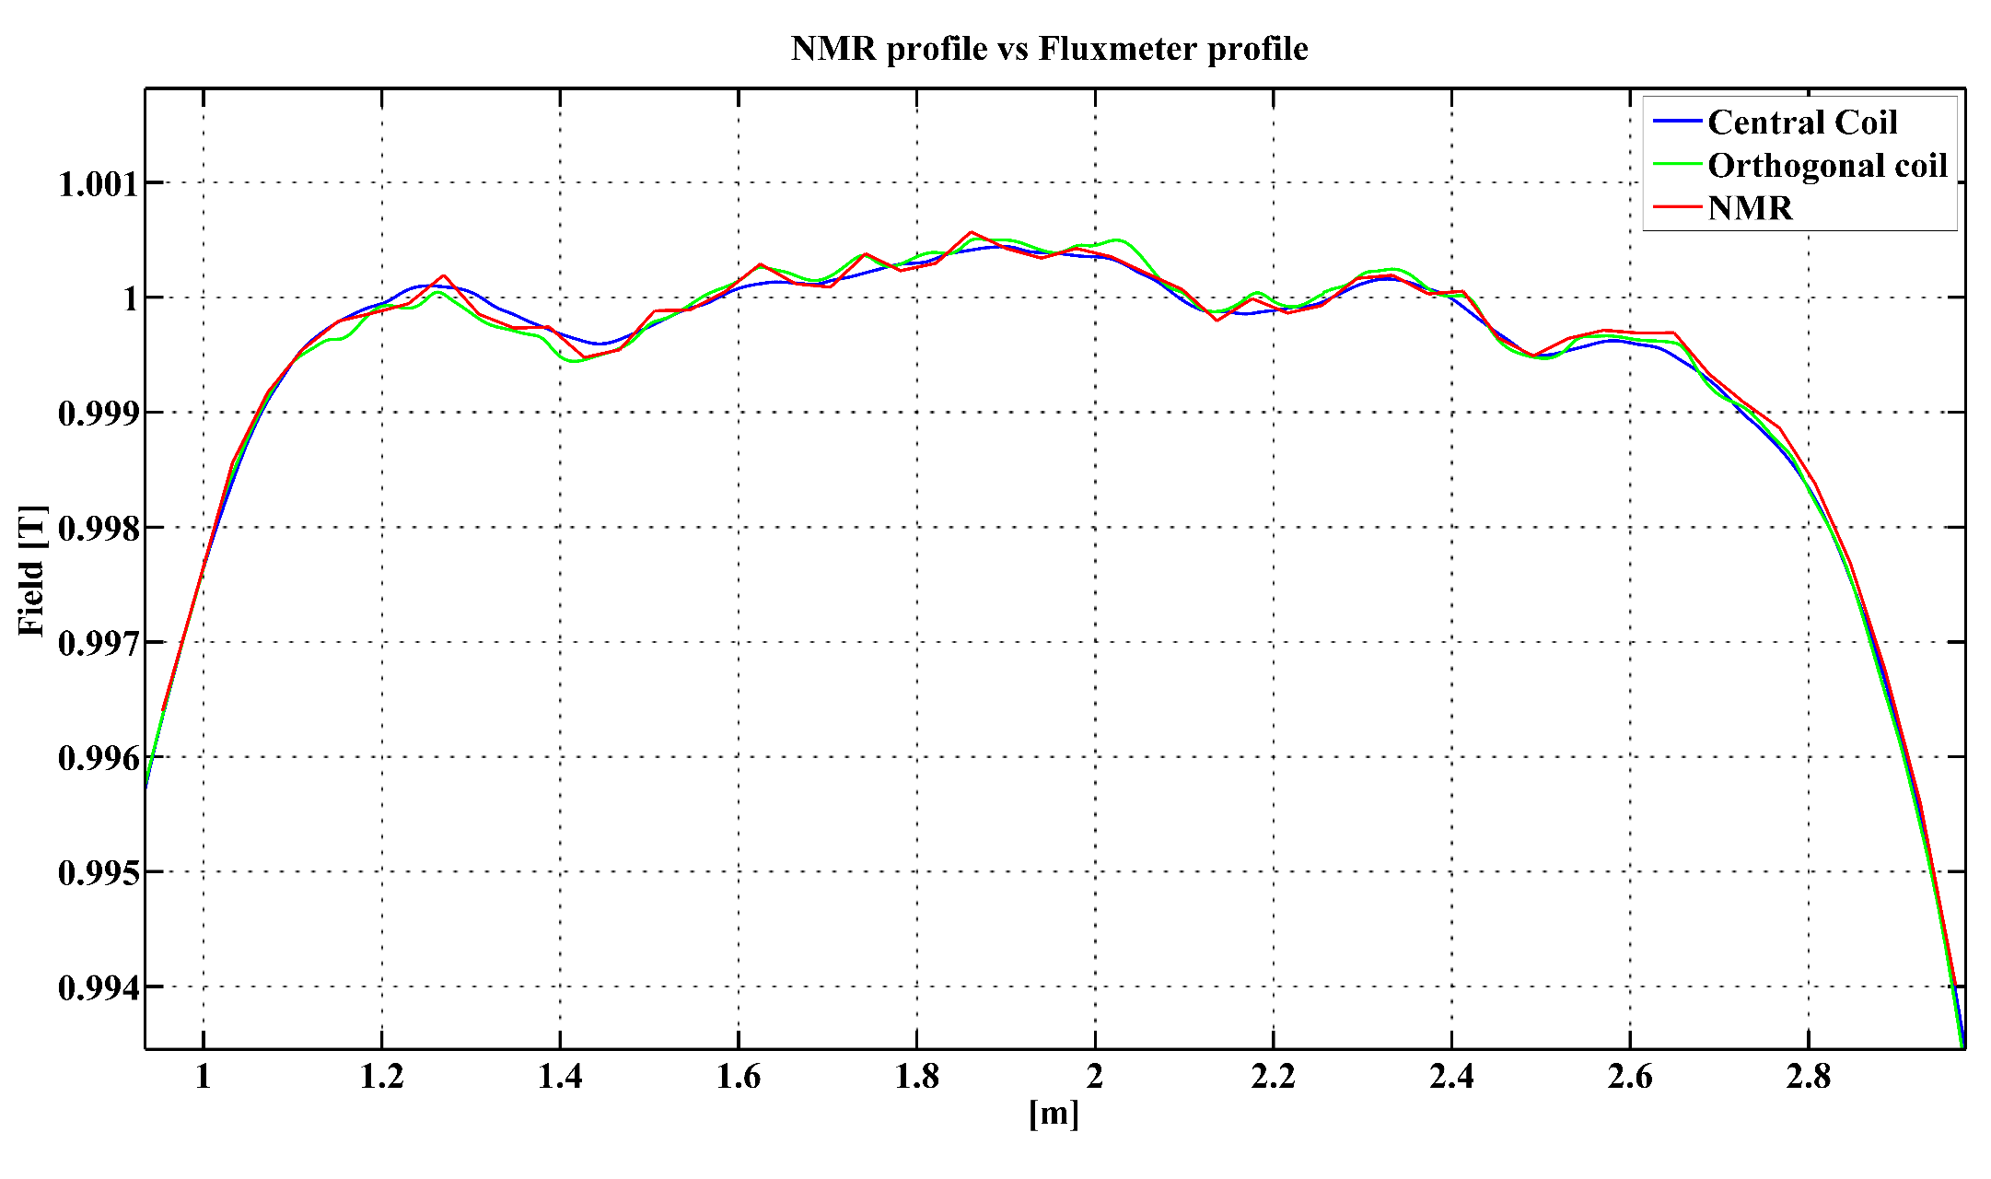
Measurement devices: Translating fluxmeter
Measurement from a prototype system:
102 mm coil
10 mm coil
NMR
102 mm coil
10 mm coil
NMR

Slide 22
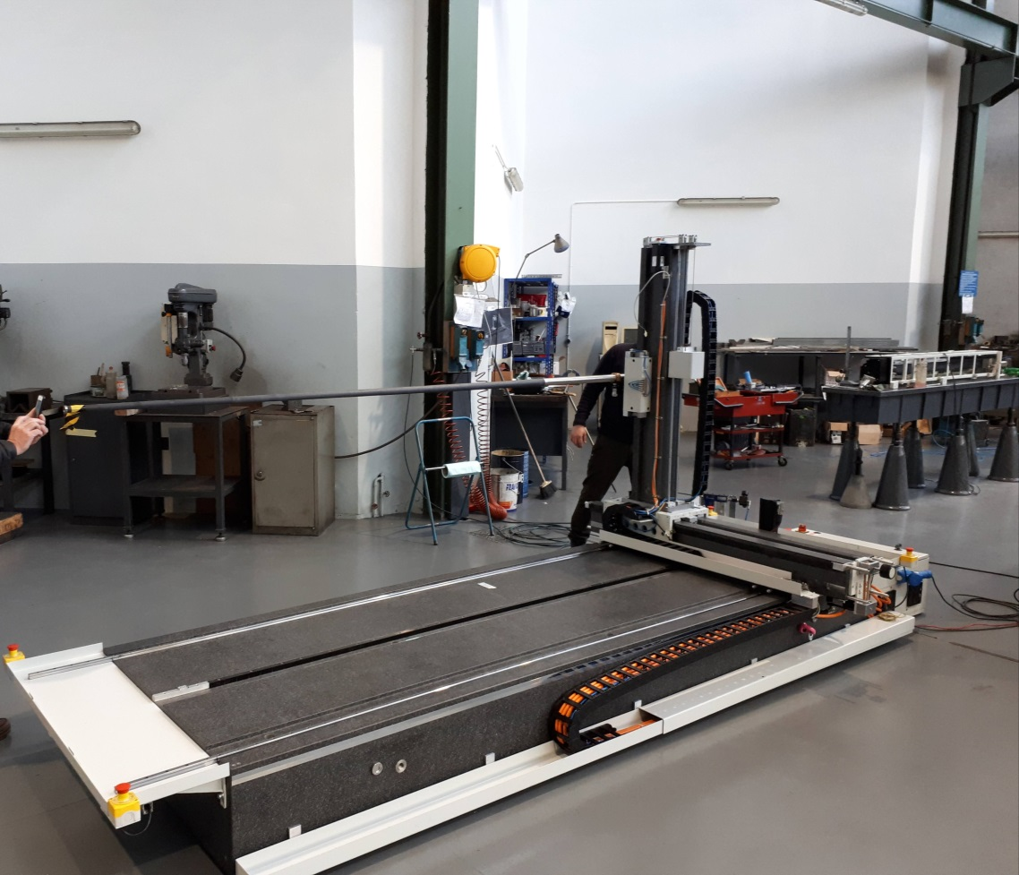
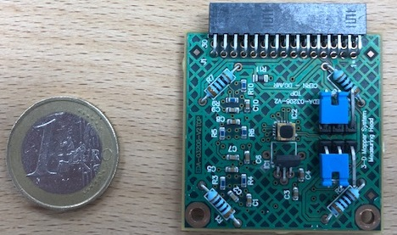
Measurement device: 3D mapper
3D mapper for dipole
3D with 3000 x 1000 x 1000 mm stroke mapper and 3D hall probe sensor
Hall probe with on board amplifiers (25 gain) and thermal regulation

Slide 23
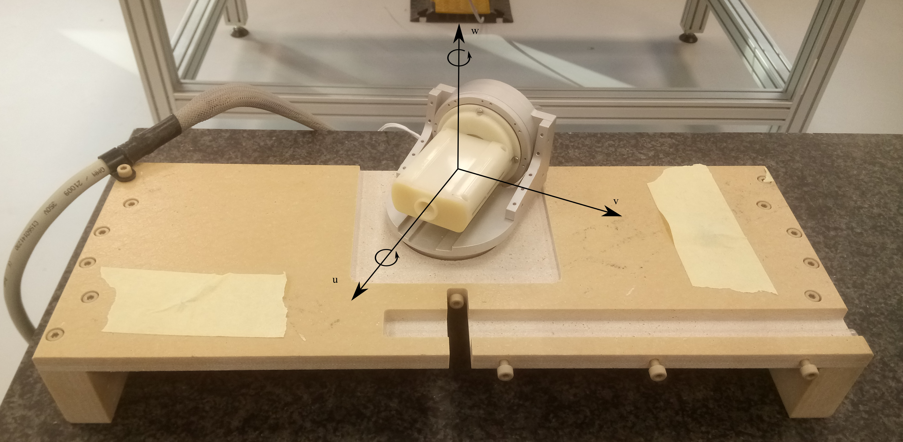


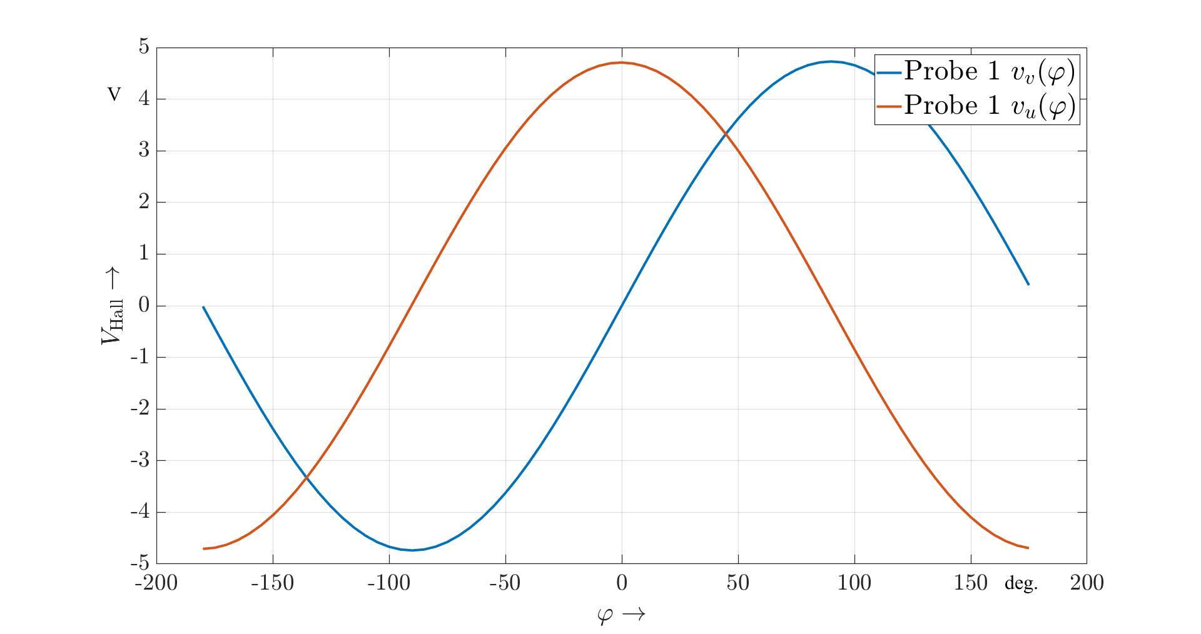
Measurement device: 3D mapper
On going:
Calibration of 3D sensors: orthogonality, linearity, planar effects
Optimization of control loop
Vibration and dumping of the measuring arm for on-fly measurements
Software for stage control and data acquisition

Slide 24
Thank you!

