Slide 1
Quench Detector Reaction Times
3rd International Workshop of the Superconducting Magnets Test Stands
University of Uppsala
Piyush N Joshi
Superconducting Magnet Division
Brookhaven National Laboratory. NY
June 12, 2019

Slide 2
Content
Magnet protection system
Time analysis of events during quench
Threshold detection
Firing of CLIQ
Firing of quench heaters
Activation of Energy Extraction

Slide 3
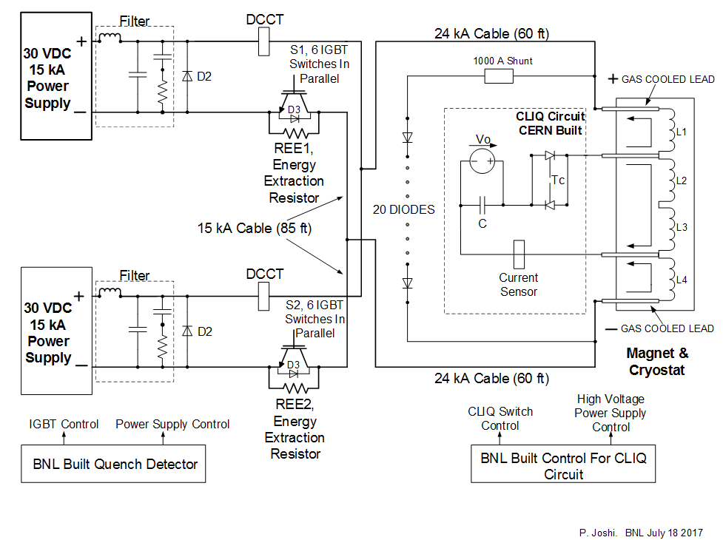
Magnet Protection System

Slide 4
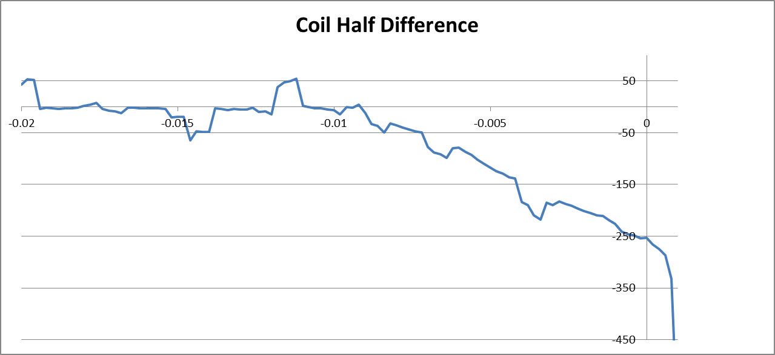
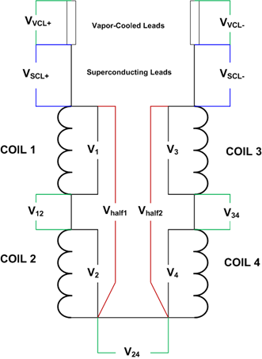
Basis Quench detector
Coil L1L2
Trig to Fast Logger
Trig to CLIQ
Trig to EE
Trig to Quench Heater PS
Trig to Magnet PS
Trig to Cryo System
Half coil
voltages
FPGA based
Quench Detector
Opto
Isolators
Coil L3L4
Coil Diff Threshold = 150mV
Validation time = 4ms
mV
seconds
4ms

Slide 5
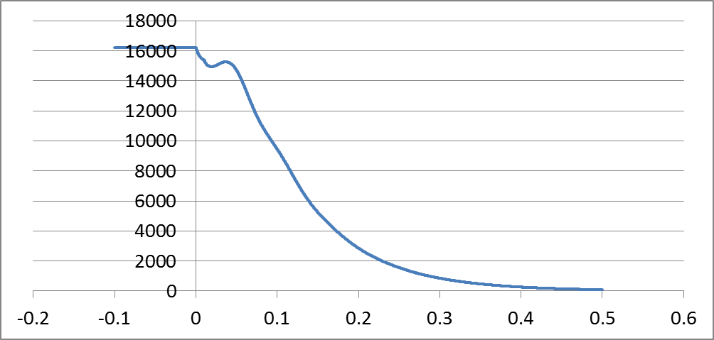
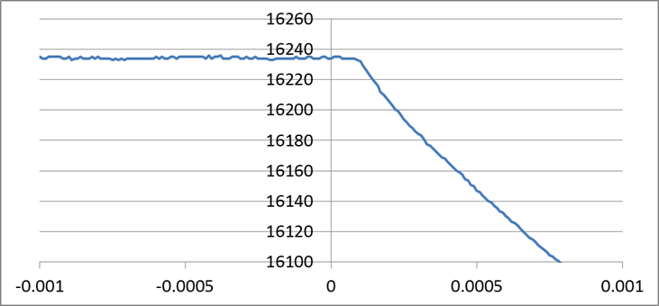
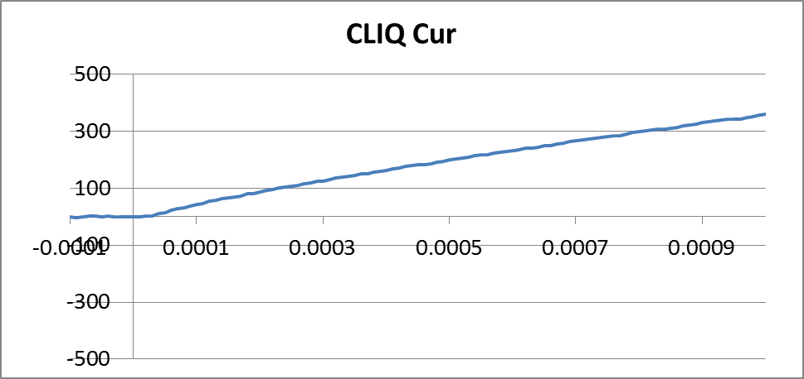
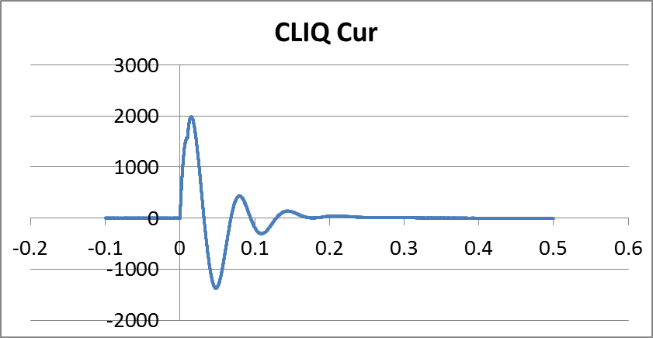
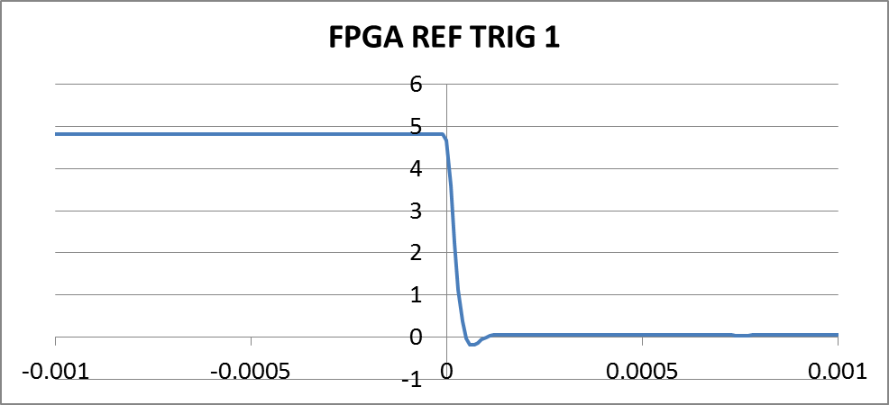
Firing of CLIQ
80µs
Magnet Current
Magnet Current
30µs
second
second

Slide 6
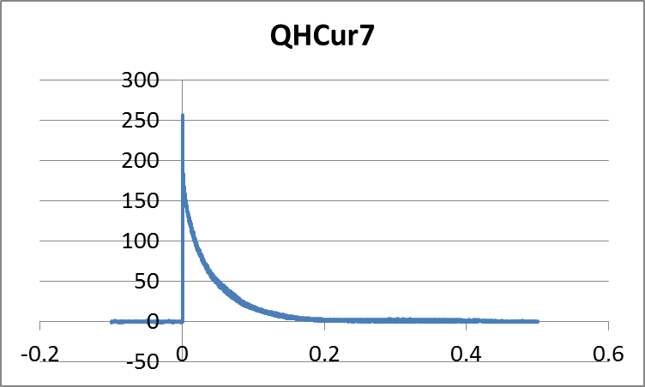
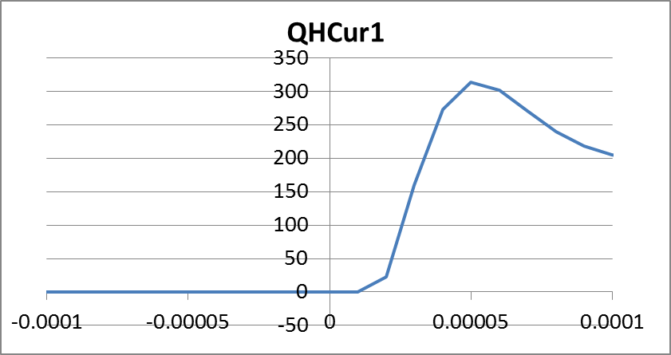
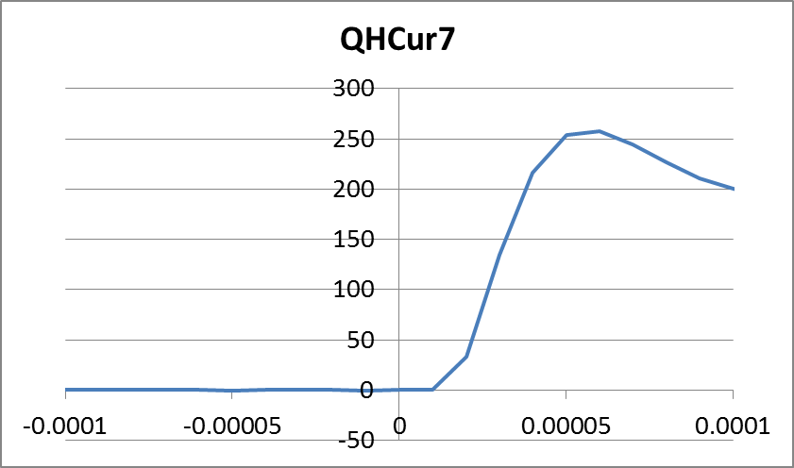
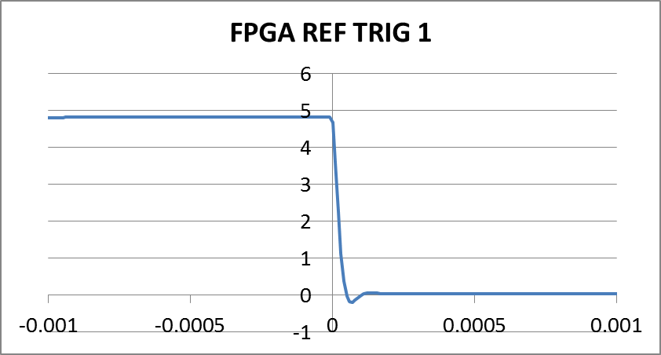
Firing of Quench Heaters
10µs

Slide 7
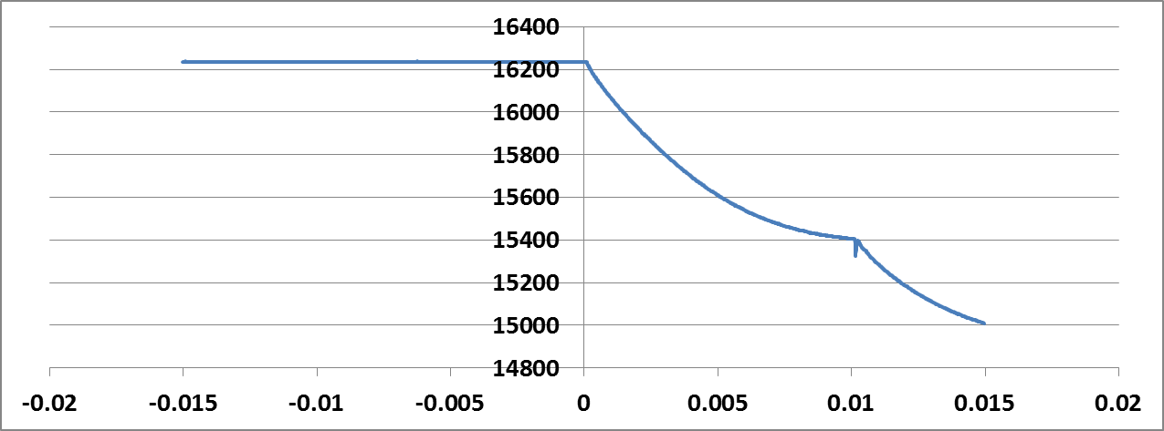
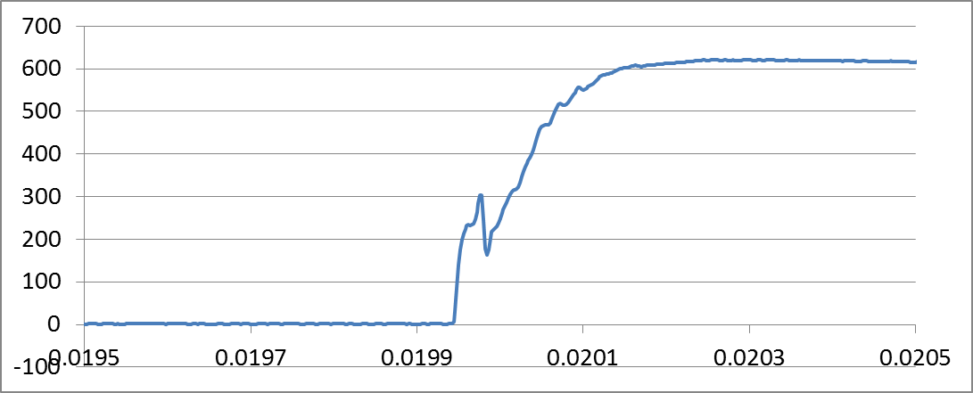
Activation of Energy Extraction
200µs
Magnet Current
A
Vce1
second
Energy Extraction Delayed by 10ms
Voltage across IGBT

Slide 8
Thanks for your attention
Any ?

