Slide 1
Mechanical measurements in test stands Optical fibers and Cloud technology M. Guinchard
12th June 2019

Slide 2
Outline
Introduction
Optical strain measurements based on Bragg® techniques
Validation process
Magnet experience
Digital transformation

Slide 3
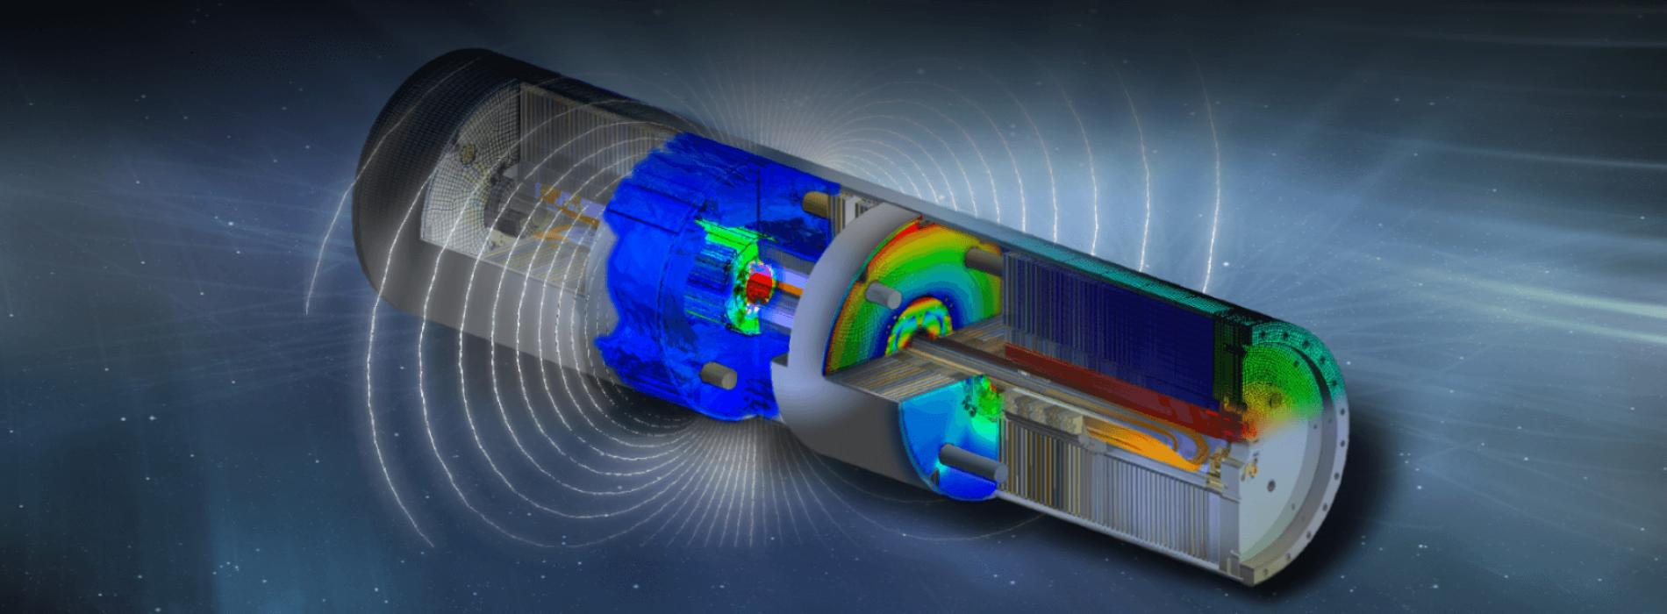
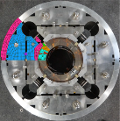
Introduction
Why perform mechanical measurements ?
Why mechanical measurements in superconducting magnets ?
Support the mechanical design during prototyping phases;
Validate Finite Element Analysis (FEA) during assembly phases, thermal cycles (down to 1.9K), powering tests and warmup;
Check the integrity of the structure during the assembly process.
Inputs for FEA :
Thermo physical properties
Mechanical properties
FEA validation & Safety

Slide 4
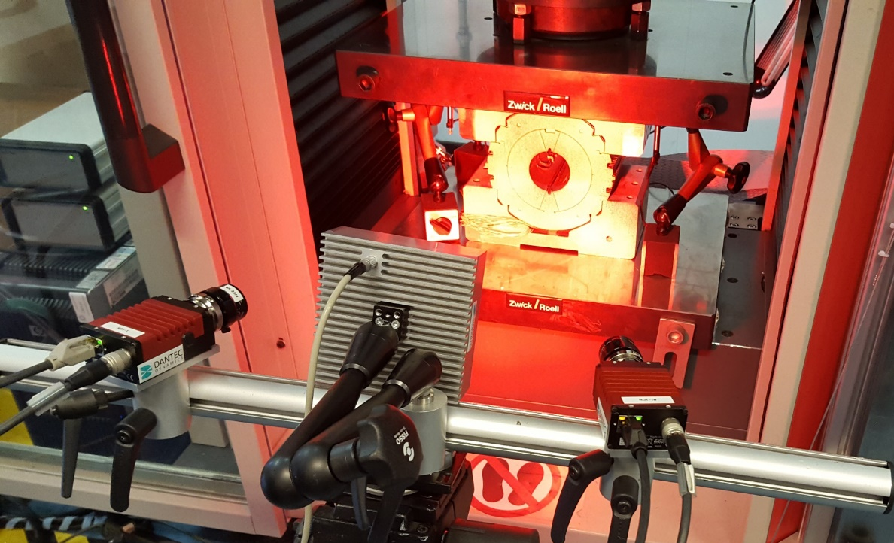
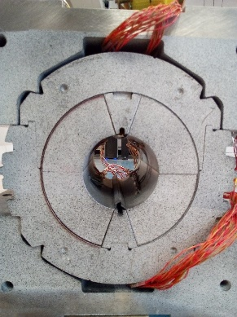
Introduction
How to perform mechanical measurements ?
Non contact video systems as Digital Image Correlation (DIC) to study collaring and mechanics, in particular coil peak stress during collaring on mock-up.
Camera#01
Lighting system
Camera#02
Useful techniques to understand the cinematic and to cross-check the standard instrumentation (electrical or optical strain gauges);
Limited to lab environmental conditions.

Slide 5
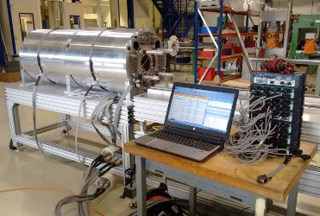
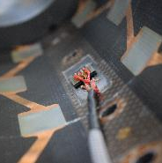
Introduction
How to perform mechanical measurements ?
Standard electrical strain gauges from 1.9K up to few hundred degrees
More than 30 years of experience of measurements in harsh conditions;
Measurement benchmark successfully done in 2017 with American lab’s;
Collaborative work with several institutes to standardized techniques and tools based on CERN experience.

Slide 6
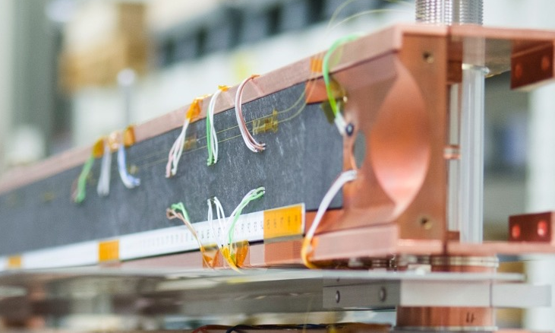
Introduction
How to perform mechanical measurements ?
Optical fiber strain gauges from 1.9K up to RT based on Bragg gratings
Well known techniques at room temperature for Civil Engineering applications;
Promising techniques for harsh environments (electro magnetic disturbances);
Distributed sensors over the full fiber length;
5 Years of study based on KT agreement with industrial researchers.

Slide 7
Optical strain measurements
Several techniques based on optical fibers (Bragg, Brillouin, Raman);
Bragg technique under validation for the moment :
Lot of advantages except the strong coupling between ε and T !
Temperature will also affect the bonding process according to the CTE of the glue and the support material itself;
Measurements in superconducting magnets request an absolute strain state measurement over the full lifetime including thermal cycles :
Request a thermal compensation to compensate the apparent strain !
ρ_{a} : Photo elastic coefficient of the fiber
: Coefficient of thermal expansion
ξ : Refractive index

Slide 8
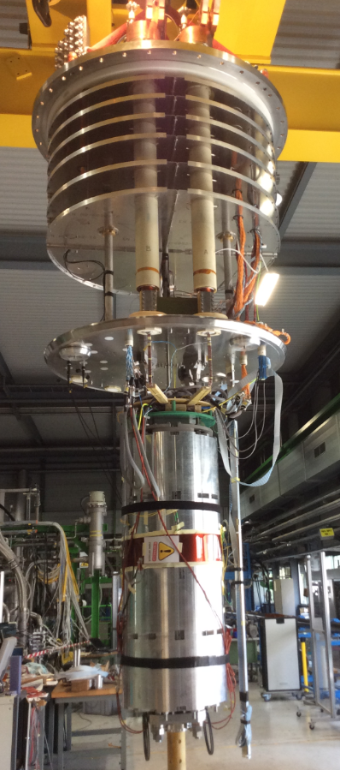
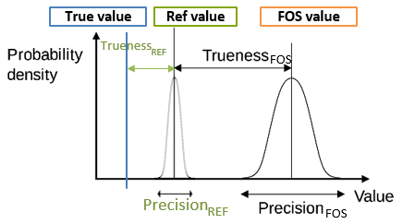
Optical strain measurements
Temperature compensation based on an external compensator in free-free stress state :
Excellent repeatability and reproducibility of the bonding process is required !
Before field implementation, several validation tests need to be performed :
Trueness determination over the temp. range to validate the measurements;
Repeatability and reproducibility determination to validate the temperature compensation.
ISO5725

Slide 9
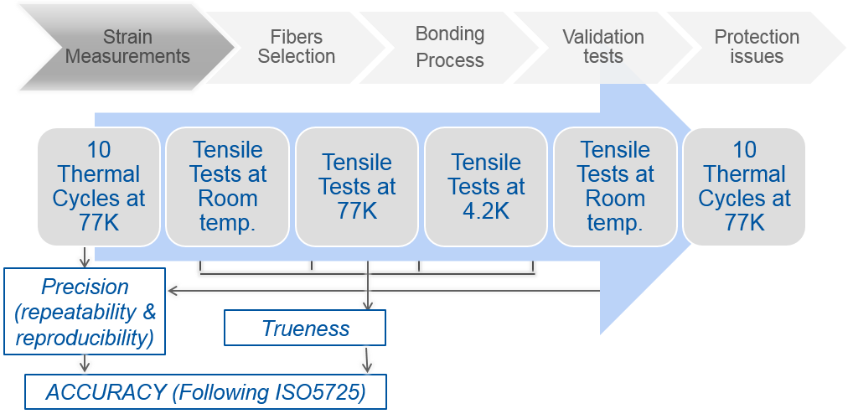
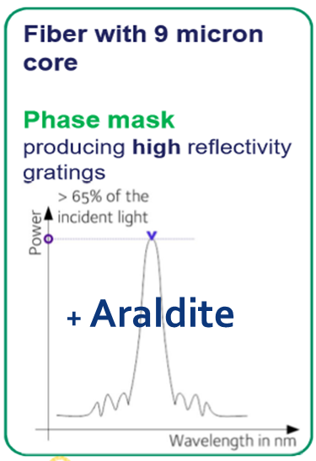
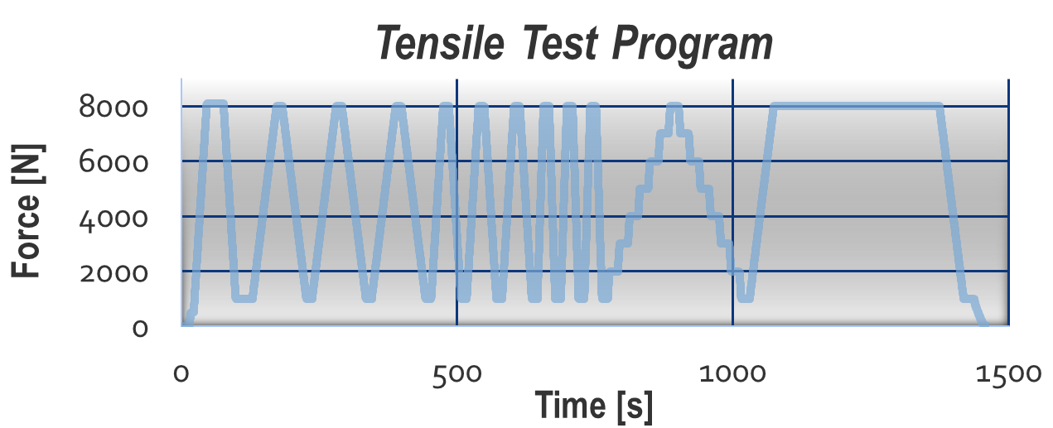
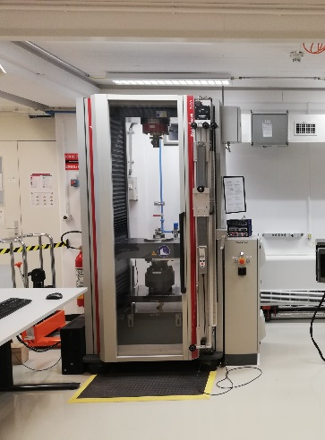
Optical strain measurements
Validation process :
Tensile test machines: Zwick/Roell® Z400 for tests down to 4.2 K;
AISI 304L flat dog-bone specimens;
2 FBG/side, polyimide coated, 5 mm gage length, 60% reflectivity;
Commercial glues were used: Vishay® M610 & Araldite®;
Precision estimated by measuring the apparent strain at 77 K;
Trueness estimated by evaluation of Young Modulus (ASTM E111-04).

Slide 10
Optical strain measurements
Precision results :

Slide 11
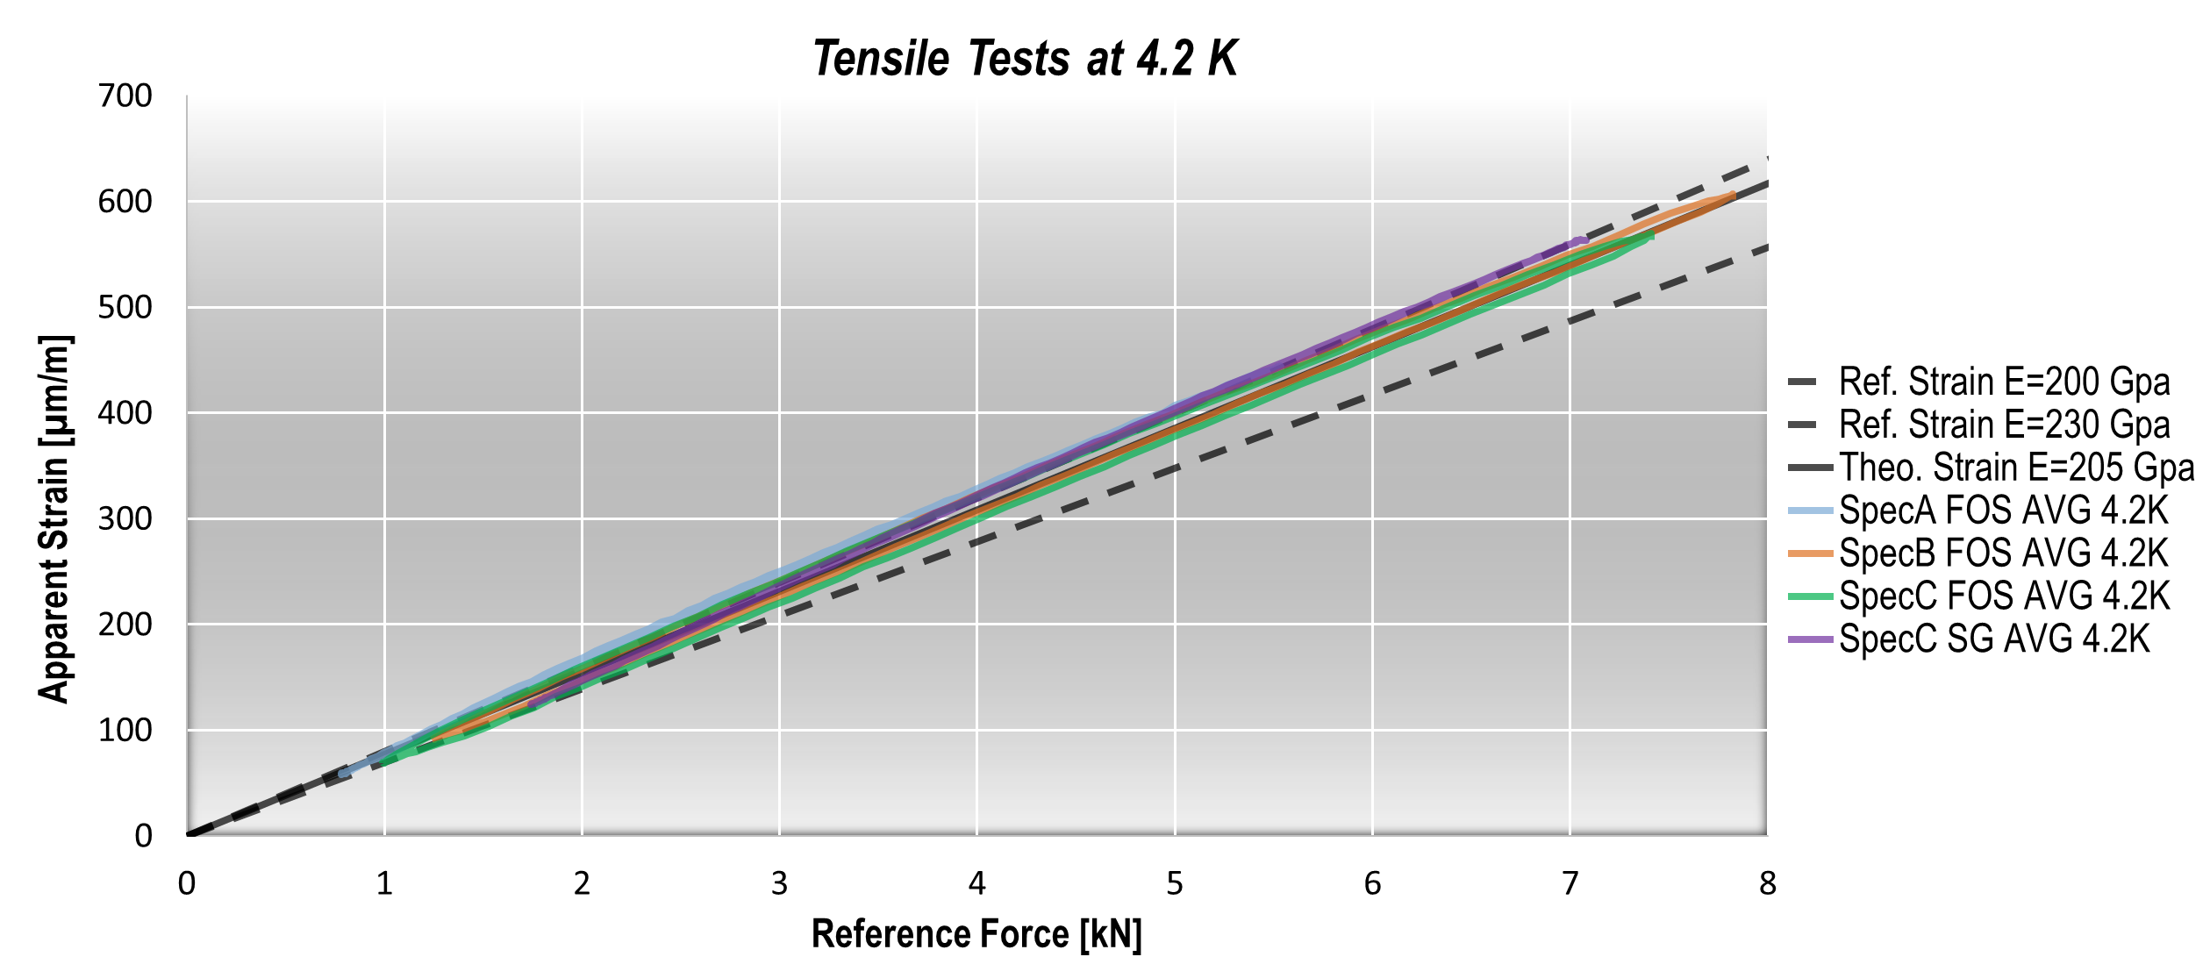
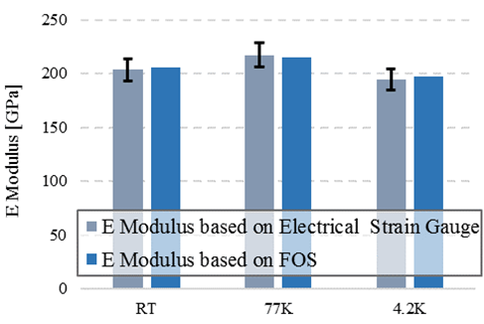
Optical strain measurements
Trueness results:

Slide 12
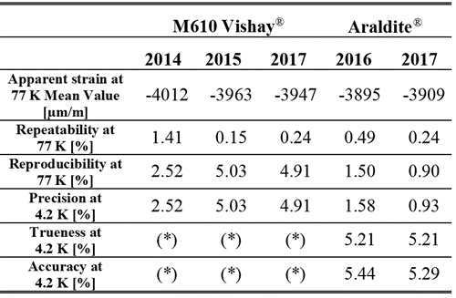
Optical strain measurements
Precision and trueness results:
More information :

Slide 13
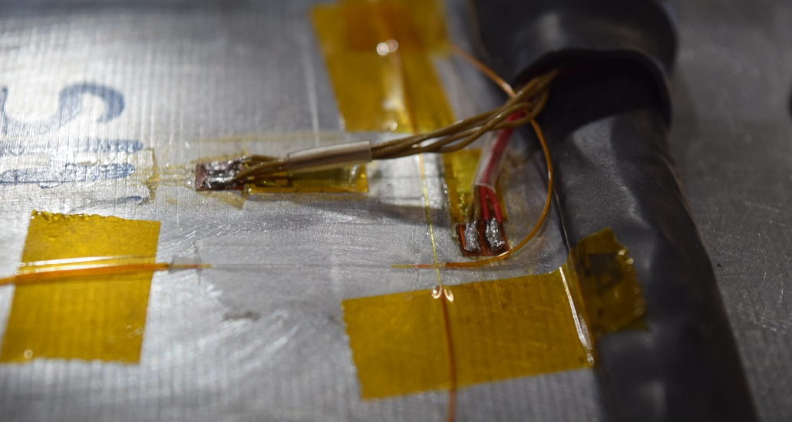
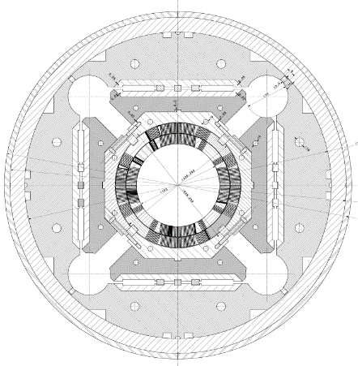
Optical strain measurements
Magnet application – MQXFS Magnet
SHT
RDZ
RAZ
CO204
CO205
SHL
SHR
CO206
CO203
RCZ
RBZ
SHB
Electrical + Optical strain gauges

Slide 14
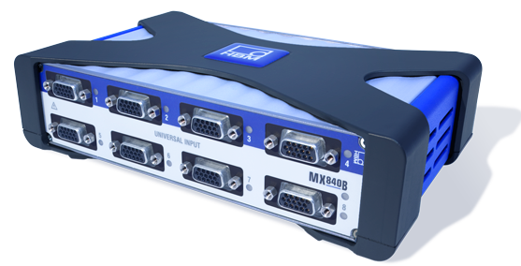
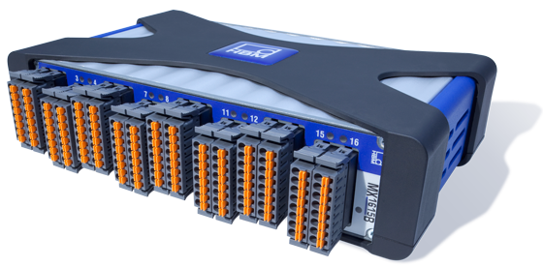
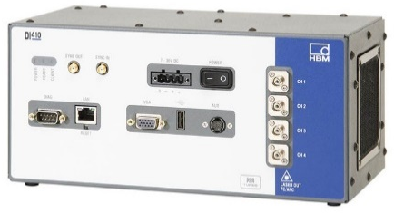
Hybrid system
Mechlab Server
Catman files
Continuous storage
MX840 for SG reading
Settings
Data
MX1615 for SG reading
SM18 Test Server
Text files created after each quench
DI405 for FBG reading

Slide 15
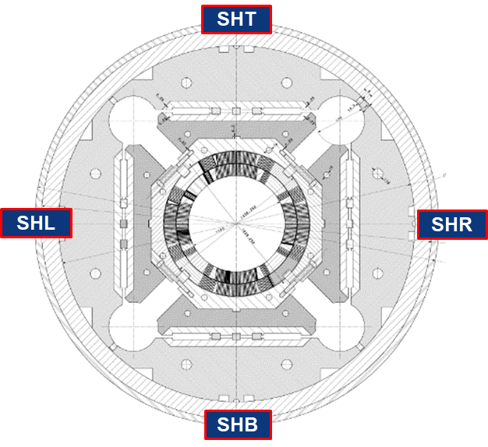
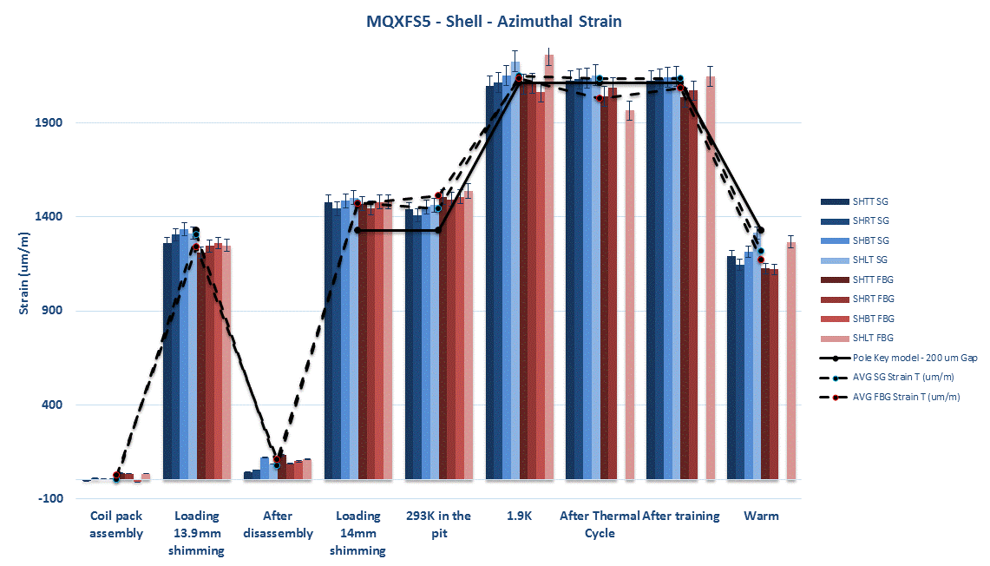
Optical strain measurements
Magnet application – MQXFS Magnet

Slide 16
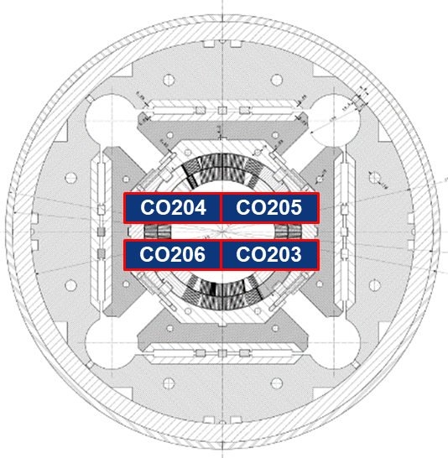
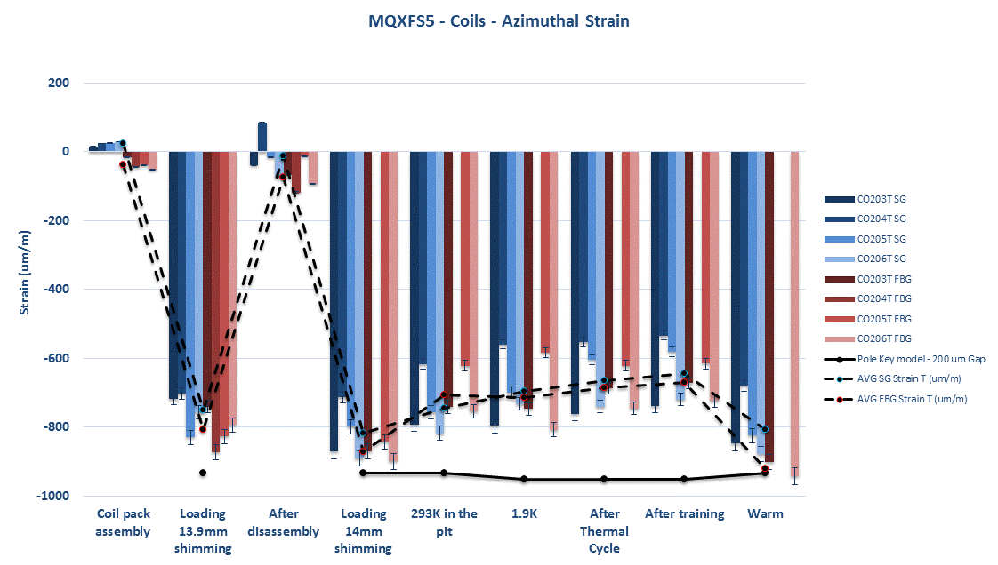
Optical strain measurements
Magnet application – MQXFS Magnet

Slide 17
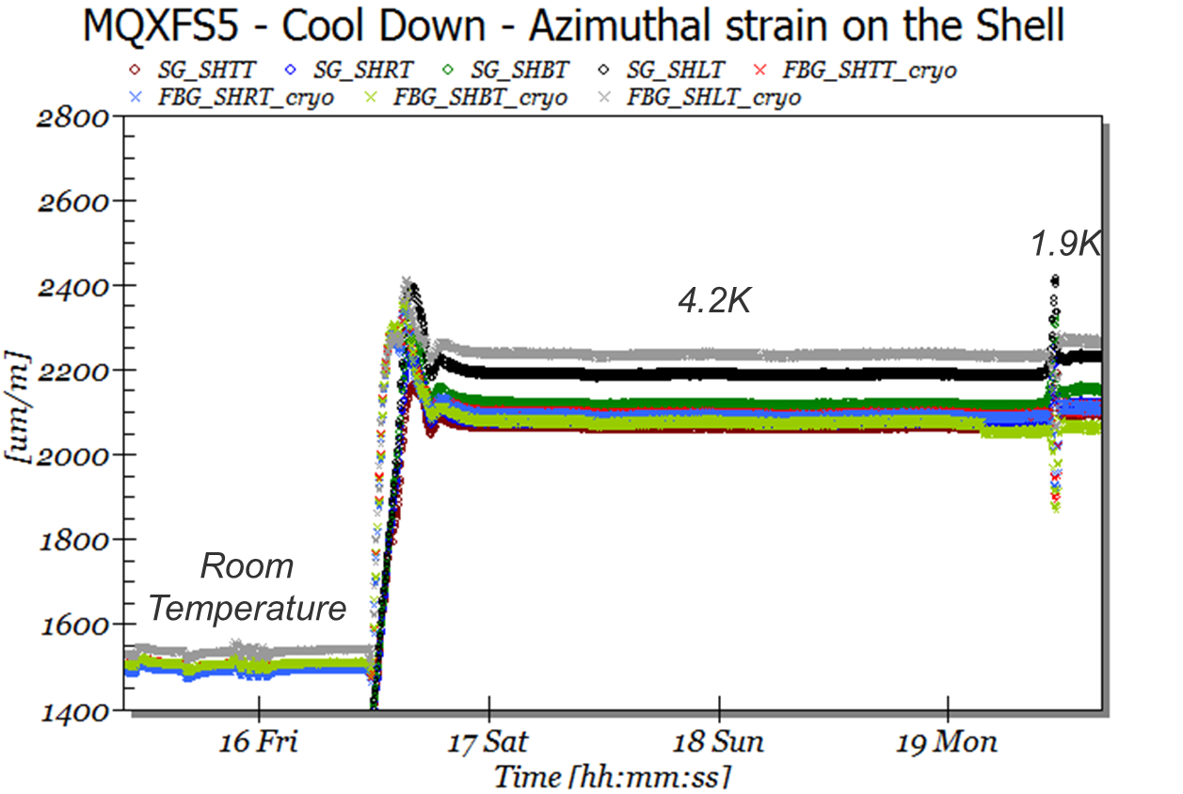
Optical strain measurements
Magnet application – MQXFS Magnet
Assembly process at RT
Cool-down process down to 1.9K

Slide 18
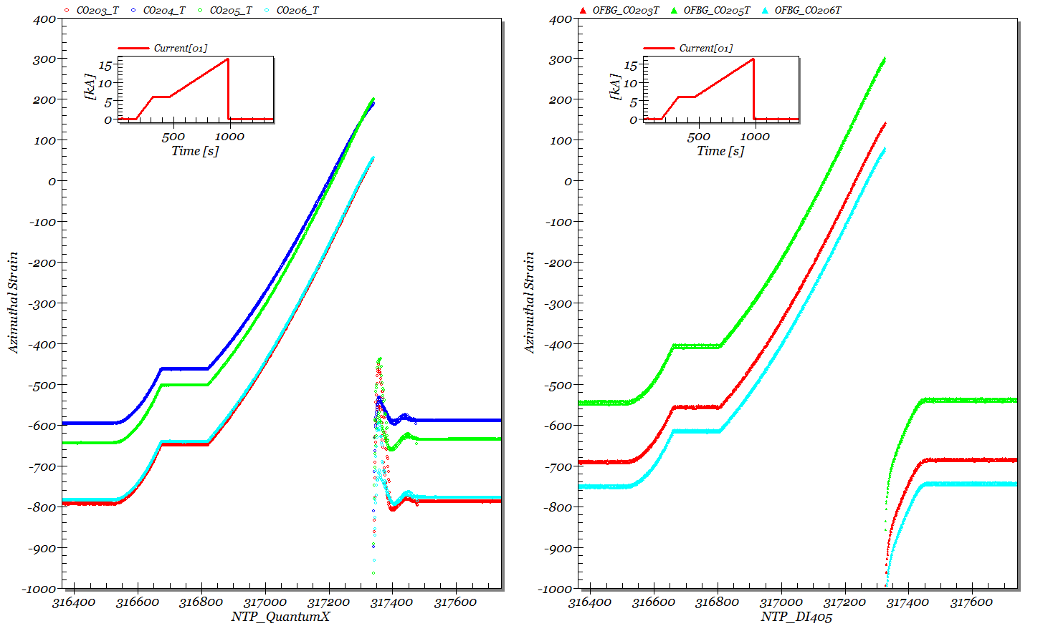
Optical strain measurements
Magnet application – MQXFS Magnet
Powering test at 1.9K

Slide 19
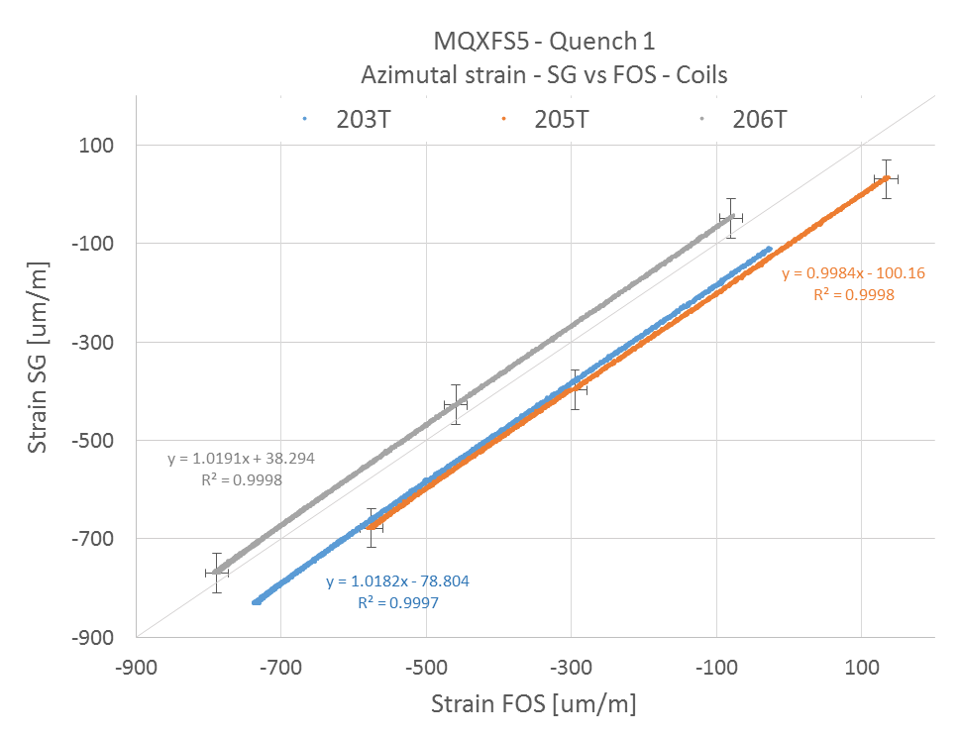
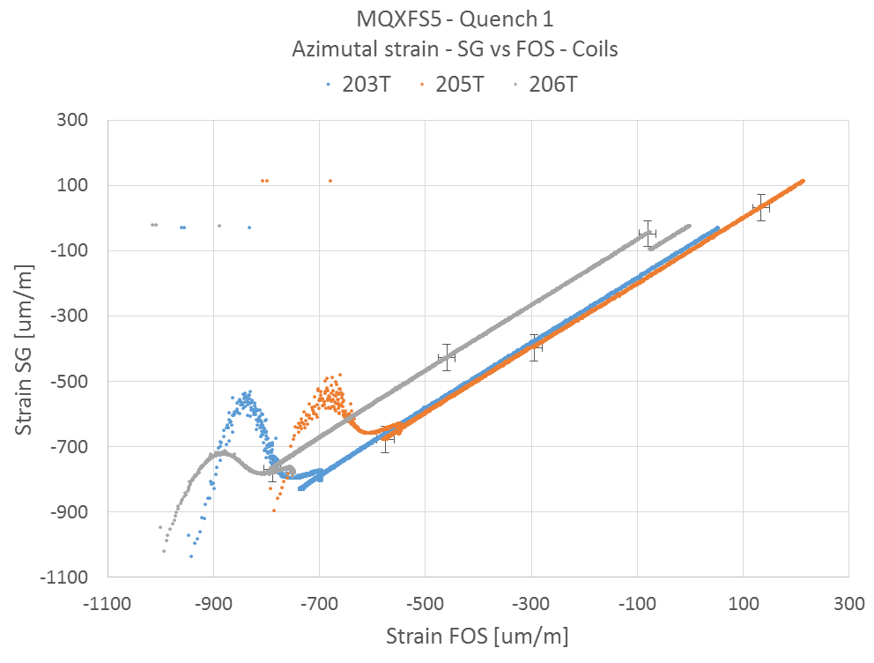
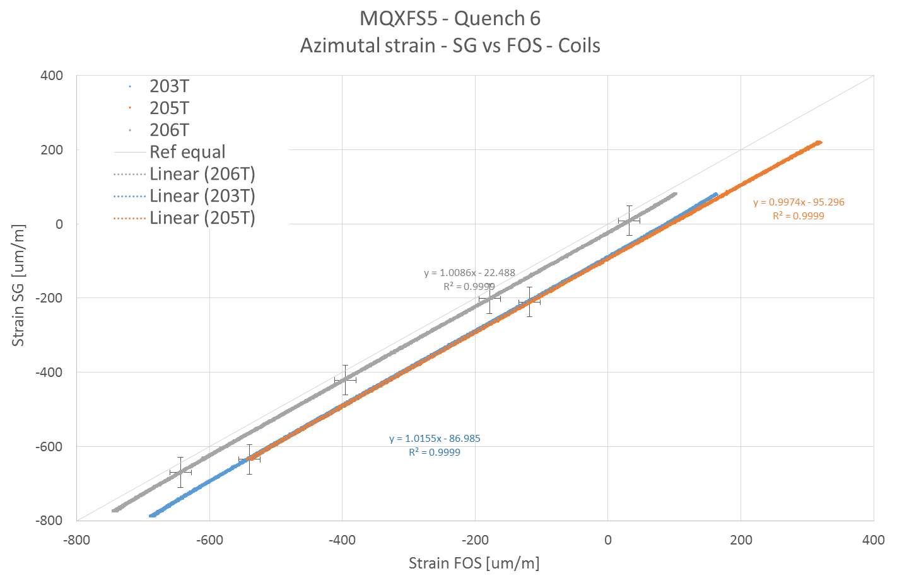
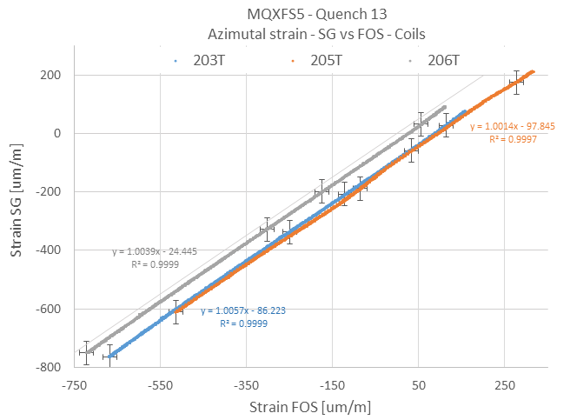
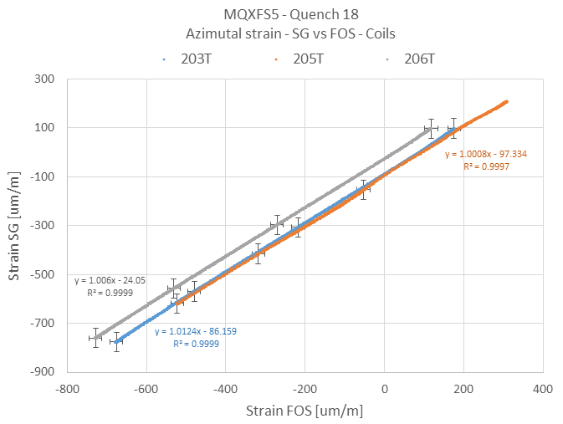
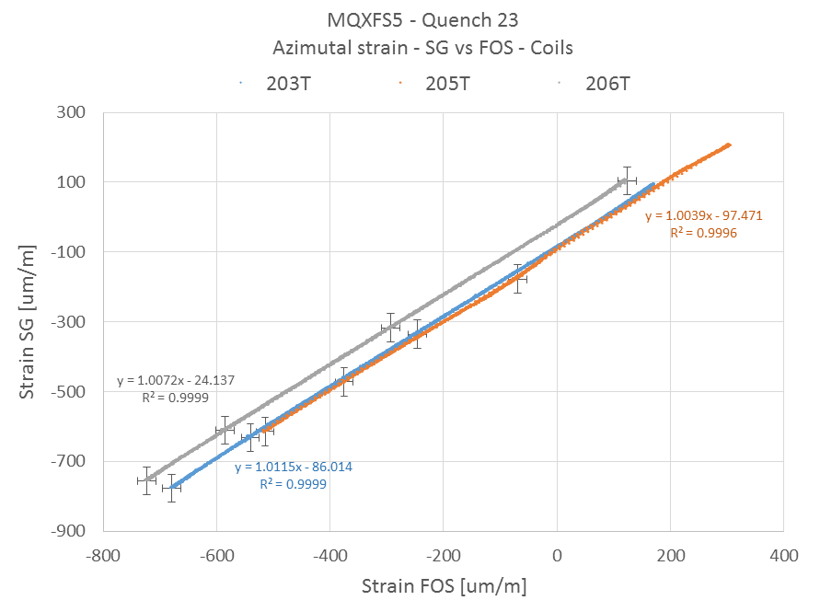
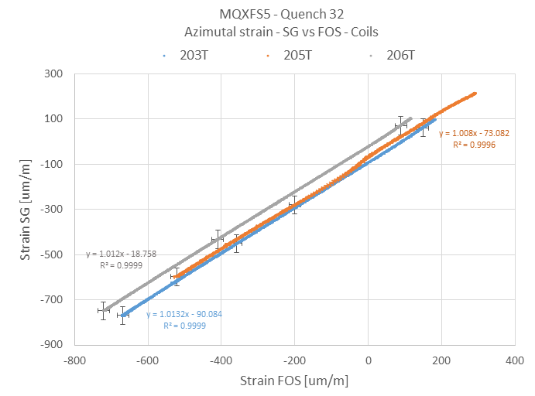
Optical strain measurements
Magnet application – MQXFS Magnet
Powering test at 1.9K

Slide 20
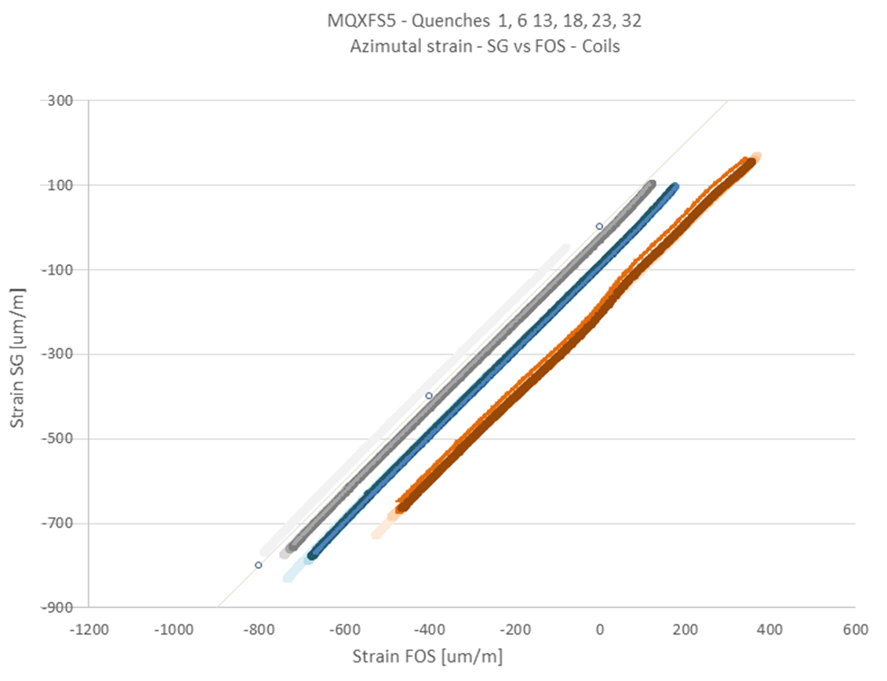
Optical strain measurements
Magnet application – MQXFS Magnet
Powering test at 1.9K
 | Ratio SG vs FBG
Quench # | 203T | 205T | 206T
1 | 1.0182 | 0.9984 | 1.0191
6 | 1.0155 | 0.9974 | 1.0086
13 | 1.0057 | 1.0014 | 1.0039
18 | 1.0124 | 1.0008 | 1.006
23 | 1.0115 | 1.0039 | 1.0072
32 | 1.0132 | 1.008 | 1.012
 | R2
Quench # | 203T | 205T | 206T
1 | 0.9997 | 0.9998 | 0.9998
6 | 0.9999 | 0.9999 | 0.9999
13 | 0.9999 | 0.9997 | 0.9999
18 | 0.9999 | 0.9997 | 0.9999
23 | 0.9999 | 0.9996 | 0.9999
32 | 0.9999 | 0.9996 | 0.9999

Slide 21
Optical strain measurements- conclusion
The precision of the bonding procedure of optical fiber sensors was established according to ISO 5725;
The trueness was evaluated down to 4.2 K: the results confirmed the capability of the optical strain sensors based on Bragg grating to measure down to 4.2 K with an accuracy below 5.5% according to ISO 5725;
A first superconducting magnet was successfully equipped with mirror instrumentation : electrical and optical strain sensors;
Measurements done during assembly, cooldown and powering phases confirmed the validity of the optical strain sensors for superconducting magnet applications;
Additional studies are on going to improve the fiber protection, splicing operation for cryogenic applications, etc…

Slide 22
Digital transformation
The Digital Transformation Revolution occurs everywhere !

Slide 23
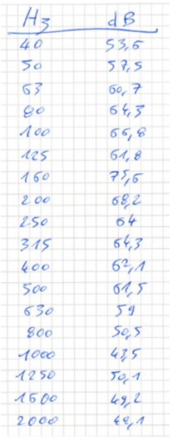
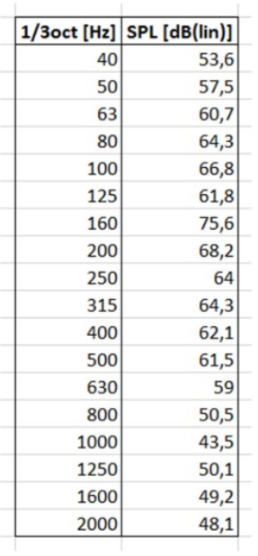
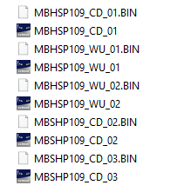
Digital transformation
V4.0
Added information
Added information
V1.0
V2.0
V3.0

Slide 24
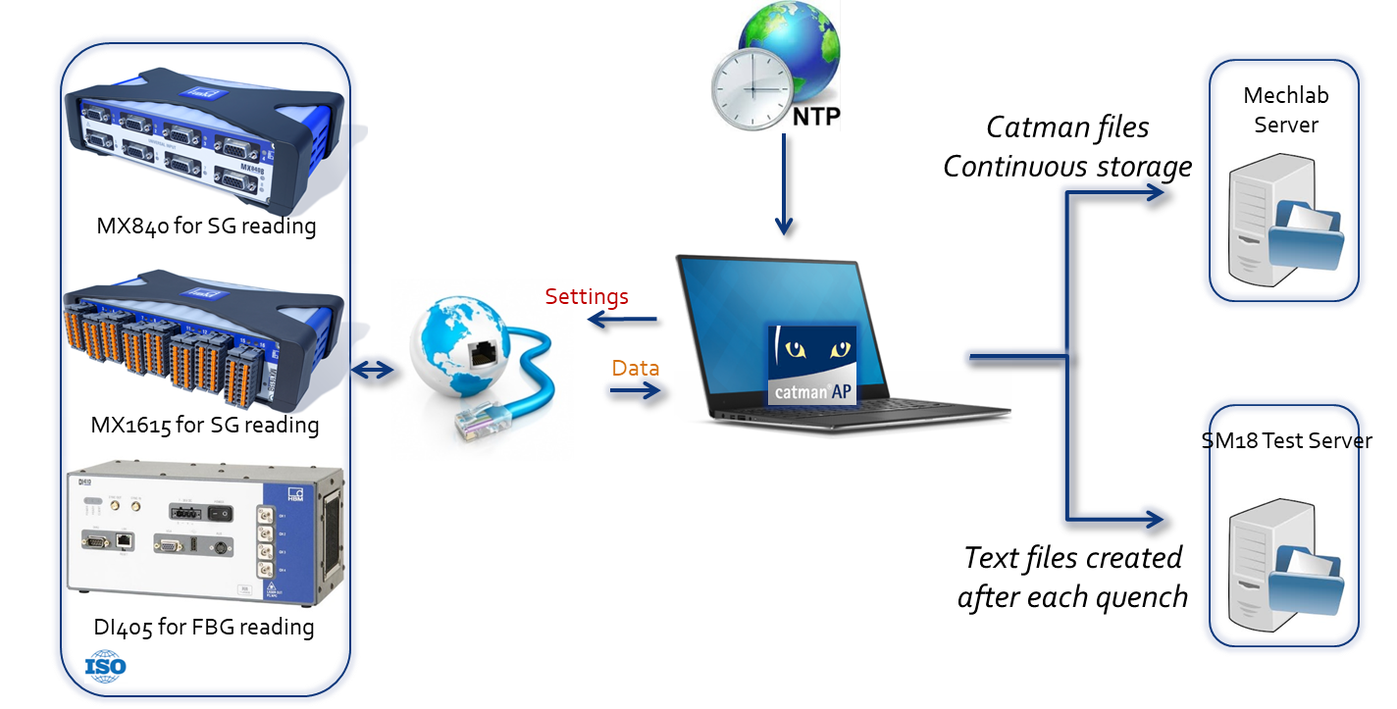
Digital transformation
Mechanical Measurements
Post-processing
Other measurement data
Many types of files, lot of exports to convert files and huge data storage;
Difficulties to merge data from several systems due to the time stamping, sampling frequency, meta data, labels, etc…
Combined data are not accessible real time.
Third party

Slide 25
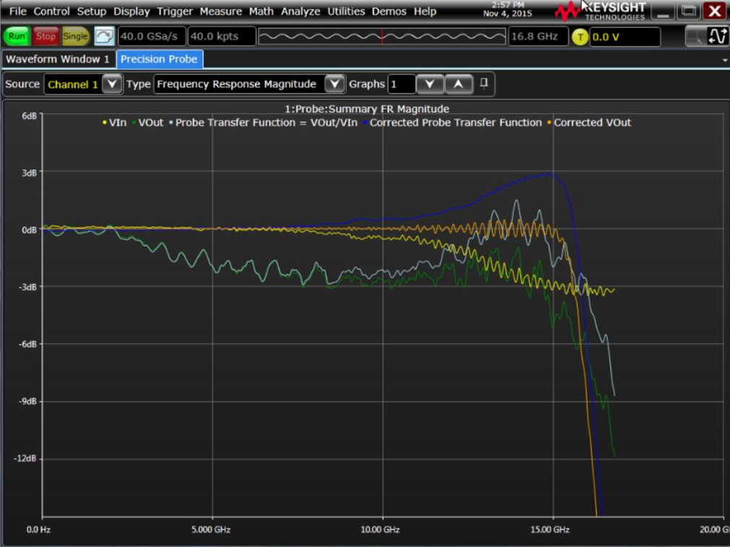
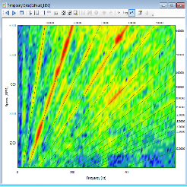
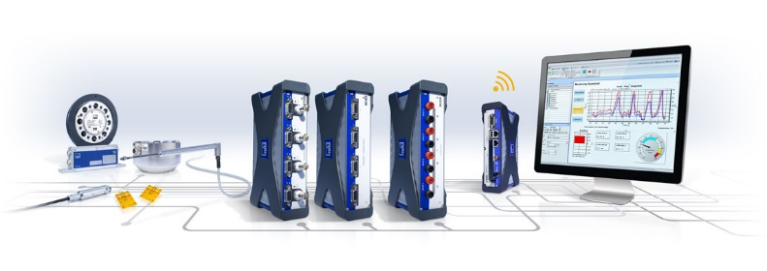
Digital transformation
…
Applications
Clients
Client XY
Client Scope
Client Analysis
Third party
Measurement
Input
Data from every systems are continuously streamed and stored on the Cloud;
Data are open and accessible with several type of software's for monitoring and/or post-processing;
Real time access by several users asking different tasks;
Mechanical Measurements
Other measurement data

Slide 26
Digital transformation in conclusion
Digital transformation revolution occurs everywhere and open a new way to measure !
Industrial companies have already implemented this kind of solution based on Cloud technologies;
Cloud technology start to be available on several commercial measurement solutions :
Request some efforts to standardized our processes (labels, etc…) as it was done in the automotive industries 20 year’s ago with ASAM-ODS ;
For the mechanical measurements at CERN, the Cloud technology will be deploy this year on specific project (Test mode), ready to take part ?

Slide 27
Thank you ! Questions ?

