Slide 1
Online data analysis
Franco J. Mangiarotti
CERN – TE-MSC-TF
2019.06.12 – 3rd IWSMTS, Uppsala, SE

Slide 2
Online vs Offline data analysis
Online data analysis:
Right-away after an event
Minimum data for operation (QI, quench location, etc)
Required to continue testing
Focus on speed instead of depth
Offline data analysis:
A few hours, days or even years after the event
Exhaustive analysis, comparison with other events

Slide 3
Online data analysis tools

Slide 4
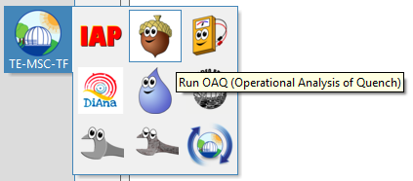
DIAdem
Great data visualization and manipulation tool
Already discussed in the previous two workshops (link1, link2)
Main software used by TF section in SM18

Slide 5
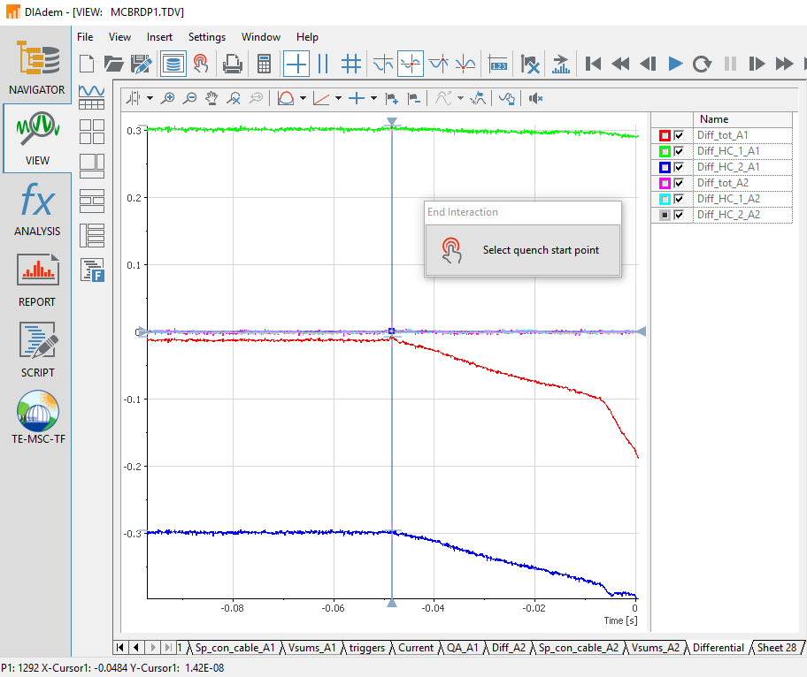
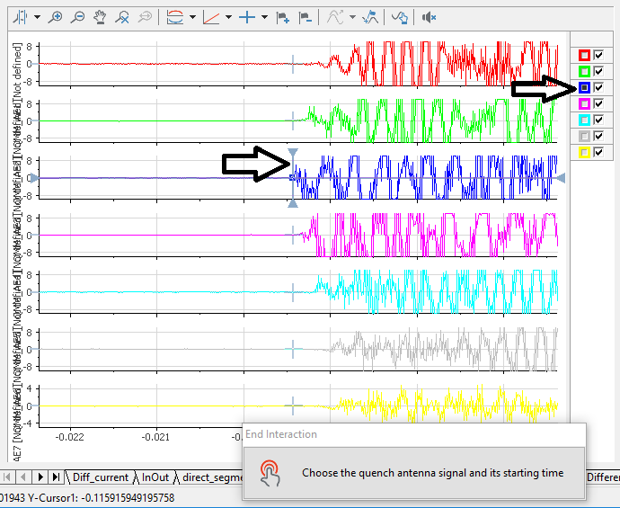
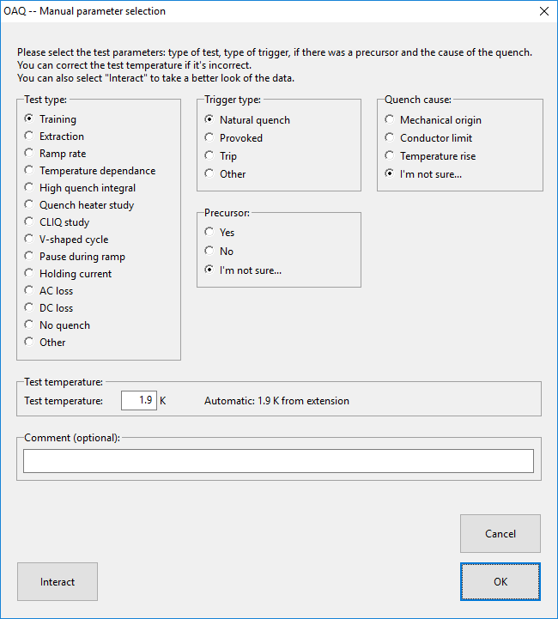
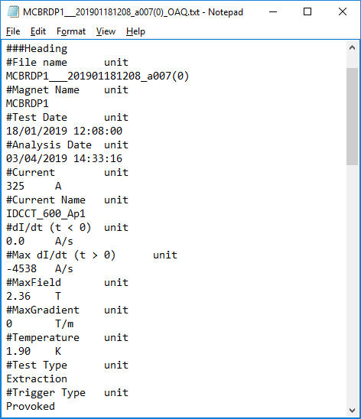
DIAdem tools: OAQ
Program to analyze a quench right after it happens
User interaction to select:
quench time,
quenched segments,
quench antenna,
test parameters, …
Outputs a text file with the main test results

Slide 6
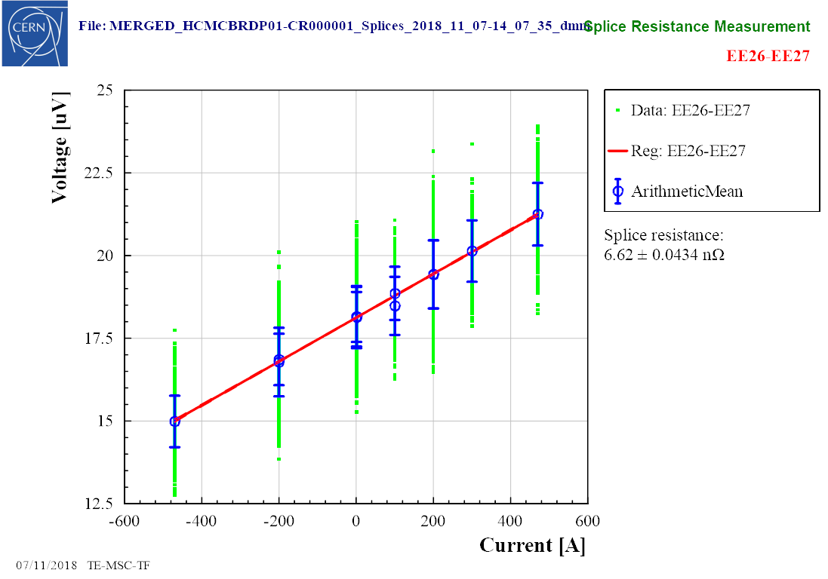
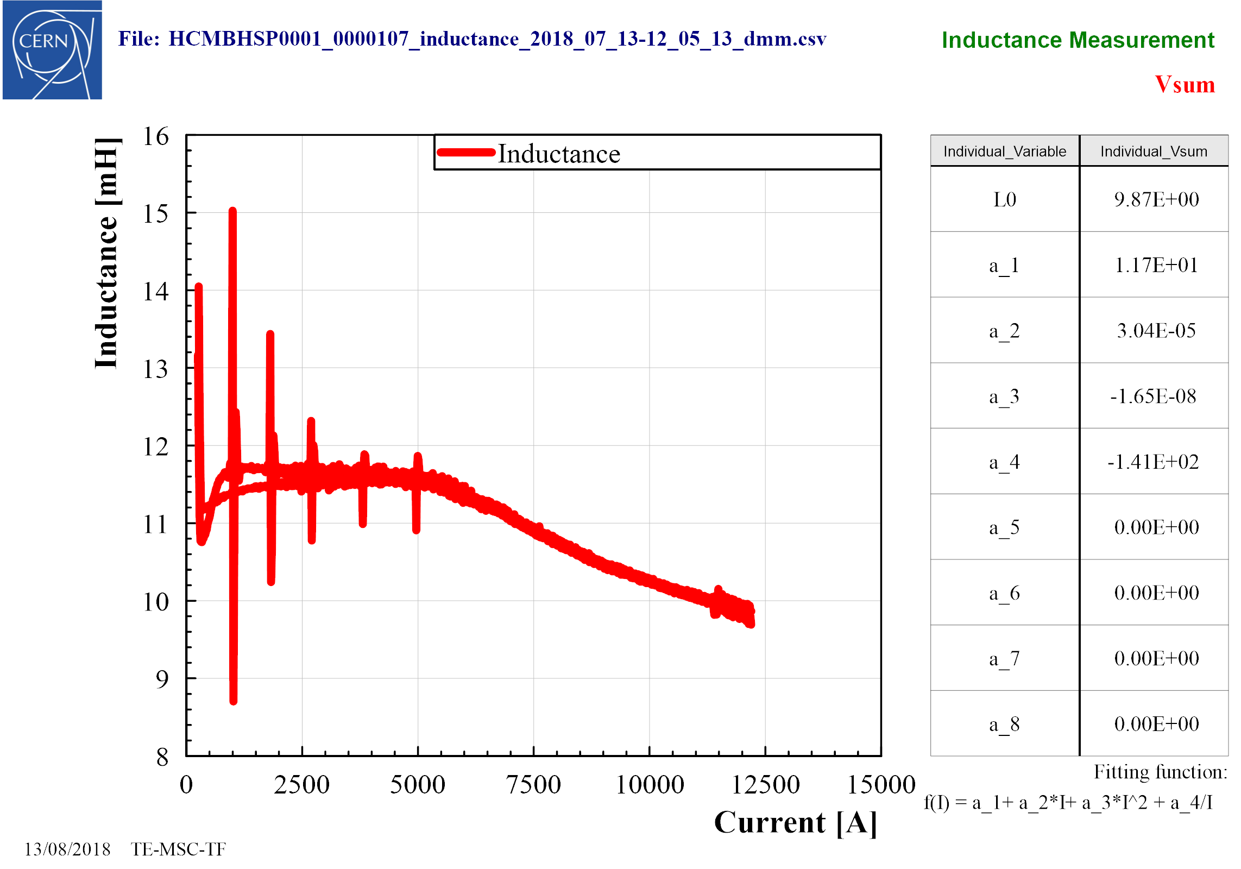
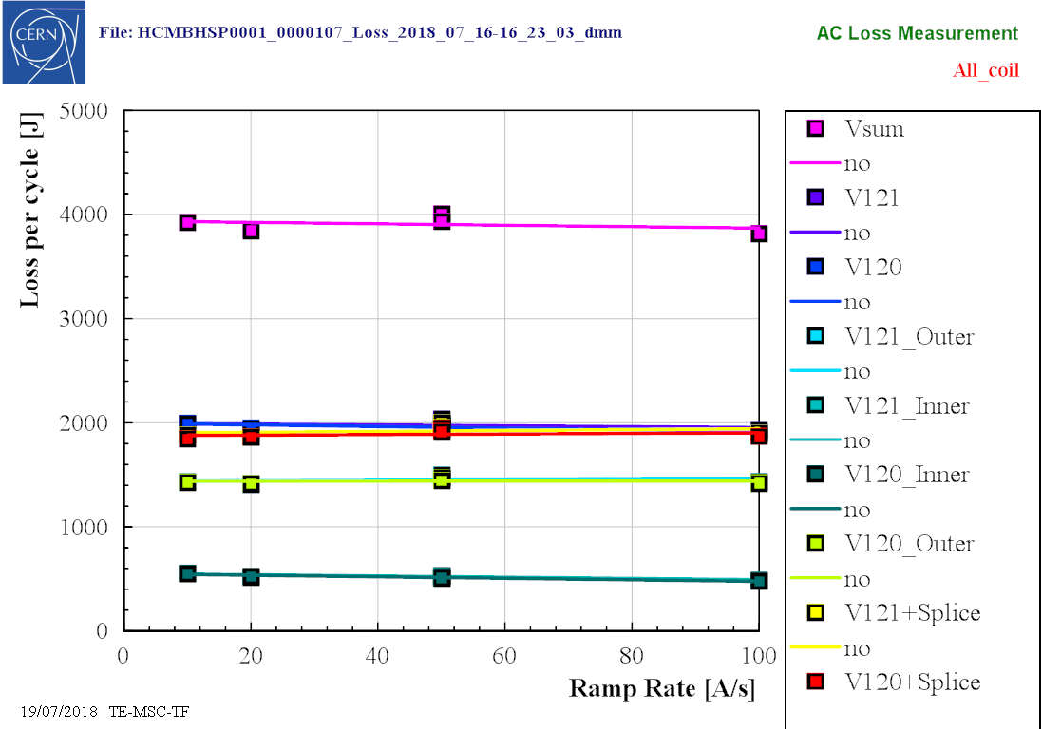
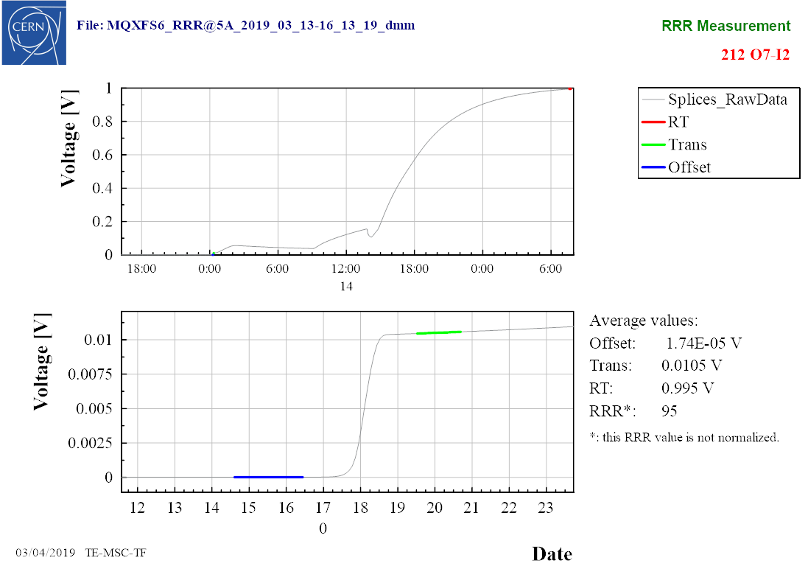
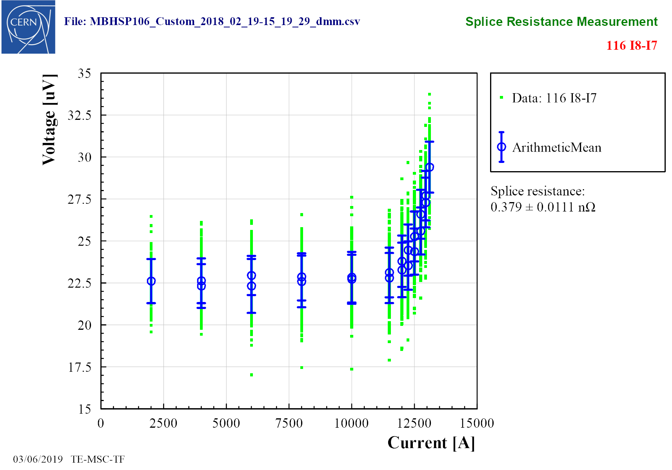
DIAdem tools: DMM-processor
Multi-purpose software to analyze slow-acquisition, high precision data:
Splices resistance
Inductance
AC loss
RRR
Superconducting transition
Outputs images and text result files

Slide 7
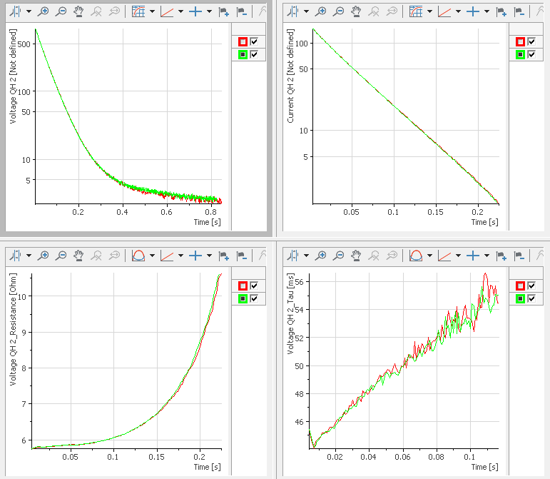
DIAdem tools: QH analysis
Goal: comparing a QH discharge with a baseline
Use V, I, R and τ
Manual (QH verificator)
Visually compare curves with baseline
Automatic (QH analysis)
Verify if deviations are within acceptable window
Calculate parameters at given times

Slide 8
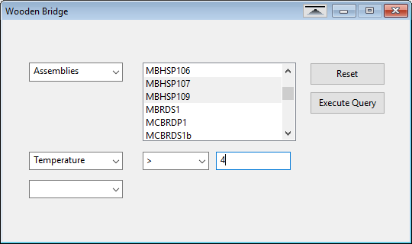
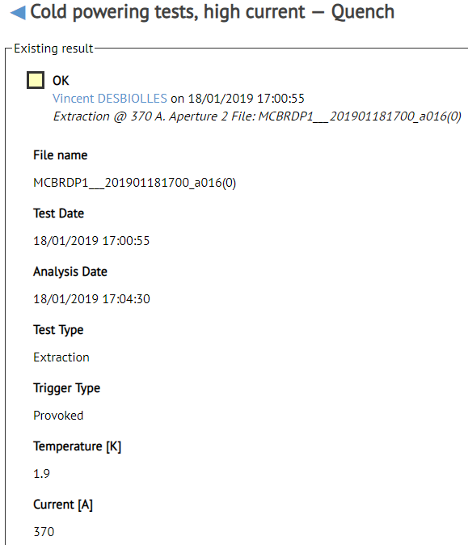
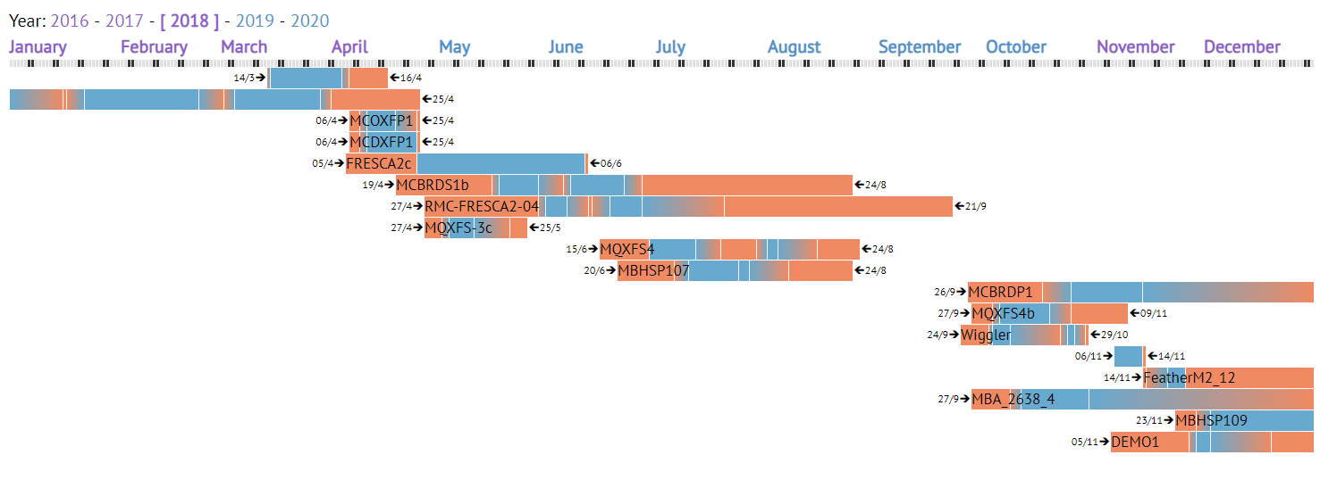
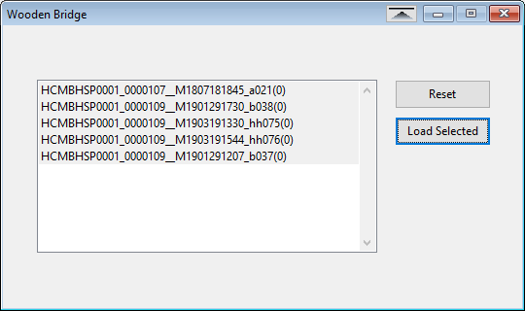
Carpenter and other offline tools
Result text files uploaded to Carpenter database
Carpenter info: link1, link2
Other programs use this data to do more analysis

Slide 9
Online data analysis examples
IWSMTS

Slide 10
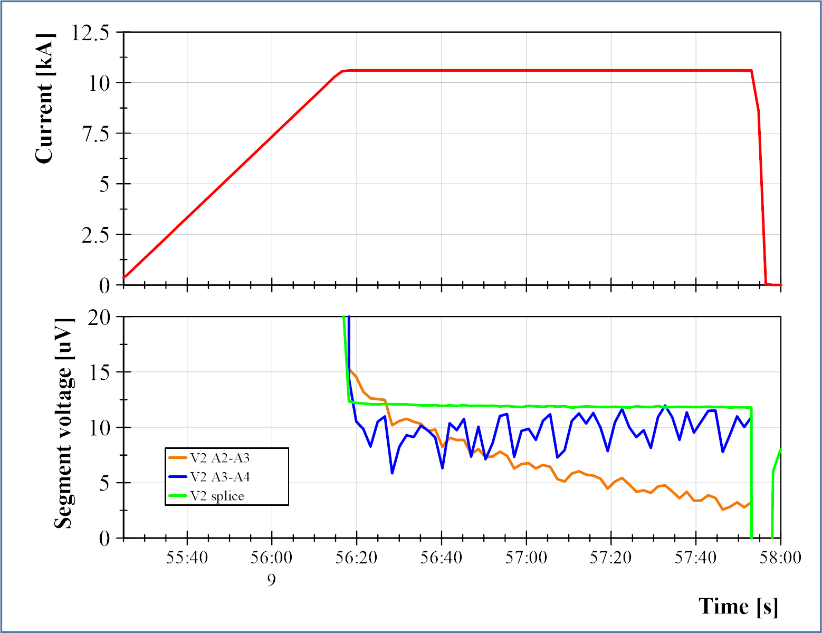
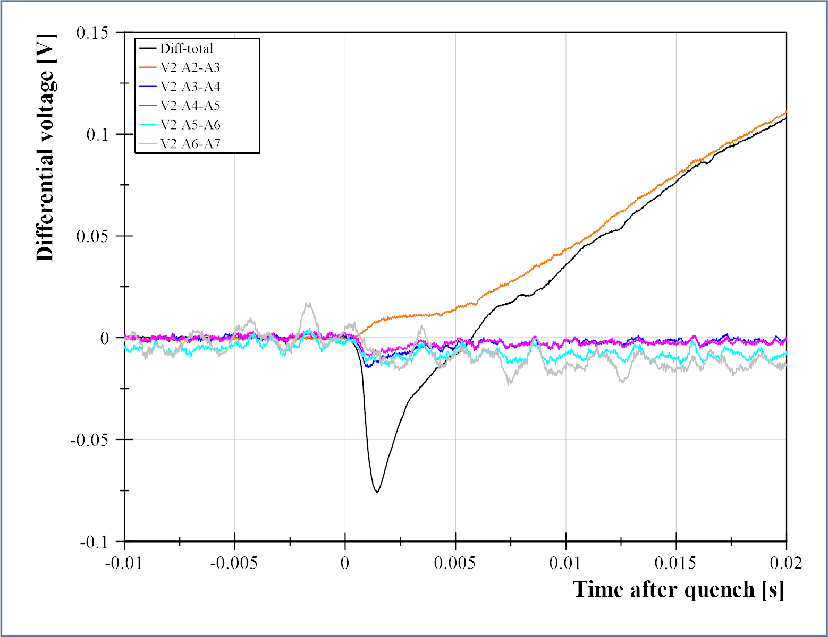
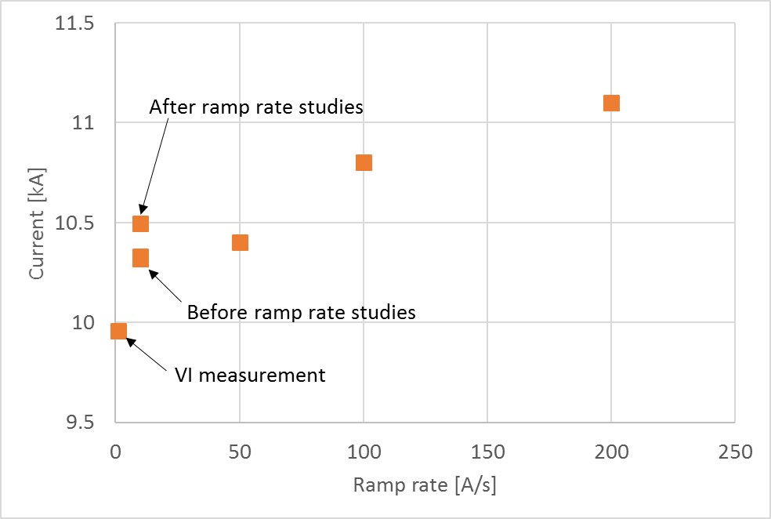
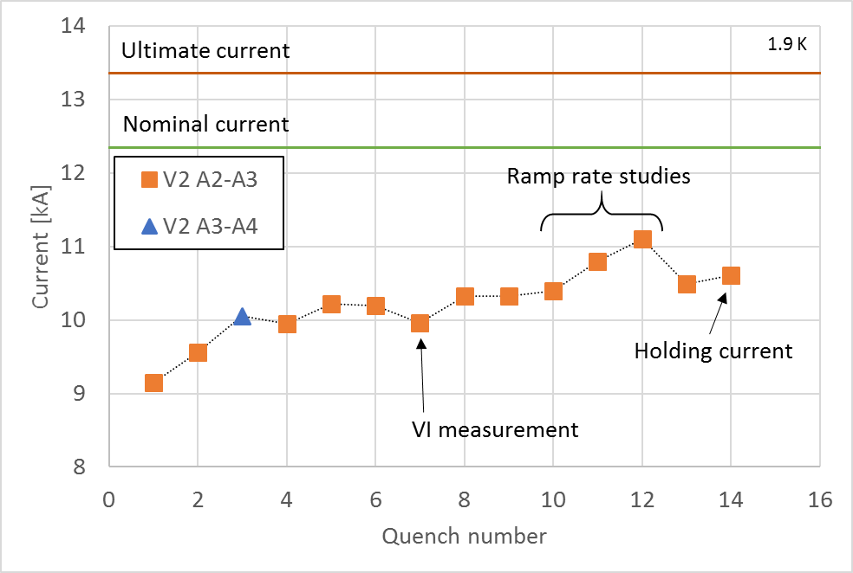
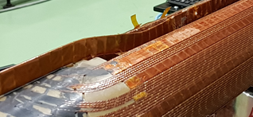
Broken strands in MBRDS1
Slow training and limit in one location
“Inverse” precursor
Atypical ramp rate dependency
Decaying voltages during flat-top
Probably conductor damage in coil exit
By-pass coil and retest
Probable location of damage

Slide 11
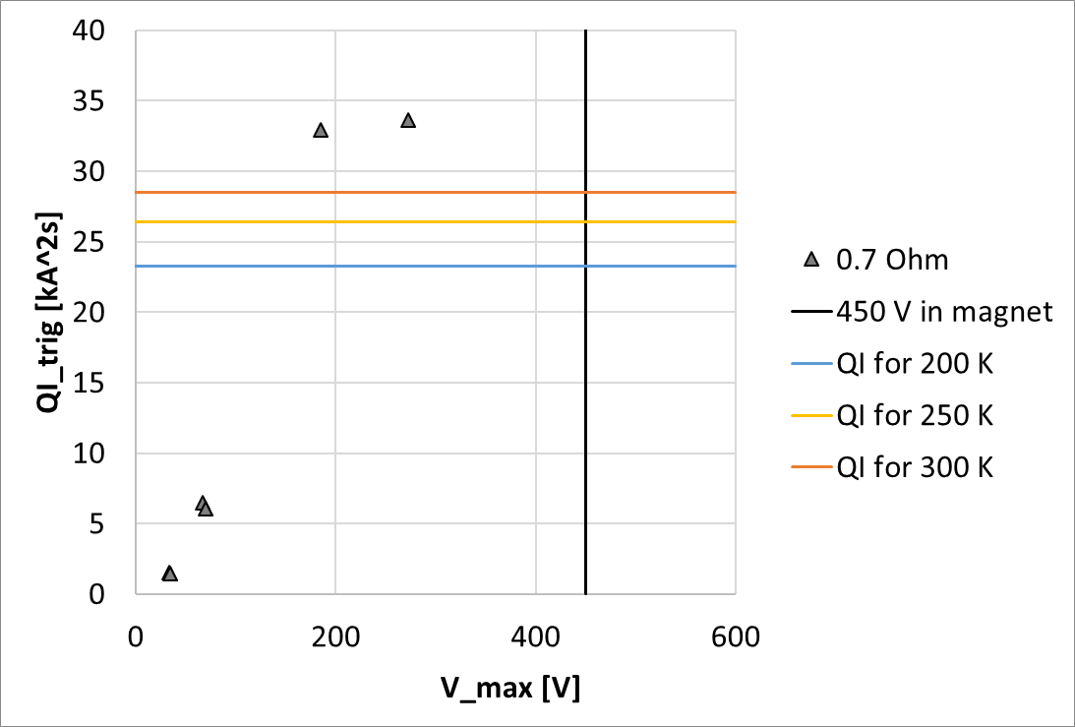
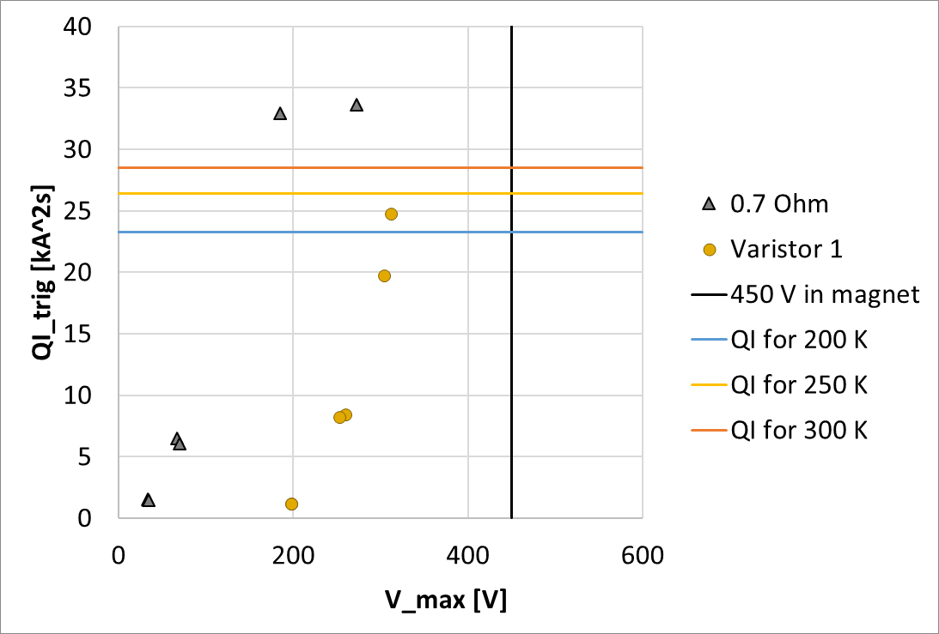
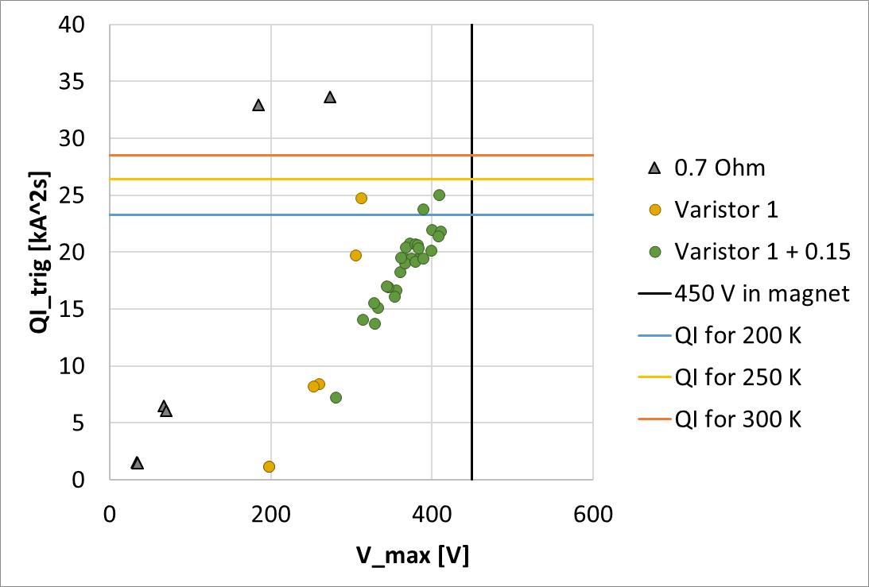
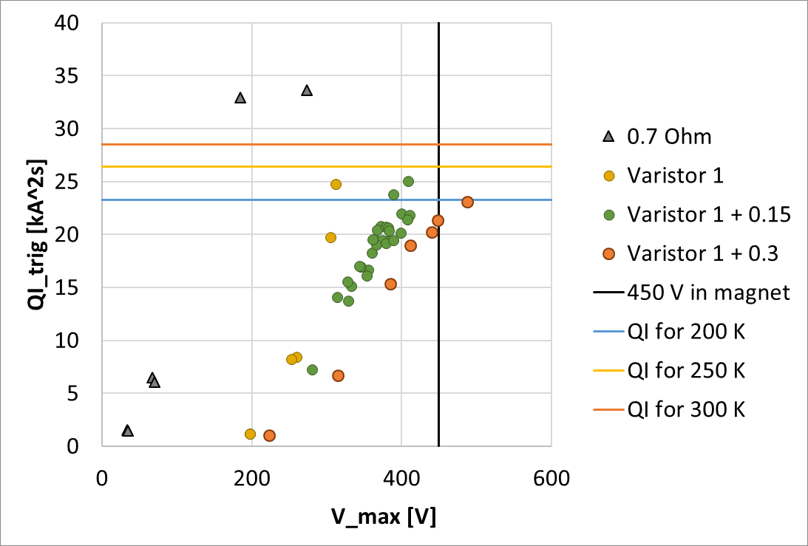
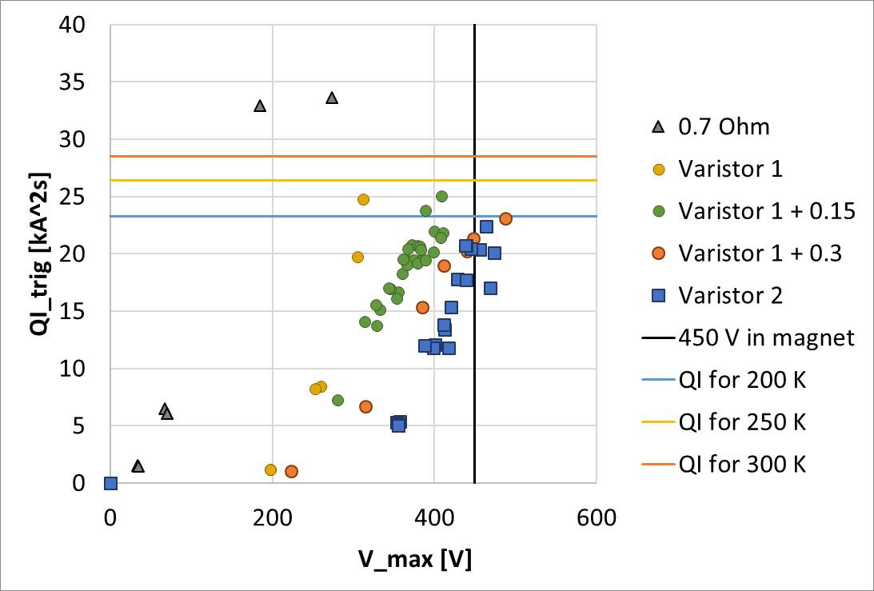
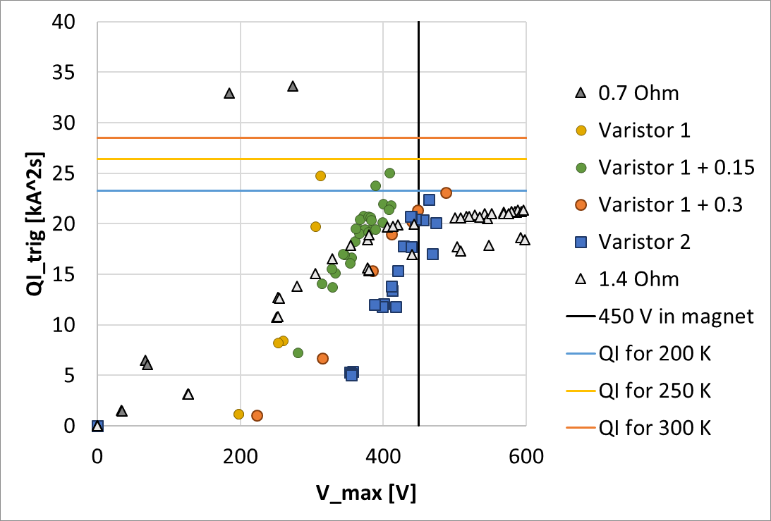
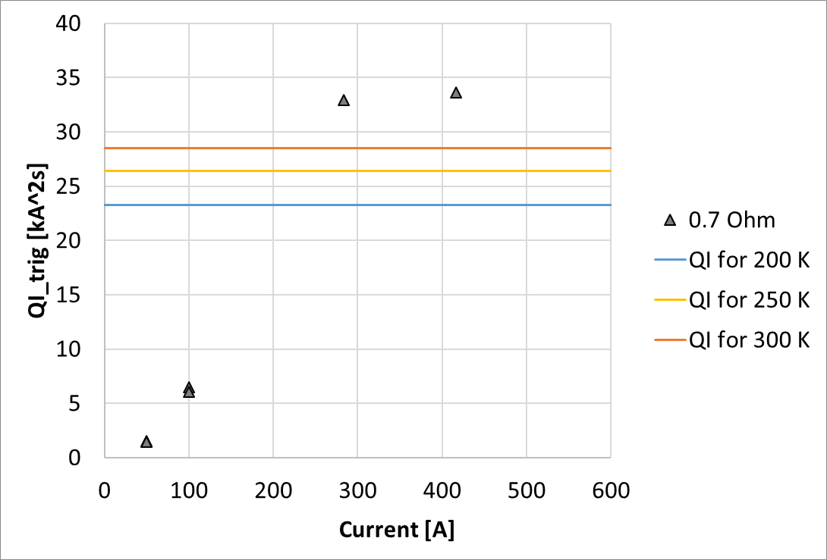
High quench integral in MCBRDP1
Quench-back not as effective as expected
Tried multiple energy extraction devices
QI < 23 kA²s
V_{max} < 450 V
Fast cycle time required fast software
Final workaround: 2x EE racks (V_{max} < 900 V)

Slide 12
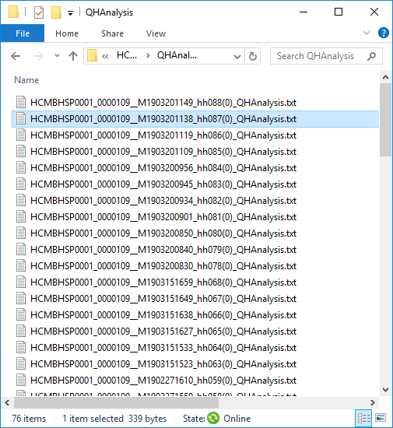
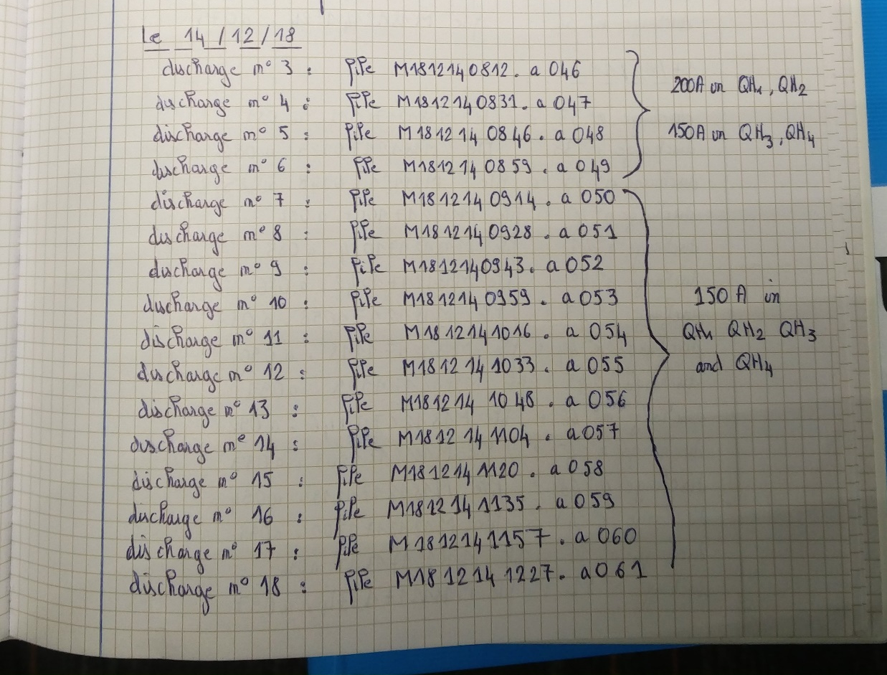
Heater discharges in MBHSP109
First ~60 discharges: manually analyzed
Check the curves look OK before continuing
Next ~70 discharges: automatically analyzed
QH analysis software
LabVIEW program
PLC

Slide 13
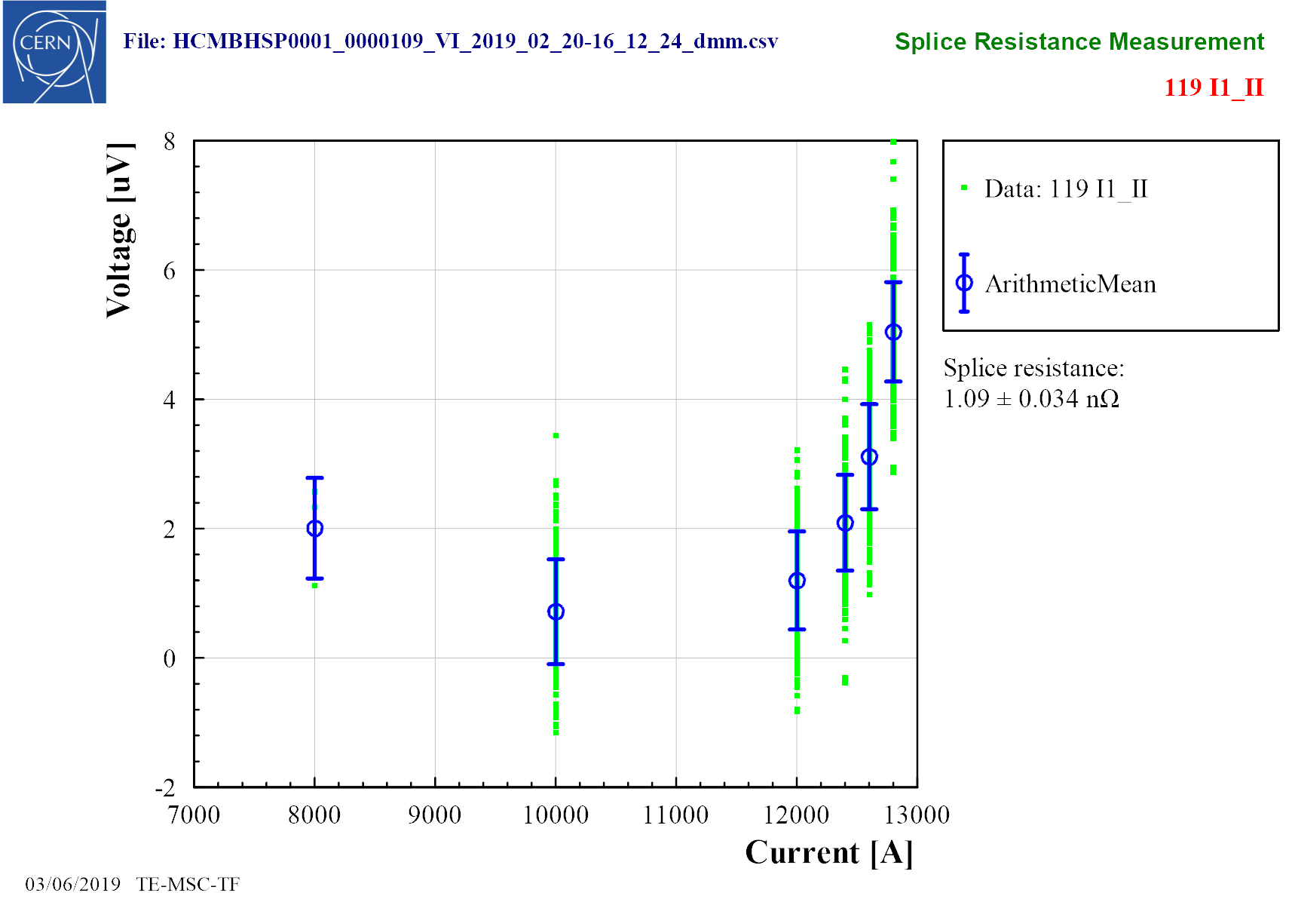
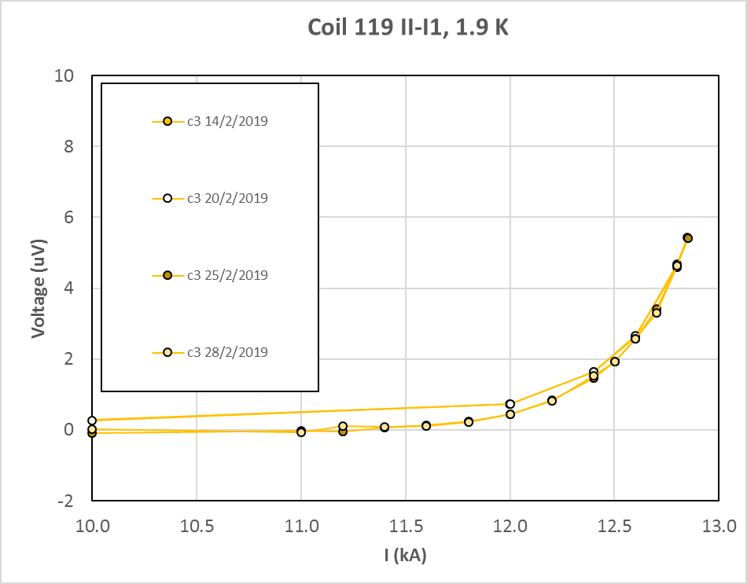
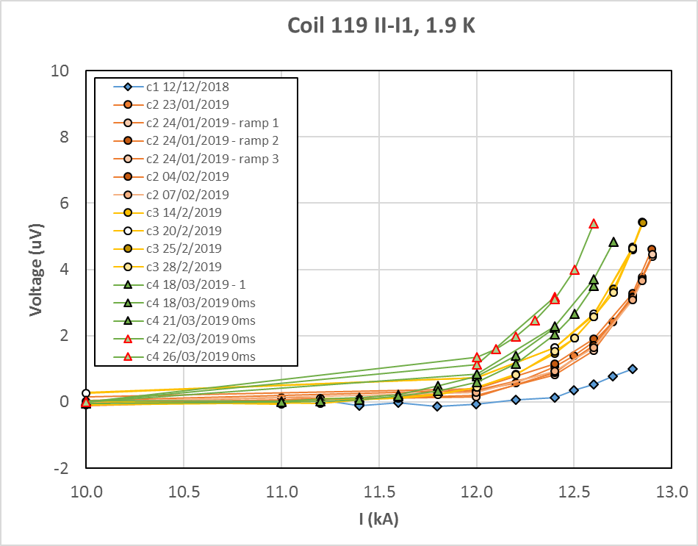
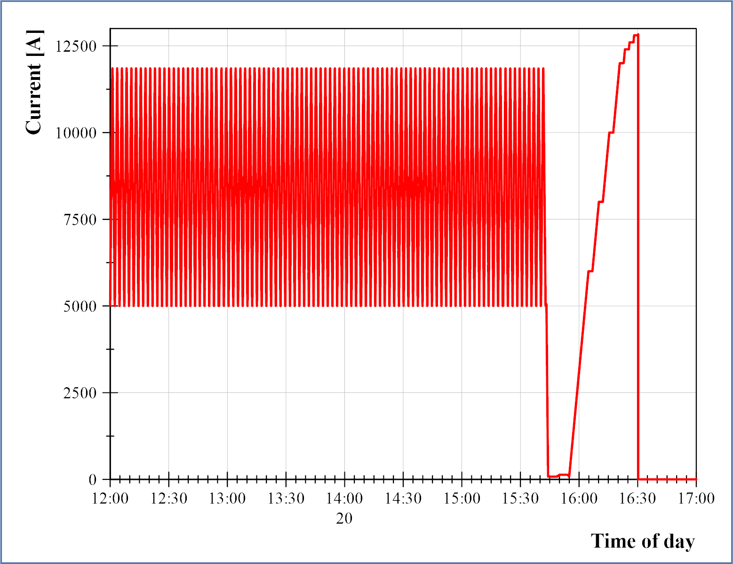
Current cycles in MBHSP109
VI measurement
~200 cycles from 5 to 11.85 kA every day
How to verify the magnet does not degrade?
Quenches
VI measurements
Analysis:
Current cycles: no degradation
Thermal cycles: ~0.5% degradation
Quench
5-11.85 kA cycles

Slide 14
Summary
Online analysis is critical to magnet testing
Validation of the test
Early troubleshooting
Permission to continue testing
Sharing tools and procedures between labs will help us get more out of the testing

