Slide 1


Summary of Diagnostics Workshop
Stoyan Stoynev /FNAL/
3rd International Workshop on Superconducting Magnet Test Stands
12 June 2019 / Uppsala, Sweden

Slide 2
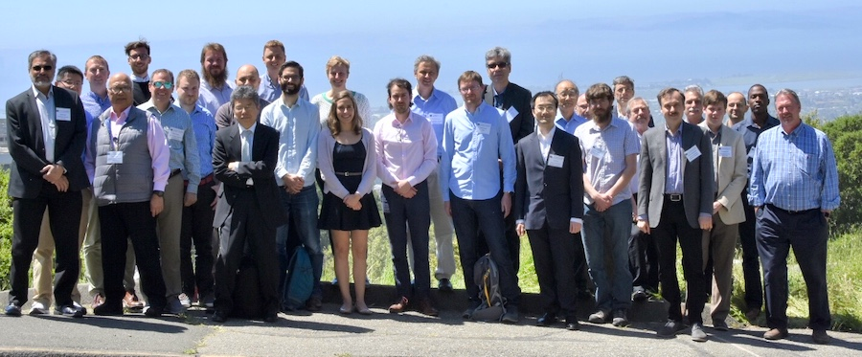
Introduction
https://idsm01.lbl.gov
The First International Workshop on Diagnostics and Instrumentation for Superconducting Magnets was held at LBNL (Berkeley, California):
24-26 April 2019
Organized by LBNL and CERN (Maxim M. and Gerard W., respectively)
The workshop participation was on “invitation only” basis and included
people from LBNL,CERN, ACT, BNL, CAS (China), CEA, FNAL, KEK, MIT,
NHMFL (Florida), NCSU (North Carolina)

Slide 3
Scope
Key challenges in magnets to be addressed with diagnostics
  Understanding mechanical and magnetic transients that lead to quenching
  Understanding training: sources, physics, statistics, mitigation
  Conductors: effect of stress, identification of defects
  Quench detection using different physical mechanisms (magnetic, thermal, resistive, inductive, capacitive, etc.)
Traditional and novel instrumentation, probes and techniques
  High resolution voltage-based diagnostics
  Magnetic measurement techniques (rotating probes, quench antennas, other magnetic sensors)
  Strain measurement techniques
  Acoustic emission diagnostics and related techniques
  Ideas for new techniques, sensors or instrumentation

Slide 4
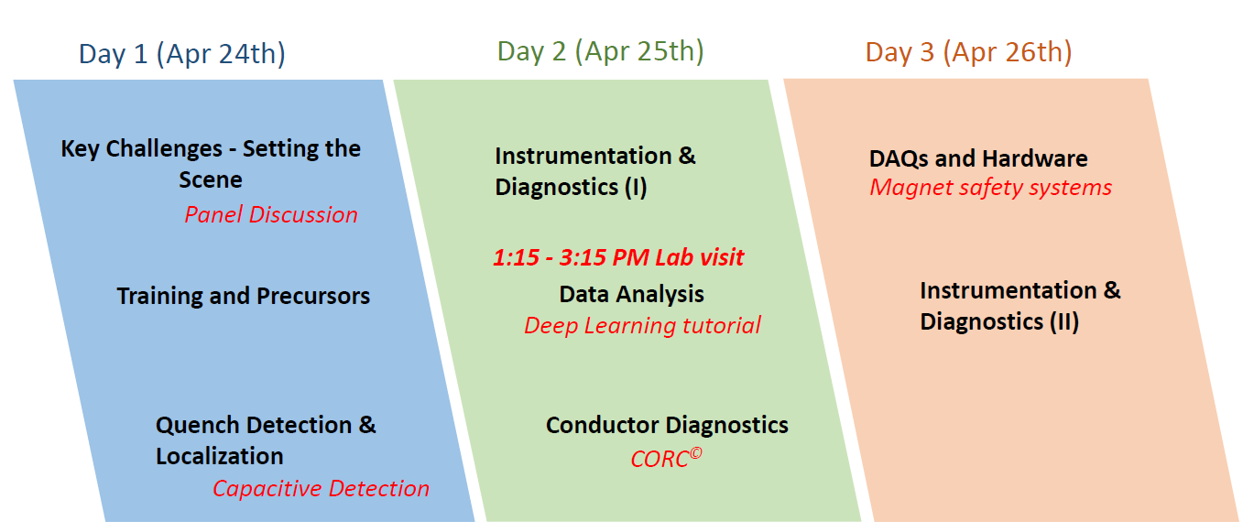
Scope (2)
Methodology, processing and management of data
  Synergy of diagnostic techniques: making good choices for magnet testing
  Data collection and review: visualization, web interfaces, databases, etc.
  Software and algorithms for magnet data analysis
  Machine learning for understanding magnet performance limitations and facilitating magnet design
Electronics and hardware
  Integrated solutions for data acquisition, conditioning and storage
  Innovative components for diagnostic instrumentation
  Cryogenic electronics for magnets

Slide 5
KEY CHALLENGES — SETTING THE SCENE
Specific to HTS (it is a significant focus in the current development)
  Cable/conductor optimizations
  Contact resistance and current sharing, conductor uniformity, role of defects, micro-cracks, screening currents, magnetization, mechanical fatigue and strain sensitivity, effective methods to investigate
  Fusion sciences have the same interest
  Protection; or shall we operate with no protection taking the risk (no quench regime; minimal monitoring, less operational costs)?
General
  Non-invasive techniques!
  Machine learning!
  Need for facilities that can study quench properties/protection techniques under varying conditions – sub-scale magnets and conductor/cable
  Highly configurable diagnostics to accommodate large variety of tests (speed/capabilities)
  Diagnostics are an excellent area for synergies and collaborations – especially with Universities and with Industry
  We need tight communication/coordination/interaction/Feedback between
    magnet design / magnet fabrication / magnet test

Slide 6
TRAINING AND PRECURSORS
Training
  Magnet training is often better understood in terms of coil training
    Very reproducible and useful data
  Training is a multi-scale and multi-physics phenomenon (study accordingly)
    Acoustics
    Quench antenna
    Strain/stress
  Innovative approaches
    Inductance (and current) changes due to mechanical disturbances
    Acoustic/Quench antenna signal correlations vs current ramp (locations, intensity of events); generally – correlations between different data sources
    Machine learning and elaborated signal processing for analysis
    Links to similar problems with known techniques (earthquakes,…)
    Event classification; multi-channel fast DAQ
Precursors
  We may need to define what it is
  However, events of different types appear before many quenches and if those are understood a new powerful tool in performance studies will be established
  Many attempts underway

Slide 7
QUENCH DETECTION AND LOCALIZATION
Again, variety of methods discussed – most are promising
Rayleigh scattering (fiber optics) – distributed approach for quench localization/detection
Capacitance change due to thermo-mechanical shifts (coil-pole, etc.)
Stray capacitance (any surfaces but sensitive to boiling He escape routes) shows it is sensitive enough to foresee a quench and possibly localize it
Attempts for quench detection by RF signals (reflective index changes due to change in resistivity)
Acoustics
  Distributed array inside CICC proposed for quench detection and localization
  Active ultrasonic approach
    Wave spectrum shifts due to heat spots – quench detection in HTS
    Mechanical integrity monitoring
  Acoustic attenuation at room temperature and training? Pre-conditioning?

Slide 8
INSTRUMENTATION AND DIAGNOSTICS (I)
Need for integrated data taking (acoustics, strain gauges/fibers, thermometers, capacitance/inductance techniques)
  Creating the full picture from different fragments
Comparisons to models (mostly mechanical, mostly global)
Need for interface measurements (between layers, layer to metal/insulation)
  Flexible quench antennas, force sensors, high-precision acoustics, fibers
  Sub-scale CCTs – a good testing bed
Magnetic measurement probes and quench antennas
  Very well developed techniques for magnetic measurements
  Contemporary PCB probes are fabricated with high precision (micron accuracy of wire placement), often multi-layer devices (sensitivity)
  Using them in multi-arrangement arrays for rotating probes allows to constraint measurement results and reduce errors – possibility of much better measurement precision
  With minor modifications (or not) could be used as multi-sensor arrays to extract quench position information (sensitivity to quench front, wire motion/vibration, turn short, magnetic shim movement) – was done in past too

Slide 9
DATA ANALYSIS
Deep learning
  Neural network and machine learning are promising techniques for data analysis
  With ever expanding amount and quality of data, and more and more tests – it may be an excellent tool to understand relevant phenomena and improve magnet fabrication
  First steps to classify acoustic events in magnets by machine learning
Data management
  Data formatting, distribution and preservation are all important topics in collaborating teams
  To address them best (and more) :
  integrated solutions for data acquisition, conditioning and storage
  CERN Carpenter is a well structured and efficient example of an integrated system
  Could be used by other Labs (needs some light agreement)

Slide 10
CONDUCTOR DIAGNOSTICS
Cables as sub-scale for Nb₃Sn magnets
  Can studies on SC cables (stress-performance relations, field dependencies) lead to better understanding of training in magnets?
  Cable stacks as sub-scales – useful data on cable deformation, energy release and acoustic signatures
  Can we link cable stacks acoustic events to magnet ramp events?
HTS cables
  There is much left for R&D in HTS cables
  Need to better understand defects along the cables and layer interfaces (inside cables), micro-cracks
  Current sharing in HTS is another major point to understand performance
  Interesting studies at very high fields (above 45 T for pulsed magnets) – automatization of V-I characterization measurements, pulsed measurements; pinning properties; very important for conductor developers
Cables quality control
  Ultimate goal is to have sufficient set of room temperature measurements giving confidence of the low temperature cable performance
  Still there is much room for improvement, especially for R&D control
  Note: R&D and production have different requirements, as well as HTS vs LTS - challenging!

Slide 11
DAQs AND HARDWARE
Operational facilities
Examples of great work and implementations presented but
Main limitations:
→ Custom hardware is painful to produce & test
→ System is too much person dependent
→ Bad initial options we live with: legacy format, time stamping,
windows platform (in some cases)
Advices for development:
  Additional project requests & contexts – manage a modular and homogeneous version
  Have an operational & validated solution for operation – moderate upgrade, use versioning
  Take into account expected long lifetime – choose robust hardware, buy spare
  Allow system evolution – work on new deployment window, test on redundant chain, use idle facility, cross project feedback
  Offer maximum availability – implement redundancy, add monitoring & reporting, fault-tolerance. Virtualization may also help
  Reduce maintenance constraints – be tolerant to degraded mode, include remote access
R&D
  Cryogenic DAQs and FPGAs! (multiplexing?)
  SERIOUSLY! I’ll return to this shortly!

Slide 12
INSTRUMENTATION & DIAGNOSTICS (II)
Optical fibers – Fiber Brag Grating (FBG)
  Temperature and strain dependent wave length shift
  Fibers can be embedded in magnets, glued to cables/coils, etc.
  Successful tests of temperature and stress monitoring (cables/magnets), real time monitoring of HTS conductor
  Promising approach for non-distributed measurements
Magneto-optical imaging (light polarization induced by magnetic field)
  Dynamic imaging of current redistribution (in HTS)
  Distinguish current redistribution and sharing in HTS conductor
Magnet performance limits and diagnostics methods
  Powerful analysis of V-I curves (dedicated measurements) – convincing conclusions on limits in many cases
  Use of correlated data from different sources
  Vibration spectrum studies (during ramp and quench)
  Precursors (acoustics, QA, voltage spikes) as a supporting tool
  Each of the diagnostic techniques can give a clue on specific problems

Slide 13
My personal favorite from the workshop
Marcos Turqueti (LBNL): Cryogenic DAQs and FPGAs for magnet diagnosis
•Data interface fully digital
•Simplification of cryostat feedthrough
•Noise reduction
•System simplification
(no long analog cables present)
•Flexibility
•Cost reduction
•Increase time of oxide breakdown
Many solutions already exist
but dedicated R&D is needed,
great for collaboration,
great for facilities
- Many options available for cryogenic data acquisition
- COTS components can be used
- Growing number of Applications Specific Integrated Circuits (ASICs) available
- Software development needed
- More collaboration needed between potential users

Slide 14
“Official” Workshop Summary: directions going forward
Paradigm change for quench diagnostics: from investigating quench causes and locations after the event towards guarding magnet system to stay within its operational and safety margins in real time. Diagnostics as key to magnet safety.
  Quench detection for HTS under extreme ac background / noise conditions
  Way to detect presence and accumulation of micro-cracks in HTS tapes in high-field solenoids
  Ways to visualize and monitor current sharing in HTS cables, NI coils
    Multi-technique diagnostics: combining voltage, acoustic and magnetic methods to get a full picture. Advanced, multi-functional probes.
    Need for well-designed and calibrated experiments to study training and build a database of diagnostic signals for typical transient events in magnets.
    Make more magnet data available for developers of Deep Learning models; adopt ML and DL as standard analysis tools for our field
      Cryogenics DAQs and digital processing integrated with the magnet
      FPGAs for various diagnostics and magnet safety functions

Slide 15
My comments
The workshop in Berkeley was well focused and indeed useful
It was the general impression and opinion it should become a regular event
Nevertheless it happens among many other workshops and events with some overlap (the current workshop, magnetic measurements workshop in few weeks to name a few)
I often heard (not at that workshop necessarily) we have too many events to attend
  Remote connections are particularly bad solutions for workshops
May be a solution would be to have “mirror” workshops – two events organized in tandem in the same week, at the same venue or at least at geographically close locations
  Tuesday-Wednesday / Thursday-Friday
  We kind of did this last year for this workshop although in a smaller scale
  Let’s optimize the trips we all take to attend
We risk fragmenting our community if we have to choose which focused events to attend

