Slide 1

HL LHC IT STRING TEST
Marta Bajko CERN
11-12 June 2019 Uppsala Sweden FREIA

Slide 2
CONTENT
The LHC STRING : the past experience @ CERN
The HL-LHC STRING
  Motivation
  Goals
  Configuration
  Main Components
  Experimental program in a nutshell
The STRING in the SM18
The time line of the project
Summary

Slide 3
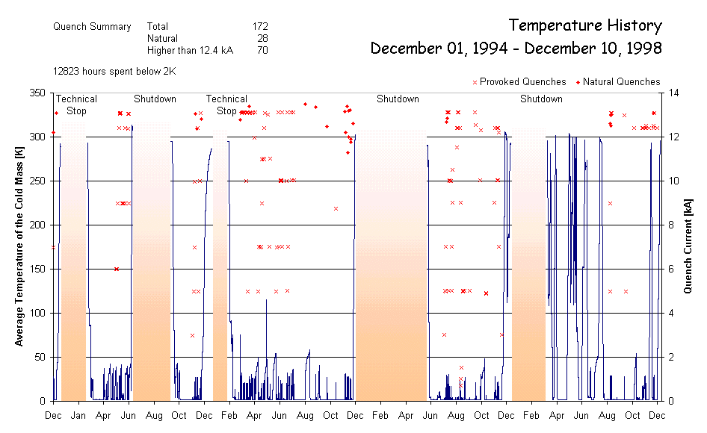
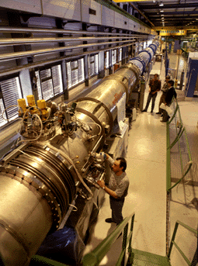
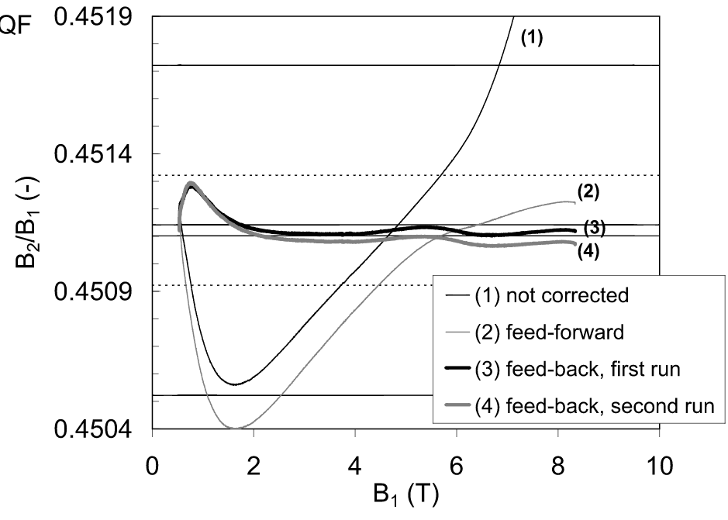
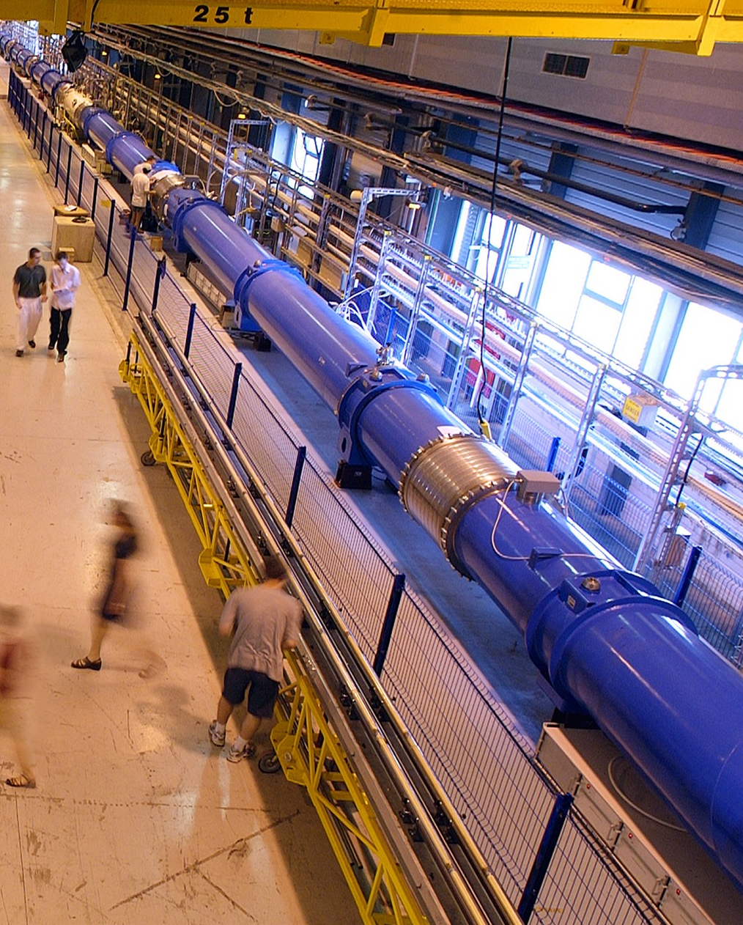
Previous experience @ CERN
STRING-1 (1994-1998)
One half LHC cell:
  3 MB (10 m) + 1 MQ
Validation of:
  Cryogenics (6 CD’s)
  Vacuum
  Quench (172) and protection
  Powering and energy extraction
STRING-2 (2000-2004)
One full LHC cell
  6 MB (15 m) + 2 MQ + correctors
Validation of:
  Cryogenics,
  Vacuum
  Quench and protection
  Powering
  Accelerator relevant operation (e.g.tracking of MQ and MB)
String-1 in SM-18
String-2 in SM-18

Slide 4
The HL-LHC IT STRING MOTIVATION
In the HL-LHC configuration, the Inner Triplet (IT) region of IR1 and IR5 of the present LHC will be heavily modified.
LHC
HL-LHC
In particular the Q1-Q2-Q3-D1 magnets will be completely different from the present LHC magnets, mainly due to the new technology they are based.
Powering cables or BB and disconnections

Slide 5
The HL-LHC IT STRING MOTIVATION
In the HL-LHC configuration, the Inner Triplet (IT) region of IR1 and IR5 of the present LHC will be heavily modified.
HL-LHC
D1 magnet will be superconductor instead of normal conductors as is today in the LHC.
Powering cables or BB and disconnections

Slide 6
The HL-LHC IT STRING MOTIVATION
In the HL-LHC configuration, the Inner Triplet (IT) region of IR1 and IR5 of the present LHC will be heavily modified.
LHC
HL-LHC
In addition, the aperture will be much larger, the cold mass configuration will be completely different and the corrector package will be substantially modified as configuration and technology, too.
Powering cables or BB and disconnections

Slide 7
The HL-LHC IT STRING MOTIVATION
In the HL-LHC configuration, the Inner Triplet (IT) region of IR1 and IR5 of the present LHC will be heavily modified.
HL-LHC
The IT quadrupoles (Q1-Q3) will use Nb₃Sn instead of the Nb-Ti used by the present ones.
Powering cables or BB and disconnections

Slide 8
The HL-LHC IT STRING MOTIVATION
In the HL-LHC configuration, the Inner Triplet (IT) region of IR1 and IR5 of the present LHC will be heavily modified.
HL-LHC
The powering of the magnets will be with higher current than the present LHC IR magnets
Powering cables or BB and disconnections
and will be made via a HT superconducting link and new generation superconducting current leads

Slide 9
The HL-LHC IT STRING MOTIVATION
In the HL-LHC configuration, the Inner Triplet (IT) region of IR1 and IR5 of the present LHC will be heavily modified.
HL-LHC
The protection of the magnets based on Nb₃Sn superconductor technology will be different from the present ones (ex. CLIQ and new QH) due to its particulate characteristics at low and medium field and the high magnetic energy stored ( 1.2 MJ/m, 2-4 x higher than in LHC) in the magnets in operational conditions.
Powering cables or BB and disconnections

Slide 10
The HL-LHC IT STRING GOAL
The main motivation is to represent, as far as reasonably achievable in a surface, the various operation modes and make of the HL LHC IT STRING a test stand to STUDY and VALIDATE the COLLECTIVE BEHAVIOURE of the different systems: magnets, magnet protection, cryogenics for magnets and superconducting link, magnet powering, vacuum, and interconnections between magnets and superconducting link, alignment.
Ref. HL-LHC IT STRING Scope https://edms.cern.ch/document/1693312/1
The HiLumi String will serve as a test bed for matters or conditions that either :
  (a) cannot be tested as a part of the components acceptance and characterization program, or
  (b) depend on the response of the integrated system.
Alternative configurations are possible for tests, with dedicated cost and resources, but unforeseen failure modes may be missed

Slide 11
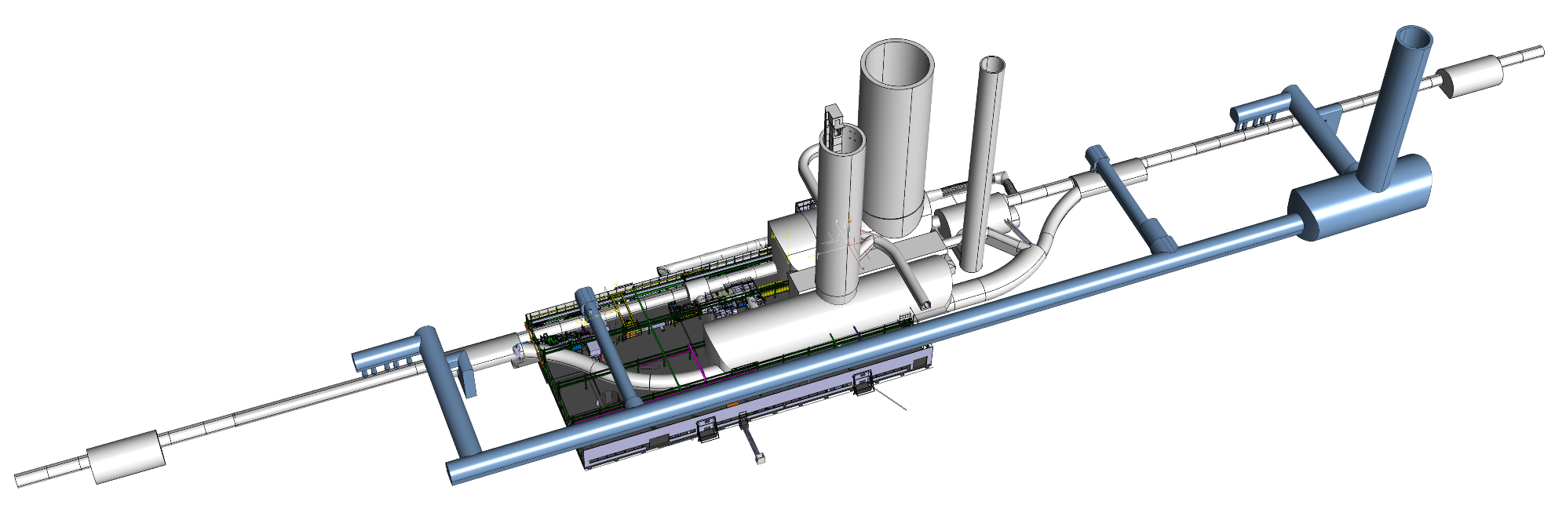
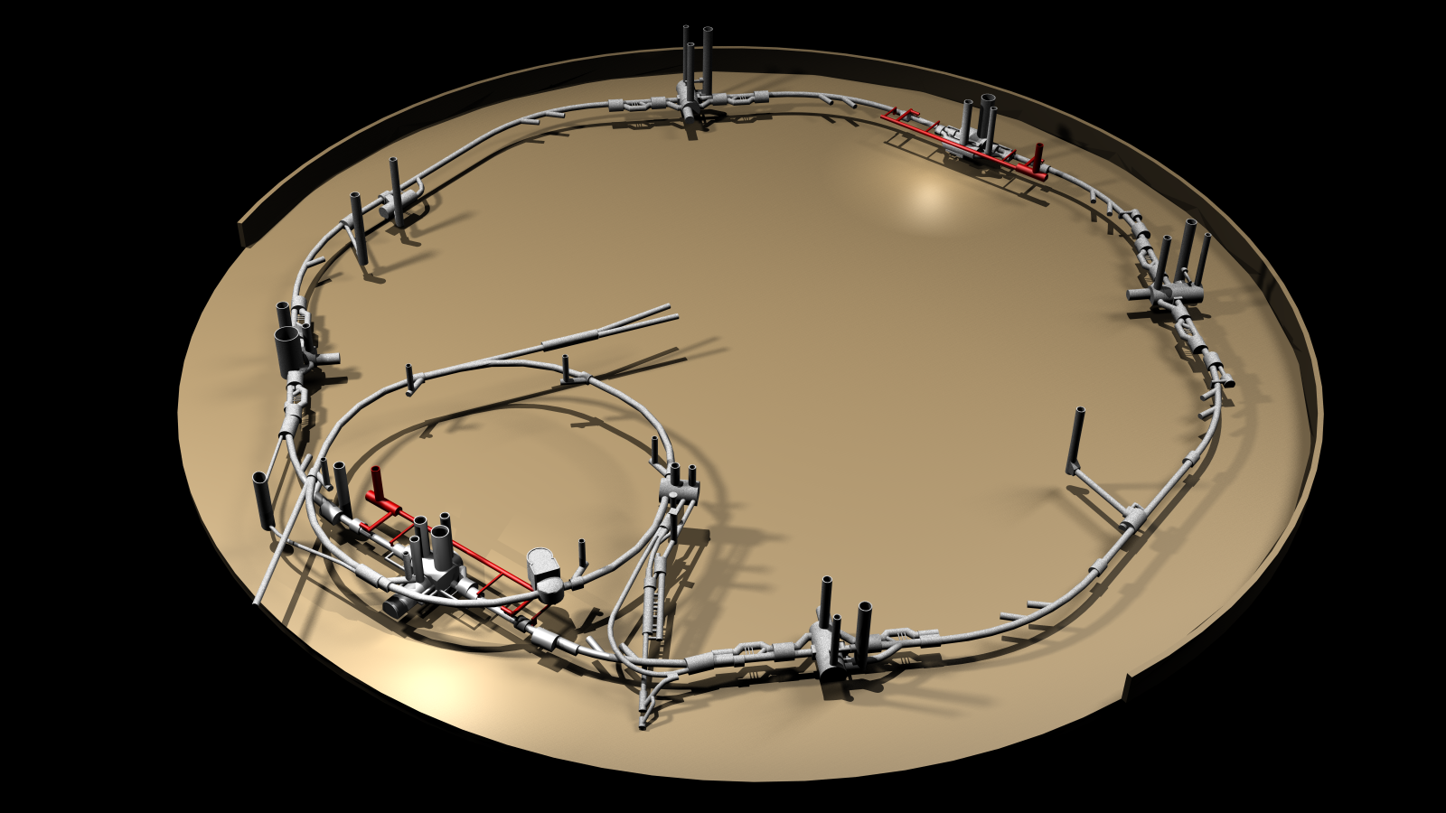
Configuration of the HL-LHC IT STRING
P5L is the most complicated and coherent set up with the Sm18 installations and the tunnel is the smallest . We plan to reproduce the space allowed in that place of the tunnel for the interventions
P4
P5
P3
HL-LHC
P6
P2
SPS
SM18
P7
P1
There is an essential difference as in HL LHC STRING we do not reproduce the SLOPE of the LHC tunnel.
P8

Slide 12
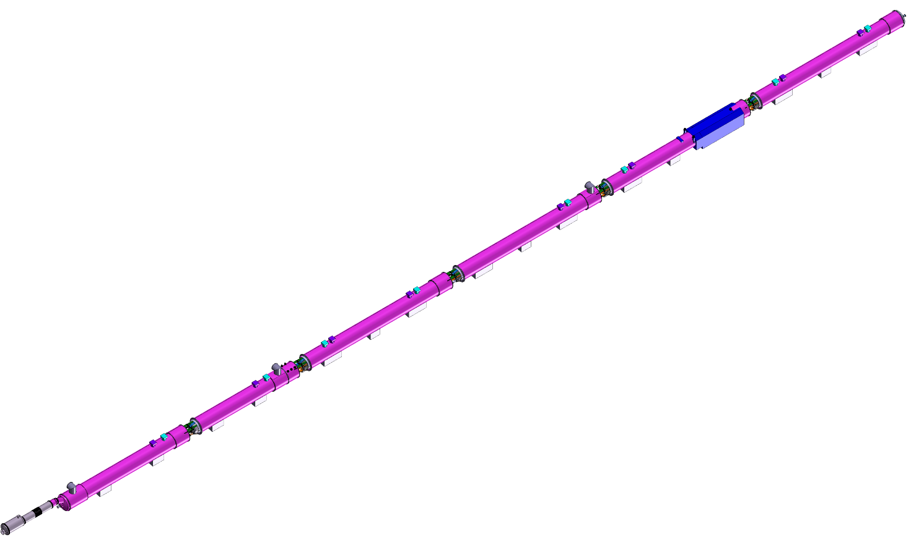
Main Components of the HL-LHC IT STRING
Q1
STRING defined between Q1 and D1, powered through Sc link
Additional instrumentation will be added only on prototypes
Common vacuum is an economic solution considered as baseline
Beam Screen only in Q1 and Q2a prototypes
DXF, DSH, DSL of 110 m : the first prototypes
Protection as in the HL-LHC ( CLIQ, QH, EE)
Powering as in HL-LHC
Prototype
BPM
IP5
Prototype
Q2a
Prototype
BPM
Additional Instrumentation
and heaters in the BS possible
Prototype
Q2b
Series
Q3
Series
CP
Series
Operation temperature 1.9 K
Powering to I_ultimate
1 thermal cycle to room temperature
1 quench / day during operation
Cryogenics designed to allow max 400 W heat extraction
D1
Prototype
DFX
Prototype
Main Steps
All components are “like series” (prototypes) or series and are owned by the WP
All infrastructure or components that can not be re-used in the HL-HC are owned by WP16

Slide 13
Experimental Program
Installation
Inter-
connection
Cooling
HWC
Exp @ Inom
Training to Iultimate
Thermal Cycle
HWC to
Inom
Exp @ I nominal
Warm up
Validation of the circuits and the protection systems powered as in HL-LHC ( first time for converters, Sc link and magnets)

Slide 14
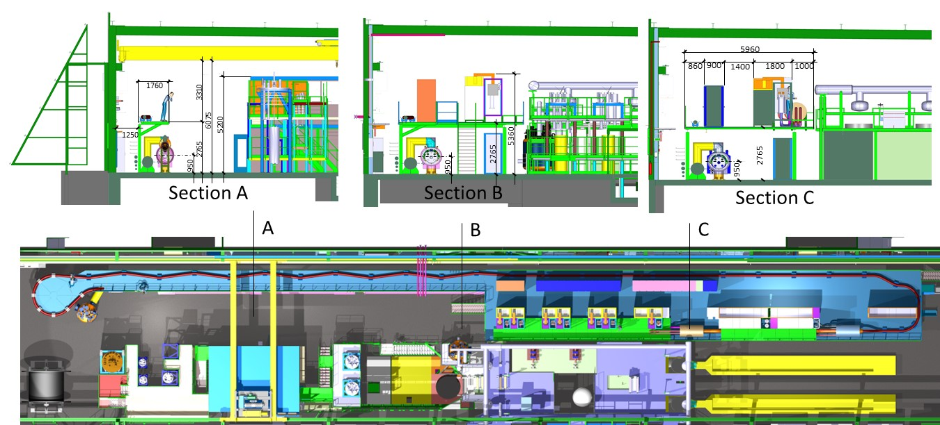
HL-LHC IT STRING in the SM18

Slide 15
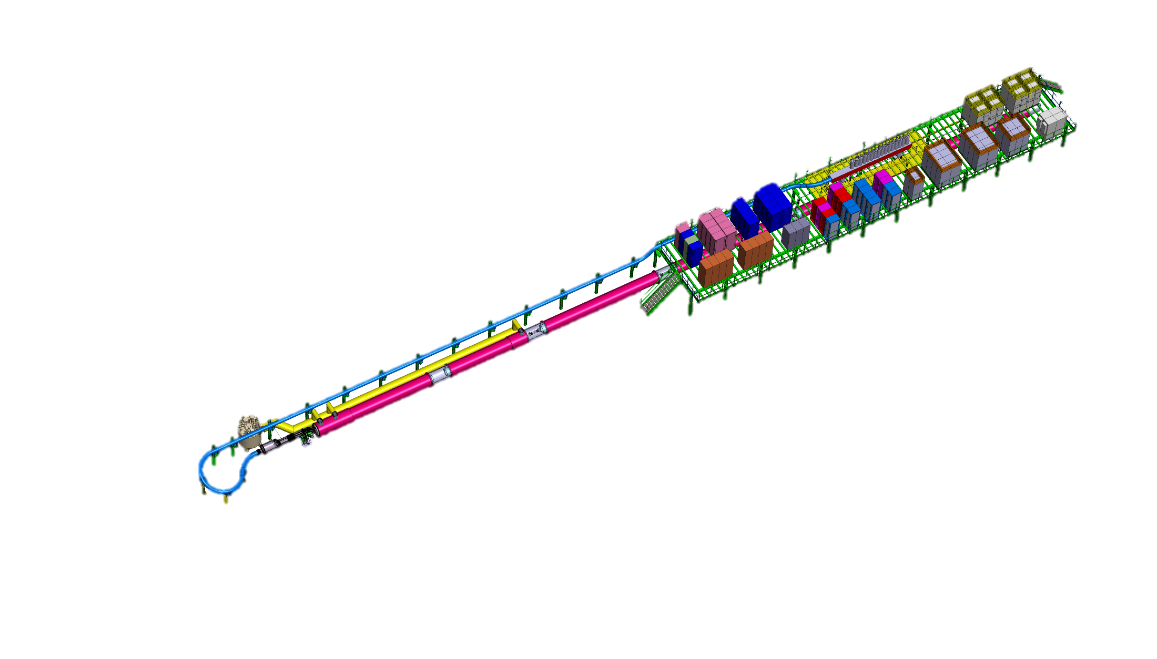
Summary
HL LHC IT STRING is foreseen to study the collective behaviour of the IT zone
The main components are: Q1-D1 with complete cold and warm powering
The test stand will be integrated into SM18 and will run
in the same time as the individual components test
Installation will start in 2020; Testing 2021 -2023
Infrastructure upgrade is ongoing
3 prototypes and 3 series magnets will be used
P5L will be reproduced without slope
180 quenches and up to 400 W heat
is planned to be possible to extract
ID CARD of the TEST STAND: HL-LHC IT STRING
TEST Facility LOCATION: SM18 (b. 2173)
TEST DATE: 2021-2023
OPERATIONAL TEMPERATURE: 1.9 K
OPERATIONAL CURRENT: Ultimate (108% I_{nominal} = 18 kA )
MAGNETS: Q1, Q2a, Q2b, Q3, CP, D1
COLD POWERING: SC link ,HTS leads DFH and DFX,
WARM POWERING: 1 x PC for 18 kA + 3 Trim for Q1-Q3 + 6 x 2 kA + 1 x 12 kA + 9x 0.1 kA + WCC
PROTECTION: CLIQ and QH ; EE where is baseline

