Slide 1
Future directions: Challenges of facilities/magnets
E. Todesco
Magnets, Superconductors and Cryostats Group (CERN)
Thanks to Marta, Sandor, Franco, Stoyan, Tatsu, Kevin, Roger, Gerard, and many others for feedback and discussions
12 June 2019 - Uppsala

Slide 2
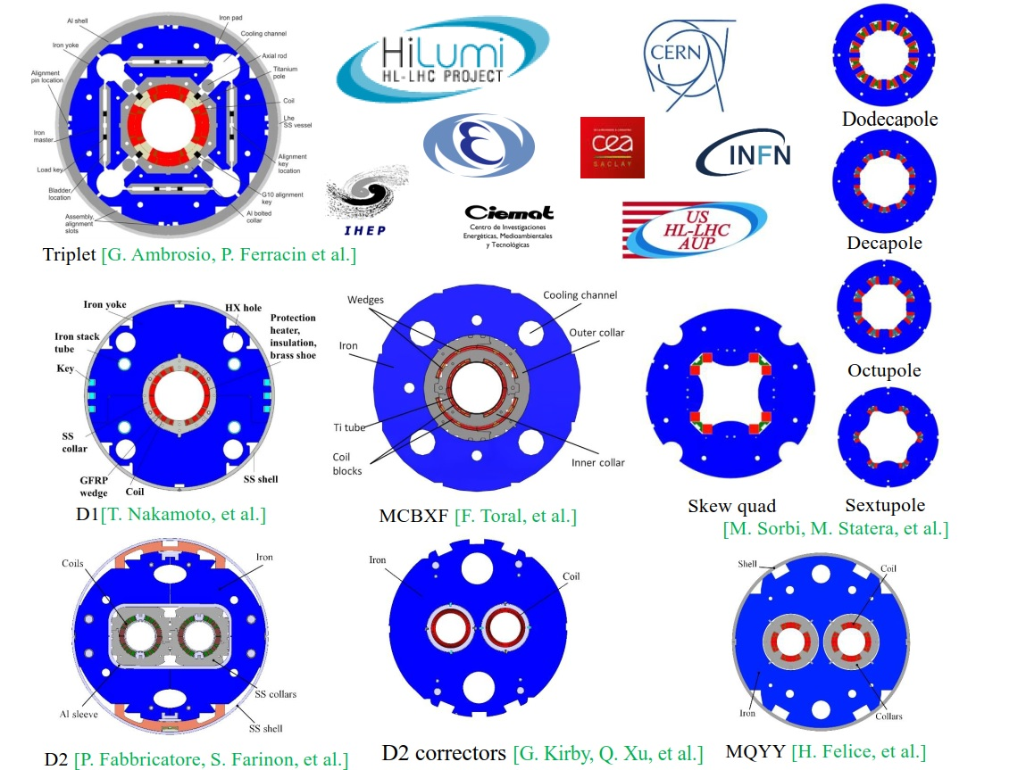
THE HL-LHC IR REGION MAGNETS
100 magnets of 11 different types, done via 6 collaborations
To be ready by 2024

Slide 3
SUMMARY
Techanical challenges
Training
Insulation
Protection
The brave new world of HTS
Managerial challenges
Communication
Training (of people)
Flux of work
Flexibility – testing also «other magnets»

Slide 4
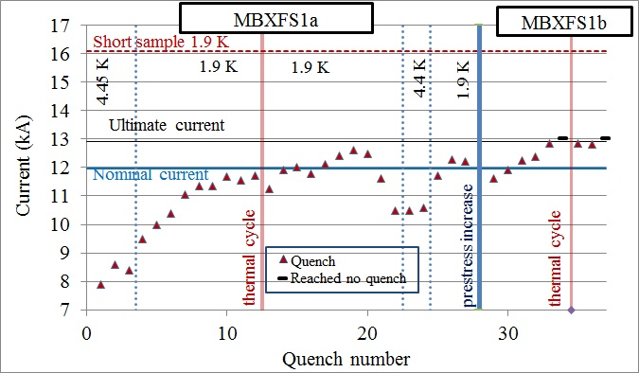
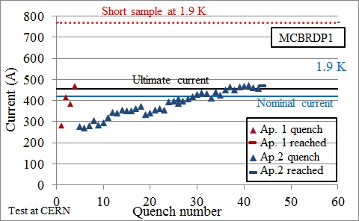
TECHNICAL CHALLENGES
Notwithstanding all efforts to eliminate training (design features as CCT, removable pole) …
Training is relevant, and it is still there
Not only in Nb₃Sn, but also in Nb-Ti
Quench performance is still the main issue for high current density magnets for accelerators
Training of D1 short model
(T. Nakamoto, et al.)
Training of D2 corrector (CCT)
(G. Kirby, et al.)

Slide 5
TECHNICAL CHALLENGES
Training mechanism is only partially understood and all instrumentation is necessary
Voltage taps (in model and prototypes, but in principle not for series magnets)
Quench antennas for longitudinal localization – looks to me that this is not a routine instrument
Other, such as acoustic emissions (for the moment still exotic)

Slide 6
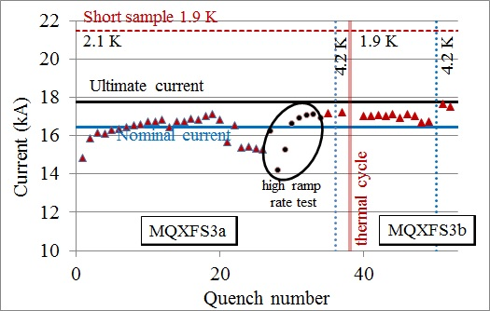
TECHNICAL CHALLENGES
For Nb₃Sn magnets are sometimes limited by instabilites
The nightmare of reverse behaviour
Better performance with higher ramp rates/ higher temperature
Important diagnosis tools: be able to make high ramp rate, and higher temperatures in a controlled mode
Instabilities and reverse behaviour in MQXFS3 (H. Bajas et al.)

Slide 7
TECHNICAL CHALLENGES
For Nb₃Sn magnets there are additional points
A relevant new tool is the VI measurements of order of nV, giving anticipation on quench and degradation
Here very high sensitivity is a must (nV!)
V I measurements in 11 T short model 109 (G. Willering et al.)

Slide 8
TECHNICAL CHALLENGES
Protection: CLIQ (G. Kirby, et al.) is becoming a standard tool
This new technology is being applied in US (FNAL and BNL) and at CERN to protect the triplet
It is routinely used without major issues in 3 test stations

Slide 9
TECHNICAL CHALLENGES
Insulation can be an issue for test stations
In many cases reaching the required level of voltage test (above 1 kV) is a challenge of the test station
In HL-LHC happened for instance in LASA, KEK
High voltage levels imply a verification of all the chain from the warm powering to the magnet
Controlled cool-down and warm-up
The issue of the maximal gradient during cool down and warm up and how to control it is non trivial, especially for Nb₃Sn magnets
Recent issues with 11 T tests

Slide 10
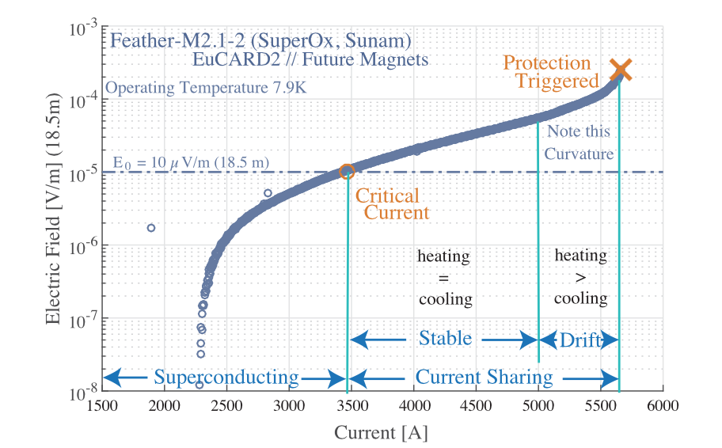
HTS: A BRAVE NEW WORLD ?
With HTS we enter a radically different domain in terms of training and protection
Very large temperature margin, current sharing regime above the short sample limit, possiblity to « see » the quench well before
Training could disappear from our dashboard of issues
Quench onset in Feather2 (J. van Nugteren et al, IEEE TAS 28 (2018))

Slide 11
SUMMARY
Techanical challenges
Training
Insulation
Protection
The brave new world of HTS
Managerial challenges
Communication
Training (of people)
Flux of work
Flexibility – testing also «other magnets»

Slide 12
MANAGERIAL CHALLENGES
The flow of magnets to be tested is very discontinous
It follows the timeline of the projects
This poses challenges for small test stations, or test stations strongly dependent on one project
Organization
Training of people
Maintenance of instrumentation

Slide 13
MANAGERIAL CHALLENGES
Communication
The sharing of the data is always a relevant issue
General approach of sharing post processed data
Immediacy of the communication is also a strategic problem
In some cases decisions have to be taken very rapidly
Test reports !

Slide 14
MANAGERIAL CHALLENGES
Schedule
Even though the time scale of our projects is of the order of 10 years, we are constantly fighting against time
Availability and efficiency are particularly critical for HL LHC project, that has very small series of magnets (practically, one is always in prototype phase)
Continuous streamlining request to remove the unnecessary tests and give priority to the relevant one
Doing everything is impossible
Very good contact between design, construction and tes team is needed

Slide 15
THANKS

