Slide 1
News from the FNAL test facility
Stoyan Stoynev /FNAL/
(major contributions by L. Kokoska; G. Velev, G. Sabbi, S. Prestemon)
3rd International Workshop on Superconducting Magnet Test Stands
11-12 June 2019 / Uppsala, Sweden

Slide 2
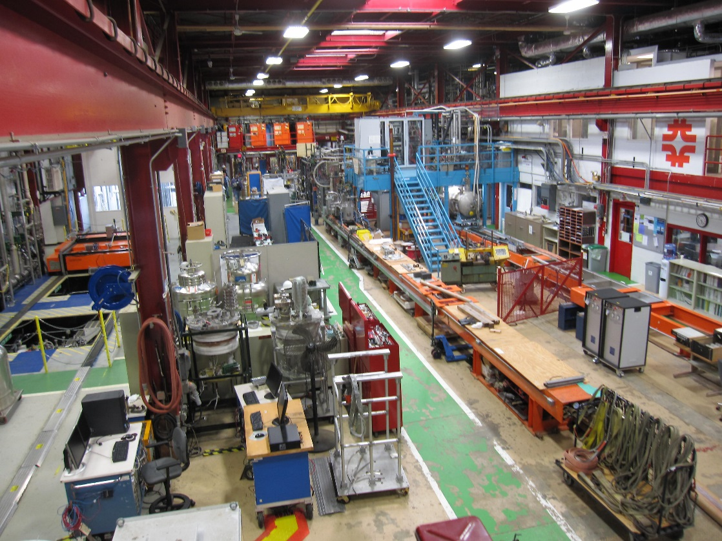
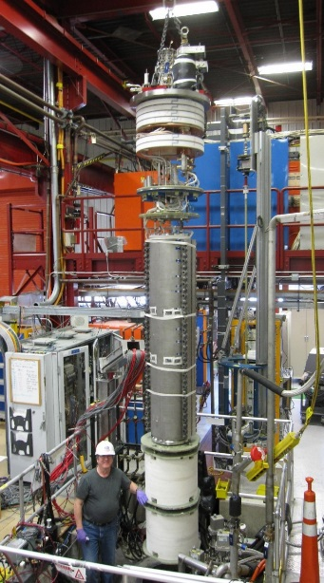
Introduction
Magnet Test Facility at FNAL (main areas)
Stand 3
Stand 4
VCTF
Stand 4
Previously used for testing Q2 optical
elements for the LHC IR final focus
Stand 6
VMTF
Operating temperature: 1.8-4.5 K
VMTF
Cooling phases: 300 to 4.5 K,
4.5 to 1.8 K
Number of cryostats
1 cryostat at VMTF - 4 m deep, 0.65 m diameter
1 cryostat at Stand 3 for 1 m long, 0.4 m diameter magnets
3 cryostats at VCTF, each 4 m deep, 0.7 m diameter
(VCTF used for cavity testing)
Lifting and Handling tools:
Two 25-top cranes,
two 10-ton cranes
More details:
https://indico.cern.ch/event/507584/contributions/2027924/attachments/1289637/1920085/SCMTS_at_FNAL.pdf
Shared cryogenics

Slide 3
Major upgrades
Cryo-assembly Horizontal Test Stand (Test Stand 4)
  Qualification and acceptance of Q1/Q3 cryo-assemblies for HL-LHC
  Overhaul or redesign of
    cryogenic plant and machinery
    mechanical support and parts
    a new 25-ton crane (already operational)
    magnetic measurement system
    quench detection, protection and control system
    Almost all key personnel associated to magnet testing involved in the project
  First test of the full system moved to March 2020
  Cryo-assembly testing in late 2020
“Super-VMTF” (High Field Vertical Magnet Test Facility for Conductor, Cable and Magnet R&D)
  Under serious consideration, could start this year
  Larger cryostat diameter (up to 1.4 m)
  Testing HTS/LTS samples, magnet components, hybrid magnets
  Similar or better capabilities compared to FRESCA2 at CERN or HEPdipo at PSI
L. Kokoska
G. Velev, G. Sabbi and S. Prestemon

Slide 4
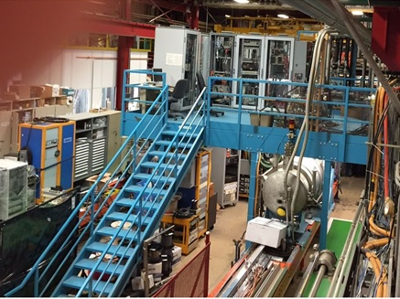
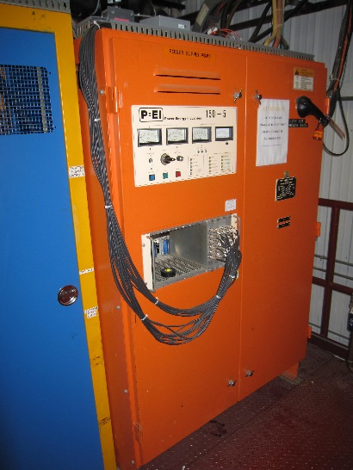
Infrastructure
The Fermilab’s Horizontal Test Facility previously was used for testing the existing LHC inner triplet quadrupoles in 2001-2006
Old LHC cryo-assembly at the
horizontal test stand
Racks with electronics for the
horizontal test stand
150 kW PEI Power Supply Module
We are making use of old components – we are either refurbishing them or using them after assessment/adjustment to meet the new requirements

Slide 5
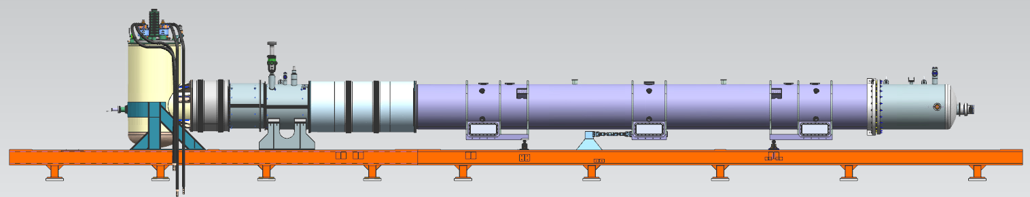
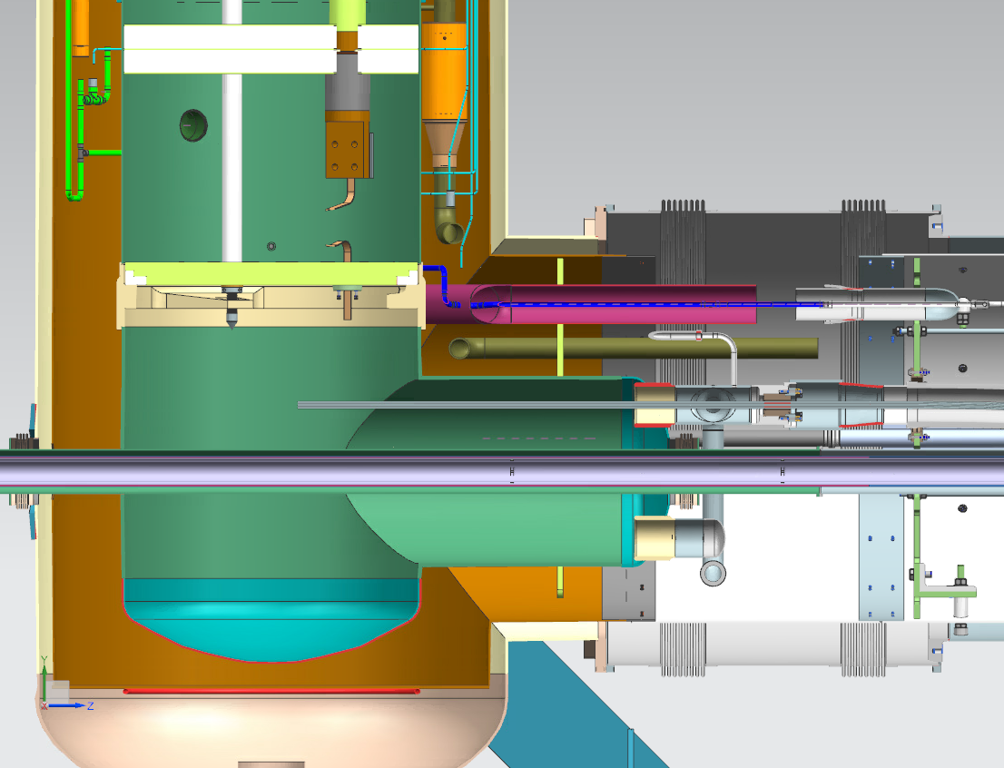
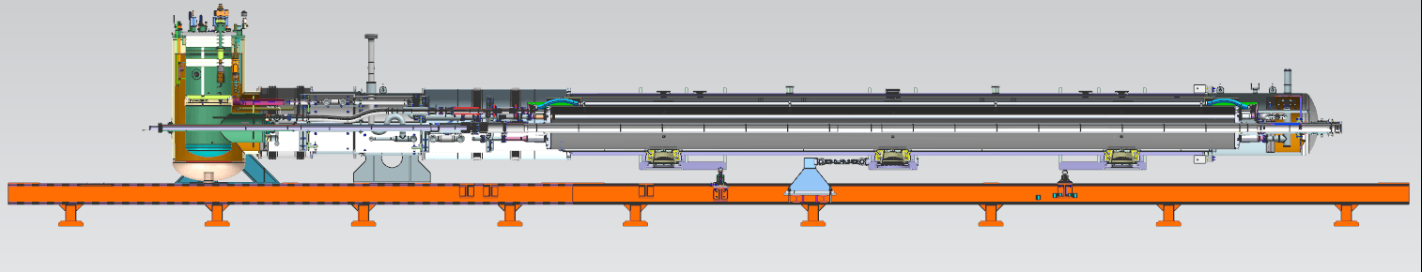
Test Stand 4 – Cryo-Mechanical Upgrades
85 psig (5.9 bar)
290 psig (20 bar)
Feed Box lambda plate replaced with an interconnect lambda plug
  Separates the 20 bar-rated HL LHC Cryo-Assembly from the existing 85 psig-rated Feed Box.
  Reduces the 1.9 K volume
    Faster pump-down time to 1.9 K
    Reduced 1.9 K heat load
    Reduced LHe usage
Added capabilities for controlled cool-down/controlled warm-up of the HL LHC Cryo-Assembly
Connection to existing IB1 Quench Recovery System
  Reduced He losses
L. Kokoska

Slide 6
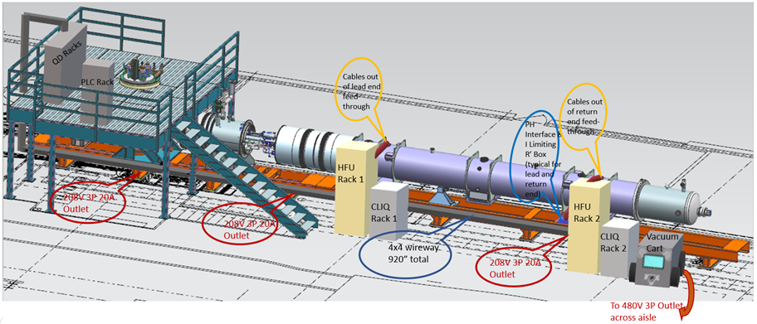
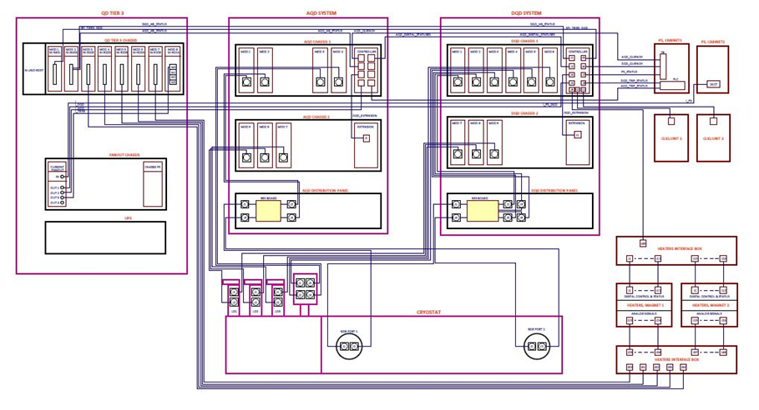
Test Stand 4 – Power & QPM
QD Tier 3
AQD System
DQD System
PS Cabinets
Controls & DAQ Upgrades
CLIQ Protection System
Power Leads re-classification from 15kA to 18kA
3-TIER QUENCH DETECTION ARCHITECTURE
CLIQ Units
Heaters Interface
Cryostat

Slide 7
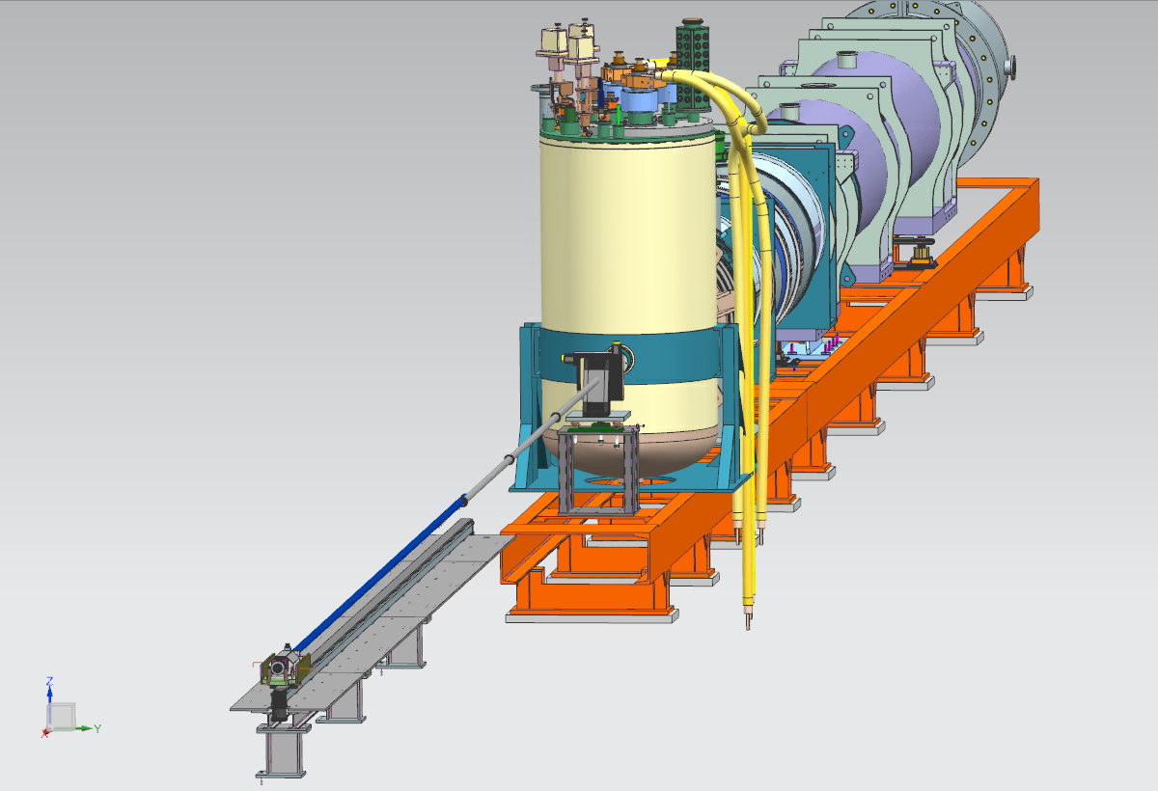
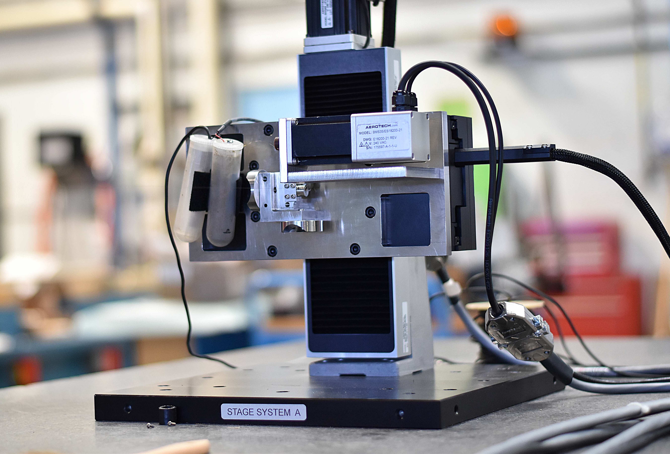
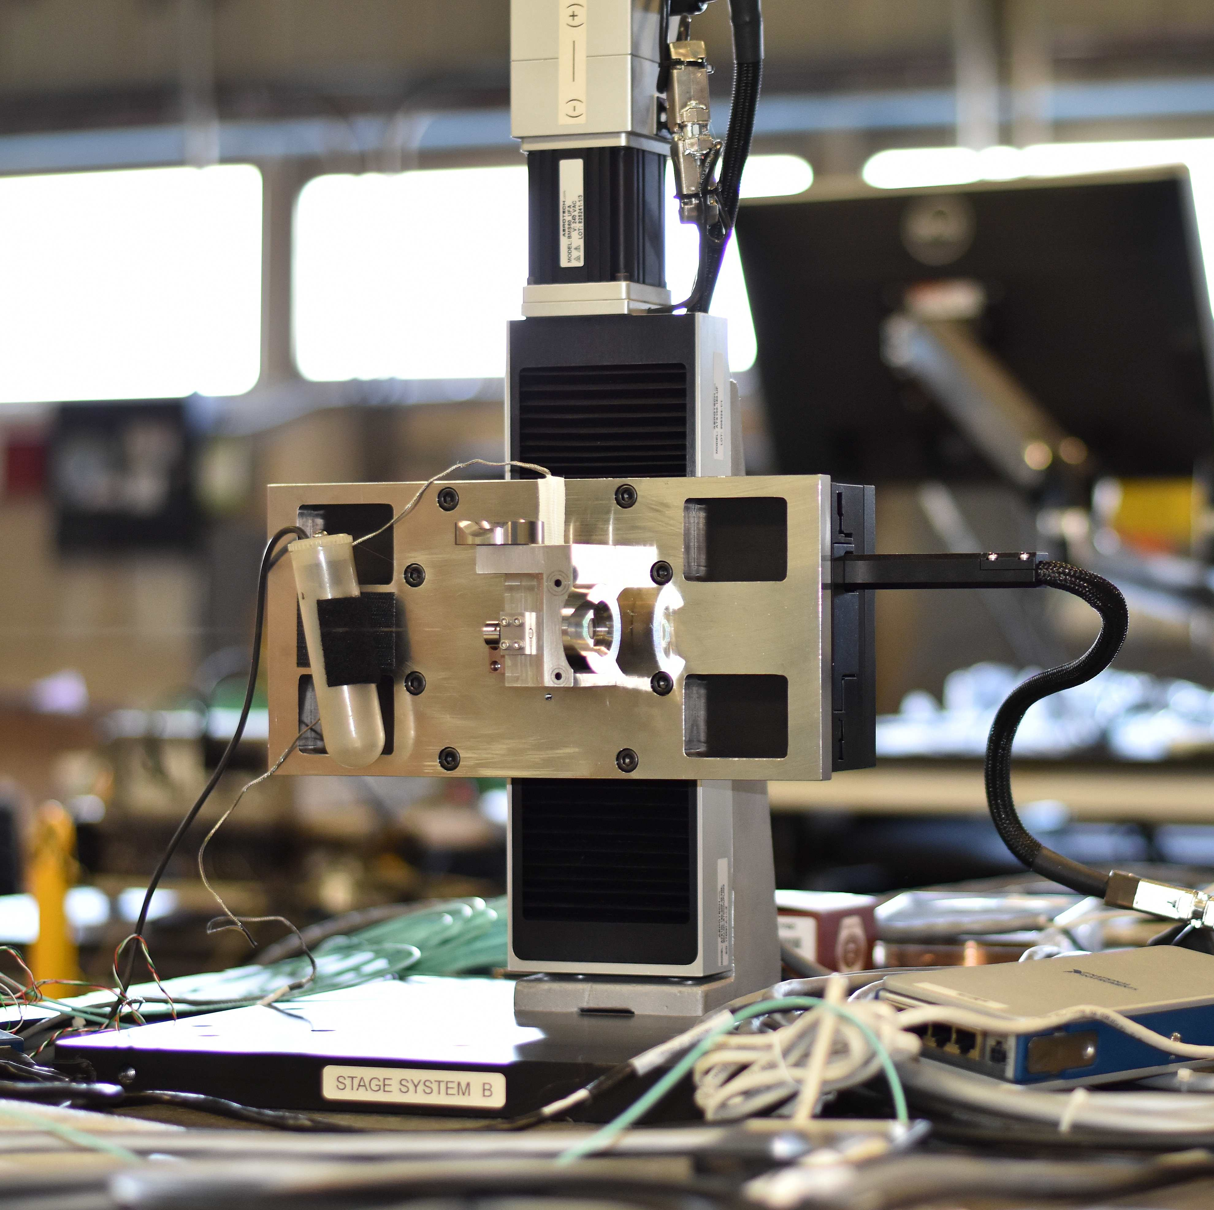
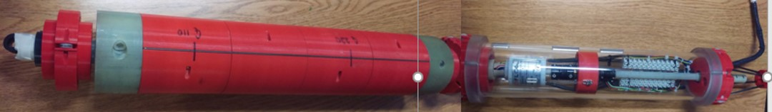
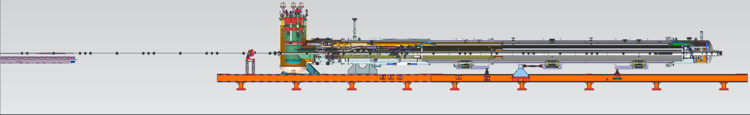
Test Stand 4 – Magnetic Measurement Highlights
23-meters
Integral strength and SSW measurements at room temperature and 1.9K for alignment of two magnets with respect to each other
Integral measurements of cold mass, including strength & harmonic field errors at 300 K and 1.9K
Local measurements along length of cryo-assemblies with:
  Self Contained (with its own encoder, slip-rings, gravity sensor) 100mm diameter rotating coil system (Ferret Probe) for local field quality measurements and alignment assessment
  23-meter (75-ft) long push-pull shaft for probe positioning
  flex drive for probe rotation while maintaining precise measurements
  PPM field measurements and 1e-4 integrals
  Incorporation of laser tracker to measure angles (along a very long & narrow pipe) and position of probe along axis to compensate for mechanical effects when determining local magnetic axes
  New ‘state of the art’ multi-channel, high precision (24-bit) DAQ and software framework

Slide 8
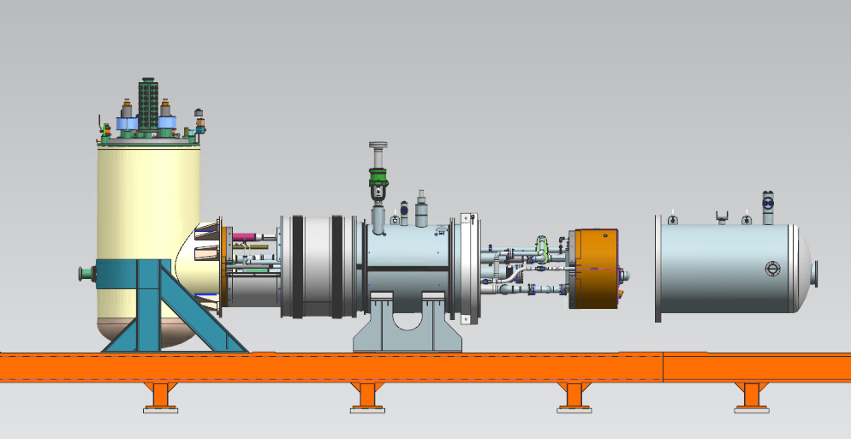
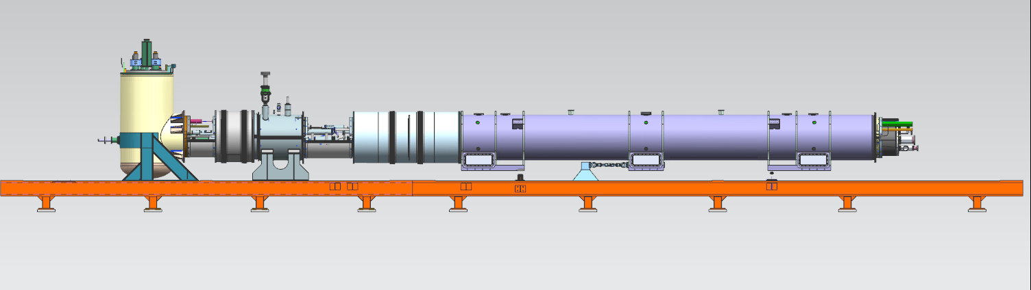
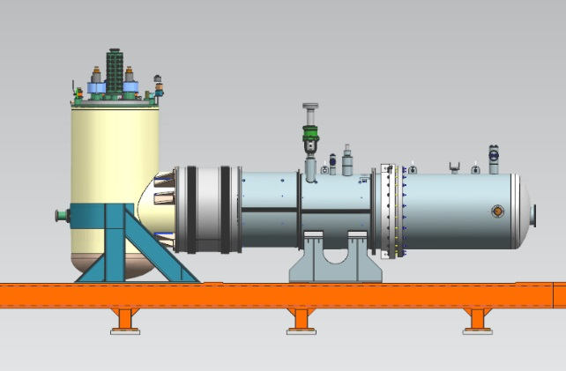
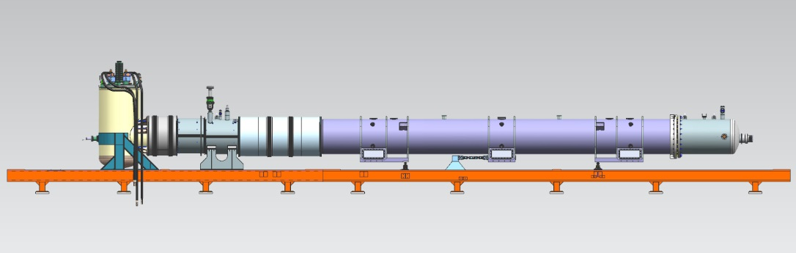
Hi-Lumi LQXFA Cryo-Assembly Testing Steps
Zero Magnet Test Configuration
  Open & Closed Assembly
Prototype & Production Test Configuration
  Open & Closed Assembly
Spring of 2020
Late 2020

Slide 9
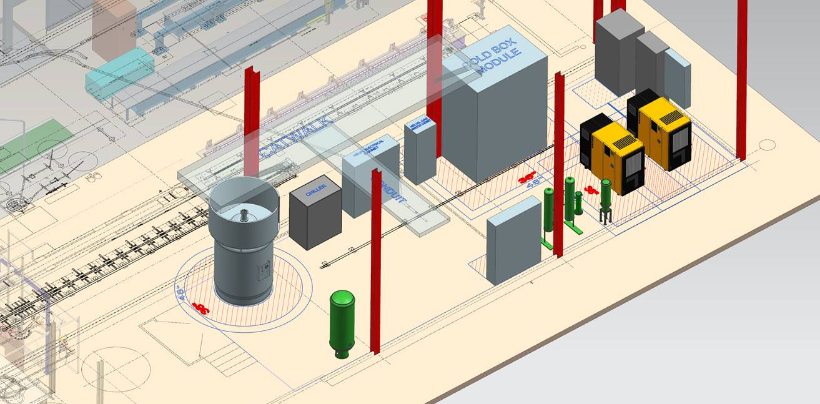
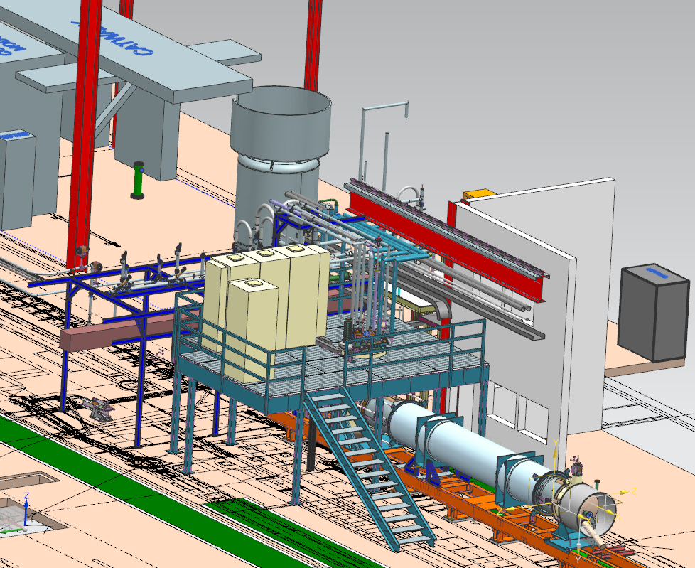
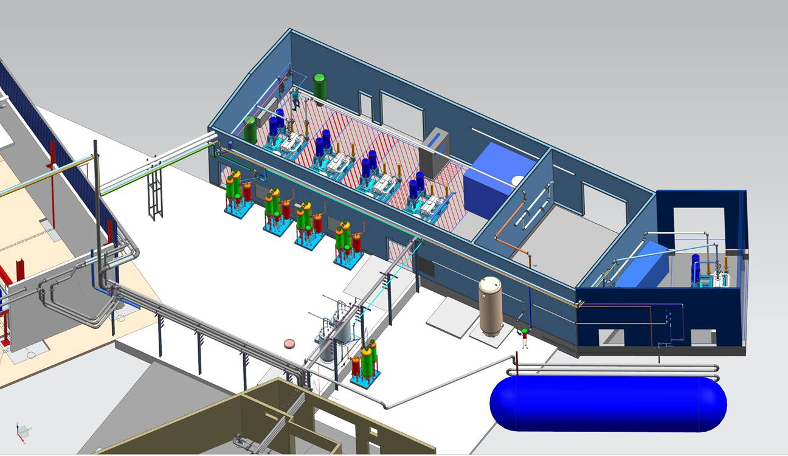
Facility Cryogenics System Upgrade
Installation of a new cryoplant (operational in the end of 2021)
in parallel with the existing cryoplant
Subsequent replacement of the existing cryoplant with a second new cryoplant
New cryogenic distribution system

Slide 10
Super-VMTF (HF-VMTF): why a new Vertical Magnet Test Facility?
One of the primary goals of the US Magnet Development Program is to pave the way for future high field accelerator magnets, e.g. 16-20 T dipoles
The x-section of magnet is increasing with the field - need a test facility with larger cryostat diameter
Goal: to construct a vertical test facility (pit) for ø= 1-1.4-m diameter magnets operating at 1.8-1.9K and max current ~24kA, for testing HTS, Nb₃Sn samples, hybrid magnets (Nb₃Sn+HTS), utility structure to test magnet components in HF
Fermilab has unique capability to build such facility
  1.8K testing capabilities
  30 kA power supply system
  2x 25-ton lifting capability for a single object in vertical direction
  New Cryo plant coming in operation at the end of 2021
This proposed setup has similar or better capabilities, comparing to FRESCA2 at CERN or HEPdipo at PSI
G. Velev, G. Sabbi and S. Prestemon

Slide 11
Super-VMTF (HF-VMTF)
Parameter | Existing VMTF | Proposed HF-VMTF
Operating Temperature | 1.8K | 1.8-1.9K
Maximum Current (1st PS) | 30 kA | 30 kA or new 24 kA
Maximum Current (2nd PS) | Not available | 15 kA (to test hybrid magnets) or 100 kA for FES
Helium Vessel Diameter | 0.66 m ( 25.8 inches) | < 1.4 m (55 inches)
Maximum Length of Test Object | 3.7 m | >2.5 m
Maximum Diameter of Test Object | 0.63 m (MQXFS1 with skin) | 1.35 m
Crane Capacity | 10 t | 25 t or 2x25 t & LF
Location | IB-1 VMTF Bay | IB-1 (IB1 High Bay)
The proposal covers two options: “pure” HEP testing facility or HEP+FES;
support is being searched for from
US DOE Office of Science, High Energy Physics and Fusion Energy Sciences (FES)

Slide 12
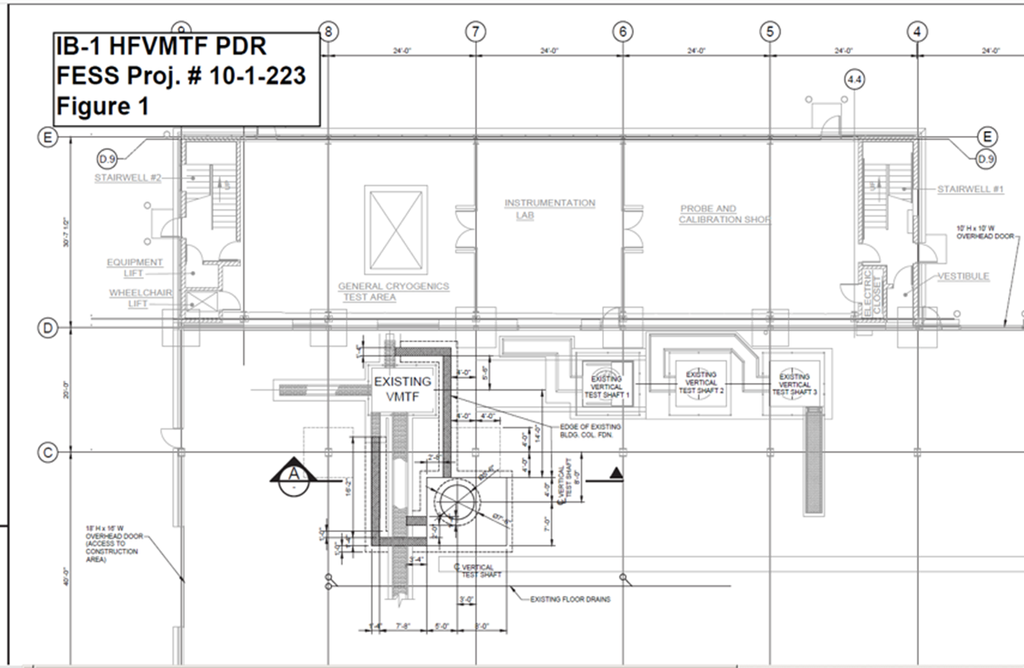
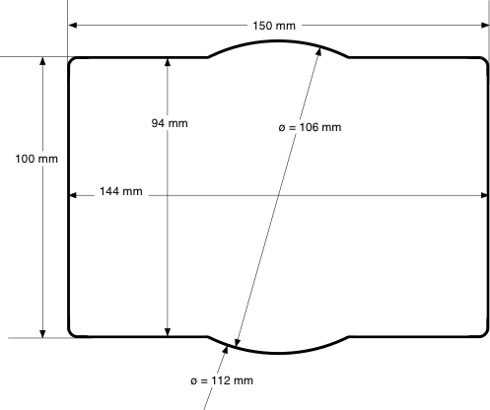
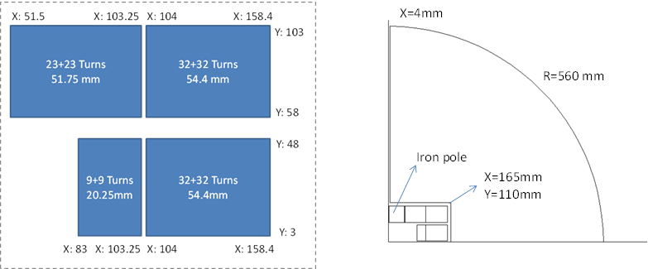
Super-VMTF (HF-VMTF) preliminary design
Preliminary Civil Construction Drawing
- Conceptual/preliminary designs
of the test facility and a 15 T*
dipole magnet exit
Schedule and cost estimations
are in place – depends on the
funding and FES interest
- No conflict with the current
projects at Fermilab is expected
Conceptual magnet design (rectangular aperture of 94x144 mm²)
When funding is available the project
can be executed for ~ 5 years
*Background field needed
for insert/sample testing

Slide 13
Summary
Existing facilities allow for “short” (up to 4 m long)
non-cryostated magnet tests at 1.9 K
Major horizontal test stand upgrade going on for testing
HL-LHC Nb3Sn quadrupole magnet assemblies
  Test Stand operational with magnet assemblies in 2020
  New He plant to be commissioned in 2021
An upgrade on the vertical test stand at FNAL is being pursued
  Possibly HEP/FES dual use
  For short R&D magnets and magnet components, inserts (HTS included)

Slide 14
Backup Slides

