Slide 1
News from the KEK test facility
Kento Suzuki on behalf of the CERN-KEK collaboration
3rd Magnet Test Stand in Uppsala, K. Suzuki, June 11

Slide 2
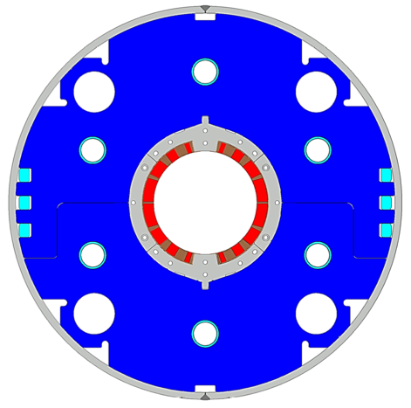
Japanese Contribution to HL-LHC: D1 magnets
MOU was contracted at MEXT, Japan on 6th July 2018
Beam separation dipole (D1) by KEK
  Design study of D1 for HL-LHC within the framework of the CERN-KEK collaboration since 2011.
  150 mm single aperture, 35 Tm (5.6 T x 6.3 m), Nb-Ti technology.
  Development 2-m long model magnets (3 units) at KEK
Deliverables for HL-LHC
  1 full-scale prototype cold mass (MBXFP)
  6 series cold masses (MBXF1-6)
7 units x 7-m long cold masses

Slide 3
Schedule
Start of series production
Contract signed
Deadline of prototype
Deadline of series 4
Bill opening for the Prototype and Series : 24th May
  Successful bidder : Hitachi Co. Ltd.
Prototype fabrication has to start before cold test of 3rd Model at Sep. 2019.
Production of Series 1 will start after the vertical test of Prototype.
Foreseen milestones: delivery date of cold masses
  MBXFP (for string test): Nov. 2020.
  MBXF1-4 (for the HL-LHC machine): April 2023.
  MBXF1-6 (all): June 2024.

Slide 4
Test stand at KEK

Slide 5
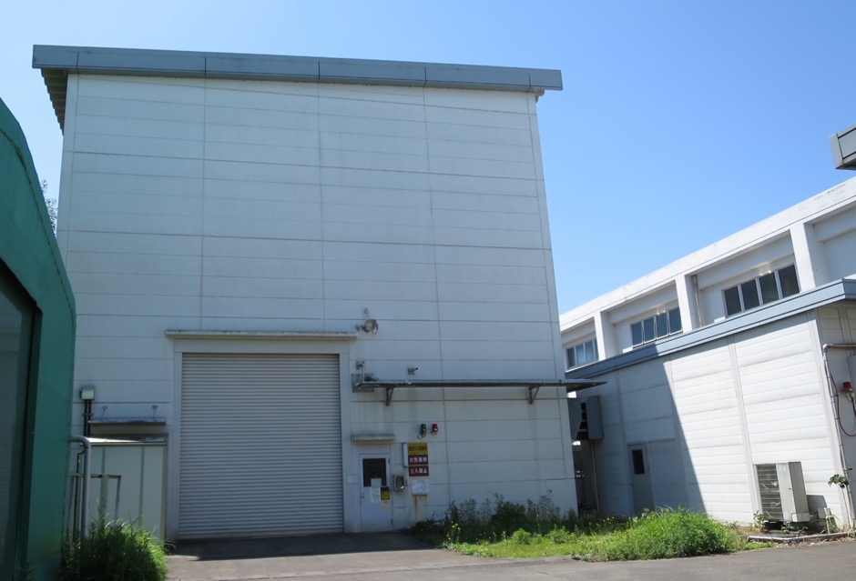
Bird’s eye view of KEK
Mt. Tsukuba (877m)
Hokkaido
Test stand at
Cryogenics Science Center
Super KEKB (e⁻ + e⁺)
Tokyo

Slide 6
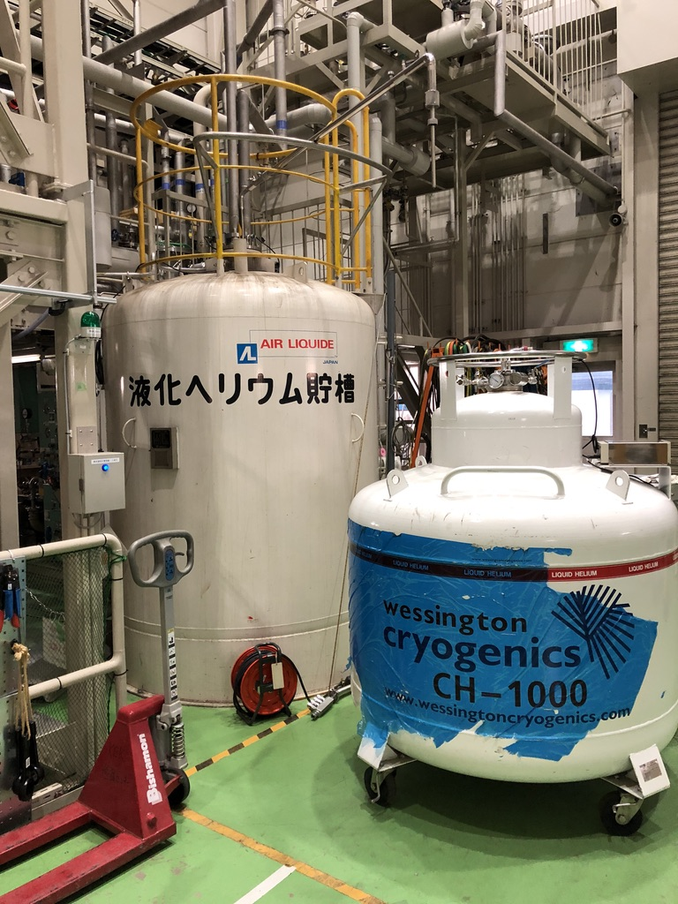
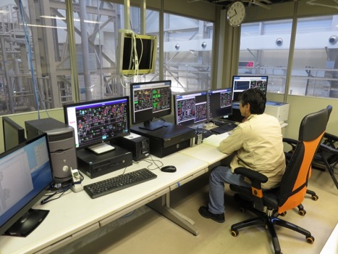
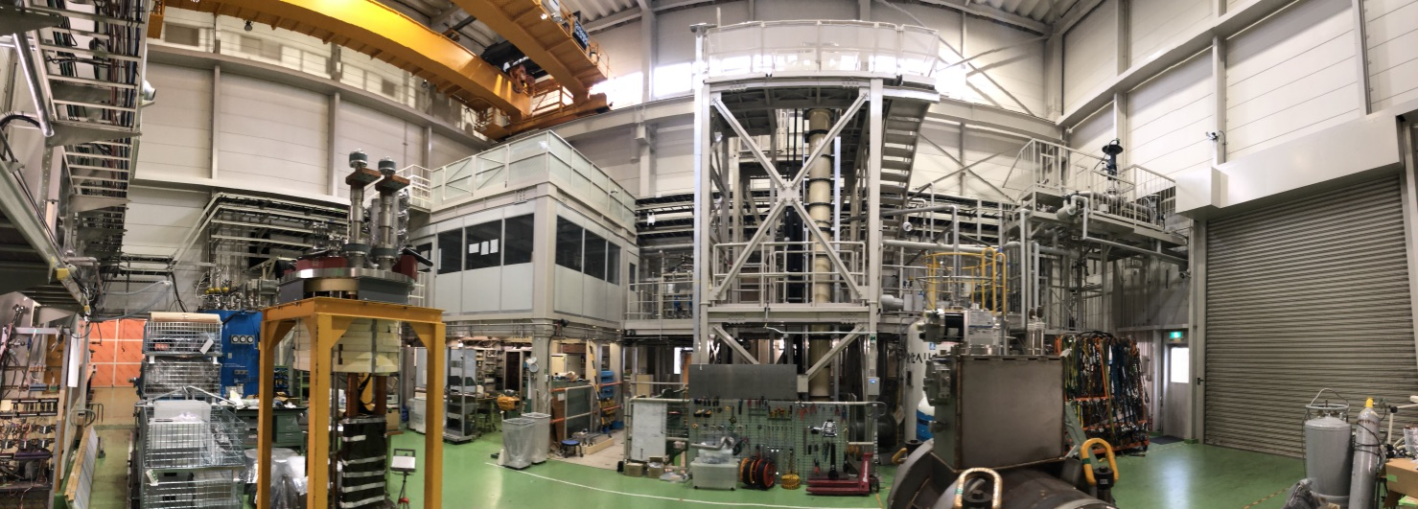
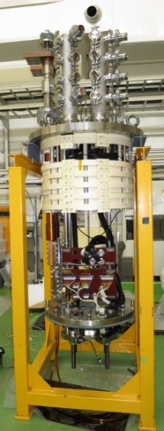
KEK Test Stand
20 t crane
MBXF header
Control room
Liquefier
(2400 L dewer)
7.5 m deep cryostat
Previous reports can be found at :
  1st workshop
    https://indico.cern.ch/event/507584/contributions/2027926/attachments/1289830/1920459/20160613KEKTestStand_NakamotoFinal.pdf
  2nd workshop
    https://indico.cern.ch/event/704235/contributions/2931999/attachments/1651165/2640917/20180508KEKD1_TestStandWSFinal.pdf

Slide 7
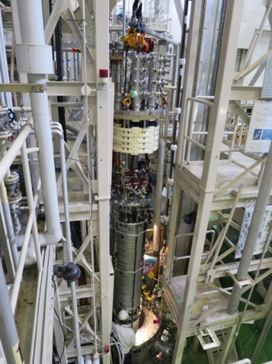
Vertical cryostat
Operating Temp.: 4.4 K to 1.9 K by HeII Sub-cooler (55 W for MQXA)
Capacity of 1.9 K bath: 7524 mm deep, 700 mm in a diameter.
  Can accommodate the prototype/series magnet
New header for the D1 (MBXF) in 2014
Anti-cryostat for field measurement: O.D. 141.3 mm
  Quench antennas: 11 arrays for 7 m long magnet
15 kA Current Leads
  HVWL: 1.5 kV

Slide 8
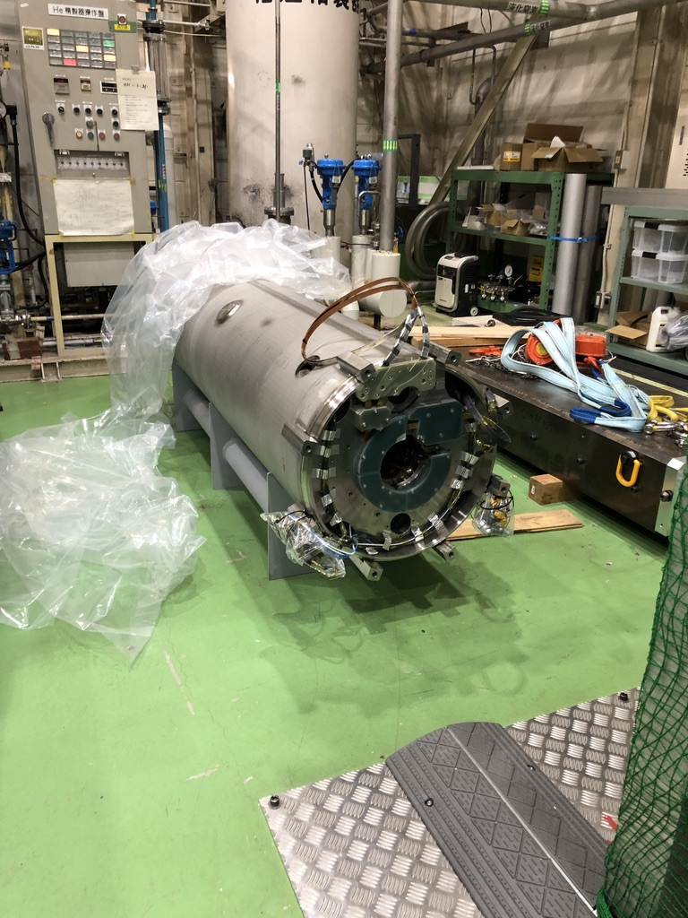
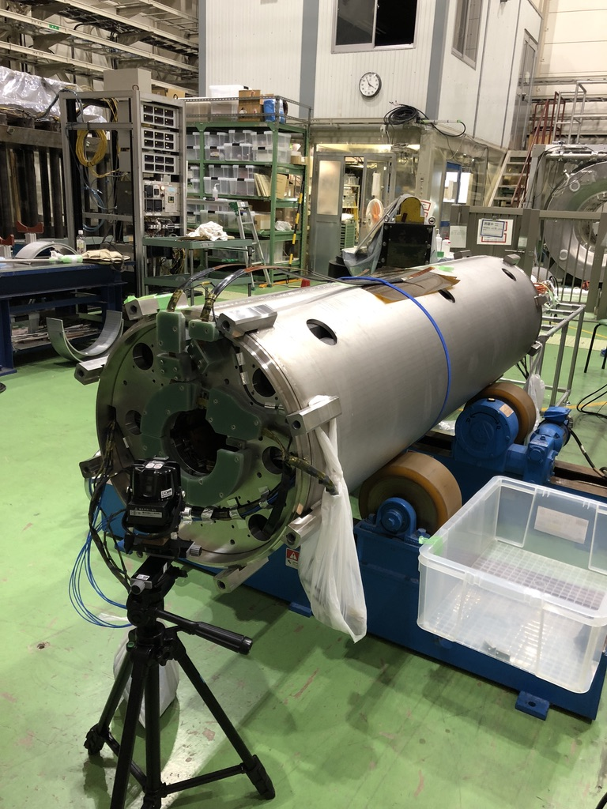
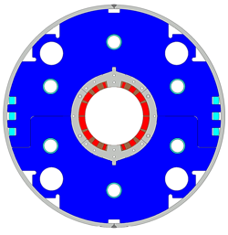
Cold test of the model magnets
DC loop
at the magnet center
~20 unit
1st model
(MBXFS1, 1b)
While good training performance was achieved in the 2nd model,
Unacceptable offset in b₃ at the magnet center in the 2nd model.
The coil possibly deforms due to the large pre-load
2nd model
(MBXFS2)

Slide 9
Cold test of the model magnets
DC loop
at the magnet center
The 3rd short model magnet production :
- FINAL model magnet
- 2nd model’s cross section, similar pre-load as well
- Check reproducibility
The cold test is planned to be held in this summer
Results will be reported at the next MT26
~20 unit
1st model
(MBXFS1, 1b)
While good training performance was achieved in the 2nd model,
Unacceptable offset in b₃ at the magnet center in the 2nd model.
The coil possibly deforms due to the large pre-load
2nd model
(MBXFS2)

Slide 10
Readiness for production of the Prototype and Series

Slide 11
Acceptance criteria for Prototype/Series
During fabrication, conformity tests have to be conducted for its quality assurance
Electrical test
  Coil to ground : 2.6 kV (Warm) / 1.3 kV (LHe)
  Coil to quench heater : 4.6 kV (Warm) / 2.3 kV (LHe)
Alignment / Field quality
  Magnetic center axis : within ± 5 mm
  Integrated field angle : within ± 5 mrad
  Deviation of local field center / angle : within ± 2 mm / 2 mrad
  Field integral : |b₃| < 2.9 unit, |b₅| < 1.5 unit, ..
Performed at
the test bench
By the warm field measurement

Slide 12
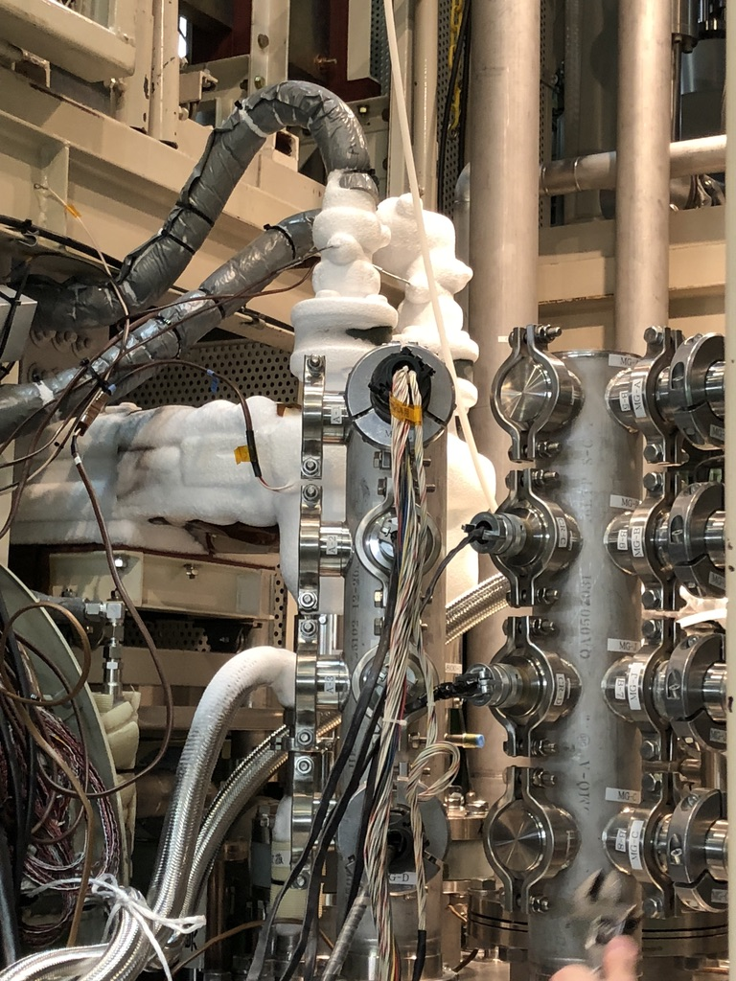
Readiness for the electrical test
Feed-through
Electrical tests with the 2nd model magnets have been performed under the LHe (1.9 K) condition after the cold test
Coil-to-ground (1.3 kV):
  Applied through the current lead (CL)
  Leakage current increases linearly
CL
+HV
+HV
Lead cable
heater line
Magnet

Slide 13
Readiness for the electrical test
Feed-through
Electrical tests with the 2nd model magnets have been performed under the LHe (1.9 K) condition after the cold test
Coil-to-heater (2.3 kV):
  Applied through the feedthrough of the header
  Breakdown before reaching 2 kV
+HV
Breakdown
Lead cable
heater line
Magnet

Slide 14
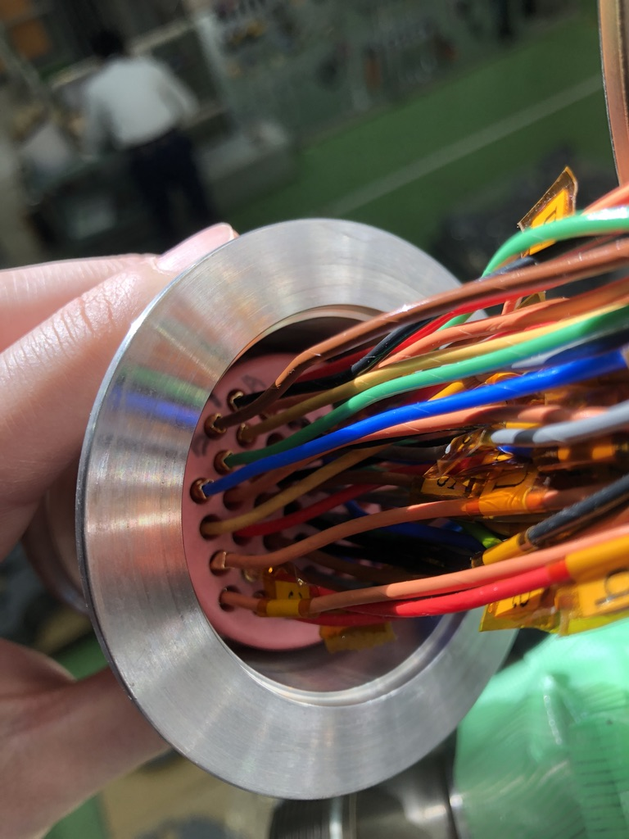
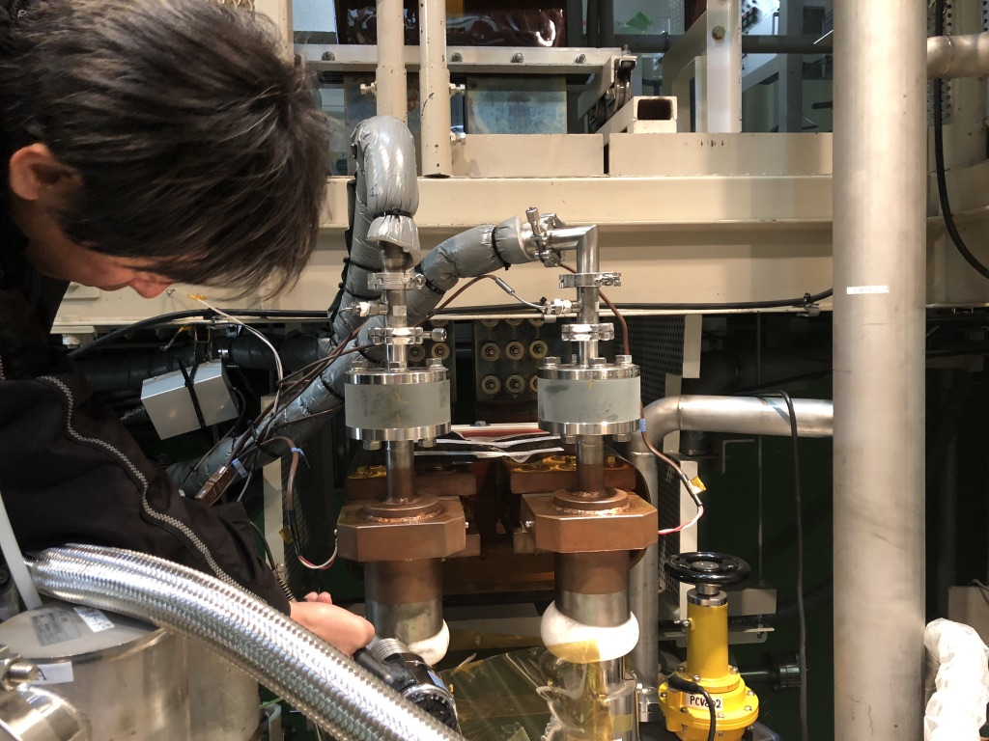
Countermeasure for the weak channels
ICE
Dry condition
Feedthrough of the
heater lines
Individual insulation performance of the header was checked without the magnet
  Unacceptable weak insulation for both channels of coil-to-ground (CL) and heater-to-ground (feedthrough)
  He gas flowing through the CL hollow to avoid thermal penetration into the cryostat, resulting in frost around CL
  Some pin plugs were weakly connected to sockets of the feedthrough and partially exposed to ~1.5 atm He gas
→ Large leakage current
→ Breakdown (Passien’s law)
Special cryogenic operation to eliminate the frost is established Improvement works for the pin-socket connection are underway

Slide 15
Countermeasure for the weak channels
ICE
Dry condition
Feedthrough of the
heater lines
Shortly ready for the Prototype / Series
Individual insulation performance of the header was checked without the magnet
  Unacceptable weak insulation for both channels of coil-to-ground (CL) and heater-to-ground (feedthrough)
  He gas flowing through the CL hollow to avoid thermal penetration into the cryostat, resulting in frost around CL
  Some pin plugs were weakly connected to sockets of the feedthrough and partially exposed to ~1.5 atm He gas
→ Large leakage current
→ Breakdown (Passien’s law)
Special cryogenic operation to eliminate the frost is established Improvement works for the pin-socket connection are underway

Slide 16
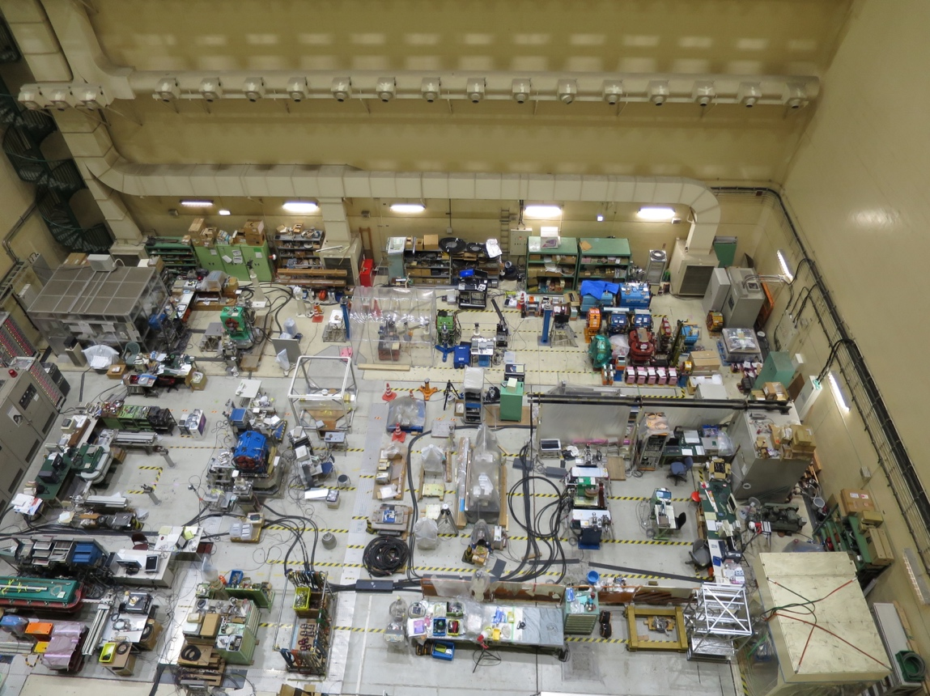
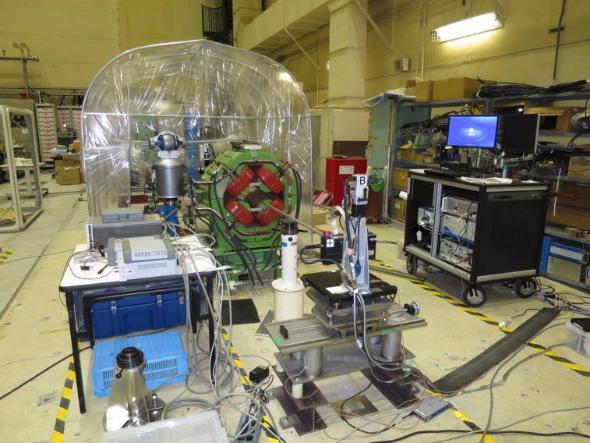
Warm field measurement: SSW for Prototype/Series
Area (15m x 5m) for MFM and survey for D1
SSW system of QCS magnet for SuperKEKB
Nikko-exp. hall for SuperKEKB
Field angle with respect to fiducials (reference alignment points) will be determined by the warm field measurement with SSW (Single Stretched Wire).
The measurement system was already developed for SuperKEKB QCS magnet and is now available for the D1.
  The dedicated team joined the HL-LHC D1 project.
  Preparation of measurement for the 7m-long prototype cold mass is underway in Nikko-Exp. Hall at KEK.

Slide 17
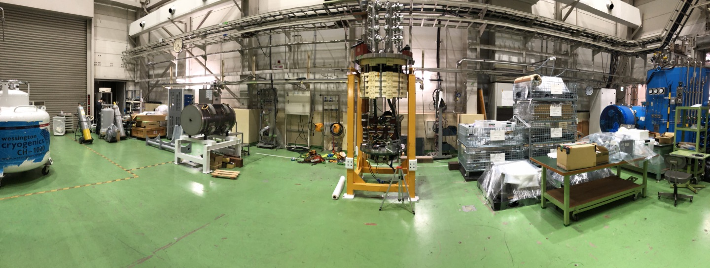
Warm field measurement: Rotating coil system for Prototype/Series
KEK Test stand
D1 Cold mass
Rotating coil system
Local field angle/ magnetic center will be determined by warm field measurements with a rotating coil which is being designed for the 7-m long magnet
Our test stand can accommodate the overall measurement system (L~15m)
Preparation of instruments is ongoing in collaboration with the QCS SuperKEKB accelerator team

Slide 18
Summary
KEK will soon start the production of the Prototype
Readiness for the production
  Electrical test
    We have investigated performance and some improvements works are ongoing
  Field measurement
    Preparation for the measurement instrumentations in collaboration of the QCS SuperKEKB acceleartor team

Slide 19
Supplement

Slide 20
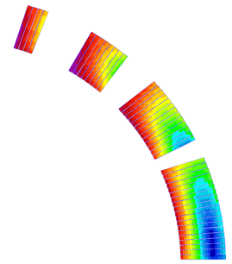
Design overview from D1 (MBXF)
 | A series production (7m) | MBXFS2 (2 m)
Coil aperture | 150 mm
Field integral | 35 T m | 9.5 T m
Field (3D) | Nominal: 5.60 T, Ultimate: 6.04 T
Peak field (3D) | Nominal: 6.58 T, Ultimate: 71.4 T
Current | Nominal : 12.047 kA, Ultimate 13.280 kA
Operating temperature | 1.9 K
Field quality | <10⁻⁴ w.r.t B₁ (R_{ref}=50 mm)
Load line ratio (3D) | Nominal: 76.5%, Ultimate: 83.1% at 1.9 K
Differential inductance | Nominal: 4.0 mH/m
Conductor | Nb-Ti: LHC-MB outer cable
Stored energy | Nominal: 340 kJ/m
Magnetic length | 6.26 m | 1.67 m
Coil mech. length | 6.58 m | 2.00 m
Magnet mech. length | 6.73 m | 2.15 m
Heat load | 135 W (Magnet total) 2 mW/cm³ (Coil peak) > 25 MGy
Radiation dose
4
8
13
4 blocks
44 turns
19
Technical challenges
・Large aperture： Management of coil size and pre-stress.
・Radiation resistance：Radiation resistant material for coil parts. Cooling capability.
・Iron saturation：Good field quality from injection to nominal current

Slide 21
Cold test of the model magnets
Training history so far
1st model
(MBXFS1, 1b)
Good training performance
achieved in the 2nd model due to sufficient pre-load
2nd model
(MBXFS2)

Slide 22
Issue in field of quality in the 2nd short model
Found offset (~20 units) in b3 which is not acceptable according to the requirement
Due to large pre-load (120 MPa at the magnet pole), oval coil deformation was possibly occurred during fabrication
DC loop
+a
Oval cross-section
Circular cross-section
dx
dy
Z scan
a=0.4 mm
θ
-a

Slide 23
Electronical insulation performance (cont’d)
ICE
1500 V applied to CL
Special study performed for eliminating the frost by our cryogenic technicians
  Stopping the He gas flow allows thermal penetration into the cryostat
  To reduce consumption of LHe, not only the test-stand liquefiers but primary ones (at different facility) are also operated cooperatively

Slide 24
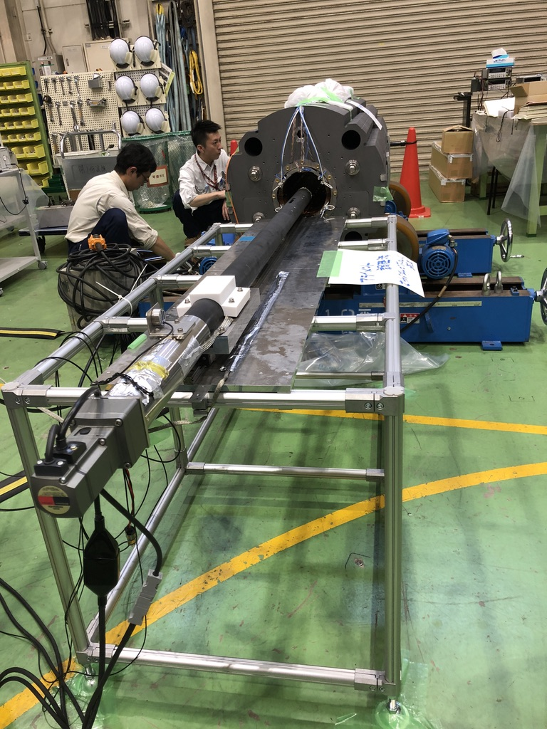
FINAL model magnet production: 3rd model
After yoking
Same magnetic cross section as that of the 2nd short model
  Similar pre-load is applied as well
To ensure effects from the coil deformation, the warm field measurement is being conducted for each fabrication step
  Very important feedback to the prototype design
Warm field measurement system
Cold test is planned to be held in this summer (August)
New results is expected to be reported at the next MT26

Slide 25
Electronical insulation issue (Cont’d)
Feed-through
Feedthrough for the
heater lines
Leakage current when
Heater-to-ground
voltage ramp to 2 kV
Breakdown voltage
Also heater-to-ground (cryostat) withstand voltage was also limited to 1.8 kV while the target voltage is 2.3 kV (under LHe condition)
Some pin plugs were weakly connected to sockets of the feedthrough and partially exposed to ~1.5 atm He gas
Design improvement is underway for

Slide 26
Manufactured by Toshiba in 2000 for vertical cold tests of LHC-MQXA magnets.
  19 LHC-MQXA (7m), 32 J-PARC SCFM (4m)
Applicable Law: Japanese High Pressure Gas Safety Act
  Operation at 1.9 K is exceptional. Category of “Designated Equipment”
Operating Temp.: 4.4K to 1.9K
Cooling
  300K to 40K by GHe, 40K to 4.4 K by LHe
  4.4 K to 1.9K by HeII Sub-cooler (55W for MQXA)
Capacity
  whole bath: 9020 mm deep, 700 mm in a diameter.
  1.9 K bath: 7524 mm deep, 700 mm in a diameter.
  Weight: 8.6 ton (MQXA). Need to check for D1.
He Cryogenic Plants (see next slide in detail)
New header for the D1 (MBXF)
  Manufactured in 2014, approval of the JHPG Safety Act in 2015.
  Anti-cryostat for field measurement: O.D. 141.3 mm
  Quench antennas: 11 arrays for 7 m long magnet
  Feedthrough: 48 poles x 10
  HVWL: 1.5 kV (present limit 0.5 kV.)
  15 kA Current Leads
    Manufactured by Fuji Electric in 2015. All copper base. (50L/h for a pair)

Slide 27
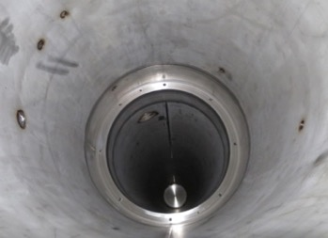
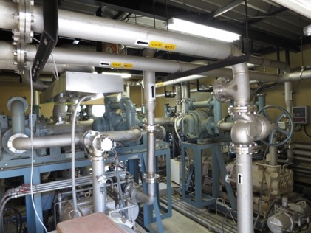
HeII Sub-Cooler
Pre-heat exchanger
  Copper spiral tube (I.D. 12mm, Spiral Dia. 42 mm)
  Fine silver-plated copper balls
  Efficiency 88%
J-T expansion valve
Main heat exchanger
  Design: ΔT=30 mK at 80 W, 1.9 K.
  Required surface area: > 3.0 m²
  4.4 m long copper tubes: 3 x φ 76.2 mm, 10 x φ 12 mm.
Pumping system
  4 parallel lines
    2 x Roots pumps: 2 x 900 m³/h
      SHIMADZU MB-1400
    1 x Oil free pump: 630 m³/h
      TAIKO MDP-1015
  Note: Current performance is limited by cooling capacity of a water chiller (old!!).
    Only 2 pumiping lines are operational.

Slide 28
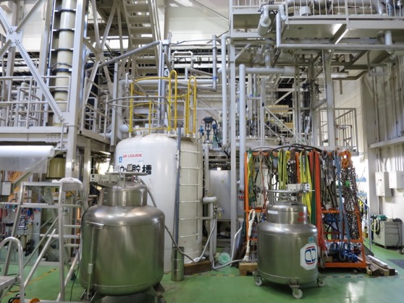
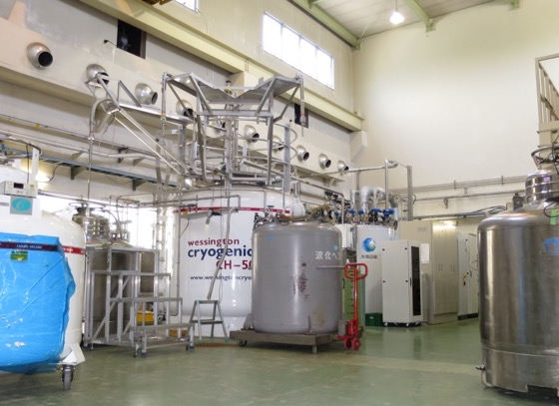
Cryogenic Plants
Refrigerator/Liquefier for Test Stand
160 L/h, 2400 L dewar
Teisan / L’Air Liquide in 1987 for the TRISTAN-AMY detector
New cold box in 2007
Backup of the primary refrigerator for LHe supply.
Neighbor refrigerator (Primary)
350 L/h, 5000 L dewar
LINDE LR280 in 2014
Mandatory to supply LHe to KEK users.
20 m long LHe transfer line to the test stand.
  In linkage operation: 510 L/h max.
Helium liquefying rate is sufficient to cover both supply for users and magnet testing.
Attention to GHe handling
  limitation in purification system
  difficulty to predict GHe recovery from KEK sites

Slide 29
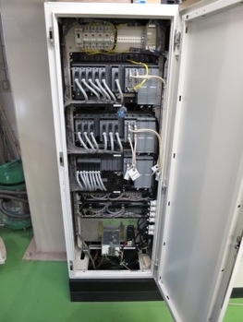
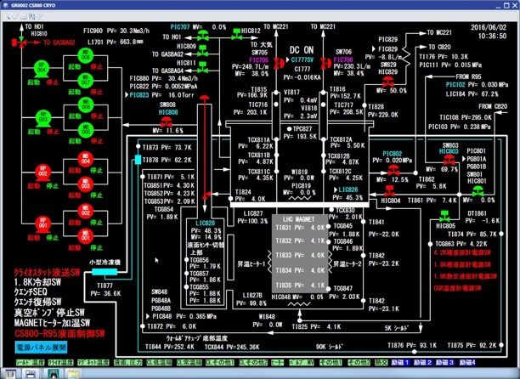
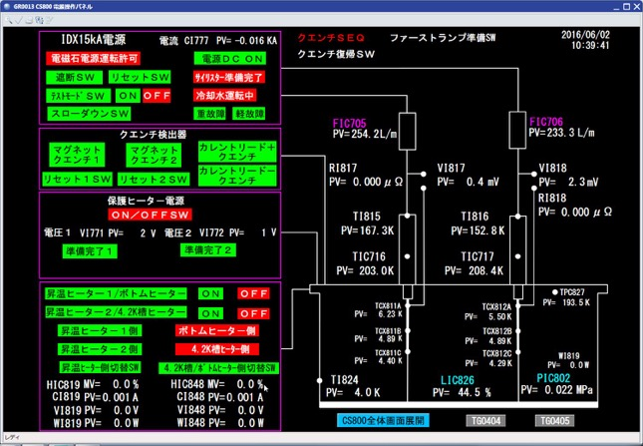
Control System
CENTUM VP, Yokogawa Electric
  A distributed control system (DCS) as a platform for automated control and operation of the cryogenic plant.
  Programmed by KEK engineers.
  Interlock for 15 kA P/C (slow down or shutoff)
    Monitor: LHe level, CL status and refrigerator
  Historical trend data
Ex) display for main cryostat control
Ex) display of interlock for 15 kA P/C

Slide 30
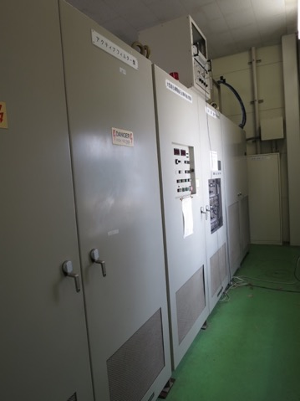
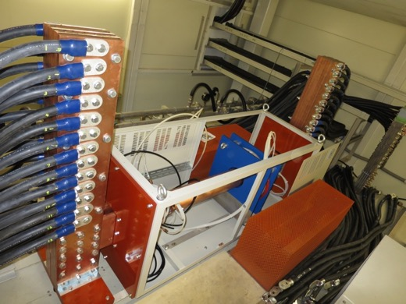
Power Converter
Manufactured by IDX in 1993 for SSC-SDC magnet development.
Nominal: 15 kA, 15V
Thyristor switch for prompt shutoff.
Dump resistor of 73 mΩ (grounding at middle point ) for the D1
  Available: 0, 12.5, 25, 50, 75 and 100 mΩ.
Water cooling: 150 L/min, 10 kg/cm2
Quench detectors
  2 x Balanced Voltage (Main)
  2 x Total Voltage
External 15 kA DCCT (Zero-Flux Current Transformer)
  Fully calibrated at CERN as a standardization of current.
  But unwanted shutoff caused by vibration during the excitation in May 2016.
  Performance degradation is concerned.
Note: some contact failures found in relays through the D1 model magnet testing.
  aged deterioration…
  Overhaul must be done be as soon as we can.

Slide 31
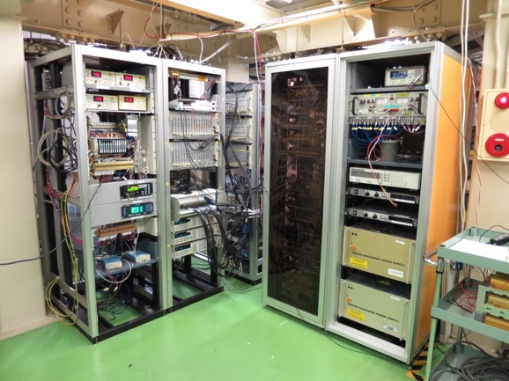
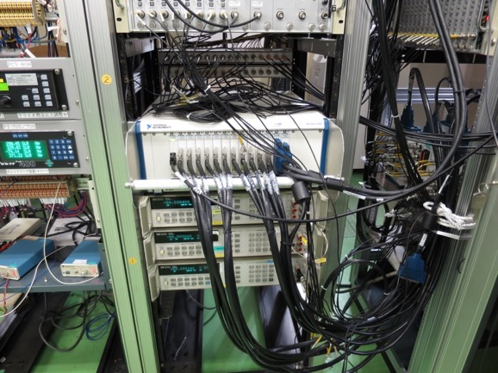
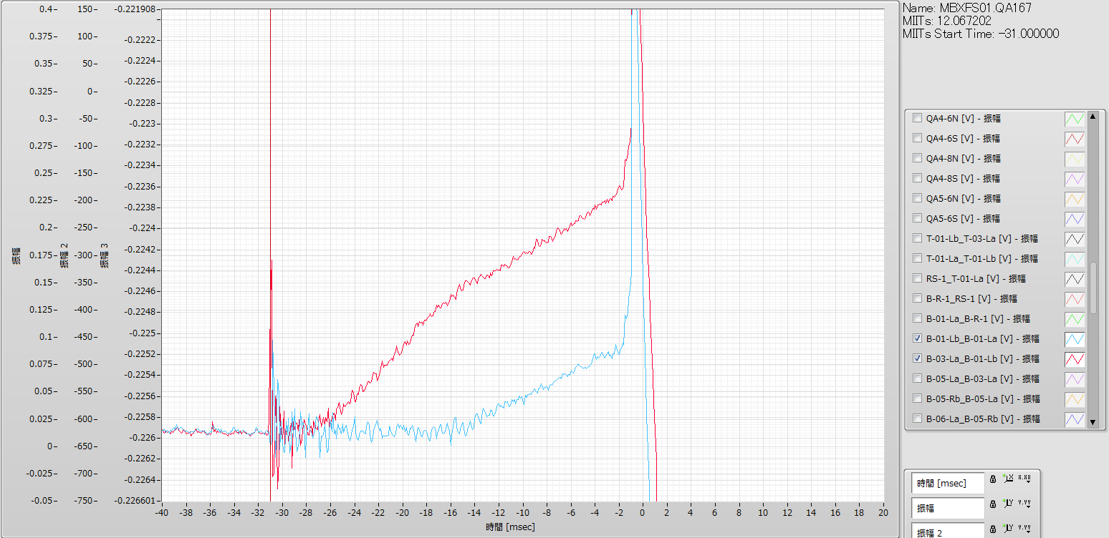
Measurement System - Present -
Isolation Amp: NF P-62A, 76 ch
Fast DAQ:
  NI PXI 1643 (16bit, 250 kS/s/ch), 88 ch
    Voltage taps, quench antennas, P/C, etc.
Slow DAQ: GP-IB
  KEYSIGHT 3458A multimeter (8.5 digit) x 3
  Kyowa UCAM-60B for strain gauge measurement, currently 30 ch (80 ch max.)
Software: Labview (& KEYSIGHT VEE only for field measurement)
3 PCs: Fast DAQ, Slow DAQ, MFM.

Slide 32
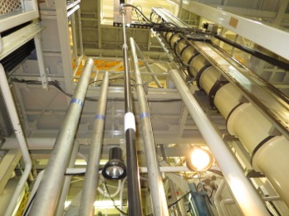
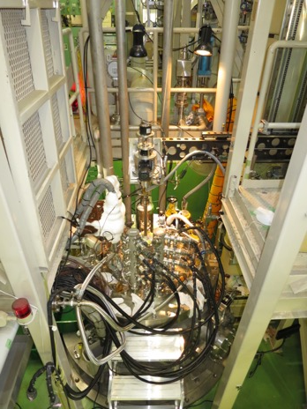

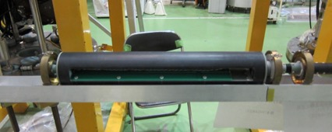
Field Measurement System
Vertical Measurement
Rotating coil in anti-cryostat (I.D. 108.3mm) at “warm” temperature.
  Printed-circuit board
  3 radial coils: B1 and analogue bucking
  Long (350mm) and short (80mm) arrays
  GN₂ flow from the end to suppress thermal shrinkage of the pipe
7 m long GFRP shaft
  not long enough for the 7 m magnet, but it can be extended.
Encoder: HEIDENHAIN RON 255
Integrator: MetroLAB PDI-5025 x 3
Magnet scale: SONY LY51
Horizontal Measurement
For warm measurements of LHC-MQXA and J-PARC-SCFM cold mass.
But the system is dismantled for the time being…
  The system will come back for the D1 magnets.

Slide 33
Operating Personnel
Operators for the cryogenic plant
  3 to 4 weeks for a test cycle.
  24 hours operation >> 3 shifts/day, 5 days/week.
  15 shifts/week: 1 shift for 8.75 hours
  10 shifts/week by outsourcing from 16:30 to 9:00 for safety reason.
  5 KEK staffs and 2 outsourcing workers
    They must be holders of “a high pressure gas production safety management”.
Operators for the magnet test
  Quench Tests: from 9h to 19h (sometimes 20h)
  Field measurement: mainly daytime, through nighttime if necessary.
  3 to 4 KEK staffs (not only dedicated to the test…)
* Staff of Cryogenics Science Center: 17 in total.
  Tsukuba: Researchers 6, Post-doc 2, Engineers 4
  Tokai: Researchers 2, Post-doc 1, Engineers 2
  Mandatory: LHe supply for users
  Projects: J-PARC (T2K neutrino, COMET, g-2, muon beam lines, etc.), HL-LHC upgrade, KAGURA (gravitational telescope)

