Slide 1
Physics potential of the ESSνSB
Mattias Blennow
KTH Physics
@ PPNT 2019, Uppsala, Sweden

Slide 2
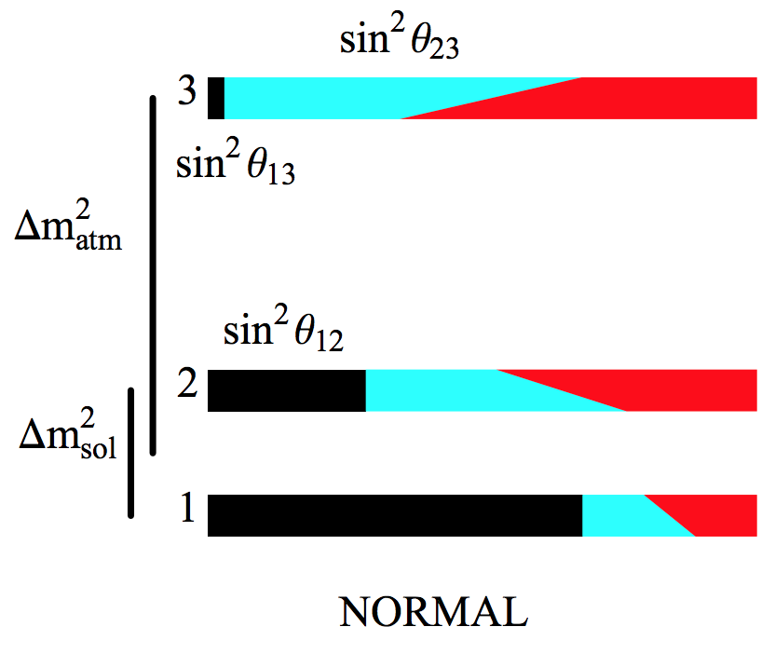
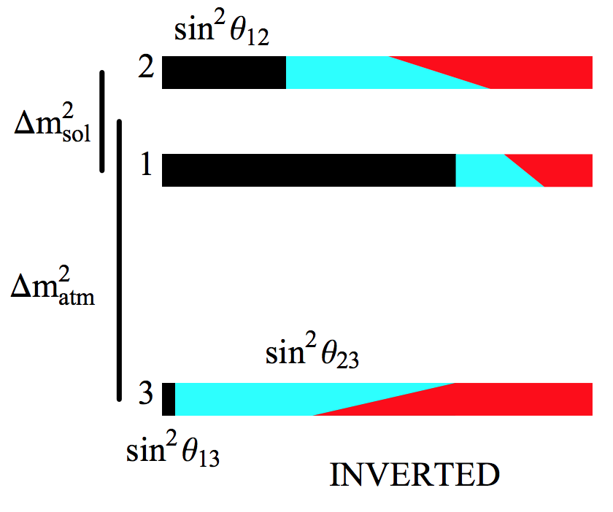
Physics goals
Establish (bounds on) CP violation in the lepton sector
Neutrino mass hierarchy
Investigate new physics in the neutrino sector
Other goals
Mena, Parke, Phys.Rev. D69 (2004) 117301

Slide 3
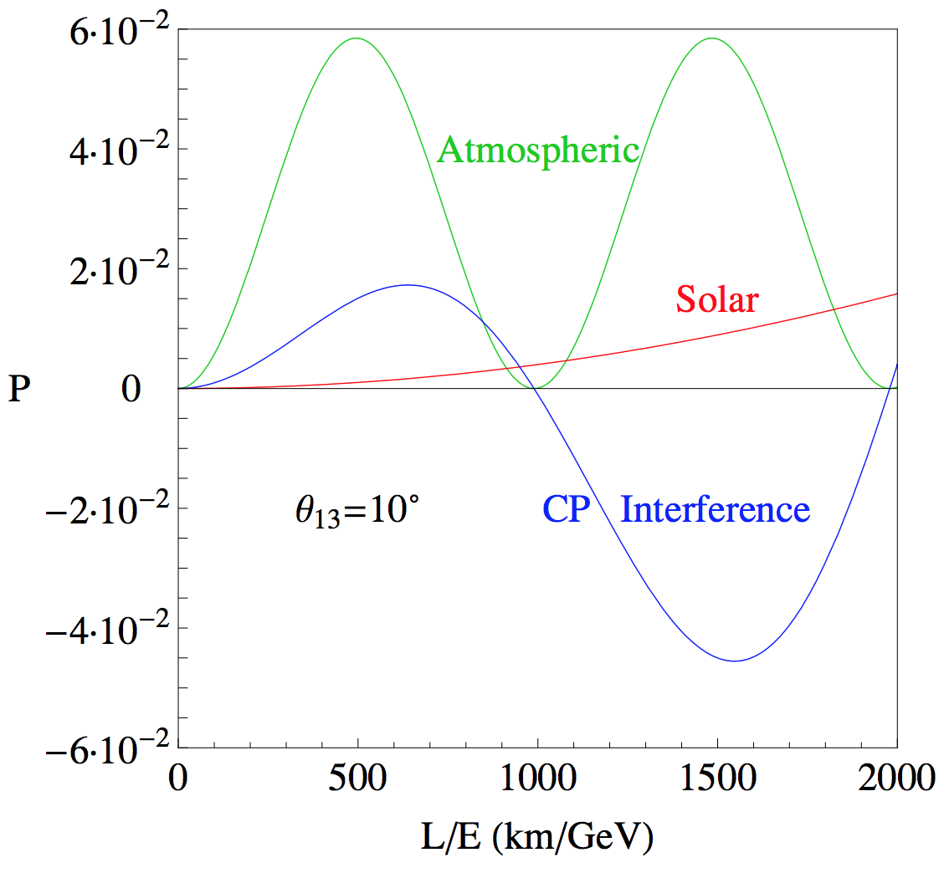
Physics of CP violation in $P_{μe}$
CP violation mainly through interference
Requires similar amplitude of different frequency oscillations
Atmospheric
Solar
$$P_{μe}= {\left|A_{sol}+e^{iφ}A_{atm}\right|}^{2}$$
$$A_{atm}=s_{23}\sin{(2θ_{13})}\sin{(\frac{∆m_{31}^{2}L}{4E})}$$
$$A_{sol}=c_{23}\sin{(2θ_{12})}\sin{(\frac{∆m_{21}^{2}L}{4E})}$$
$$φ= ±δ−\frac{∆m_{31}^{2}L}{4E}$$
Coloma, Fernandez Martinez, JHEP 1204 (2012) 089

Slide 4
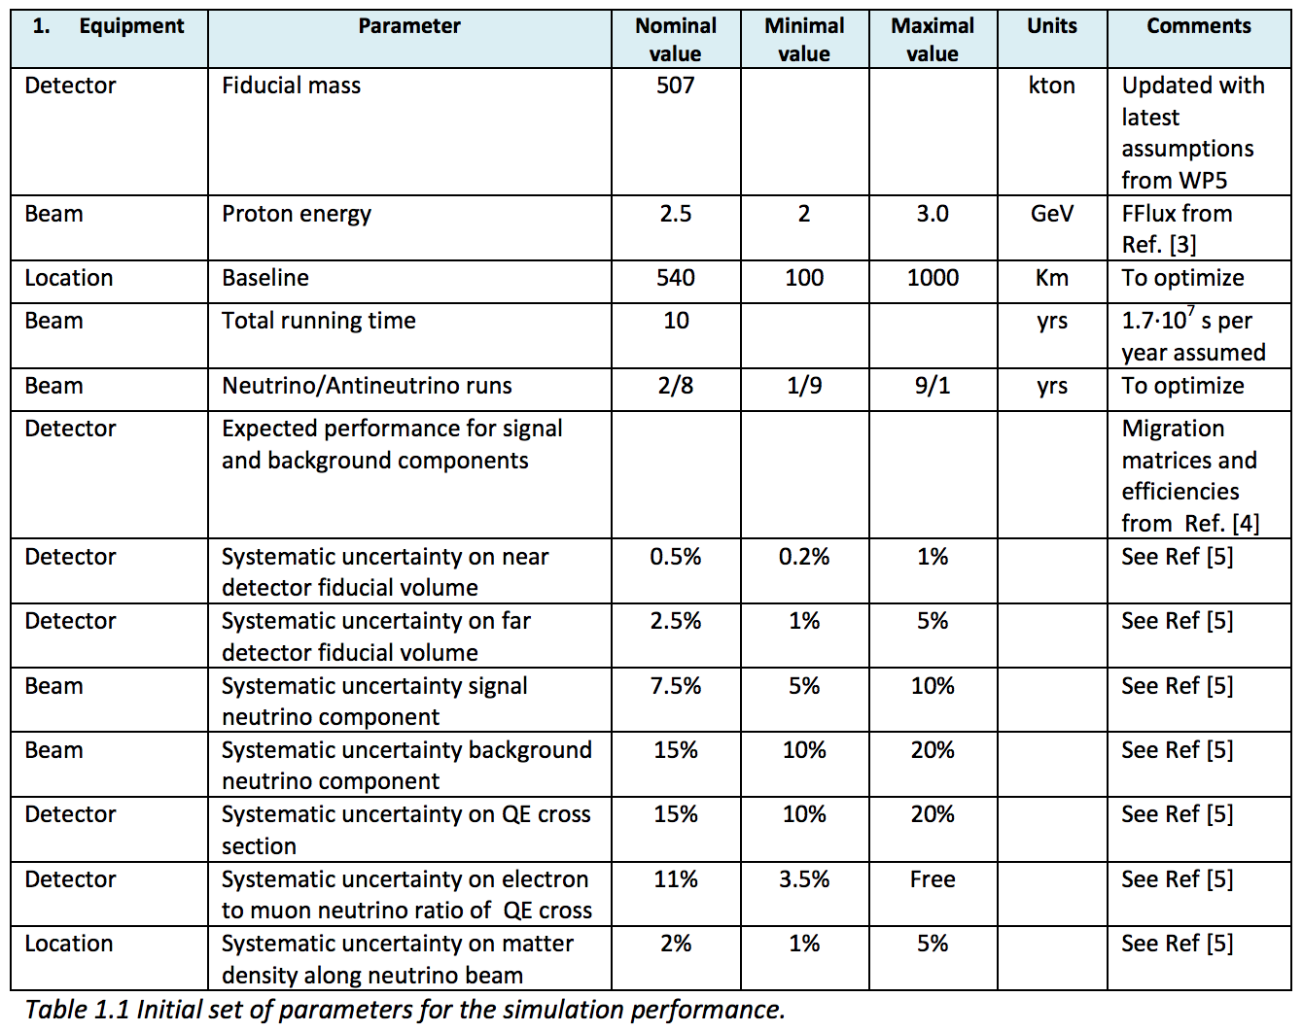
Base setup and assumptions
ESSnuSB WP6, Deliverable 6.1

Slide 5
Performance of the beam experiment
What is the expected sensitivity to CP violoation?
What is the expected precision on $δ$?
What is the expected sensitivity to the neutrino mass hierarchy?
What is the impact of degeneracies in the oscillation parameter space?

Slide 6
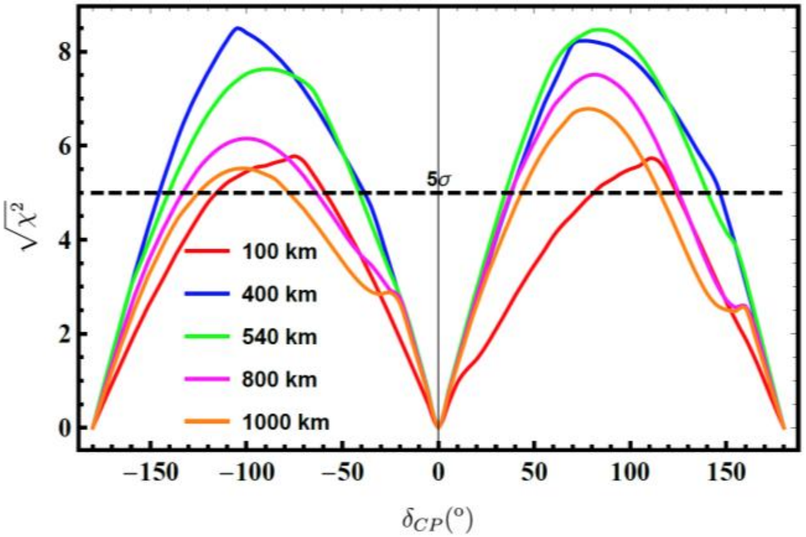
CP violation
ESSnuSB WP6, Deliverable 6.1

Slide 7
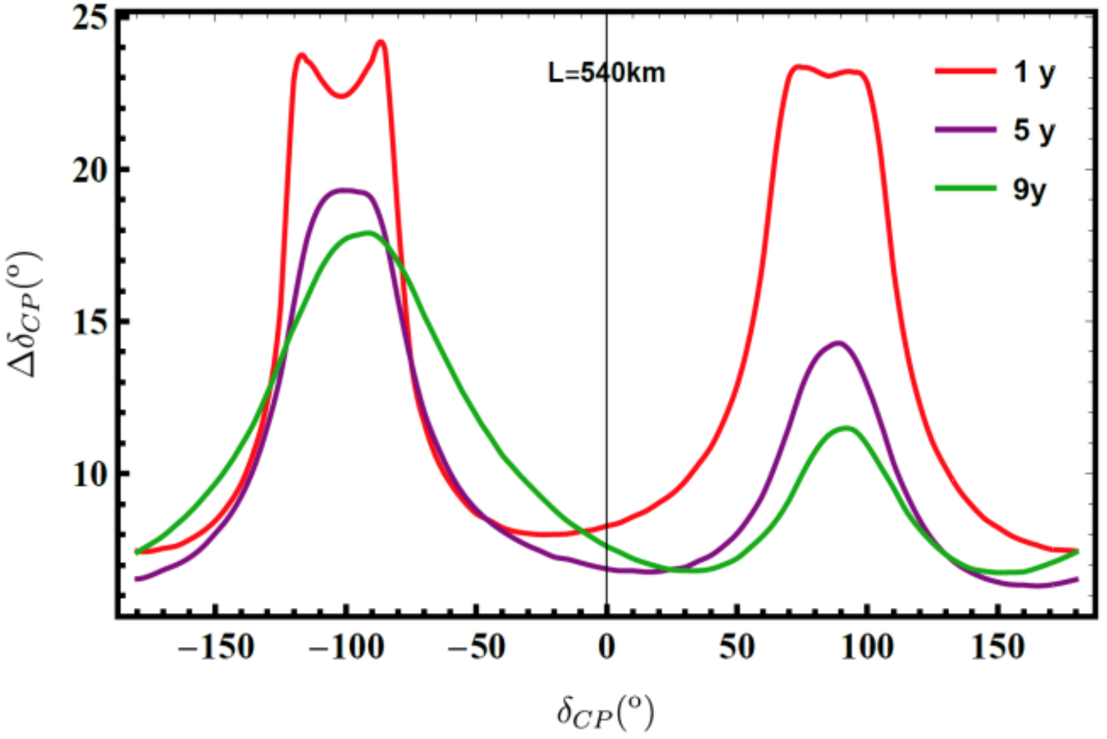
CP precision
ESSnuSB WP6, Deliverable 6.1

Slide 8
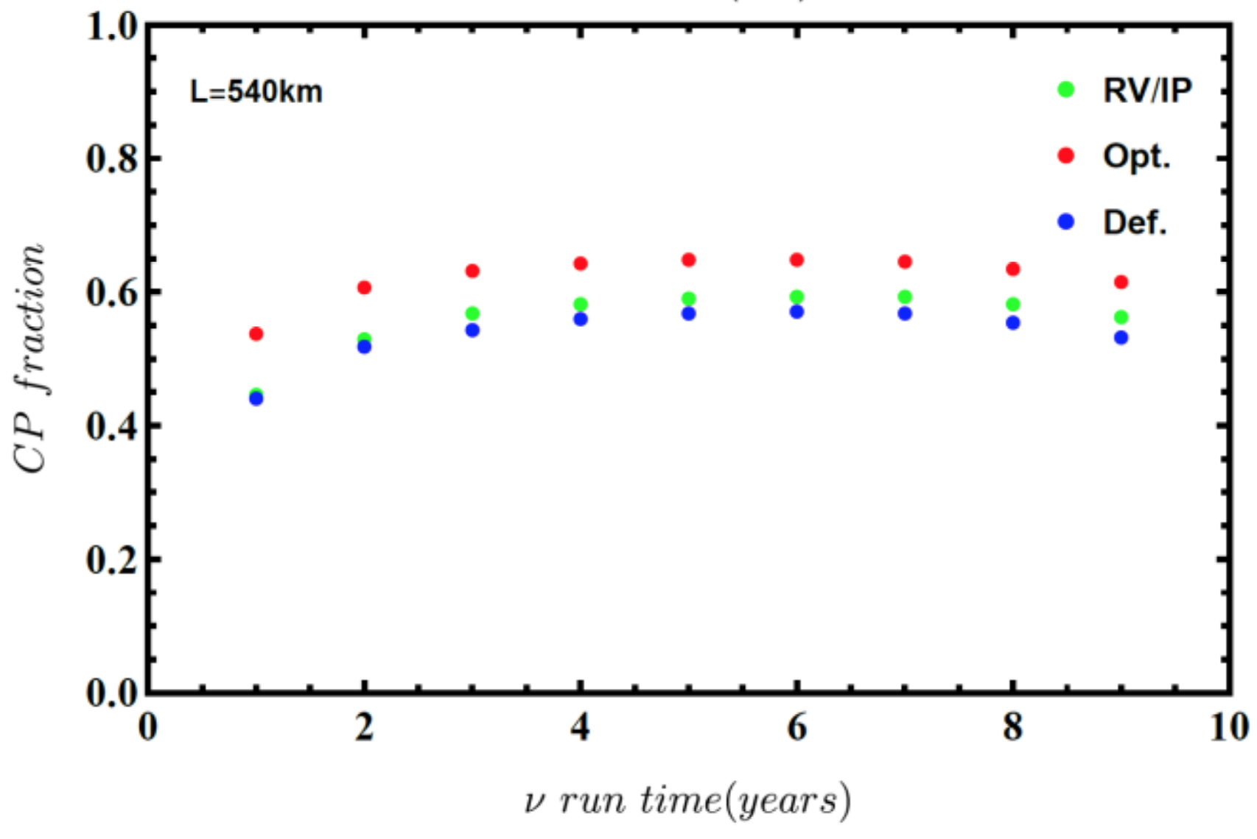
Effects of changing $ν/\overline{ν}$ running times
ESSnuSB WP6, Deliverable 6.1

Slide 9
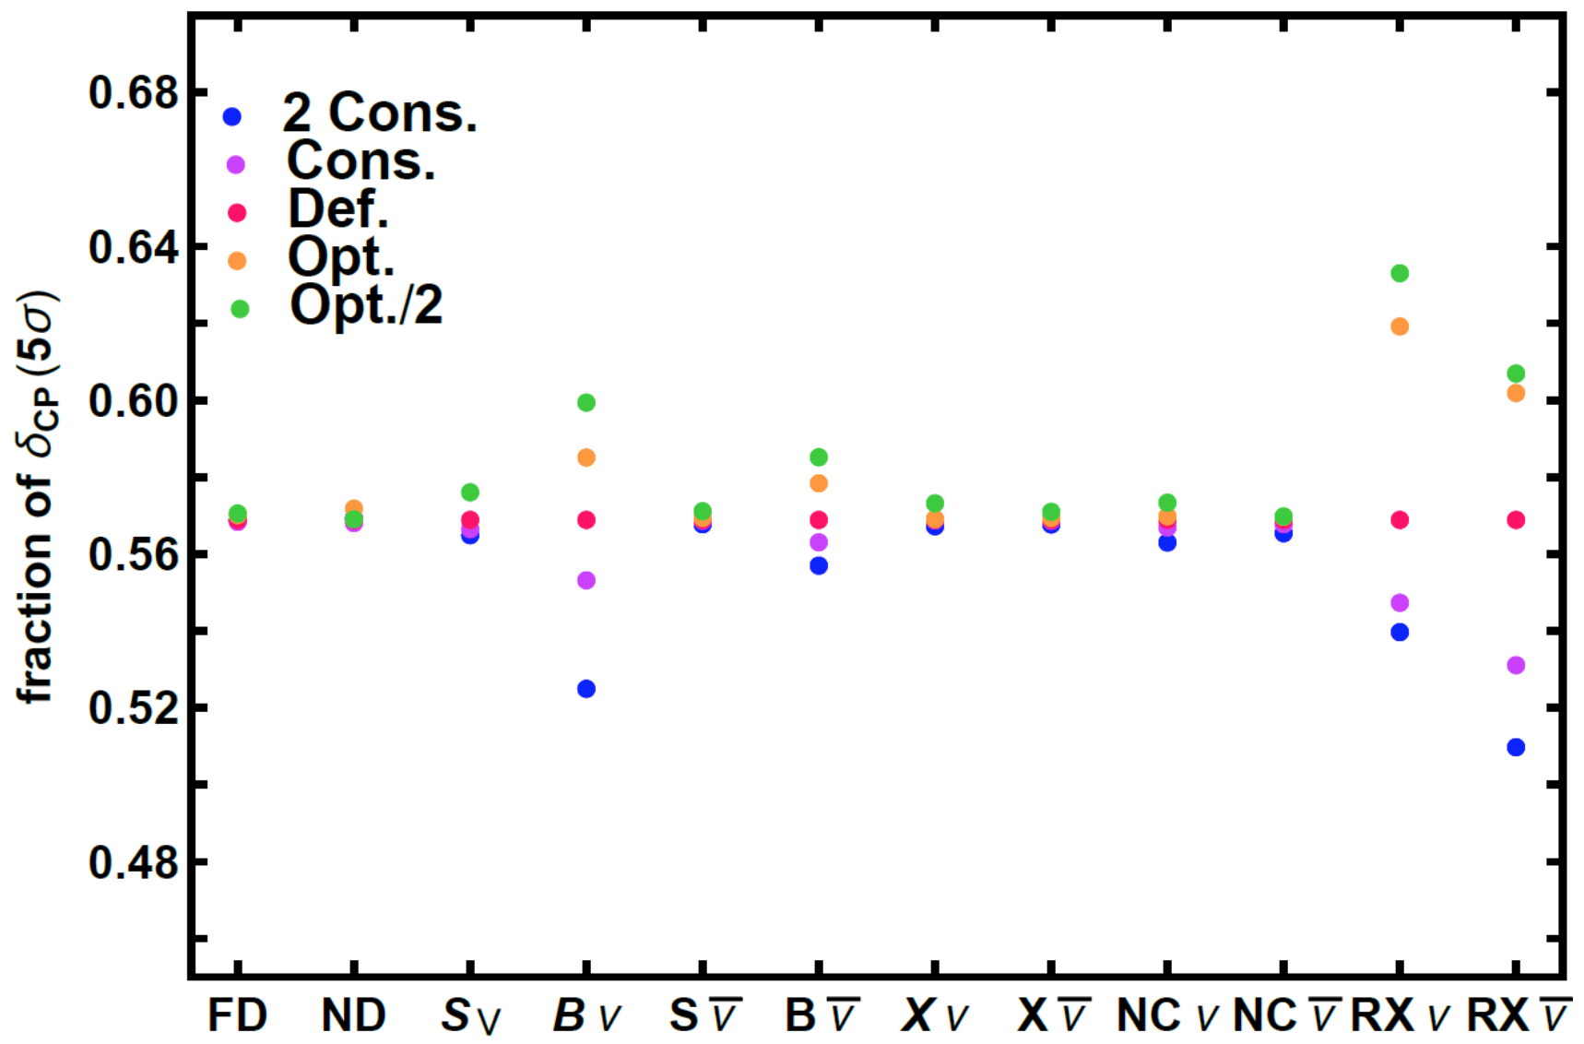
The impact of systematic errors
ESSnuSB WP6, Deliverable 6.1

Slide 10
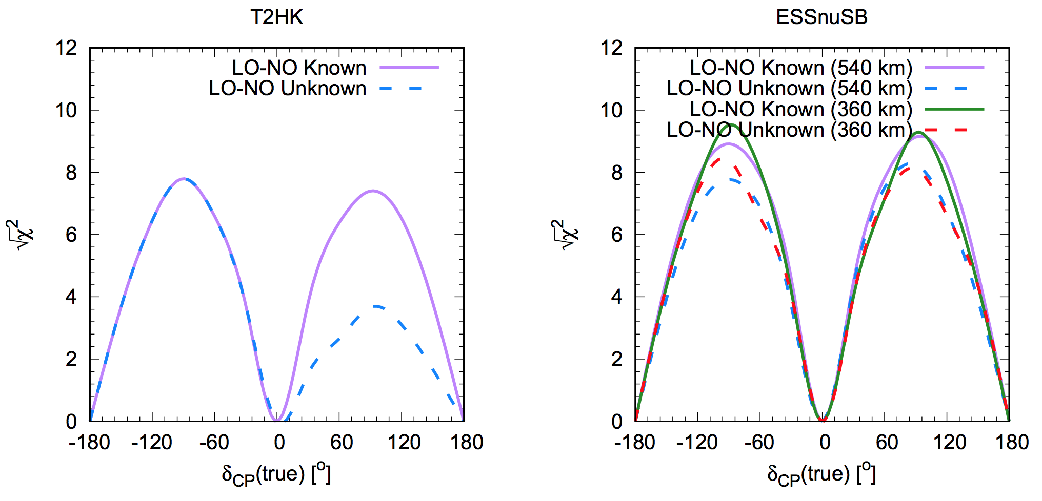
Comparisons to T2HK
Ghosh, Ohlsson, arXiv:1906.05779

Slide 11
Adding atmospheric neutrino data
A megaton WC detector will collect a significant sample of atmospheric neutrinos
Will add crucial information for the oscillation analysis
Octant sensitivity for $θ_{23}$
Hierarchy sensitivity
Kajita, Proceedings of the Japan Academy, Series B

Slide 12
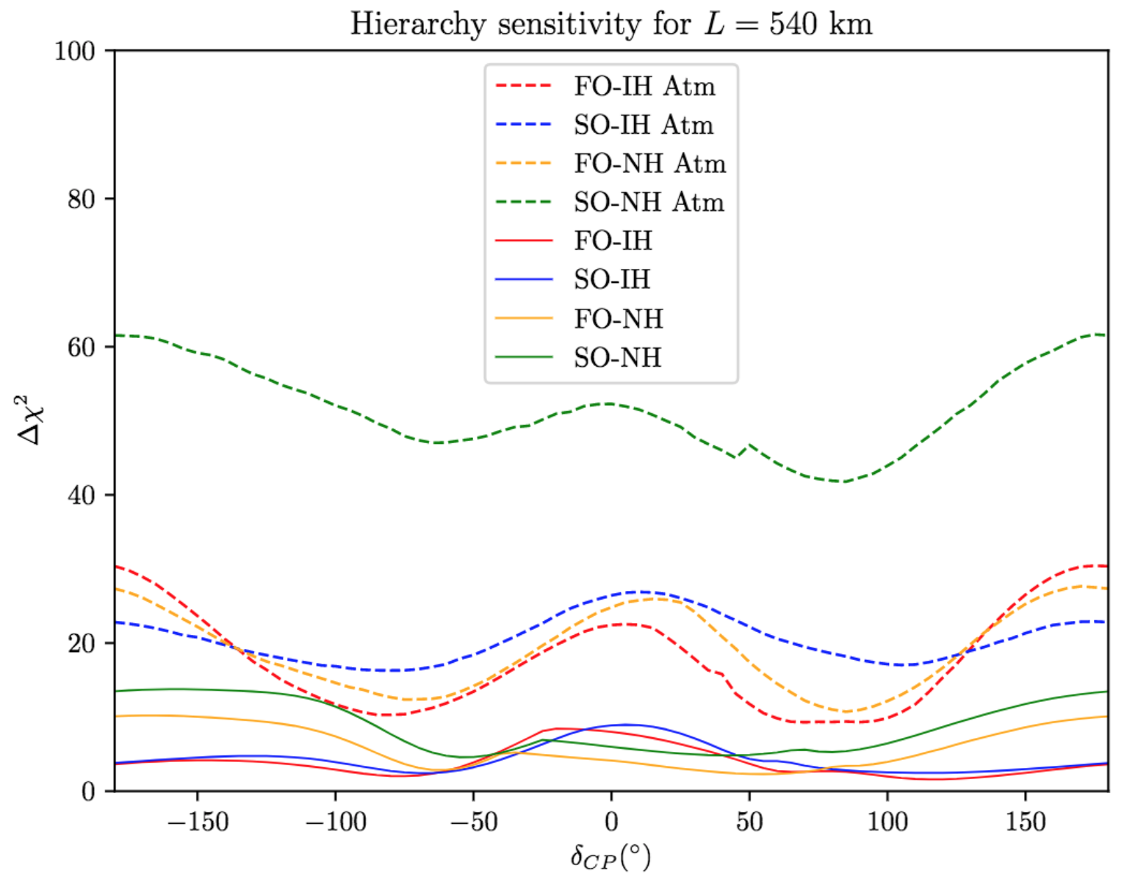
Mass hierarchy
ESSνSB WP6
PRELIMINARY
Courtesy of S. Rosauro

Slide 13
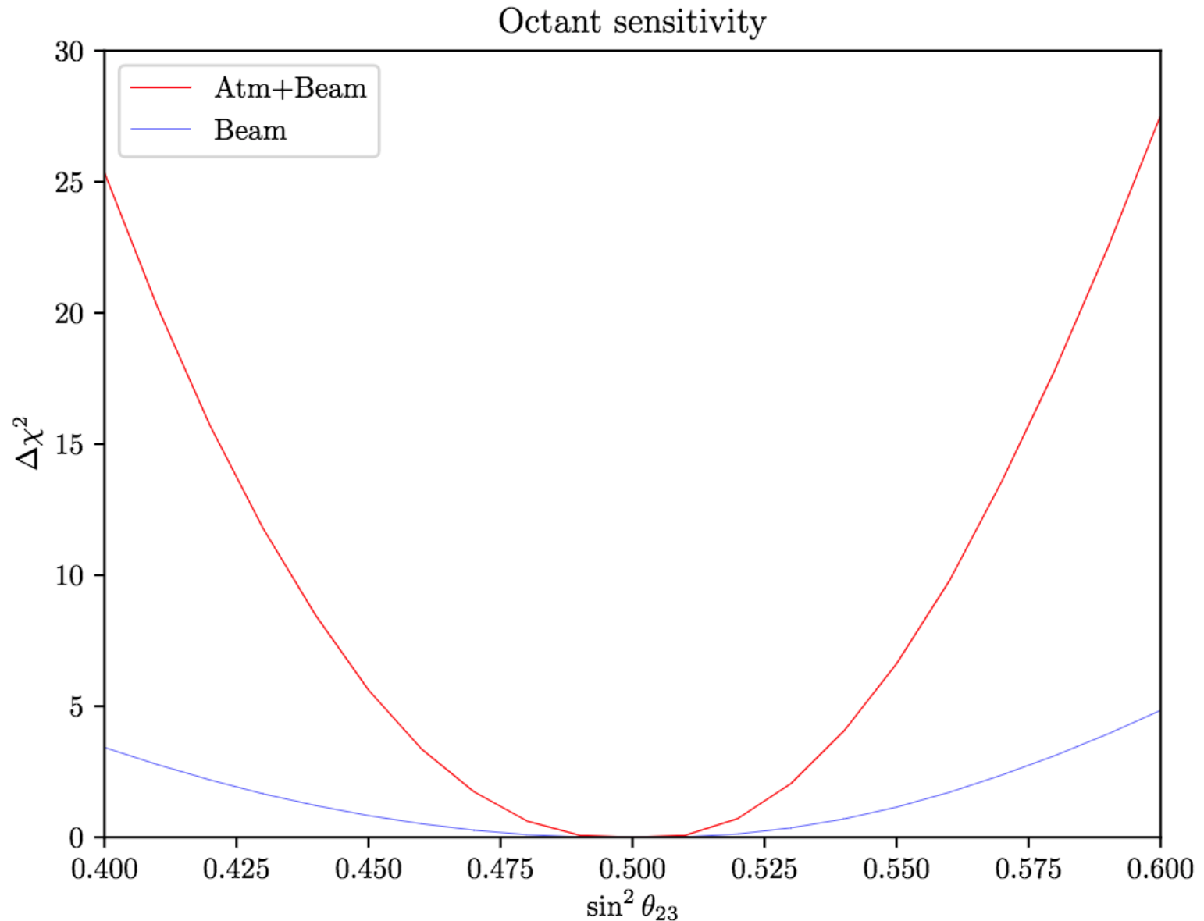
Octant sensitivity
ESSνSB WP6
PRELIMINARY
Current best-fit
Courtesy of S. Rosauro

Slide 14
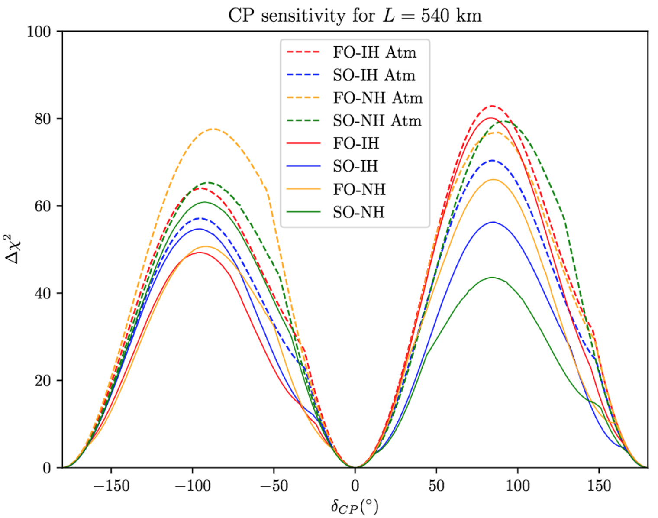
CP sensitivity
ESSνSB WP6
PRELIMINARY
Courtesy of S. Rosauro

Slide 15
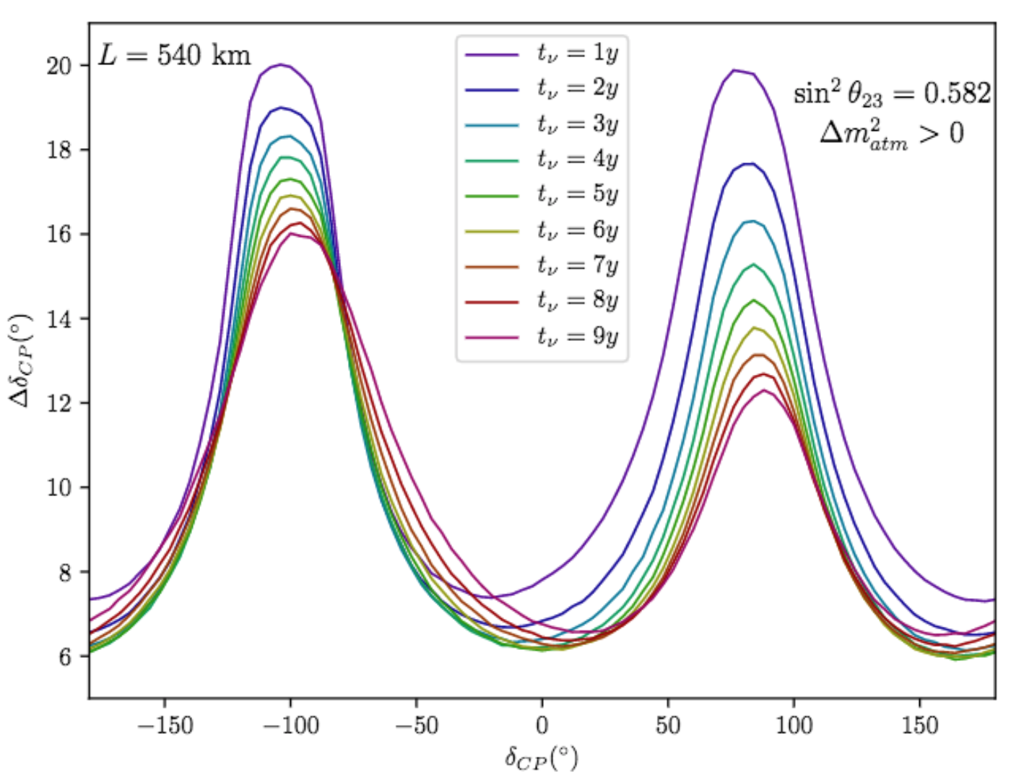
CP precision @ 540 km
ESSνSB WP6
PRELIMINARY
Courtesy of S. Rosauro

Slide 16
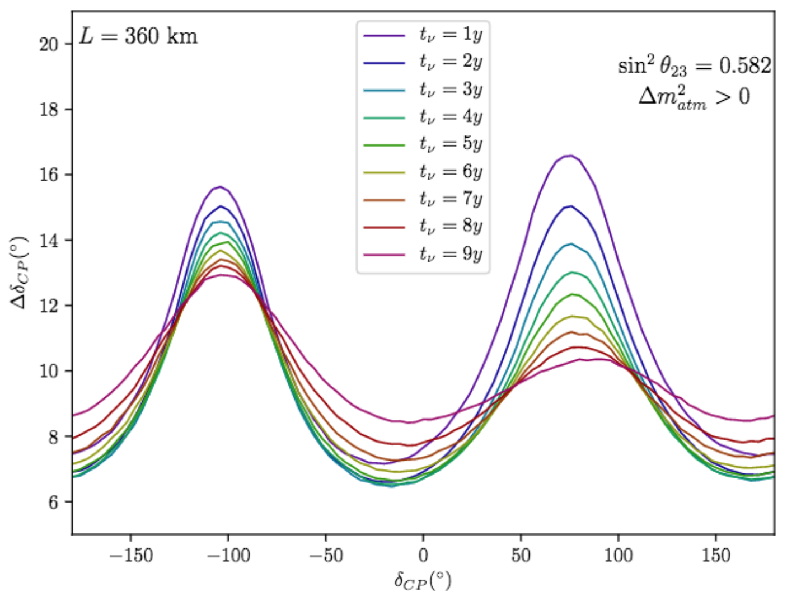
CP precision @ 360 km
ESSνSB WP6
PRELIMINARY
Courtesy of S. Rosauro

Slide 17
New physics scenarios
A number of new physics scenarios are being/will be investigated
Non-standard neutrino interactions (NSI)
Light sterile neutrinos
Neutrino mass model discrimination

Slide 18
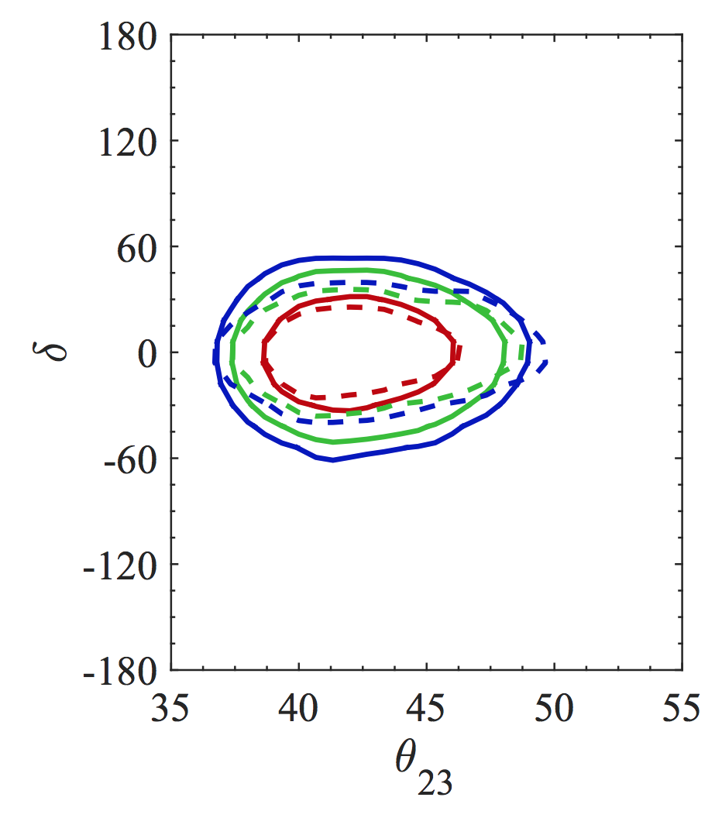
Non-standard neutrino interactions (NSI)
Effects of NSI on standard measurements
Sensitivity to NSI
Current bounds on NSI strong enough to limit impact
MB, Choubey, Ohlsson, Raut, arXiv:1507.02868

Slide 19
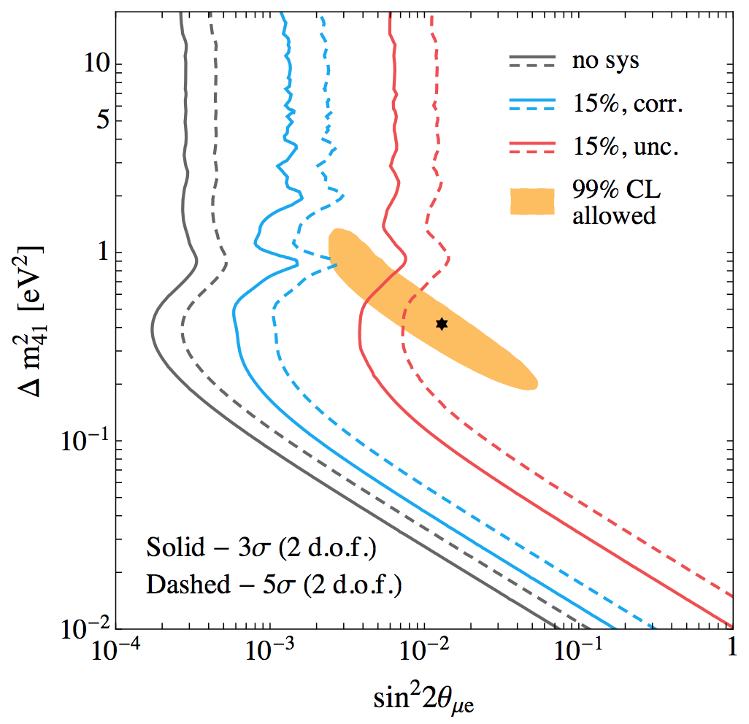
Sterile neutrinos
A sterile neutrino with mass splitting of order 1 eV²
Oscillation pattern in near detector around 1 km
Currently under investigation by the physics reach WP (WP6)
MB, Coloma, Fernandez-Martinez, arXiv:1407.1317

Slide 20
Other physics
All of the typical (beam independent) capabilities of a megaton WC detector remain
Proton decay ($\sim 2∙{10}^{34}$ yr @ 5 MT yr)
Solar neutrinos
Supernova explosions (${\sim 10}^{5}$ events, Milky Way – $\sim 20$, Andromeda)
Diffuse supernova neutrinos
Cosmological neutrino sources
Geo-neutrinos

Slide 21
Summary
The ESSnSB aim is to measure the leptonic CP phase with good precision
Second oscillation maximum
Degeneracies (sufficiently) solved by atmospheric neutrino sample
Running time in nu/anti-nu can be adapted to hints from earlier experiments without significantly affecting CP-discovery potential
Robust to systematic errors
An extensive program related to the far detector possible
Several avenues for investigating new physics

