Slide 1
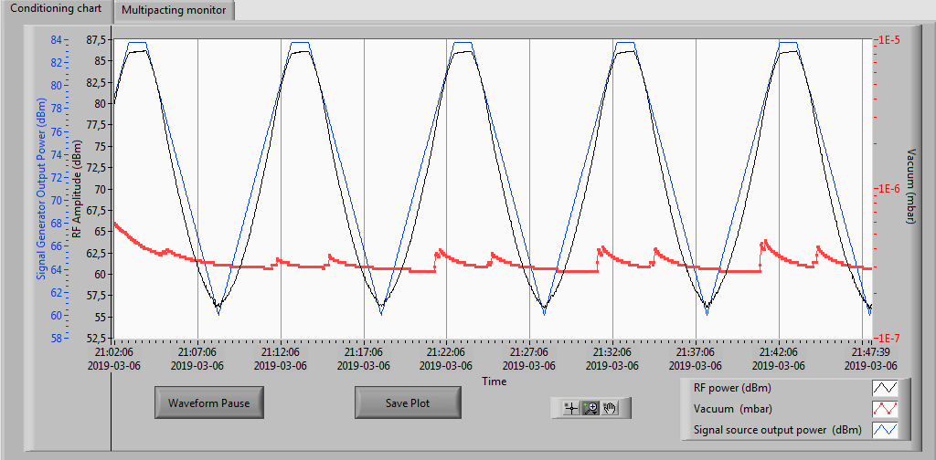
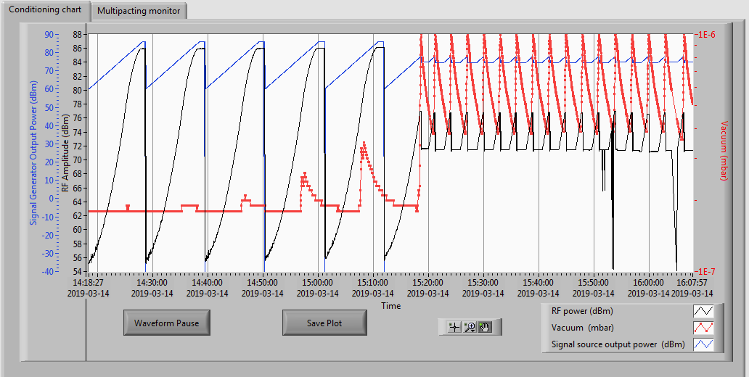
FPC2 conditioning history
After warm conditioning of FPC2, only vacuum lower then 4e-7 mbar is observed at full power full pulse length
Vacuum higher then 1e-6 mbar is found at long pulses for FPC2 reconditioning
*Just after FPC1 conditioning
*This value is limited by softerware threshold

Slide 2
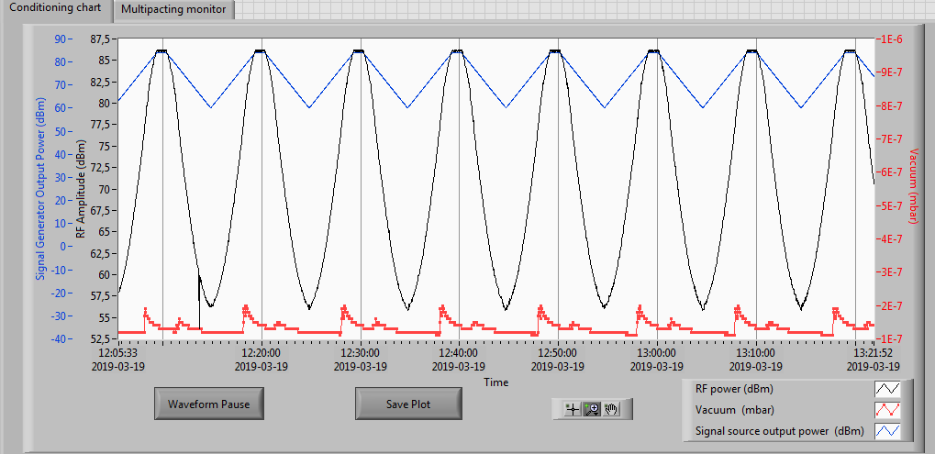
After 1st reconditioning of FPC2, vacuum is lower then 2e-7 mbar

Slide 3
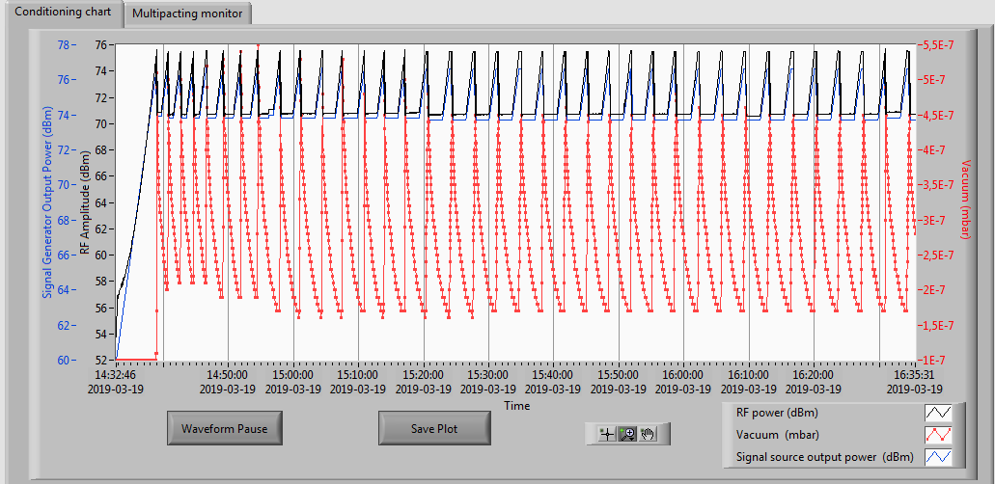
FPC1 conditioning history
Vacuum higher then 5e-7 mbar is found at long pulses for FPC1 reconditioning
*Just after FPC2 reconditioning
*This value is limited by softerware threshold

Slide 4
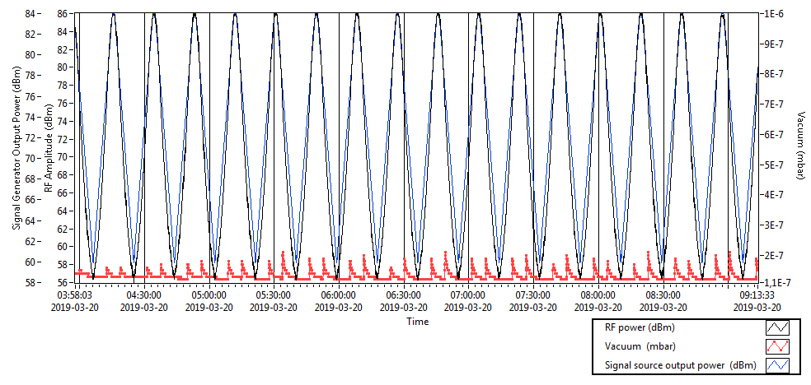
After 1st reconditioning of FPC1, vacuum is lower then 2e-7 mbar

