Slide 1
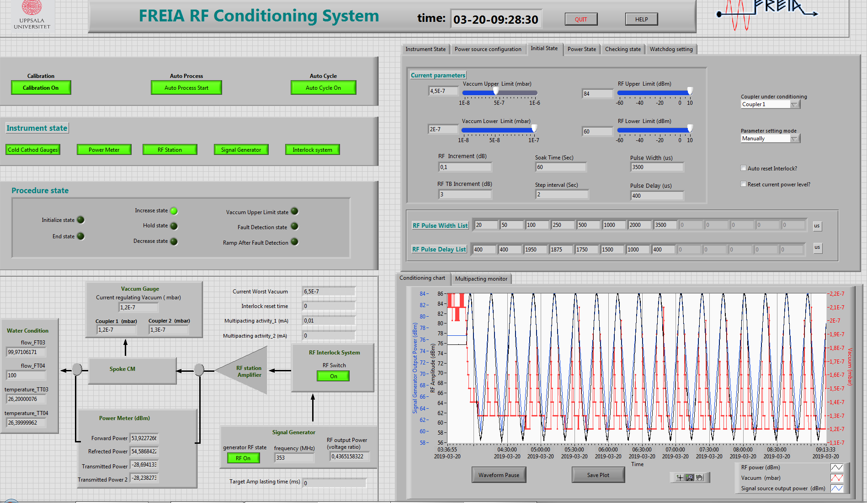
FPC warm conditioning
Parameter | value
Pulse repeat rate (Hz) | 14
Vacuum upper limit (mbar) | 5e-6
Vacuum lower limit (mbar) | 5e-7
pulse length step | 20 µs, 100µs, 250µs,500 µs, 1ms, 2 ms,3.5ms
Vacuum hardware interlock (mbar) | 1e-5
e- pickup interlock (mA) | 2

Slide 2
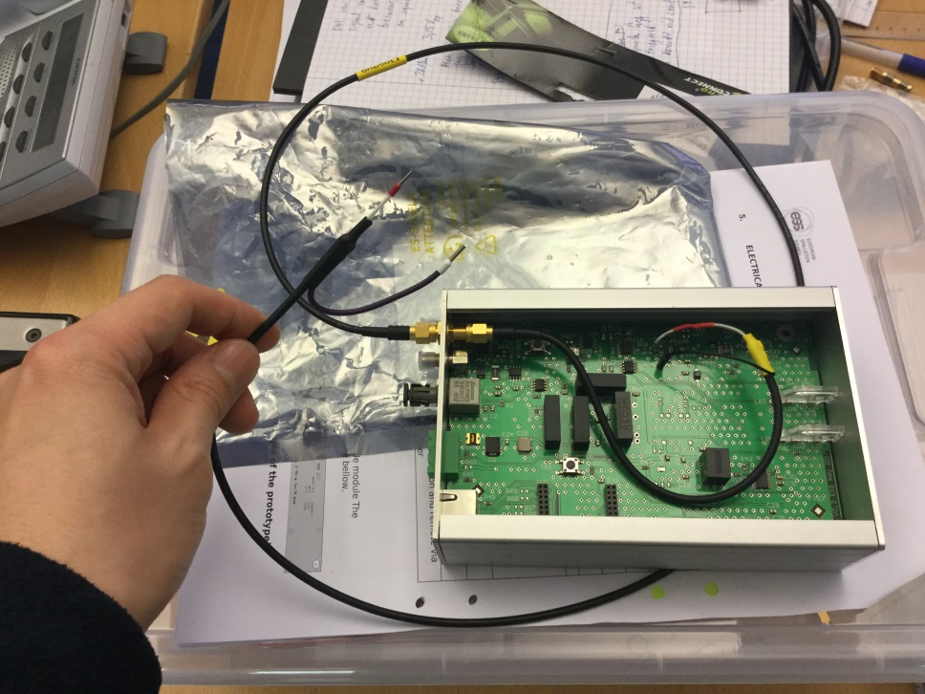
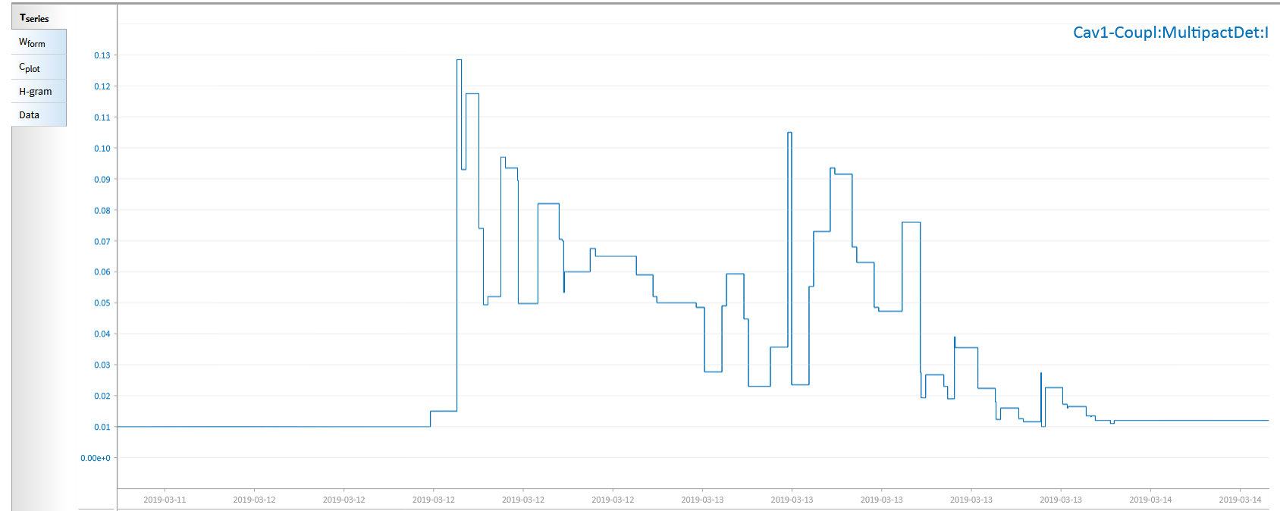
E- pickup history

