Slide 1
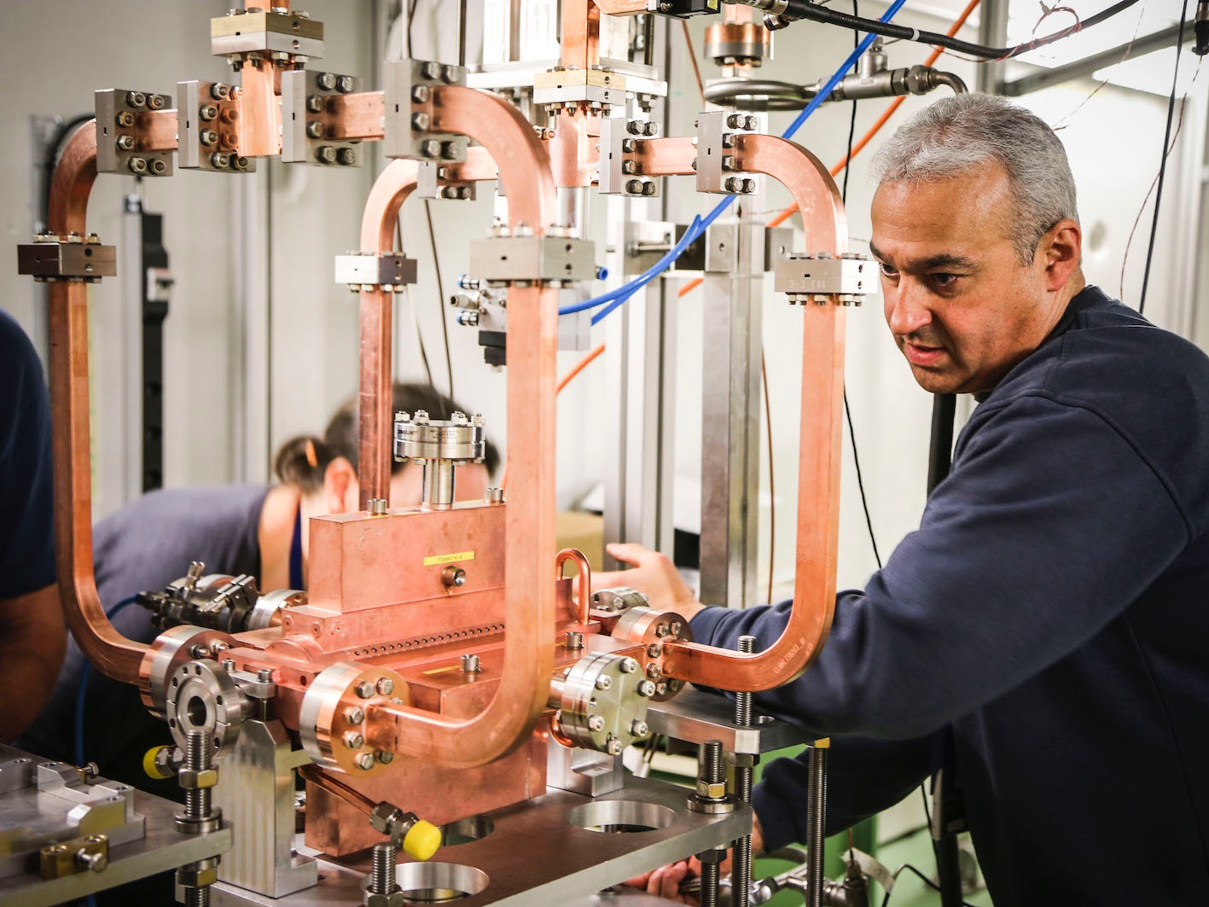
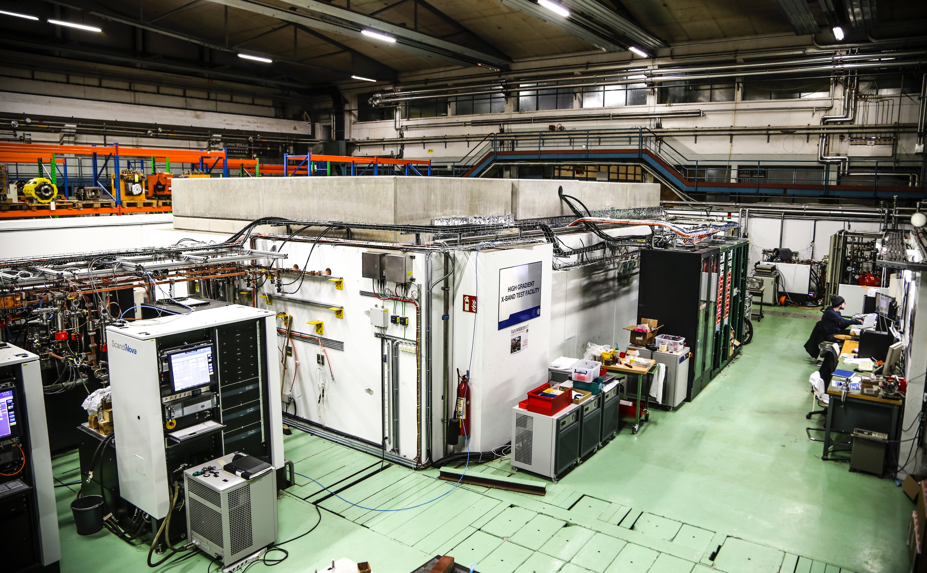
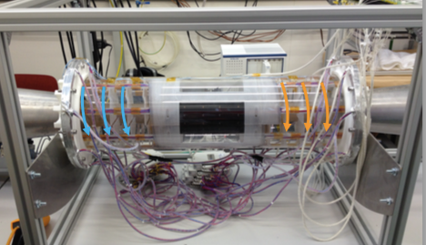
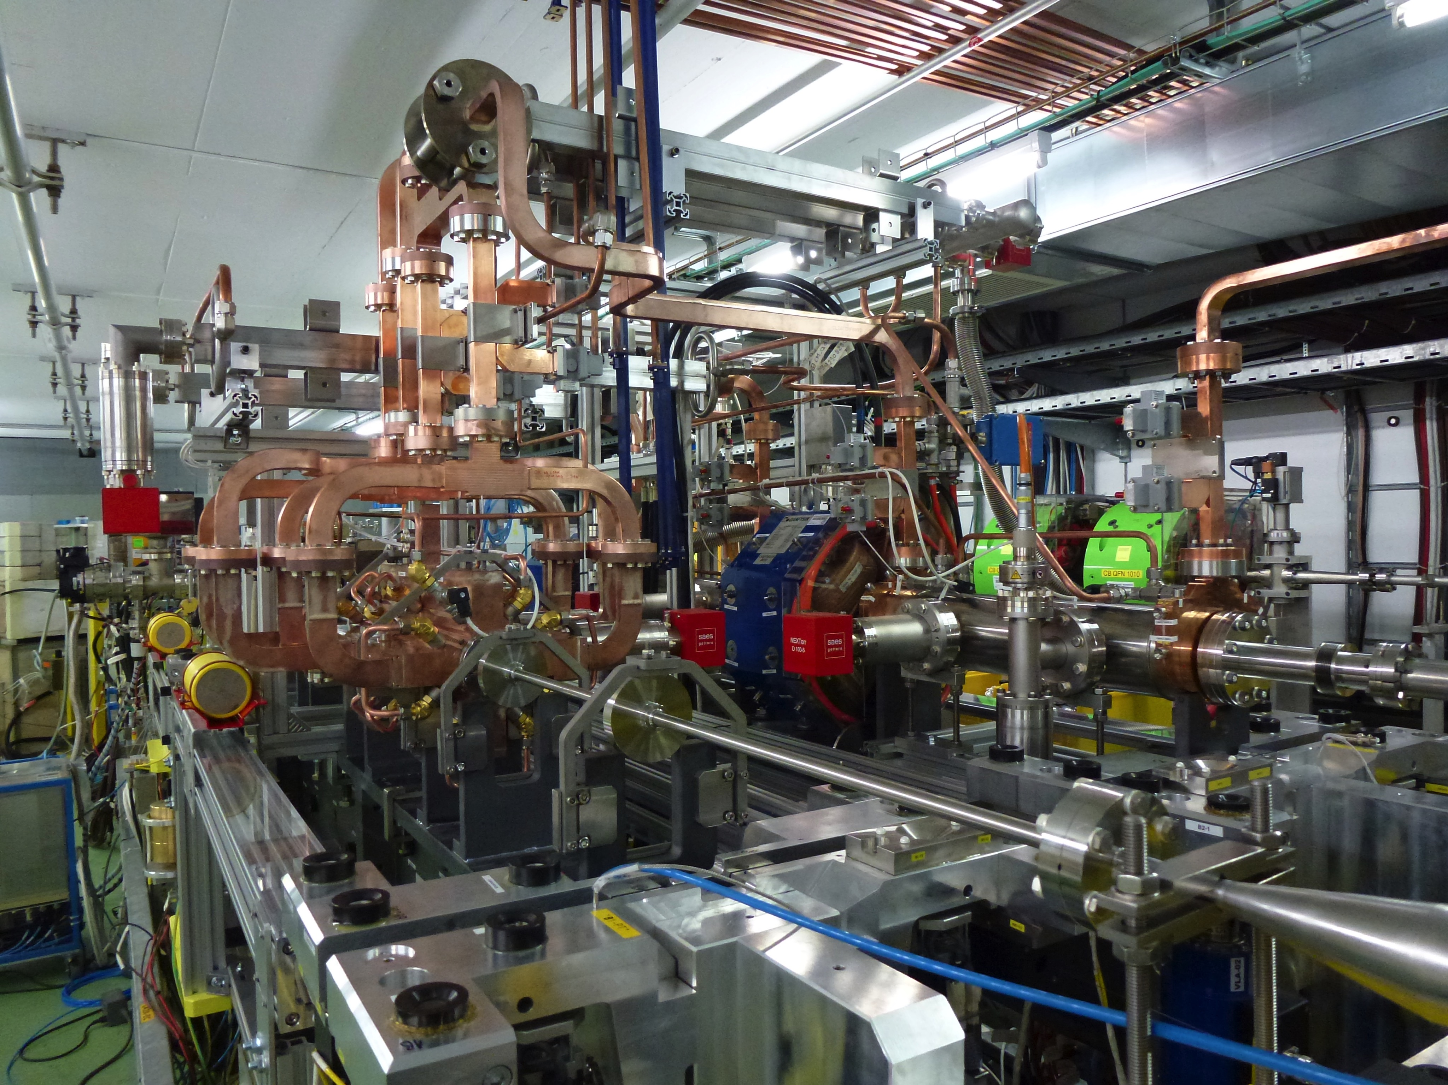
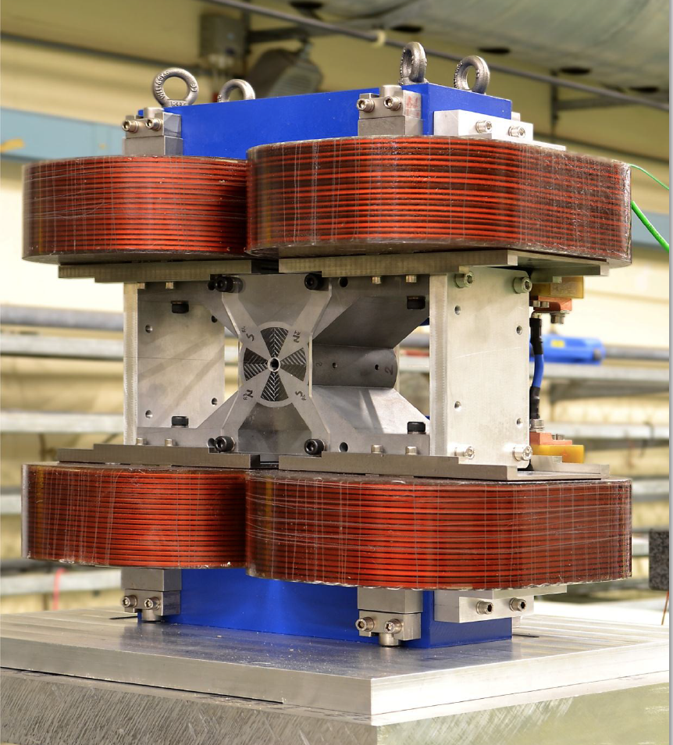
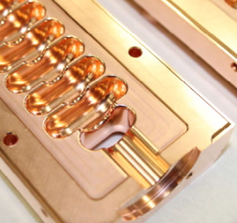
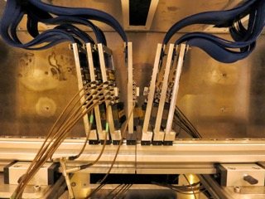
The CLIC Study
Compact Linear Collider
Uppsala University – May 9, 2019
Andrea Latina, CERN
on behalf of the CLIC and CLICdp Collaborations
Notes:
The Compact Linear Collider (CLIC) is a proposed TeV-scale high-luminosity linear particle collider that aims to explore the next energy frontier.

Slide 2
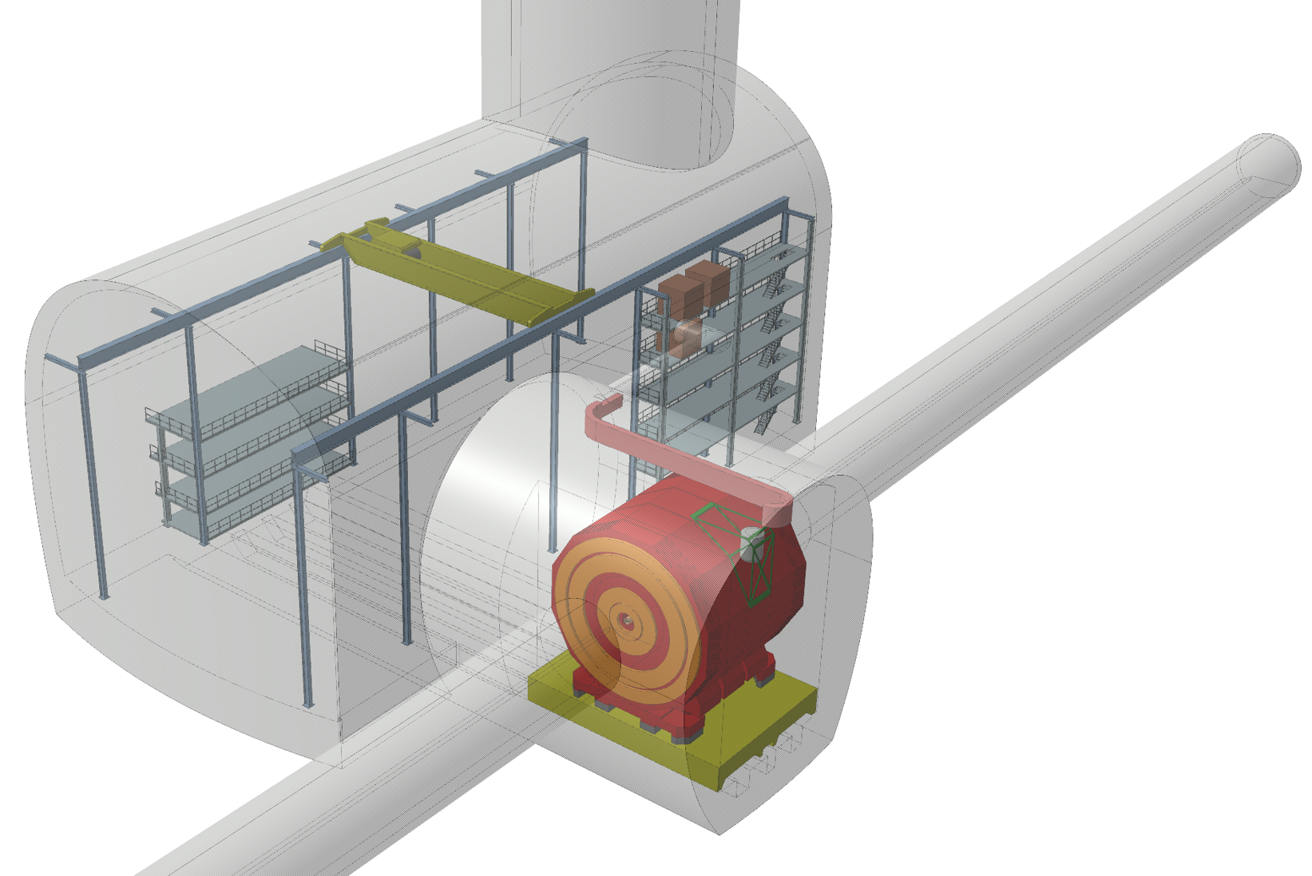
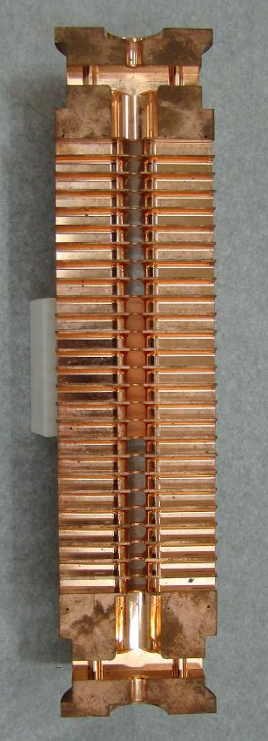
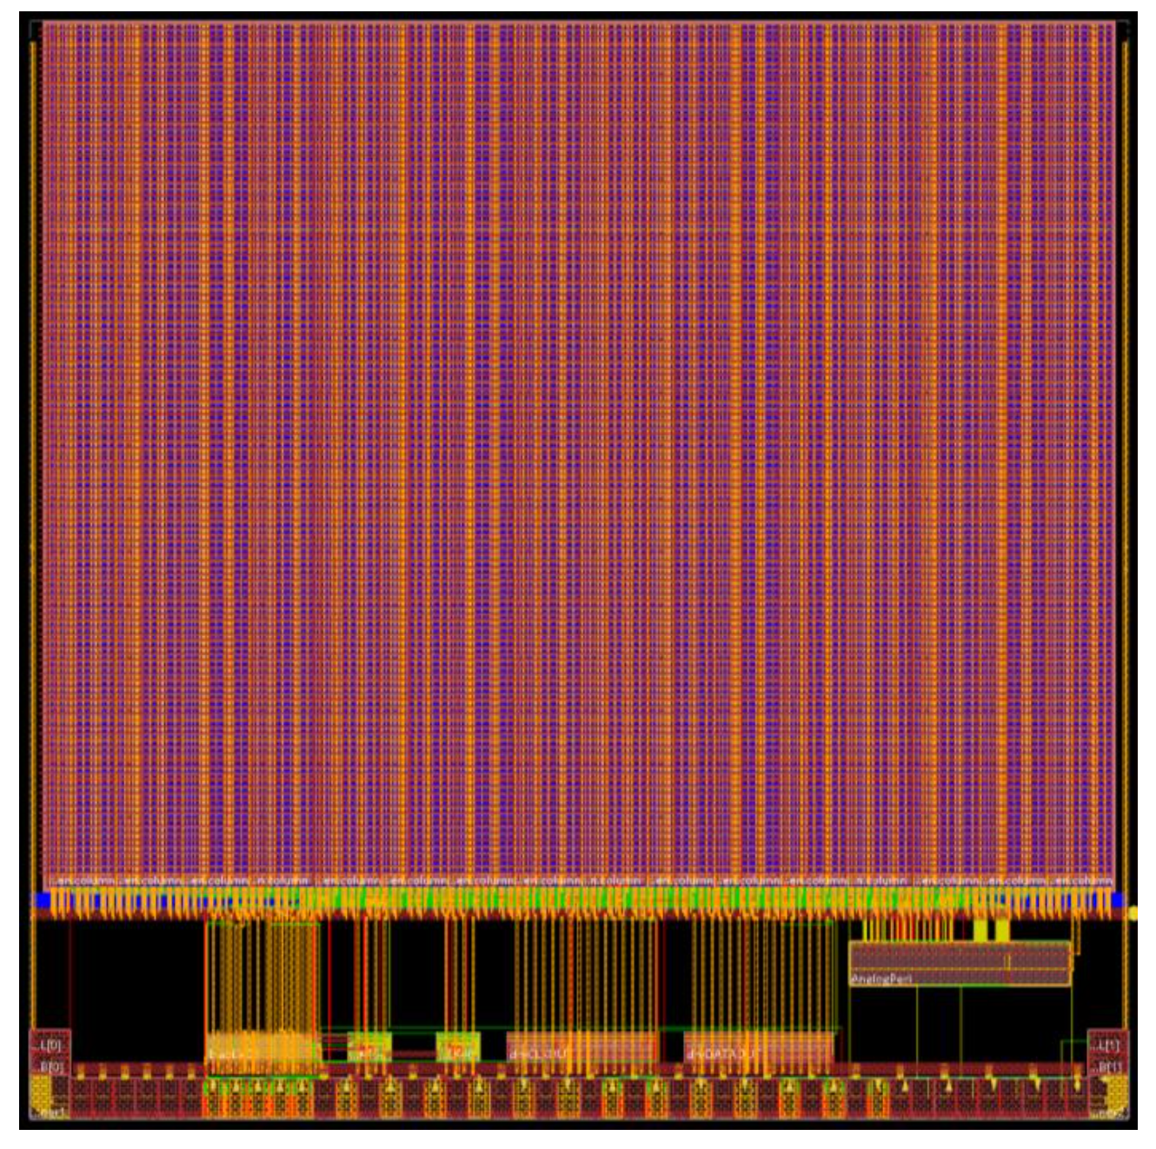
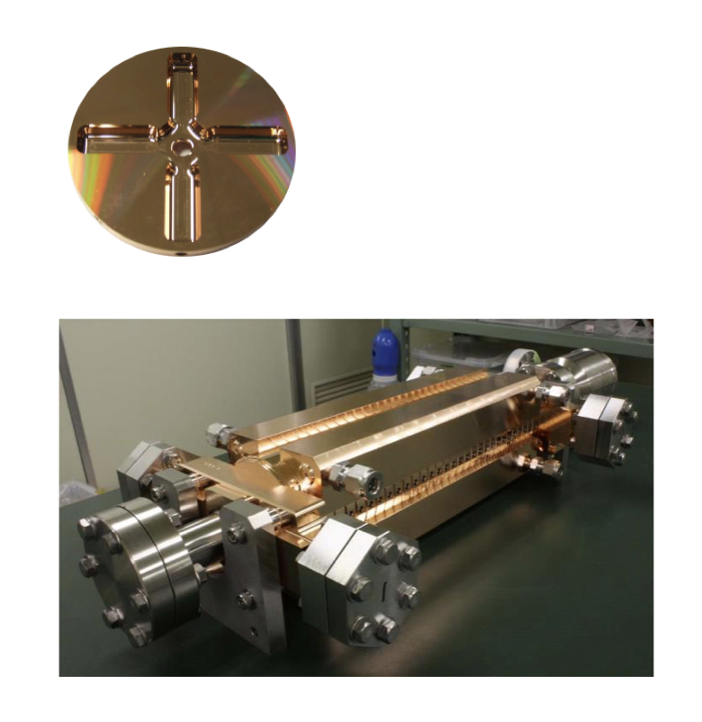
The CLIC Study
Compact Linear Collider
◆ Project overview
◆ Physics reach
◆ Accelerator technologies
◆ Outlook
Compact Linear Collider
e⁺e– collisions up to 3TeV
http://clic.cern/
Uppsala University – May 9, 2019
Andrea Latina, CERN
on behalf of the CLIC and CLICdp Collaborations

Slide 3
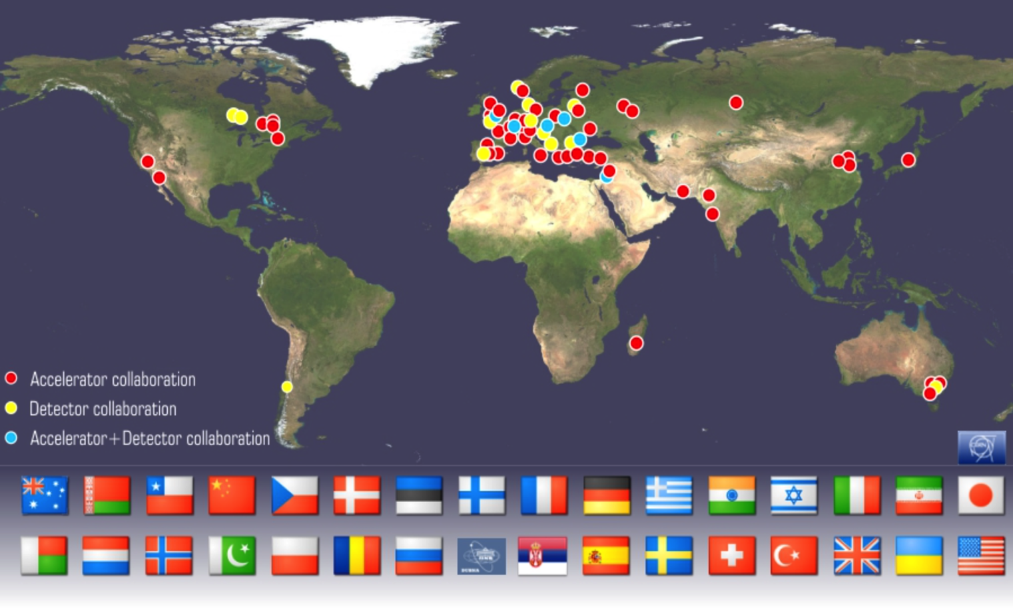
Collaborations
http://clic.cern/
CLIC accelerator design and development
(Construction and operation of CTF3)
CLIC physics prospects & simulation studies
Detector optimization + R&D for CLIC
CLIC accelerator collaboration
~60 institutes from 28 countries
CLIC detector and physics (CLICdp)
30 institutes from 18 countries

Slide 4
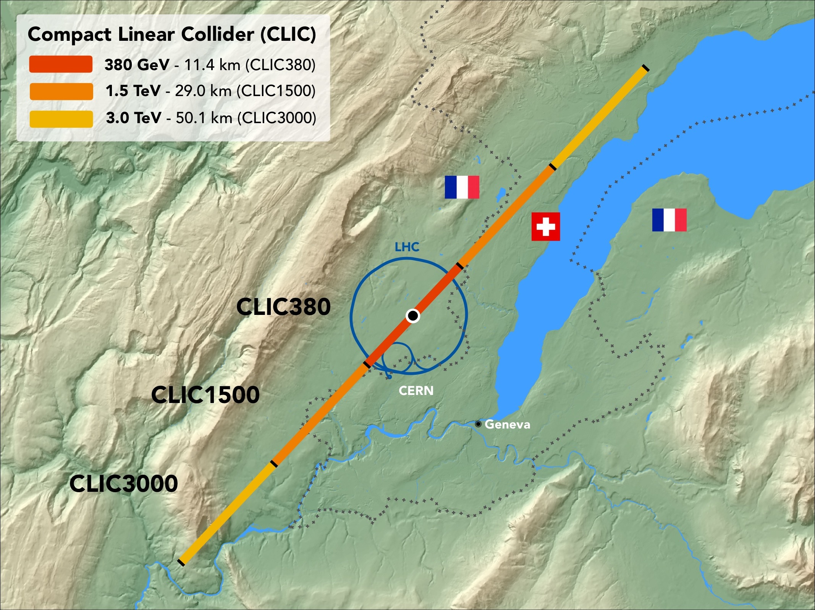
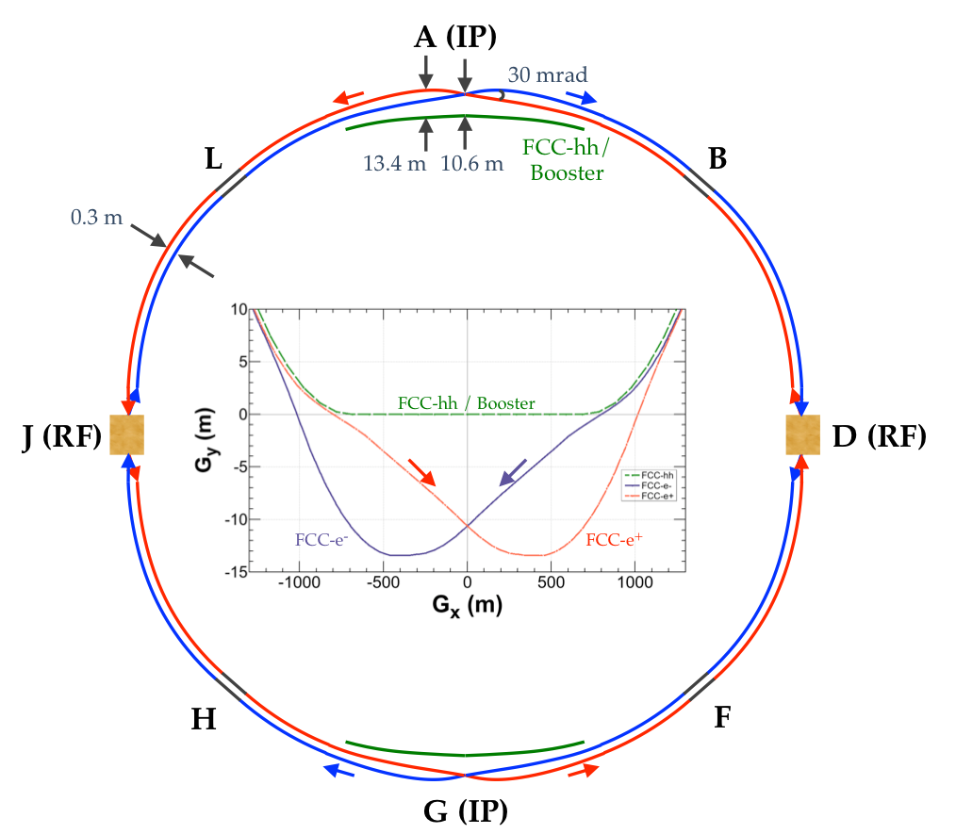
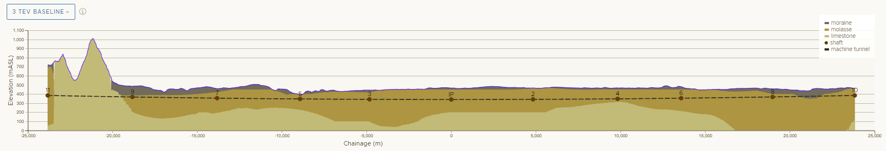
CLIC
FCC-ee

Slide 5
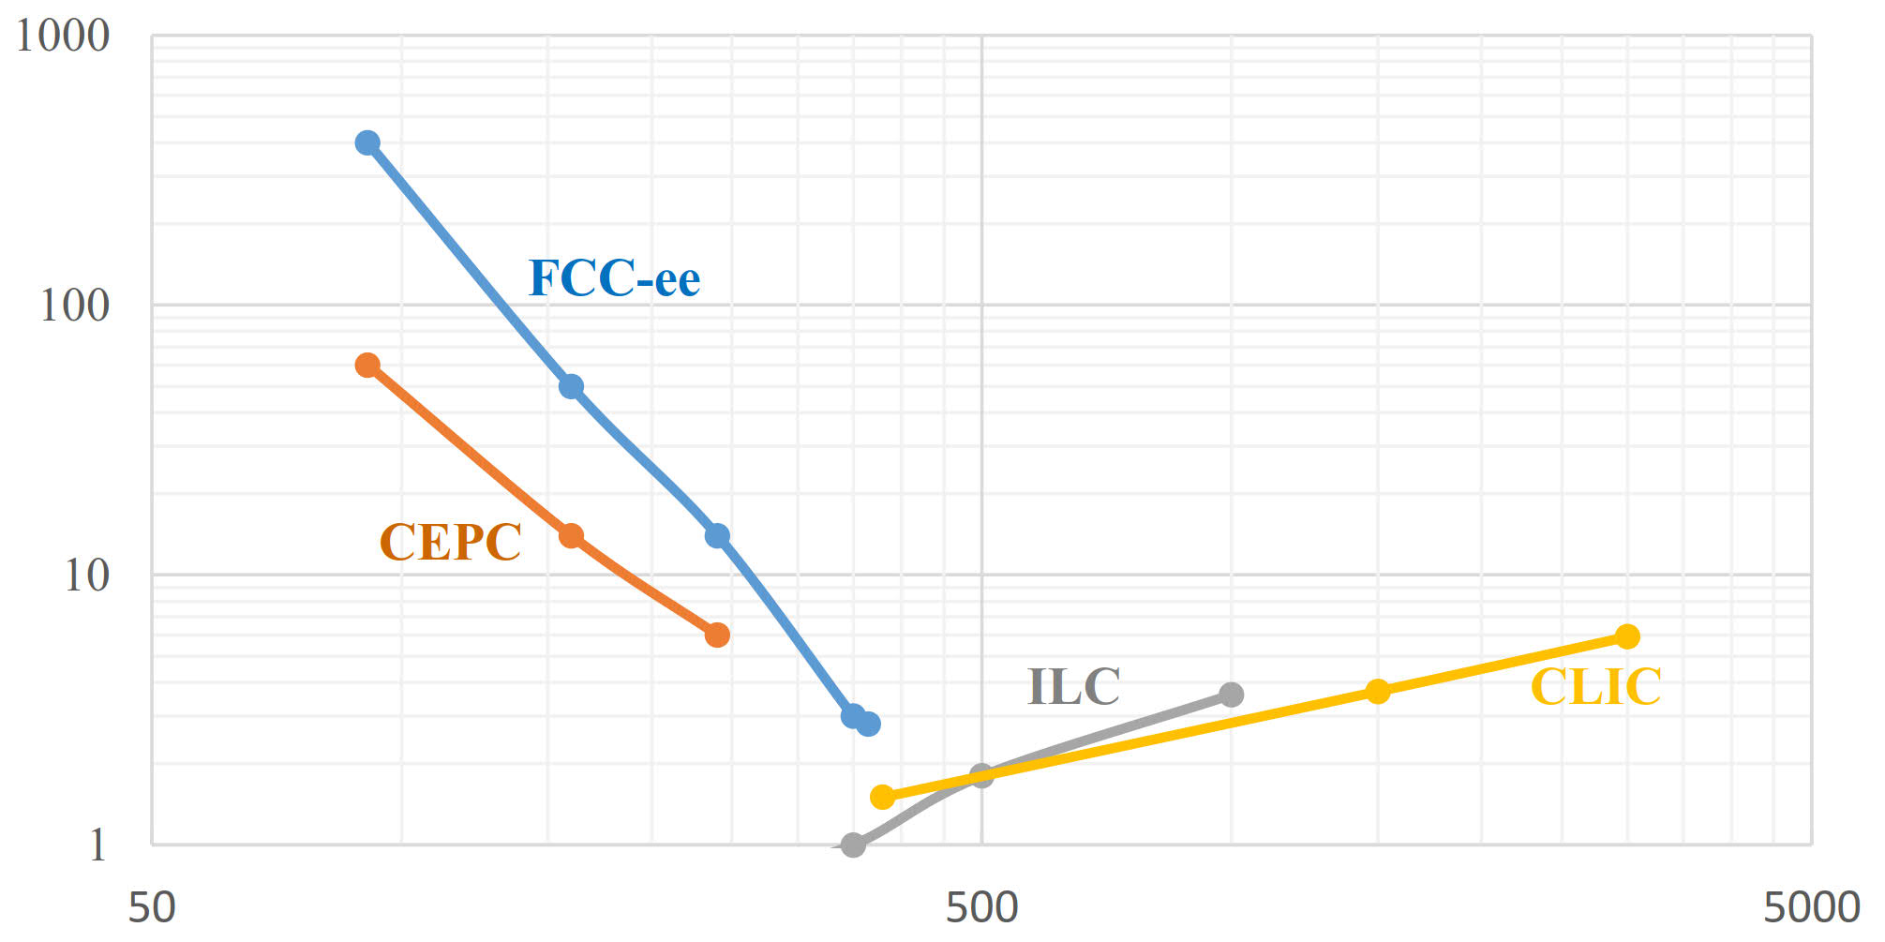
Luminosity vs Energy
A. Blondel, F. Zimmermann, arXiv:1112.2518 (2011).
A. Blondel et al., arXiv:1208.0504 (2012).
A. Bogomyagkov, E. Levichev, and D. Shatilov, Beam-beam effects investigation and parameters optimization for a circular e⁺e⁻ collider at very high energies, Phys. Rev. ST Accel. Beams 17, 041004 (2014).
K. Ohmi, N. Kuroo, K. Oide, D. Zhou, and F. Zimmermann, Coherent Beam-Beam Instability in Collisions with a Large Crossing Angle, Phys. Rev. Lett. 119, 134801 (2017).
D. Shatilov, FCC-ee Parameters Optimization, ICFA Beam Dynamics Newsletter #72 (2017).
Total luminosity [10³⁴ cm⁻²s⁻¹]
Center of mass energy [GeV]

Slide 6
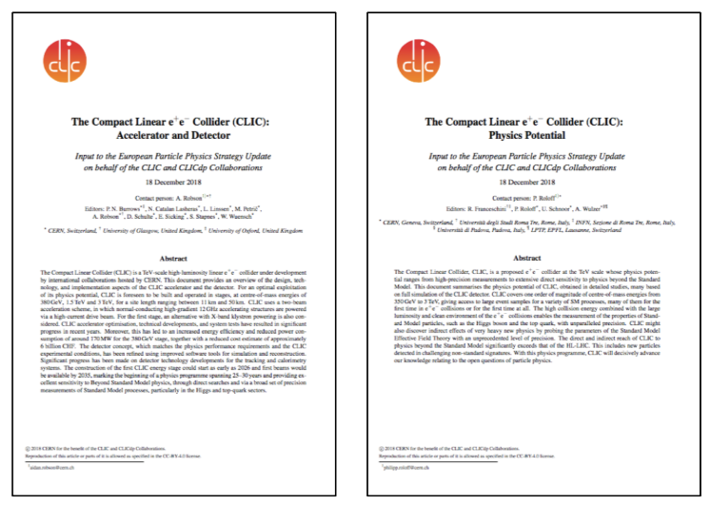
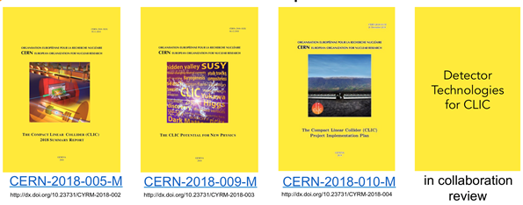
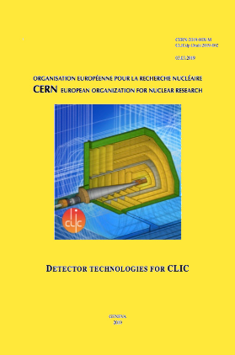
CLIC European Strategy Inputs
Submitted to CREB
http://clic.cern/european-strategy
Reports on design, technology, and implementation
Notes:
A number of documents report on the CLIC accelerator and detector and physics status in advance of the European Strategy update 2018-2020, including the design, technology, and implementation aspects of the CLIC accelerator and the detector, and summaries of the physics potential of CLIC.

Slide 7
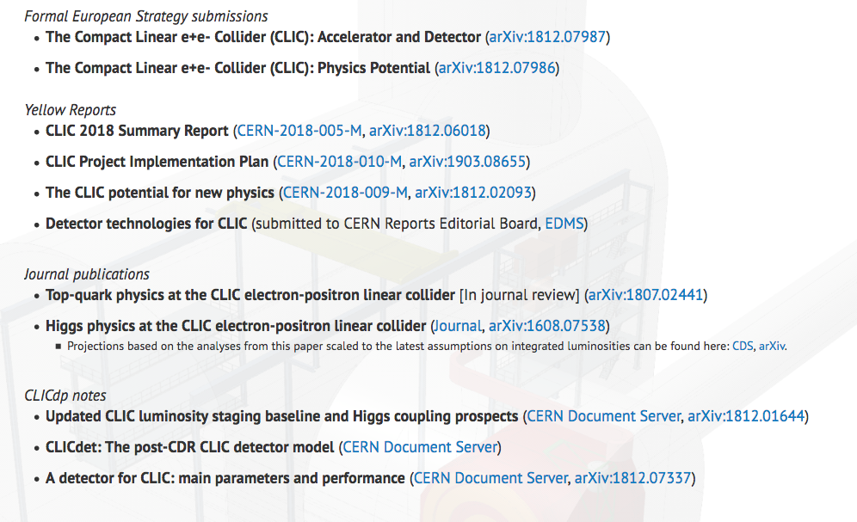
CLIC European Strategy Inputs

Slide 8
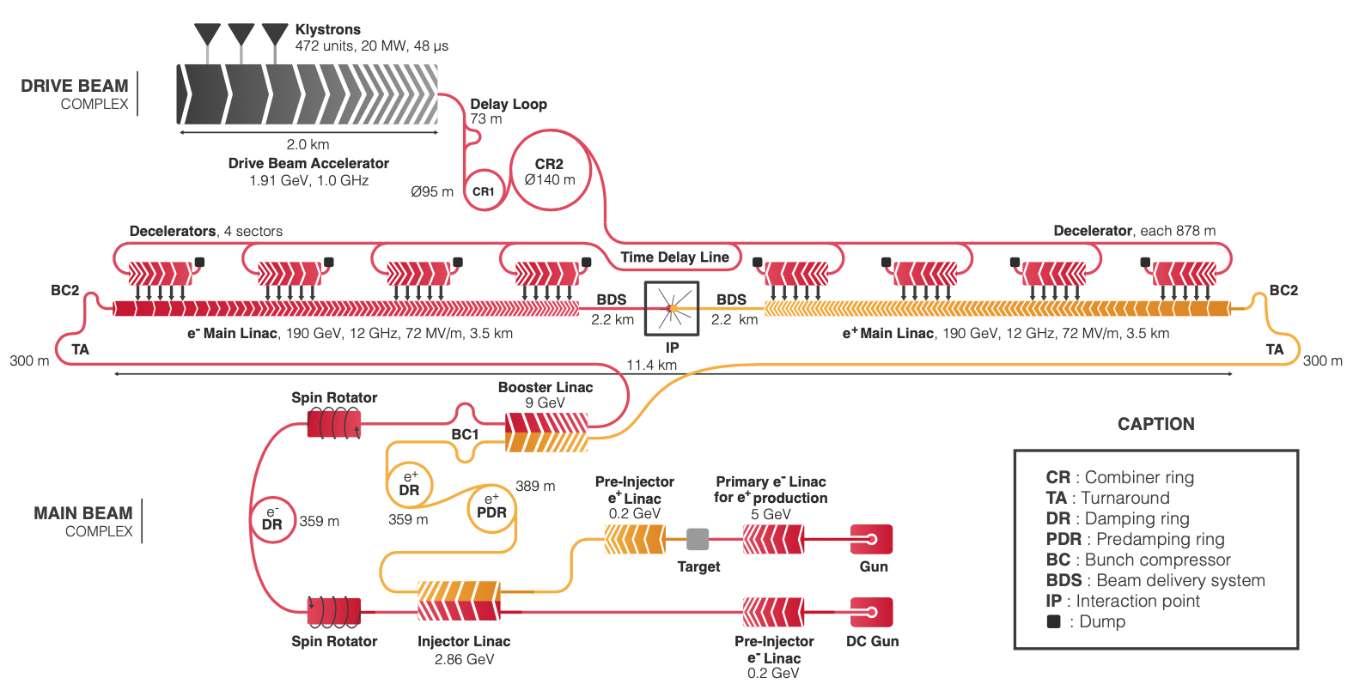
CLIC layout and power generation
380 GeV c.o.m. energy
Baseline electron polarisation ±80%
Notes:
Two-beam acceleration scheme, in which
normal-conducting high-gradient
12 GHz accelerating structures are
powered via a high-current drive beam.

Slide 9
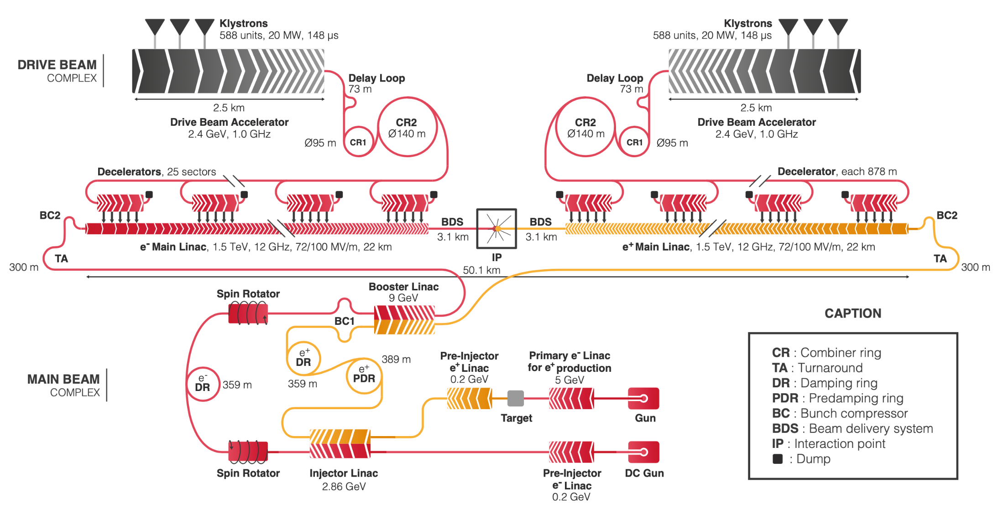
CLIC layout – final stage
3 TeV c.o.m. energy
Baseline electron polarisation ±80%

Slide 10
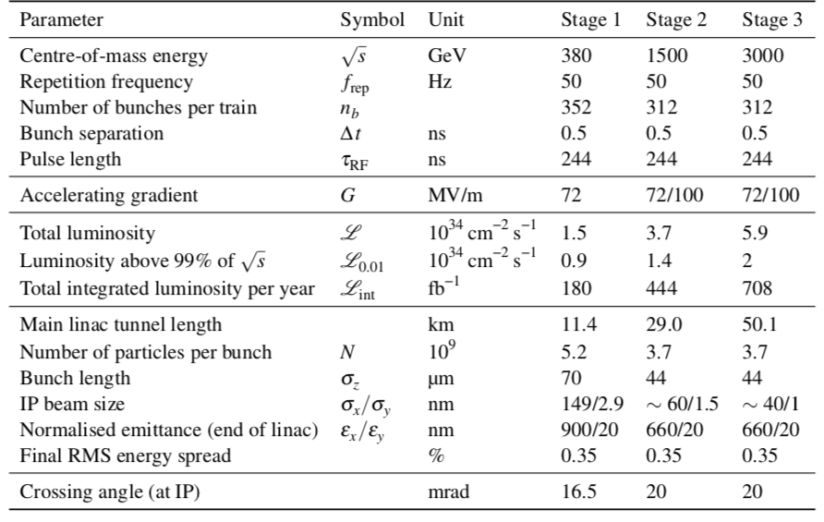
CLIC parameters

Slide 11
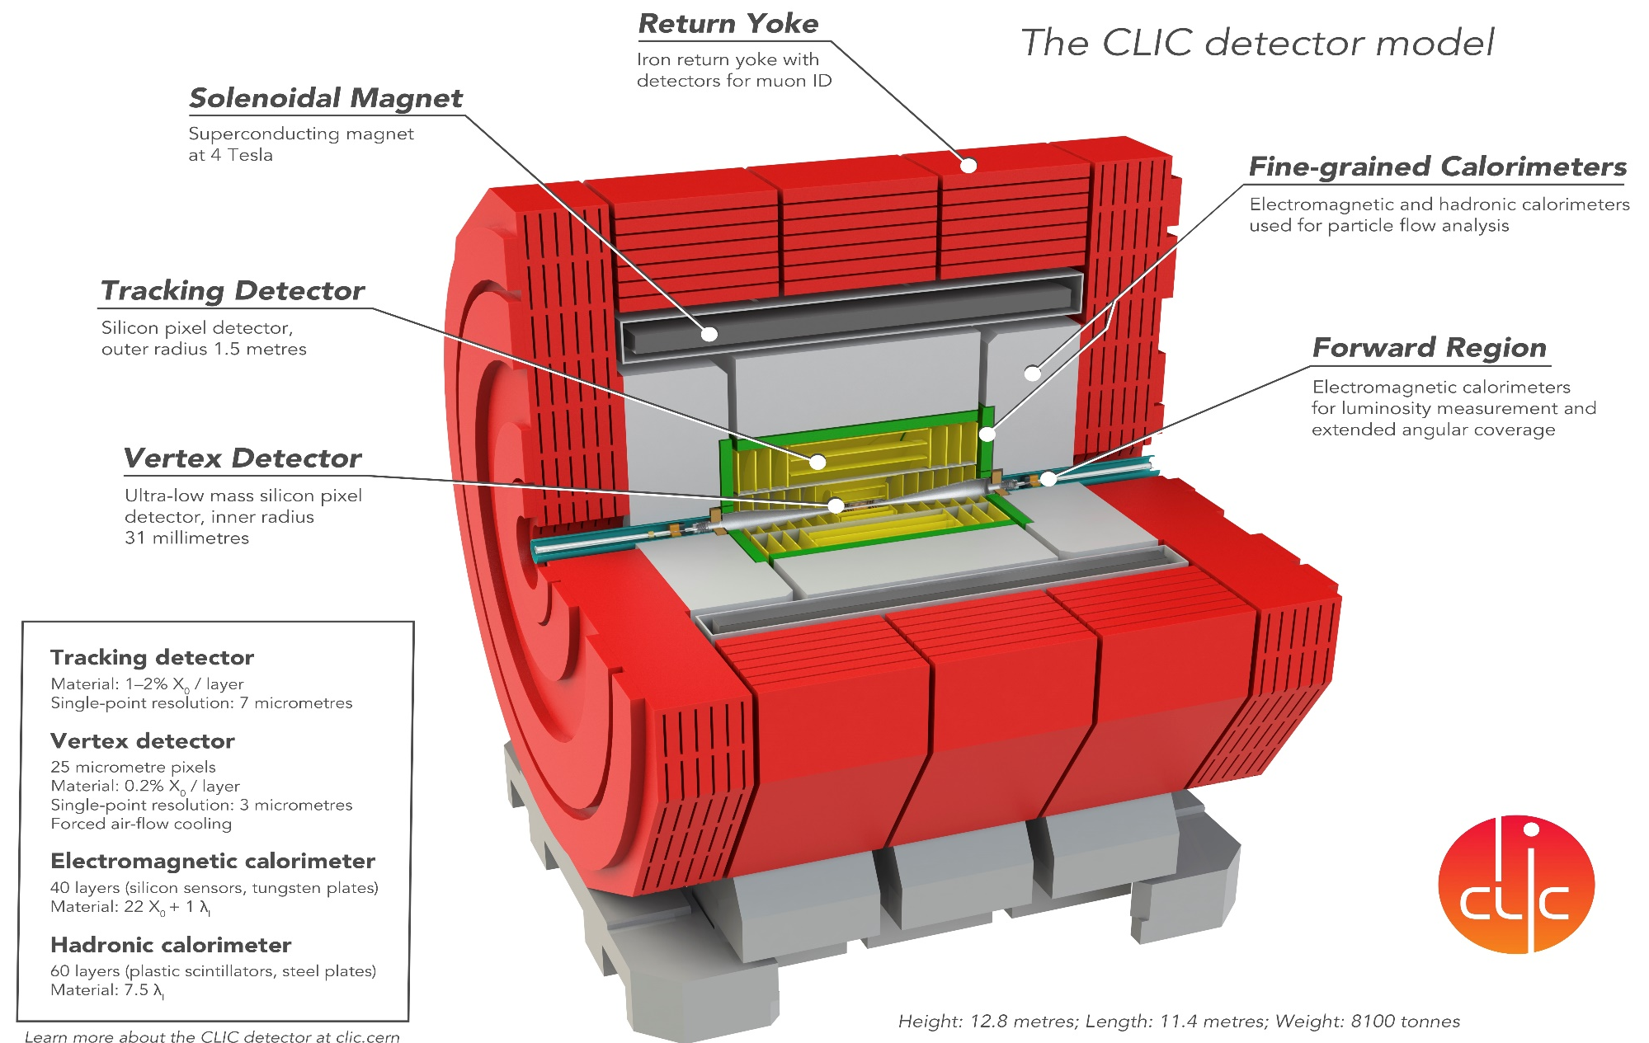
CLIC detector
Mature CLICdet detector model; performance extensively validated:

Slide 12
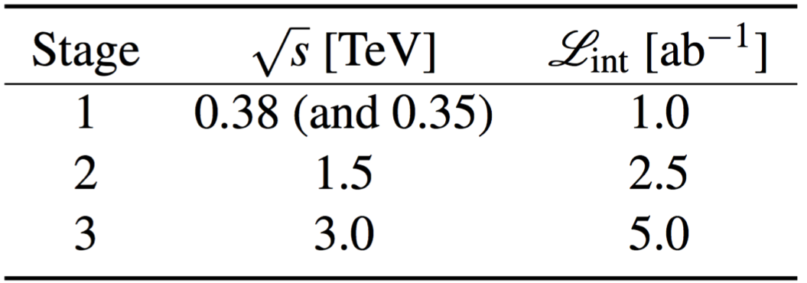
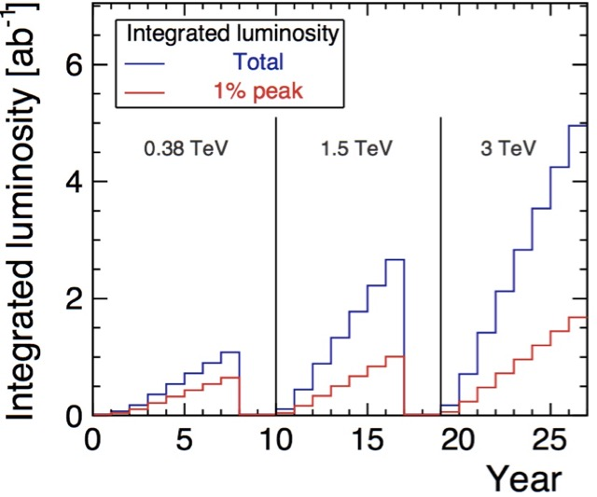
Luminosity staging baseline
New!
increased
from
0.5+0.1ab^{–1}
1.5ab^{–1}
3ab^{–1}
Electron polarisation enhances Higgs production at high-energy stages and provides additional observables
Baseline polarisation scenario adopted:
electron beam (–80%, +80%) polarised in ratio
(50:50) at √s=380GeV ; (80:20) at √s=1.5 and 3TeV
γγ collider using laser scattering also possible
Upgrades using novel accelerator techniques also possible
Staging and live-time assumptions following guidelines consistent with other future projects:
Machine Parameters and Projected Luminosity Performance of Proposed Future Colliders at CERN
arXiv:1810.13022, Bordry et al.

Slide 13
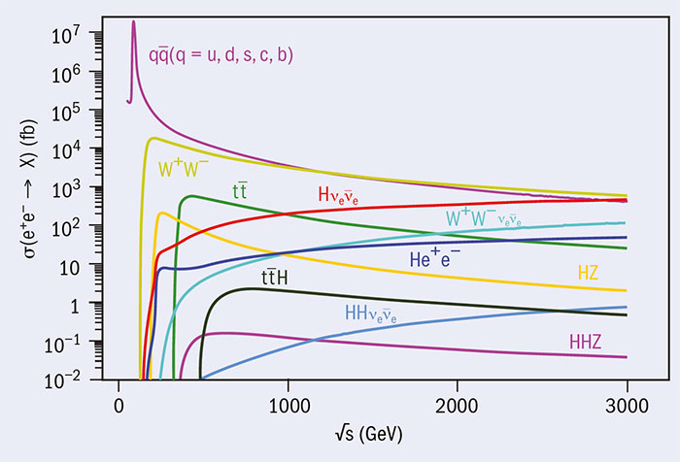
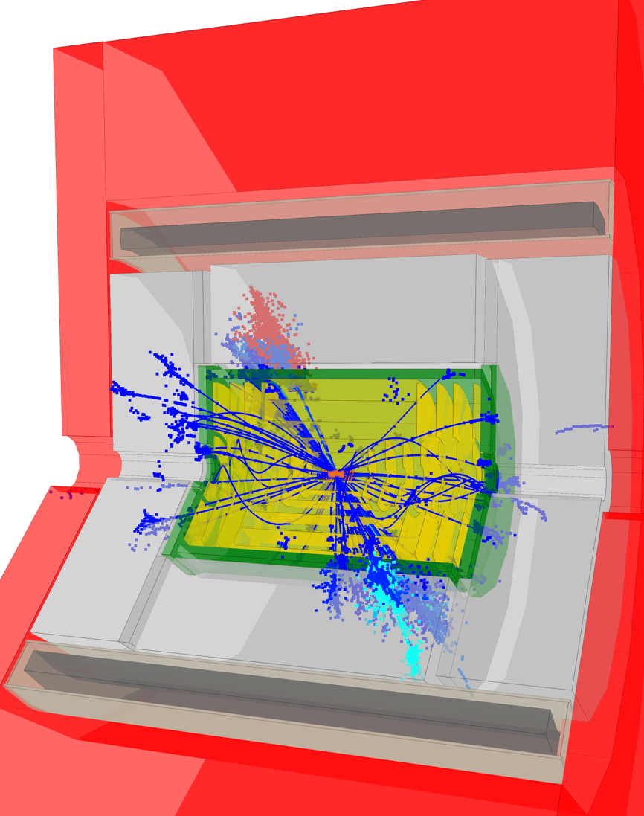
CLIC Physics
◆
Precision
Higgs
e+
ν
W
H
H
W
H
e–
ν
e+
Z
tt at √s=3TeV
Z
H
Precision
top
H
◆
e–
H
Beyond Standard Model
◆
Issues not addressed by SM:
origin of the weak scale interactions
dark matter
origin of matter/antimatter asymmetry
Many new studies focused on discovery prospects at CLIC
Exploring the physics landscape as broadly as possible
The CLIC Potential for New Physics
Yellow Report
in preparation
New!

Slide 14
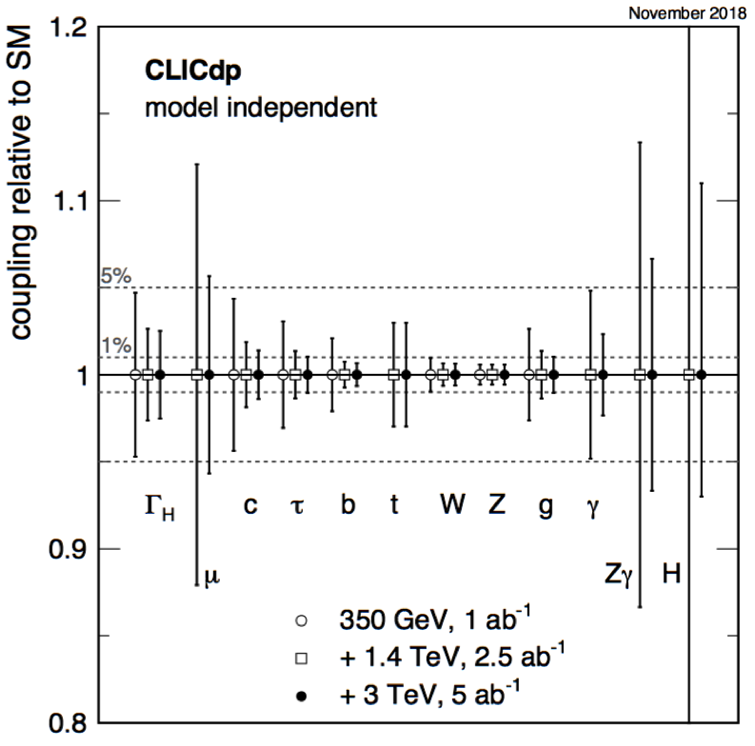
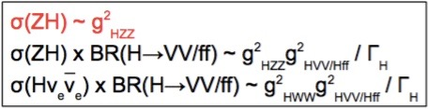
Higgs coupling sensitivity
Full GEANT-based simulation studies including beam backgrounds of many channels at all 3 stages
–> global fit including correlations;
Precision <1% for most couplings
c/b/W/Z/g couplings significantly more precise
than HL-LHC even after 380GeV stage
Γ_{H} is extracted with 4.7 – 2.5% precision
Each energy stage contributes significantly
no assumptions on additional Higgs decays – unique to lepton colliders
~
Higgs self-coupling requires high energy
e+
e+
ν
Z
W
H
Using M(HH)
differential
distribution:
Z
H
H
H
W
H
New!
e–
λ_{HHH}
H
e–
λ_{HHH}
ν
Δλ/λ =
+11%
–7%
complementary
at 1.5TeV
dominates
at higher √s
New!
Based on Eur. Phys. J. C 77 475 (2017)
updated to new luminosity scenario
Notes:
All results limited by 0.6% precision of gHZZ from σ(HZ) measurement

Slide 15
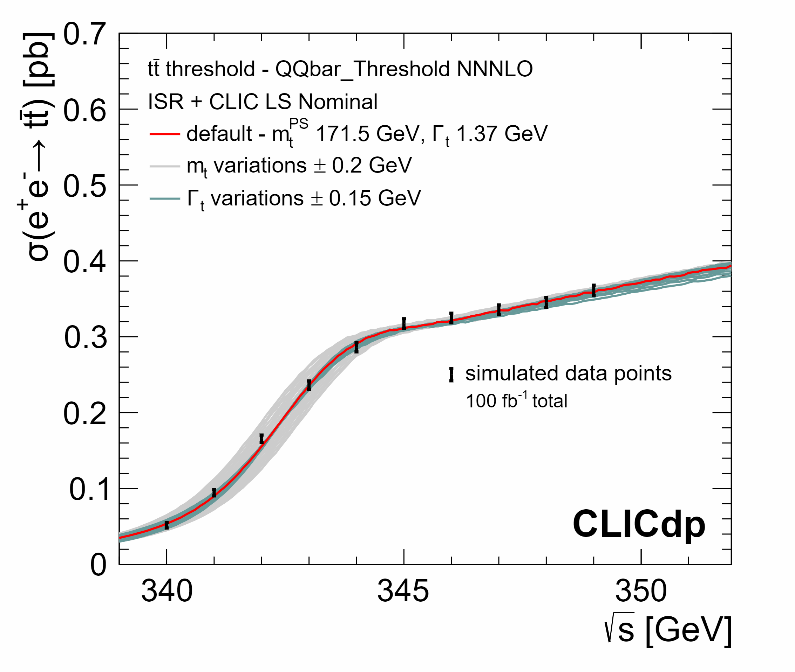
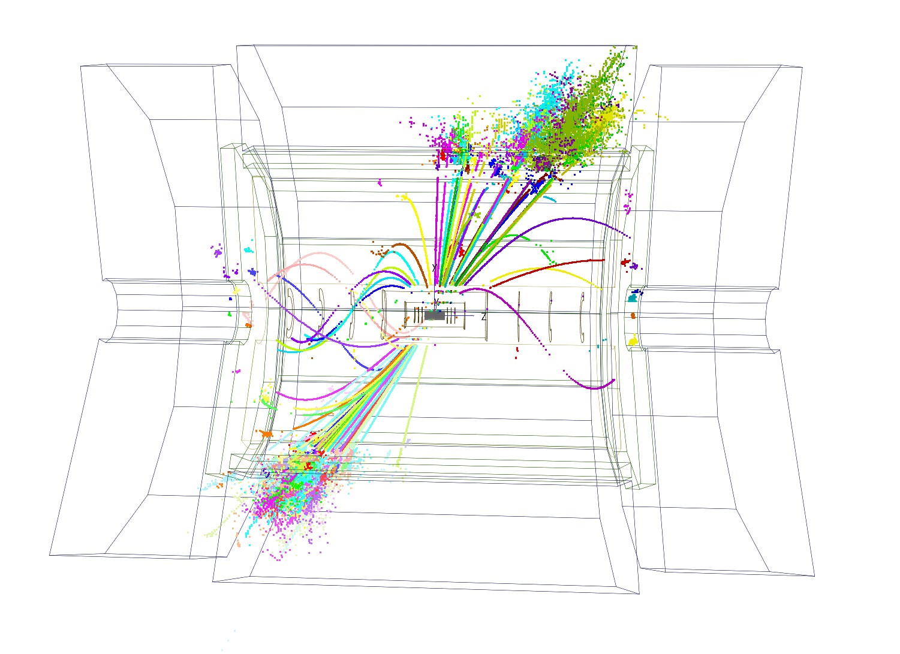
Top physics
◆ Intending threshold scan around 350 GeV (10 points,
~1 year) as well as main initial- stage baseline √s=380GeV
First study of boosted top production in e⁺e–
◆ sensitive to top mass, width and couplings
◆ observe 1S ‘bound
state’, Δm_{t} ~ 50 MeV
√s=3TeV
◆ FCNC decays
◆ CP properties of ttH
◆ cross-section and A_{FB}
-> resolved, semi-resolved,
boosted
◆ couplings to Z and γ
◆ EFT interpretation
e⁺e– -> tt -> qqqqbb
Hadronic decays of high-energy top quarks do not lead to 3 separated jets
–> identify substructure
Δsin²φ
New!
arXiv 1807.02441:
Top-quark physics at the CLIC electron–positron linear collider
–> initial and high-energy stages
are very complementary
Polarisation provides new observables
in journal review
sin²φ

Slide 16
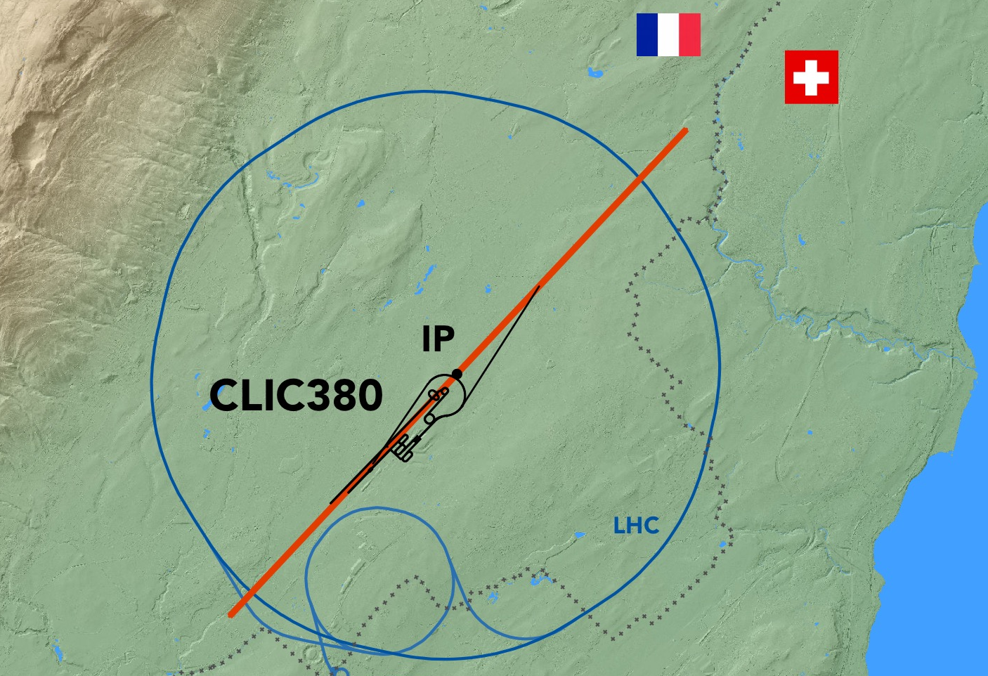
CLIC Accelerator
◆ Key technologies have been demonstrated
◆ CLIC is now a mature project, ready to be built

Slide 17
Key accelerator challenges
High-current drive beam bunched at 12 GHz
Power transfer + main-beam acceleration
100 MV/m high gradient in main-beam cavities
Produce, transport, and collide low-emittance beams
System integration, alignment and stability, engineering, cost, power …

Slide 18
CLIC Test Facility (CTF3)
Uppsala - May 2019
Andrea Latina
18

Slide 19
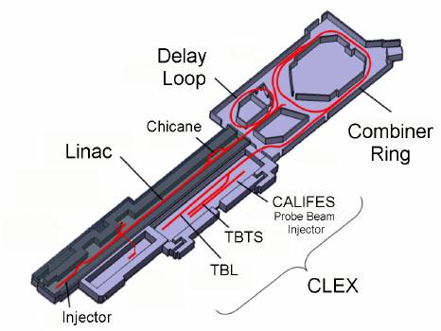
Accelerator challenges
Drive beam quality:
Produced high-current drive beam bunched at 12GHz
Key challenges:
High-current drive beam bunched at 12 GHz
Power transfer +
main-beam acceleration
~100 MV/m gradient in main-beam cavities
Low emittance generation
Alignment & stability
3 GHz
Drive beam
arrival time
stabilised
to CLIC specification of 50fs:
x2
x3
28A
12 GHz
Current in combiner ring
Examples of measurements from CLIC Test Facility, CTF3, at CERN.
CTF3 now the ‘CERN Linear Electron Accelerator for Research’ facility, CLEAR

Slide 20
Accelerator challenges
Demonstrated 2-beam acceleration
Key challenges:
High-current drive beam bunched at 12 GHz
Power transfer +
main-beam acceleration
~100 MV/m gradient in main-beam cavities
Low emittance generation
Alignment & stability
31MeV = 145MV/m

Slide 21
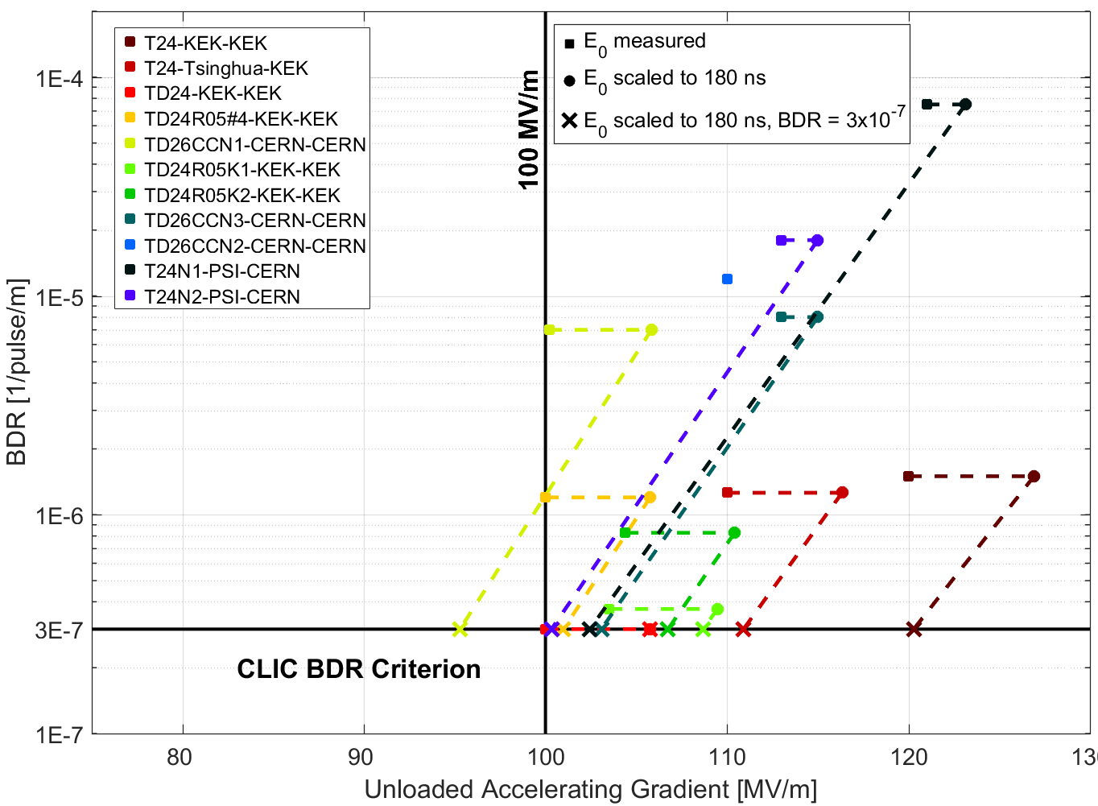
Accelerator challenges
X-band performance: achieved 100MV/m gradient in main-beam RF cavities
Key challenges:
High-current drive beam bunched at 12 GHz
Power transfer +
main-beam acceleration
~100 MV/m gradient in main-beam cavities
Low emittance generation
Alignment & Stability

Slide 22
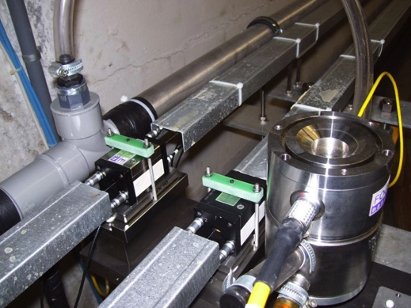
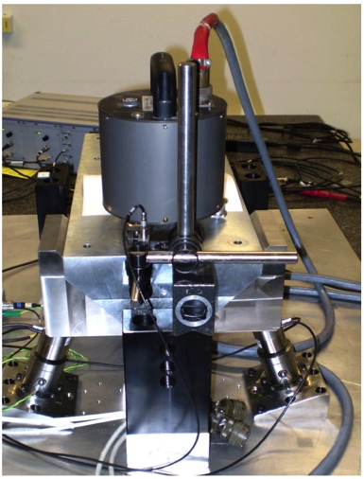
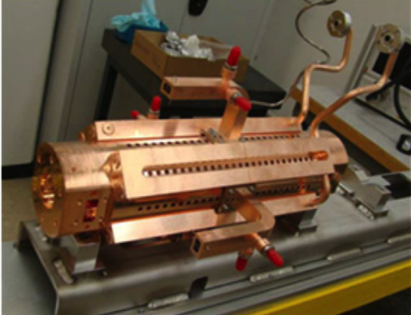
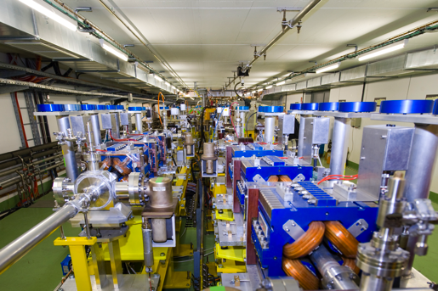
Accelerator challenges
Nano-beams
The CLIC strategy:
Align components (10μm over 200m)
Control/damp vibrations
(from ground to accelerator)
Measure beams well
– allow to steer beam and optimize positions
Algorithms for measurements, beam
and component optimization, feedbacks
Tests in existing accelerators of equipment
and algorithms (FACET at Stanford,
ATF2 at KEK, CTF3, Light-sources)
Key challenges:
High-current drive beam bunched at 12 GHz
Power transfer +
main-beam acceleration
~100 MV/m gradient in main-beam cavities
Low emittance generation
2008
CLIC emittance at damping rings

Slide 23
Accelerator challenges
Nano-beams
The CLIC strategy:
Align components (10μm over 200m)
Control/damp vibrations
(from ground to accelerator)
Measure beams well
– allow to steer beam and optimize positions
Algorithms for measurements, beam
and component optimization, feedbacks
Tests in existing accelerators of equipment
and algorithms (FACET at Stanford,
ATF2 at KEK, CTF3, Light-sources)
Key challenges:
High-current drive beam bunched at 12 GHz
Power transfer +
main-beam acceleration
~100 MV/m gradient in main-beam cavities
Low emittance generation
2016
CLIC emittance at damping rings

Slide 24
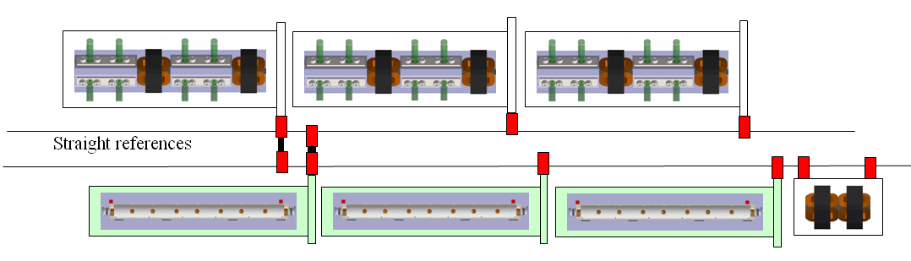
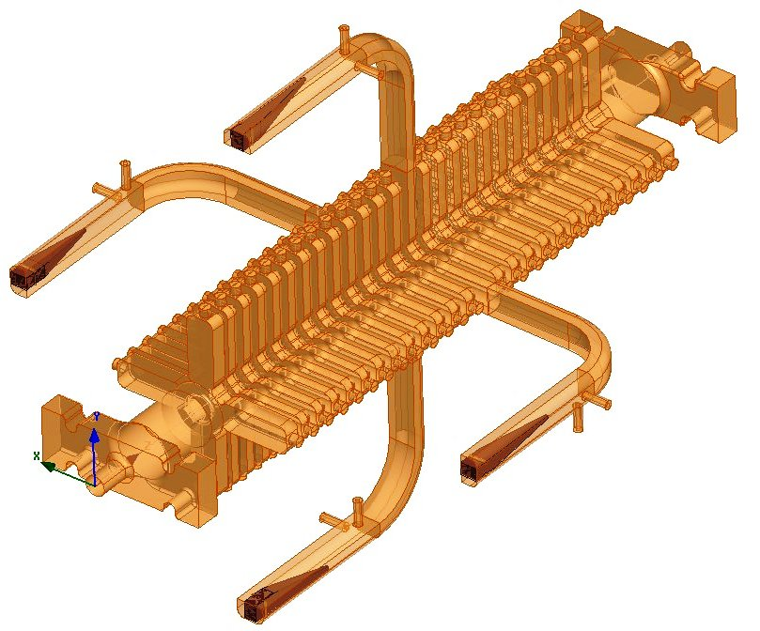
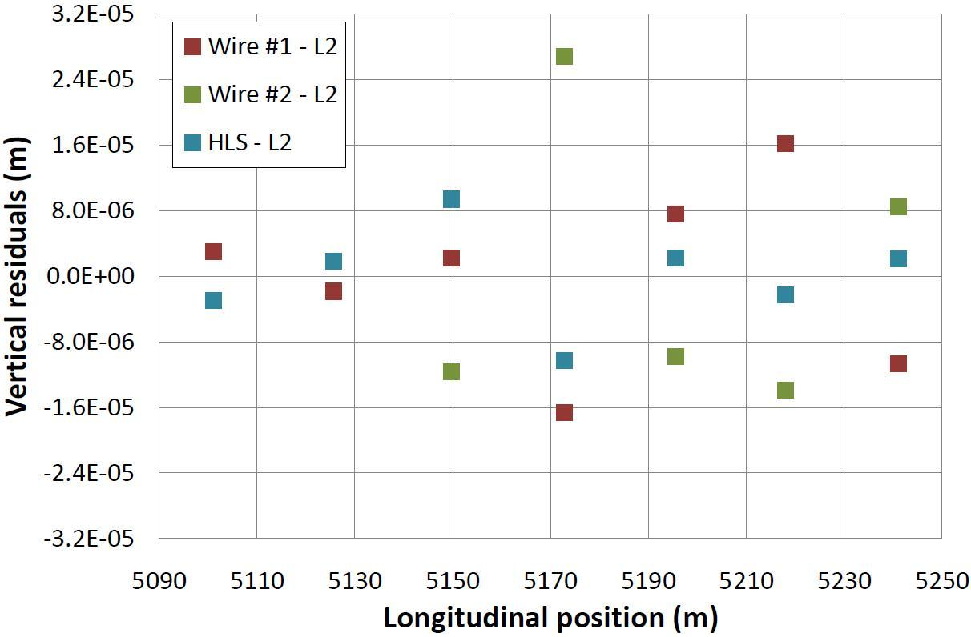
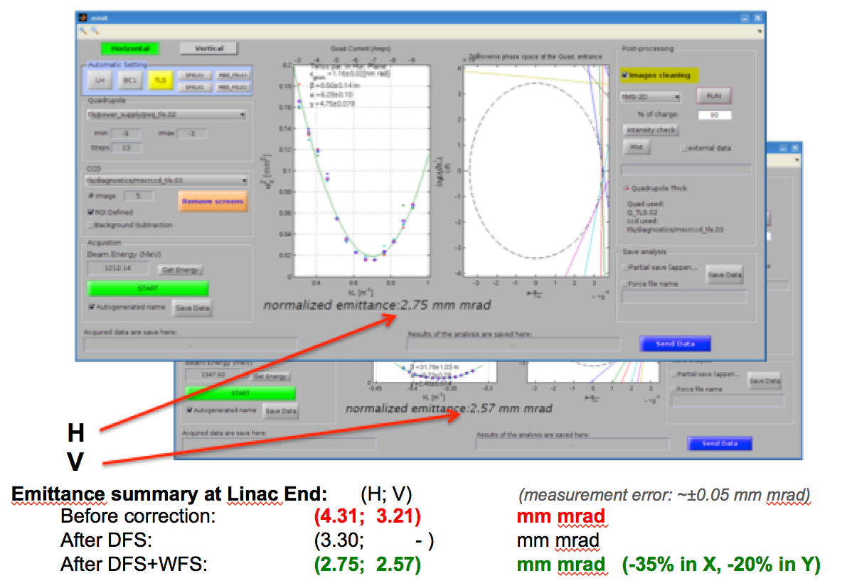
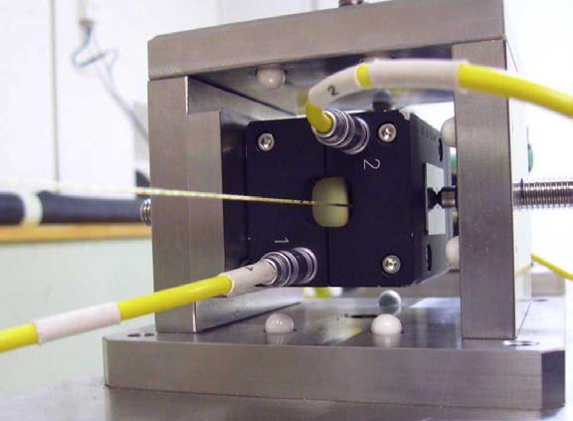
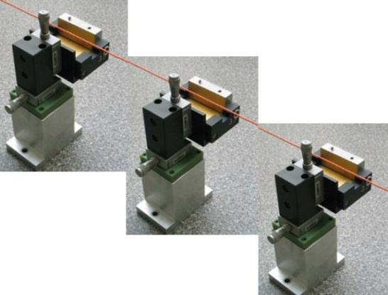
Low emittance transport
Stabilise quadrupole
O(1nm) @ 1Hz
1) Pre-align BPMs+quads
accuracy O(10μm) over about 200m
3) Use wake-field monitors accuracy O(3.5μm) – CTF3
FACET
FERMI
2) Beam-based alignment
PACMAN, Marie Curie Action:
vertical RMS error of 11μm
i.e. accuracy is approx. 13.5μm
24

Slide 25
Final focus system
ATF2 @ KEK

Slide 26
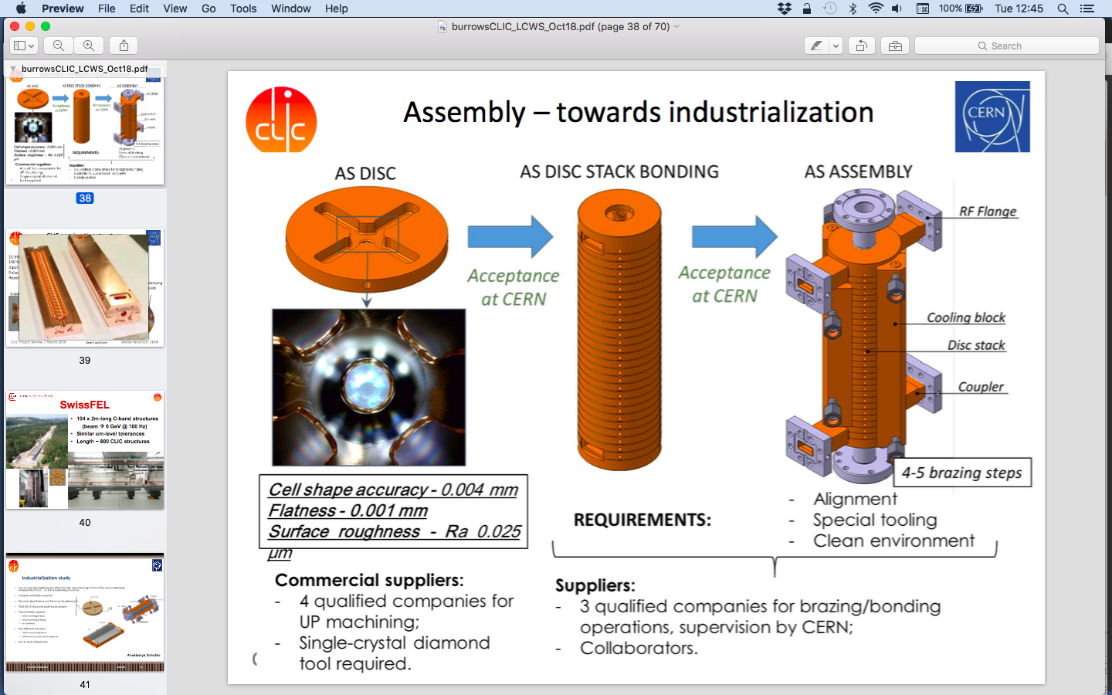
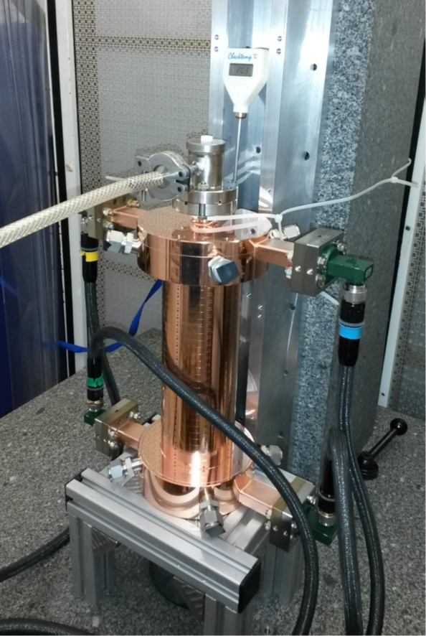
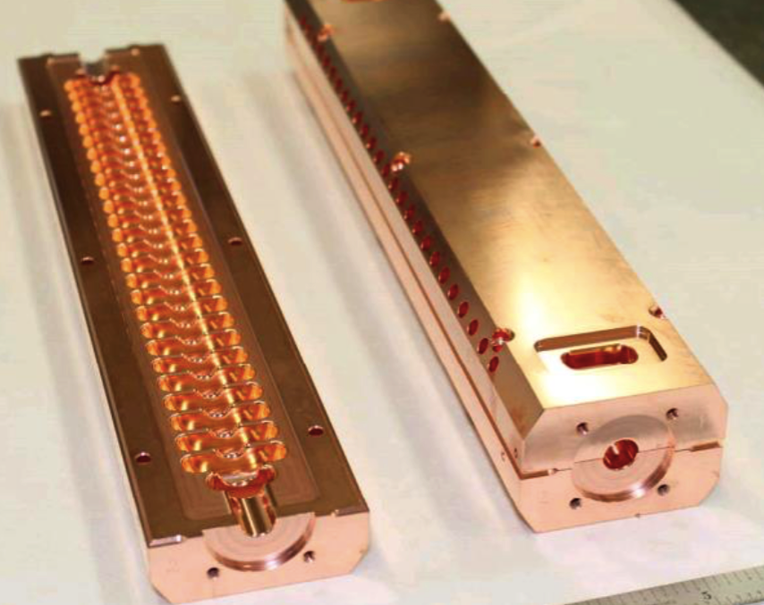
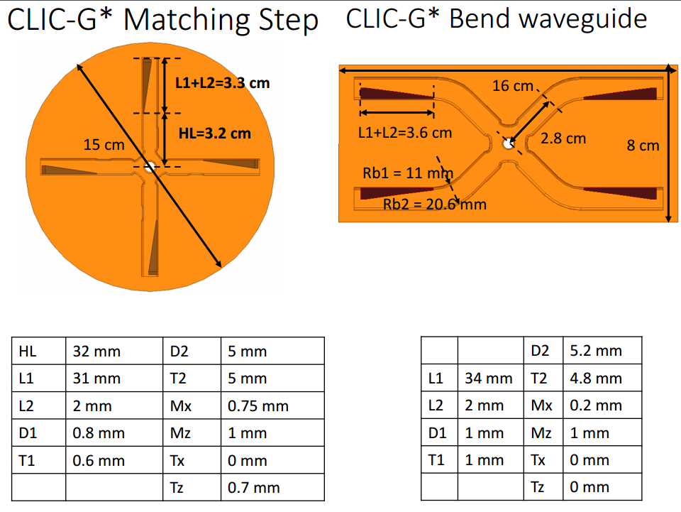
Towards industrialisation
Investigating paths to industrialisation
Baseline manufacturing technique:
bonding and brazing
Alternatives:
brazing as for SwissFEL
machining halves
Target is structures that are
low-cost & easy-to-manufacture

Slide 27
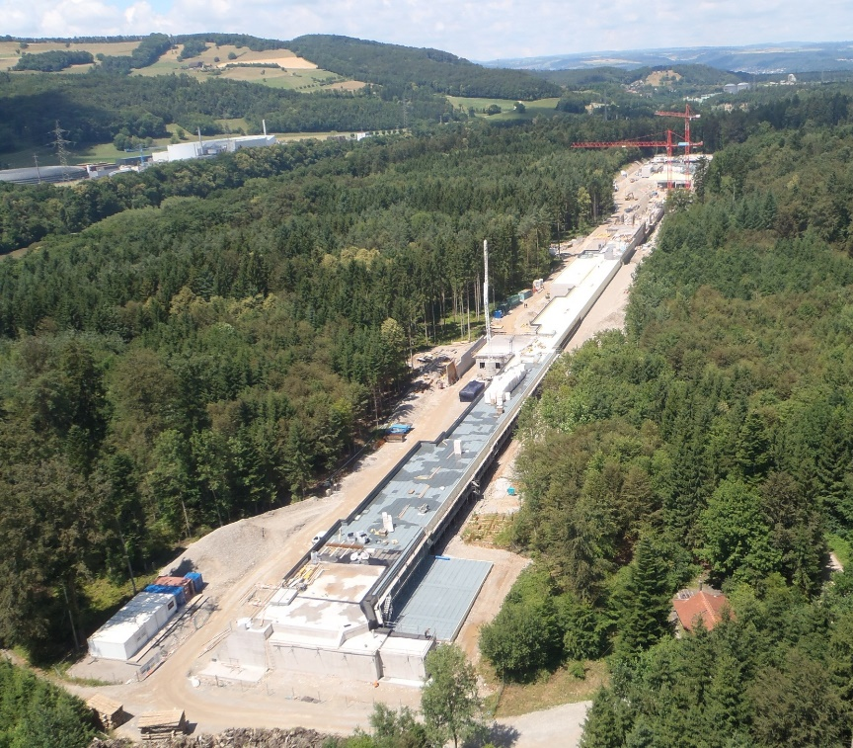



SwissFEL – C-band linac
104 x 2m-long C-band structures
(beam → 6 GeV @ 100 Hz)
Similar μm-level tolerances
Length ~ 800 CLIC structures
Being commissioned

Slide 28

Power
Preliminary power consumption for 380GeV CLIC
Being updated for changes in design parameters, and using operating (not specification) values for RF power sources and magnet power supplies
Included so far:
Vacuum systems
RF and RF power systems
Magnet & magnet powering systems
Beam instrumentation
Active alignment and stabilization
in ML and BDS
Electricity
2016 estimate
To be added:
Experimental area
Cooling & ventilation
Safety systems
Machine control
& operational
infrastructure
Total energy use will be updated once power consumption complete
+~20–30%
( Klystron-based option: 142 MW + ~20-30% )
Final power estimate will be < 200MW (compared with 252MW in 2016)
~

Slide 29

380 GeV Klystron option

Slide 30

Cost
Machine has been bottom-up re-costed in 2018
Cost → ~5.9 BCHF
for initial stage
(Finalised for ESU)
Maintenance cost 116 MCHF per year.
Project Implementation Plan 2018

Slide 31

Schedule
Updated schedule:
Construction + commissioning: 7 years
Year
Year
Year
Year
Year
Year
Year

Slide 32
Schedule
Updated schedule:
Construction + commissioning: 7 years, followed by 25–30 year physics programme

Slide 33
CLIC roadmap

Slide 34

Next phase
2020–2025 Preparation Phase:
Finalisation of implementation parameters
Preparation for industrial procurement
Drive Beam Facility & other system verifications
Technical Proposal of the experiment
Site authorisation
2026 Construction start

Slide 35


CLIC technology applications
CLIC technology for different applications:
CompactLight: EU co-funded FEL design study
SPARC at INFN-LNF
Medical applications
INFN Frascati advanced acceleration facility
EuPRAXIA@SPARC_LAB
CompactLight
Eindhoven University led
SMART*LIGHT Compton Source
Electron accelerator implementation at CERN
X-band based 70m LINAC to ~3.5 GeV in TT4-5
Fill the SPS in 1-2s (bunches 5ns apart) via TT60
Accelerate to ~16 GeV in the SPS
Slow extraction to experiment in 10s as part of the SPS super-cycle
Experiment(s) considered by bringing beam back on Meyrin site using TT10
–> Potential experiment e.g. LDMX
Would fulfil many of CLIC accelerator next steps
EoI to SPSC, autumn 2018: https://cds.cern.ch/record/2640784

Slide 36


CLEAR
CERN Linear Electron Accelerator for Research
80–220 MeV electrons
Bunch charge 0.01–1.5 nC
CALIFES beamline
CLEAR started with beam in August 2017
Main activities:
CLIC & high-gradient X-band
Instrumentation R&D
VESPER irradiation test station
Electronic components for space applications
(with ESA)
Medical applications (VHEE)
Electronic components for accelerators
and detectors
Novel techniques: plasma focusing and acceleration, THz radiation, dielectric structures
Open to proposals for user experiments

Slide 37
Summary
◆ CLIC is now a mature project, ready to be built
◆ The main accelerator technologies have been demonstrated
◆ The physics case is broad and profound
◆ The detector concept and detector technologies R&D are advanced
◆ The full project status is presented in a series of Yellow Reports
Thanks to all who provided material, including: Steinar Stapnes, Phil Burrows, Daniel Schulte,
Walter Wuensch, Aidan Robson, Lucie Linssen, Andrea Wulzer, Roberto Franceschini, Jorge de Blas, Philipp Roloff

Slide 38

CLIC workshop January 2019
215 participants

