Slide 1
CRYO and RF for Big Science 8th of May 2019

Slide 2
RFR Solutions develops and manufactures first-rate stainless steel solutions for customers with high demands.
We call it stainless steel excellence
Ren energi, rent vatten och ett ständigt fokus på att ta vara på vår värld och dess resurser.
Det är kärnan i vår verksamhet.

Slide 3
RFR Solutions in short
We offer a complete production set-up in combination with module supply mainly to the Nordic market
10,000 m² facility in Landskrona and representative office at Medicon Village in Lund (Sweden)
400 tons yearly turn-over of stainless steel
Turnover 7 MEUR with 45 employees

Slide 4
Our focus is on stainless steel solutions
We believe in partnership
Brand promise
Stainless steel excellence
Values
Together
Constantly on track
Always better
Development/Cooperation
Luleå University (laser)
Lund University (machining)
Uppsala University (cryo technic)

Slide 5
ISO 9001:2015 certified since 2009
ISO 3834-2:2005 certified since 2011
Achilles Sellicha certified since 2012
SS-EN ISO 9606-1:2017 certified welders
ISO 14000 adaptation in progress (2019)
Why RFR Solutions?
Complete partner from prototype to production
Project management, design support, production reviews and material expertise
Turnkey projects
3D and CAM infrastructure (RFR Solutions 4.0)
Delivery and quality precision
ASSEMBLY, TEST & SITE INSTALLATIONS
DESIGN
MANUFACTURING

Slide 6
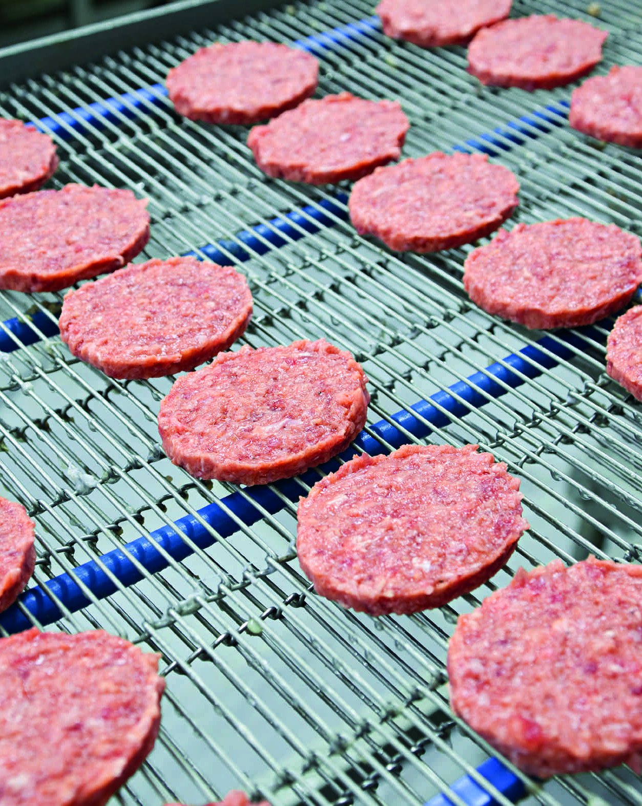
Food
Packaging
Processing

Slide 7
Greentech
Water treatment
Air purification
Swimmingpools

Slide 8
Medtech
Pharma
Biotech

Slide 9
Energy
Oil and gas
Biogas
Nuclear power industry

Slide 10
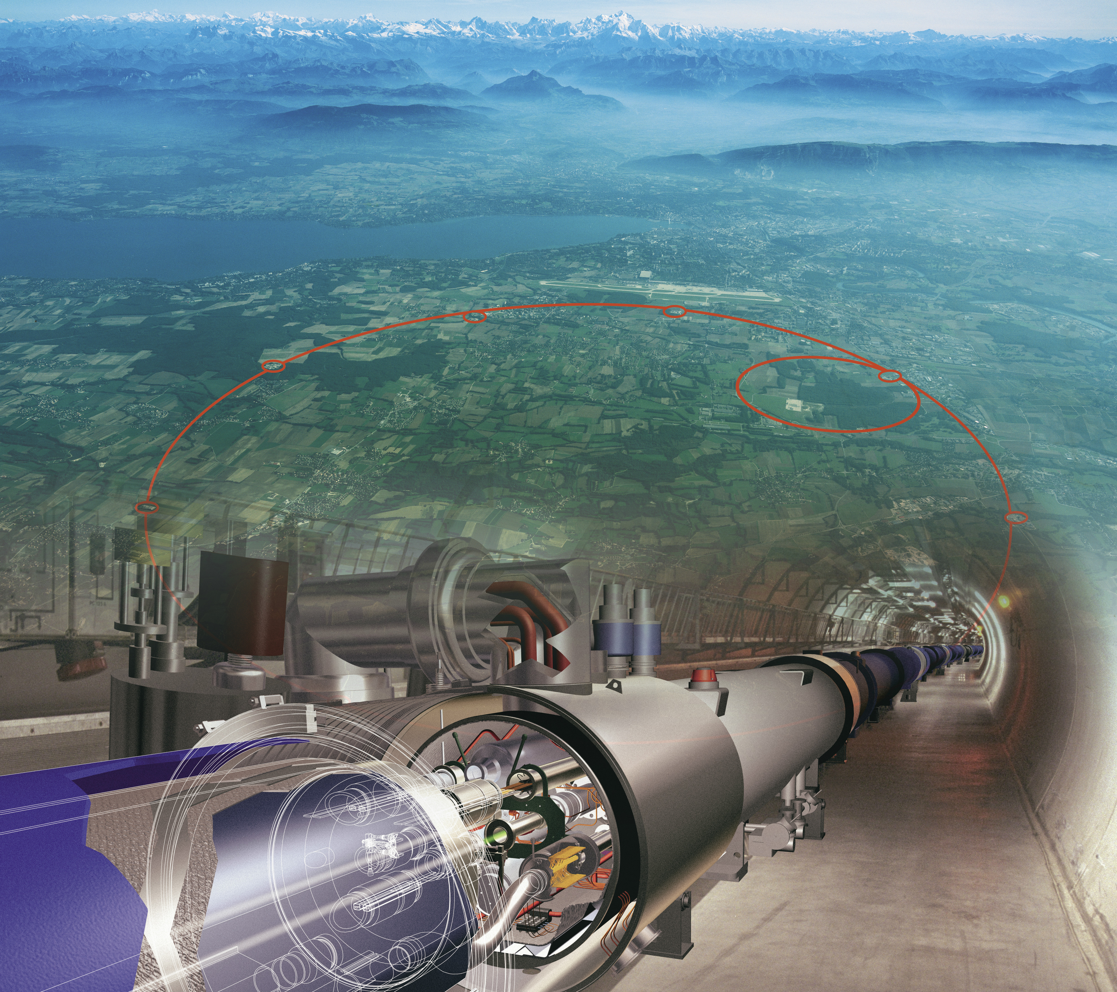
Big Science
CERN
ESS
MaxLab4

Slide 11
Project Model ”Cold Box”
Uppsala Universitet
RFR Solutions (Vinnova)
CERN

Slide 12
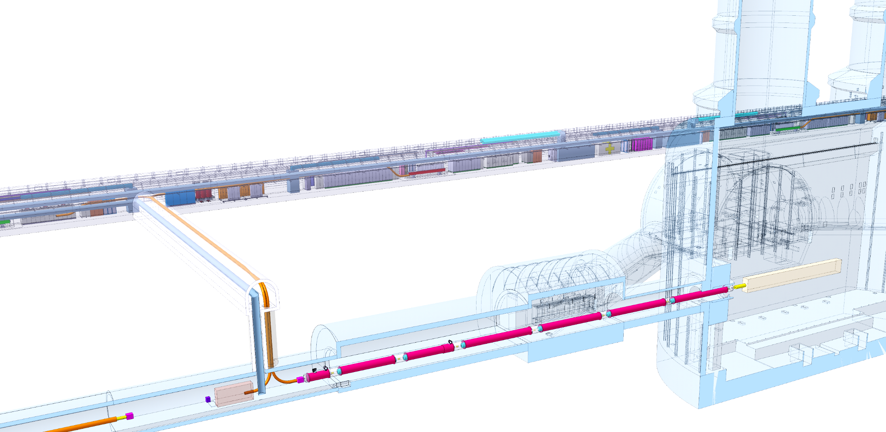
New High Luminosity magnets Cold powering with superconducting links
DFHX
DFHM
SCLink DSH
Q1
IP
DFX
Q2a
Q2b
Q3
DFM
CP
D1

Slide 13
DFHx box – conceptual design
Electrical layout - Superconductors, circuits
Cryogenic layout - Helium fluids layout, dynamic
Integration - Tunnel allocation

Slide 14
Thank you for your attention!
www.rfrsolutions.se

