Slide 1


UPPSALA
CRYO and RF
Big Science
Sven-Christian Ebenhag
190508
Notes:
[Titelsida]
[Du byter bakgrundsfärg genom att högerklicka på bakgrunden och välja Formatera bakgrund.]
[Byt rubriknivå genom att markera ett ord i stycket och klicka TAB(Mindre) eller SHIFT + TAB(Större).]

Slide 2
RISE´s Mission
from the Swedish Government
“The industrial research institutes shall be internationally competitive and facilitate sustainable growth in Sweden by strengthening competitiveness and renewal in the business community.”
  Excerpt from the Research Bill 2016/17: 50 (Kunskap i samverkan).
Notes:
[Citatsida]
[Du byter bakgrundsfärg genom att högerklicka på bakgrunden och välja Formatera bakgrund.]
[Byt rubriknivå genom att markera ett ord i stycket och klicka TAB(Mindre) eller SHIFT + TAB(Större).]

Slide 3
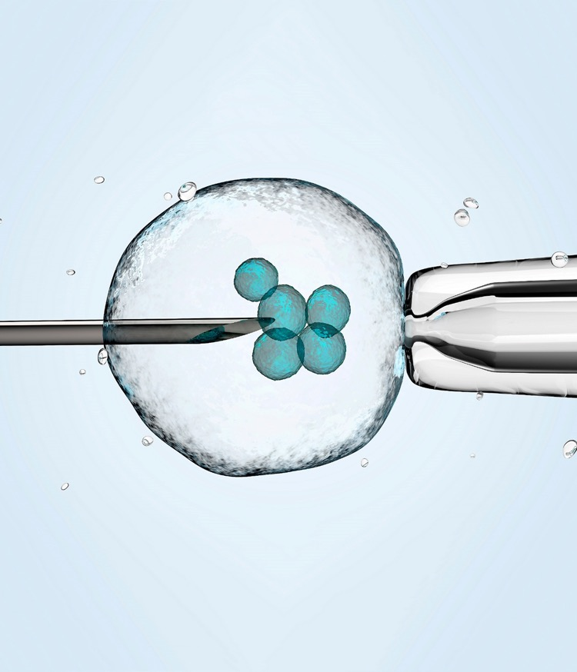
One strong, unified institute for Sweden
Sweden needs a strong, national innovation capacity to compete on the international stage and to meet major global challenges.
The new RISE aims to build a stronger Swedish institute sector that will actively support Swedish industry, providing increased benefits for trade and industry, and society in general.
Notes:
The new RISE creates conditions that allow us to take better advantage of the strengths we have in today’s research institute, and to gather new strengths for the future. Meaning that the group can expand and deliver even more. We are now a stronger organisation, that can disseminate research results and innovation to the market more quickly and efficiently. And become a more relevant player in the European and international innovation system.
Another way of expressing this is that we must…
Become a familiar and natural hub in the Swedish innovation system.
Constitute a critical mass for cooperation with leading national and international players.
Contribute to sustainable business.
Be an attractive employer, both internally and externally by creating a world-leading research environment.

Slide 4
RISE in brief
Present across the whole of Sweden.
2,700 employees, 30 % with a PhD.
Turnover approx. SEK 3 billion (2018).
A large proportion of customers are SME clients, accounting for approx. 30 % industry turnover.
Runs 100s of test and demonstration facilities, open for industry, SMEs, universities and institutes (RISE is owner and partner in 60 % of all Sweden’s T&D facilities).
Notes:
+355 nya medarbetare från Swerea från den 1 oktober 2018.

Slide 5
Turnover distribution
RISE group
5%
22%
3 066 MSEK (2018)
51%
22%
Notes:
Camilla: Nya siffror för 2018 inlagda

Slide 6
Our vision
An internationally leading partner for innovation
Notes:
[Citatsida]
[Du byter bakgrundsfärg genom att högerklicka på bakgrunden och välja Formatera bakgrund.]
[Byt rubriknivå genom att markera ett ord i stycket och klicka TAB(Mindre) eller SHIFT + TAB(Större).]

Slide 7
With our broad range of competencies and unique expertise, we create added value
Bioeconomy
Fire and safety
Cement and concrete
Certification
Circular economy
Design
Electronics
Energy and fuels
Packaging
Glass
Health and Care
ICT and telecoms
Agriculture and food
Chemistry, materials
and surfaces
Life Science
Maritime
Mechanical engineering
Mechanics
Metrology and
measurement technology
Paper and Pulp
Process development
Built environment
Safety
Mobility
Wood
Water

Slide 8
Our combined offer
Applied Research and Development
Research and Innovation projects
Expert consultation
Service design and design processes
Innovation support for SMEs
Industrialisation
and Verification
Testbeds and demonstration facilities
Technical assessments and verification
Prototypes and pilot line production
Quality Assurance
Certification

Slide 9
RISE
  Testbeds and demonstration facilities
Notes:
[Citatsida]
[Du byter bakgrundsfärg genom att högerklicka på bakgrunden och välja Formatera bakgrund.]
[Byt rubriknivå genom att markera ett ord i stycket och klicka TAB(Mindre) eller SHIFT + TAB(Större).]

Slide 10
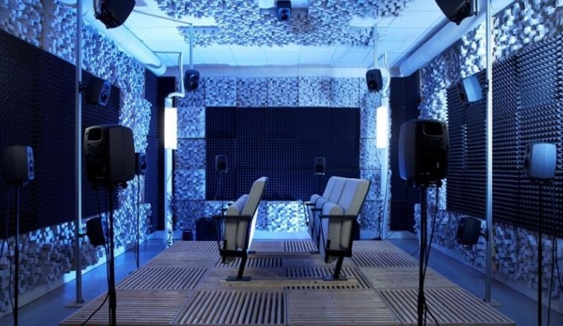
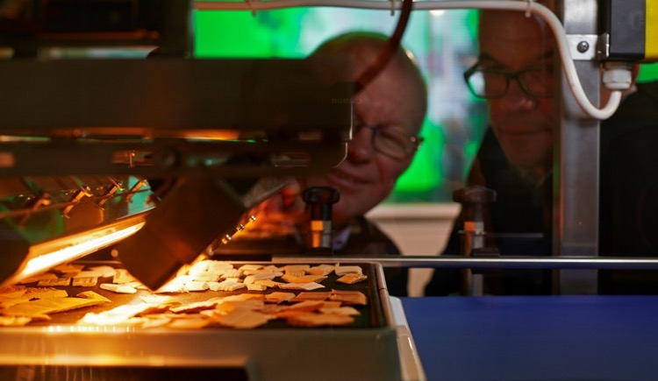
RISE testbeds and demonstration facilities
Unique infrastructures for research, development and verification on lab and pilot scale
Physical or virtual environments where businesses, academia, research institutes and the public sector can collaborate
Equipment adapted for industrial applications with qualified operators and technicians
Expertise in research, industrial applications and project management
RISE owns, and has partnerships in, more than 100 unique test beds and demonstration facilities.

Slide 11
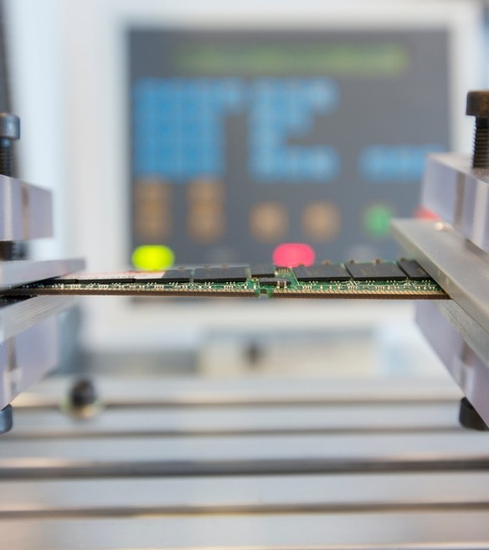
What can be done at a RISE testbed and demonstration facility?
Test and scale up the products and processes of the future under realistic conditions
Direct, confidential assignments or, in research and innovation projects, assignments together with multiple stakeholders
Access to a well-developed network of stakeholders and expertise that can contribute to new solutions and business opportunities

Slide 12
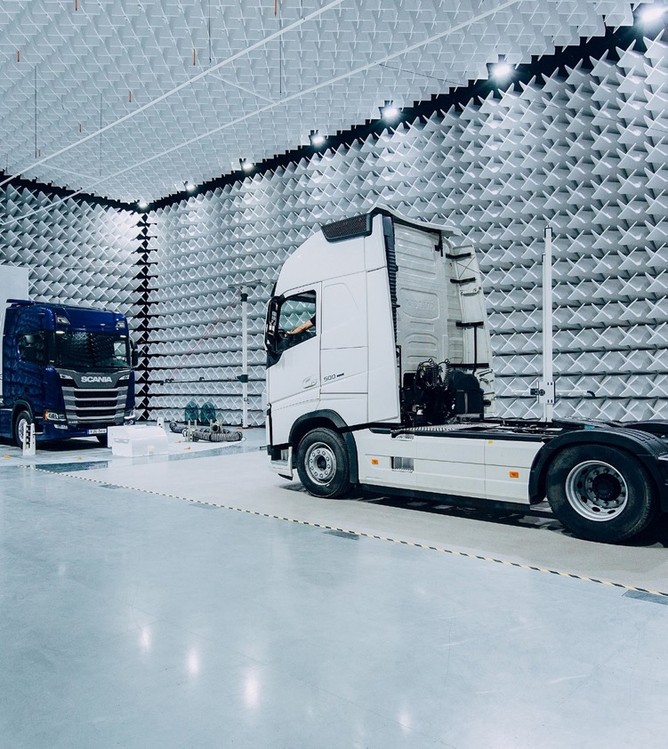
Awitar – a unique testing facility for autonomous vehicles
The complexity of the vehicles on our roads – equipped with radar, cameras, and sensors – is growing rapidly. The disruptive testing of automotive electronics is therefore increasingly important and a prerequisite for transitioning to future autonomous vehicles, which must be able to communicate wirelessly with one another
Awitar has been developed in close cooperation with the Swedish automotive industry. The new test facility for future vehicles is unique in its capacity and flexibility.
Notes:
The complexity of the vehicles on our roads – equipped with radar, cameras, and sensors – is growing rapidly. The disruptive testing of automotive electronics is therefore increasingly important and a prerequisite for transitioning to future autonomous vehicles, which must be able to communicate wirelessly with one another. To meet the new needs of the automotive industry, we have invested in a new testing facility in Borås called Awitar. Awitar is an acronym of Auto-motive Wireless Test and Research Facility, and has been developed in close cooperation with the Swedish automotive industry. The new test facility for future vehicles is unique in its capacity and flexibility.

Slide 13
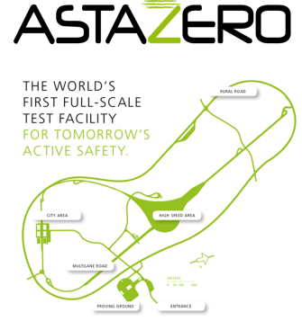
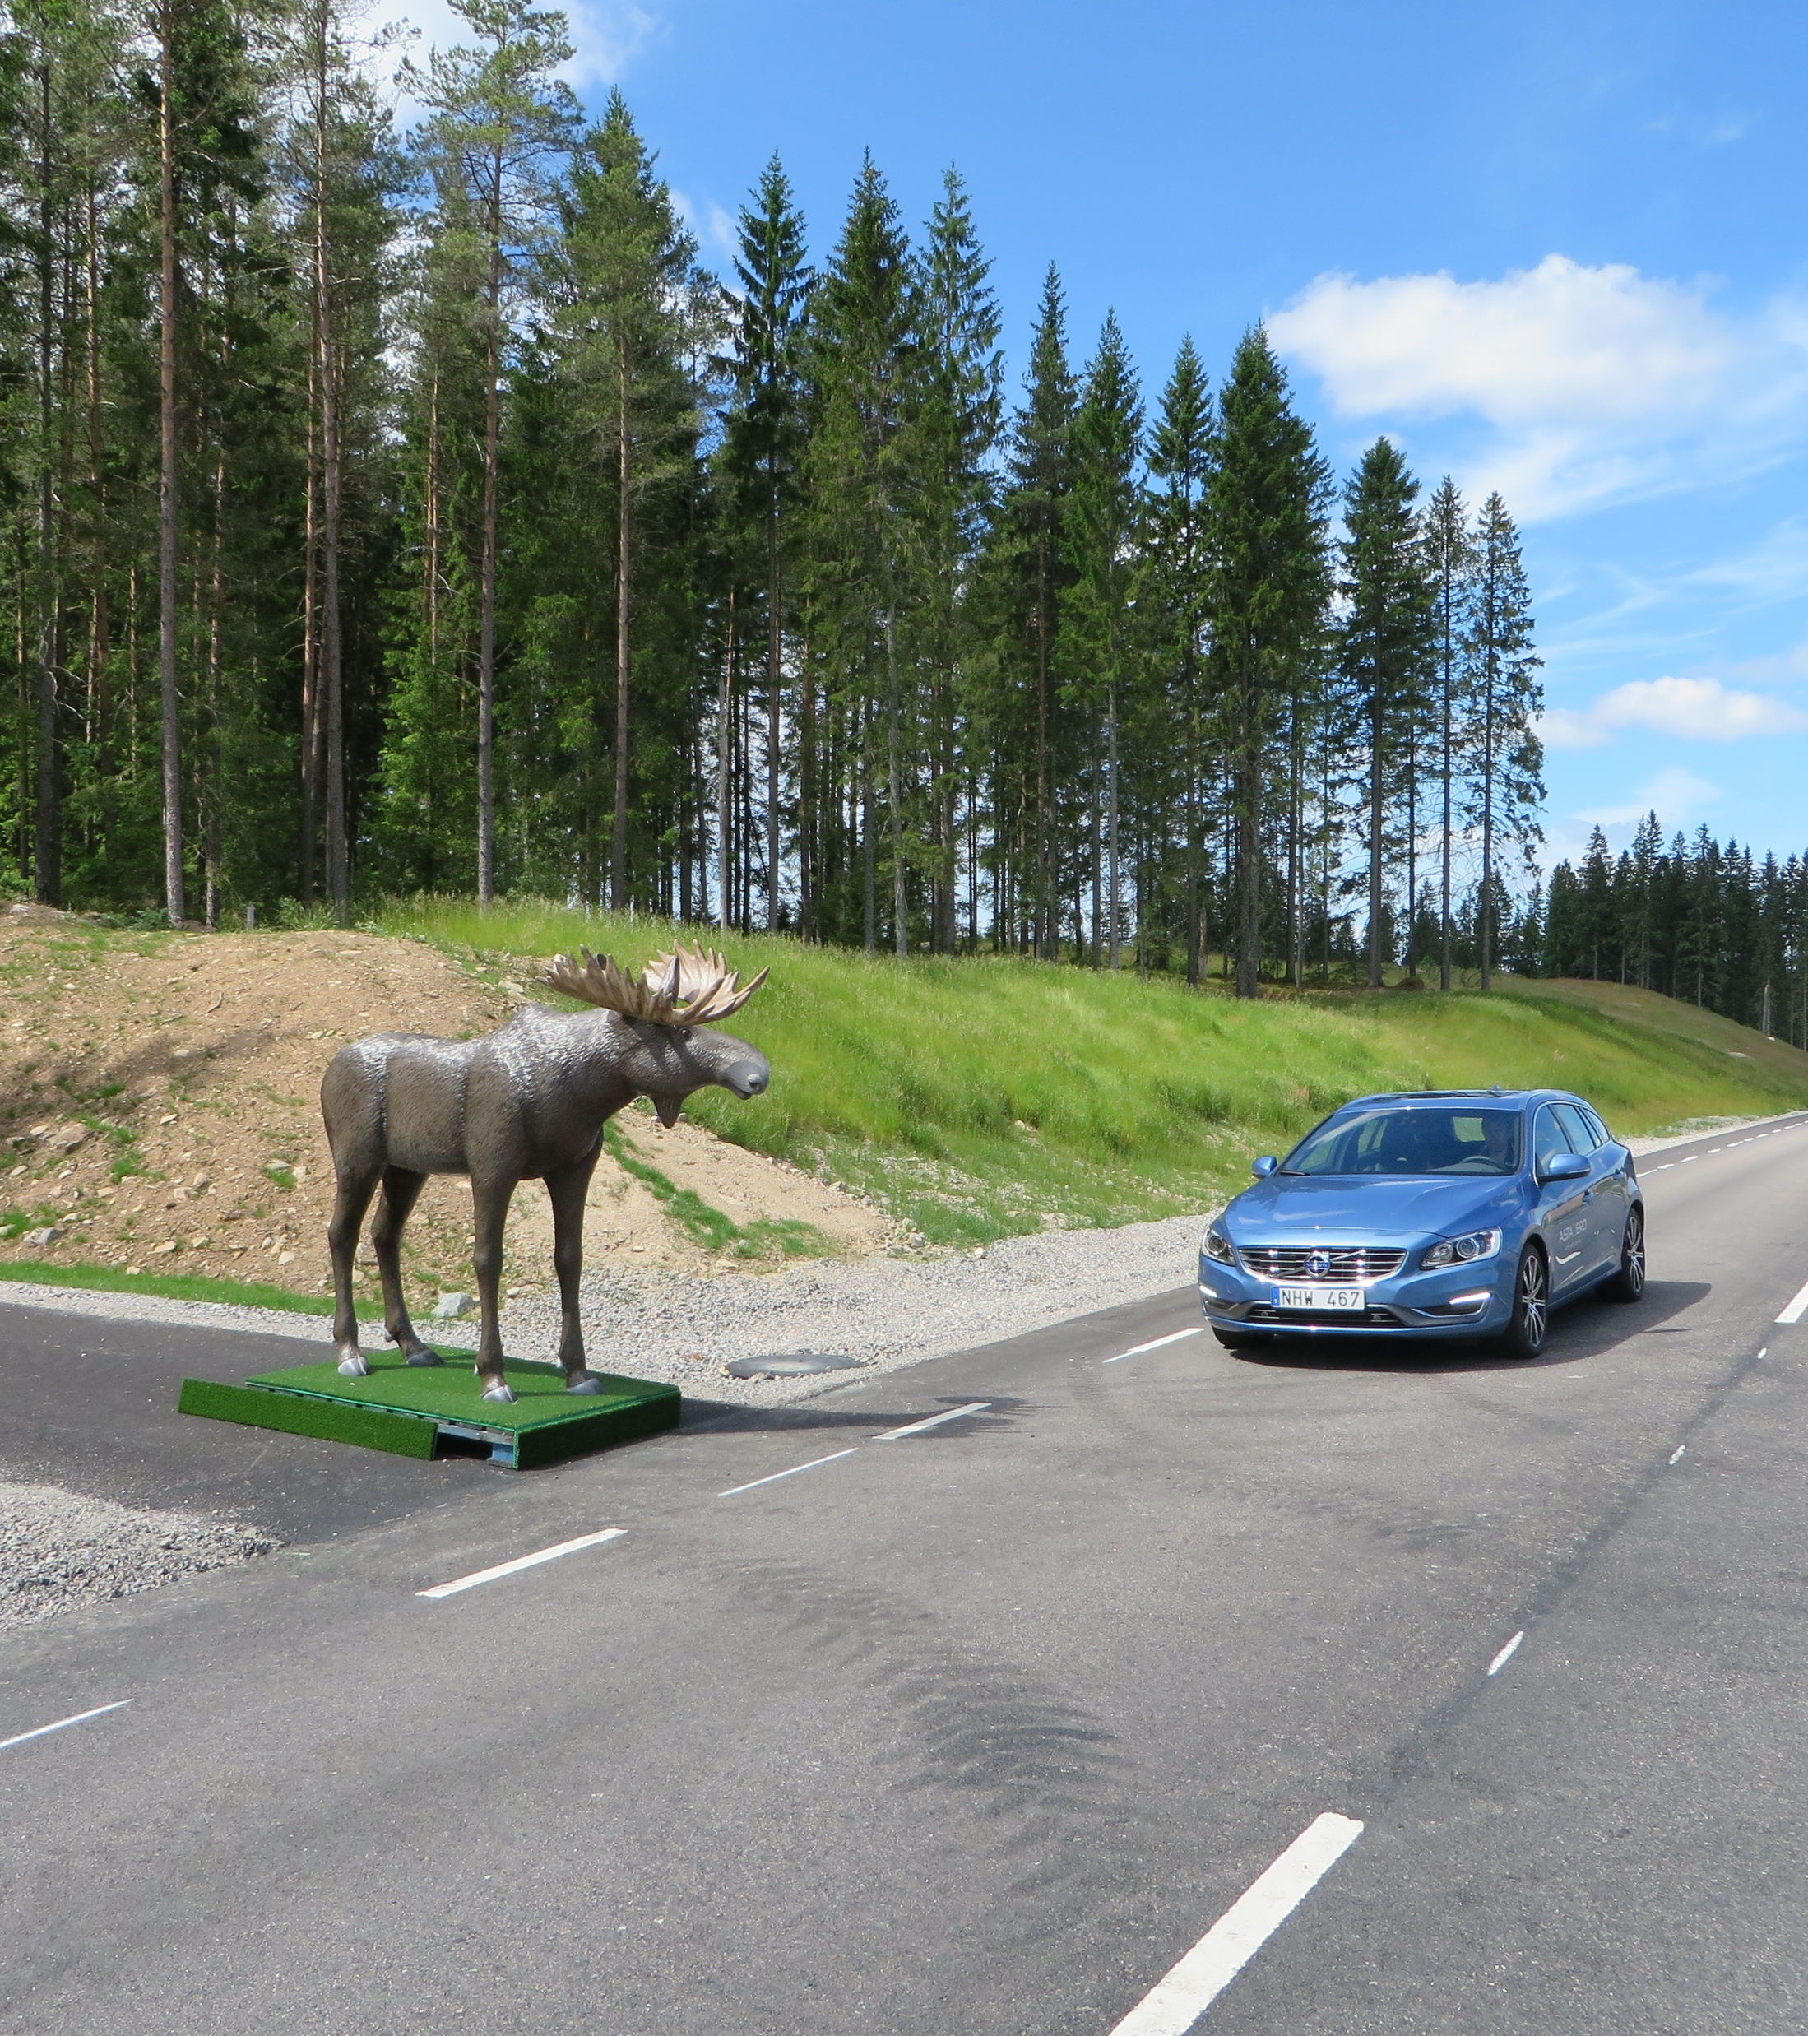
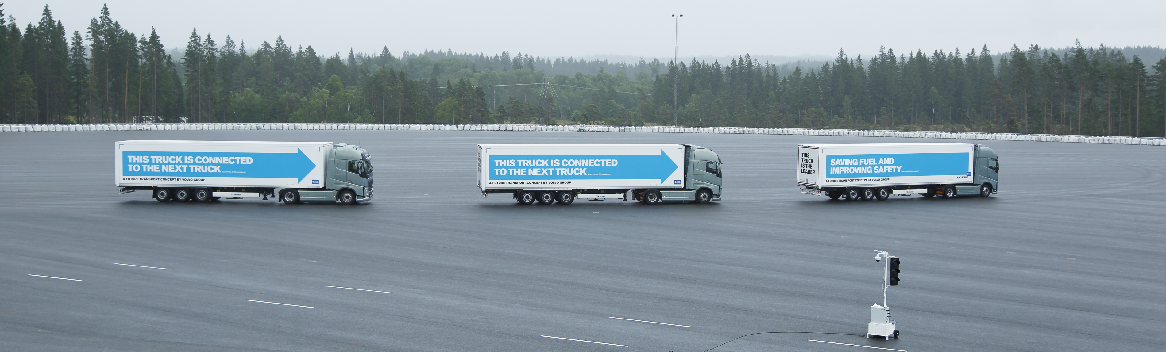

Slide 14
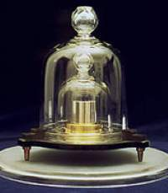
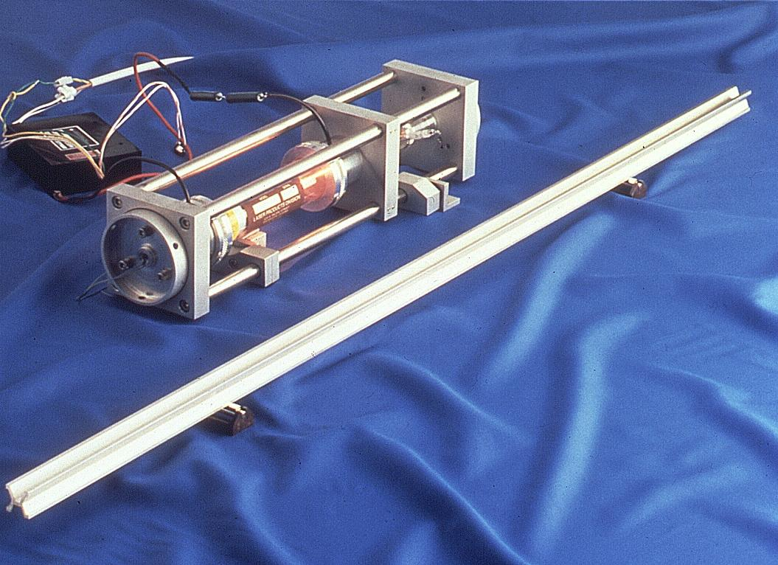
A Small NMI in a Large Institute
(RISE Research Institutes of Sweden)
Definition SI
International/national standards
Primary/secondary standard
Working standard
Industrial use
Measurement uncertainty

Slide 15
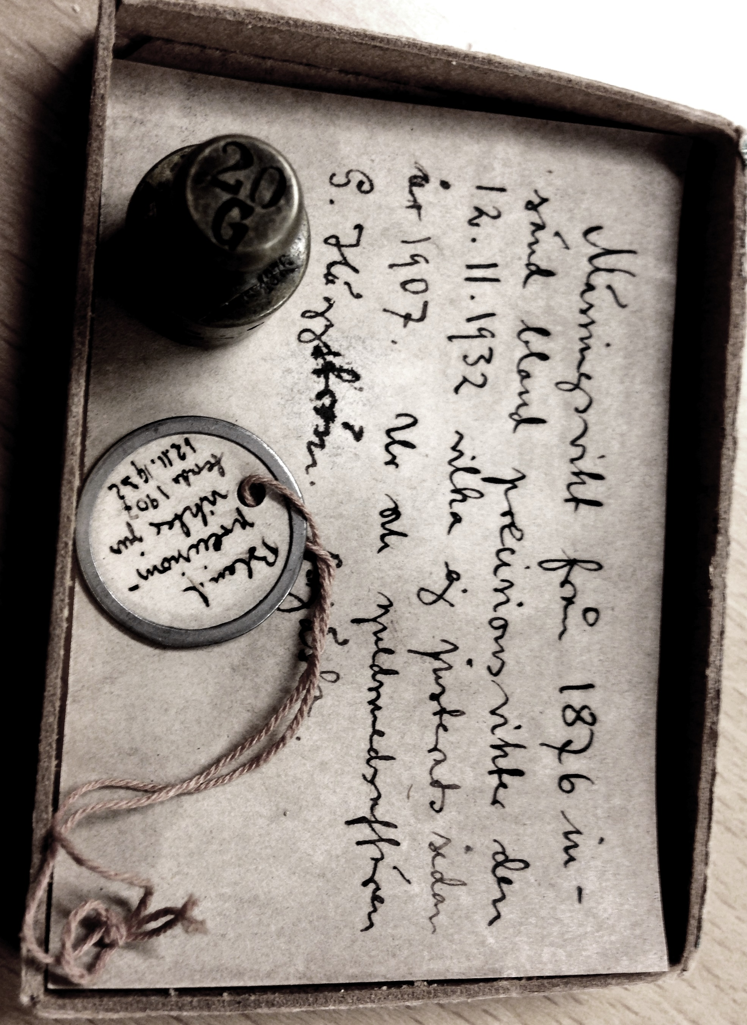


History in short
1665 Weights & measures ordinance
1831 Swedish royal control and testing
1875 Jernkontoret (Iron Office) testing institute
1920 Statens Provningsanstalt (SP) was founded in Stockholm
1993 SP Swedish National Testing and Research Institute
    SP is converted from authority to company owned by the Ministry of Enterprise.
2007 SP Technical Research Institute of Sweden
    A holding company called RISE is formed, owning SP and other technical institutes
2017 RISE Research Institutes of Sweden
SP staff: 300
NMI staff: 80
SP staff: 1600
NMI staff: 100
RISE staff: 2300
NMI staff: 130

Slide 16
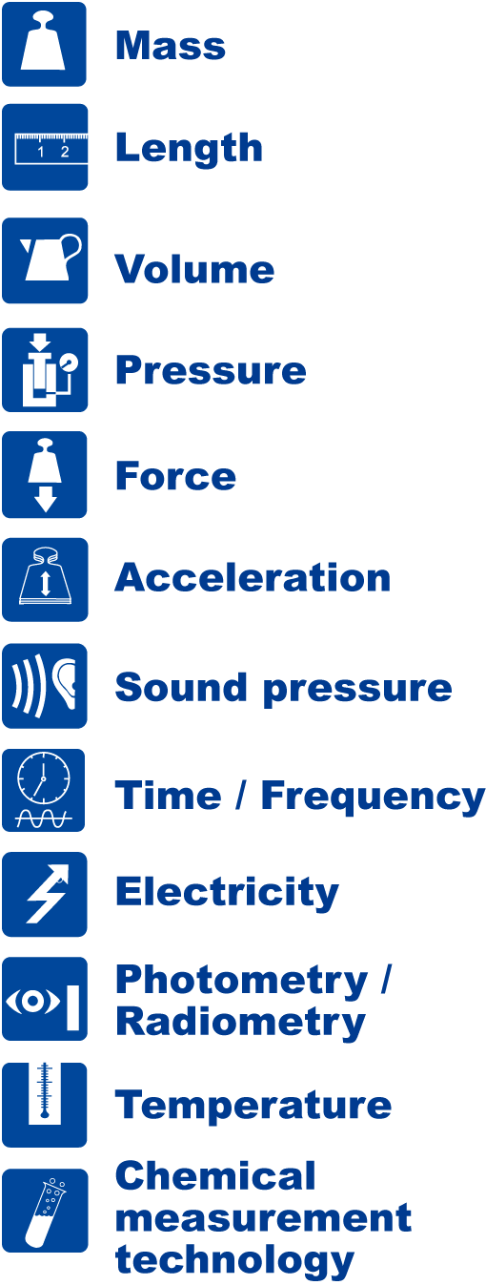
RISE as Swedish National Metrology Institute
Ministry of Enterprise and Innovation
Government funding, CB
Vinnova – Sweden’s innovation funding agency
RISE Research Institutes of Sweden
Government funding, CB
Metrology Advisory Board
NMI & EMPIR
RISE NMI
Sweden has one Designated Institute – Swedish Radiation Safety Authority (SSM) - responsible for ionizing radiation

Slide 17
Connections between quantities
EL
HF
EL
HV
Force
EL
DC, LF
Mass
Length
Temp
ToF
Flow
Fot/Rad
Acc/Vibr
Press
Very strong
Strong

Slide 18
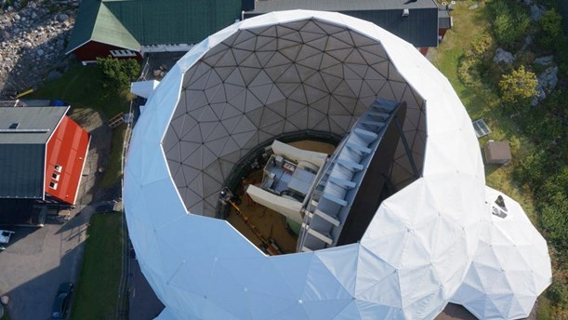

Establishment of secure timing centers in Sweden
Transport and Safety
Measurement Science an Technology

Slide 19
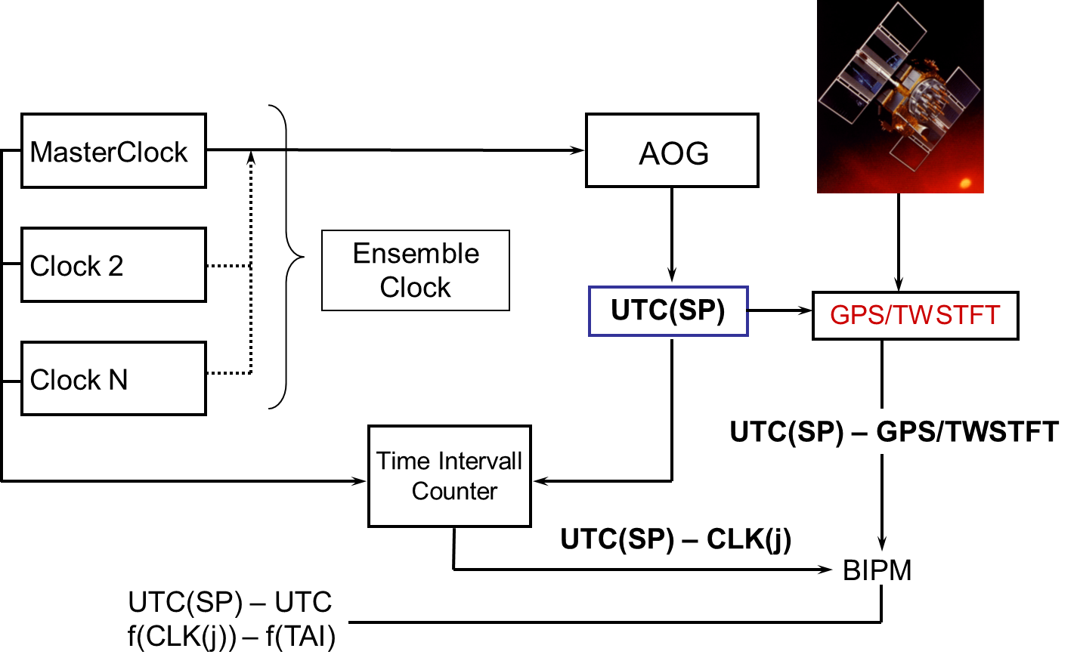
TAI reporting
Schematic graph
Clocks on distant locations measured over GNSS links
MasterClock SigmaTau H-maser
Weight approx. 4-6 %
27-28 clocks in official BIPM list
RISE sites utilize Multichannel Time Interval Counters, MCTIC for simultaneous measurements

Slide 20
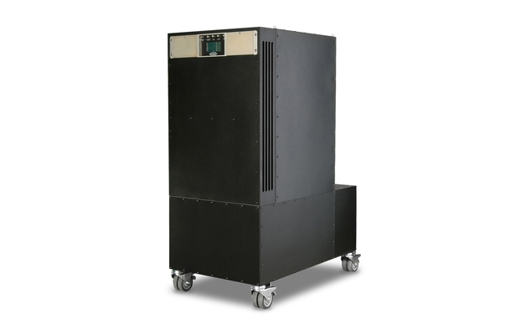
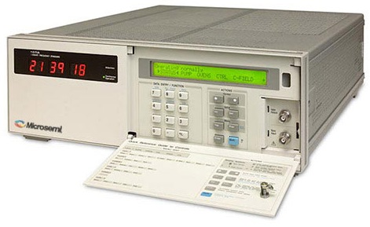
UTC realization
UTC(SP), realized at RISE Borås
Based on clock data from Cs and H-masers in Borås, OSO, and Stockholm (four sites)
Difference UTC – UTC(SP) < 30 ns last 4 years, reported to BIPM
Participate in rapid UTC (UTCr)

Slide 21
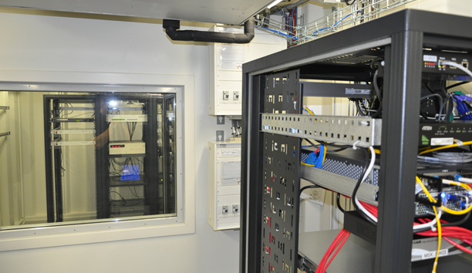
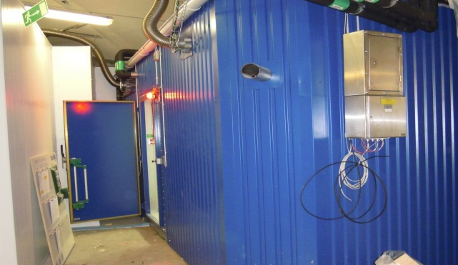
Secure clock site
Deployed clock labs in cavern
A dual Time and Frequency lab has been built in secured cavern
Stockholm area
> 15 m below surface level
EM-shielded, vibration absorbers, shock wave protection
UPS, batteries and 3 diesel generators
Climate control, with redundancy
Locations divided in two separate, identical labs
Separate redundant power and cooling supply.
Identical set of timing and communication equipment in both

Slide 22
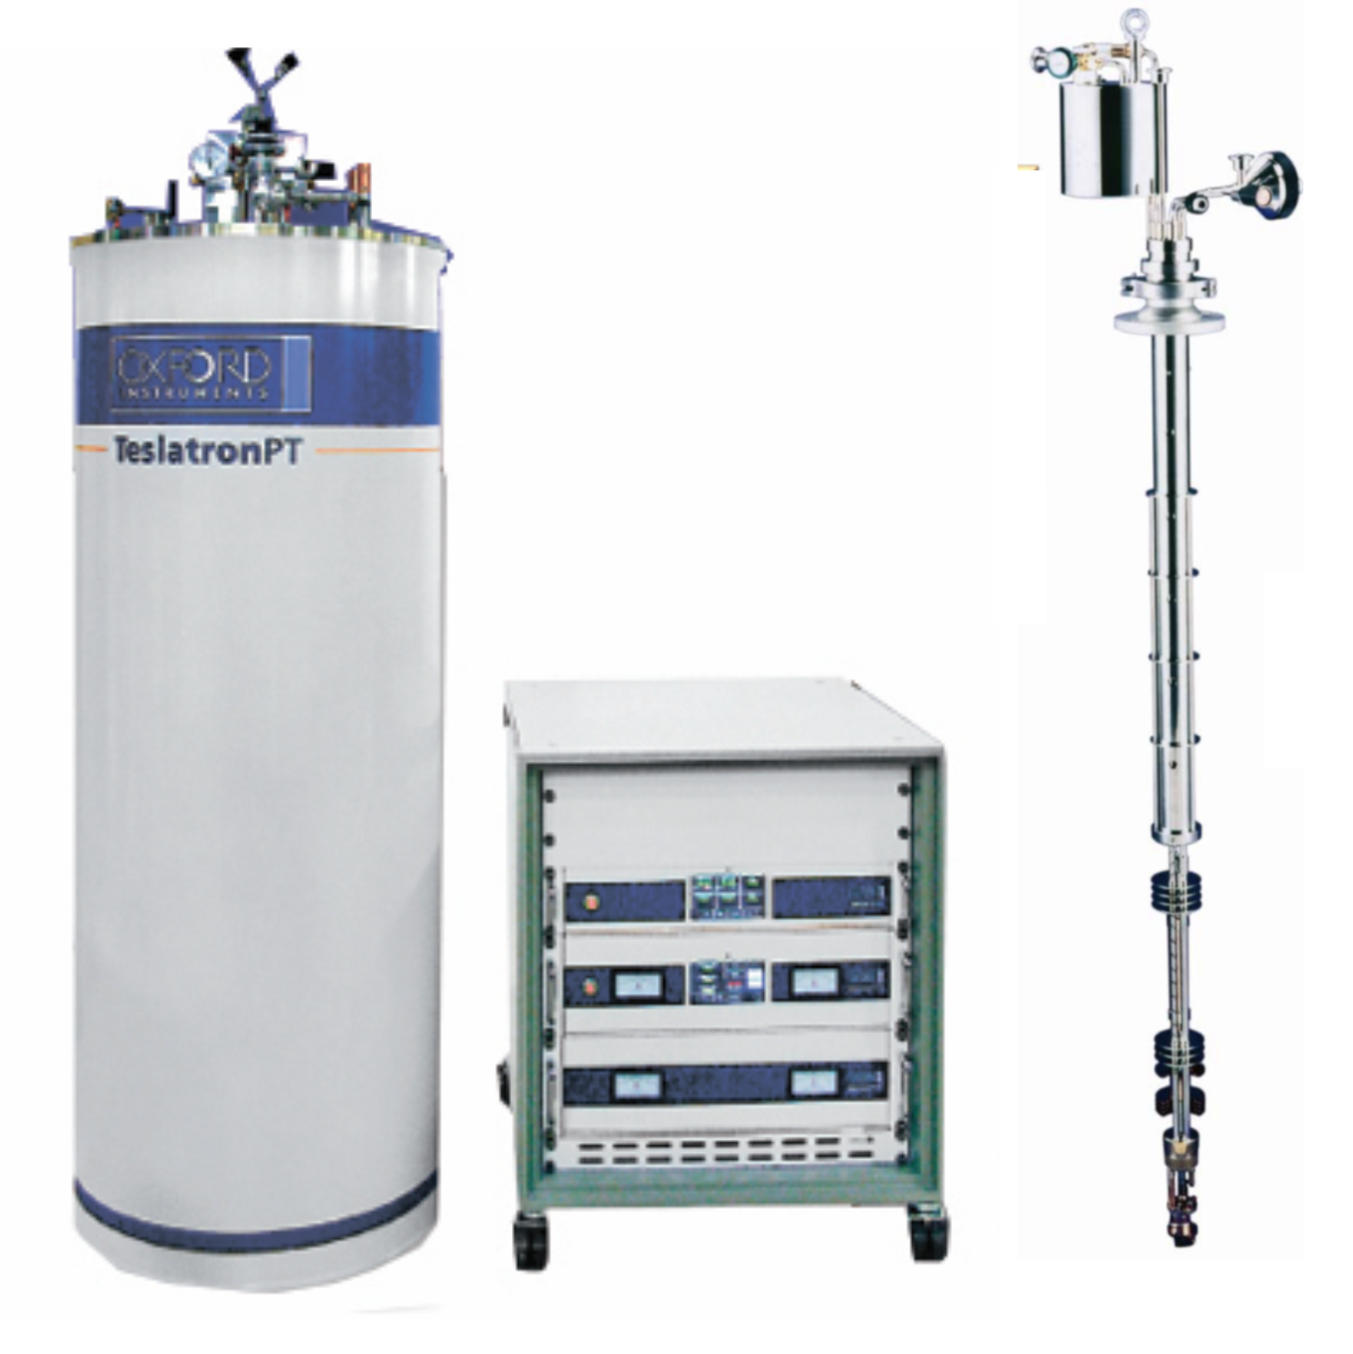
New cryostat for quantum metrology at the National Metrology Institute
Oxford Instruments TeslatronPT med 3He-prob
Dry cryostat - no helium bath
12 T superconducting magnet
Variable temperature from room temperature down to 1.5 K with the passive probe
Temperature down to 0,3 K with ³He-prob
Realization of quantum hall resistance with graphene and GaAs
Development of new quantum metrological applications, such as ac resistance, capacitance
Part of the development of a new Kibble scale

Slide 23
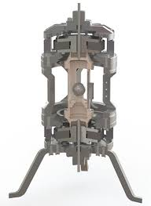
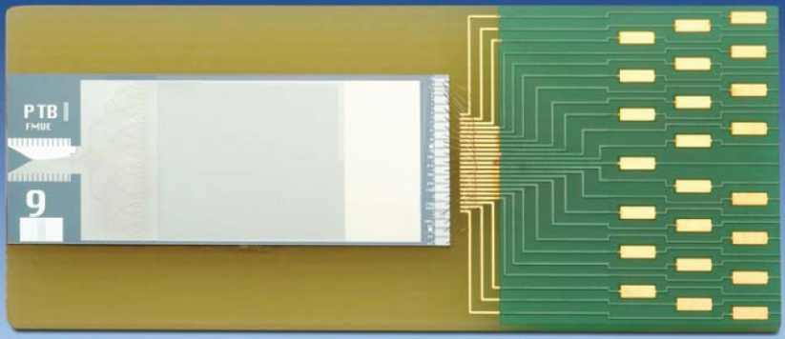
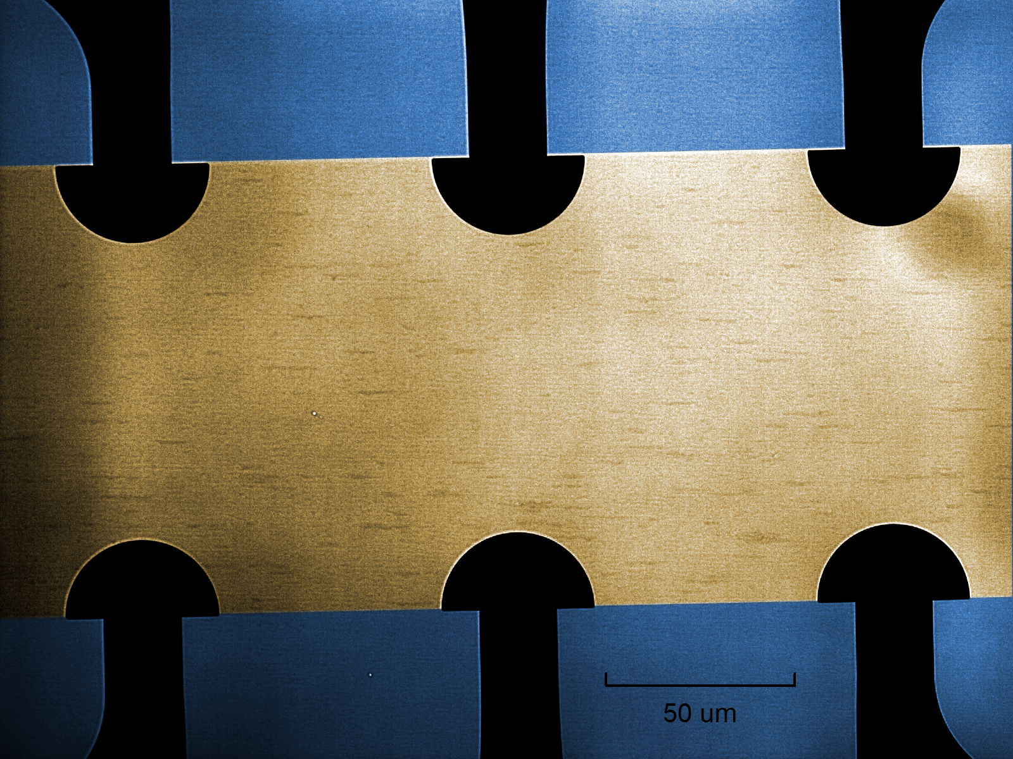
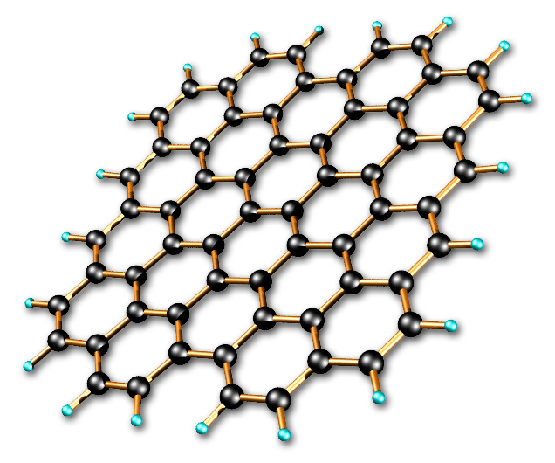
Applications with the new cryostat
Realization of mass with a new Kibble scale
(Cooperation with NPL and others)
Realization of AC voltage and impedance
With programmable Josephson array
(Cooperation with PTB and NPL)
Realization of resistance with graphene chip
(Collaboration with Chalmers and Linköping University)
In a new EU project (starting June 2019), we will combine Josephson array and a chip of graphene in the same cryostat - a step on the way towards a quantum multimeter that measures electrical quantities directly using the SI definitions.

Slide 24
Some examples of PhD students at NMI
Measuring pressure with optics (refractometry), Umeå University
Sensor fusion i.e. using different kinds of sensors for making steering algorithms, Chalmers
Optical combs using microresonators, Chalmers
Light admission during new construction of modern cities, University of Trondheim

Slide 25
CRYO and RF
High power RF sources
Cryogenics and Superconductors
Fast control systems (FPGA), control criterias

