Slide 1
Cryostats
Rocío Santiago Kern
On behalf of the FREIA team
FREIA Laboratory, Uppsala University
8th of May 2019

Slide 2
Contents
Introduction and main concepts
Horizontal cryostat HNOSS
Vertical cryostat Gersemi
Double spoke cryomodule
Cold boxes

Slide 3
Contents
Introduction and main concepts
Horizontal cryostat HNOSS
Vertical cryostat Gersemi
Double spoke cryomodule
Cold boxes

Slide 4
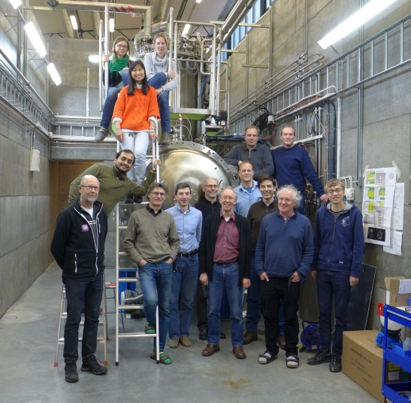
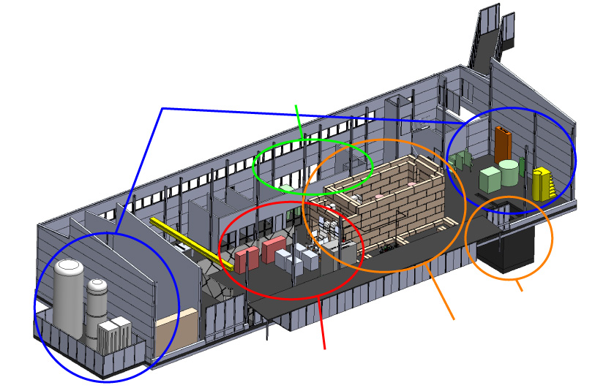
What and Whom?
Facility for Research Instrumentation and Accelerator Development
State-of-the-art Equipment
cryogenics
- liquid helium
- liquid nitrogen
control room
- equipment controls
- data acquisition
Competent and motivated staff
collaboration with physics (IFA),
engineering (Teknikum), TSL
and Ångström workshop
Funded by
KAWS, Government, Uppsala Univ.
vertical cryostat
3 bunkers
with test stands
horizontal cryostat
RF power sources

Slide 5
FREIA Collaborations
FREIA has collaborations to test the following:
  Superconducting (SC) double spoke cavity for ESS
  (done)
  Superconducting (SC) high beta elliptical cavity for ESS
  (done)
  Cryomodules housing two superconducting double spoke cavities for ESS
  (ongoing)
  Superconducting dipole magnets for CERN Hi-Lumi project
  (to start at the end of the year)
  Superconducting cold boxes for CERN (together with RFR Solutions)

Slide 6
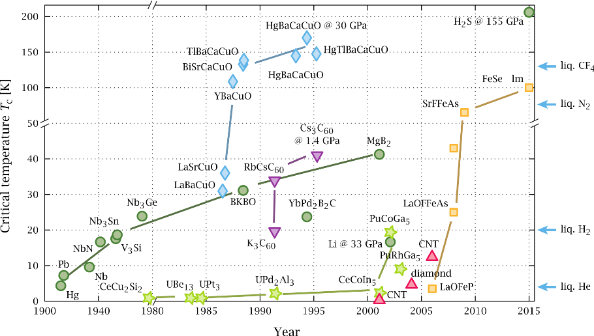
Superconductivity
  SC materials offer almost no electrical resistance → Lower heat disipation in the material
- Less heat to the cavity
- More power available for the beam
Cavities
- Wires conduct much larger electric currents
- More intense magnetic fields
Magnets
- Helium liquefaction plant
- Using LHe/GHe means a recovery system
T_{operation} = 2 K (31 mbar)
Superfluid He
Source: https://en.wikipedia.org/wiki/Superconductivity#/media/File:Timeline_of_Superconductivity_from_1900_to_2015.svg

Slide 7
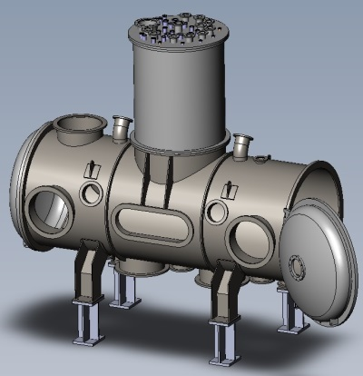

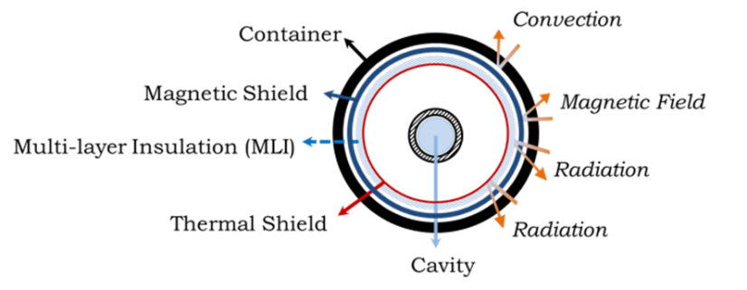

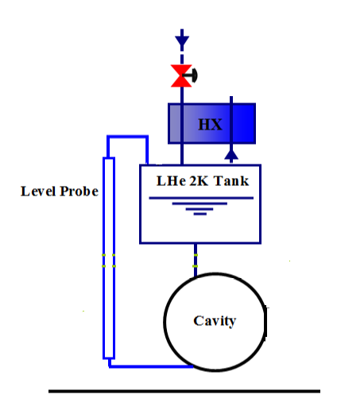
Cryostat Fundamentals
Cryogens in
Main conversions
P_{plug} = 1 kW to generate 1 W cooling power at 4.2 K
V_{GHe at 293 K} = 700 V_{LHe at 4.2 K}
Minimise the amount of heat that reaches the cold parts, i.e. the device under test (DUT)
  Convection → vacuum
  Radiation → thermal shield, multilayer insulation
  Conduction → thermal anchors
Cryogens out
LHe 4K Tank
Joule-Thomson Valve

Slide 8
Cryostats: General Components
Vacuum vessel
  Main container, outermost component
  Under vacuum. A high vacuum (≤10⁻⁵ mbar) already reduces the heat into the cold parts by 90%
Thermal shield
  Blocks the thermal radiation
  Works as a thermal anchor or heat sink for the equipment connected to room temperature, like valves and cable instrumentation linking to equipment placed at lower temperatures
  Usually cooled via LN₂ or GHe at a certain temperature
Multi layer insulation (MLI)
  Further reduces the radiation heat
  Might help in an event of vacuum insulation loss
  Wrapped around the thermal shield, the DUT, etc.
Magnetic shield
    Made of a high permeability material
    Reduces the effect of the earth’s magnetic field on the cavities
    Can be placed at any temperature
    Unless removable cannot be in place while testing magnets: saturation

Slide 9
Contents
Introduction and main concepts
Horizontal cryostat HNOSS
Vertical cryostat Gersemi
Double spoke cryomodule
Cold boxes

Slide 10
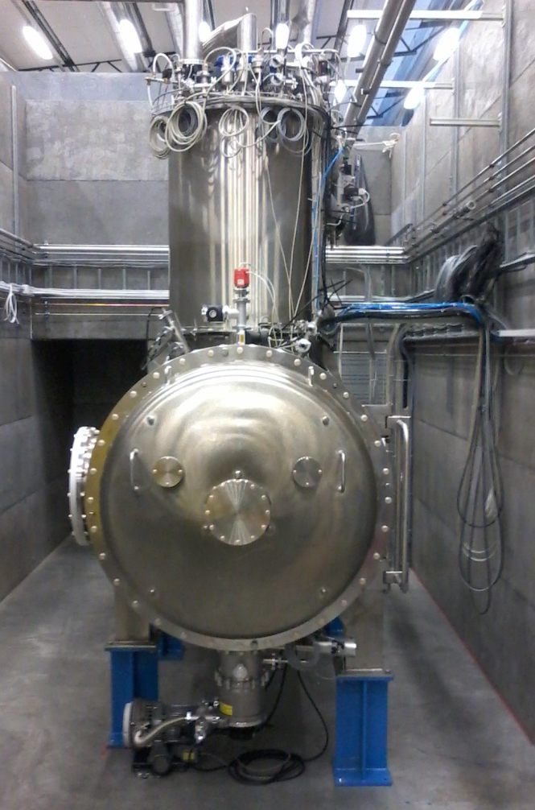
HNOSS
Purpose: test of superconducting cavities
Has two parts:
  Valvebox (VB): contains all the valves and tanks and most of the piping
  The cryostat itself (HCS): houses the cavities and the table
Both parts have:
  Magnetic shield (room temperature)
  Thermal shield (LN₂ temperature)
Total volume ca. 7 m³

Slide 11
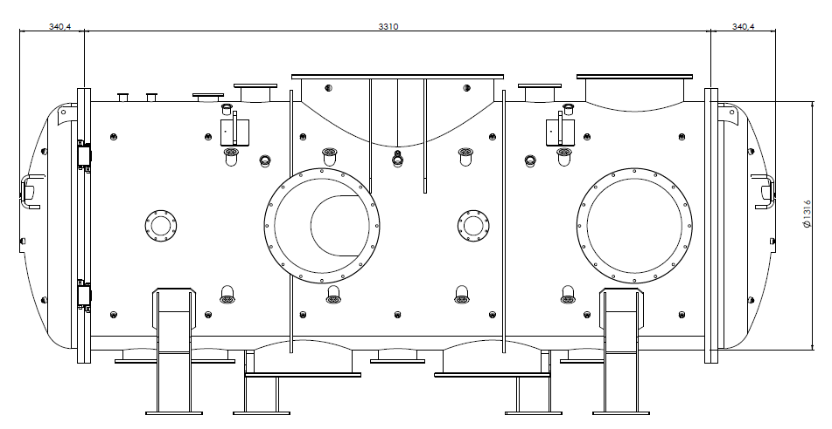
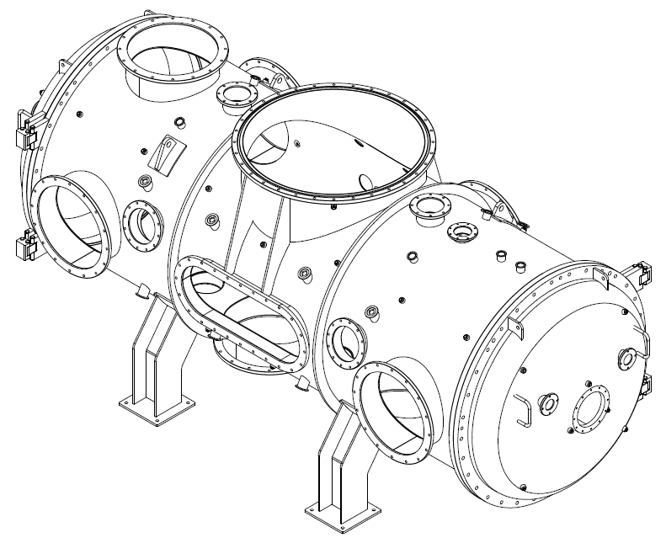
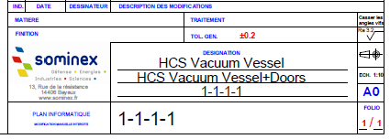
Vacuum Vessel
Material: 304L
Flange types (high vacuum): ISO F, ISO K, ISO KF
Flange types (ultra high vacuum): ISO CF

Slide 12
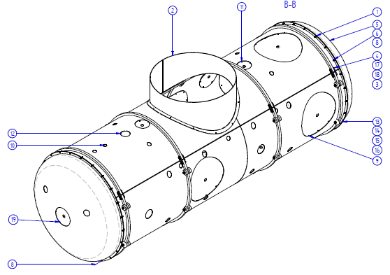
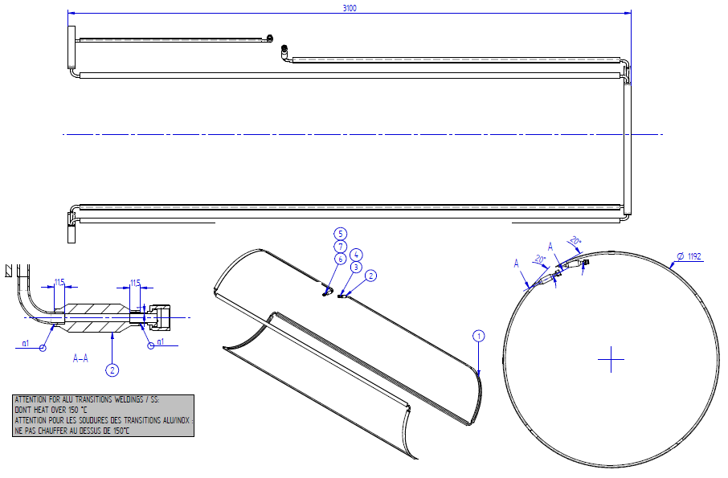
Thermal Shield
Material: Al (EN 573-3 AW6060T6 )
Other usual material: Cu (more expensive, more weight but better σ_{th})
Cooling pipes: Aluminium (omega-type pipes)
Transition between Al (thermal shield) and SS (pipes from the valvebox)
Thermal shield not continuous

Slide 13
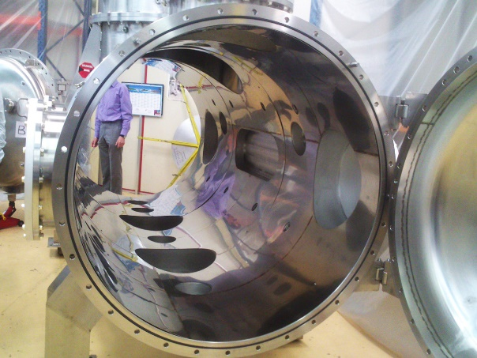
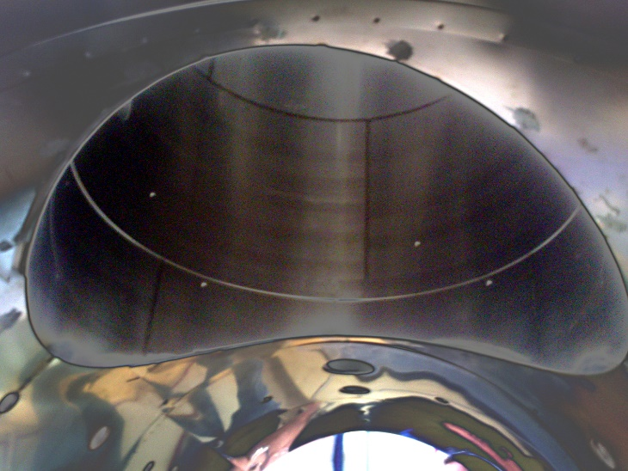
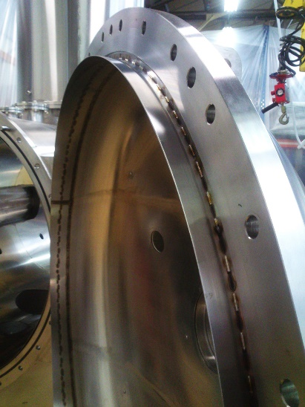
Magnetic Shield
Made of several parts of mu-metal (high permeability material) welded together
The material is made into shaped and placed on a furnace following a certain procedure to activate the material
This material is very sensitive to further handling: those parts of the material exposed to work will lose the magnetic properties

Slide 14
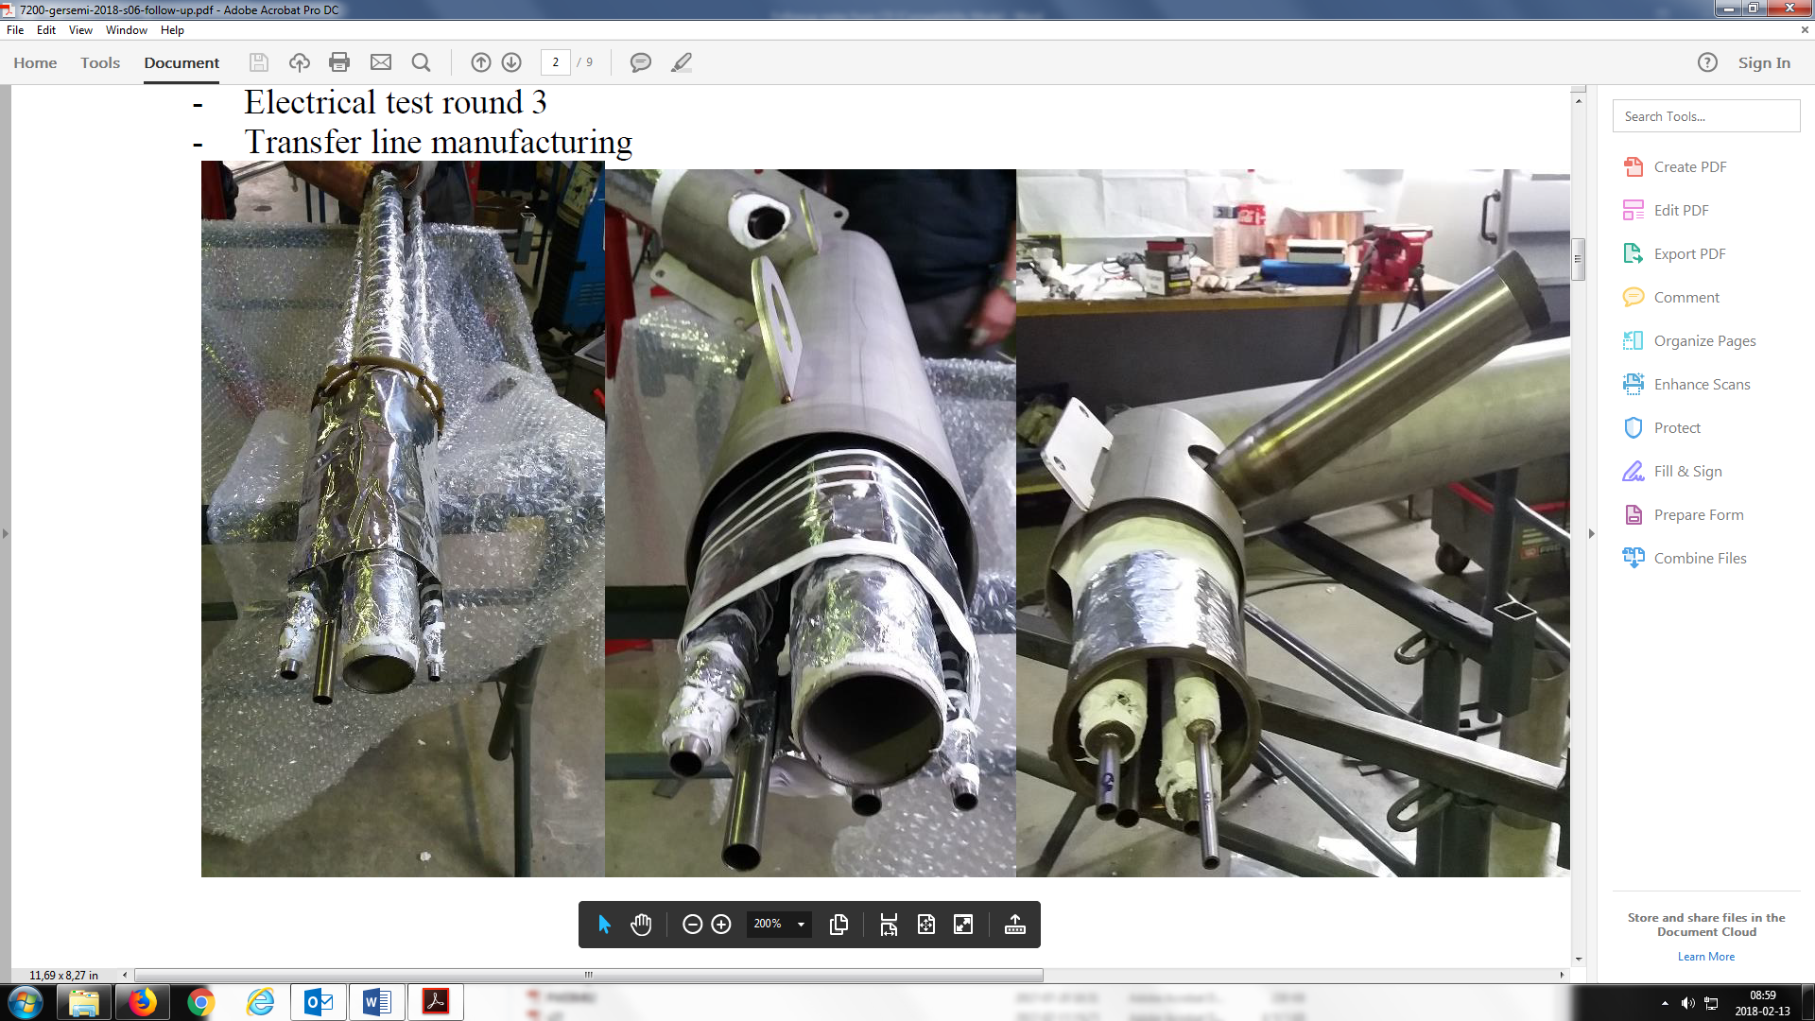
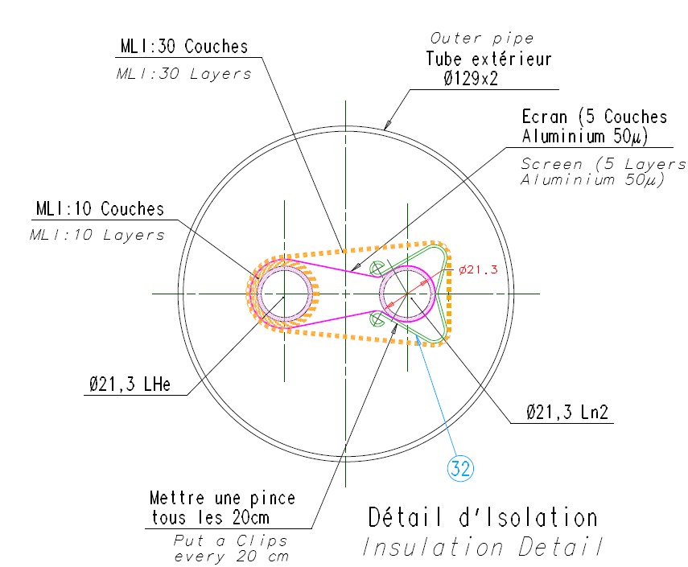
Transfer lines
Material: SS
Space between the transfer line and the cooling lines
LN2 and LHe line separated, not touching
Insulation material: multilater insulation (MLI)
Usually under vacuum

Slide 15
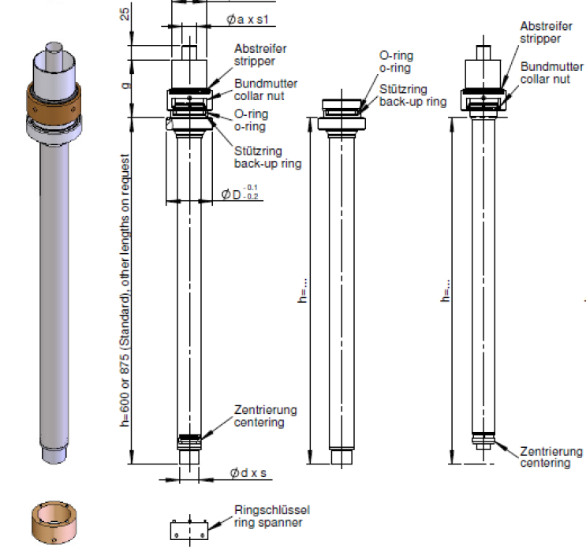
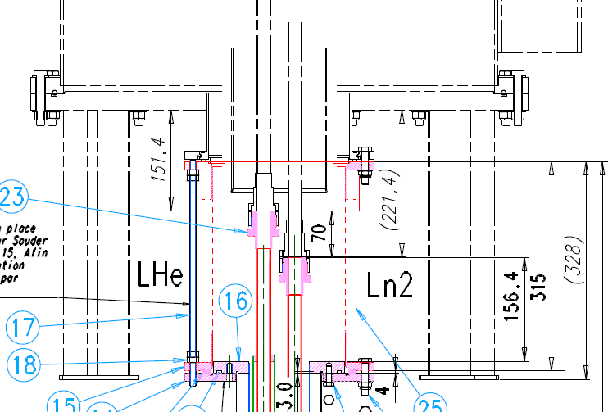
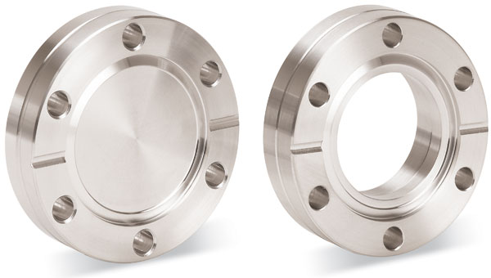
Transfer Lines: Couplings
For cryogen transfer (LN2, LHe)
Swagelok VCR:
  Requires less space
Bayonet:
  Lower heat leak (small sizes), thus more efficient in transfer
  Provide a vacuum insulated joint
  More expensive
CF connections:
  Only to be used if need to remove for every test
Bayonet Female Male
CF gasket
Swagelok VCR
Picture taken from Kurt Lesker

Slide 16
Contents
Introduction and main concepts
Horizontal cryostat HNOSS
Vertical cryostat Gersemi
Double spoke cryomodule
Cold boxes

Slide 17
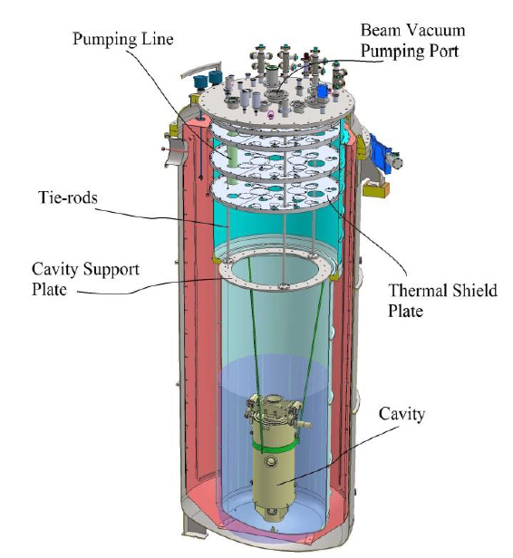
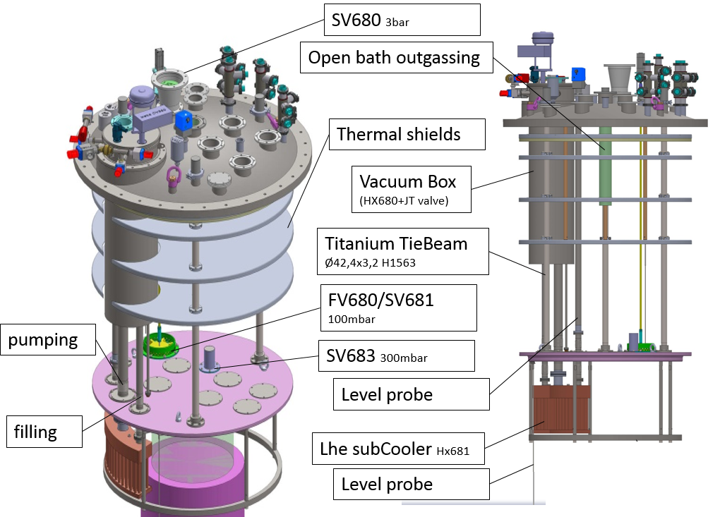
Purpose
To test superconducting magnets (max 2kA)
To test superconducting cavities

Slide 18
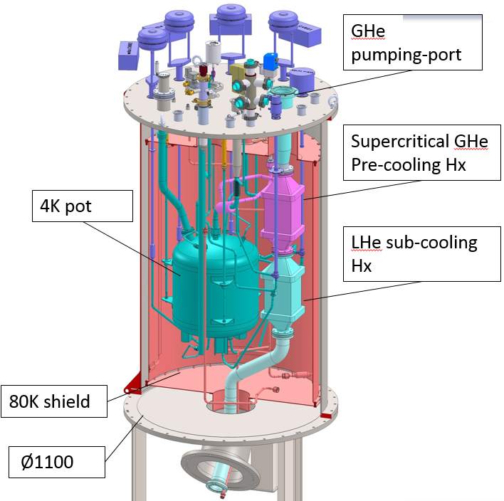
Valvebox
Used to deliver the cryogens to the cryostat
Height: 2300 mm
Vacuum Vessel Material: SS
Thermal shield material: Cu
Flange types (high vacuum): ISO F, ISO K, ISO KF

Slide 19
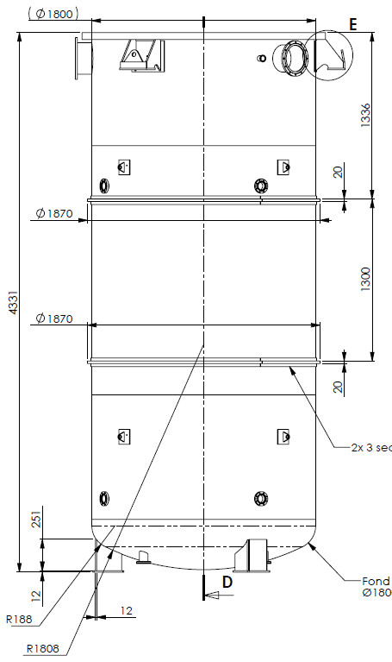
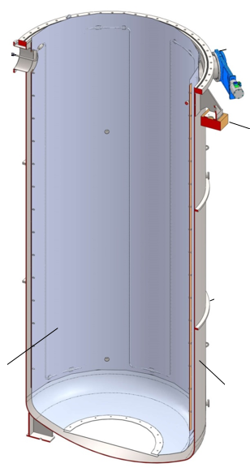
Vacuum Vessel and Thermal Shield
Vacuum Vessel Material: SS
Thermal shield material: Al
Thermal shield not continuous
Flange types (high vacuum): ISO F, ISO K, ISO KF
Multi transfer line
Vacuum port
Thermal Shield
Vacuum Vessel

Slide 20
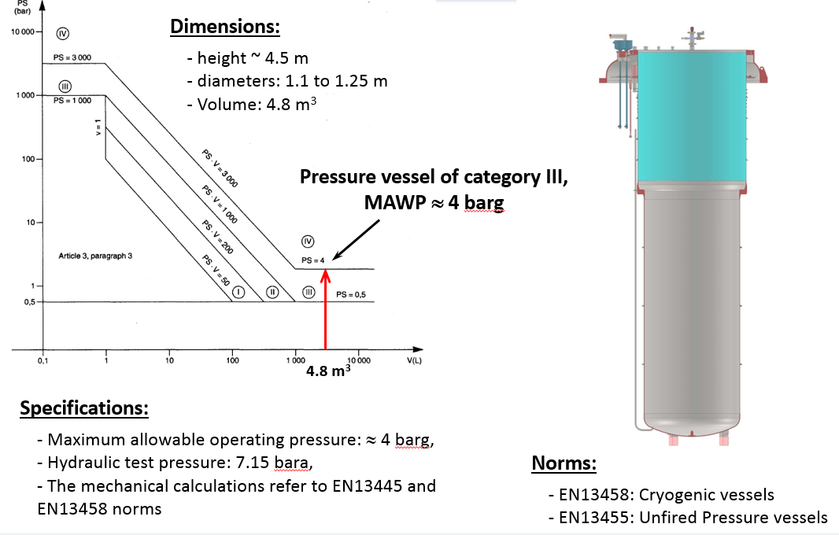
Pressure Vessel

Slide 21
Contents
Introduction and main concepts
Horizontal cryostat HNOSS
Vertical cryostat Gersemi
Double spoke cryomodule
Cold boxes

Slide 22
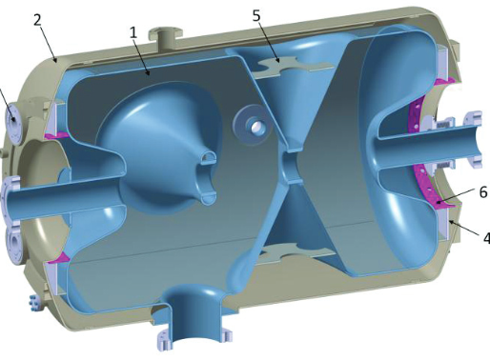
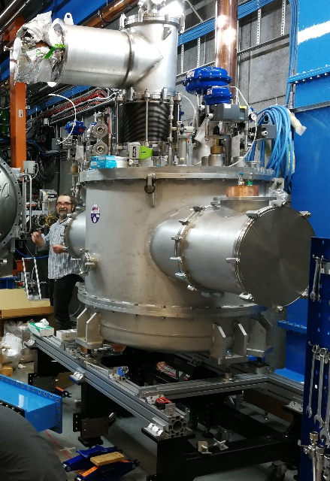
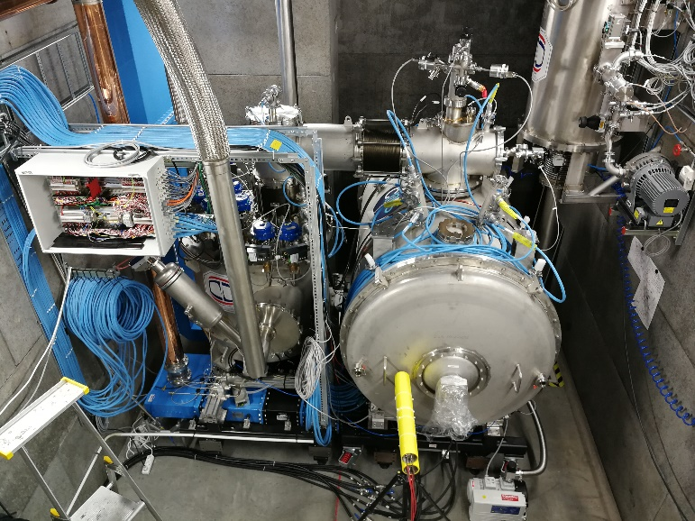
Purpose
The spoke cryomodule section at ESS will increase the protons beam energy from 90 to 216 MeV
This section
  Is supercoducting
  Is 56 m long
  Has 26 double spoke cavities
  In 13 cryomodules
Source: P. Duchesne et al. “Design of the 352 MHz Beta 0.50 double s
poke cavity for ESS”, Proceedings of SRF2013, Paris, France (FRIOC01)

Slide 23
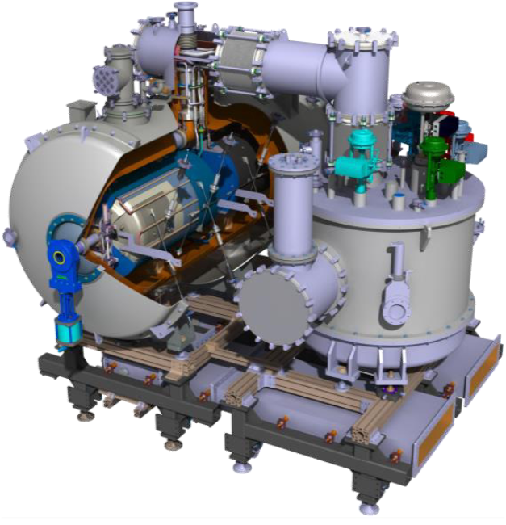
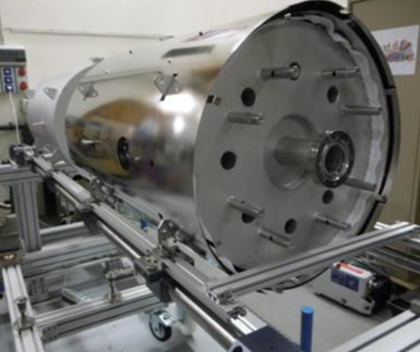
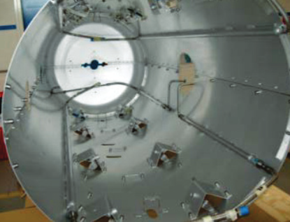
Components
It is a specialized version of HNOSS
Has two double spoke cavities inside
  hanging from tie-rods
  each has a magnetic shield around
Thermal shield made of Al, cooled via LN₂
  Note: For ESS cooling is with GHe (no LN₂ available)
The prototype has more instrumentation than the series cryomodules
Source: P. Duthil et al. “Design and Prototyping of the Spoke
Cryomodule for ESS” Proceedings of HB2016, Malmö, Sweden, WEAM4Y01
Source: P. Duthil et al. “Design and Prototyping of the Spoke
Cryomodule for ESS” Proceedings of HB2016, Malmö, Sweden, WEAM4Y01
Source: G. Olry et al. “Recent Progress of ESS Spoke and Elliptical
Crymodules”, Proceedings of SRF2015, Whistler, BC, Canada (TUAA06)

Slide 24
Contents
Introduction and main concepts
Horizontal cryostat HNOSS
Vertical cryostat Gersemi
Double spoke cryomodule
Cold boxes

Slide 25
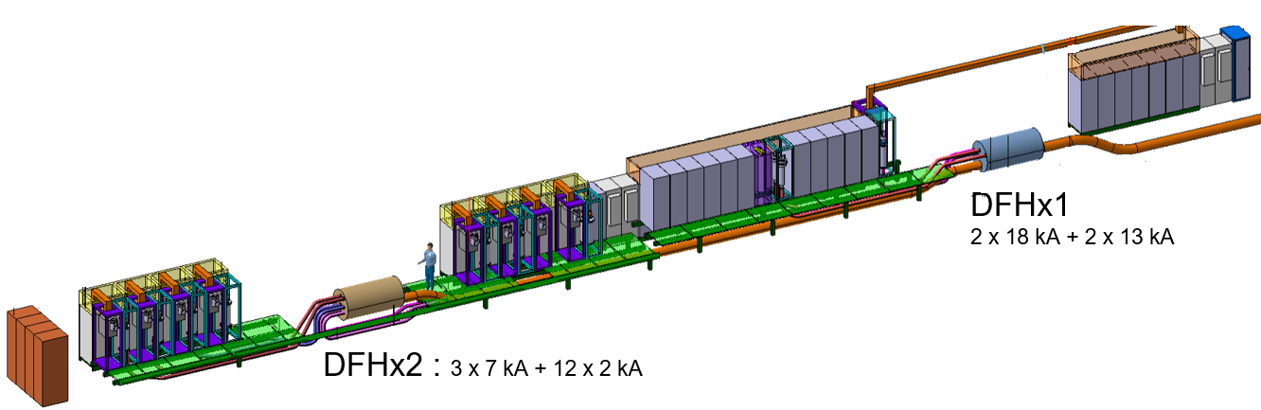
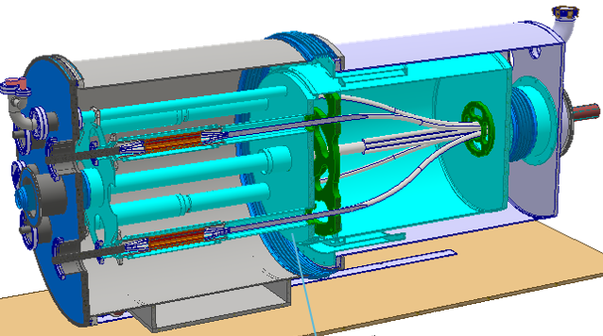
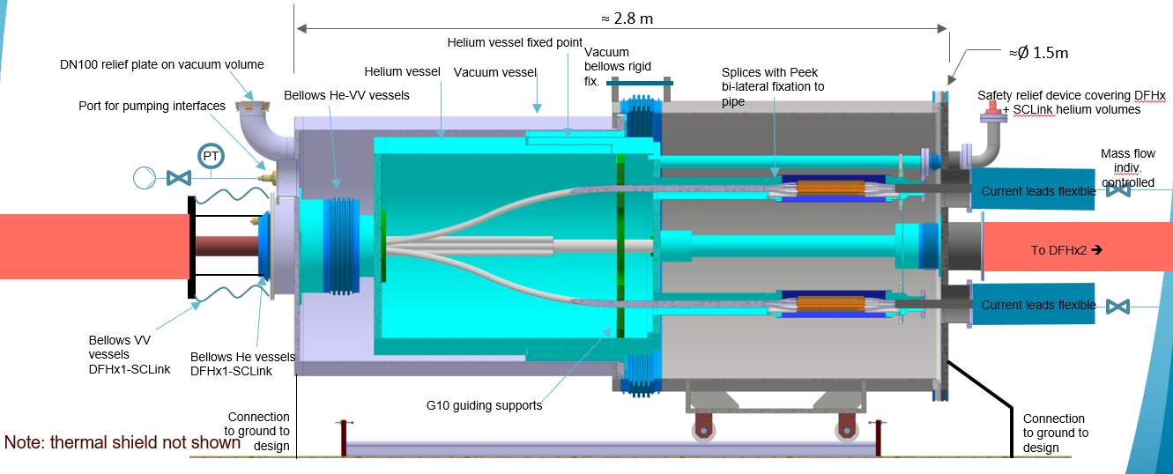
Purpose
Interconnection (splices) and cooling of superconducting cables
Preliminary design, in collaboration with RFR Solutions
Courtesy of V. Parma
Courtesy of V. Parma
Courtesy of V. Parma

Slide 26
Components
The vacuum vessel
  Made of SS (304L or 316L)
  Independently sliding parts to provide access to internal components
  Flanges : ISO-K, ISO-KF, CF type
  Tube thickness : about 6 mm
Thermal shield
  Made of Al alloy or Cu alloy
  Half tube thickness : 2 mm
Courtesy of J. Dequaire and Y. Leclercq
The SC cable vessel
  Made of SS 316L
  Mass flow of helium below 17 K
  The design pressure is 4 bar
  Flanges : CF type
  Tube thickness : about 3 mm
Courtesy of J. Dequaire and Y. Leclercq
Courtesy of J. Dequaire and Y. Leclercq

Slide 27
THANK YOU
for your
ATTENTION

Slide 28
Helium Vessel
The internal envelope of the DFH cryostat contains the superconducting cables in a gaseous mass flow of helium below 17 K. The design pressure is 4 bar.
The helium vessel is composed of a main vessel and several smaller vessels connected in between by flexible hoses. The smaller vessels are composed of double sleeves to allow access on either side.
Formed bellows ensures the compensation of thermal contractions
Material :
  Helium vessel : 316L (1.4404 or 1.4435)
  Bellows : 316L (1.4404 or 1.4435, Note: 316Ti not allowed)
  Flexible hoses with braids : 316L (1.4404 or 1.4435)
  Supports : Composite epoxy/glass fiber : G10
  Conflat flanges : 316LN 3D forged (CERN procurement)
  Fasteners : A4 degreased (silver plated for dedicated application)
  Conflat fasteners : A4-100 degreased
Leak tight welds :
  Welds shall be full penetration and qualified to the PED requirements
  TIG welds (141 or 142)
Flanges : CF type
Tube thickness : about 3 mm
Courtesy of J. Dequaire and Y. Leclercq

Slide 29
Thermal Shield
Composed of three independent shields made in thermal conductive material.
Material :
  Thermal shield : Aluminum alloy to be defined or copper alloy
  Fasteners : A2, A4, Aluminum
Assembly:
  The shields must be half shelled
Half tube thickness : 2 mm
Courtesy of J. Dequaire and Y. Leclercq

Slide 30
Equipment
Safety valves
  possible closed volumes (betwen valves)
  closed volumes (vacuum vessel)
Bellows
Cryogenic valves
  Depending on where they sit they should be thermalized
  For LHe used WEKA or VELAN
  For LN2 use SELFA
LHe level probes from American Magnetics Inc.
Temperature sensors
  From Troom to 30 K: normal Pt100
  From Troom to 1.4 K: CERNOX
Heaters for flat surfaces: thin film MINCO or OMEGA
Heaters for gas outlets: heater cartridges from VULCANIC
Cable connectors (Burndy, Lemo, etc.)

