Slide 1
CCT Superconducting Magnets
CRYO and RF for Big Science - Meet researchers and industry
Kévin Pepitone
Uppsala, May 8, 2019

Slide 2
Outline
CCT magnet
  Definition and history
  Mathematical model
  How does it work
CERN CCT magnet
  Pictures
  Results
Modulated double helical coils
Conclusions

Slide 3
CCT Magnets: Definition
What is a CCT magnet ?
A dipole
Often called double-helix coils or tilted coils, the Canted-Cosine-Theta (CCT) coils are made of two concentric modulated helical coils having a winding shift of π and inverse currents.
Configuration proposed in the 60’s by D.I. Meyer and that will be used for first time for high-energy physics particle accelerator
D.I. Meyer, R. Flasck, “A new configuration for a dipole magnet for use in high energy physics applications,” Nucl. Instrum. Methods, Vol. 80, Issue 2, 1970
Canted-Cosine-Theta magnet is based on the superposition of two oppositely skewed solenoids with respect to the bore axis

Slide 4
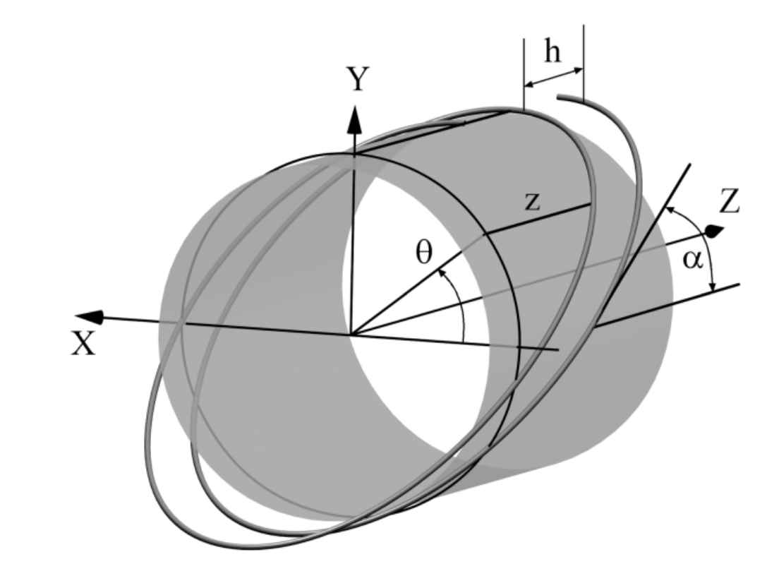
CCT Magnets: Definition – Mathematical model
Each turn of the coil can be well approximated as an ellipse tilted at an angle α with respect to the axis of the coil.
This produces a transverse field component superimposed on the solenoid field component. When pairs of such windings with opposite tilt angles are assembles concentrically, the solenoid field components cancel and the dipole components add to produce a pure dipole field.
Where a is the coil radius, θ is the azimuthal angle around the cylinder and α is the skew angle
R.B. Meinke, et al., Proc. Particle Acc. Conf., pp. 1996-1998, 2003

Slide 5
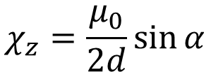
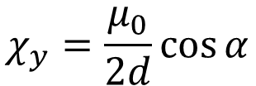

CCT Magnets: Definition – Mathematical model
Consider the an ideal infinitely long, tightly wound, tilted solenoids and a particle focusing spot small compared with the dimensions of the coils.
The magnetic flux density per unit current (or transfer function) can be defined by:
I
B_{z}
α
z
y
B₁
B_{y}
$$χ_{y}=\frac{μ_{0}}{2d}\cos{α}$$
$$χ_{z}=\frac{μ_{0}}{2d}\sin{α}$$
d is the wire effective diameter
$μ_{0}=4π {10}^{−7}$T m/A magnetic constant
J. Alonso, et al., J. Magn. Reson., Vol. 235, pp. 32-41, 2013

Slide 6
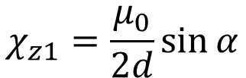
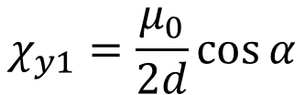

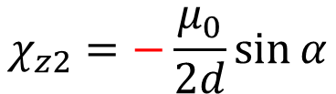
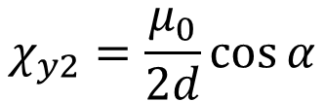
CCT Magnets: Definition – Mathematical model
Consider the two ideal infinitely long, tightly wound, tilted solenoids and a particle focusing spot small compared with the dimensions of the coils.
The magnetic flux density per unit current (or transfer function) can be defined by:
I
B_{z}
α
-B_{z}
I
z
y
B₂
B₁
B_{y}
B_{y}
$$χ_{y1}=\frac{μ_{0}}{2d}\cos{α}$$
$$χ_{y2}=\frac{μ_{0}}{2d}\cos{α}$$
$$χ_{z1}=\frac{μ_{0}}{2d}\sin{α}$$
$$χ_{z2}=−\frac{μ_{0}}{2d}\sin{α}$$
d is the wire effective diameter
$μ_{0}=4π {10}^{−7}$T m/A
J. Alonso, et al., J. Magn. Reson., Vol. 235, pp. 32-41, 2013

Slide 7

CCT Magnets: Definition – Mathematical model
Consider the two ideal infinitely long, tightly wound, tilted solenoids and a particle focusing spot small compared with the dimensions of the coils.
The magnetic flux density per unit current (or transfer function) can be defined by:
I
B_{z}
α
-B_{z}
I
z
y
B₂
B₁
B_{y}
B_{y}
$$χ_{y1}=\frac{μ_{0}}{2d}\cos{α}$$
$$χ_{y2}=\frac{μ_{0}}{2d}\cos{α}$$
$B_{y}=B_{Dipole}=$ $\frac{μ_{0}I}{d}\cos{α}$
$$χ_{z1}=\frac{μ_{0}}{2d}\sin{α}$$
$$χ_{z2}=−\frac{μ_{0}}{2d}\sin{α}$$
d is the wire effective diameter
$μ_{0}=4π {10}^{−7}$T m/A
J. Alonso, et al., J. Magn. Reson., Vol. 235, pp. 32-41, 2013

Slide 8
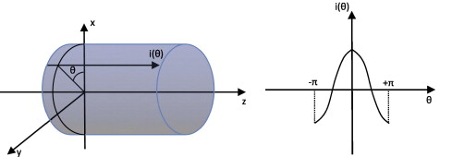

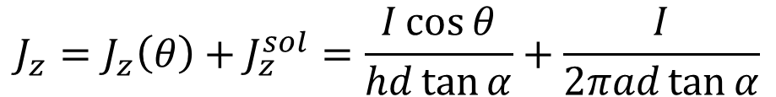

CCT Magnets: Definition – Mathematical model
The ideal current distribution on an infinitely long conductive cylinder, for producing the best homogeneity of a transverse magnetic field inside the cylinder, is:
$$i\left(θ\right)=I\cos{θ}$$
The axial current density of a CCT coil can be described is:
$$J_{z}=J_{z}\left(θ\right)+J_{z}^{sol}=\frac{I\cos{θ}}{hd\tan{α}}+\frac{I}{2πad\tan{α}}$$
h is the pitch of the winding
Constant canceled by the second coil
Proportional to θ
The current density of the CCT magnet is:
$J_{z}^{CCT}=2J_{z}\left(θ\right) \sim \cos{θ}$
A. Akhmeteli, et al., IEEE Trans. Appl. Supercond., pp. 1439-1443, 2005
Notes:
Infinitely long CCT magnet has the ideal current distribution in order to produce a perfectly homogeneous transverse magnetic field

Slide 9

CCT Magnets: How does it work
Main component: tilted current loop
The arrow represents the magnetic field

Slide 10
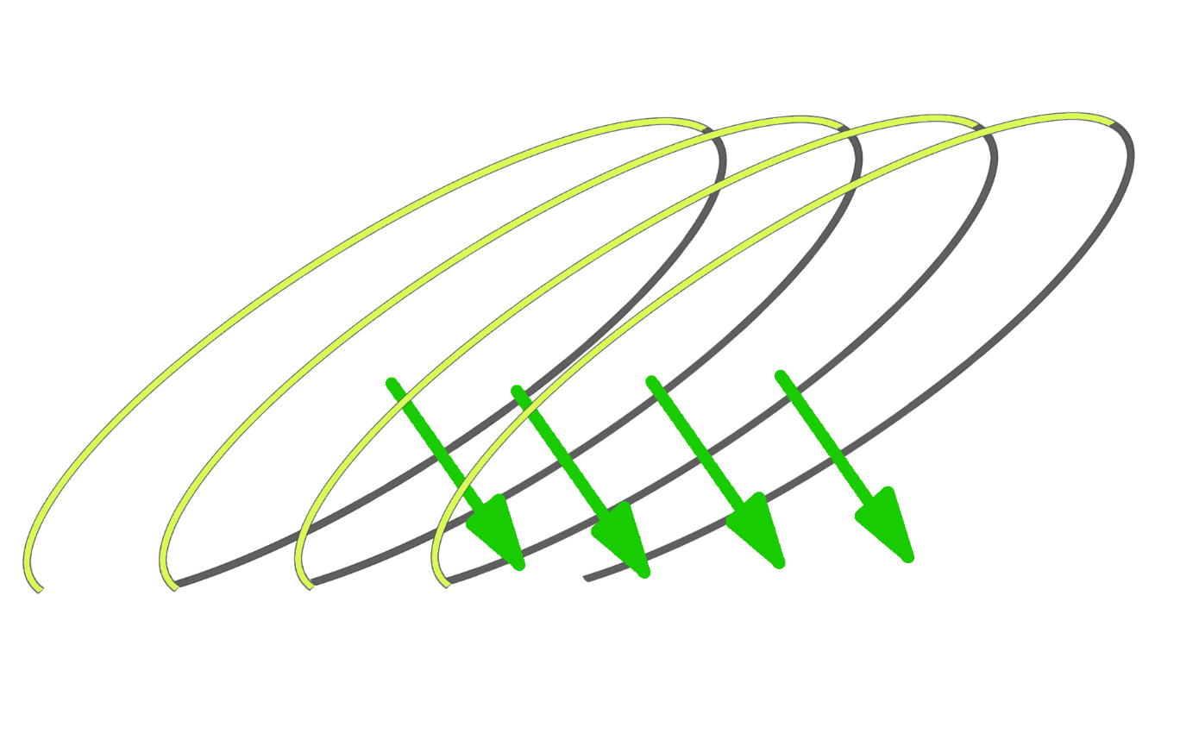
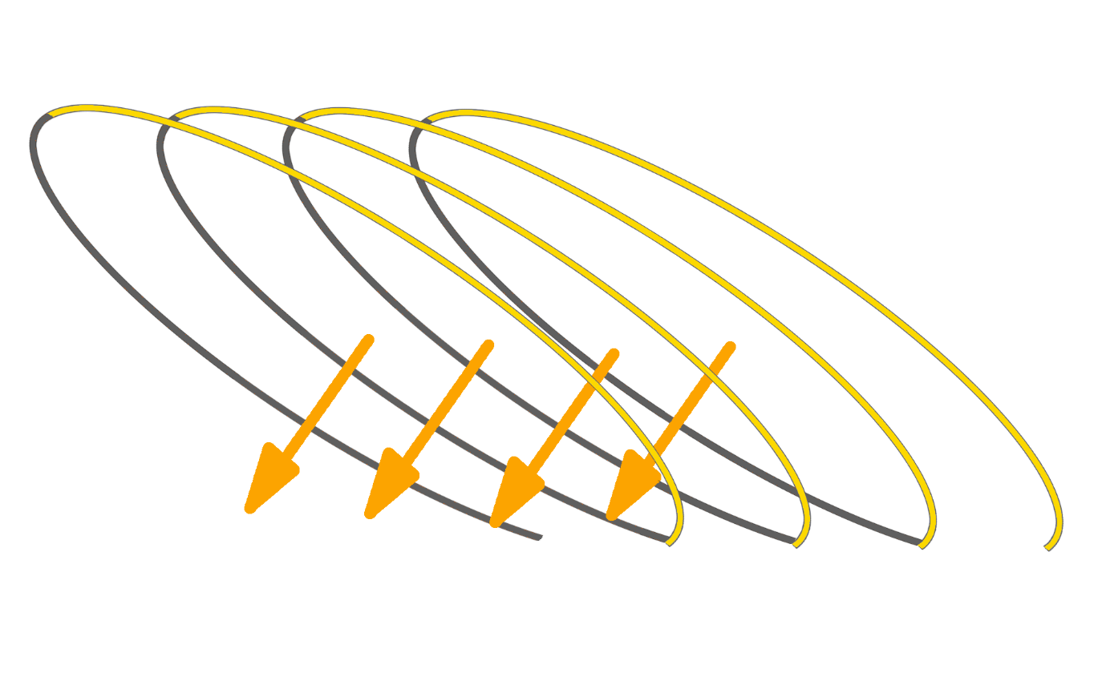
CCT Magnets: How does it work
CCT is built out of 2 canted (tilted) solenoids
Several tilted loops: tilted magnetic field
We have another tilted loop in the other direction

Slide 11
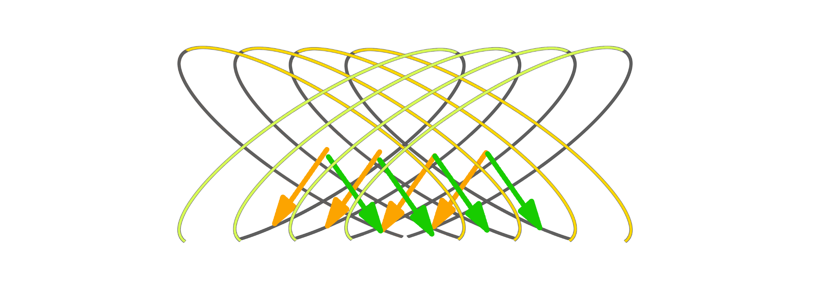
CCT Magnets: How does it work
CCT is built out of 2 canted (tilted) solenoids
We put one inside the other: the magnetic fields add up

Slide 12
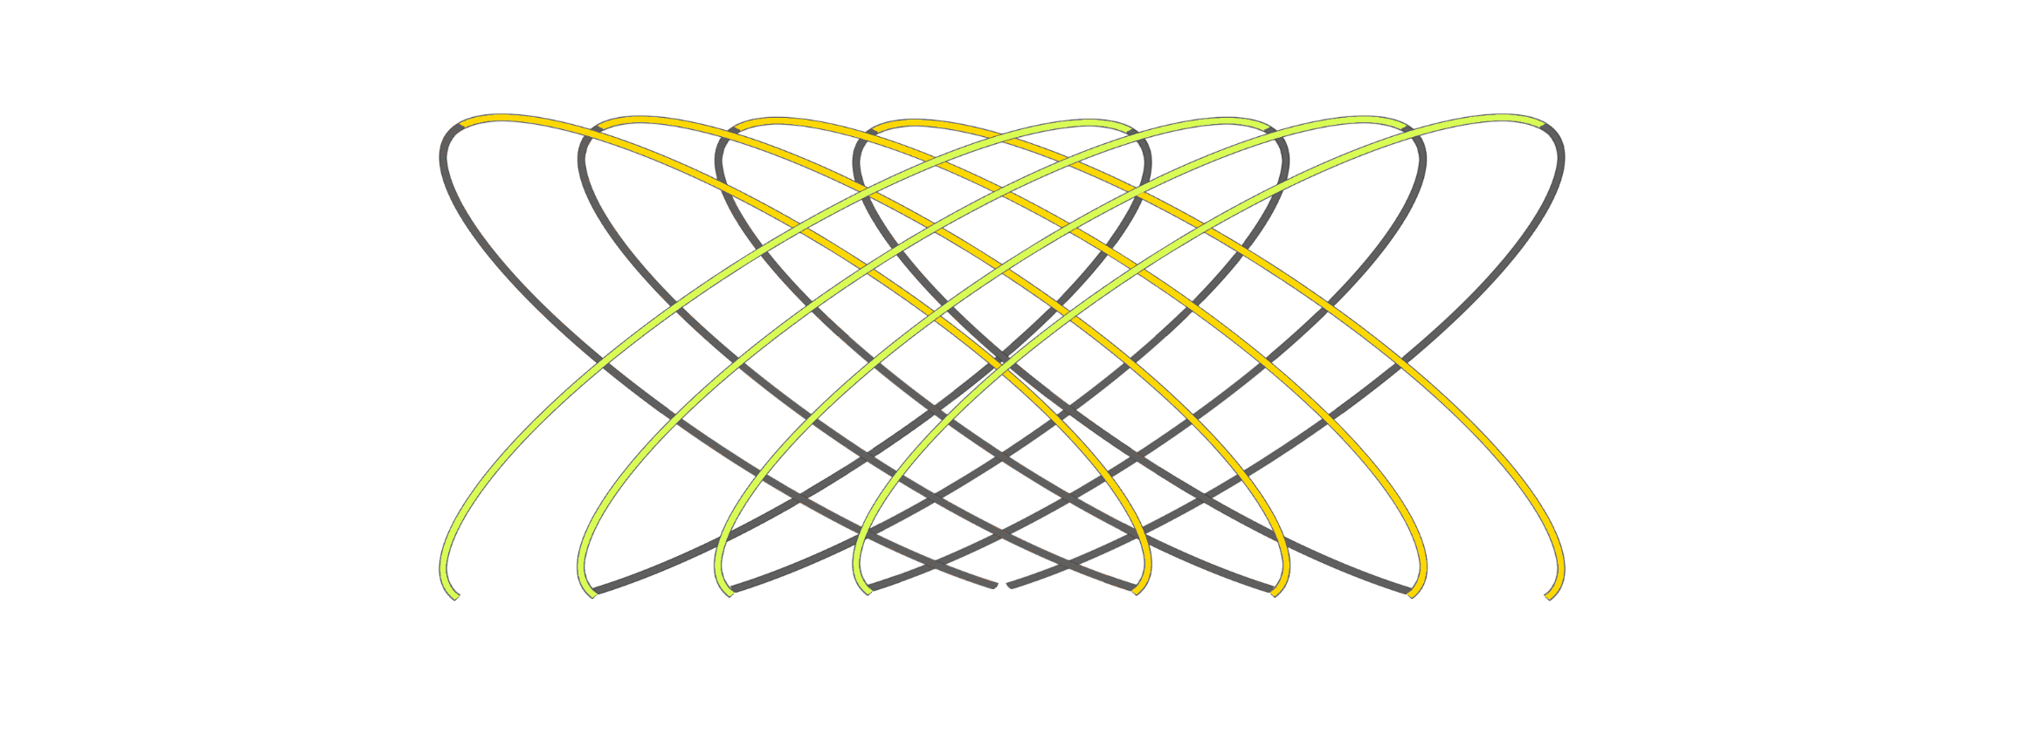

CCT Magnets: How does it work
Net magnetic field on CCT

Slide 13
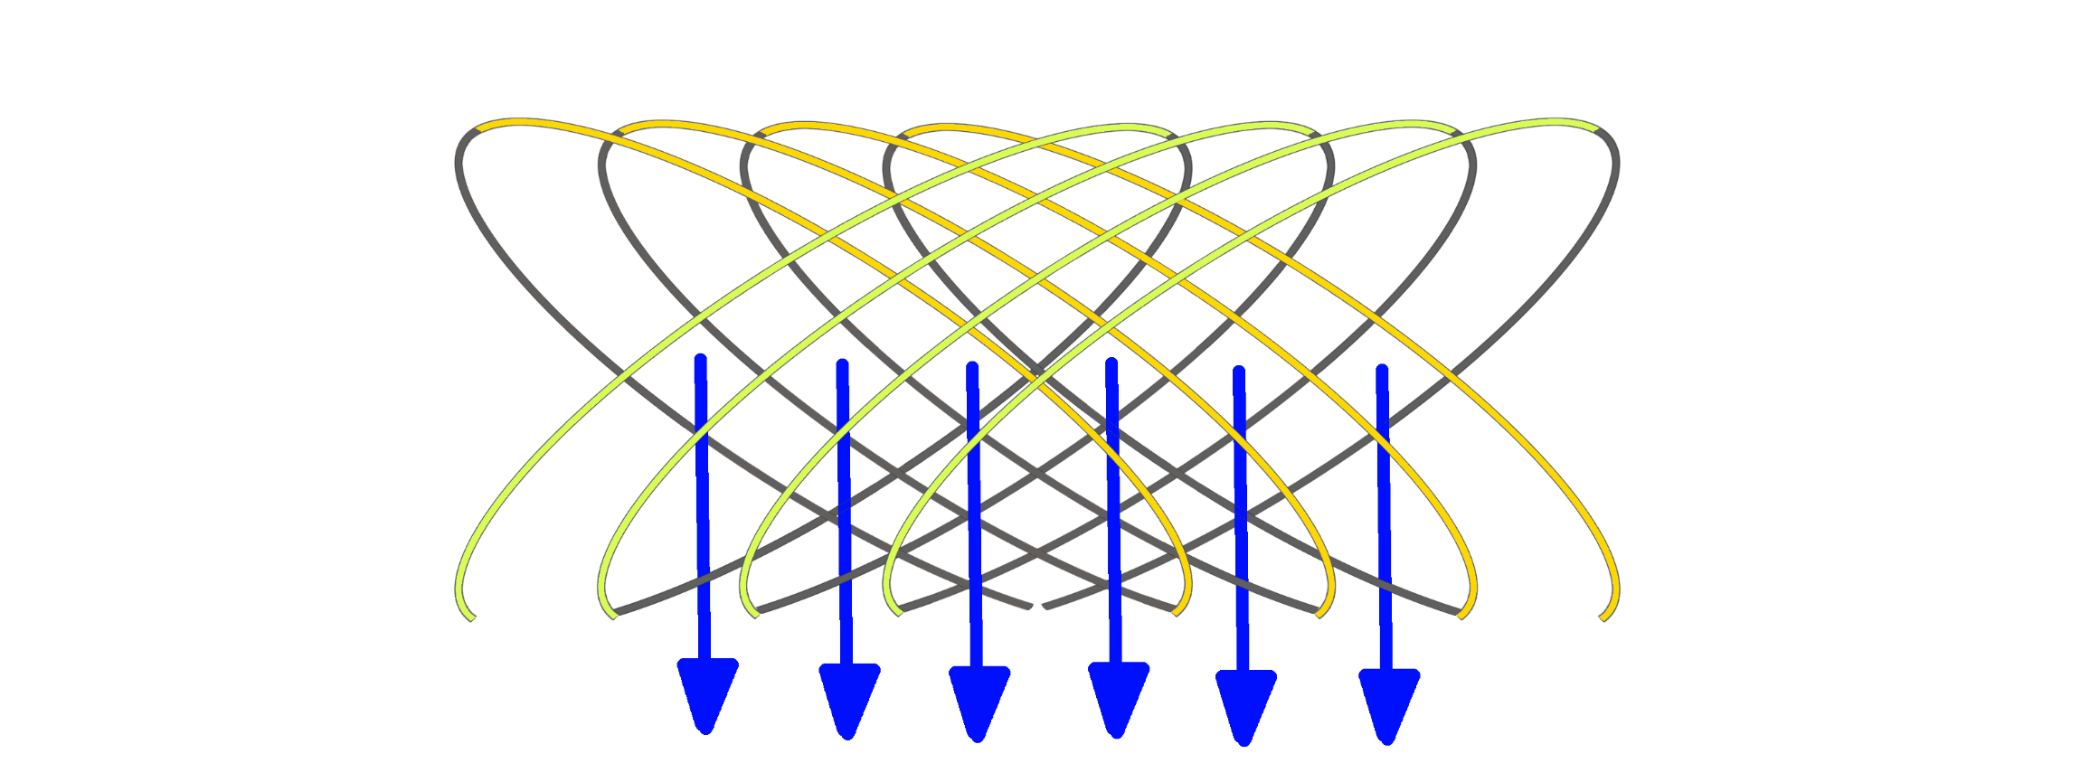
CCT Magnets: How does it work
Net magnetic field on CCT
This yields a net dipolar field
Courtesy F. Mangiarotti

Slide 14
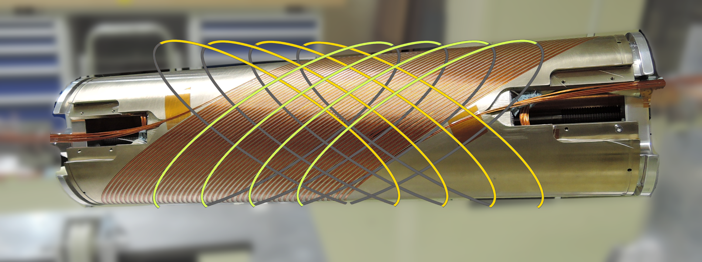
CCT Magnets: Pictures

Slide 15
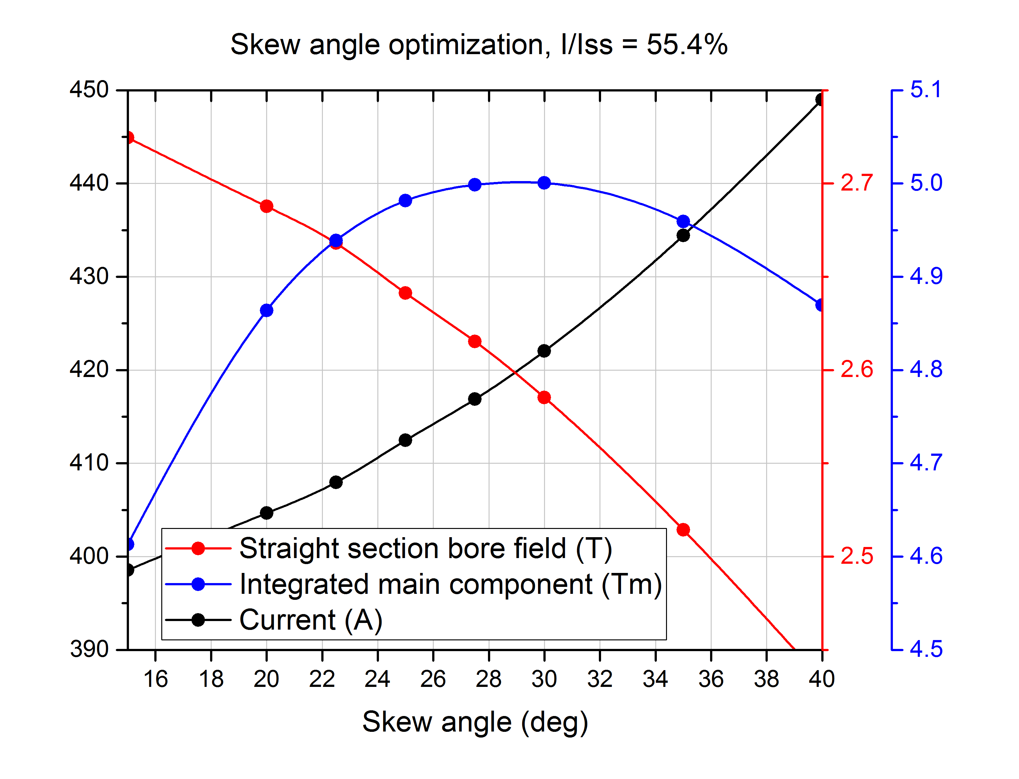
CCT Magnets: Example
Field integral, magnetic current, and central magnetic field as function of the skew angle
The D1 is an orbital corrector required for the High Luminosity upgrade of the LHC at CERN.
Required is a 5 T.m dipole field integral with less than 10 units field error and an operating current less than 600 A.
The magnetic field is limited at 2.6 T by the saturation of the iron. This results in a design which is 2.2 m long. Space is limited and a much shorter magnet option would be preferable.
Courtesy G. Kirby

Slide 16
CCT Magnets: Avantages
Perfect field:
  As “true” a cosine-theta current density distribution
  Field quality over the straight section without optimization required
Low conductor stress:
  Structure intercepts Lorentz-Forces, reduced coil stress by an order of magnitude
  No need for pre-stress
Cost-effective:
  All poles inclusive just like solenoids, inherently a 3D structure
  Small number of components
  10 drawings instead of 100, so fewer components and less tooling to assemble
  Coil assembly not needed (all poles are wound together around a single bore)
  Compatibility between NbTi, Nb₃Sn and HTS
But requires about 50% more conductor than normal sector coils
more cost effective to manufacture than a comparable classical cosine-theta magnet with ribbon wire

Slide 17
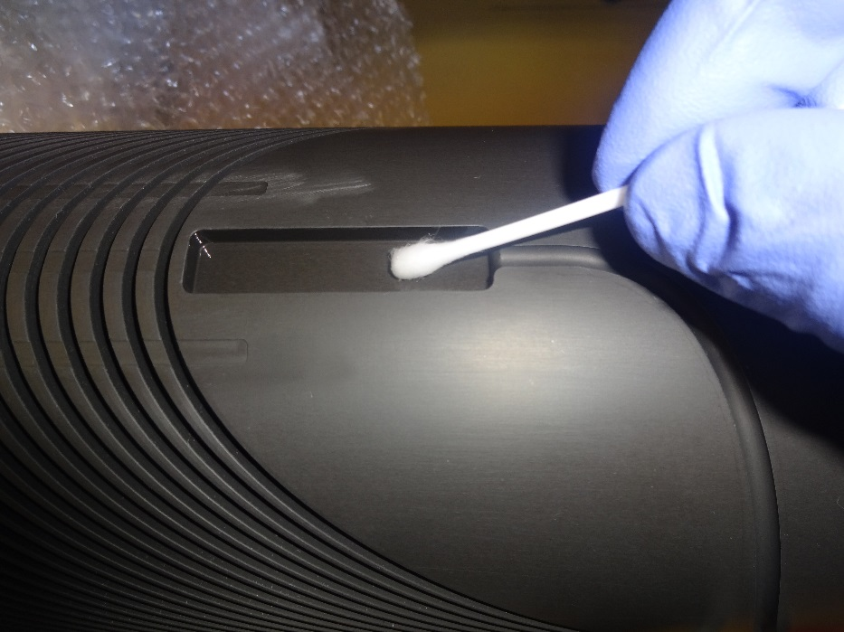
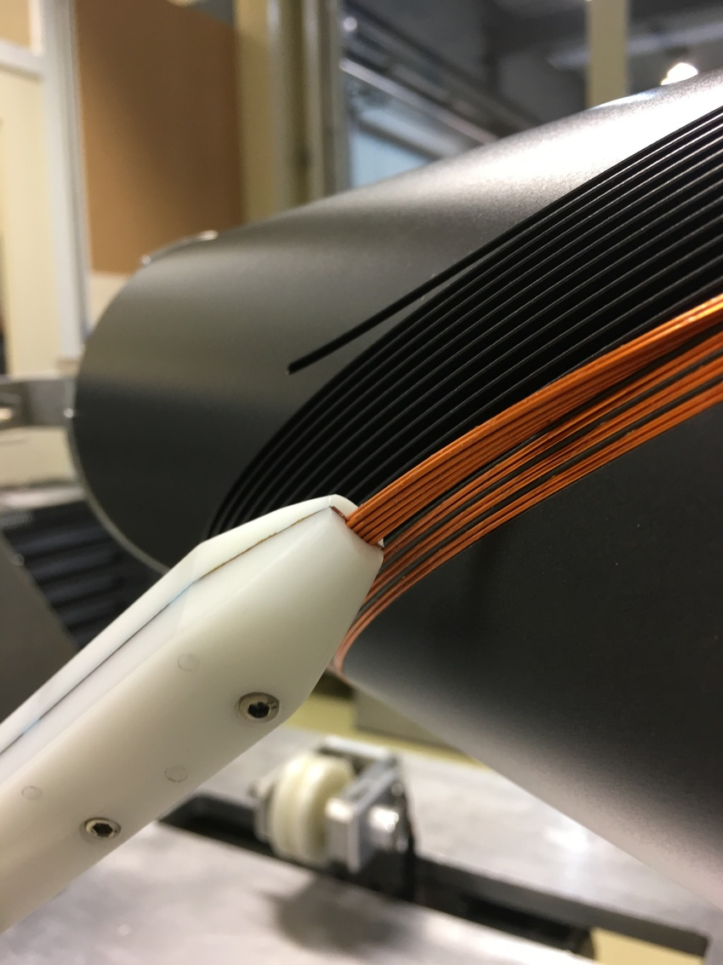
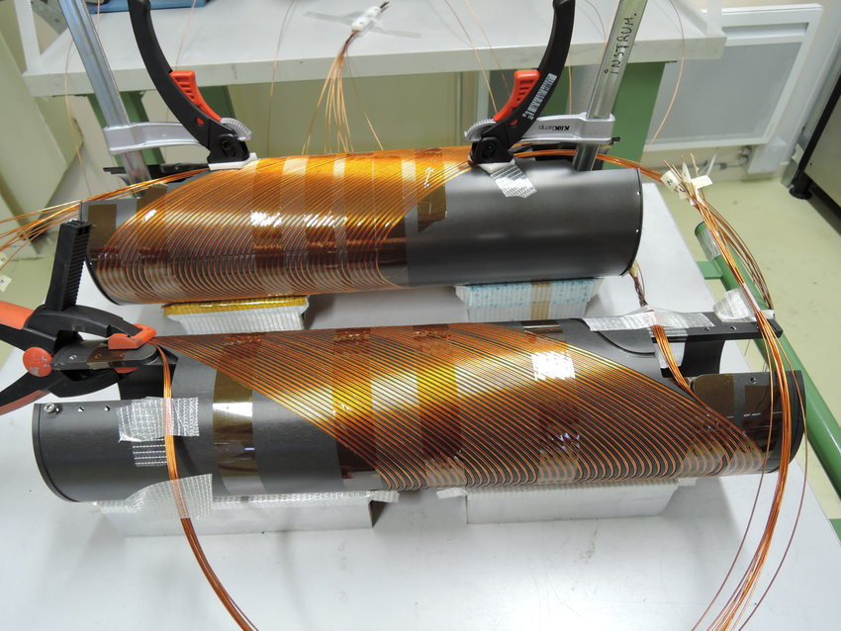
CCT Magnets: Coil Winding
Use a tilted helix form that can be easily fabricated by first milling a groove of the correct geometry into a tube. A commercially available numerically controlled machining software package may be used to generate the tool cutting paths directly from the path equation with specified parameters of diameter, pitch, tilt angle and number of turns. Conductor is then wound into the groove and any necessary overwrap or fill materials are applied.

Slide 18
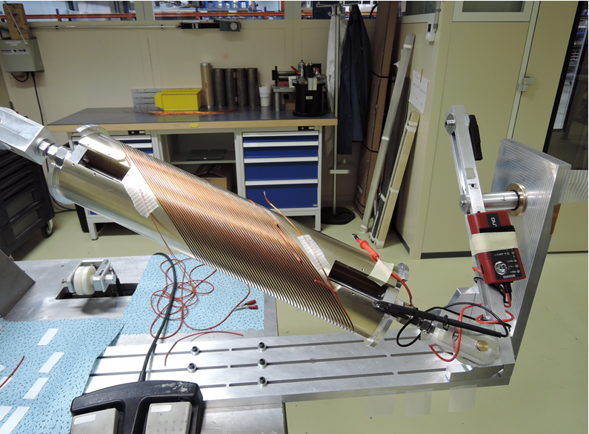
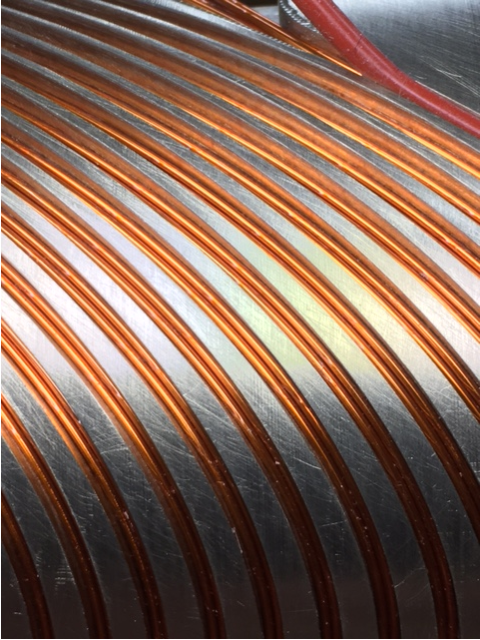
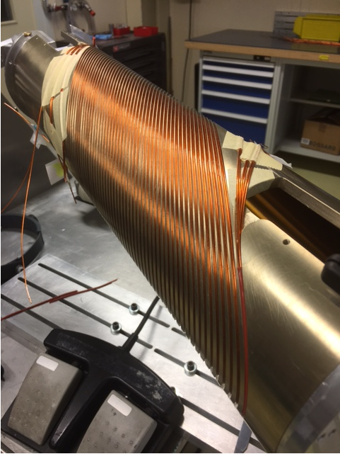
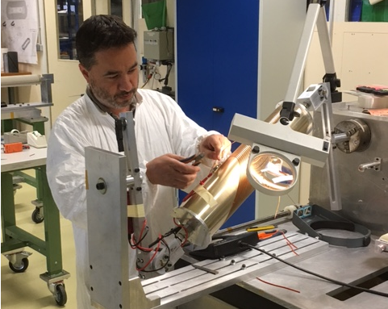
CCT Magnets: Coil Winding
Two wires are wound at the same time, with low tension.
This is repeated until we have the full 2 wide by 5 high coil.

Slide 19
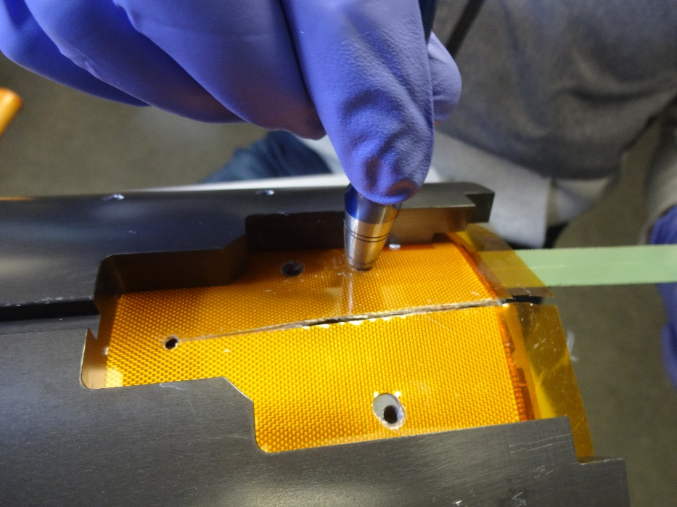
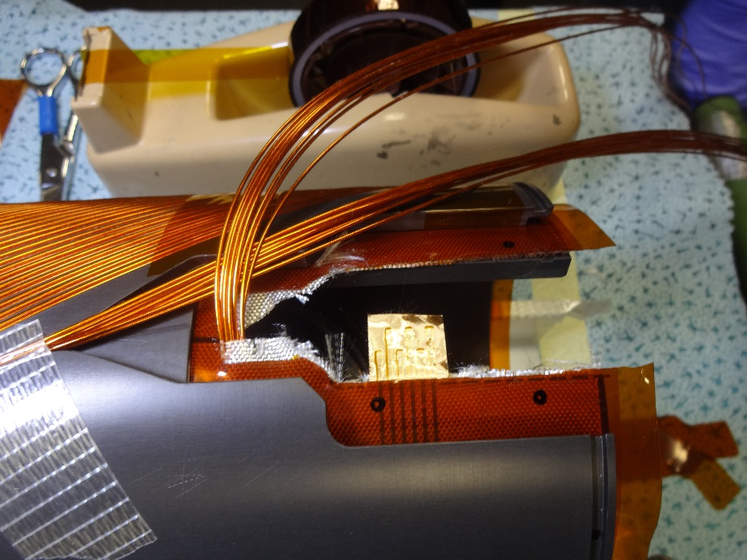
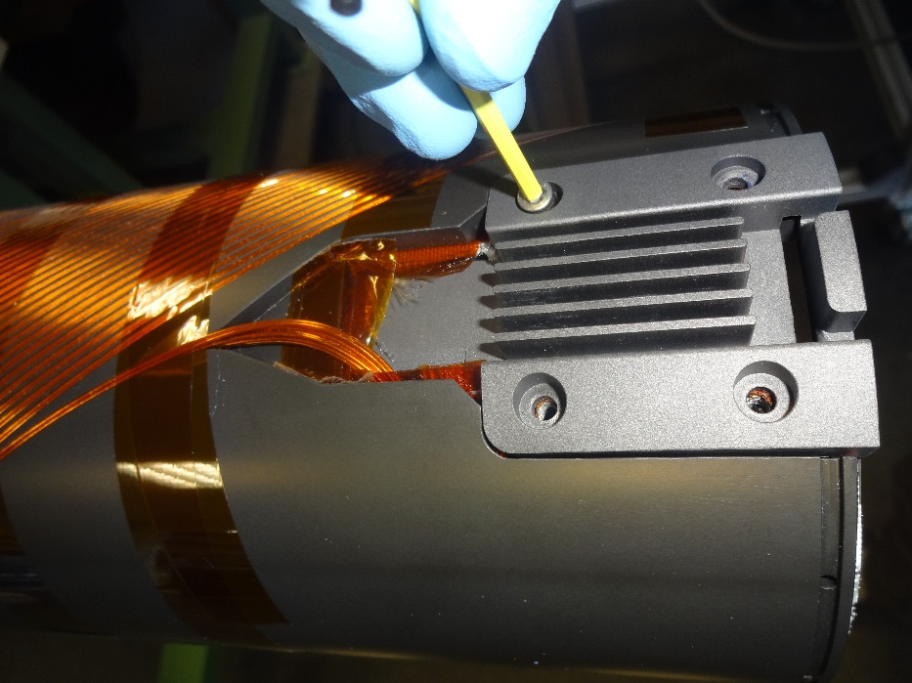
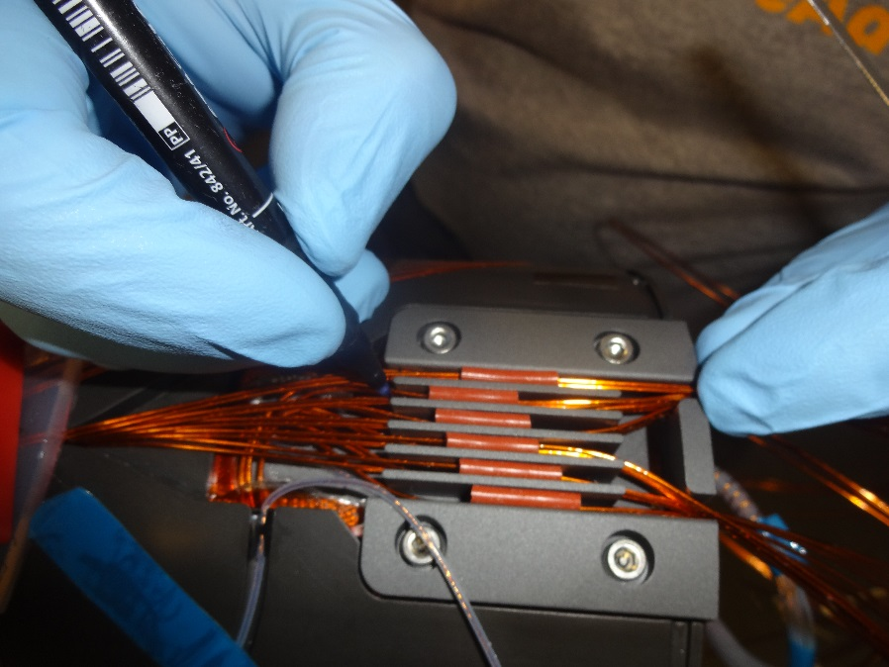
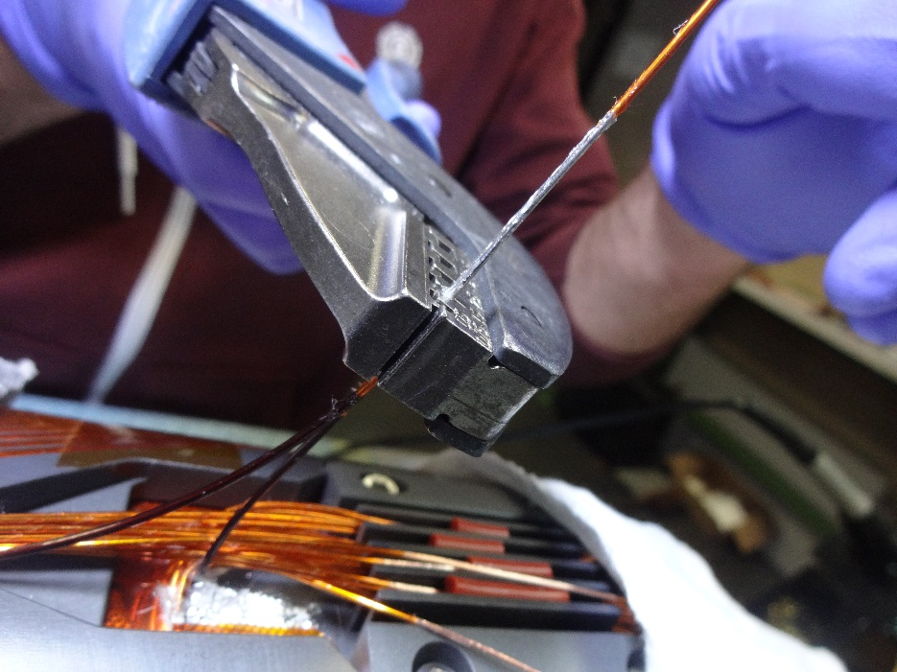
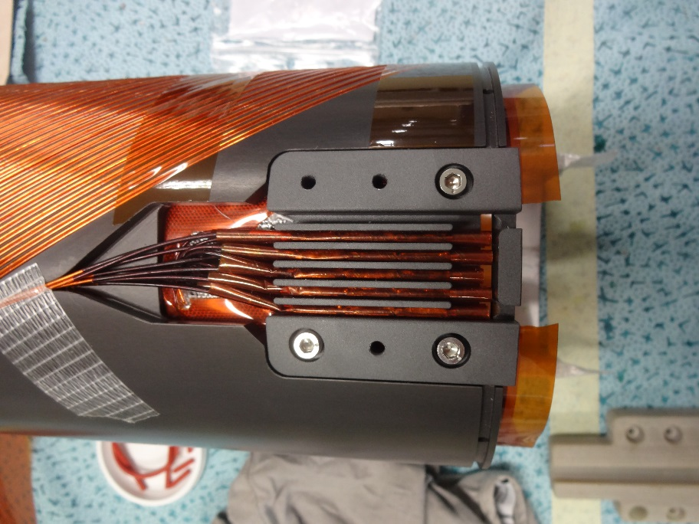
CCT Magnets: Connection box
Fiber glass stack and polyimide sheet
Window on the interlayer to install the connection box
Connection box
Connection box before filling with fiber glass
Marking
Crimping the end-sleeve

Slide 20

CCT Magnets: Diagrams and wiring
10-strand cable wound in the grooves
The strands are connected in series
Cable in a groove
White and red represent the two halves of the magnet winding

Slide 21
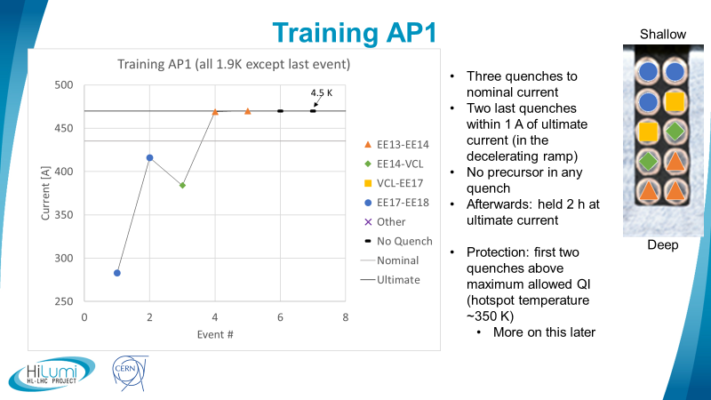
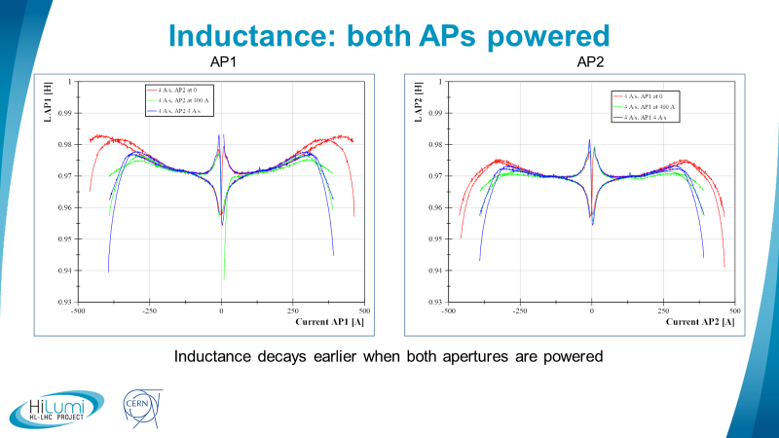
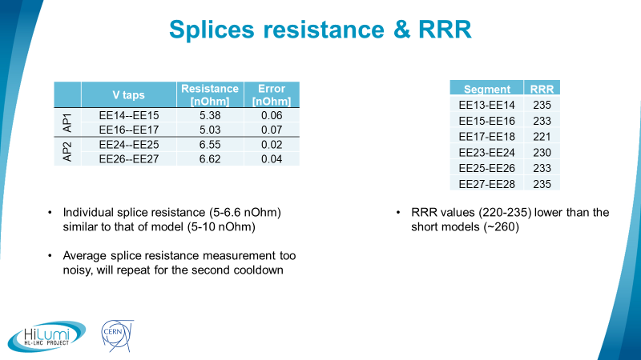
CCT Magnets: Results
Not presented here but:
  Nominal field level of 5 Tm at 393 A
  Field quality was in the specifications, better than 10 units

Slide 22
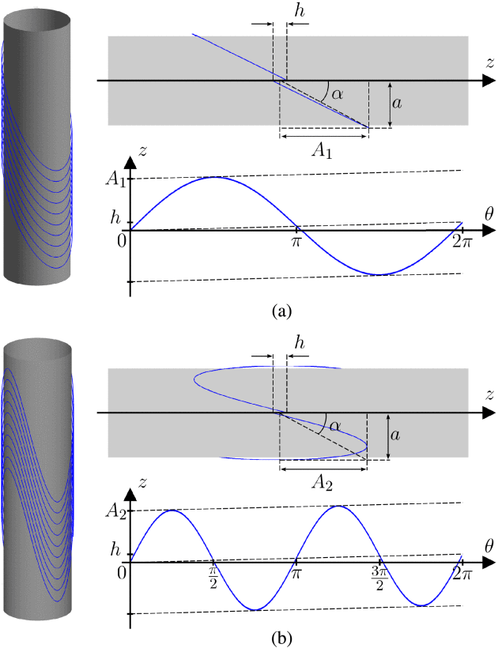
Modulated double helical coils
Concentric pairs of complementary coils with opposite current flow enhance the multipole field and cancel the solenoid field components of the two layers. Thus, magnets of any multipole order, without systematic error fields, are possible by using multiple nested pairs of such coils.
R.B. Meinke, et al., IEEE Trans. Appl. Supercond., Vol. 13, 2003
L. Queval, IEEE Trans. Appl. Supercond., Vol. 25, 2015

Slide 23
Conclusions
The CCT is a paradigm shift in the design of high field SC magnets and the potential of high gain in SC magnet technology (reduce stress, improve training and “short-sample” expectation, field quality etc)
The CCT has the potential of reducing cost especially at high fields
CCT technology can work with NbTi , Nb₃Sn and HTS
Modulated double helical coils can produce pure multipole fields of order n-1
Only 30 drawings. Other similar magnets have 500 + drawings. This is a clear additional cost and time load.

Slide 24
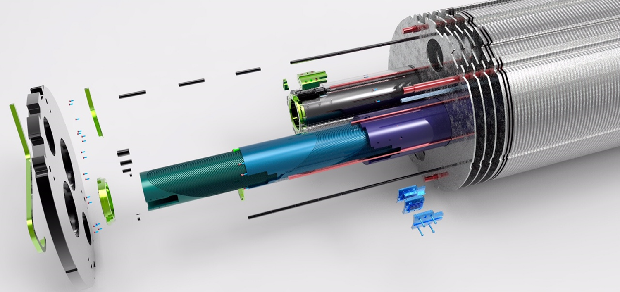
Thank you for your attention

