Slide 1
Development and Innovation through Big Science
Natasa Pahlm, Vinnova
Leif Eriksson, Swedish Research Council

Slide 2
Innovation Arenas with Big Science
Construction / Maintenance / Upgrade
Scientific Experiments
Technology Development
Tech-Transfer
Advanced Research

Slide 3
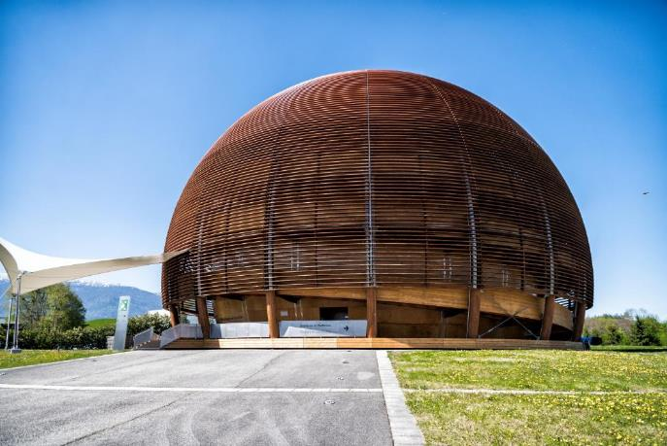
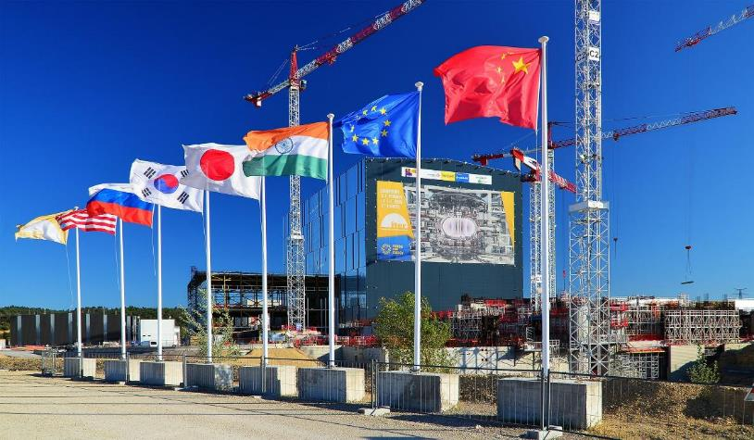
Particle Accelerators
Fusion reactor
Academia
CERN, ESS, MAX IV, ESRF, ILL, XFEL, DESY, FAIR
ITER
Research Facilities
Industry
Telescopes and radars
ESO, SKA, EISCAT
Notes:
Dessa 13 anläggningar representerar ganska skilda områden
Ändock samma typ av leverantörer – skruv, mutter, stål, mjukvara, energiförsörjning osv.
Mångmiljardmarknad
Men framförallt – en enorm arena för teknikutveckling och innovation
Partikelacceleratorer – strålbehandling
Fusion – kärnkraftsindustri – kontrollsystem för flygplan
Rymd – energiproduktion t.ex. solcellstillverkare – producerar mer data per år än FB och Google tillsammans – fantastisk arena för utveckling inom Artificiell intelligens och Big Data

Slide 4
Three ways to deliver to Big Science
 | Procurement | 2. Collaboration projects | 3. In-kind contributions
Contract party | Companies | Public research laboratories (institutes, universities etc) | Public research laboratories (institutes, universities etc)
Financing | Big Science facility | Shared (Big Science facility – Participating country) | Country
Level of innovation / expertise development | Both standard and new development | Always new development (detta är själva incitamentet för att delta i samarbetsprojekt) | Often new development
Handling in Sweden | Facilitated by Big Science Sweden (Swedish ILO organisation) | Financing: no formal process, ad-hoc Development: universities (sometimes in collaboration with companies) | Financing: VR/RFI (calls) Development: universities (sometimes in collaboration with companies)
Handling in other countries | Facilitaded by Industrial Liaison Offices (ILOs) | Financing: research funding authorities / governments Development: institues and laboratories in strong collaboration with academia and large number of companies Long-term roadmap | Financing: research funding authorities / governments Development: institues and laboratories in strong collaboration with academia and large number of companies Long-term roadmap

Slide 5
Ongoing work
Sweden has disadvantage compared to other countries when it comes to 2 & 3
Joint Vinnova-Vetenskapsrådet working group
Discussions with universities’ reference group and reserachers with experience from collaboration and in-kind projects
Several areas for improvement have been identified
Goal to propose actions to enable that Sweden gets bigger return on investment in the research infrastructures

Slide 6
What we would like to see
That there are long-term, strategic technology development environments that use in-kind and collaboration projects as a part of their strategy and for competece development
That such environments have an ongoing operation that is not dependent of in-kind and collaboration project financing
That there is a strong involvement of industry in the projects (as a supplier or collaboration partner)
That technologies developed in such environments are brought to industry and other application areas
That financiers can include potential in-kind and collaboration projects in the negotiations when considering new investments

Slide 7
What we are doing
Use existing possibilities
BiSS an example there a new development has been very positive
SKA proposal was made with the kind of involvement we would like to see
A certain amount of the budget for Vetenskapsrådet set aside for deliveries to RI in the latest research bill. One call has been made and some good examples have been funded.
Increase the knowledge about the problem through our round-tables and discussions with RFI and URFI
Use existing channels to try to change the current situation, i.e. targeting the next research bill

Slide 8
Preparing for in kind deliveries to ESS
Preparations for the phases initial operations and operations
Negotiations for the budget for these phases under way
New development at Vetenskapsrådet and Vinnova – assignment from the government to coordinate the Swedish involvement 2019-2025
Results of first assigment (2014-2018) reported with three recommendations to the government:
Coordinate at the governmental level
Policy and funding streams need to be coordinated
Incentives for universities to develope tools for research need to be in place

Slide 9
Meanwhile…

Slide 10
Thank you!

