Slide 1
PROGRAM – RF and CRYO
9.00-10.00 Introduction
9.00 Registration and coffee
9.30 Big Science Sweden – An international market, Fredrik Engelmark
09.45 The FREIA Laboratory and Big Science, Tord Ekelöf
10.00-11.20 COMPANY PRESENTATIONS
10.00 RFR Solutions, Mats Orup
10.20 Scanditronix, Mikael Vieweg
10.40 GE Healthcare, Erik Strömqvist
11.00 RISE, Sven-Christian Ebenhag
11:20-11:40 COFFEE
11.40-13:00 RESEARCHER PRESENTATIONS
11.40 Superconducting Cables Connection Cryostats, Rocio Santiago Kern
12.00 CCT Superconducting Magnets, Kevin Pepitone
12.20 Radiofrequency Power Transistor Amplifiers, Dragos Dancila
12.40 Superconducting Accelerators for Medicine, Hermann Dürr
13.00-14.00 LUNCH
14.00-15.00 STUDY VISIT TO FREIA LABORATORY
15.00-15.30 VETENSKAPSRÅDET AND VINNOVA
15.00 Leif Eriksson, Vetenskapsrådet
15.15 Natasa Pahlm, Vinnova
15.30-16.15 Panel discussion about Big Science as part of the Swedish research and innovation system, Moderator: Patrik Carlsson

Slide 2
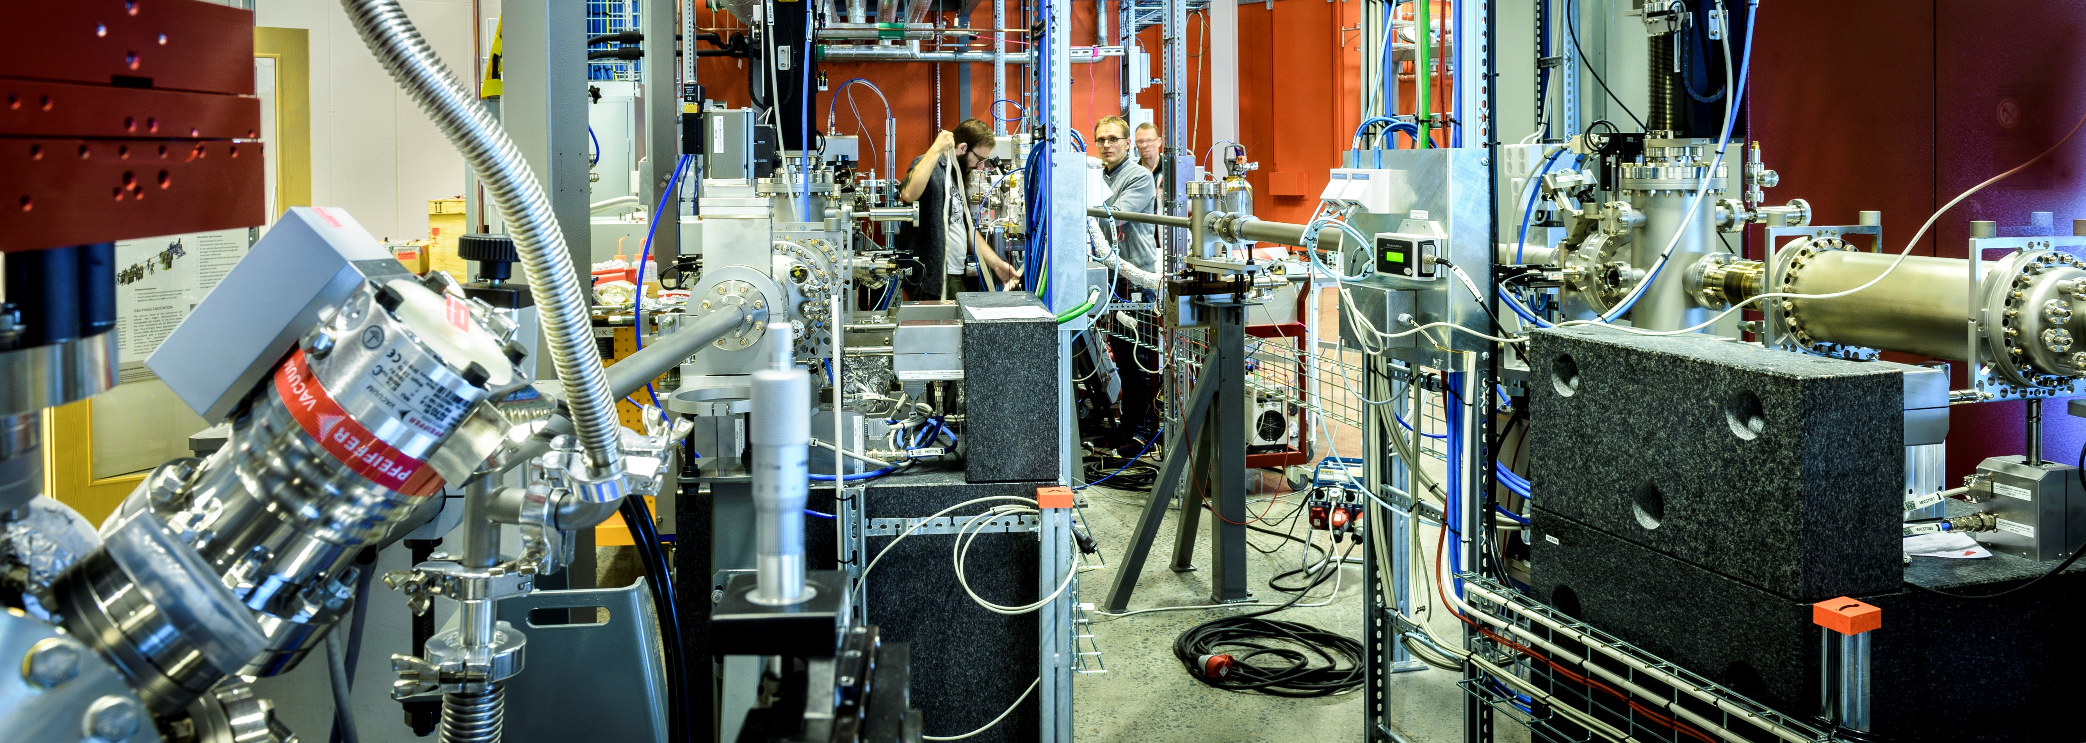
Big Science Sweden

Slide 3
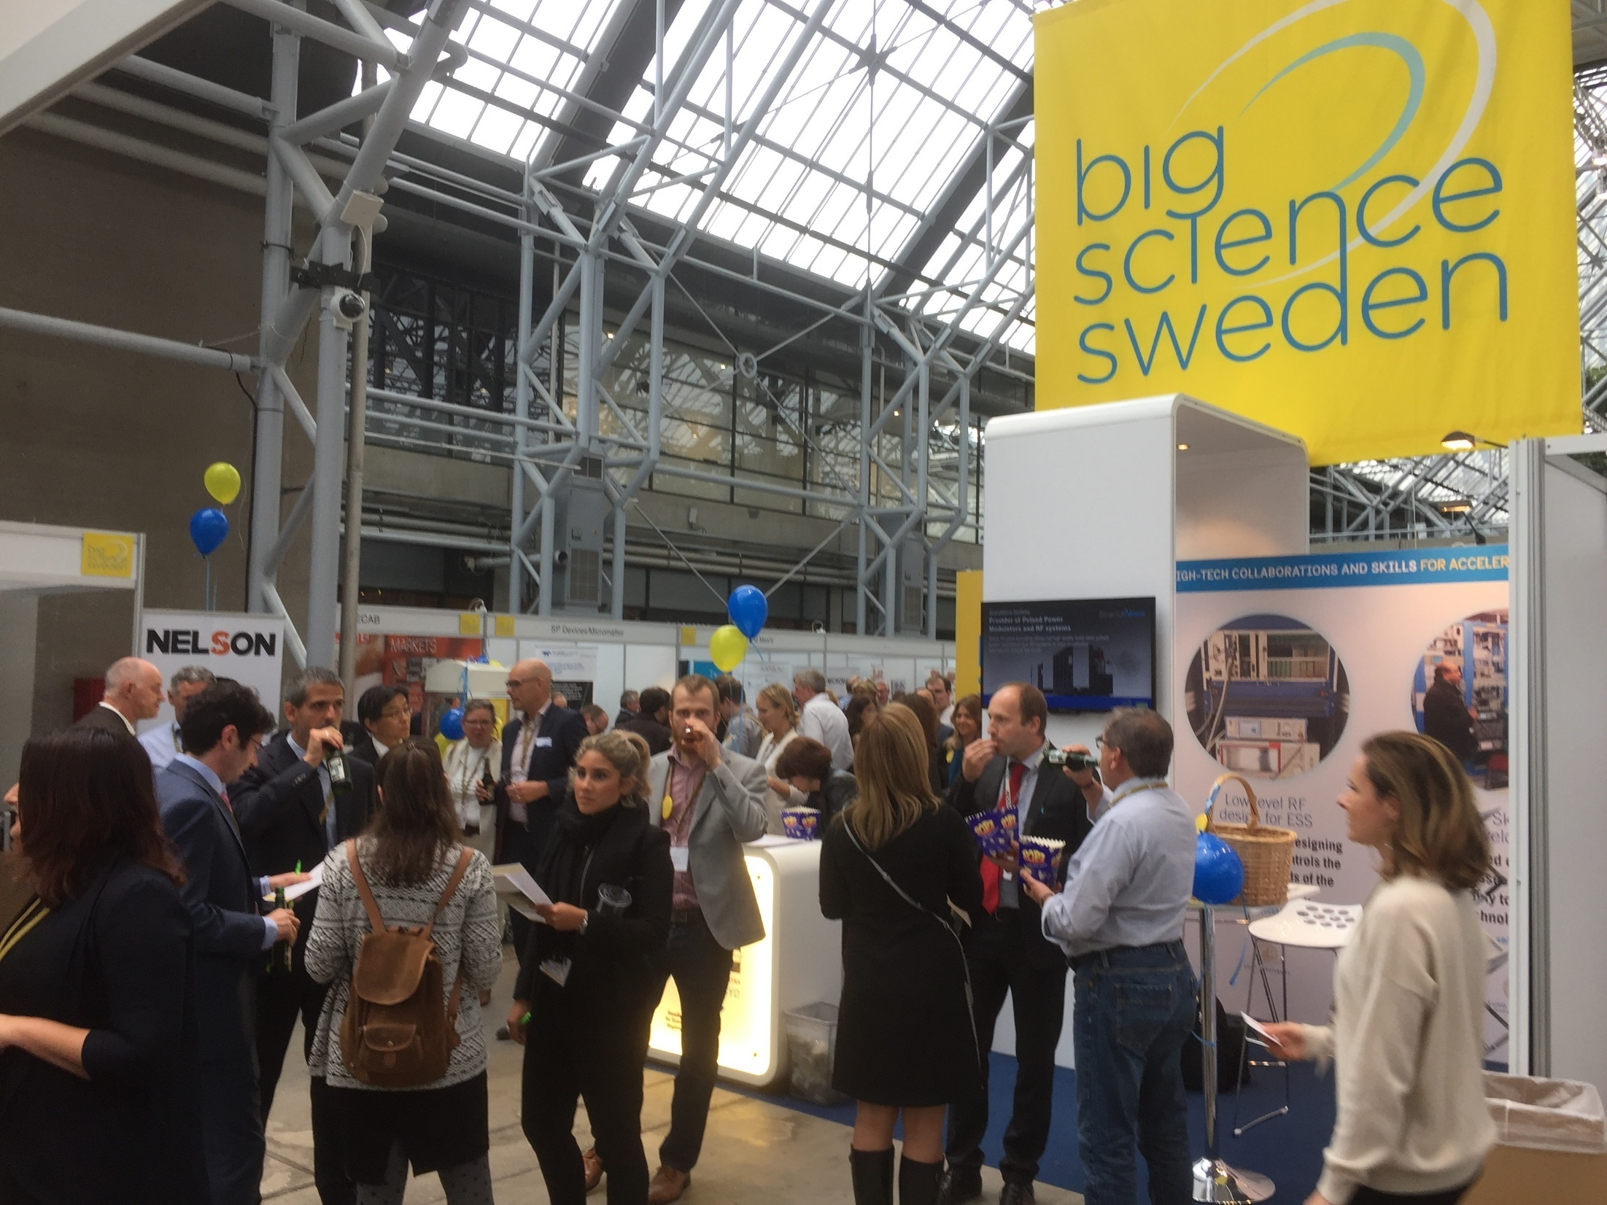
National operation, with offices in four locations
LULEÅ/KIRUNA
UPPSALA
GÖTEBORG
LUND
Big Science Sweden is a consortium:
Financed by:
.

Slide 4
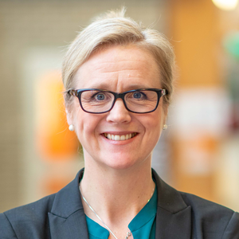
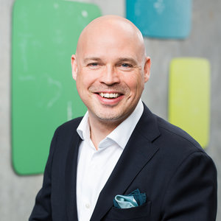
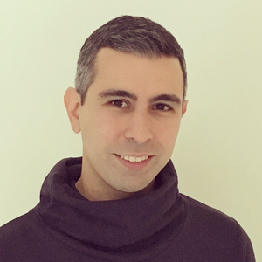
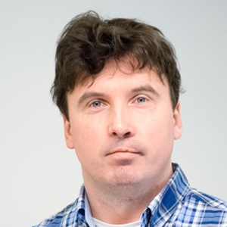
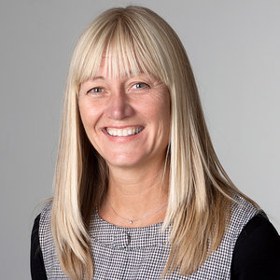
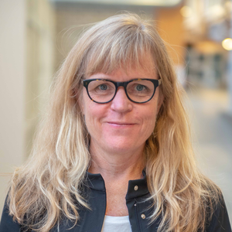
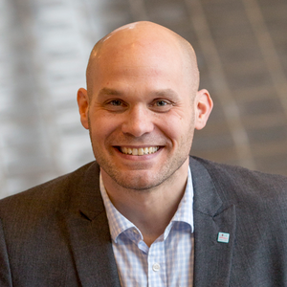
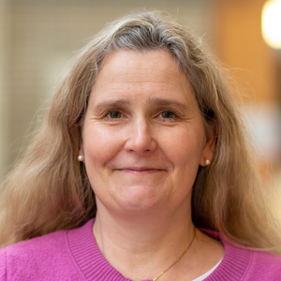
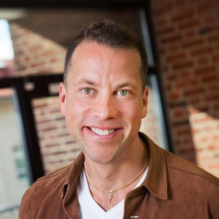
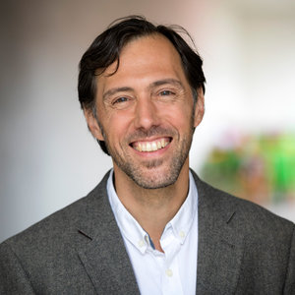
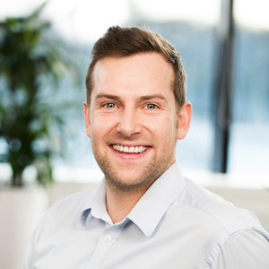
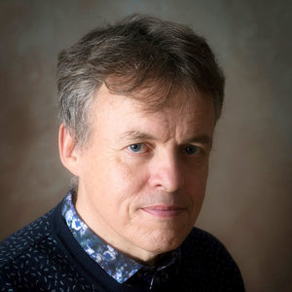
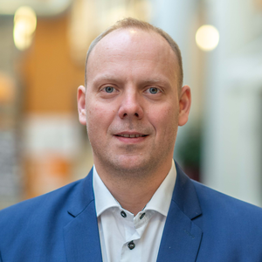
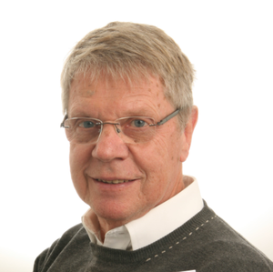
TEAM
BiSS
Anna Hall
Director
Patrik Carlsson
Co-Director
Ali Moyassari
Business Development
Adan Wikström
Business Development
Johanna Bergström-Roos
Business Development
Frida Tibblin Citron
Business Development
Fredrik Engelmark
Business Development
Cajsa Fredlund
Communication
Lennart Gisselsson
Business Development
Ernesto Gutiérrez
Business Development
Bernd Ketzler
Business Development
Mats Larsson
Business Development
Sven-Christian Ebenhag
Business Development
Håkan Nilsson
Business Development

Slide 5
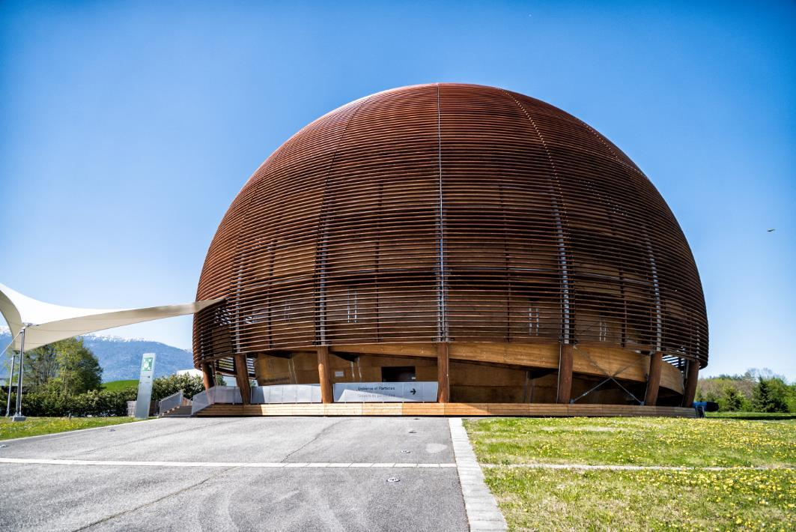
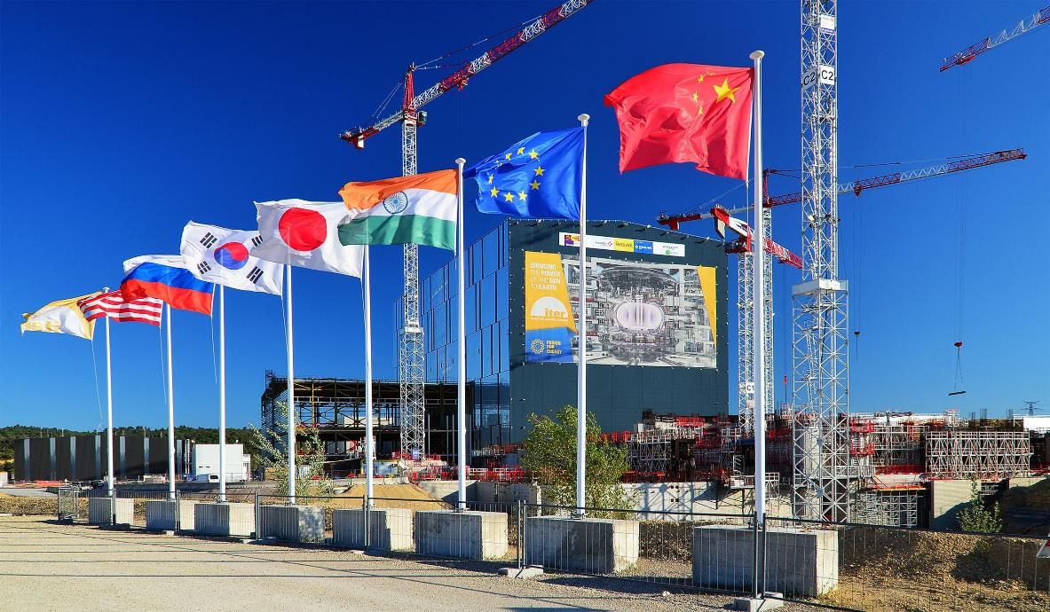
Particle Accelerators
Fusion
CERN, ESS, MAX IV, ESRF, ILL, XFEL, DESY, FAIR
ITER
Space
ESO, SKA, EISCAT
Notes:
Dessa 13 anläggningar representerar ganska skilda områden
Ändock samma typ av leverantörer – skruv, mutter, stål, mjukvara, energiförsörjning osv.
Mångmiljardmarknad
Men framförallt – en enorm arena för teknikutveckling och innovation
Partikelacceleratorer – strålbehandling
Fusion – kärnkraftsindustri – kontrollsystem för flygplan
Rymd – energiproduktion t.ex. solcellstillverkare – producerar mer data per år än FB och Google tillsammans – fantastisk arena för utveckling inom Artificiell intelligens och Big Data

Slide 6
”Membership
Fee”
Return

Slide 7
Swedens official ILO Didicated ILO’s for infrastructures with Swedish membership
Industry
Academia
Research Facilities
BIG SCIENCE SWEDEN
IDUSTRY RETURN
HIGH-TEC DEVELOPMENT
INNOVATION
Notes:
Short term goals and long term goals
Build business capacity
Short term goal, meet direct demands with ”off-the-shelf” products.
The long term goal is to work towards technical solutions that does not yet exist. Projects that increases the technology level also in the surrounding society. This is the real challange…

Slide 8
”Everything is needed”…
Building and construction
Thin film deposition
Cast details and AM
Electronics, RF and micro wave components
Magnets
Mechanics
Optics and optical sensors
Power supply
Big Data
Remote control
Robotics
Vacuum and CRYO
Software
Automation
Instrumentation
Etc…
INNOVATION

Slide 9
BIG SCIENCE SWEDEN
GOAL
To capitalize on our investments:
– Industry return, high-tec delivery and innovation

Slide 10
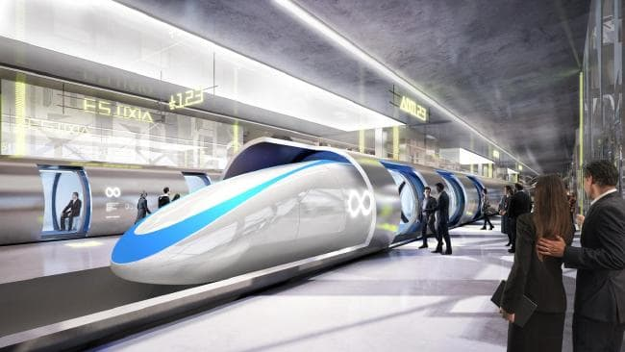
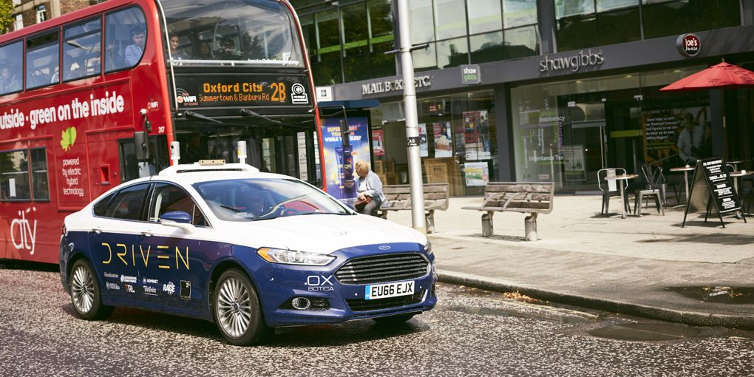
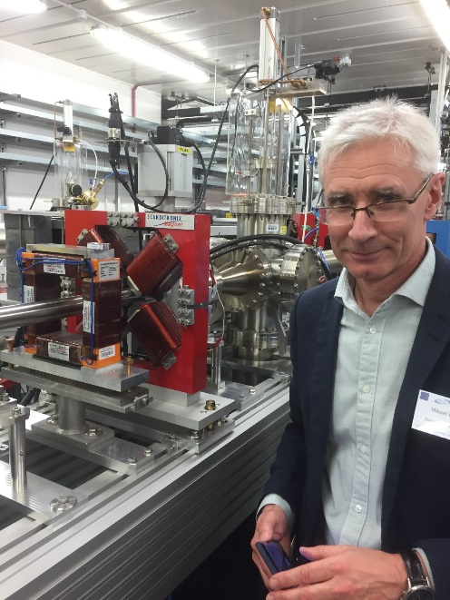
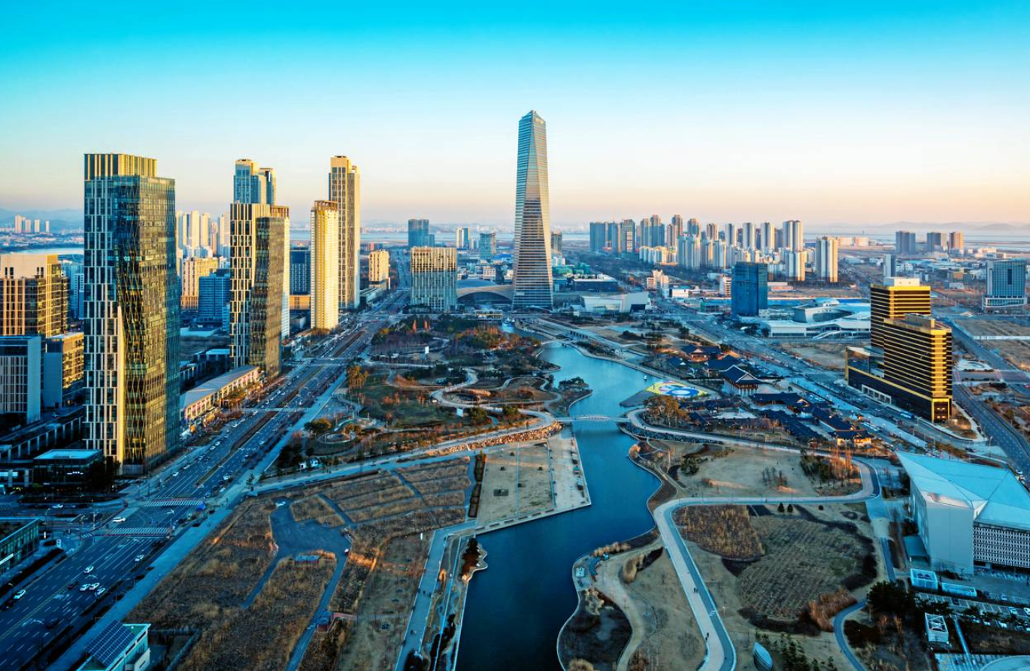
Innovation and ”Spill-over”
Particle accelerators → Mobility
Fusion → Autonomous cars
Particle accelerators
→ Cancer treatment
Particle accelerators
→ Medtech
Particle accelerators
→ AI → Smart Cities

Slide 11
What do we do?

Slide 12
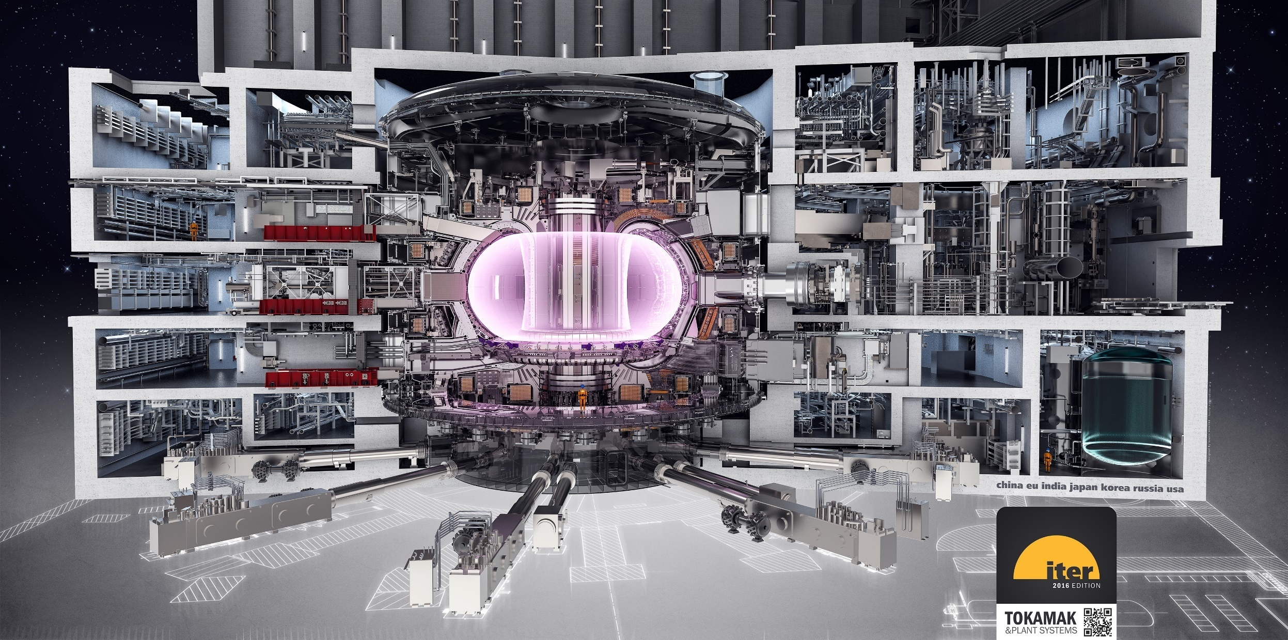
ITER
ITER Tokamak
Total cost: 200.000.000.000SEK
F4E share ca 80.000.000.000SEK
Picture: ITER
Foto: baraBild
Notes:
…This includes the assembly of the ITER Tokamak, with its estimated one million components, and the parallel installation and integration of plant systems such as radio frequency heating, fuel cycle, cooling water and high voltage electrical systems.
150 miljoner grader i mitten (nästa 10 ggr varmare än i solens mitt), flera hundra minusgrader några meter därifrån
Värmeflöde 20 MW/m2 – vilket motsvarar en raket med full spätta…

Slide 13
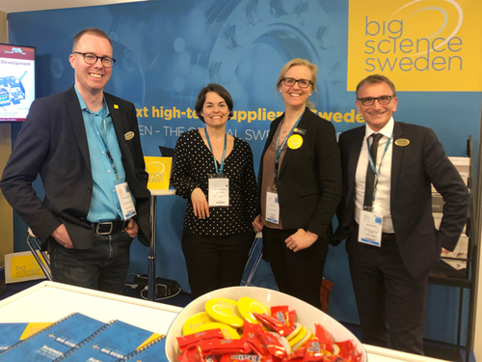
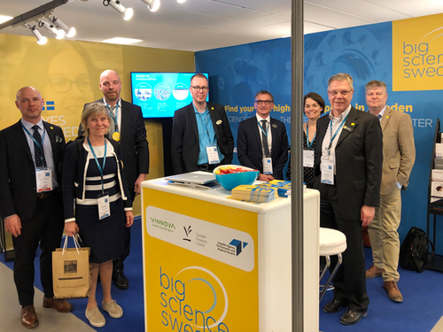
ITER 25-28 March
10 companies
Site visit
1-to-1 meetings
Presentations

Slide 14
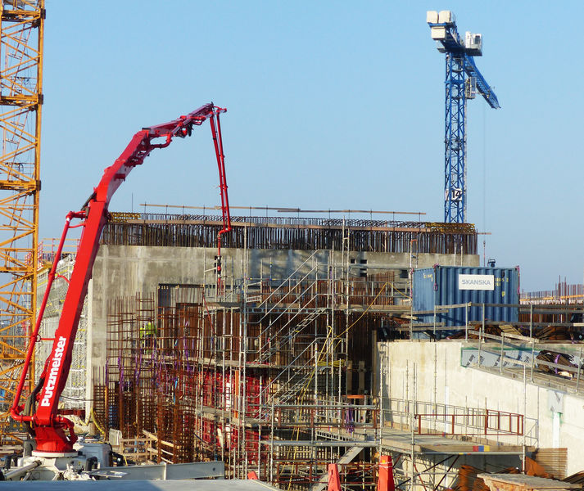
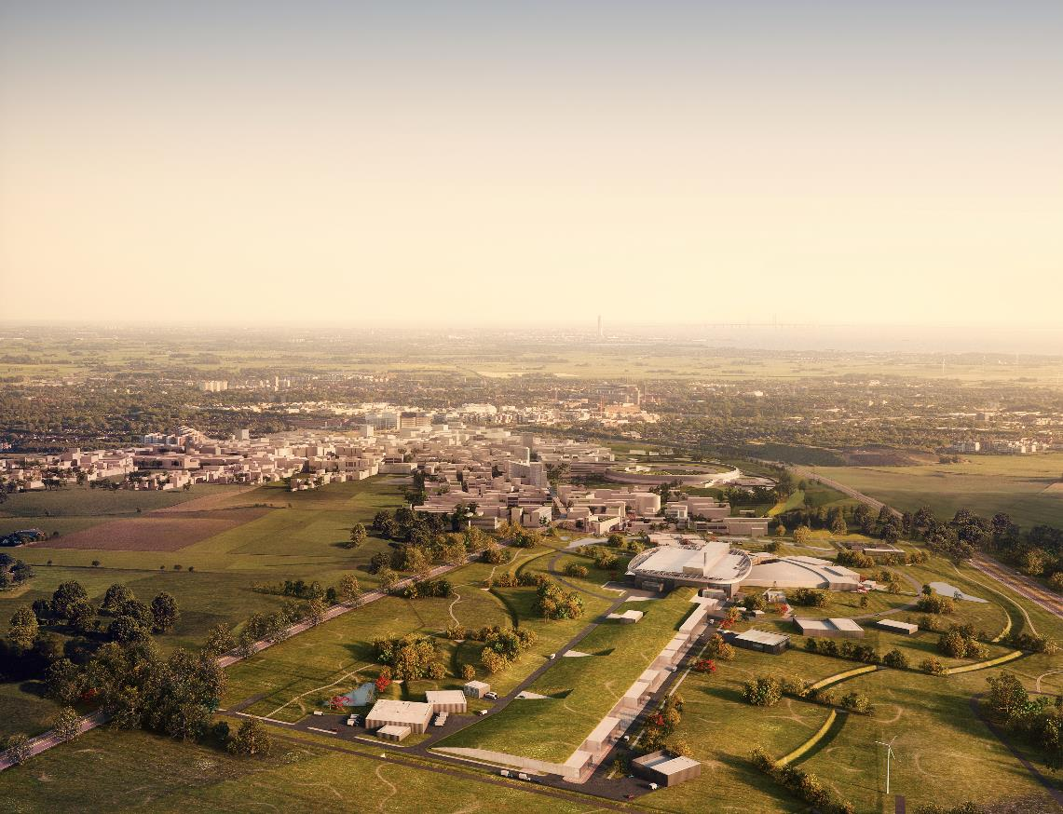
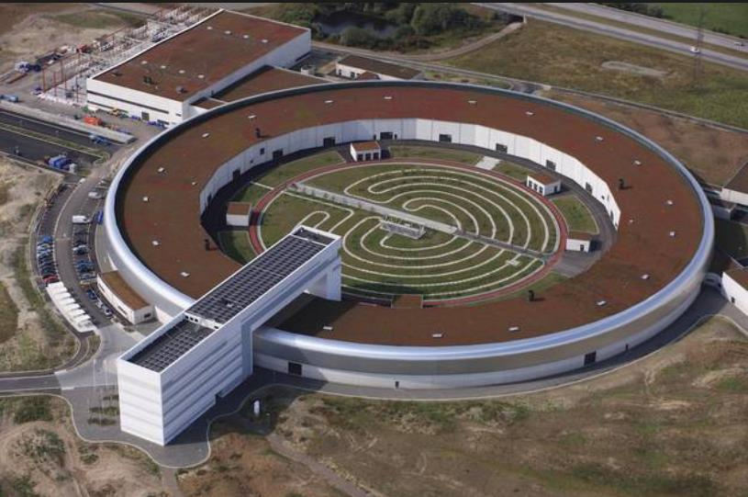
ESS och Max IV
Notes:
Började byggas 2014
Användarprogrammet börjar 2023
Byggkostnad ca 18 Miljarder

Slide 15
CERN
CERN
Notes:
HiLUMI
Protonkolliderare

Slide 16
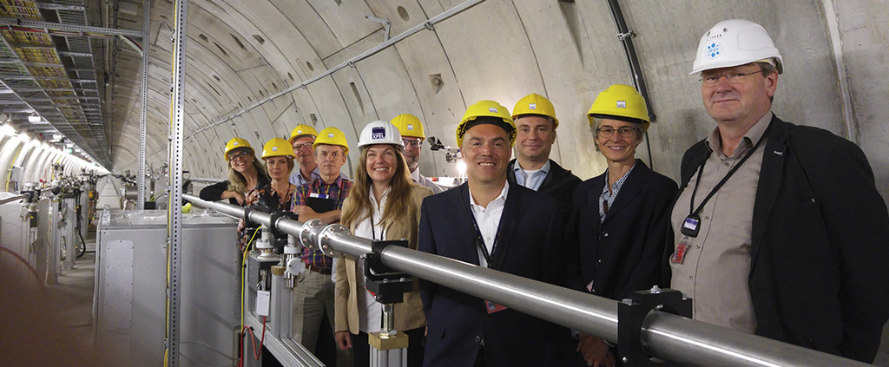
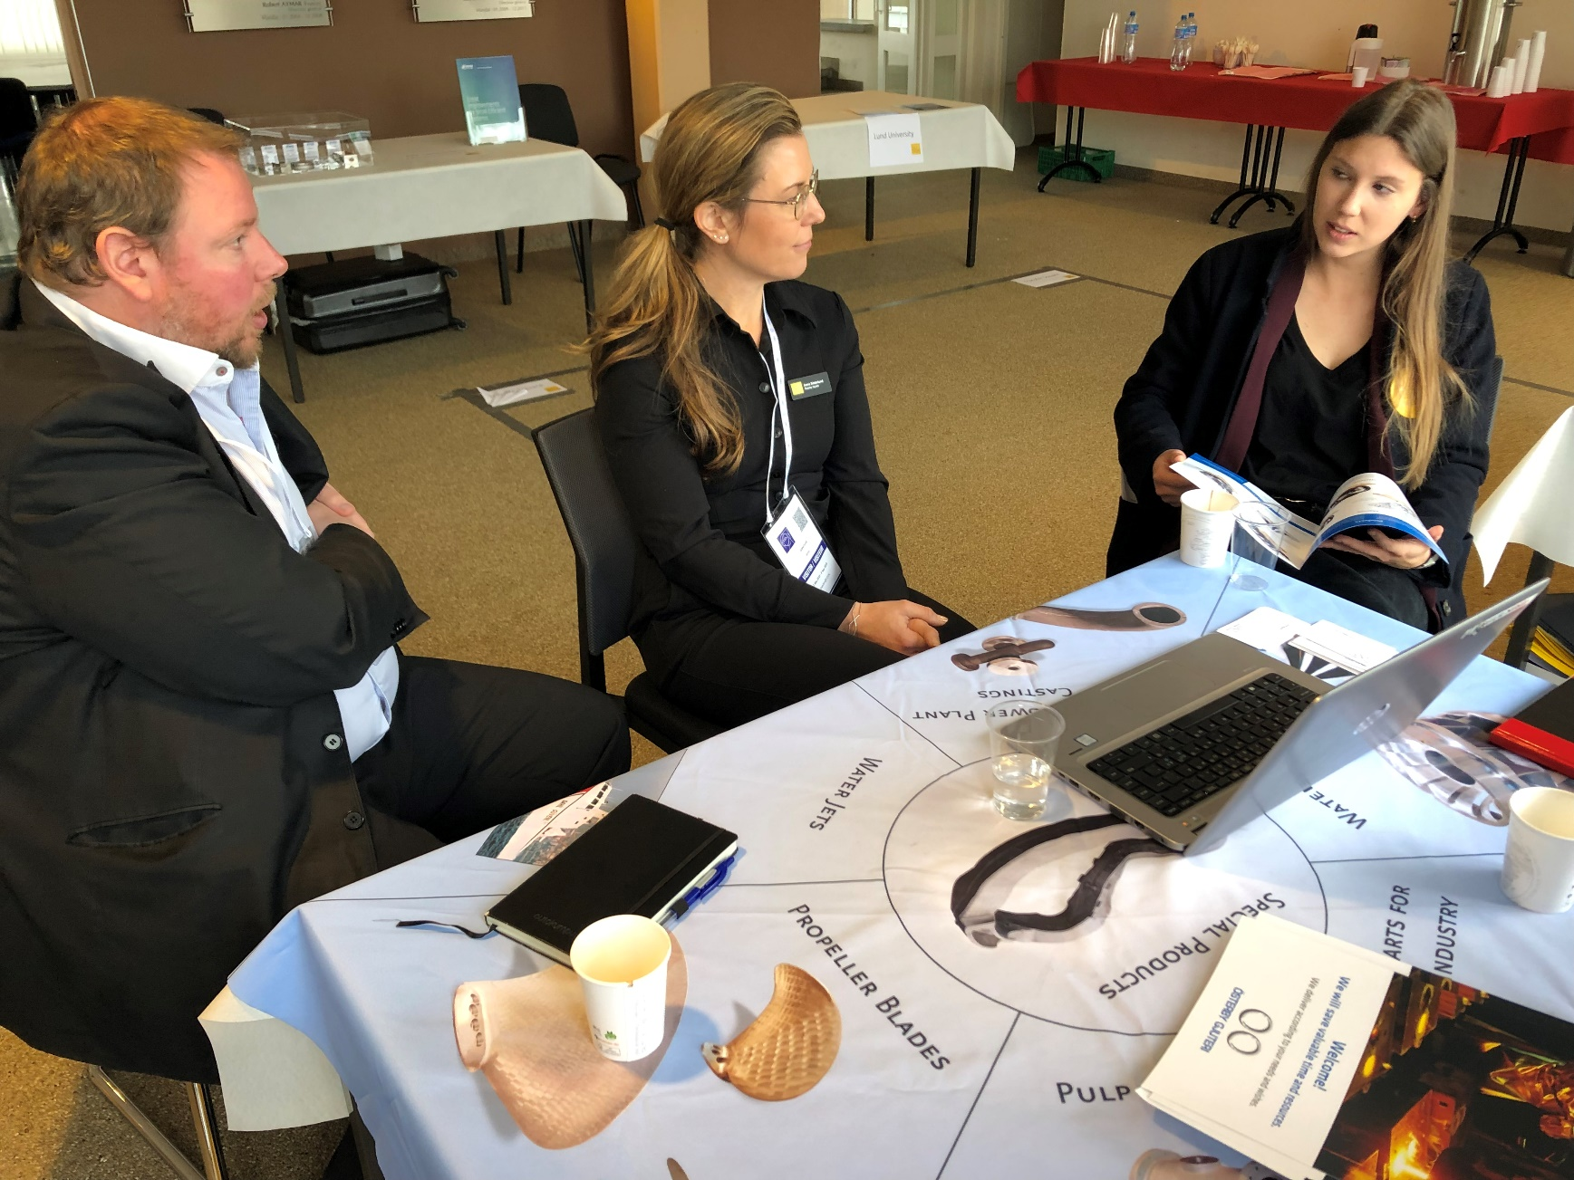
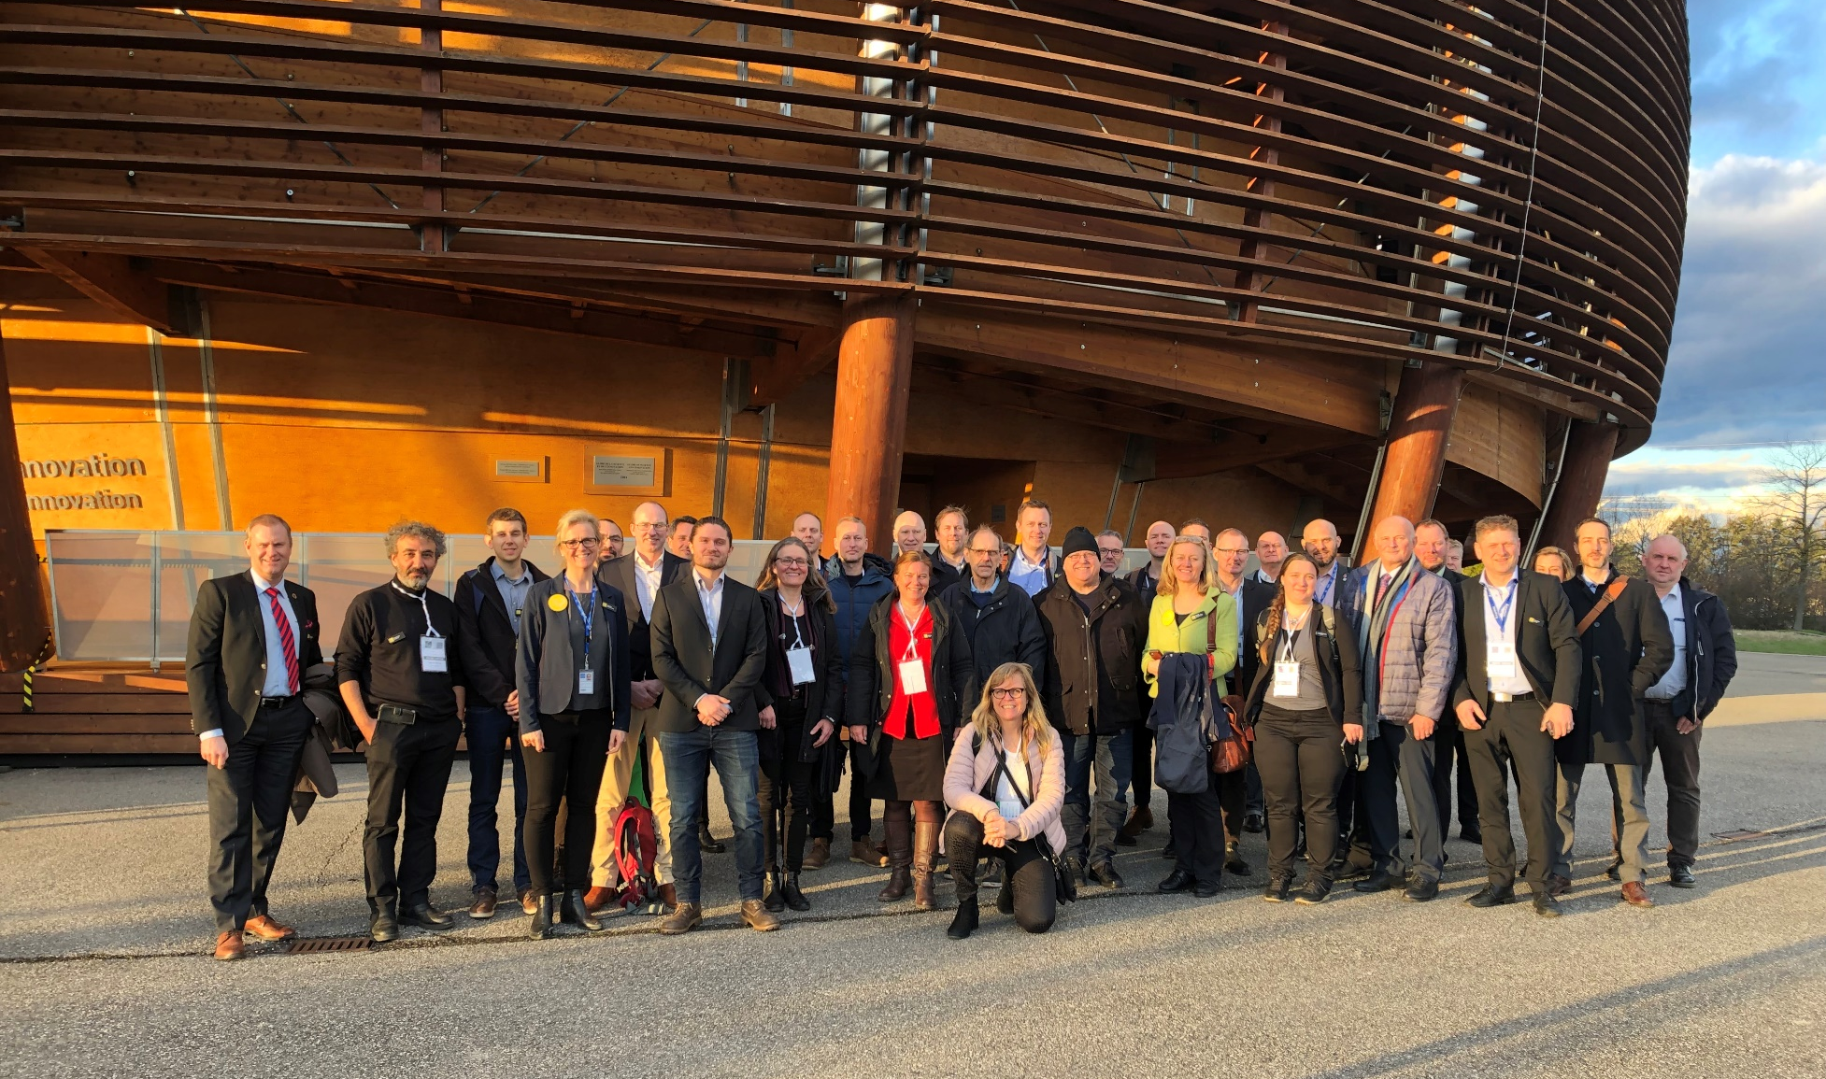
Big Science Facility visits Ex. CERN 7-8 Mars
Notes:
7-8 Mars åker vi med företag till CERN och träffar teknisk personal och upphandlare

Slide 17
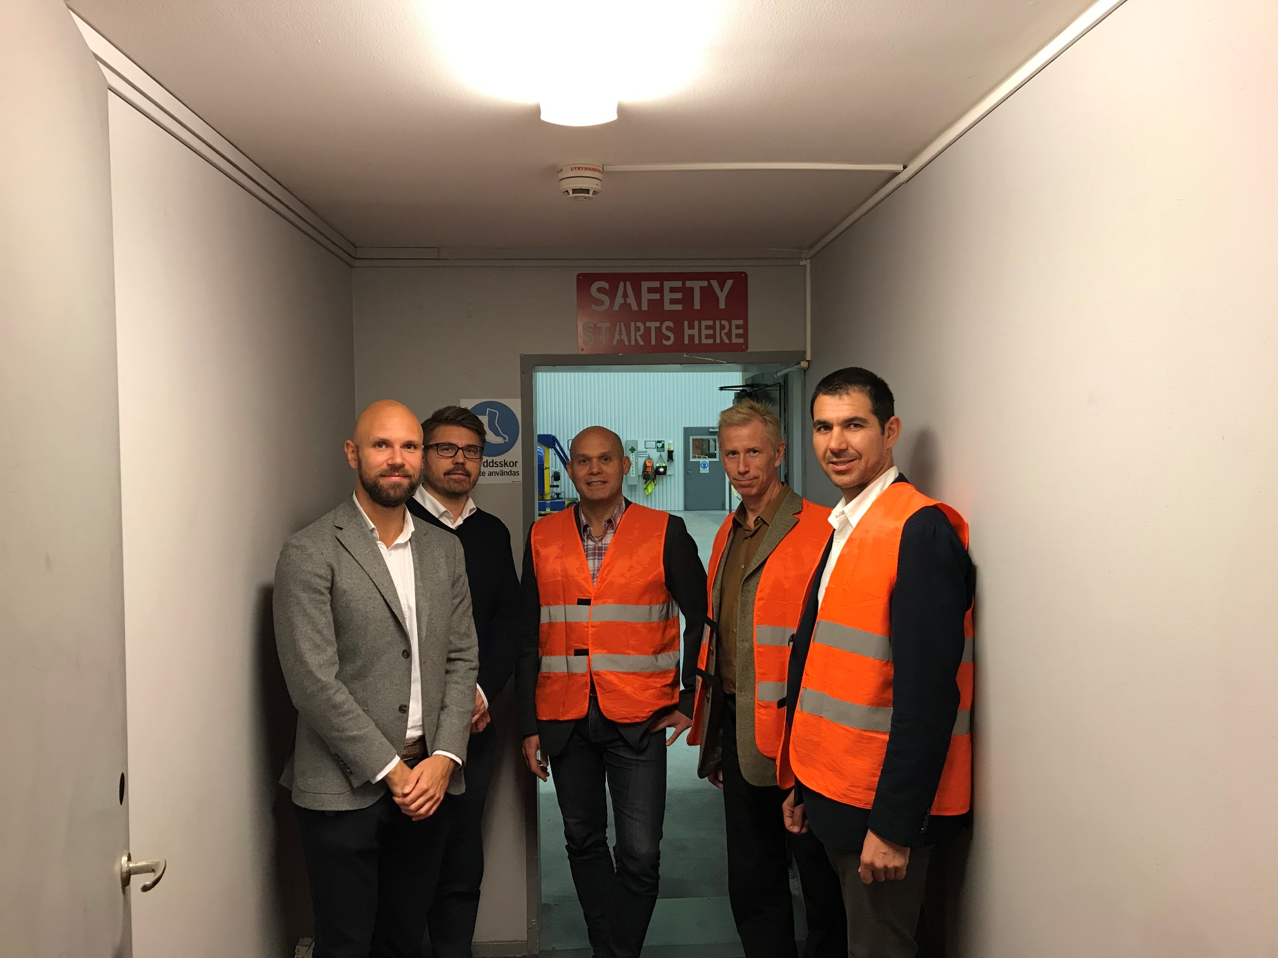
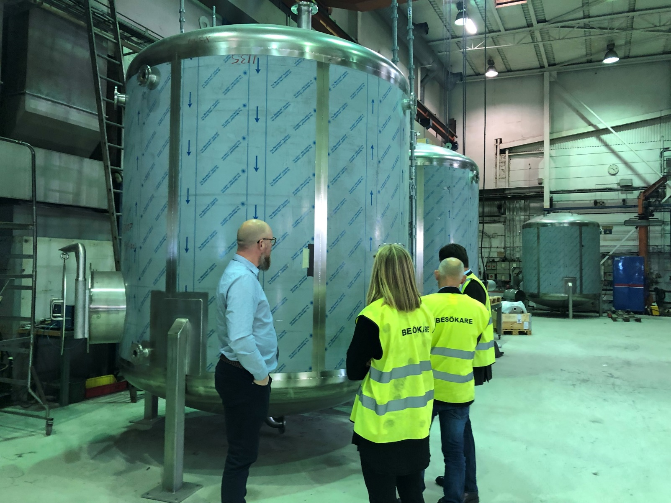
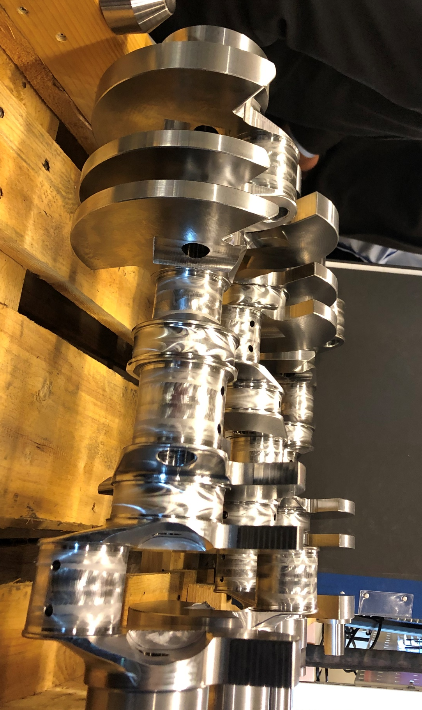
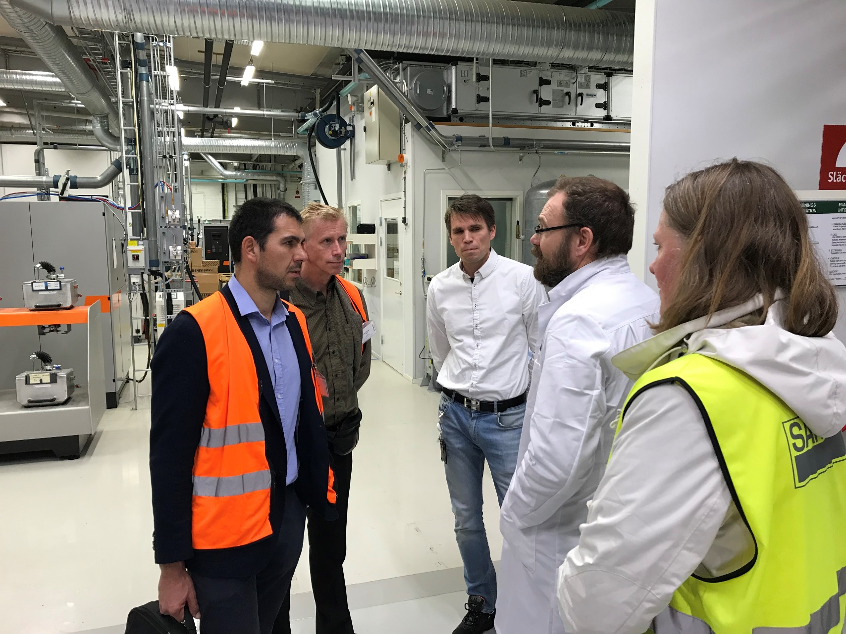
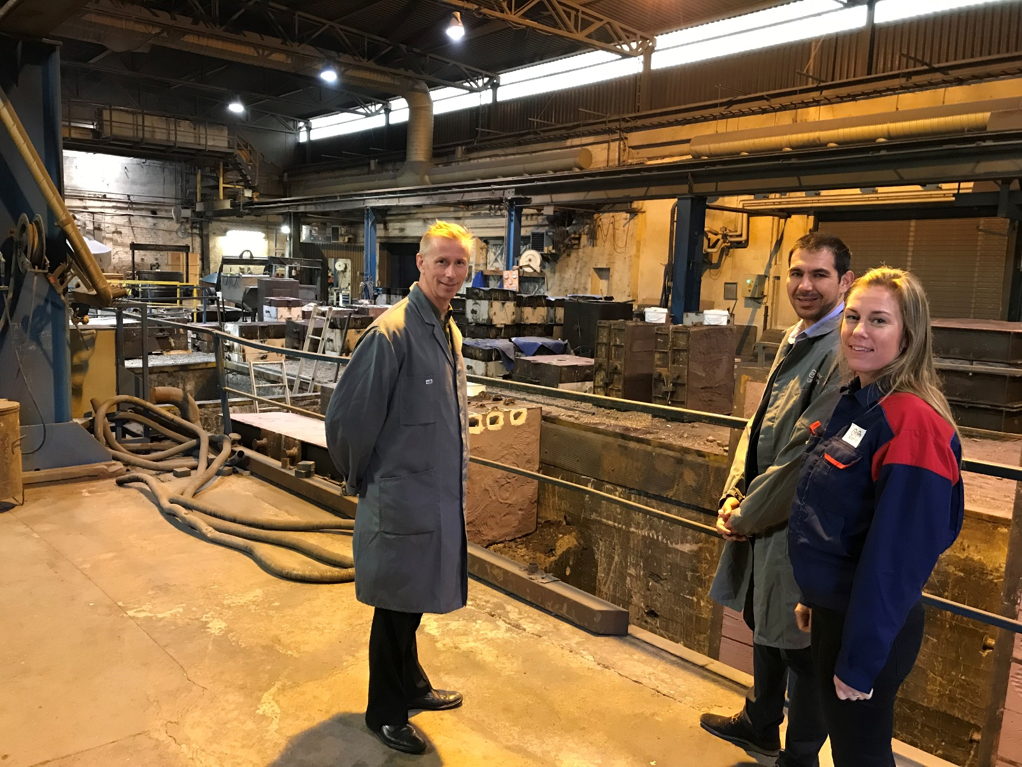
CERN On The Road
Notes:
November 2018

Slide 18
Technical workshops with industry, university och big science facilities

Slide 19
Bläddringsexemplar på https://www.bigsciencesweden.se/

Slide 20
CERN – Supplyer experience
38% developed new products
42% increased international visibility
44% incresased technical competence
52% developed selling competence
17% opened a new market
60% got new customers
All companies experienced
CERN as an extremely good reference on the market

Slide 21
Big Science by SWEDEN
26-27 November
Lund

Slide 22
Thank you!!!
www.bigsciencesweden.se
Fredrik Engelmark,
fredrik.engelmark@bigsciencesweden.se
+46-72 9999 268

