Slide 1
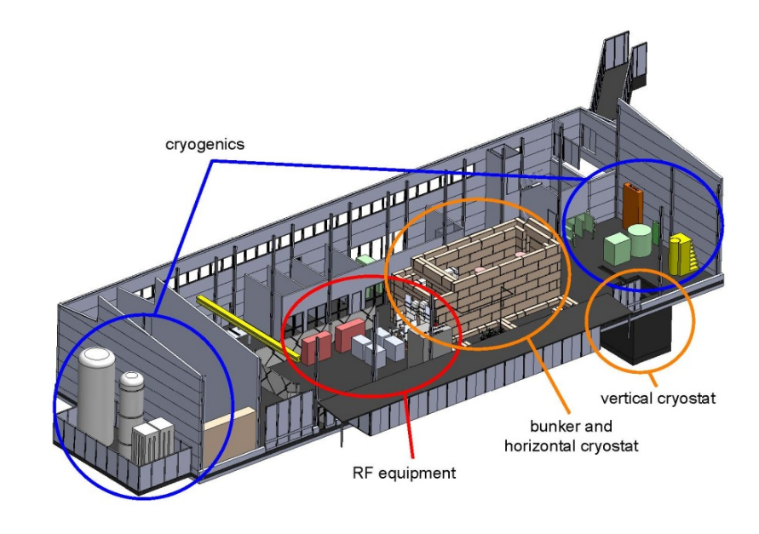
FREIA Laboratory
Presentation of the FREIA Laboratory at the Cryo and RF Workshop at Ångström Lboratory room 80101 8 May 2019

Slide 2
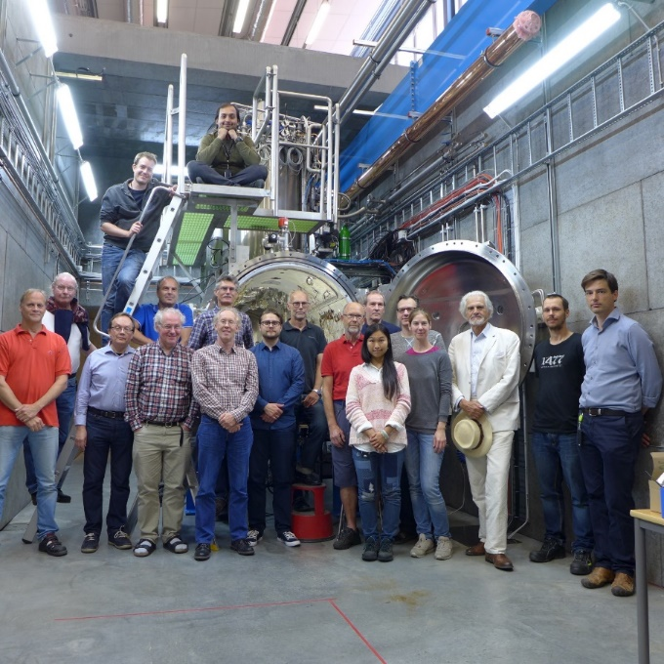
Personnel
Eight senior staff have been recruited from the former National Uppsala Accelerator Laboratory TSL.
New recruitments of mostly younger members of the personnel have been made through wide international announcements.

Slide 3
Infrastructure
Major high-tech infrastructure for accelerator and instrumentation development and tests.
The nearby Ångström Mechnical Workshop with its highly qualified workshop personnel and large set-up of modern numerical workshop machines is a significant asset for FREIA.
The FREIA laboratory will have to continuously develop and complement its infrastructure when collaborations on new projects will be added to the current activities.
Funding will be needed in future not only to cover the operational costs but also for investments in new infrastructure.
2017-09-15
VR visit to FREIA 2017-09-15 Tord Ekelöf
3

Slide 4
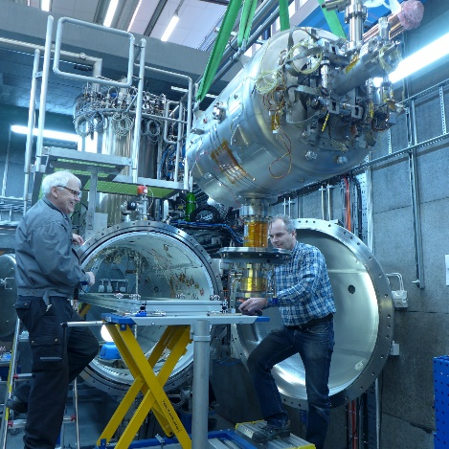
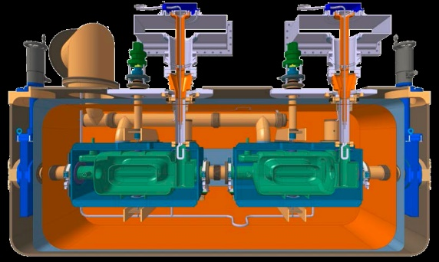
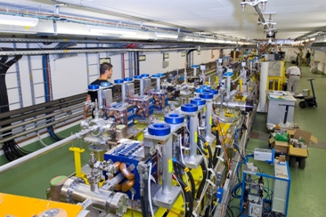
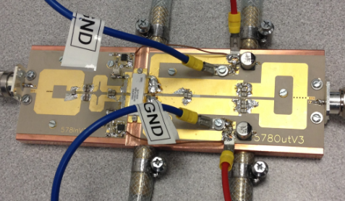
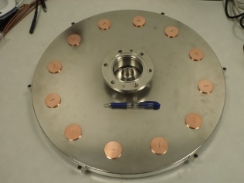
Research profiles
Ongoing or starting projects
Study of accelerating gradient
limiting discharges in CLIC
accelerating cavities at CERN
Test and development of Superconducting Accelerating Cavities and Radio Frequency High Power sources for ESS
Test and development of
superconducting Crab cavities
and magnets for the CERN
LHC Luminosity Upgrade
4
Commission the Laser Heater for X-FEL
Solid State Radio Frequency High Power Generation for accelerators

Slide 5
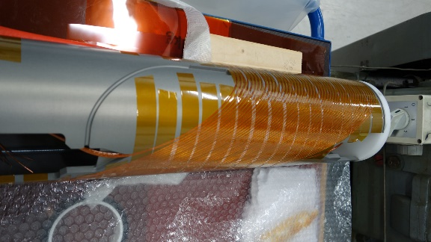
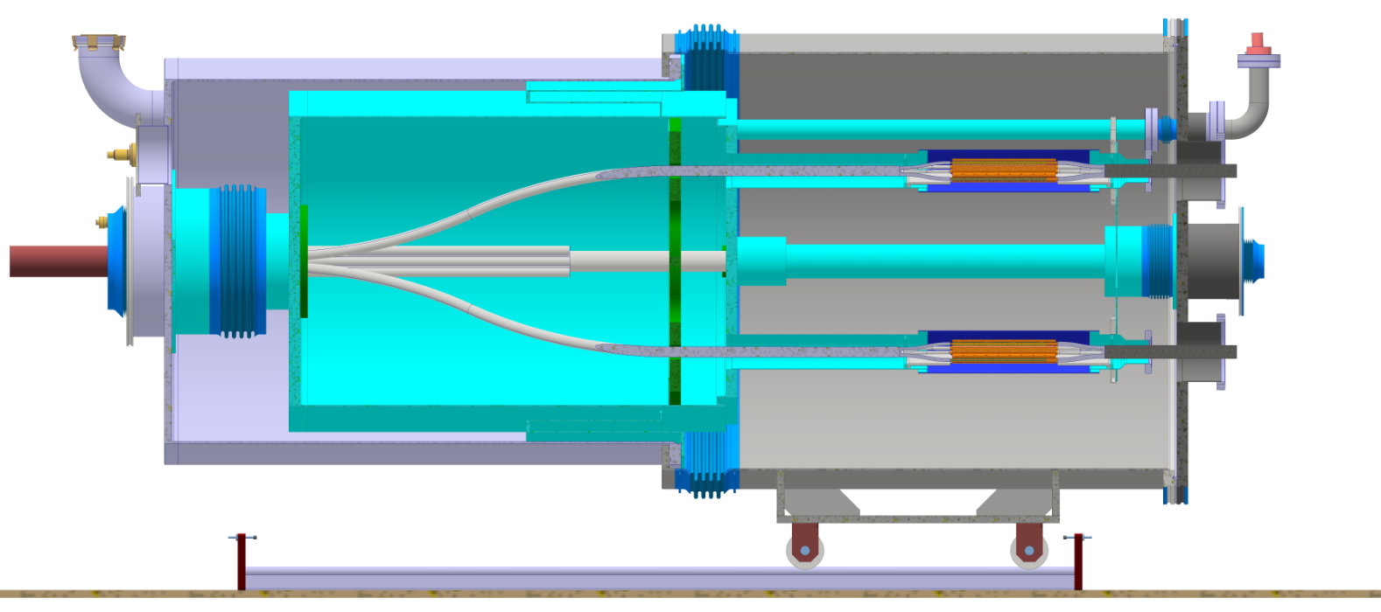
Research profiles
More starting projects
‘Cold Box’ for
distribution of
100s kA through
super-conducting
cables for CERN/
HL-LHC
A new type of
Superconducting
Magnest ‘CCT’ for
CERN/ HL-LHC

Slide 6
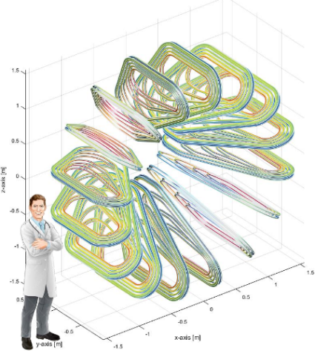
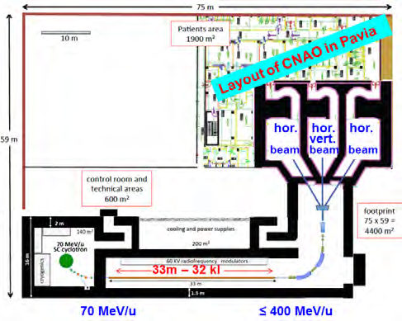
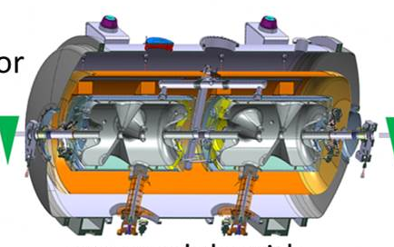
Research profiles
Some planned activities
Development of
Control system for
ESS modulators
with Swedish
industry
Doubling of the linac power
and compression of the proton
pulse for the ESS Neutrino
Super-Beam (ESSnuSB) project
Generation of
single-cycle THz
light-beams
Light ion cancer therapy
with a toroid gantry to
guide the beam to the
tumour in the patient

Slide 7
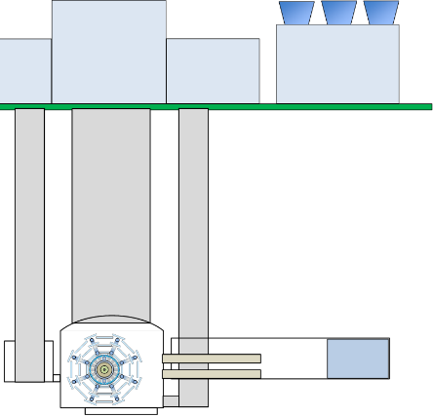
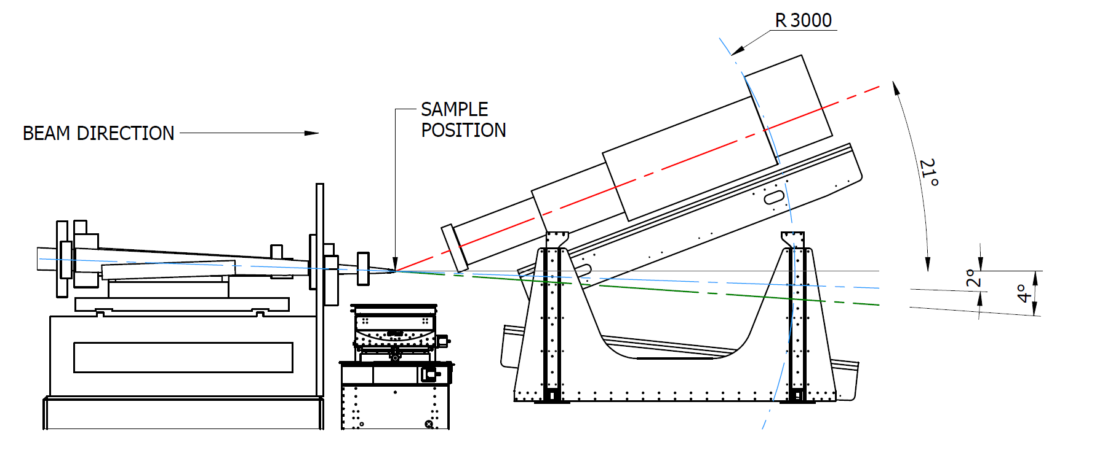
Research profiles
More planned activities
Surface buildings
Cooling towers
Superconducting
accelerating cavities
for the MYRRHA
radioactive waste
incineration
project in Belgium
A cooling system based on the use of liquid CO2 for the ATLAS experiment at LHC in CERN
Concentric transfer lines
The FREIA neutron instrument
for ESS

Slide 8
Finances
From EU-projets:
EUCARD2 40 kEUR
ARIES 337 kEUR
EuroNuNet 16 kEUR
AMICI 100 kEUR
ESSnuSB 500 kEUR

Slide 9
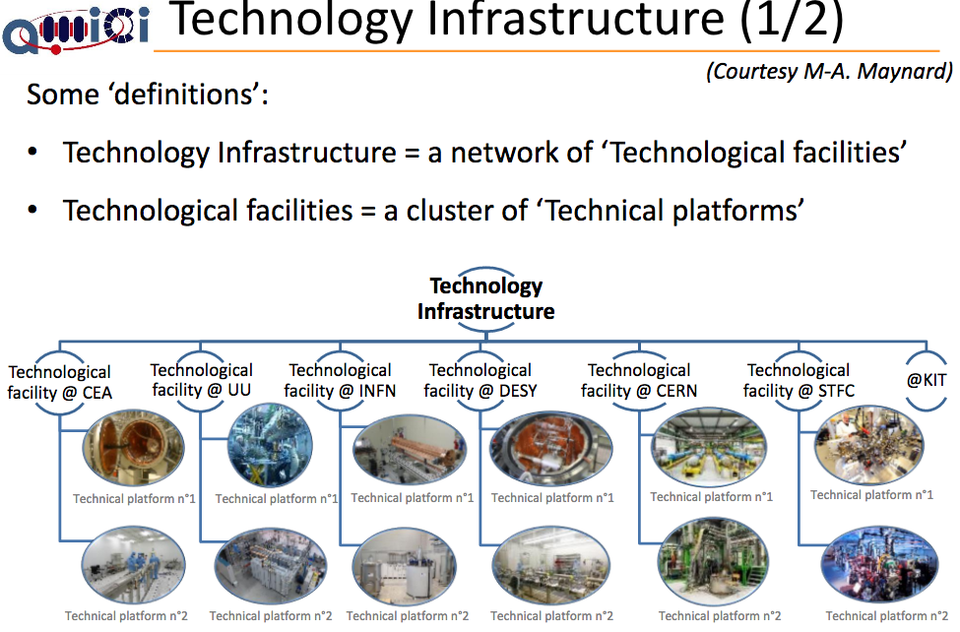
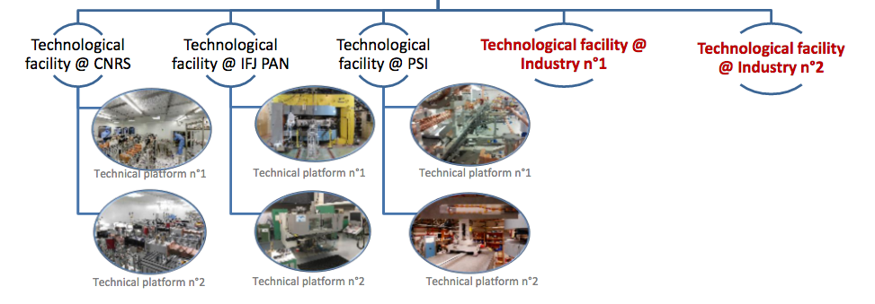
AMICI
Accelerator and Magnet Infrastructure for
Cooperation and Innovation
H2020-INFRAINNOV-2016-1
EU contribution:
EUR 2 279 750
http://cordis.europa.eu/project/rcn/207191_en.html
Most of these European Technological Facilities are former national accelerator centers, like TSL was at UU. In Europe no new large Research Infrastructures like ESS, CLIC, ILC or FCC could be constructed without the massive support of these Technological Facilities. The prime example of this is the build-up of ESS, where till now all technological developments and tests are being made at the above European Technology Facilities
and not on the ESS site.
2017-09-15
VR visit to FREIA 2017-09-15 Tord Ekelöf
9

Slide 10
FREIAs current financing plan
Costs 2019 | Mkr | Income 2019 | Mkr | Income 2020 | Mkr | Income 2021 | Mkr
Personnel | 18.4 | ESS | 22.3 | ESS | 20.0 | Project grants | 11.0
Rent of locals | 5.8 | Current grants | 7.7 | Current grants | 7.7 | Current grants | 8.0
Operations | 4.5 | One-off grant | 8.0 | One-off grant | 10.3 | Governmental grant | 19.0
Overhead | 5.7
Depreciation | 3.6
Sum | 38.0 | Sum | 38.0 | Sum | 38.0 | Sum | 38.0

Slide 11
Concluding remark
FREIA is playing a unique role in Sweden by developing, testing and producing in collaboration with high-tech industry new technology for the large international research infrastructures, thereby contributing to the advancement of frontline Big Science research and to new innovations in Swedish industry.

