Slide 1
FREIA Laboratory
Facility for Research Instrumentation and Accelerator Development
The FREIA Test Stand
and the
Burst Disc Rupture on 9 April
Han Li and Roger Ruber
for the FREIA Team
Burst Disc Review
21 May 2019

Slide 2
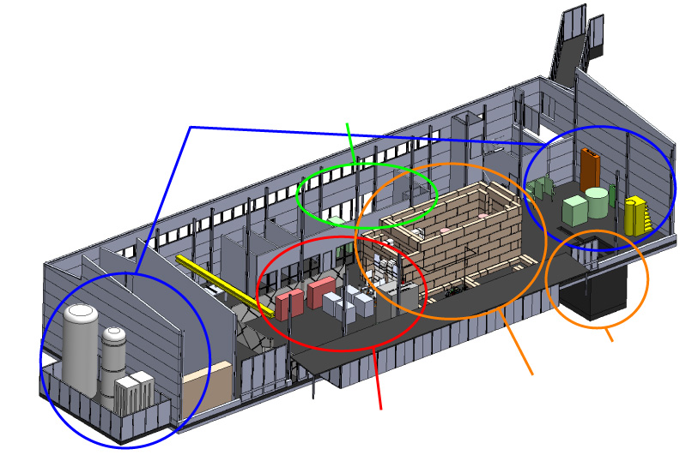
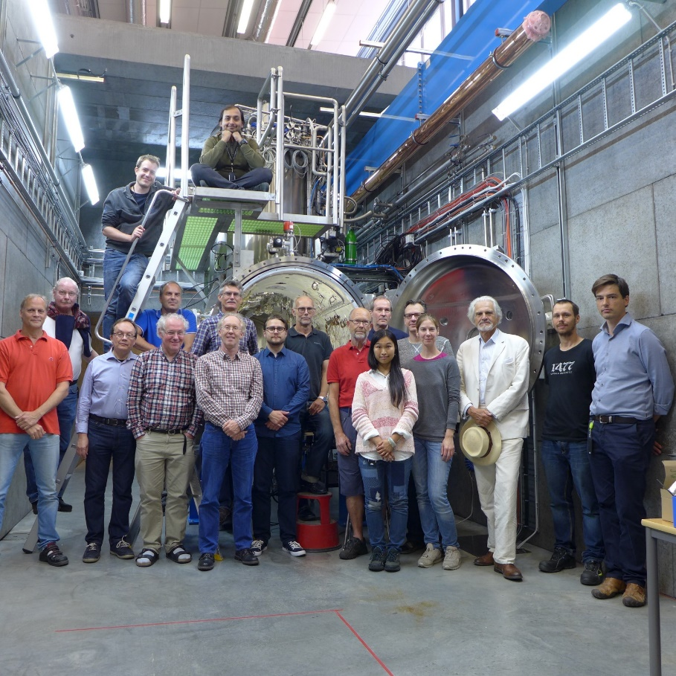
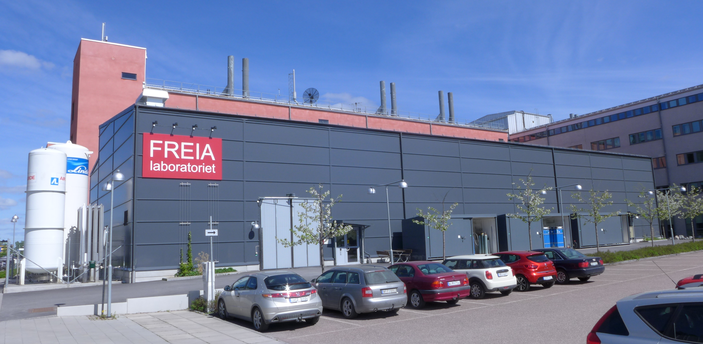
FREIA Laboratory
Facility for Research Instrumentation and Accelerator Development
Competent and motivated staff
collaboration of physics (IFA)
and engineering (Teknikum).
State-of-the-art Equipment
cryogenics
- liquid helium
- liquid nitrogen
control room
- equipment controls
- data acquisition
vertical cryostat
3 bunkers
with test stands
horizontal cryostat
radio-frequency (RF) power sources

Slide 3
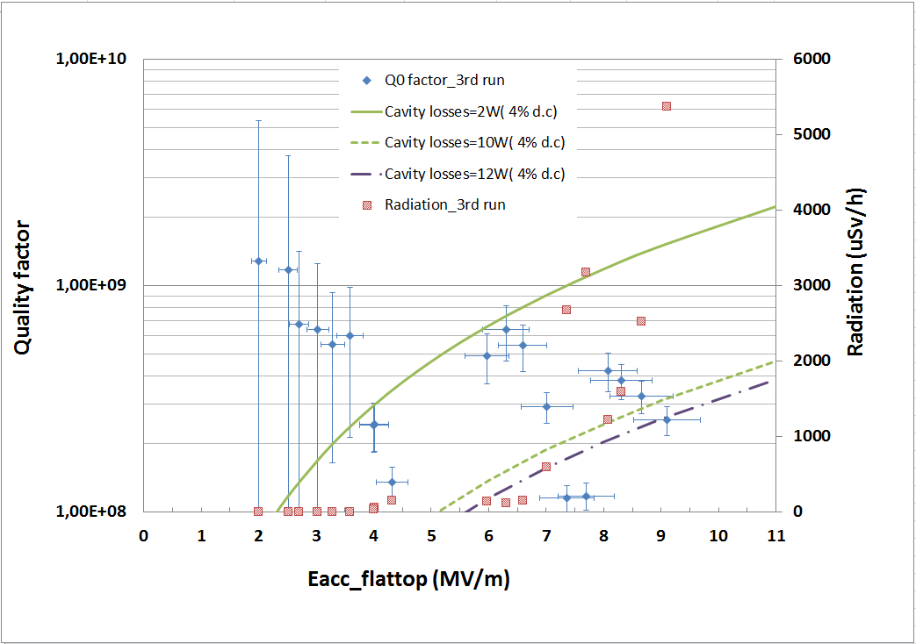
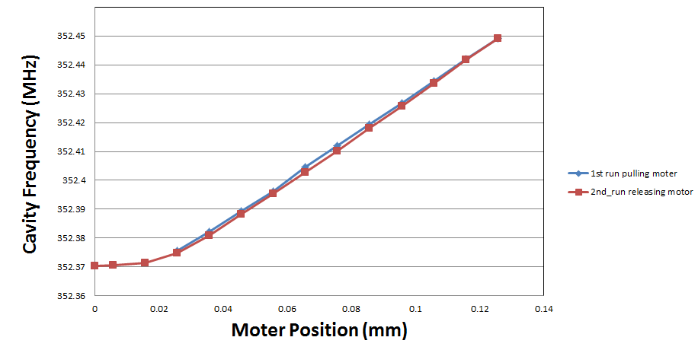
Double Spoke Cavity Package (2017)
Test from March – May 2017
Warm
  RF conditioning with IPNO then FREIA system
    about 30h; multipacting in 20-60 kW region
    max 120 kW forward power (limit set by IPNO)
Cold
  RF conditioning with FREIA system
    about 30h; 3 major multipacting regions
  RF testing
    Q₀ = 2.6 x10⁸ at 9 MV/m (w/ heat load correction)
    Lorenz force detuning ~400 Hz at 9 MV/m
    cavity tuning sensitivity = 150 kHz/mm@2K
    pressure sensitivity = +27.1 Hz/mbar
Final status/results
  results presented at SLHiPP-7 (9 June 2017)
  full report published: urn:nbn:se:uu:diva-335434

Slide 4
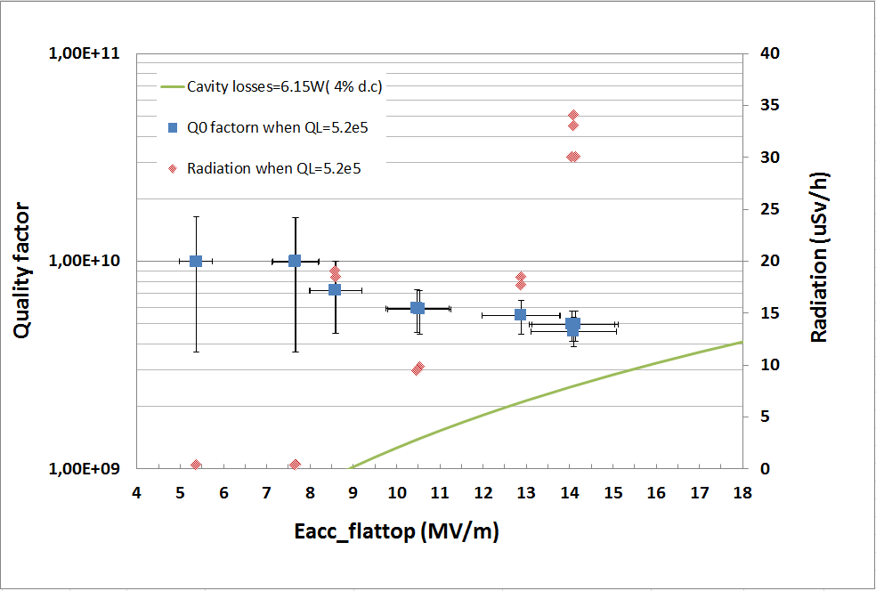
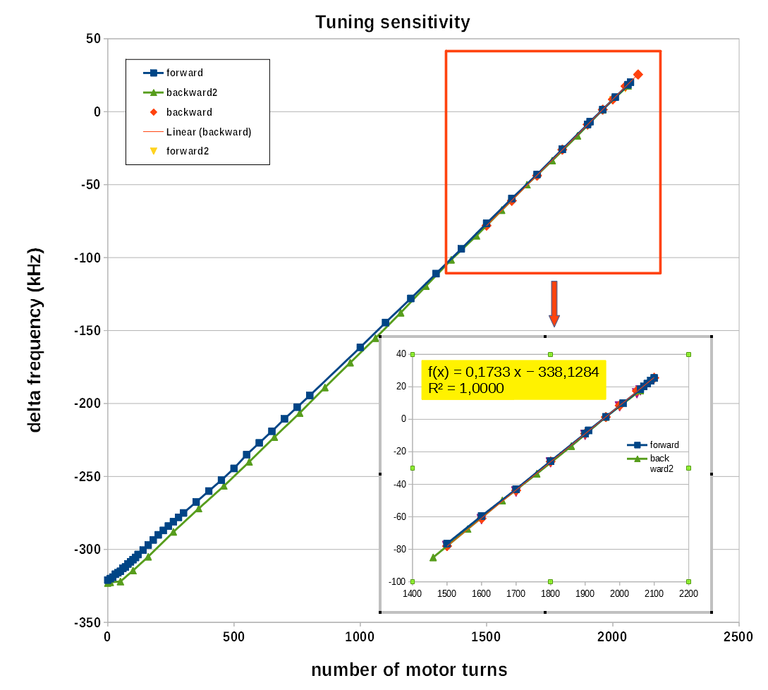
High-β Elliptical Cavity Package (2018)
1st run in June 2018
Warm-up and open to fix tuner problem
2nd run in August 2018
  cooldown, then RF re-conditioning at cold
  measurement
    Q₀ preliminary result >10⁹
      not much multipacting, cavity and coupler very quiet during last tests
    Lorenz force detuning, cavity tuning sensitivity
      lost some motor steps during 1st movement, others ok
  test of new electronics for cold tuner system
  as being developed by our Polish colleagues
    preliminary satisfied with the results
Final status/results
  cavity back to CEA, modulator/klystron to ESS
  results presented at SLHiPP-8 (12 June 2018)
  full report published: urn:nbn:se:uu:diva-371627

Slide 5
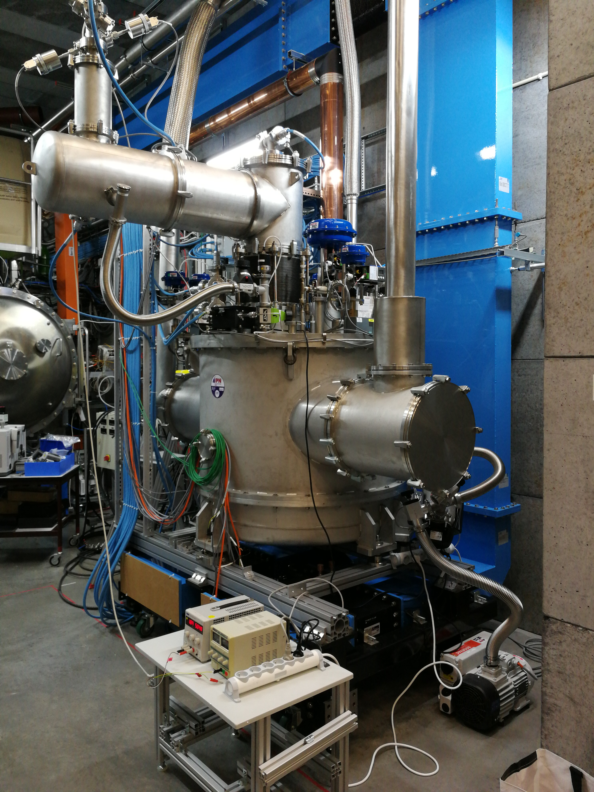
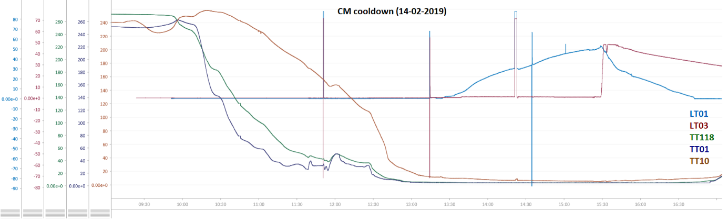
Spoke Valve Box Prototype (2019)
Cryo test run with simulator (Dec + Jan)
  commissioning controls & functionality test
Thermo-acoustic oscillations
  installed RLC-circuit to damp the oscillations
  (test with cryomodule cool down)

Slide 6
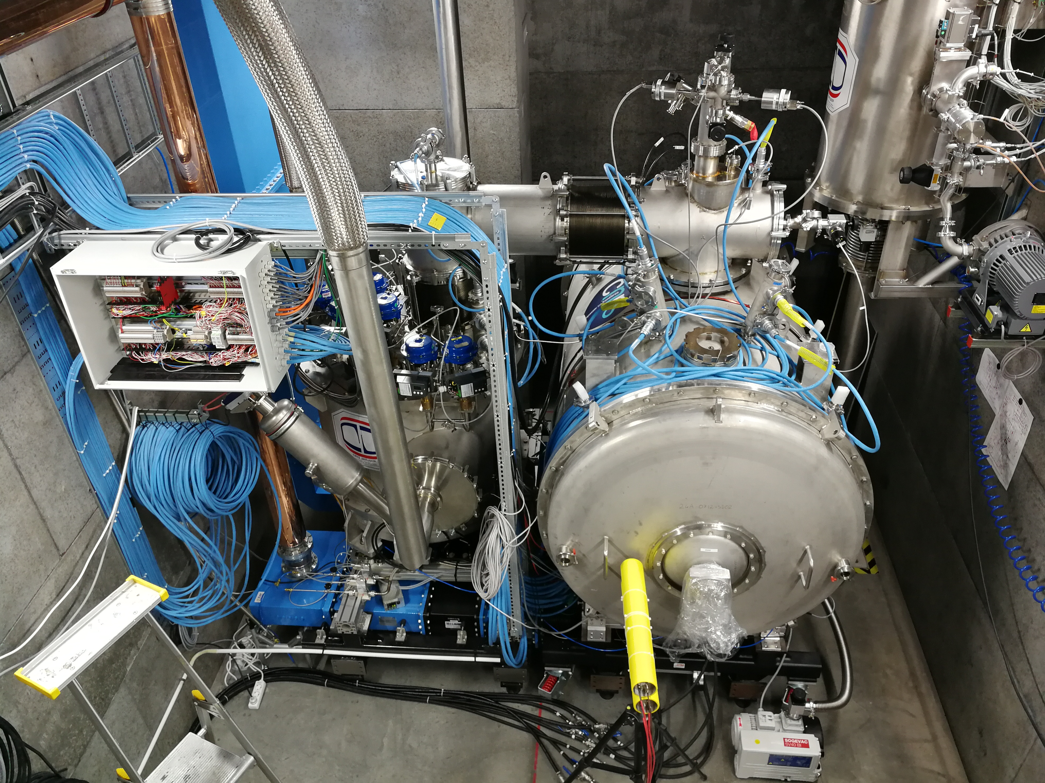
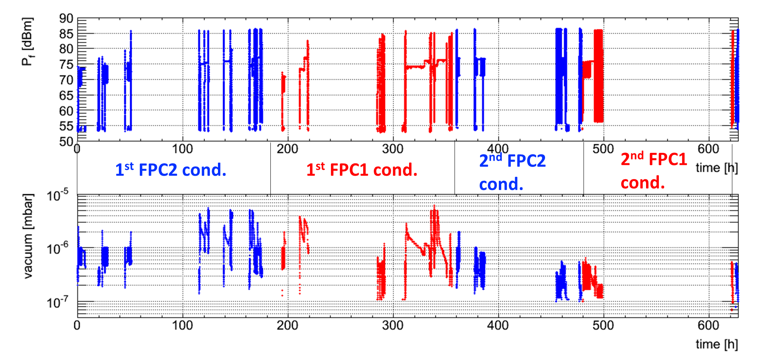
Spoke Cryomodule Prototype (2019)
Warm RF conditioning
  ~3 days/cavity
    1st conditioning ~50 hours
    2nd conditioning ~20 h (cross-contamination)
  fully automatic system conditioning system
    commissioned, now implemented to run 24h/day
  MP bands were consistent with HNOSS test
    strength depends on pulse length, 1st/2nd conditioning…
Cool Down
  4h 15min to 4.5 K
    2h 30 min for shield
Cold RF conditioning
  ~5h both couplers
    no activity
  cavity conditioning
    multipacting activity

Slide 7
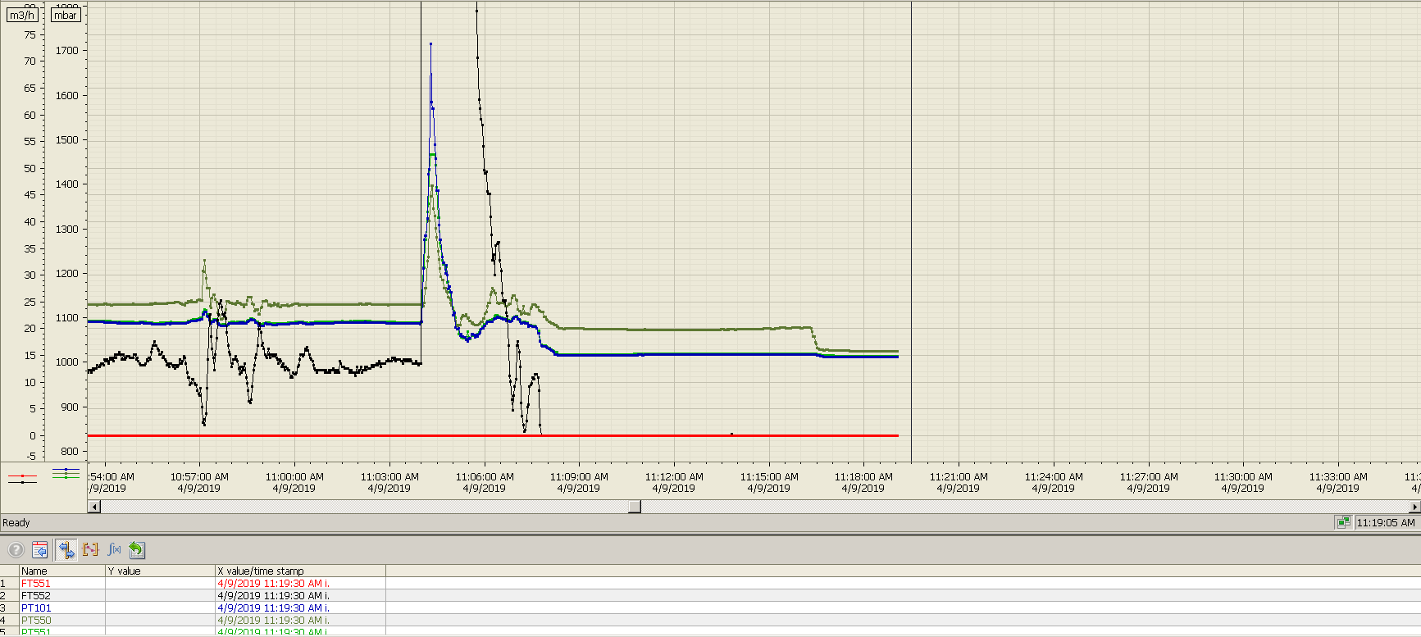
Cavity Quench on 9 April 11:04
Cavity #2 conditioning
  started around 9:30
  4 K operation
  self-excited loop (SEL)
  RF peak power up to ~24 kW
    3.2 ms pulse length
    14 Hz repetition rate
    4.5% duty factory
Cavity quench at 11:04
  RF was shortly cut after notice rupture disk opened (manual cut)
  Q_{e} of the FPC is 1.7 E5.
    consider Q0 of cavity at critical temperature is about 1E5,
    then heat load into the cavity about 1kW
  cavity temperature increase to ~6.8 K (TT215)
  radiation level increase to ~8 mSv/h
  Helium pressure had a large burst
GHe flow
GHe pressure

Slide 8
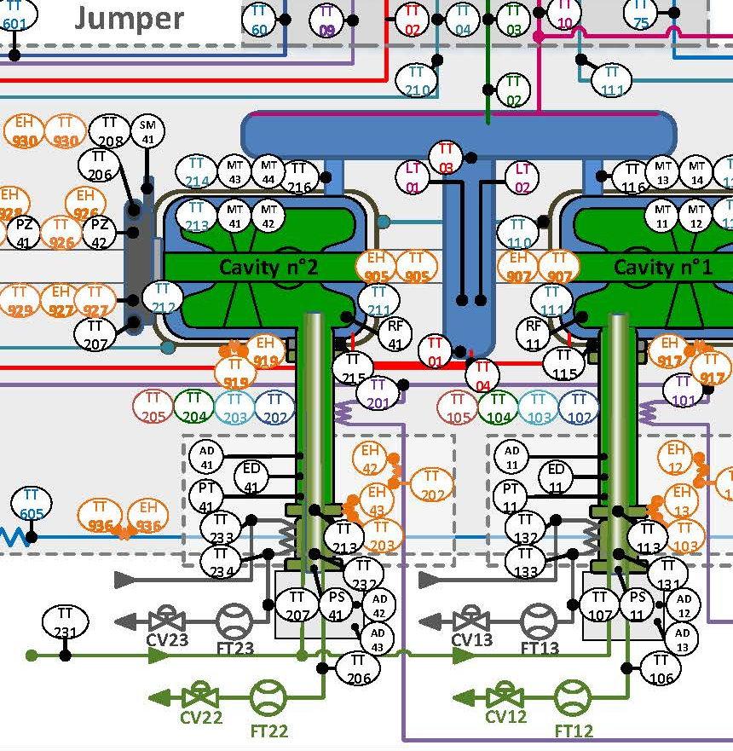
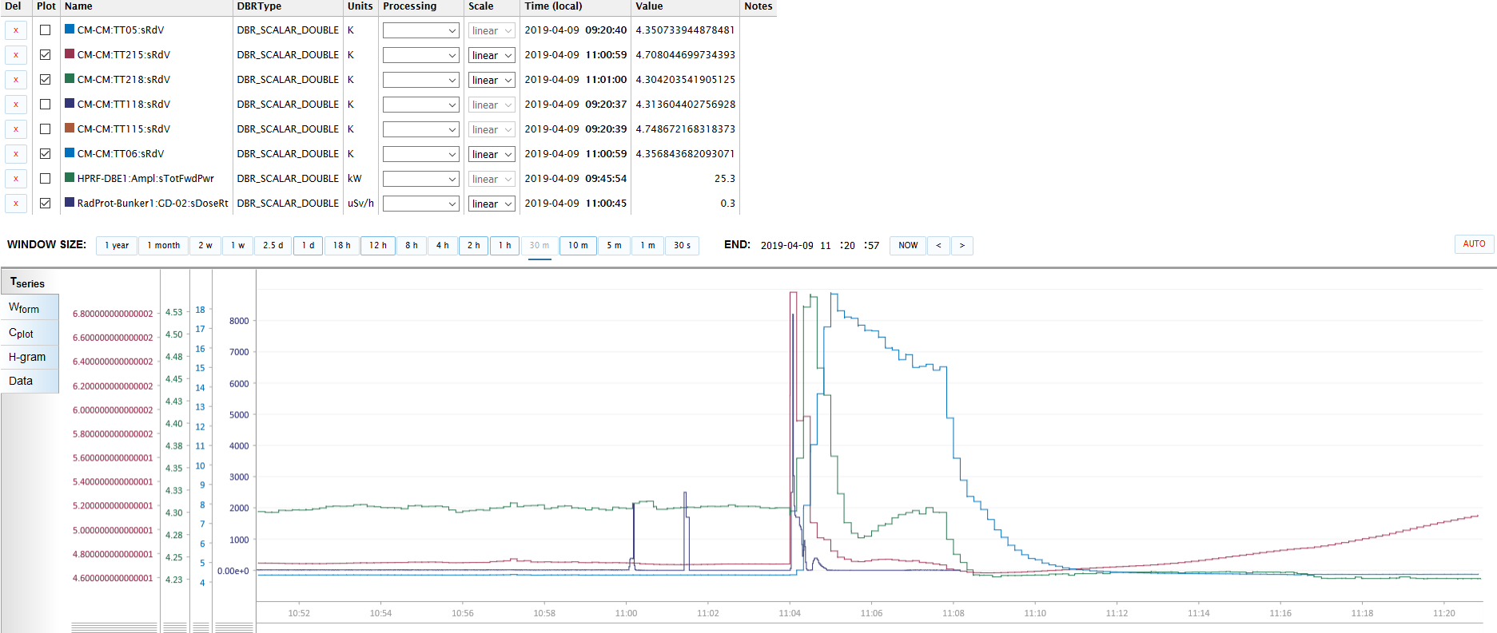
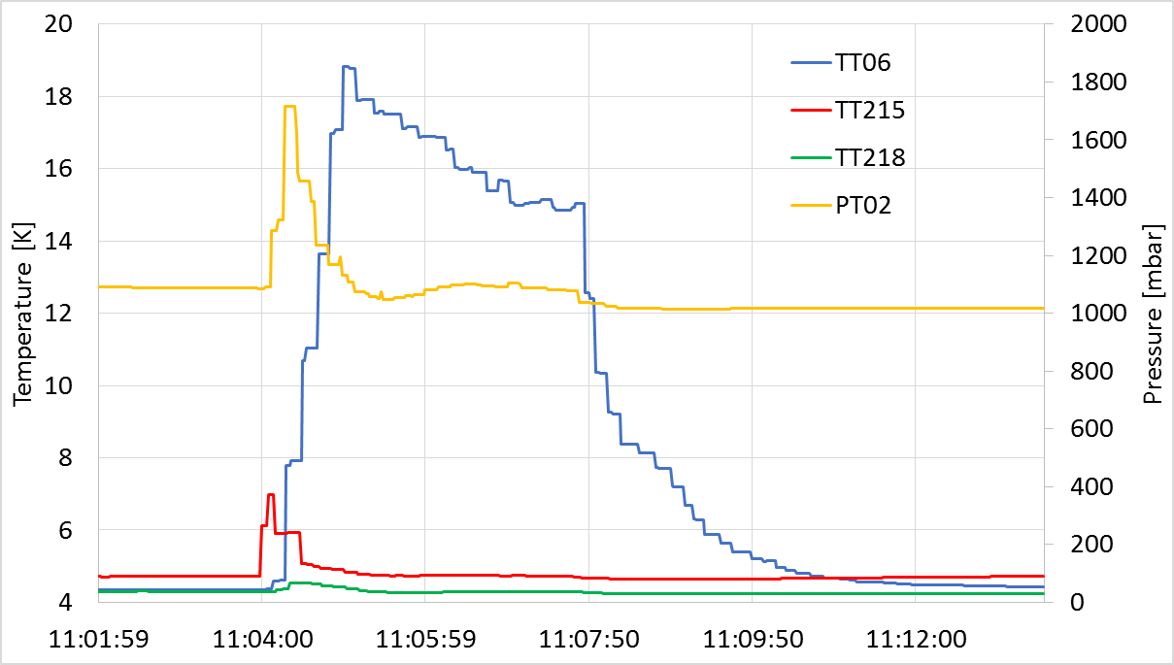
Cavity Quench on 9 April 11:04 (2/2)
Pressure increase from 1.05 bar up to 1.7 barA
  PT02 (Helium vessel) within 20 s
Temperature increase
  TT215 (interface FPC and cavity) within 10s (~7K)
  TT218 (cavity vessel) within 40s (~4.6K)
  TT06 (top of cavity) within 60s (~19K)
TT06
TT215
TT218
PT02
TT215
TT06
TT218
radiation level

Slide 9
Observed Phenomenon
Cavity was running stable more than 1 hour before the event
  TT215 shows some small peak while there was radiation in the cavity, but unfortunately, we were too focusing on the RF part and did not noticed
  TT215 (close to coupler) indicates higher temperature than TT218 (on cavity)
  RF arcing interlock triggered several times
    indication of the arc detector was located on the doorknob of cavity 1 while we were running cavity 2
    A few minutes before the quench (11:00 o'clock), all arc detectors triggered, including one arc detector not used and fiber cable is not connected
  Radiation peak observed when RF switch off/on due to interlock trigger/reset

Slide 10
RF Power Monitoring
  E_{acc_peak_Pt} < 1 MV/m
    based on the transmitted power calculation
Monitoring both forward and transmitted signal
  both of them showed low signal
  so we believed that there was low power in the loop
Actually, peak forward power of 24 kW
was send to the cavity, based on the following analysis
  output from DB station = forward power of 74 dBm,
  this power level corresponds to a E_{acc} ~ 4.5 MV/m,
    according experience of ROMEA cavity package test two years ago,
  this power level is close to the quench point at 4K test at IPNO

Slide 11
False Forward Power
Actually monitoring cavity 1 while running cavity 2
  not enough equipment required frequently cable change:
    have 2 power meters with 4 sensors.
    two transmitted signals are always being monitored
    forward and reflected signals need to be swapped from cavity to cavity
  manual settings introduces a risk of mistake
    cold FPC conditioning was done with a loop connection to cavity #1
    from FPC conditioning to SEL, a lot of connections need to be changed
    unfortunately this power monitor swapping connection was missing
    check done by several persons, but unfortunately none noticed this mistake

Slide 12
False Transmitted Power
Transmitted power connected to the right channel and showed a correct reading
E_{acc} calculation based on this power was wrong
Thorough investigation found a different definition of the decimal point in the software
  Windows OS and LabVIEW used a ‘comma’ as decimal point
    Swedish definition
  embedded function of gradient calculation used a ‘dot’ as decimal point
    US definition
The parameter input with this combination of decimal point definitions led to a wrong result,
  but coincidently showed a low result of the same order as the result calculated by the (false) forward power

Slide 13
Lessons Learned
Reset of the system only after a full investigation of the interlock
  From the data investigated during this run, it is found that a radiation peak always associated with events of cutting off/ restart the RF power.
  This quench happened when the interlock system was reset just after a ‘strange’ arc interlock.
  Therefore a more careful loop running/reset is required.
Lack of personal
  For a cavity cold test, an ideal working group should include cryo team, RF team and control team.
  Unfortunately, when the quench happened we did not have enough people on site.
  When we were mostly focusing on the RF part, we were not aware of the fast change of the cryo part in time and therefore lost the time to cut the RF as soon as possible.
  An automatic safety system is a requirement.

Slide 14
Immediate System Improvements
Introduce some cryogenic parameters into the interlock system.
  already added pressure and temperature, both in LabVIEW and LLRF
Put all important parameters in a more convenient/visible location
  in order to help the operator to keep alert of running status.
  collect all important parameters at the same interface.
  Set one emergency ‘stop’ button
Develop a quench detector system in hardware layer (FPGA or LLRF).
  loaded Q value monitoring for each pulse, cut directly FPGA output in the SEL if loaded Q drops/fluctuates out of preset tolerance,
  transmitted power level monitoring, trigger interlock when transmitted power drop down to 70%. (this function has been implemented and verified in the conditioning of cavity 2)
Improve hardware set-up
  ordered extra power meters to implement a permanent loop set up without frequently cable change preventing mistakes
See Akira's presentation for detailed information on our mitigation measures.

Slide 15
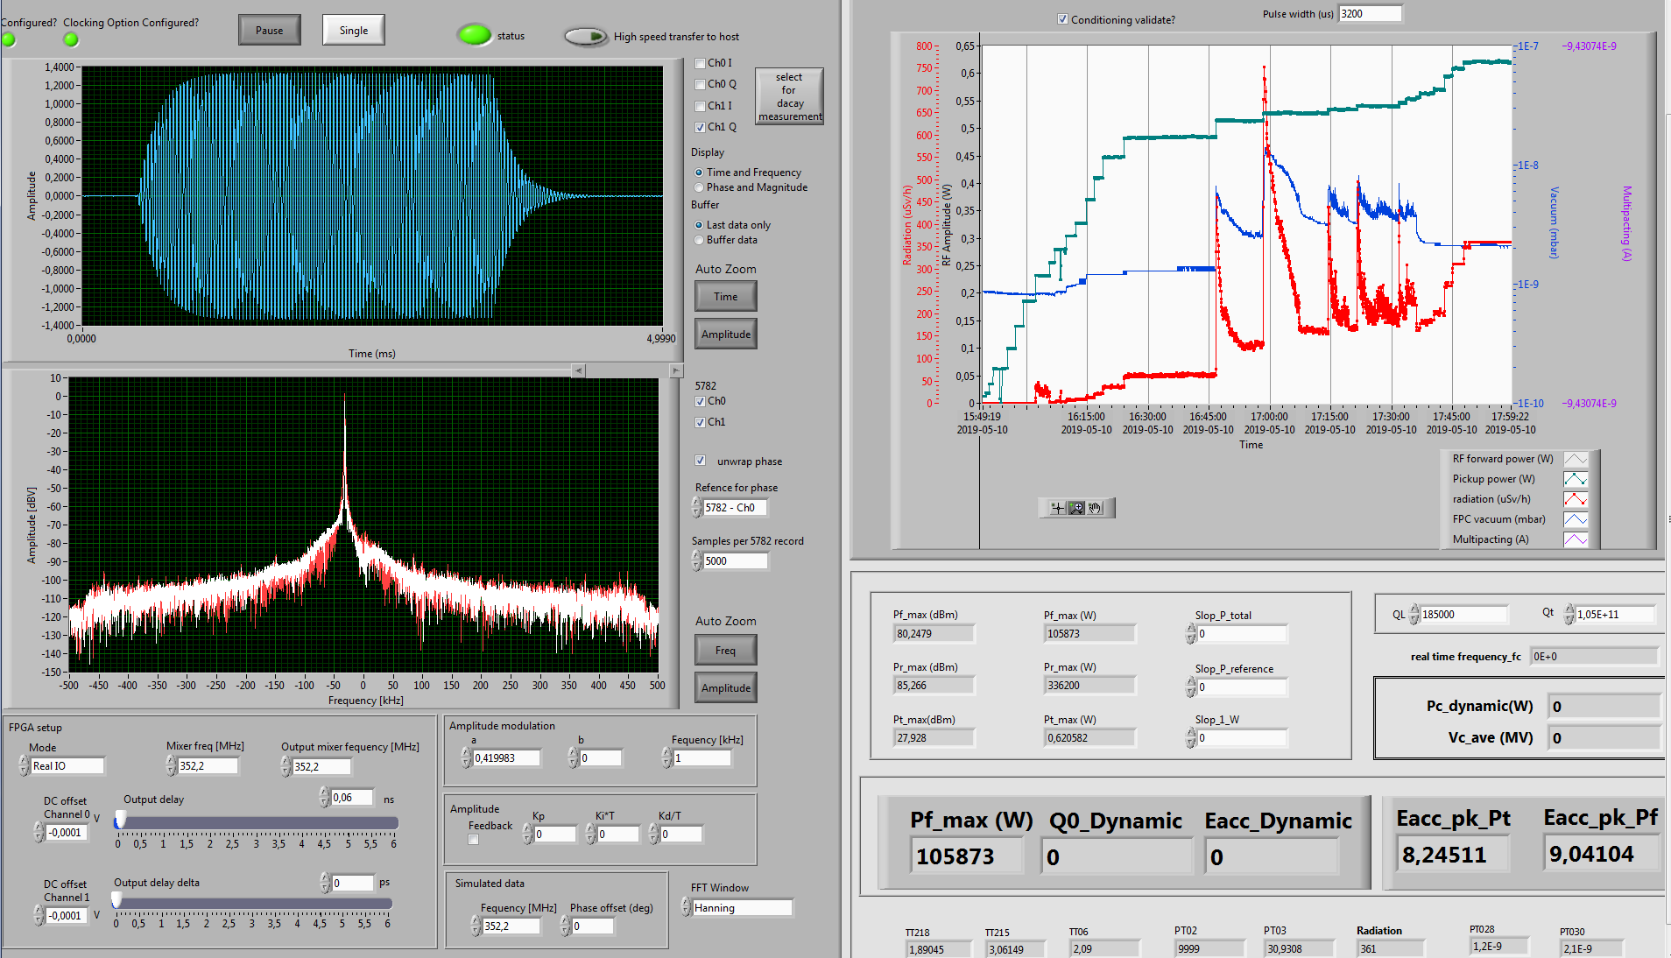
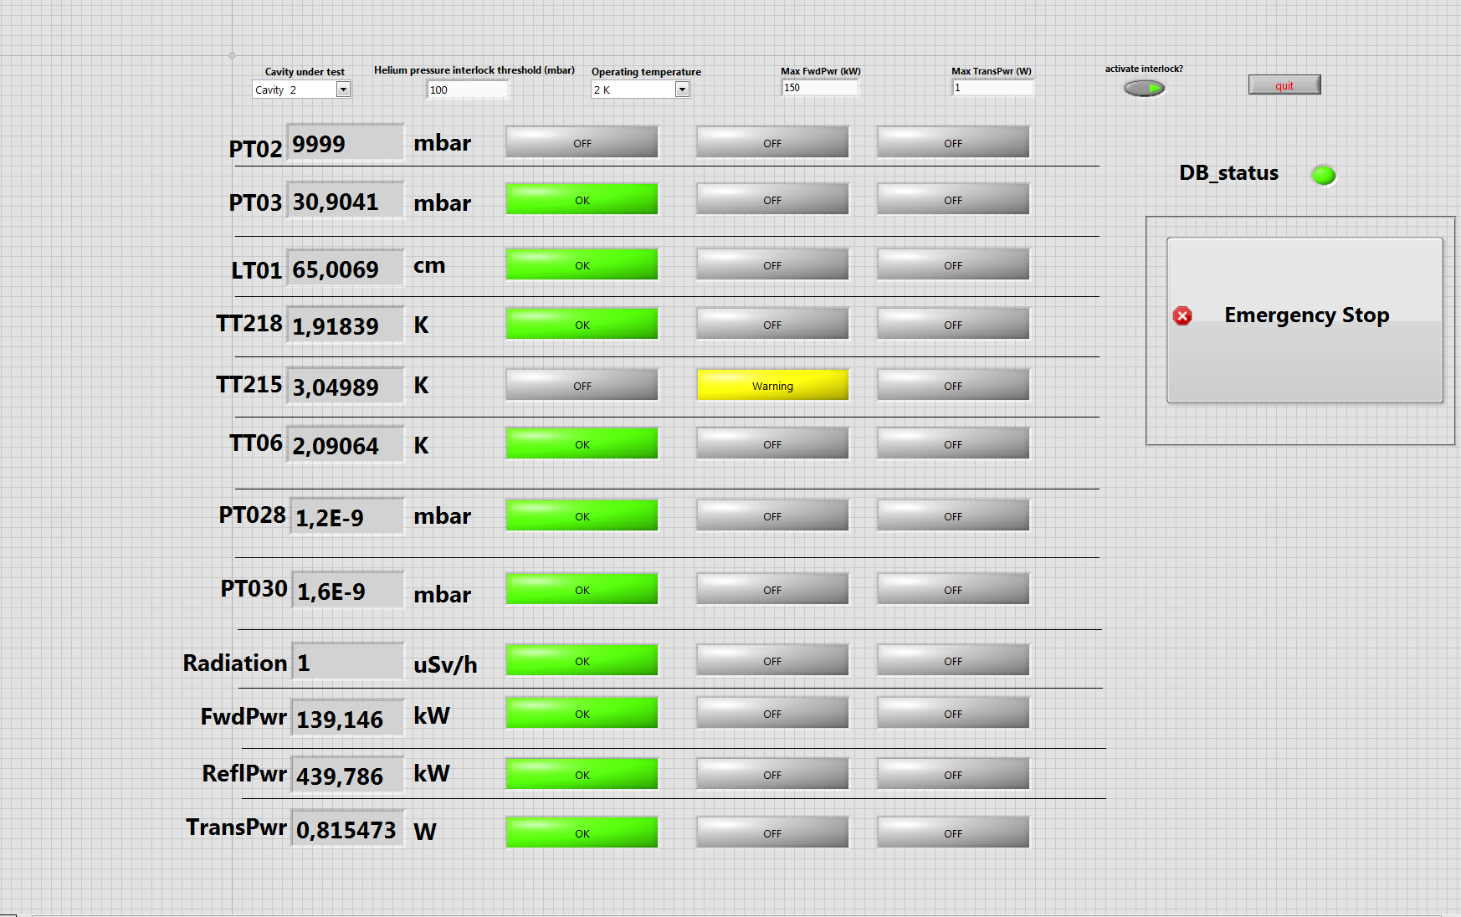
LabVIEW Control System Interface
New Summary Dispay
RF Conditioning Interface
See Akira's presentation for detailed information on the mitigation measures.

Slide 16
Summary
FREIA Test Stand up and running
We learned from the quench and improve our system and procedures
procedure validation and optimization
ongoing on prototype
strongly motivated & flexible personnel
to make it work
support from ESS and IPNO when
needed (RF/SRF/vacuum/...)
BUT:
tight in scheduled time &
available resources

