Slide 1
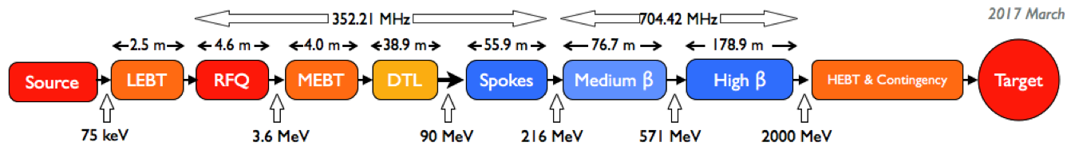
Burst Disc Experiences at CEA Test Stand
C. Mayri - Burst discs review – 21 May 2019

Slide 2
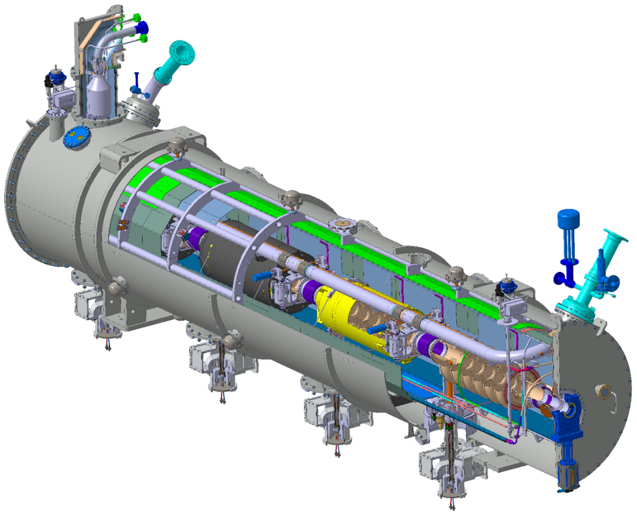
General layout of the elliptical cryomodules
C. Mayri - Burst discs review – 21 May 2019

Slide 3
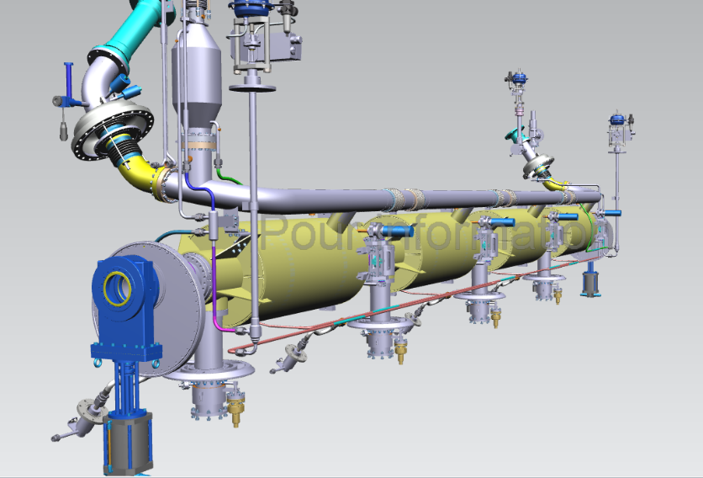
Cryo piping of the elliptical cryomodules (ESS configuration)
CV91
Controlled valve
Burst disc
SV90
Safety valve
Heat exchanger
LCV02
Cooling valve
Burst disc
LCV01
JT valve
C. Mayri - Burst discs review – 21 May 2019

Slide 4
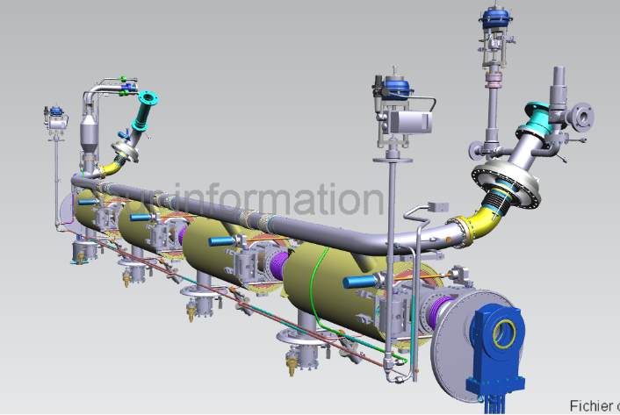
Cryo piping of the elliptical cryomodules (ESS configuration)
2 LHe level gauges
C. Mayri - Burst discs review – 21 May 2019

Slide 5
Design is done to be compliant with the article 4.3 of PED
1.04 bar
48 l
Limit of the 4.3 article
Volume of the largest circuit vessel: the cavity helium tank

Slide 6
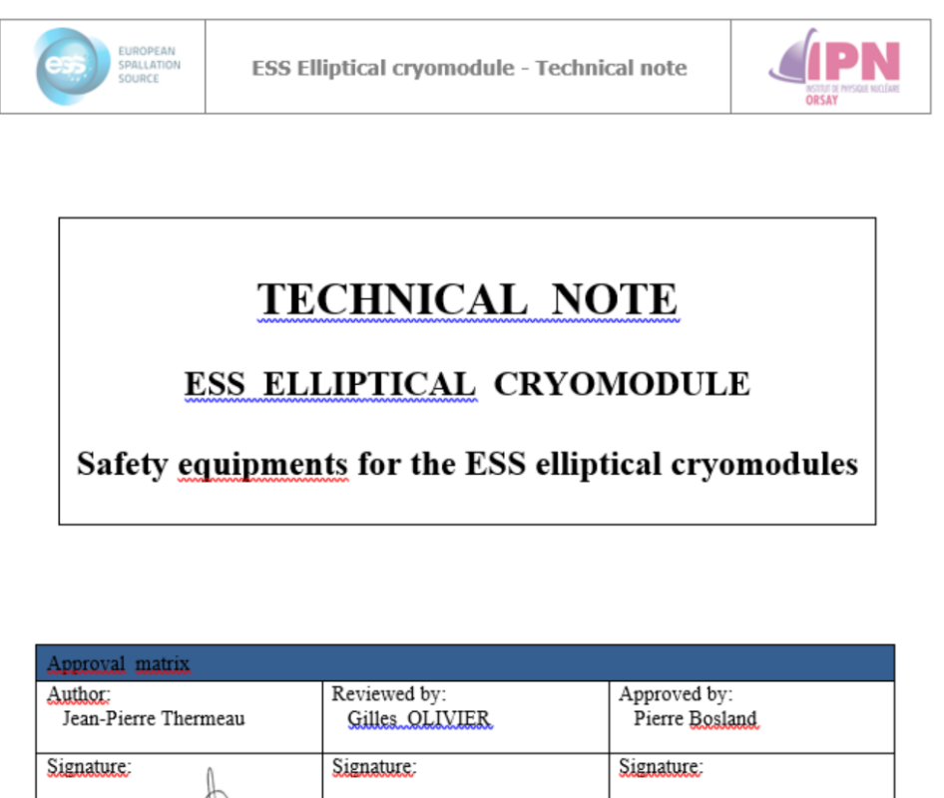
Sizing of the safety equipment
C. Mayri - Burst discs review – 21 May 2019

Slide 7
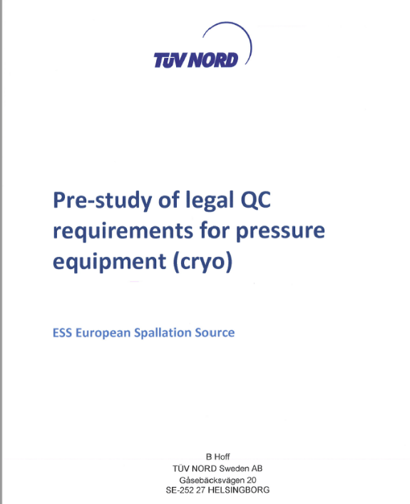
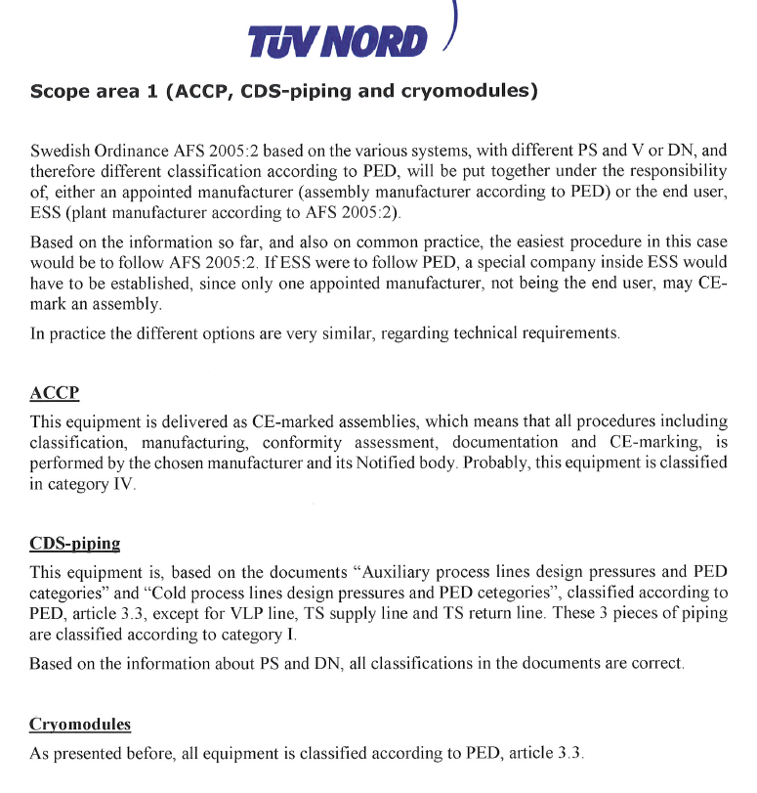
TUV classified the cryomodules according PED, article 4.3
Ps=1.04 barg
C. Mayri - Burst discs review – 21 May 2019

Slide 8
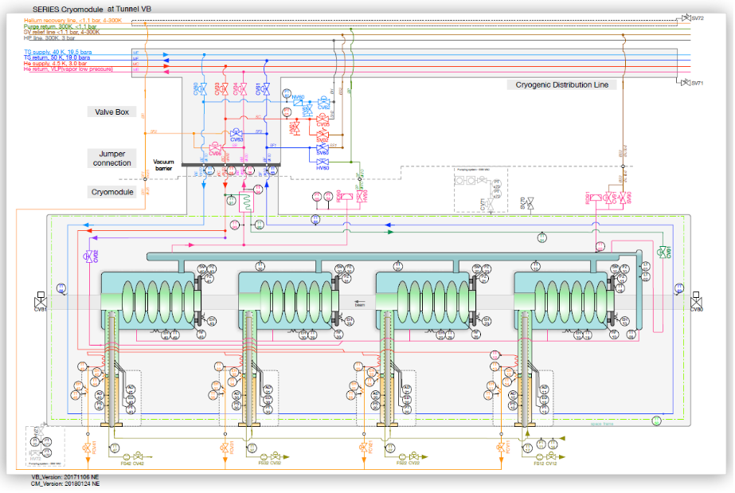
Recovery lines in ESS tuNnel and test stand
SV relief line
< 1.1 bara

Slide 9
The 2 limit conditions of SV relief line pressure in the ESS conditions
Scale of pressures of the cavities vessels, the SV relief line is at atmospheric pressure
Scale of pressures of the cavities vessels, the SV relief line is at 1.1 bara

Slide 10
CEA test stand conditions are different from ESS conditions
CEA test stand condition | ESS conditions
Diphasic LHe at 1 bar | Supercritical He at 3 bars
No controlled valve CV91 | One controlled valve CV91 at ~1.5 bara
2 safety valves SV90 (0.5 barg) | 1 safety valve SV90 (0.64 barg)
No GHe recovery lines on the SV (P = 1 bara) | GHe recovery lines on the SV (P < 1.1 bara)
2 burst discs at P = 0.99 barg | 2 burst discs at P = 0.99 barg
Thermal shield cooled with LN2 | Thermal shield at 40 K with GHe 19 bars

Slide 11
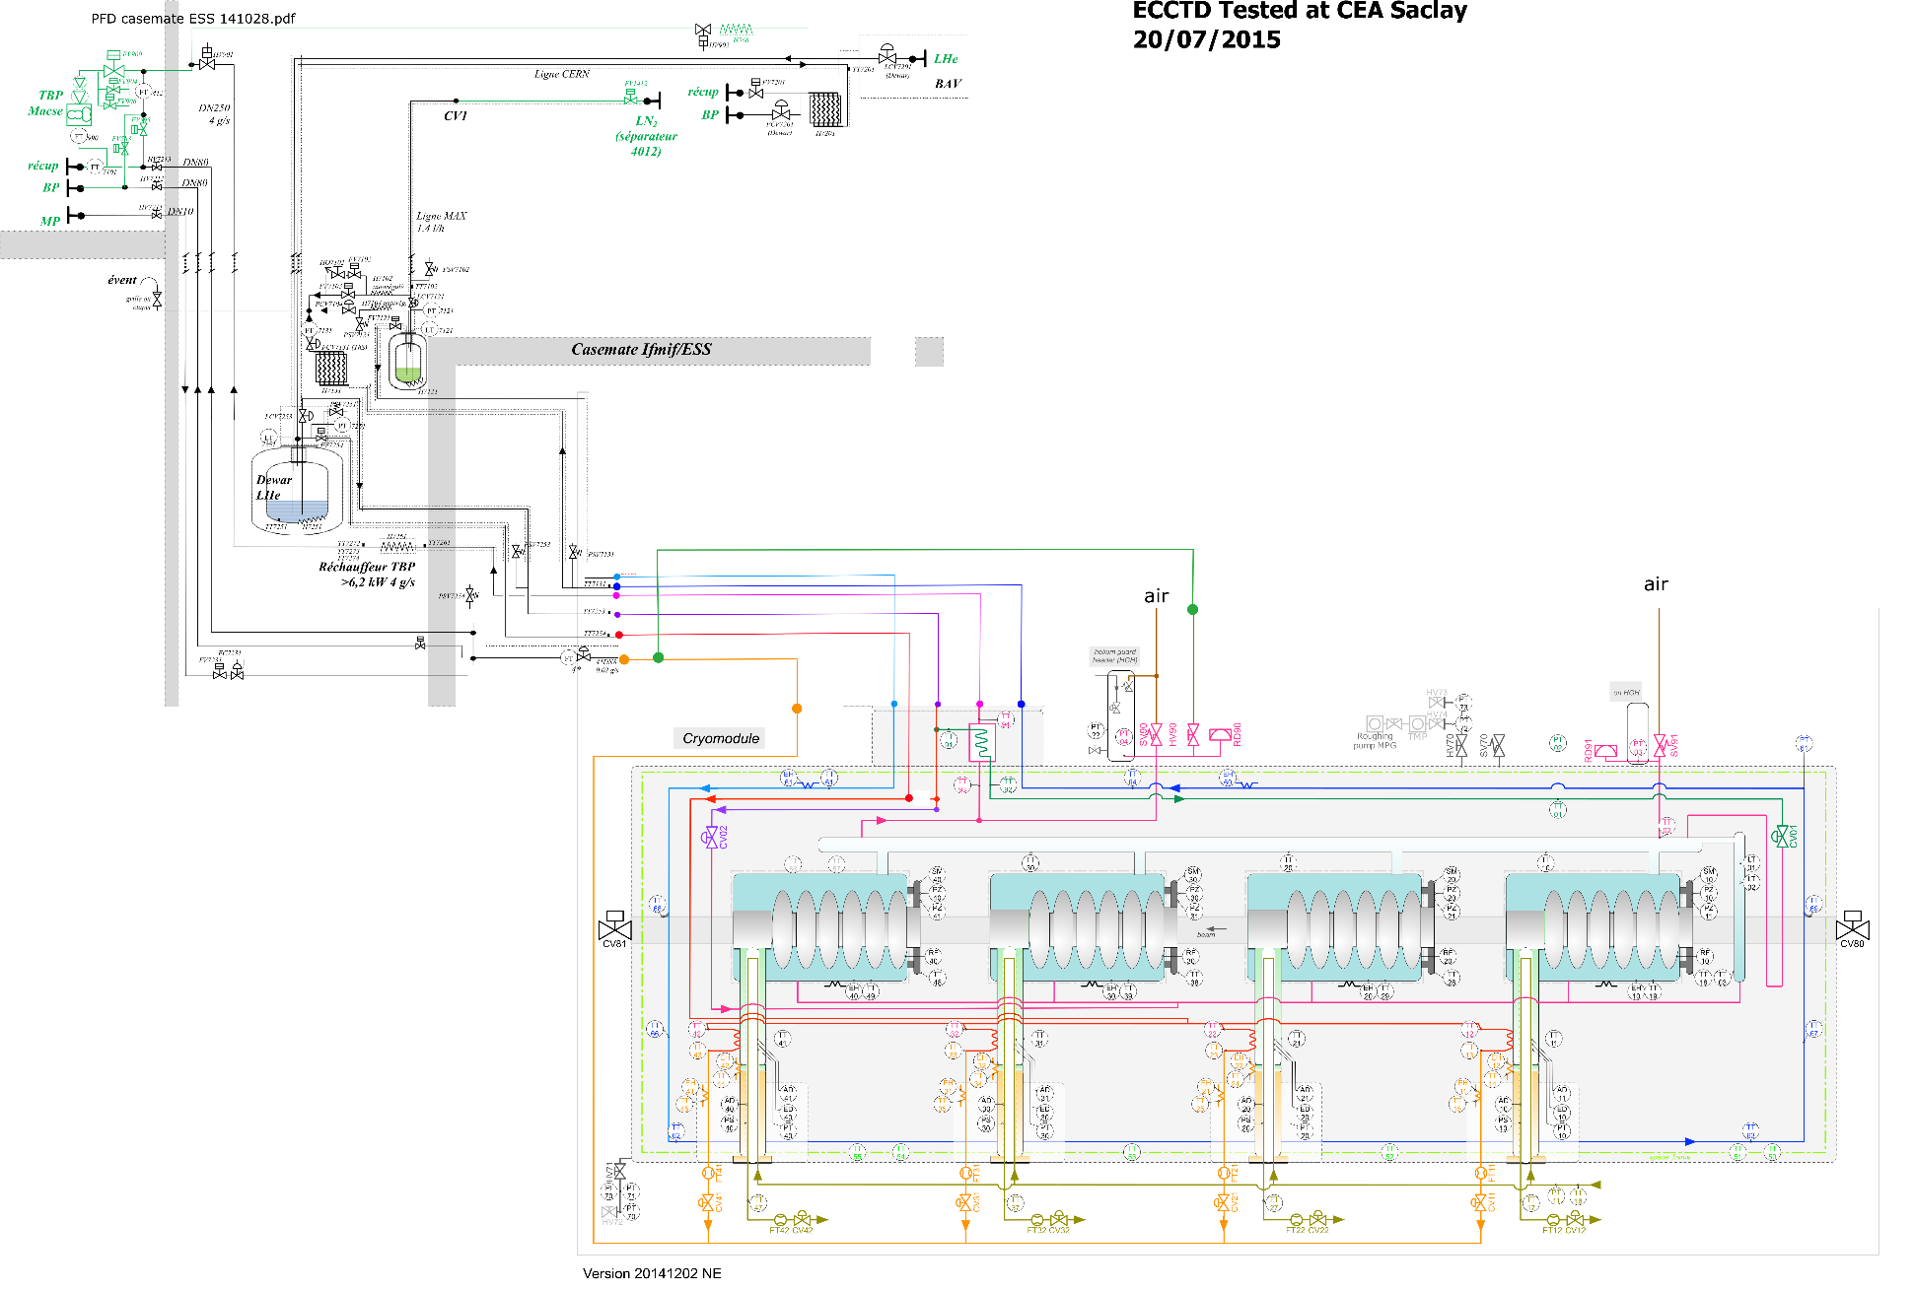
P&ID of the CEA test stand and M-ECCTD
C. Mayri - Burst discs review – 21 May 2019

Slide 12
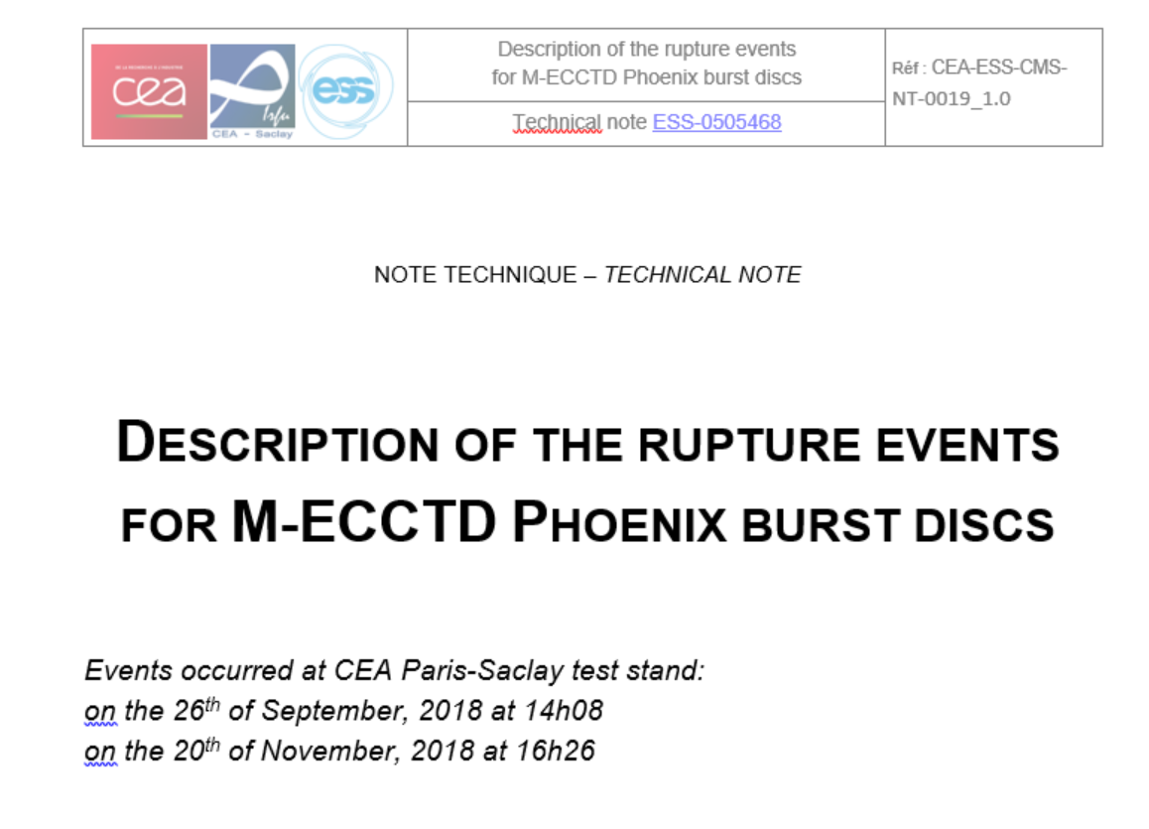
Rupture of the burst discs during the tests of the M-ECCTD prototype in 2018
Detailed description of the cryogenics events in a technical note
C. Mayri - Burst discs review – 21 May 2019

Slide 13
Explanation of the rupture events
The following characteristics of the M-ECCTD cryomodule and the characteristics of the CEA test stand are the main origins of the events:
    Problem of design on the LHe gauges chamber
    A Hampson type heat exchanger optimized for supercritical He at 3 bars used with diphasic LHe at 1 bar in CEA test stand
    No phase separator between the LHe filling line and the cryomodule
C. Mayri - Burst discs review – 21 May 2019

Slide 14
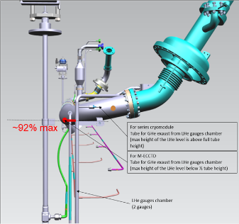
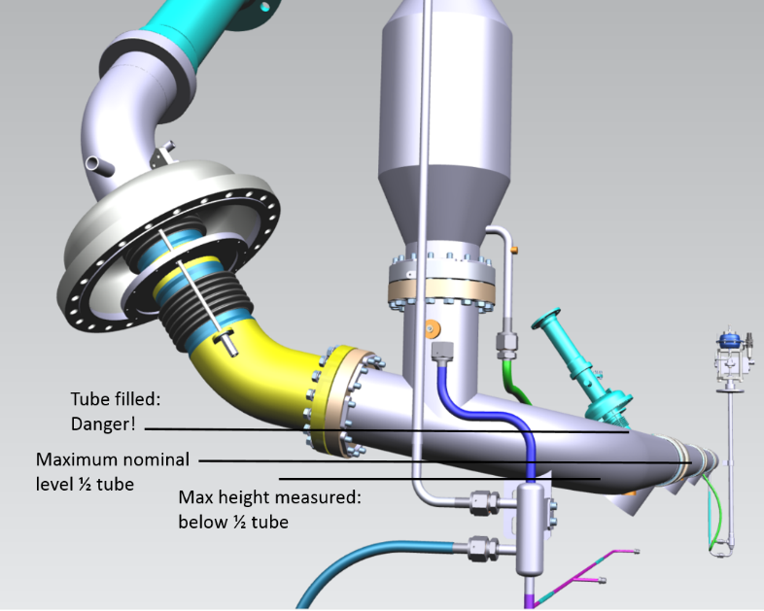
Explanation of the rupture events
Problem of design on the LHe gauges chamber of the M-ECCTD
The GHe exhaust line of the LHe gauges chamber is connected to the bottom of the diphasic line where the volume is filled with liquid helium.
=> The 2 LHe gauges saturate at about 92% and are blind above this level.
C. Mayri - Burst discs review – 21 May 2019

Slide 15
Explanation of the rupture events
The problem of design on the LHe gauges chamber led to uncontrolled LHe level above ~92% (lower part of the diphasic pipe)
The use of Hampson HX with diphasic LHe containing a high level of GHe caused cryogenic instabilities and difficulties to keep a stable LHe level at 2 K in the diphasic pipe over long periods.
Filling the cavities with LHe at 2 K was possible but it was needed to use the LCV02 cooling valve in addition to LCV01 JT valve.
The RF power tests of the cavities required to take some risks relative to the cryogenics pushing the 2 K LHe level higher than 92%.
Before the disc burst we probably completely filled the diphasic pipe (confirmed by the drop of the TT02 sensor - see description in the technical note). The exhaust of the GHe at the opposite side of the jumper connection can only be done by pushing the LHe to the jumper side warm pipes generating fast vaporization that pushes back the liquid in the opposite side. The pressure increase on both sides was so fast that the SV had not time to open before the discs burst.
C. Mayri - Burst discs review – 21 May 2019

Slide 16
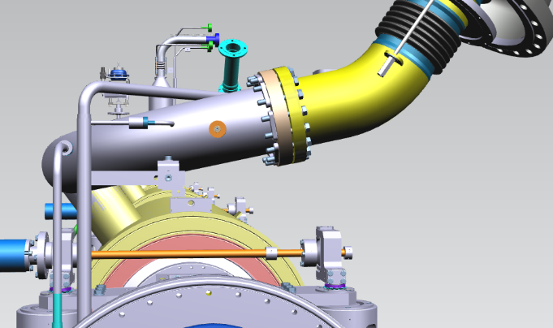
improvements done for series cryomodules
New position of the GHe exhaust line of the LHe level gauges above the upper part of the horizontal diphasic line
C. Mayri - Burst discs review – 21 May 2019

Slide 17
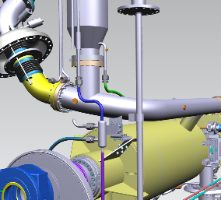
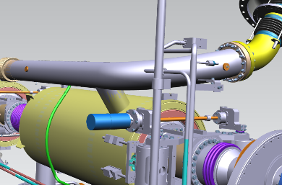
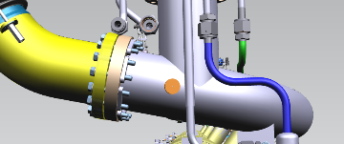
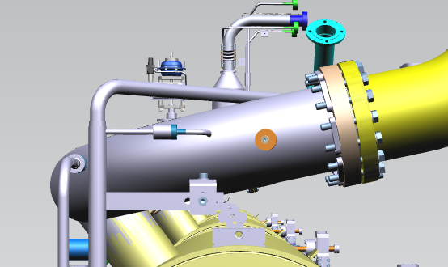
improvements done for series cryomodules
New position of T sensors on the diphasic line that can be used for alarms
TT02 is kept at the same position
C. Mayri - Burst discs review – 21 May 2019

Slide 18
Conclusions
The explanation we have of the rupture event leads to comfort us in the better behavior of the elliptical cryomodules in the ESS conditions
with supercritical He at 3 bars
with a correct GHe exhaust connection of the LHe level gauges to the diphasic pipe
The LHe level should be correctly controlled in the middle of the diphasic pipe.
Thermal sensors will be placed on the diphasic pipe in adequate location for using them for alarms and closing LCV01 and LCV02 if necessary for avoiding complete filling of this pipe.
In the CEA test stand an additional phase separator is added on the LHe filling line to remove the GHe at the cryomodule connection. That should help to improve the efficiency of the Hampson heat exchanger and suppress the cryogenic instabilities observed.
C. Mayri - Burst discs review – 21 May 2019

Slide 19
Thank you for your attention

