Slide 1
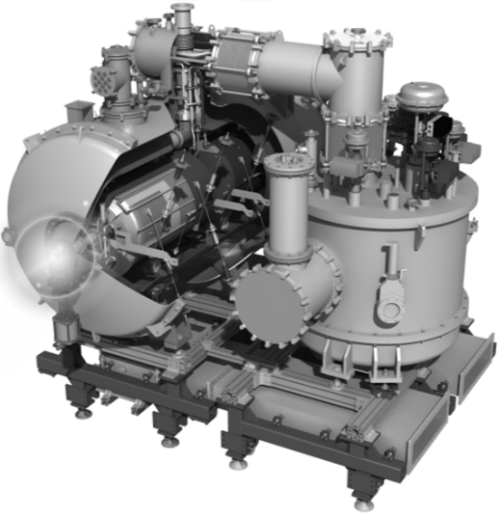
Source Spallation European (ESS)
May 21th 2019
P. DUTHIL (CNRS-IN2P3 IPN Orsay / Division Accélérateurs)
on behalf of the IPNO team

Slide 2
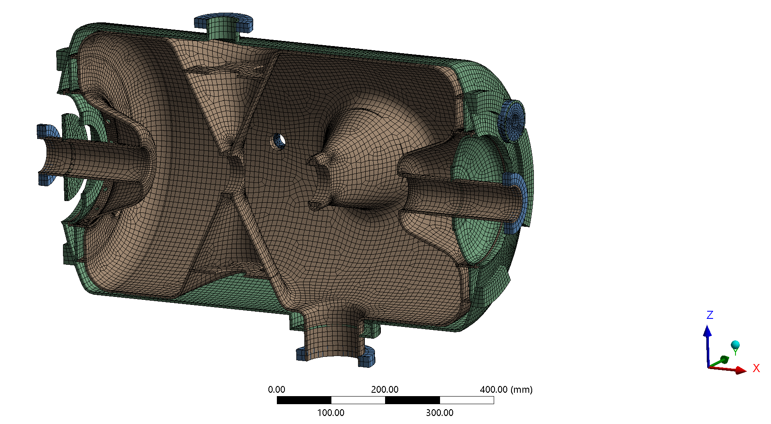
SRF Spoke cavity β = 0.5 1/14
Cavity and liquid helium tank: construction
(from P. DUCHESNE)
Cavity:
Niobium 4 mm
Tank:
Titanium 4 mm
Cold tuning system side
Dish end:
Titanium 3 mm
Disk:
Titanium 4 mm
Reinforcement ring:
Niobium 4 mm
Reinforcement disk:
Niobium 4 mm
Coupler port :
Titanium 3 mm
LHe volume in the tank: 43 L
Reinforcement ring:
Niobium 4 mm

Slide 3
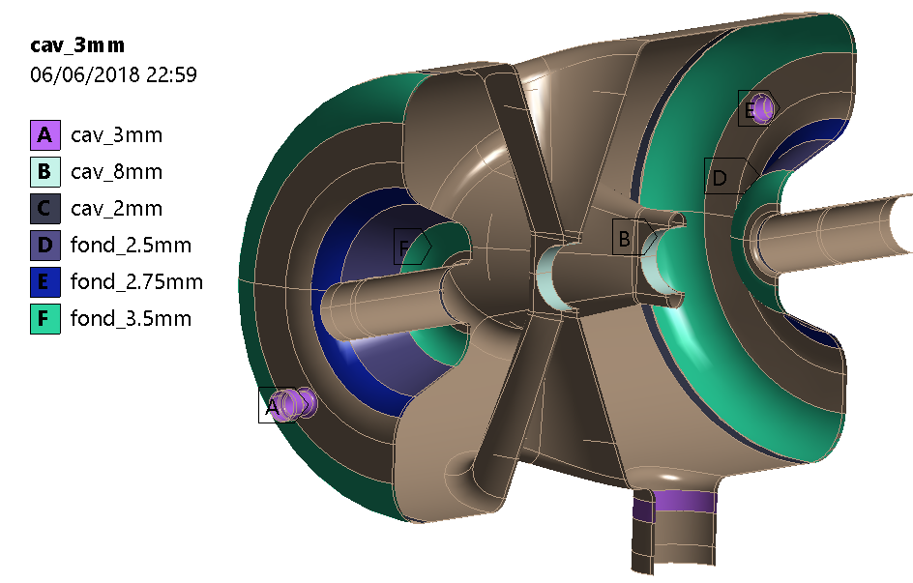
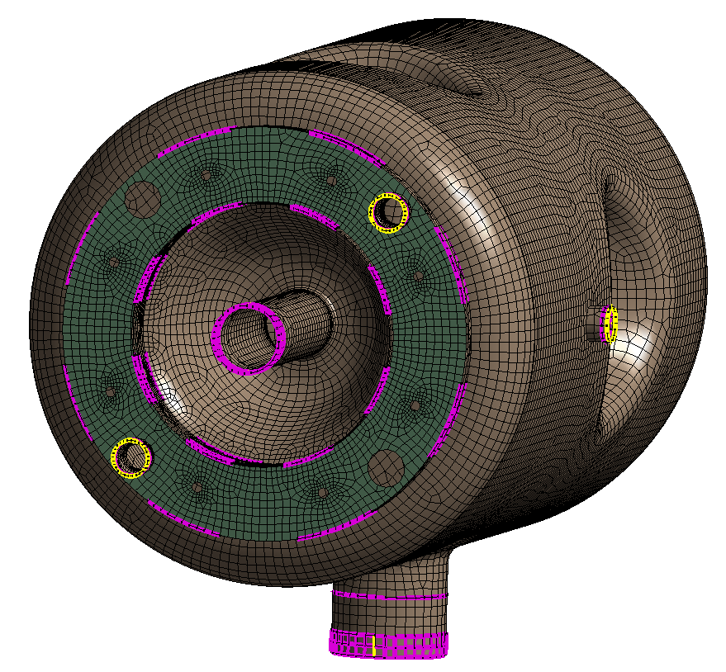
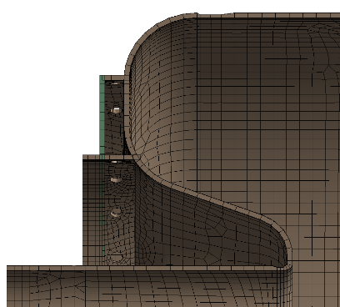
SRF Spoke cavity β = 0.5 2/14
Cavity and liquid helium tank: construction
Considered thickness affected to the shell for static analysis:
Connection of the reinforcement rings onto the shell cavity and shell LHe tank:
4mm
2 cases were considered:
- 100% of the circumference is welded
- 50% of the circumference is welded
50mm
(from P. DUCHESNE)
80mm
8 weld /per circle

Slide 4
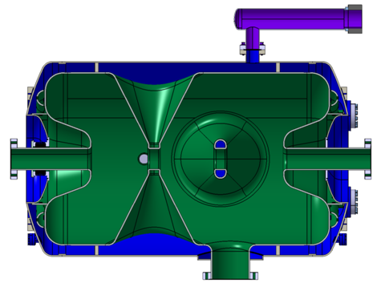
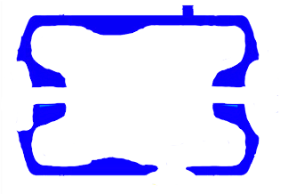
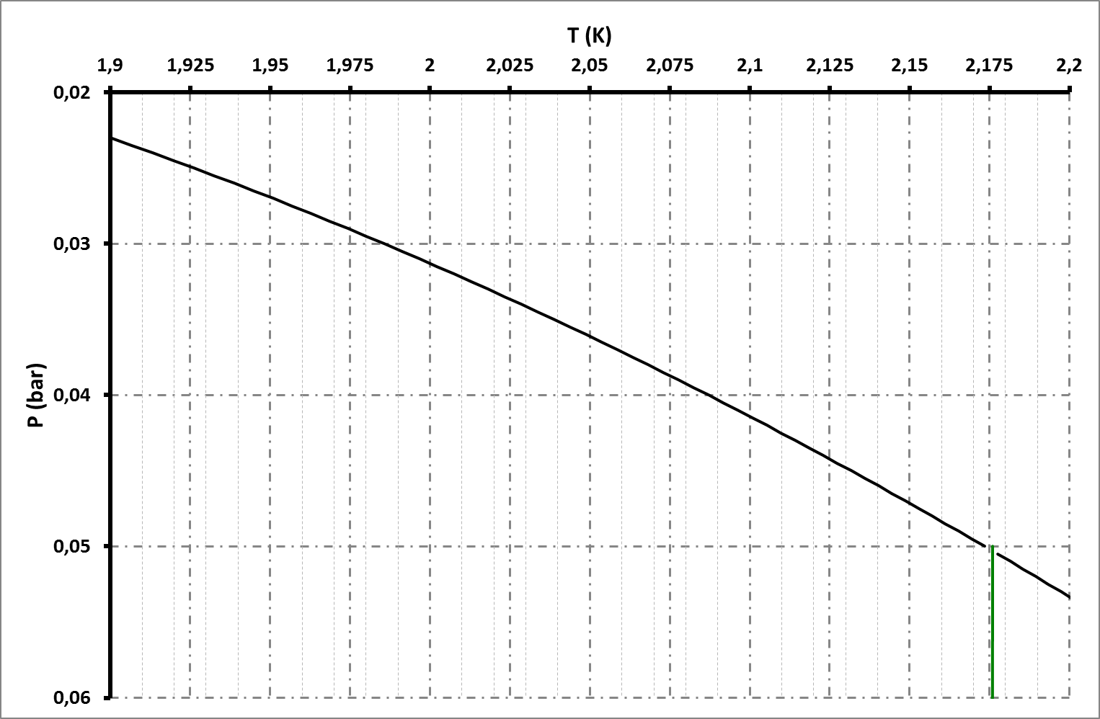
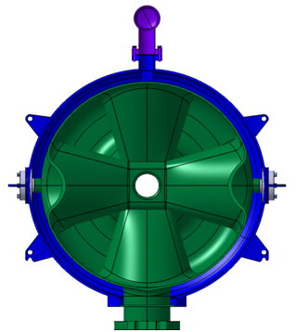
SRF Spoke cavity β = 0.5 3/14
Operating SRF Spoke cavities (nominal operations)
609 mm
Bi-phase pipe: liquid/vapour interface
150 mm
Mean dynamic heat load for one cavity: 2.5 W
488 mm
VAPEUR
Subcooled liquid
Bi-phase pipe
Top of the cavity
Bottom of the cavity
Thermal Margin
Point λ
SUPERFLUID
LIQUID
(He II)
Ligne λ
Bath pressure

Slide 5
SRF Spoke cavity β = 0.5 4/14
Pressure Equipment Directive (PED)
{Cavity + LHe tank} = cryogenic pressure vessel
PS = MAWP = 1.04 barg
=2.04 bara
48
Volume of the cavity helium tank at the time of definition of the cavity (proto) : 48 L
(series cavity: 43 L ⇒ 1.16 barg)
ESS goal: to remain in 4.3 category

Slide 6
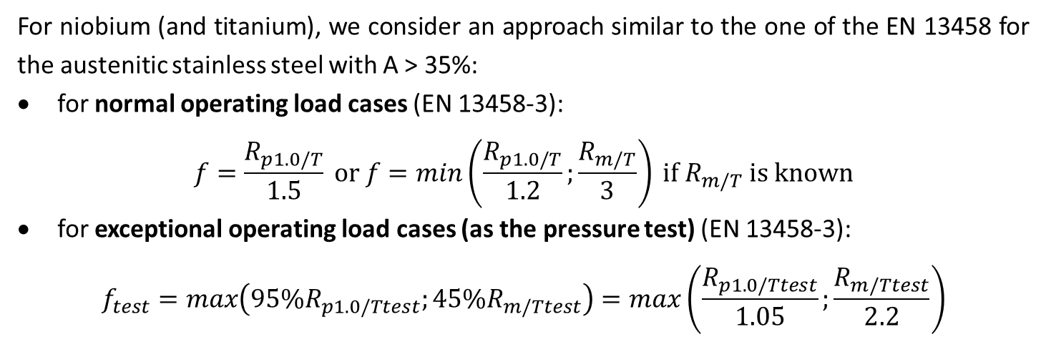
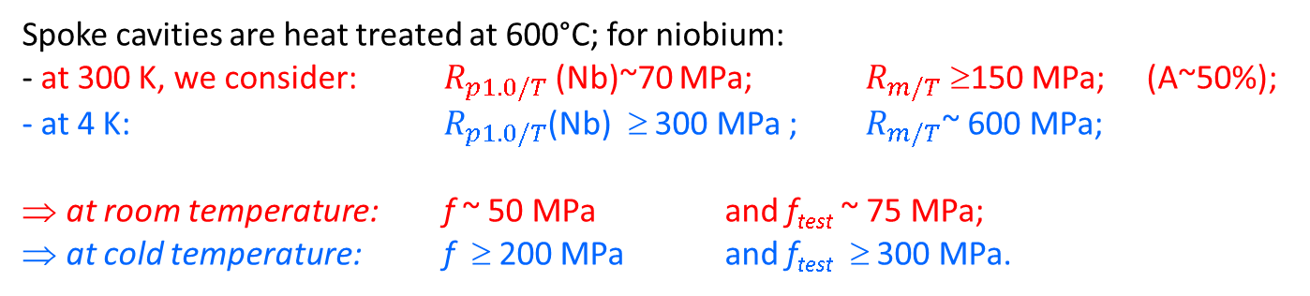
SRF Spoke cavity β = 0.5 5/14
Allowable stress criteria
  Material: niobium
For niobium (and titanium), we consider an approach similar to the one of the EN 13458 for the austenitic stainless steel with A > 35%:
for normal operating load cases (EN 13458-3):
$$f=\frac{R_{p1.0/T}}{1.5} \text{or} f=min\left(\frac{R_{p1.0/T}}{1.2};\frac{R_{m/T}}{3}\right) \text{if} R_{m/T} \text{is} \text{known}$$
for exceptional operating load cases (as the pressure test) (EN 13458-3):
$$f_{test}=max\left({95\%R}_{p1.0/Ttest};45\%R_{m/Ttest}\right)=max\left(\frac{R_{p1.0/Ttest}}{1.05};\frac{R_{m/Ttest}}{2.2}\right)$$
    Spoke cavities are heat treated at 600°C; for niobium:
    - at 300 K, we consider: $R_{p1.0/T}$(Nb)~70 MPa; $R_{m/T}$ ≥150 MPa; (A~50%);
    - at 4 K: $R_{p1.0/T}$(Nb) ≥ 300 MPa ; $R_{m/T}$~ 600 MPa;
    at room temperature: f ~ 50 MPa and f_{test} ~ 75 MPa;
    at cold temperature: f ≥ 200 MPa and f_{test} ≥ 300 MPa.

Slide 7
SRF Spoke cavity β = 0.5 6/14
Allowable stress criteria
  Criteria for numerical analysis
For shell elements:
  for areas far from the shape discontinuities:
the general primary membrane stresses: P_{m} ≤ f (normal operation) or P_{m} ≤ f_{test} (pressure test). The post-processing of the shell elements is done by considering the neutral fiber.
  for areas near the shape discontinuities:
the local primary membrane stresses: P_{l} ≤ 1.5f (normal operation) or P_{l} ≤ 1.5f_{test} (pressure test). The post-processing of the shell elements is done by considering the neutral fiber.
  In all cases:
the sum primary membrane + bending stresses: P_{l}+P_{b} ≤ 1.5f (normal operation) or P_{l}+P_{b} ≤ 1.5f_{test} (pressure test). The post-processing of the shell elements is done by considering the top or bottom fiber.
    at room temperature: 1,5f ~ 75 MPa and 1,5f_{test} ~ 107,5 MPa;
    at cold temperature: 1,5f ≥ 400 MPa and 1,5f_{test} ≥ 450 MPa.

Slide 8
SRF Spoke cavity β = 0.5 6/14
Allowable stress criteria
  Criteria for numerical analysis
For solid elements: as long as the maximum stress intensity is less than f (or f_{test}), the post-processing of stress intensity (Tresca stress) is sufficient. If not, it’s necessary to linearize the maximum stress intensity along the thickness of the elements to obtain the different primary stresses: membrane stresses, bending stresses, and membrane+bending.

Slide 9
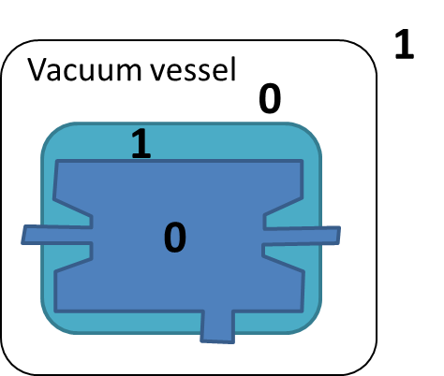
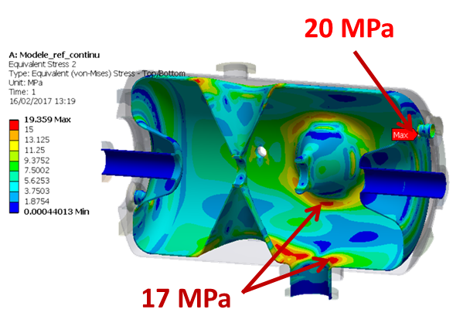
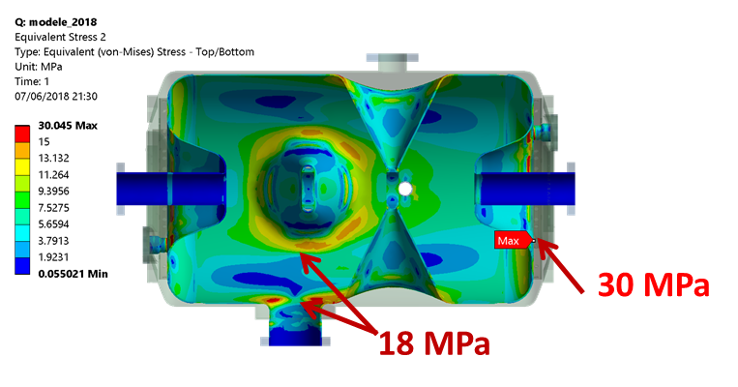
SRF Spoke cavity β = 0.5 7/14
{Cavity + LHe tank}: mechanical considerations
  Linear static analysis 1:
    vacuum in the cavity
    pressure in LHe tank
    vacuum in the vacuum vessel of the SPK CM
x 1 bara
100% of the circumference is welded
50% of the circumference is welded
VV stress
(P. DUCHESNE)
(P. DUCHESNE)
    max stress at a cavity/ HPR port junction (shape discontinuity): σ_{max} = 20 Mpa
    max stress at the welded junction of a reinforcement ring/cavity junction (shape discontinuity): σ_{max} = 30 MPa
    for the rest of the cavity: stress ≤ 18 MPa

Slide 10
SRF Spoke cavity β = 0.5 8/14
{Cavity + LHe tank}: mechanical considerations
  Linear static analysis 1:
    We can offset this result (linear analysis)
    We can scale the result (linear analysis)
    We can scale and offset the result (linear analysis)
0
1
1
=2 ~ PS
0
x 1 bara + 1 bara=
1
20 ≤ σ_{max} ≤ 30 MPa
(at room T°)
0
1
0
2.04 = PS
→ e.g. MAWP at room or cold T°
0
x 2.04 bara =
0
40,8 ≤ σ_{max} ≤ 61,2 MPa (at room T°)
(at cold T°: P ≤ 4.9 ≤ 7.3 bara for σ_{max} ≤ 300 MPa)
0
1
1
3
→ e.g. 3 bara ~ (PS+1)x1.43 for the pressure test of a cryogenic vessel (EN 13458)
0
x 2 bara + 1 bara =
1
40,0 ≤ σ_{max} ≤ 60,0 MPa (at room T°)

Slide 11
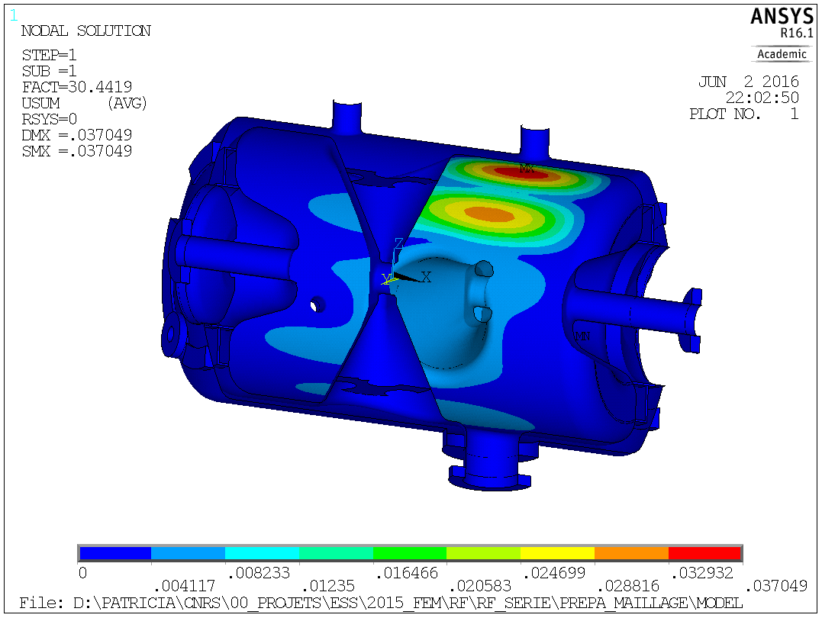
SRF Spoke cavity β = 0.5 9/14
{Cavity + LHe tank}: mechanical considerations
  Linear buckling analysis 1 of the cavity:
    Based on deformed shape resulting from static analysis 1 (previous slide)
0
1
0
(P. DUCHESNE)
for the cavity: P_{crit} = 30.4 bara (no safety factor)
(welds have nearly no influence)

Slide 12
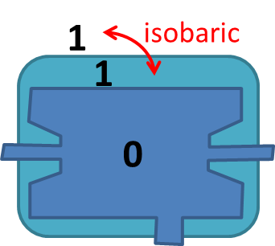
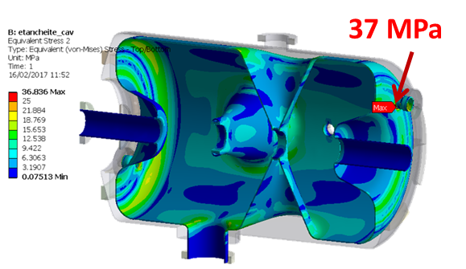
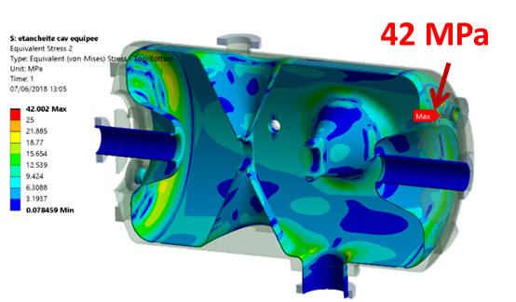
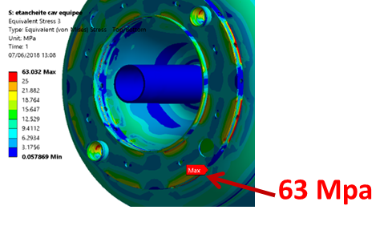
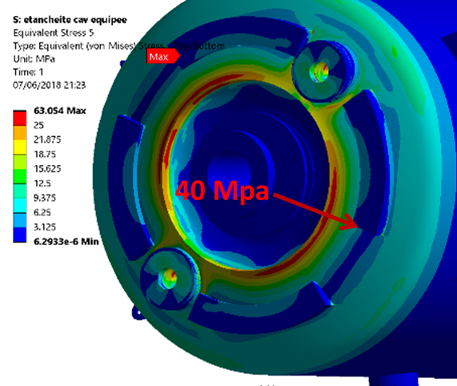
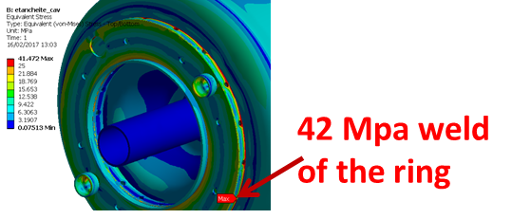
SRF Spoke cavity β = 0.5 10/14
{Cavity + LHe tank}: mechanical considerations
  Linear static analysis 2:
    vacuum in the cavity
    pressure in LHe tank
    pressure in the vacuum vessel of the SPK CM
x 1bara
100% of the circumference is welded
50% of the circumference is welded
(P. DUCHESNE)
(P. DUCHESNE)
    max stress at the welded junction of a reinforcement ring/cavity junction (shape discontinuity)σ_{max} = 42 Mpa
    max stress at the welded junction of a reinforcement ring/cavity junction (shape discontinuity): σ_{max} = 63 MPa
    for the rest of the cavity: stress ≤ 22 MPa

Slide 13
SRF Spoke cavity β = 0.5 11/14
{Cavity + LHe tank}: mechanical considerations
  Linear static analysis 2:
    vacuum in the cavity
    pressure in LHe tank
    pressure in the vacuum vessel of the SPK CM
    → e.g. leak test of the LHe tank
    If we scale this result (linear analysis)
x 1bara
1
1
1.5
1.5
→ e.g. Discharge of helium in the vacuum vessel (=leak) at cool-down
0
x 1,5 bara =
0
⇒ 63MPa ≤ σ_{max} ≤ 94.5 MPa at geometric discontinuity
but σ ≤ 22 Mpa for the rest of the cavity

Slide 14
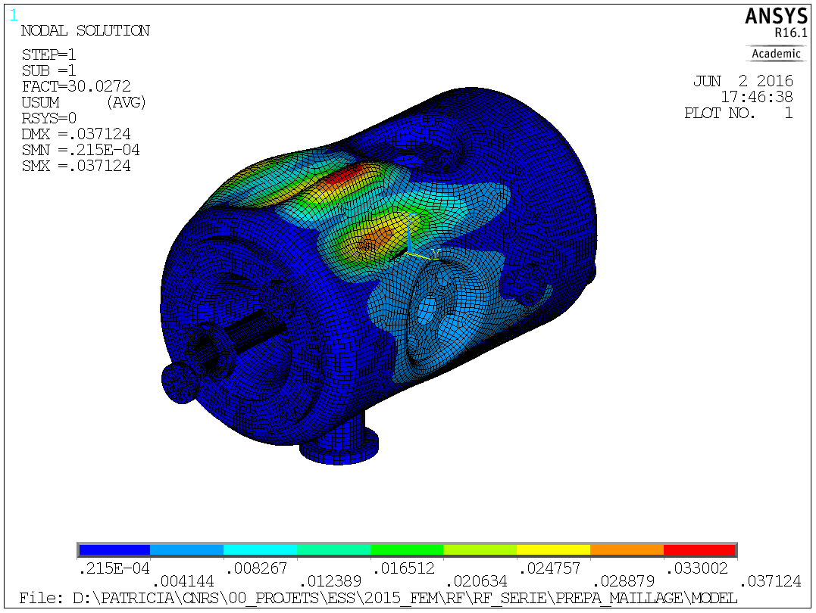
SRF Spoke cavity β = 0.5 12/14
{Cavity + LHe tank}: mechanical considerations
  Linear buckling analysis 2 of the cavity:
    Based on deformed shape resulting from static analysis 2 (previous slides)
1
1
0
⇒
(P. DUCHESNE)
for the cavity: P_{crit} = 30.0 bara (no safety factor)

Slide 15
SRF Spoke cavity β = 0.5 14/14
To sum-up:
  Maximum allowable pressure PS = 2.04 bara
    to comply with article 4.3 of the PED
  Mechanical behaviour wrt to PS (MAWP):
    some margin at room T° before plastic deformation of a cavity (max stress at a shape discontinuity)
    much more margin at cold T° before plastic deformation
    sufficient margin wrt buckling
  Operating constrains:
    opening pressure of the safety device(s) below PS ~ 1 barg
    pressure required by the cryogenic plant is 1.43 bara,
    ⇒ the pressure margin between the operating pressure and safety device(s) pressure set is low.
  Cavity safety strategy (ESS):
    Level 1: Burst disk(s) designed for accidental scenarios = safety device
    Level 2: Safety valve designed for abnormal operations and to avoid the bursting of the disk(s)
    Level 3: Control valve (CV90) is designed to limit the pressure at a level lower than the opening pressure of the safety valve and is regulated at an absolute pressure

Slide 16
Cold helium circuits: safety devices 1/12
Pressure scale 1
Absolute pressure
(bara)
Gauge pressure
(barg)
2.14
1,1 x PS = Max. pressure = 1.04
2.04
PS = MAWP = 1.04
Bursting range of the burst disks
0.99 ± 0,05: bursting pressure
Relief pressure
= 1 atm
1.94
0.94
Pressure margin
∼ 0.2
1.74
0.74: max. pressure for a 100% opening of the relief valve
(1,05 x 0.67 ∼ 0.74 bar)
∼ 0.67 (1.05 x Pset)
Relief pressure
(SF relief line)
= 1 atm
Opening area of the relief valves
0.64 ± 5%: set pressure of the safety valve (Pset ± 5%)
∼ 0.61 (0.95 x Pset)
1.55
0.55: minimum pressure to allow the closing of the relief valve (0.9 x 0.61 ∼ 0.55 bar)
1.5
~0.5: PLC control valve (regulated via absolute pressure measurement)
1.43
Minimum operation pressure of the cryoplant
(max. operation of the cryomodule)
Is there some margin here?
Operating pressure area
30·10⁻³
Pressure operation at 2 K

Slide 17
Cold helium circuits: safety devices 2/12
Pressure scale 2
Absolute pressure
(bara)
Gauge pressure =P - P_{atm}
(barg)
2.14
1,1 x PS = Max. pressure = 1.04
2.04
PS = MAWP = 1.04
Bursting range of the burst disks
0.99 ± 0,05: bursting pressure
Relief pressure
= 1 atm
Pressure margin ∼ 0.1
1.94
0.94
1.84
0.84: max. pressure for a 100% opening of the relief valve
Opening area of the relief valves
Relief pressure
(SF relief line)
= 1.1 bara
0.74 ± 5%: set pressure of the safety valve (Pset ± 5%)
1.65
0.65: minimum pressure to allow the closing of the relief valve
1.5
~0.5: PLC control valve (regulated via absolute pressure measurement)
1.43
Minimum operation pressure of the cryoplant
(max. operation of the cryomodule)
Is there some margin here?
Operating pressure area
30·10⁻³
Pressure operation at 2 K

Slide 18
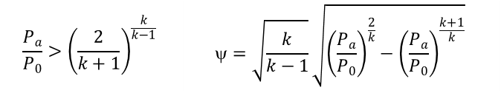

Cold helium circuits: safety devices 3/12
Burst disk sizing
  Considered worst scenario: loss of beam vacuum
    air leak through the power coupler window (I.D .= 100 mm)
    air fully condensates onto the non insulated walls of the cavities
    considered heat power density : 38 kW/m² [Lehmann, 1978 + CERN]
    (not widely accepted ; but very conservative !)
    for 2 cavities (~2 m² each): 152 kW vaporizing saturated He II
  Helium properties:
  Disk sizing (ISO 21013, EN 13648-3):
    Mass flow rate:
    Subsonic flow considered as
    Min. relief cross section:
    Burst pressure:
    1.94 to 2.04 bara
P (bara) | T (K) | ρ (kg/m3) | h (J/kg) | L_{V} (J/kg)
2.04 | 5.052 | 42.42 | 27380 | 10750
2.04 | 5.052 | 97.55 | 16630
at max discharge pressure
to minimize L_{v}
to maximizes (vapour) mass flow rate
$$\dot{m}=\frac{\dot{Q}}{L_{V}}\frac{ρ_{L−}ρ_{V}}{ρ_{L}}$$
    (vaporization of saturated He II)
$$\frac{P_{a}}{P_{0}}>{\left(\frac{2}{k+1}\right)}^{\frac{k}{k−1}}$$ | $$=\sqrt{\frac{k}{k−1}}\sqrt{{\left(\frac{P_{a}}{P_{0}}\right)}^{\frac{2}{k}}−{\left(\frac{P_{a}}{P_{0}}\right)}^{\frac{k+1}{k}}}$$
Min. burst disk I.D.
Po (bar) | Pa (bar) | ρ_{L} (kg/m3) | ρ_{V} (kg/m3) | Surf. Cav (m²) | Heat density (W/cm²) | Heat load (kW) | Mass flow (kg/s) | k hélium | Crit. Pressure ratio | Pa/P0 | Ψ | α | A (mm2) | D_{min} (mm)
2,04 | 1 | 97,55 | 42,42 | 2 | 3,8 | 152 | 8,0 | 1,67 | 0,487 | 0,490 | 0,51 | 0,73 | 5830 | 86,16

Slide 19
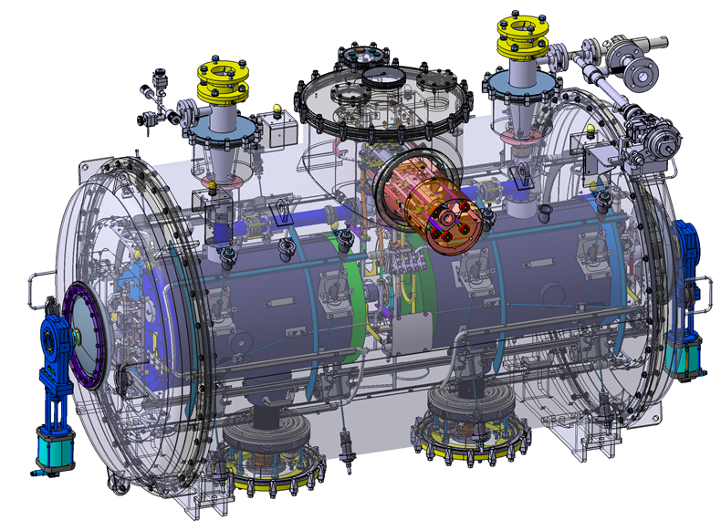
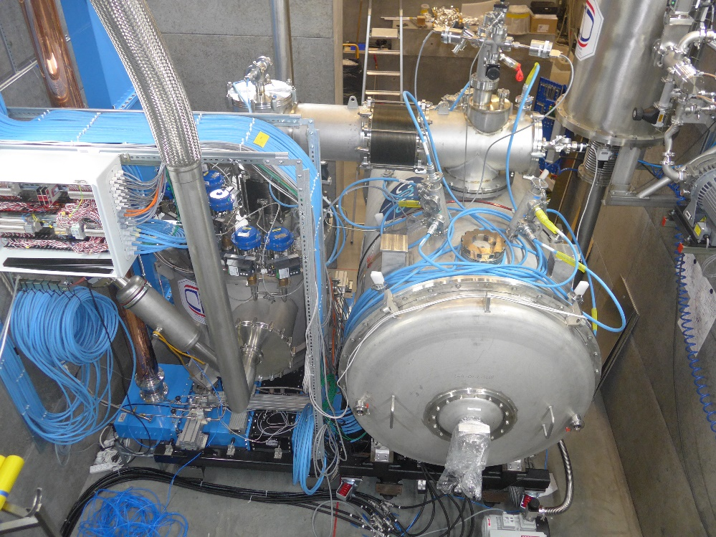
Cold helium circuits: safety devices 4/12
Burst disk(s) location(s)
1x Burst disk ∅90 mm
2x Burst disks ∅100 mm
Prototype SPK CM
Series SPK CM

Slide 20
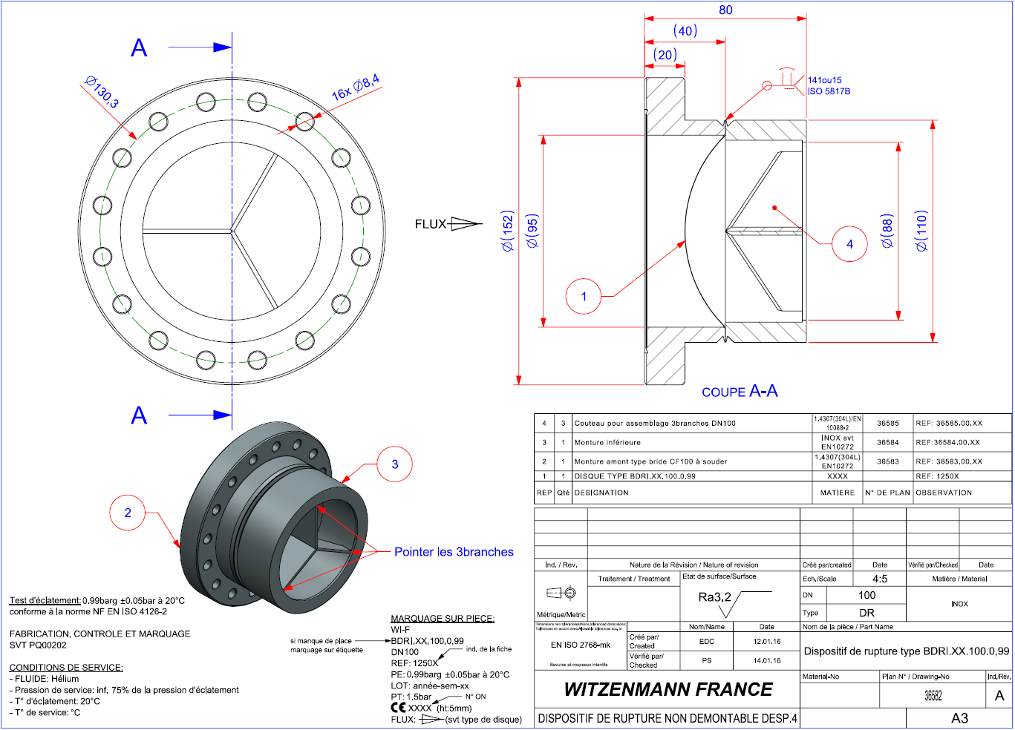
Cold helium circuits: safety devices 5/12
Burst disk technology
  Prototype SPK CM
  Series SPK CMs
    ⇒ New design by Witzenmann: circular knife to obtain a better cutting of the disk and a larger flow area
Prototype: CF flange
Series: welded interface
Dimensions updated by Witzenmann on 2016/04/07
Ø97mm
Ø90mm

Slide 21
Cold helium circuits: safety devices 6/12
Burst disk: pressure drop in the exhaust line
  Helium properties:
    Burst pressure: 1.94 to 2.04 bara
    Mass flow rate is evaluated at max. discharge pressure: 2.04 bara (cf. burst disk sizing)
    ⇒ ~4 kg/s per cavity (~8 kg/s total)
    Pressure drops are evaluated by considering a discharge pressure of 1.94 at the inlet of the burst disk ⇒ to maximize the pressure drops (lowering the density)
    He saturated vapour is considered (not liquid nor diphasic flow) ⇒ to maximize the pressure drops
    He properties (density and viscosity) are pressure dependant
    Estimated total volume of LHe in the circuit: ~ 120 L

Slide 22

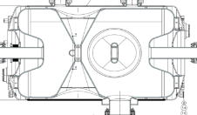
Cold helium circuits: safety devices 7/12
Burst disk: pressure drop in the exhaust line
  EN 13648-3
    ΔP in the exhaust line shall be ≤ 3% x burst pressure ⇒ Δp_{max} ∼ 30 mbar !
    Exhaust line = from the outer jacket of the cryogenic reservoir to the outlet
    Allowed overpressure during accident: 110 % x Ps ⇒ p_{max} = 2144 mbara
∅_{int} = 63 mm
LHe tank outer jacket
Singular pressure drop due to the fluid entering the exhaust line not to take into account?
Not clear in EN13648 nor in ISO 21013
⇒ We consider those pressure drops (~90mbar)
Equivalent network
We consider all:
- regular pressure drops (friction)
- Singular pressure drops in:
. cavities outlets (intrances of exhaust line)
. tee junctions and cones
4 kg/s
4 kg/s
⇒ Δp_{max} ~ 160 mbar > 30 mbara
p_{max} = 2085 mbara < 2144 mbara ⇒ In agreement with EN13648
(NB: if discharge pressure = 2.04 bara,p_{max} = 2168 mbara > 2144 mbara

Slide 23
Cold helium circuits: safety devices 8/12
Burst disk: pressure drop in the exhaust line
    It is not possible to respect Δp_{max} ≤ 30 mbar in the burst disk exhaust line with such Ps considering pressure drops at the entrance of the cavity.
    However:
      we are talking about tens of mbar
      we don’t foresee any mechanical risk for the Spoke cavities (and not for people).
.

Slide 24
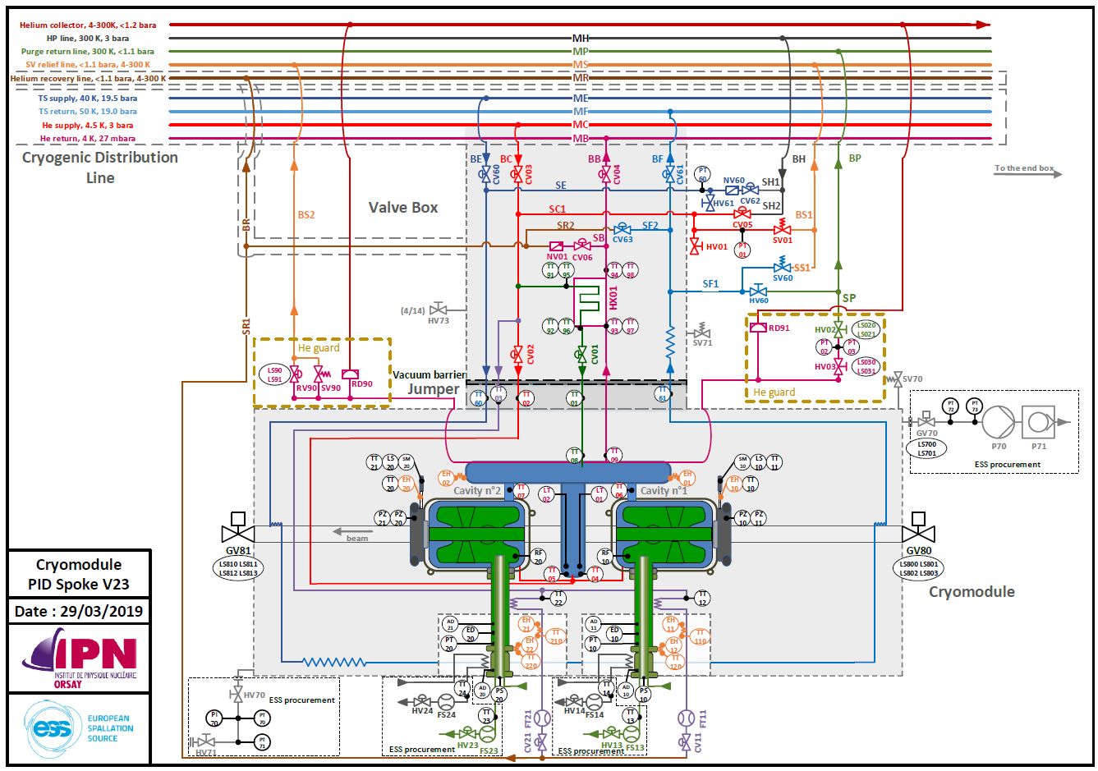
Cold helium circuits: safety devices 9/12
PID of the cold helium circuits
Safety device
Cryogenic control valve

Slide 25
Cold helium circuits: safety devices 10/12
Cryogenic Valves
Valve name | CV01 | CV02 | CV03 | CV04 | CV06
Fonction | HeII production; 2 K mode cavities tanks fill in | Cool-down – 4 K mode cavities tanks fill in | Helium supply shut-off valve | VLP shut-off valve | Helium recovery from VLP shut-off valve
DN | 8 | 8 | 8 | 32 | 10
Kv max (m³/h) | 0.1 | 1.014 | 1.82 | 21.7 | 2.8

Slide 26
Cold helium circuits: safety devices 11/12
Burst disk Safety valves protection
  Considered worst scenario:
    HP He supply: 3 bara, 5 K
    Valves CV01, CV02 and CV03 fully opened (at kv max)
    Cool-down phase (He return line is warm)
    VLP valve CV04 closed
max. mass flow rate
3 bara, 5 K
CV03
(shut-off)
Kv=1.82 m³/h
106.8 g/s
2.7 bara, 5 K
CV01
(JT)
Kv=0,1 m³/h
9.6 g/s
CV02
(SRF cool-down)
Kv=1,014 m³/h
97,2 g/s
1.74 bara
300 K
CV90
Kv=10.9 m³/h
34.0 g/s
SV90
72.8 g/s
1.1 bara

Slide 27
Cold helium circuits: safety devices 12/12
Protection of the burst disk
SV90: procurement is ongoing
SVs: 2x Circle seal 1/2" opening at 140 – 150 mbar
CV90: VELAN DN20 KV = 14.7m₃/h
Prototype SPK CM
Series SPK CM

Slide 28
Thank you for your attention
CSP12
28 Novembre 2014

