Slide 1
FREIA Laboratory Facility for Research Instrumentation and Accelerator Development
Spoke Cryomodule Testing
Roger Ruber, for the FREIA team
Uppsala, 26 August 2019

Slide 2
Overview of Infrastructure for Cryomodule Testing
FREIA infrastructure

Slide 3
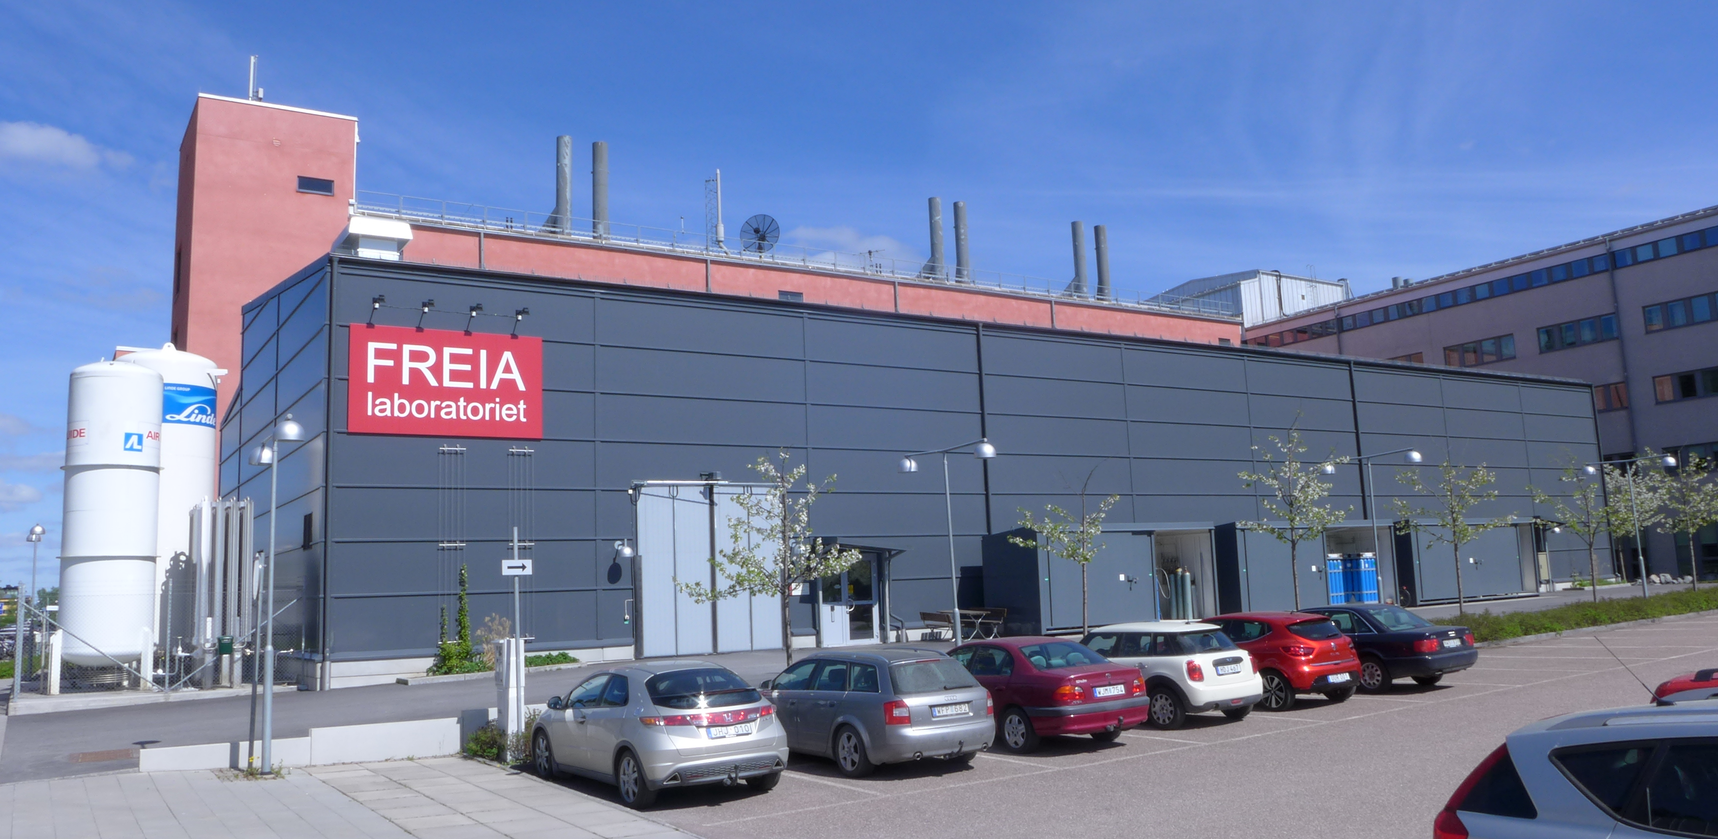
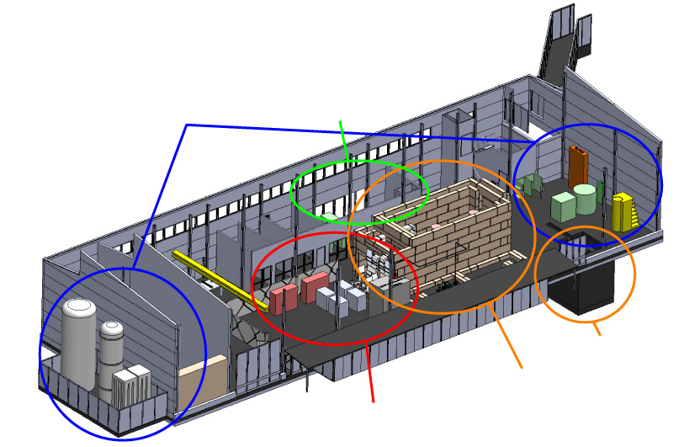
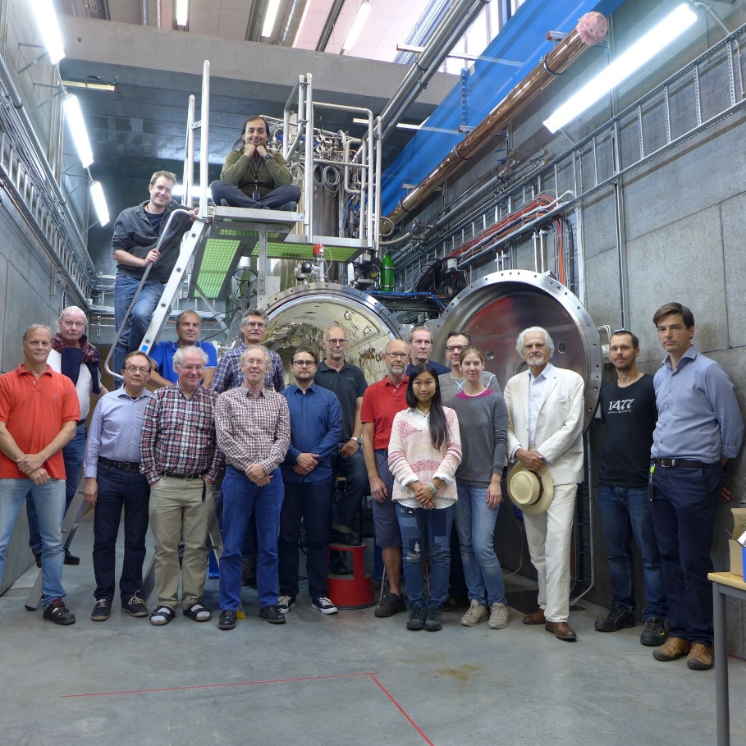
FREIA Laboratory
Facility for Research Instrumentation and Accelerator Development
Funded by KAWS, Government, Uppsala Univ.
State-of-the-art Equipment
cryogenics
- liquid helium
- liquid nitrogen
control room
- equipment controls
- data acquisition
Competent and motivated staff
collaboration of physics (IFA) and engineering (Teknikum).
vertical cryostat
3 bunkers
with test stands
horizontal cryostat
radio-frequency (RF) power sources

Slide 4
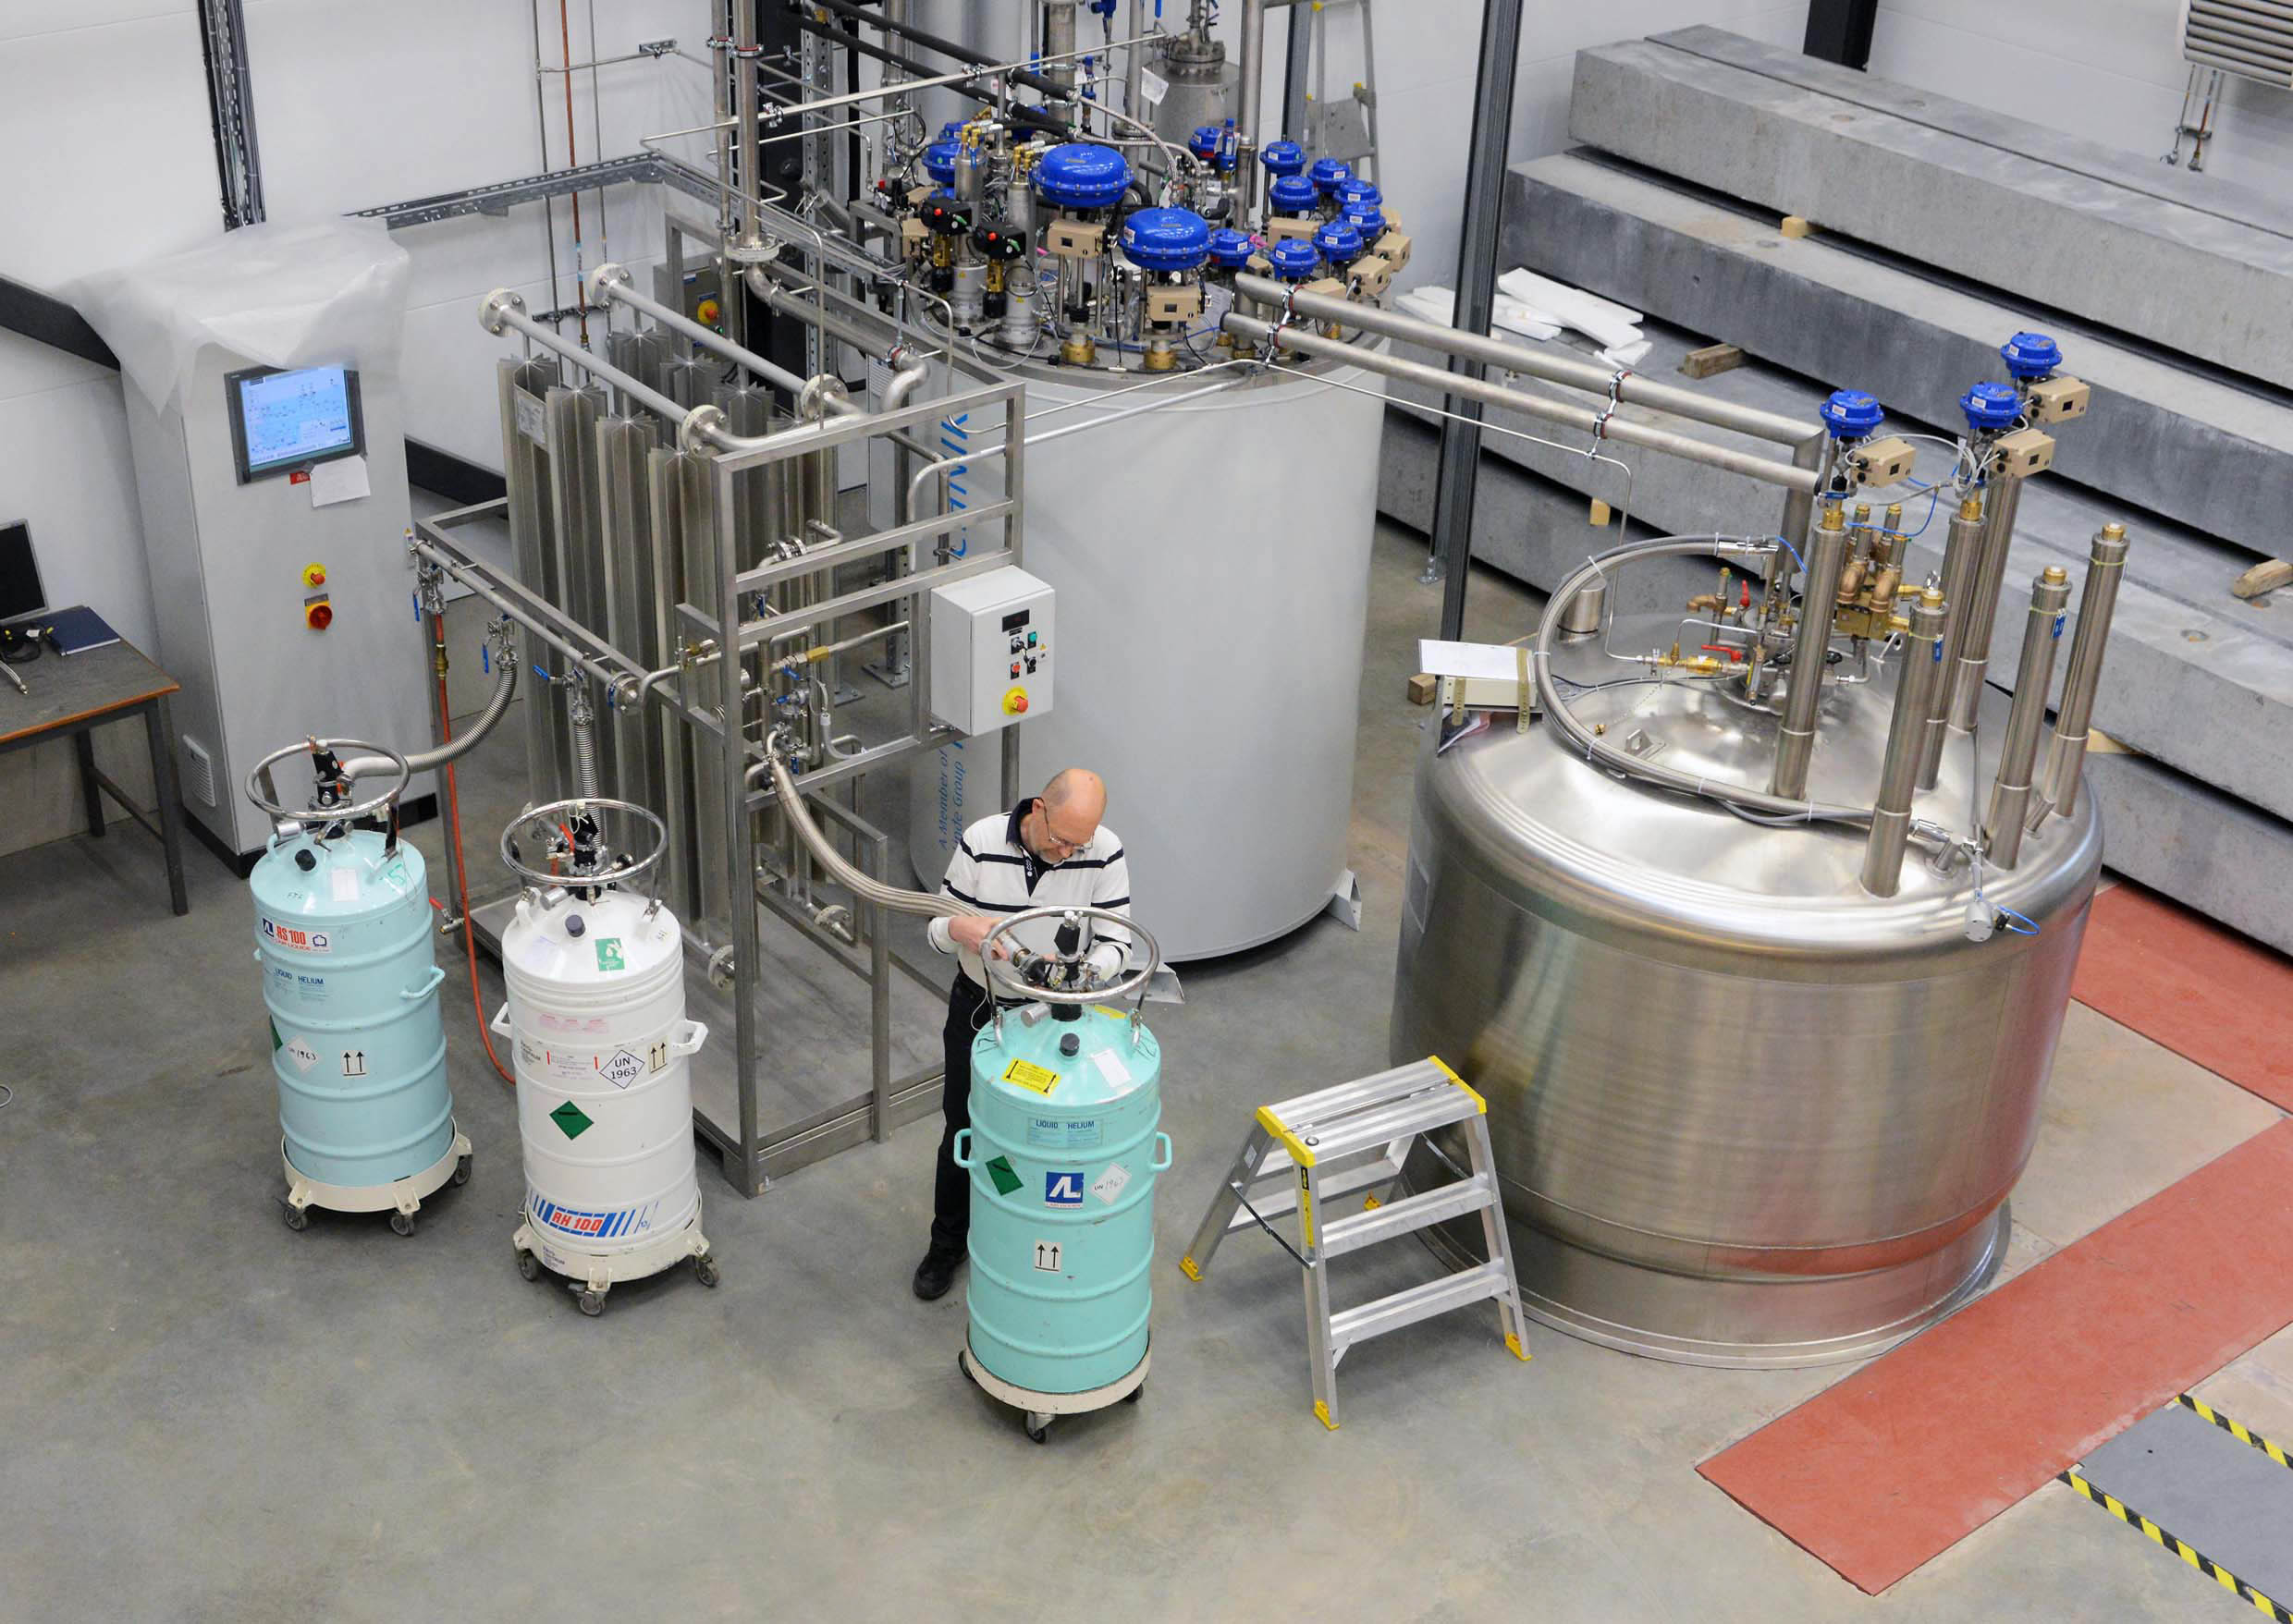
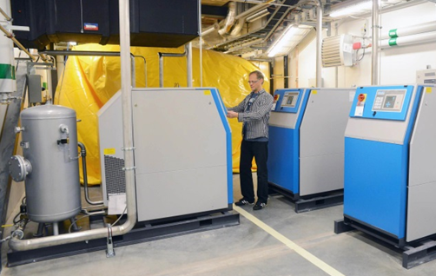
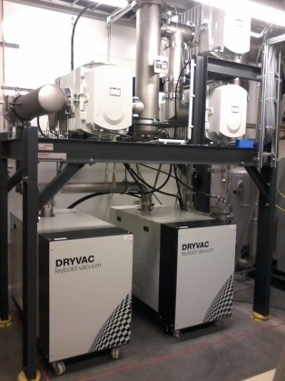
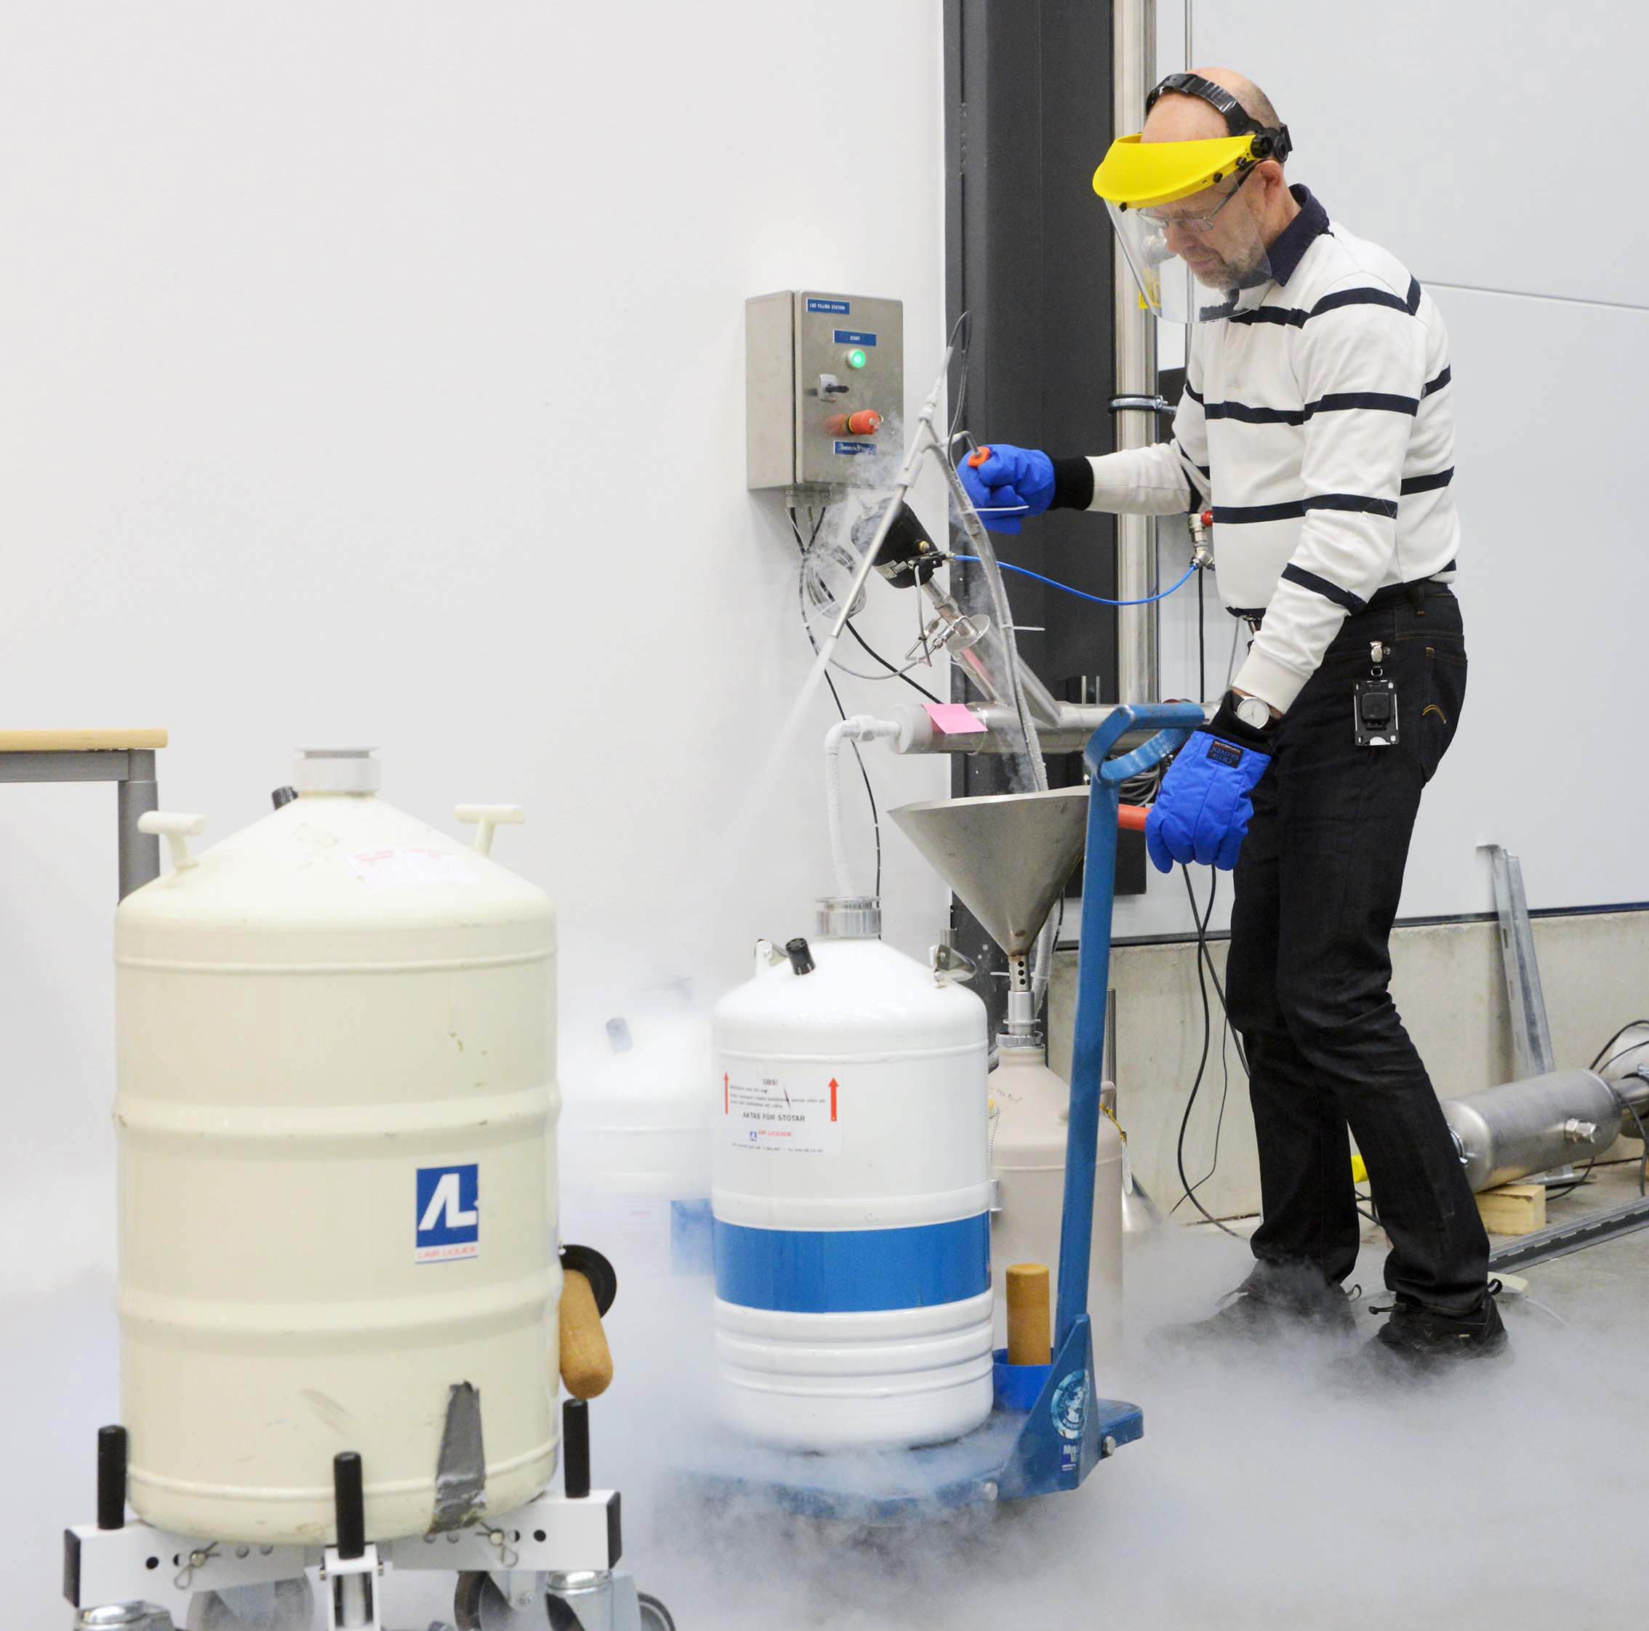
Cryogenics
Helium liquefaction
150 l/h at 4.5K (LN2 pre-cooling)
2000 l LHe dewar/buffer, 3+1 outlets
cryostats connected in closed loop
Gas recovery
100 m³ gasbag
3x 25 m³/h compressor
10 m³ 200 bar storage
2K Pumping
~3.2 g/s at 10 mbar
~4.3 g/s at 15 mbar
110(90)W at 2.0(1.8)K
Liquid nitrogen
20 m³ LN2 tank
Helium gas recovery system
Sub-atmospheric pumping station

Slide 5
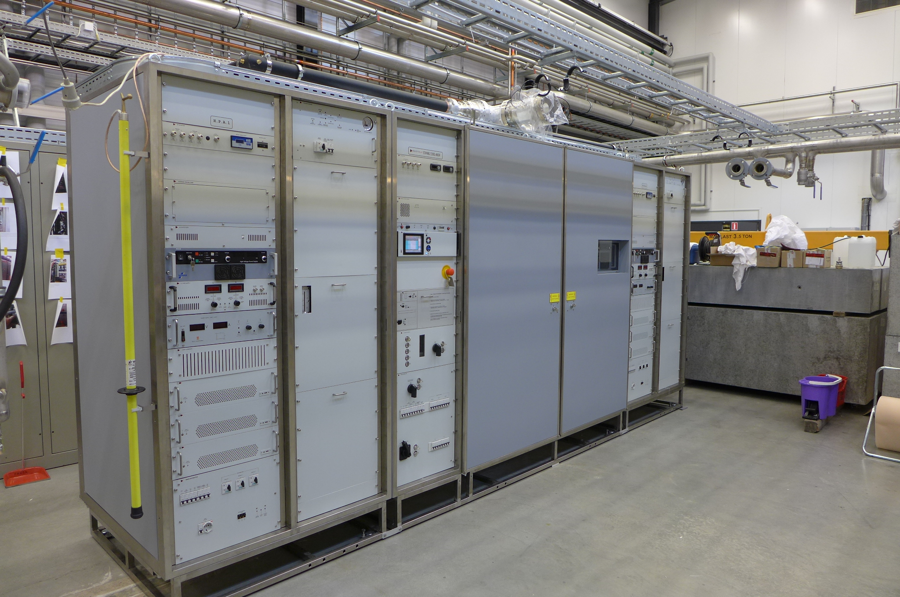
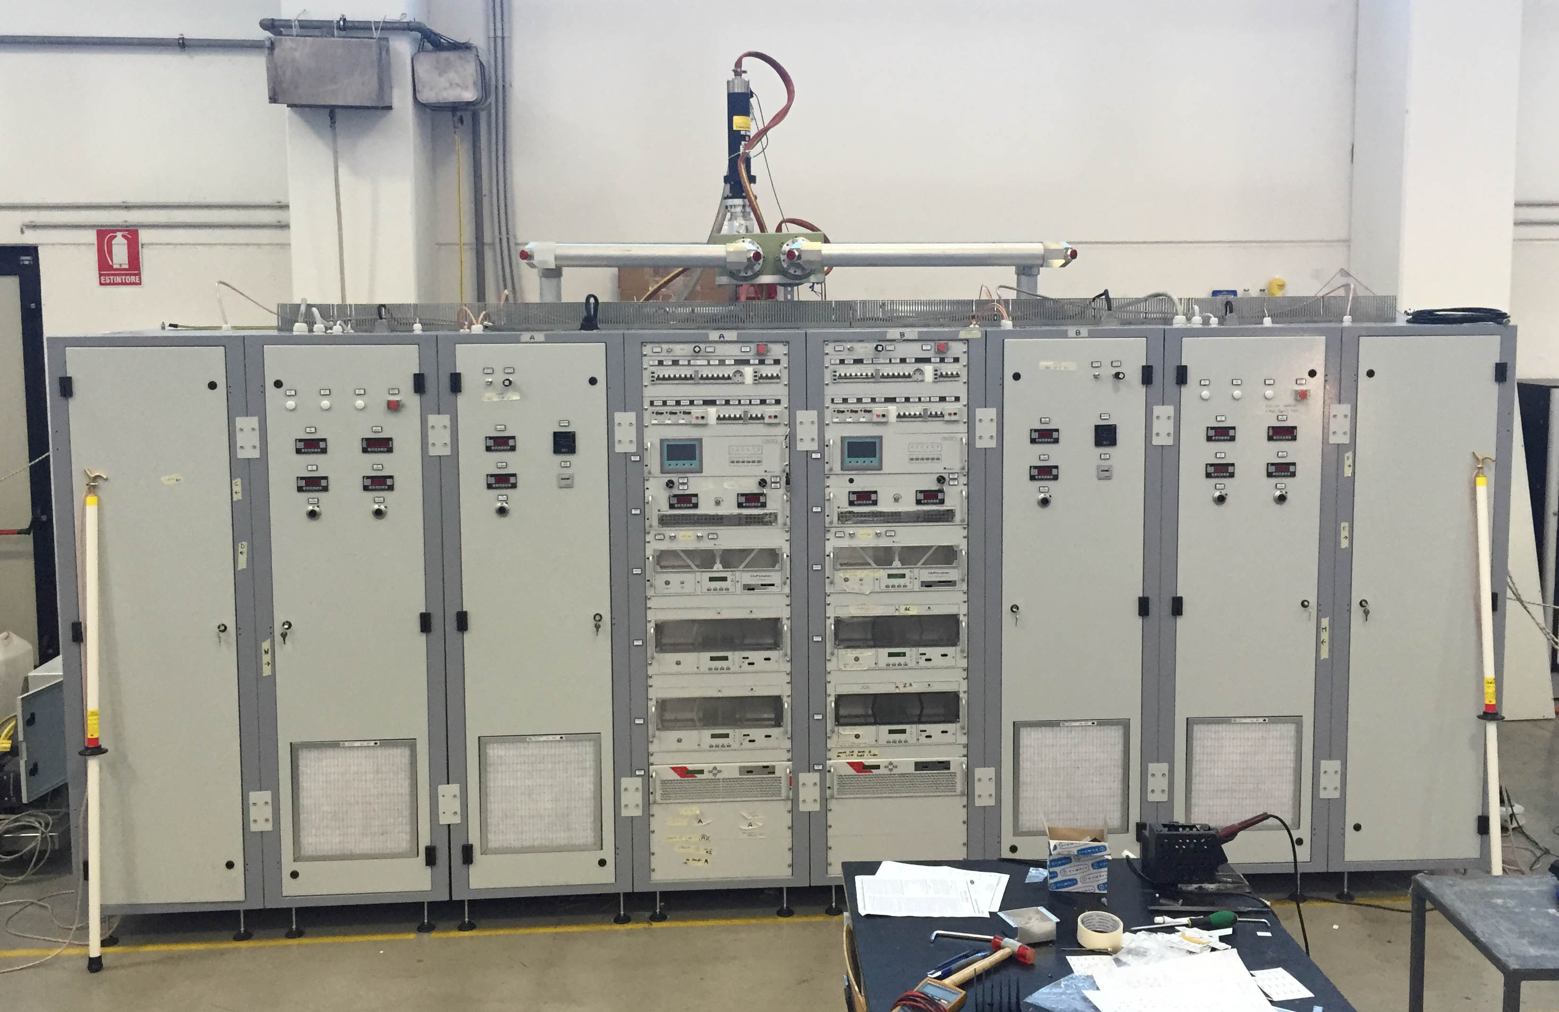
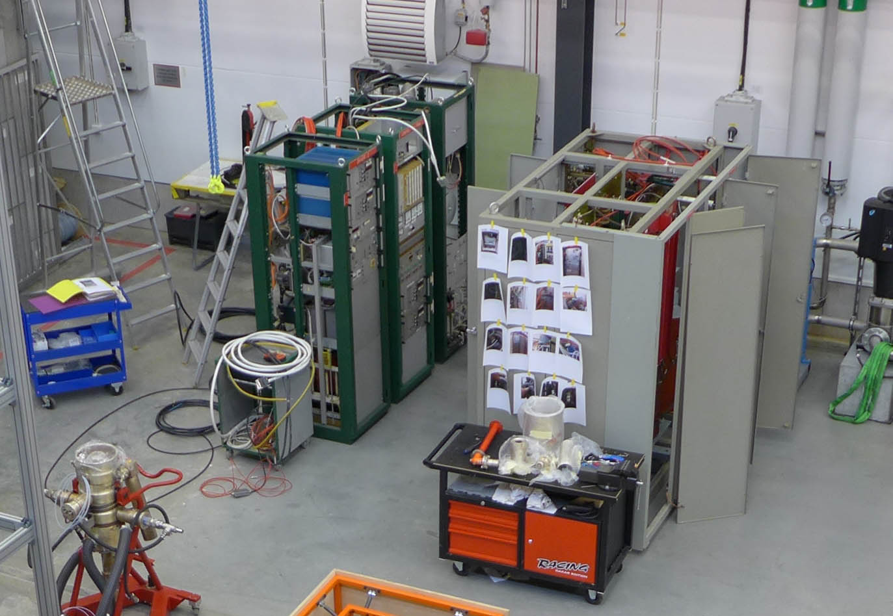
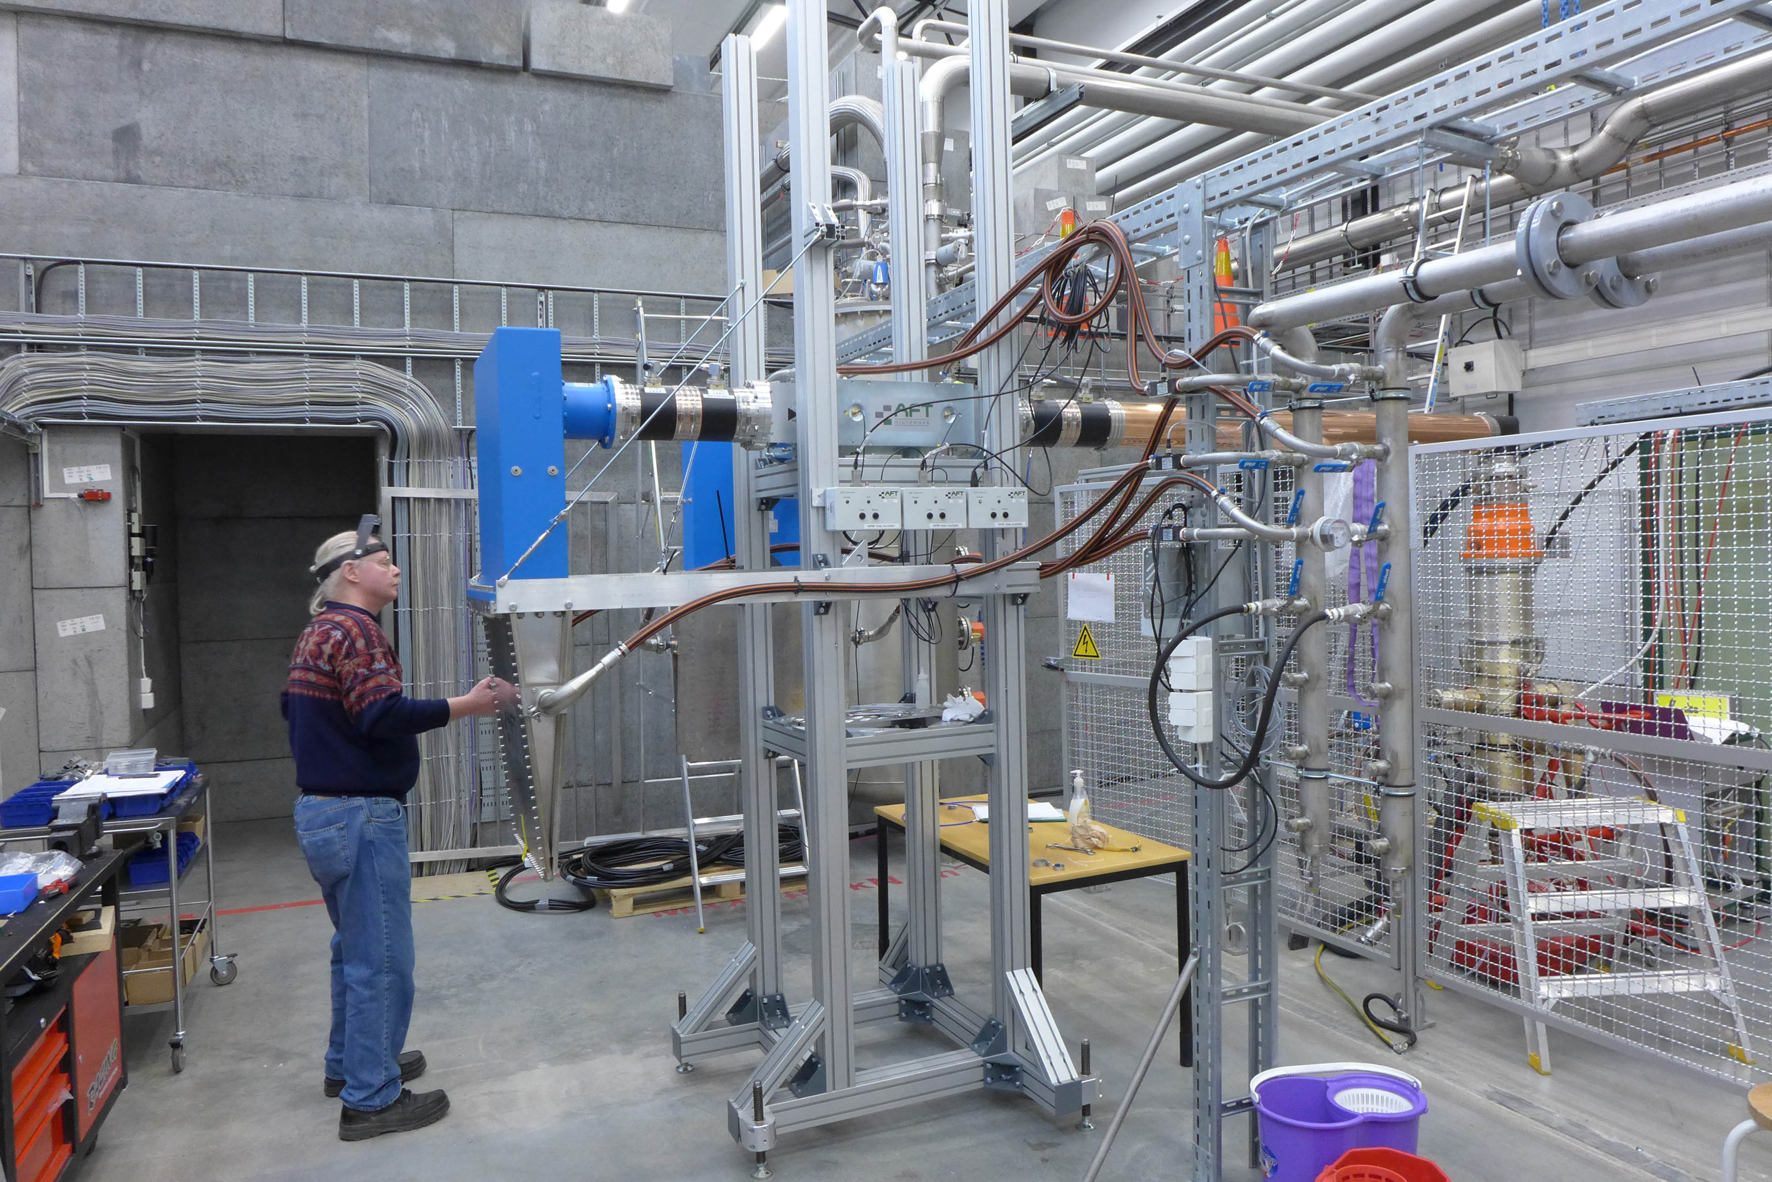
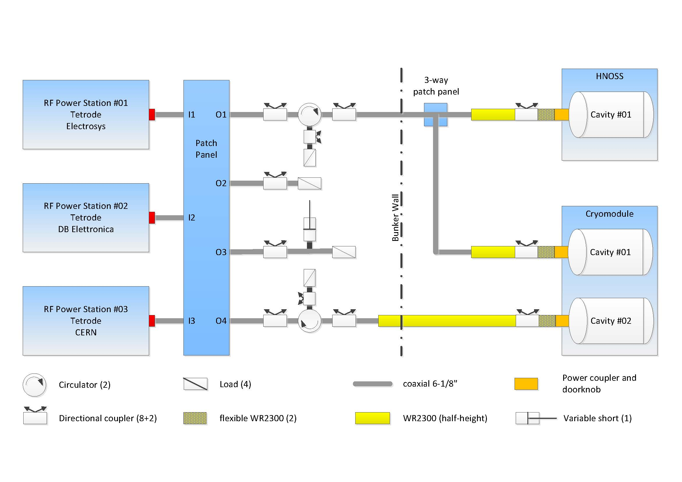
High Power RF Amplifiers
400 kW pulsed (352 MHz)
2 stations, each 2 tetrodes TH595(A)
3.5 ms, 14-28 Hz
50 kW CW (352/400 MHz)
single tetrode TH571b
RF Switch Board (coax)
~15 min switch time

Slide 6
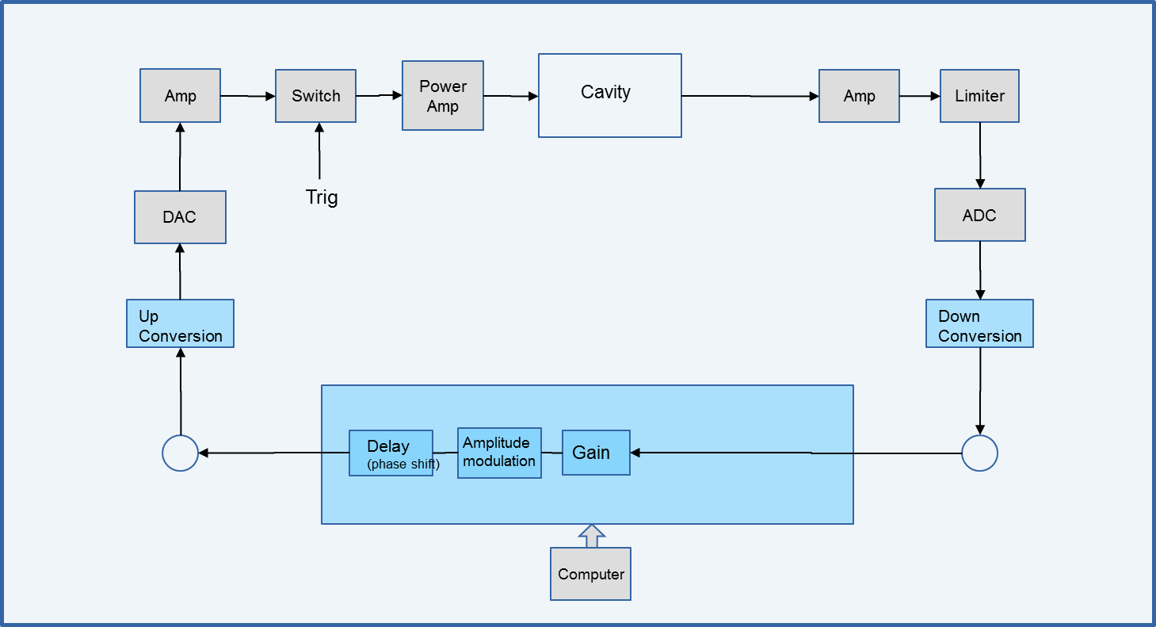
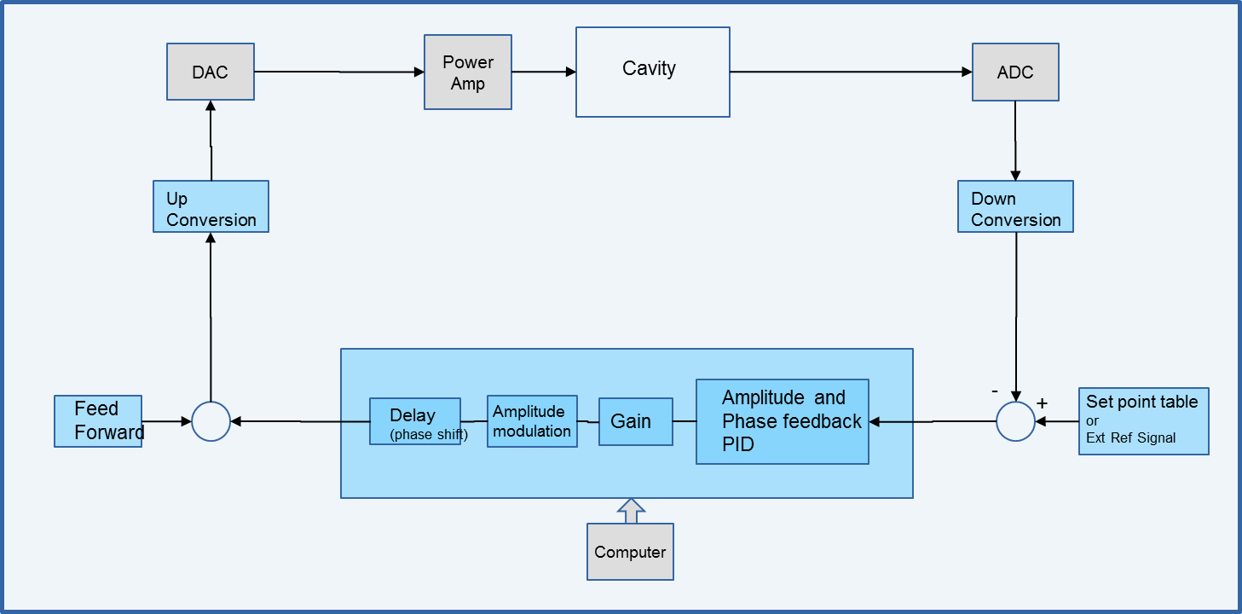
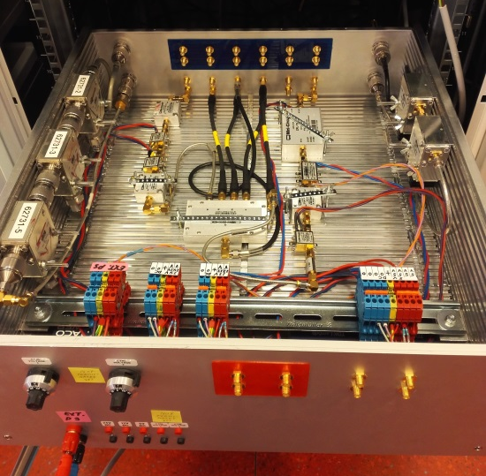
FPGA Based Digital LLRF
Signal Driven
Self-excited Loop
2 ADC inputs at 250 Msps
(*) analogue bandwidth of 750 MHz
2 DAC outputs at 500 Msps
Digital downconversion to baseband 0 Hz, no analog mixers
downconverted signal at 10 Msps or 1 Msps, selectable
undersampling to operate at any frequency from 10 to 750 MHz*
CW or
pulsed mode
switch closes the loop for a duration of 3.2 ms, repetition rate of 14 Hz.
Code in the FPGA

Slide 7
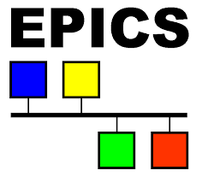
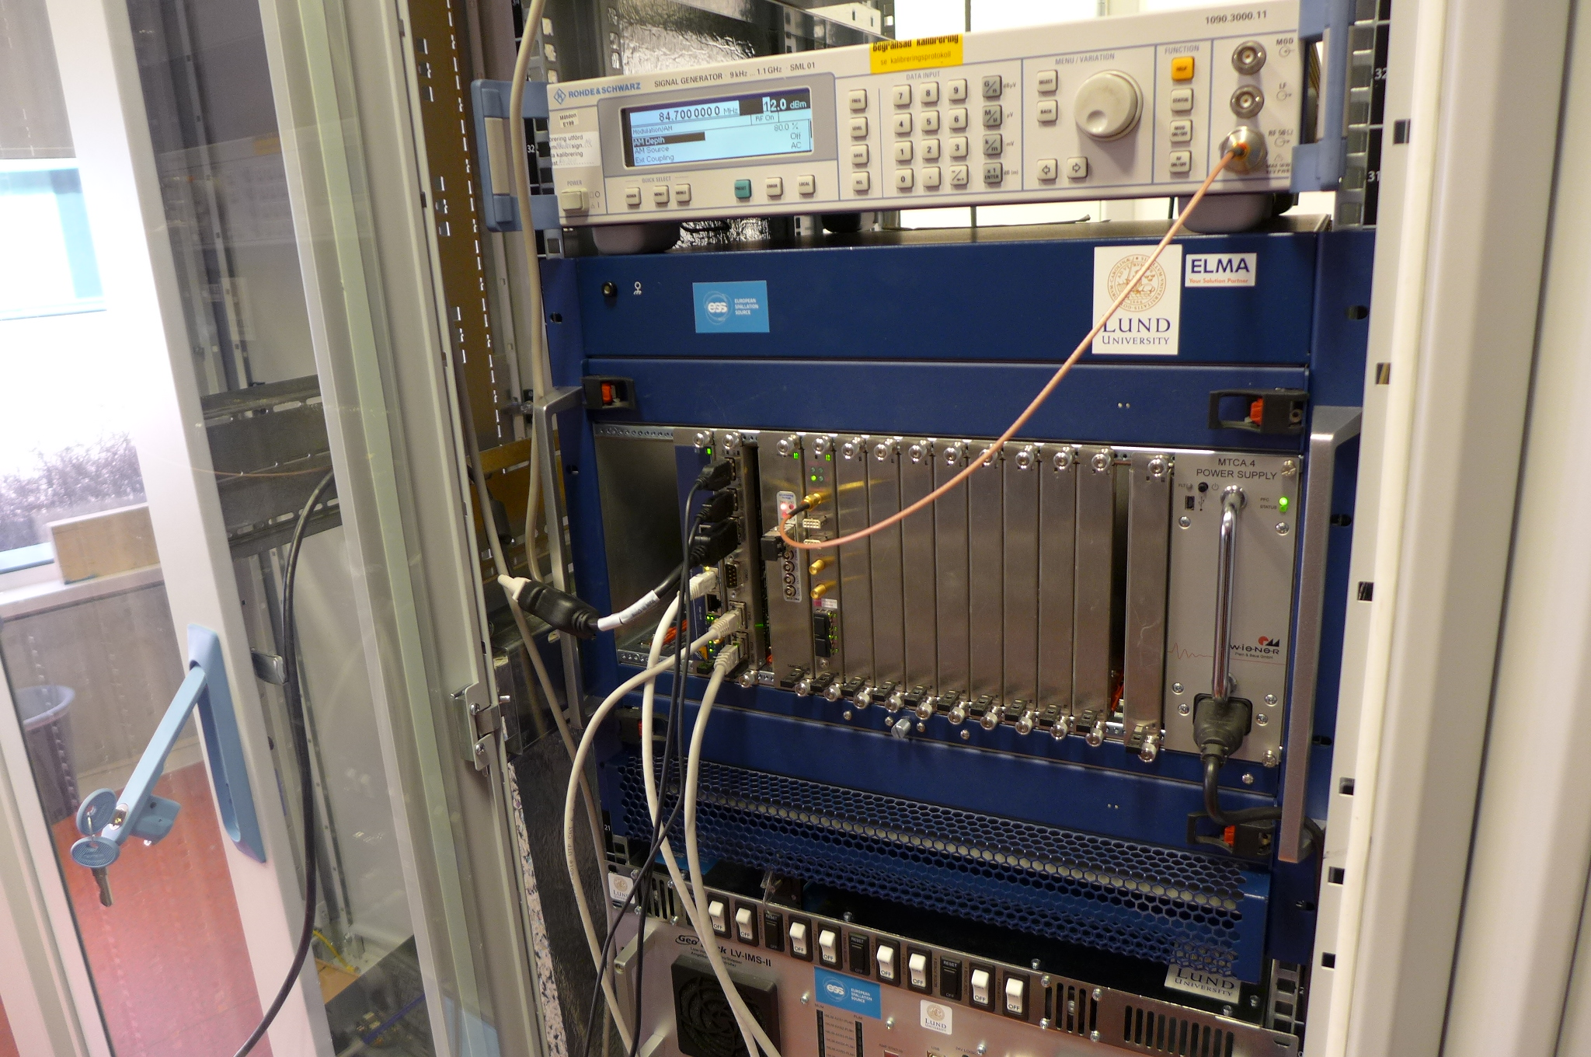
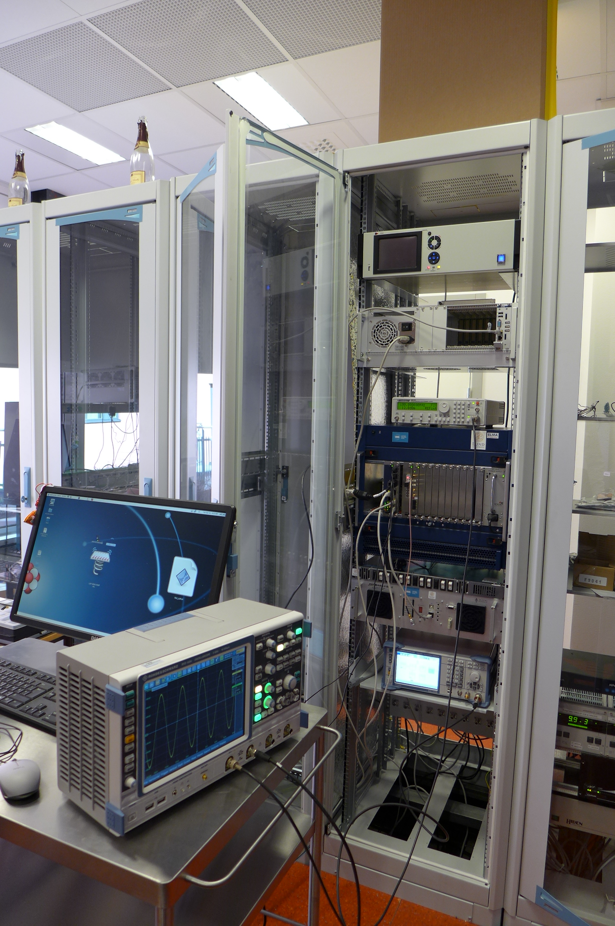
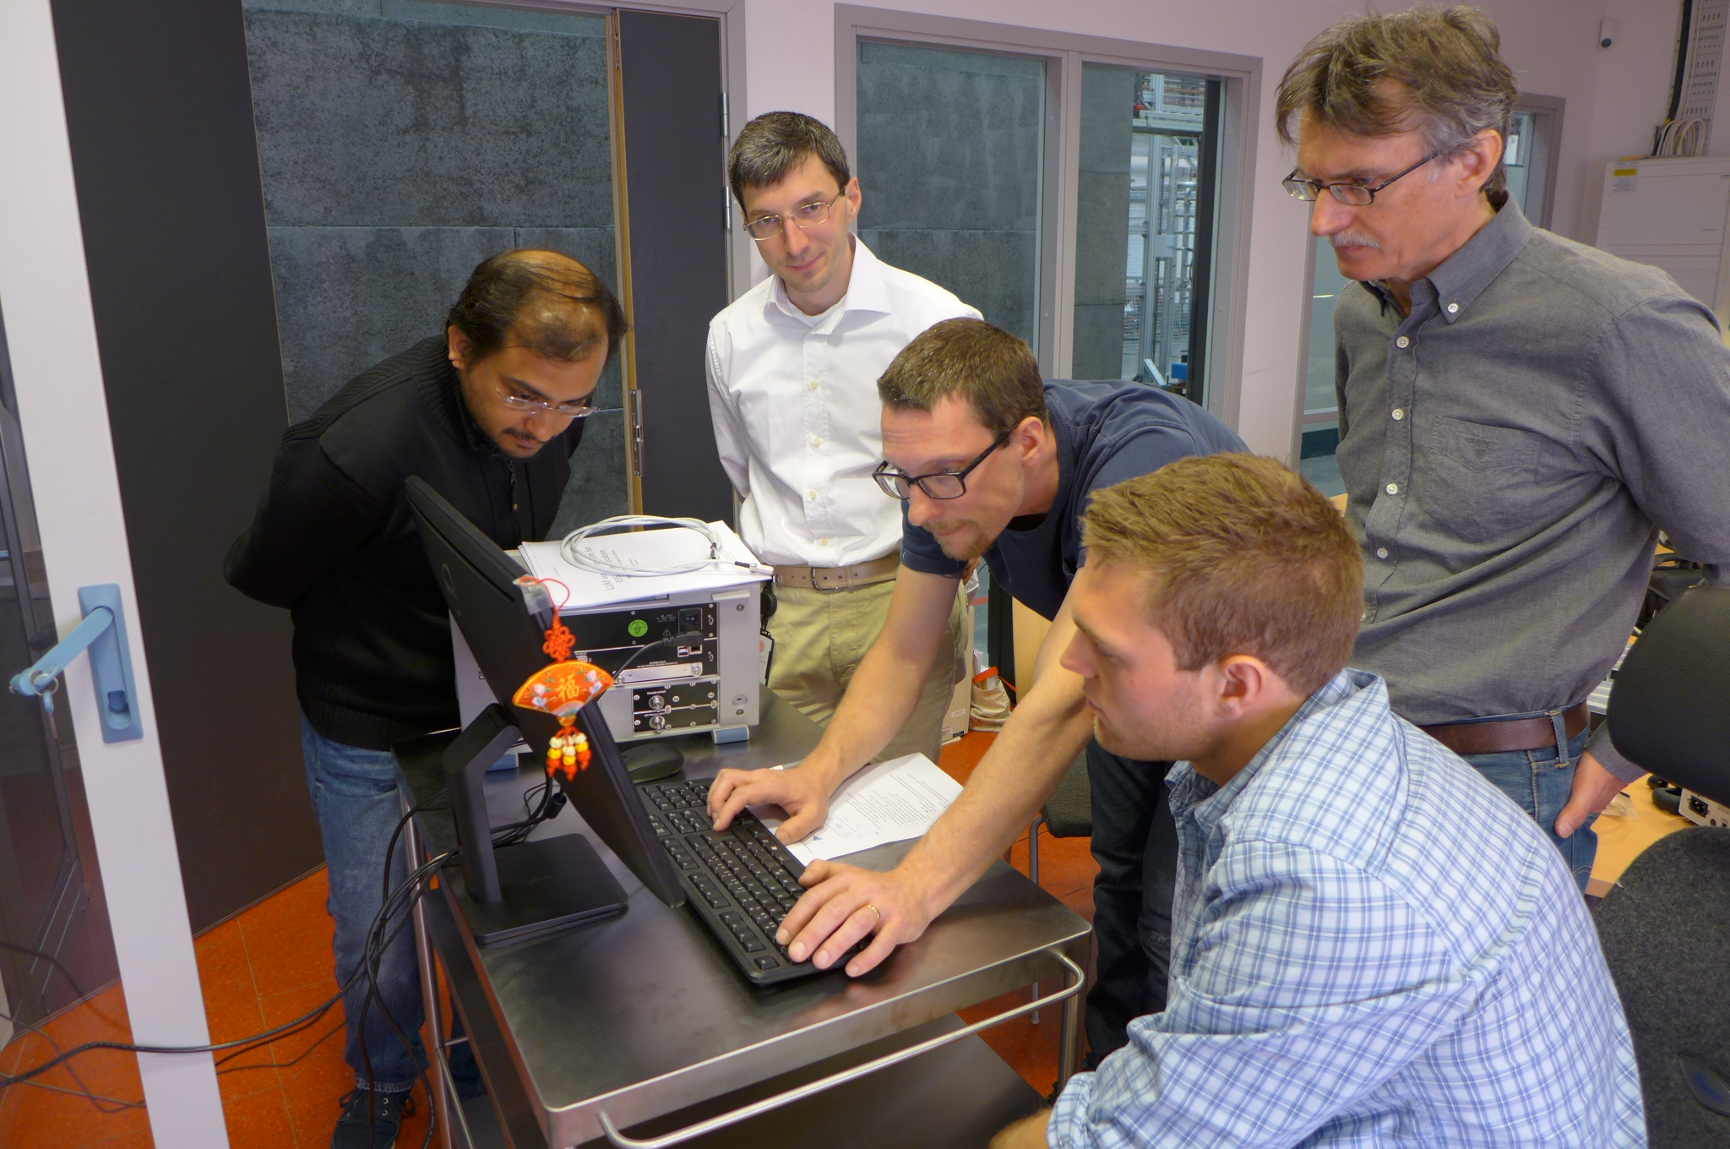
Controls and Measurement
Slow Controls & Safety Interlock
quench detection
connecting different sub-systems: cryogenics, cryostats, powering, ...
Siemens PLC + Nat.Instr. cRIO
LabVIEW
power coupler auto conditioning
pulse length, power level, (rep rate=14 Hz)
SEL control and data acquisition
monitor cavity profile (IQ)
cavity frequency shift tracing
dynamic Lorentz force detuning
EPICS
user interface
data archiver

Slide 8
Ongoing Maintenance Work
Cryomodule
water flow meters
added filter, installed new meters → seems ok for the moment
Cryogenic system
loosing small amount of helium gas during operation
suspect leak in the recovery compressors
recovery compressors run below capacity
looking for replacement compressor
Control system
implementing the valve box and cryomodule in EPICS
LLRF implementation (new system version)
Improving software
automatic conditioning and measurement software

Slide 9
Prototype Spoke Cryomodule Testing
cryomodule Experience so far

Slide 10
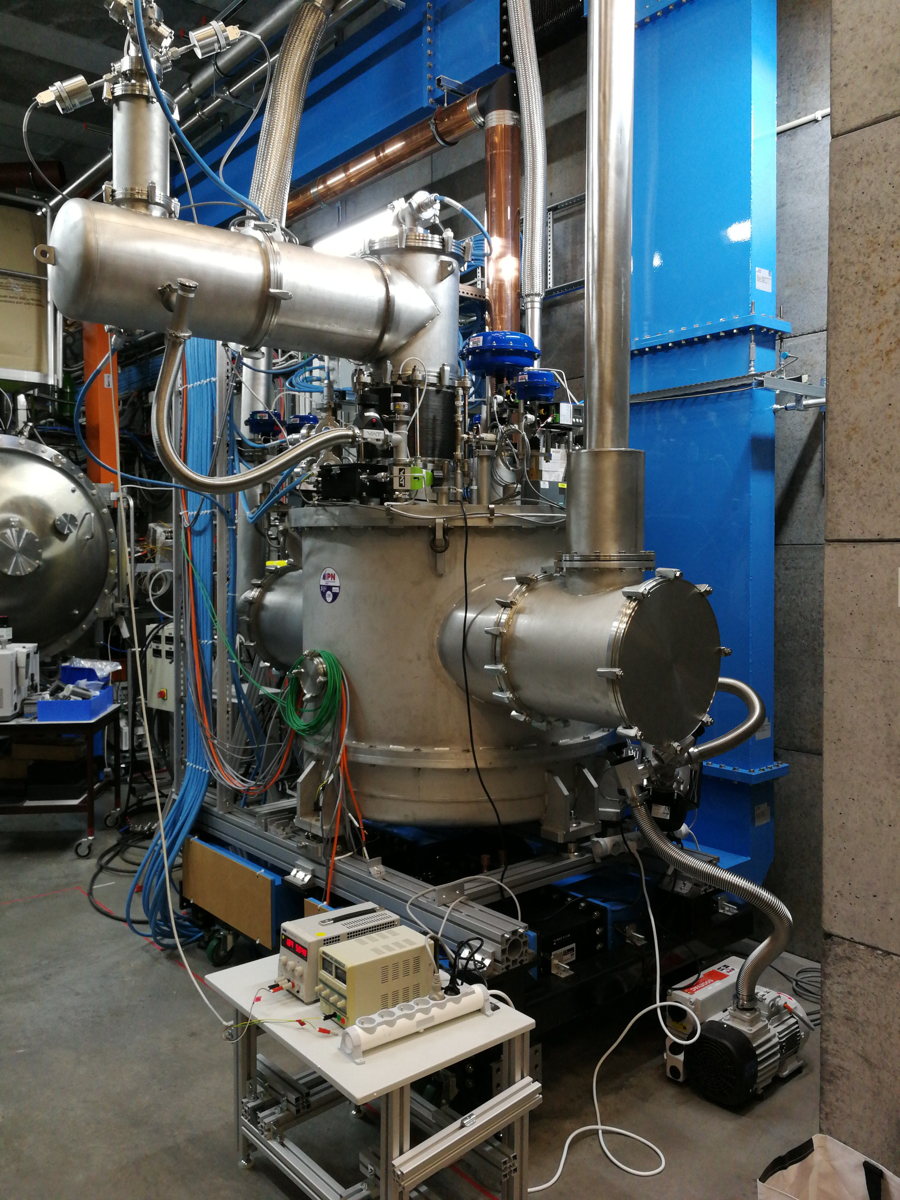
Spoke Valve Box Prototype
Cryo test run with simulator (Dec + Jan)
commissioning controls & functionality test
Thermo-acoustic oscillations
installed RLC-circuit to damp the oscillations

Slide 11
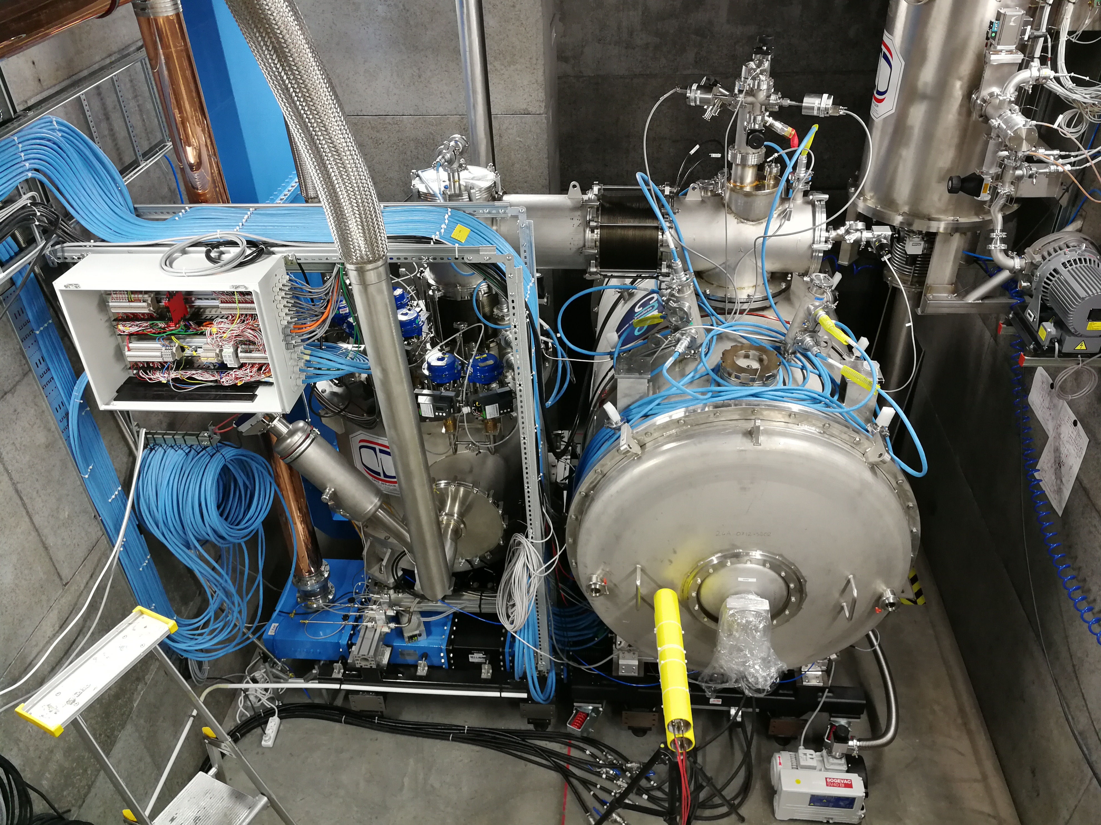
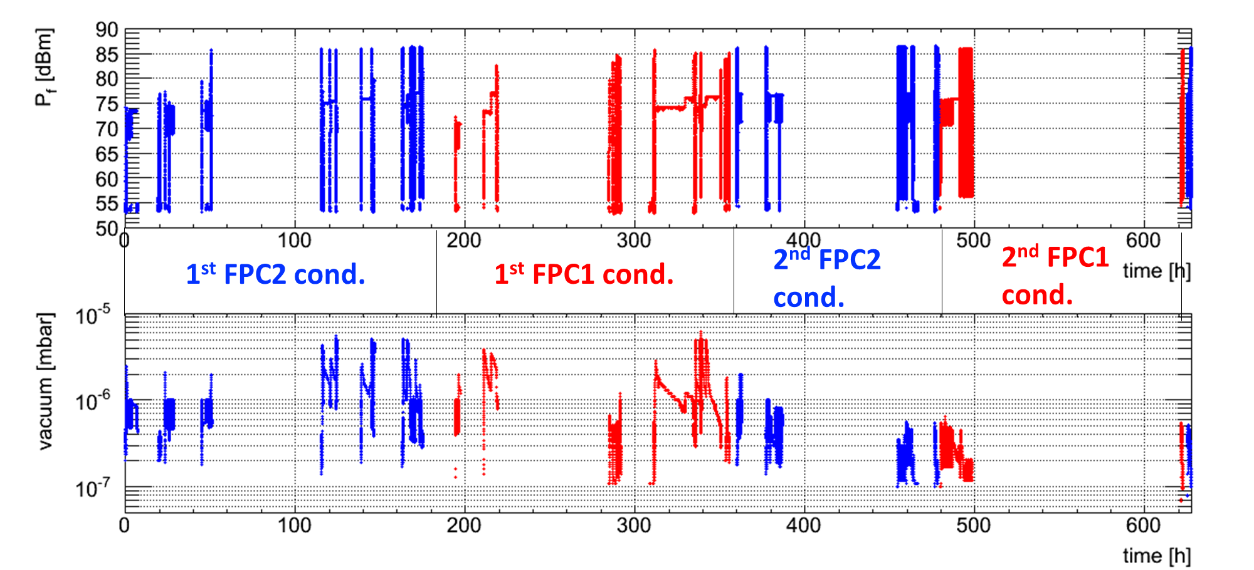
Warm RF Conditioning
~3 days/cavity
1st conditioning ~50 hours
2nd conditioning ~20 h (cross-contamination)
fully automatic system conditioning system
commissioned and implemented to run 24h/day
MP bands consistent with HNOSS test
strength depends on pulse length,
1st/2nd conditioning…

Slide 12
Cool Down
Cool Down
4h 15min to 4.5 K
2h 30 min for shield
~1/2 day to 2 K
including stabilization

Slide 13
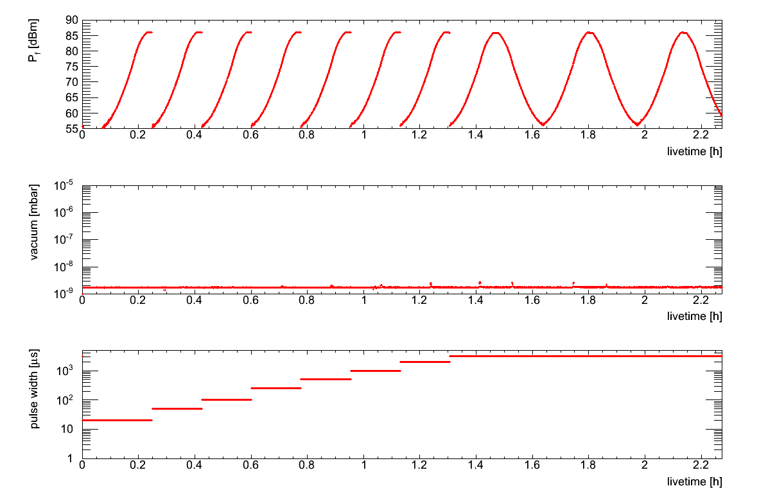
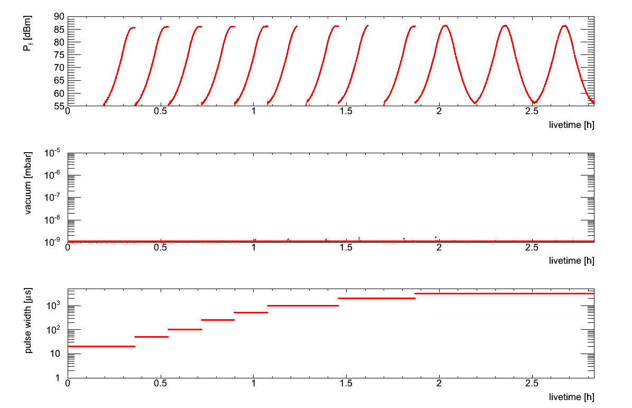
Cold RF Conditioning
FPC1
FPC conditioning (4K)
no coupler activity
Quench during cavity conditioning at 4 K
burst disc rupture → thermal cycling
implemented quench detection
from now on always at 2 K
FPC conditioning (2K)
~1/2 day/cavity
Forward power (dBm)
vacuum
Pulse length
FPC2
Forward power (dBm)
vacuum
Pulse length

Slide 14
Overview FPC Conditioning
FPC1 | Warm | Cold
Real time [h] | 304 | 4.1
Intervention # | 17 | 2
Live time [h] | 76 | 2.3
Dead time [h] | 228 | 1.8
FPC2 | Warm | Cold
Real time [h] | 297 | 2.9
Intervention # | 23 | 1
Live time [h] | 78 | 2.8
Dead time [h] | 219 | 0.1
Re-conditioning is required due to cross contamination
Total conditioning timing was
about 4 weeks (real time),
can be improved to 7 days (based on live time) or
3 days if conditioning two couplers simultaneously

Slide 15
Cavity Conditioning
 | Cav1 | Cav2 1st run | Cav2 2nd run | Cav2 3rd run
live time [h] | 6 | 6.7 | 7.3 | 7.4
Loop | Open loop | SEL | SEL | SEL
Conditioning strategy | 1ms@ 14Hz 3.2ms@14Hz | 1ms@ 14Hz 3.2ms@14Hz | 3.2ms@ 1Hz 3.2ms@14Hz | 1ms@ 14Hz 3.2ms@14Hz
Different loop setting and conditioning strategies were studied
no significant difference was found in the time variation of cavity conditioning.
Open loop with a fixed repetition rate of 14 Hz would be an optimal option
Total cavity conditioning timing is about 2 days

Slide 16
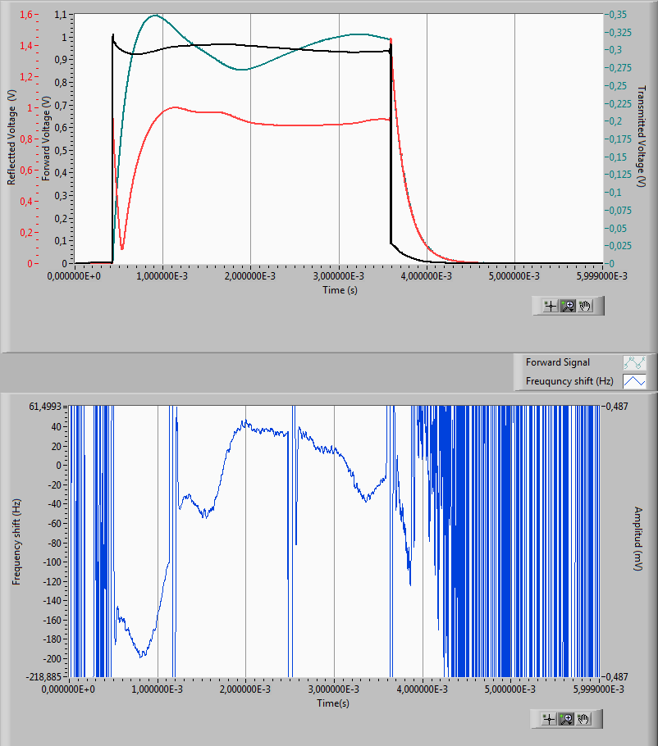
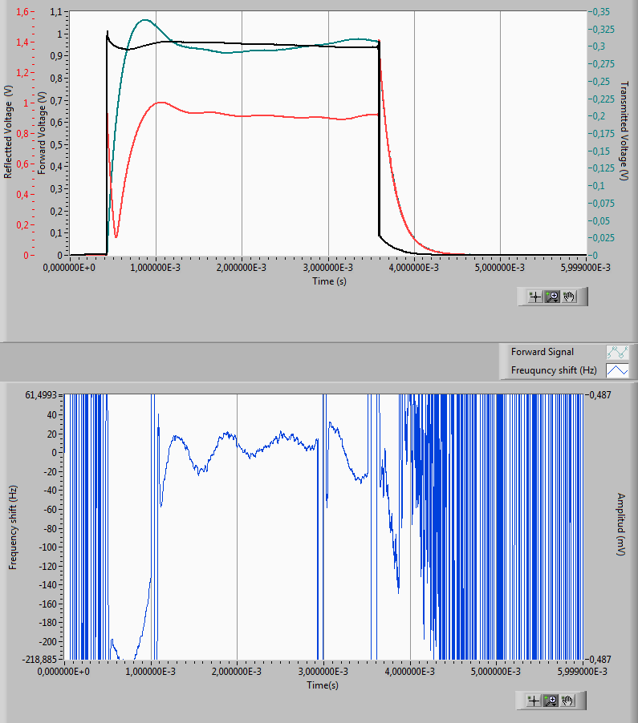
Spoke Cryomodule Prototype (2019)
Fast tuner performance
Lorenz force detuning compensation (piezo)
w/o correction
w/ correction
P_{fwd}
P_{ref}
P_{trans}
f_{shift}

Slide 17
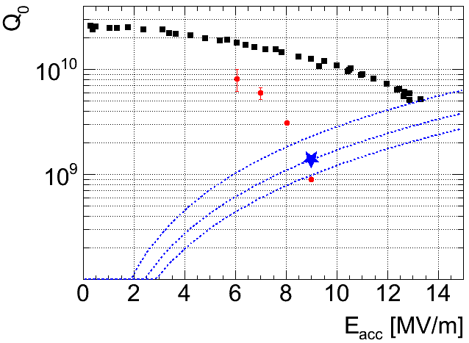
Spoke Cryomodule Prototype (2019)
Cavity #2 performance
multipacting regions similar as prototype
2-3; 4-5; 7-8 MV/m
field emission sensitive to tuner motion or position (under investigation)
thermal cycle cryomodule up to 40 K
outgassing up to 10-4 mbar observed around 20 K,
implying that hydrogen is vaporized from the cavity surface.
field emission almost back as before the CTS activities
maximum E_{acc} improved from 9 MV/m to 10 MV/m after thermal cycle
Q₀ performance of cavity2 recovered as before the CTS activities
FREIA CAV2 after tuner test (2019)

Slide 18
Series Spoke Cryomodule Testing
how to keep testing to 4 weeks, and
which additional resources required to achieve that?
outlook

Slide 19
There Will Be Differences ...
Prototype to 1st series cryomodule
5 people from IPNO did the prototype installation
none of FREIA was unfortunately able to follow up all the details
we should learn when removing the prototype
support frame / trolley is different
doorknob is different
instrumentation connectors are different
have to redo connectors on local cabling (and commission)
1st to following series cryomodules
pumping ports
trade-off between speed and safety
1st cryomodule can/will be tested with 2 pumps

Slide 20
Testing and Operation
2 hours for moving the tuner (1 hour for one direction)
thus there is an advantage to prolong the daily operation time
need & accuracy of the Q₀ value
measurement time depends on required accuracy
is it enough to give the upper limit of the power dissipation?
RF stations reliability and maintenance is a problem
need a good high power RF engineer
previous announcements did not result in a good candidate → try again
LLRF: waiting for a new system (replacing an old version)
hardware available, but no working system yet
integrated control system part needs more work
Documentation and test results
report should be ready before completing test next module/installation at ESS
also: agree on what & how to test (on reception, cold test, ...)

Slide 21
Critical Personnel Resources
During installation
1st cryomodule:
Patxi and Matthieu from IPNO, to teach us and check our work
1st + following
1 or 2 mechanics, to help us, and (if from ESS) for their training
During testing
on-site: 3 operators in CR for cryo, SRF, LLRF/controls
1 or 2 operators, to off-load Rocio/Lars + help extend daily operation time
on-call: high power RF
1 engineer, to assist Rolf & co
remote: LLRF
ICS/uTCA-LLRF expert from ESS (have no expertise at FREIA)

Slide 22
Critical Spare Parts
RF stations
extra RF station as back up, and/or
preferably same amount of spare tetrode tubes as in use
2 ordered: 1 to arrive end August, 1 in Feb 2020 (10 months delivery time!)
order more from Thales and/or can we rely on ESS stock?
LLRF
spare FPGA cards for Uppsala NI/LabVIEW system
spare µTCA cards in Uppsala, as delivery from Lund takes a few days
Other
cooling water flow meters (FPC)
preparing Eletta flow switches as back-up
RF power meters
want to keep the ESS power meters to speed up calibration procedures

Slide 23
Summary
Uppsala University & FREIA Laboratory doing their best efforts to make this project a success and on-time
Most critical resources
operator/technician
mechanic during installation
operator during testing
ICS remote support for LLRF
high power RF engineer
spare parts
tetrodes
LLRF
acceptance criteria

