Slide 1
FREIA Laboratory
Facility for Research Instrumentation and Accelerator Development
Accelerator Development
in Uppsala
Roger Ruber
J-PARC, 6 June 2019

Slide 2

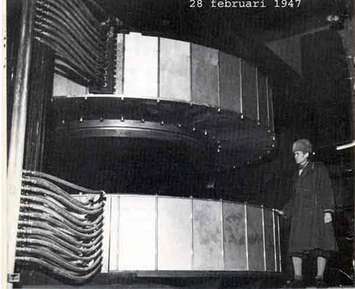
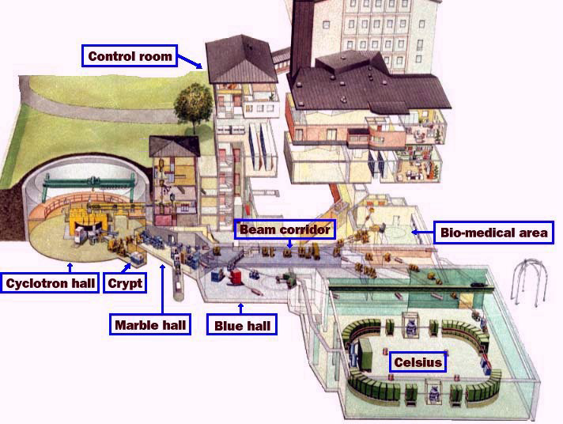
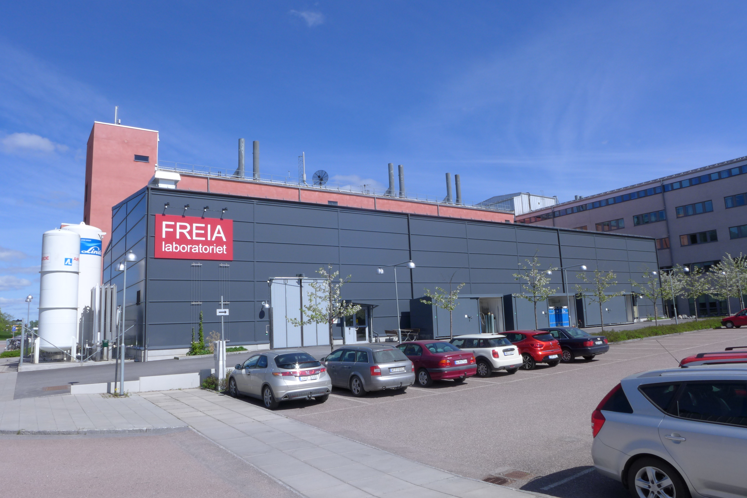
Uppsala Accelerator History
1477: Uppsala University, oldest in Scandinavia
25'000 students, 7'000 staff
historical profiles: Linné, Rudbeck, Celsius, Ångström, Svedberg
1940's: The(odore) Svedberg builds a cyclotron
Gustaf Werner synchro-cyclotron (1947 - 2016)
  nuclear physics & oncology
CELSIUS ring (1984 - 2005)
  nuclear & particle physics
2000's: External projects
CTF3/CLIC (since 2005)
FLASH/XFEL (since 2006)
ESS (since 2009)
2010's: New ventures
FREIA laboratory (est. 2011)
Skandion clinic (est. 2015)

Slide 3
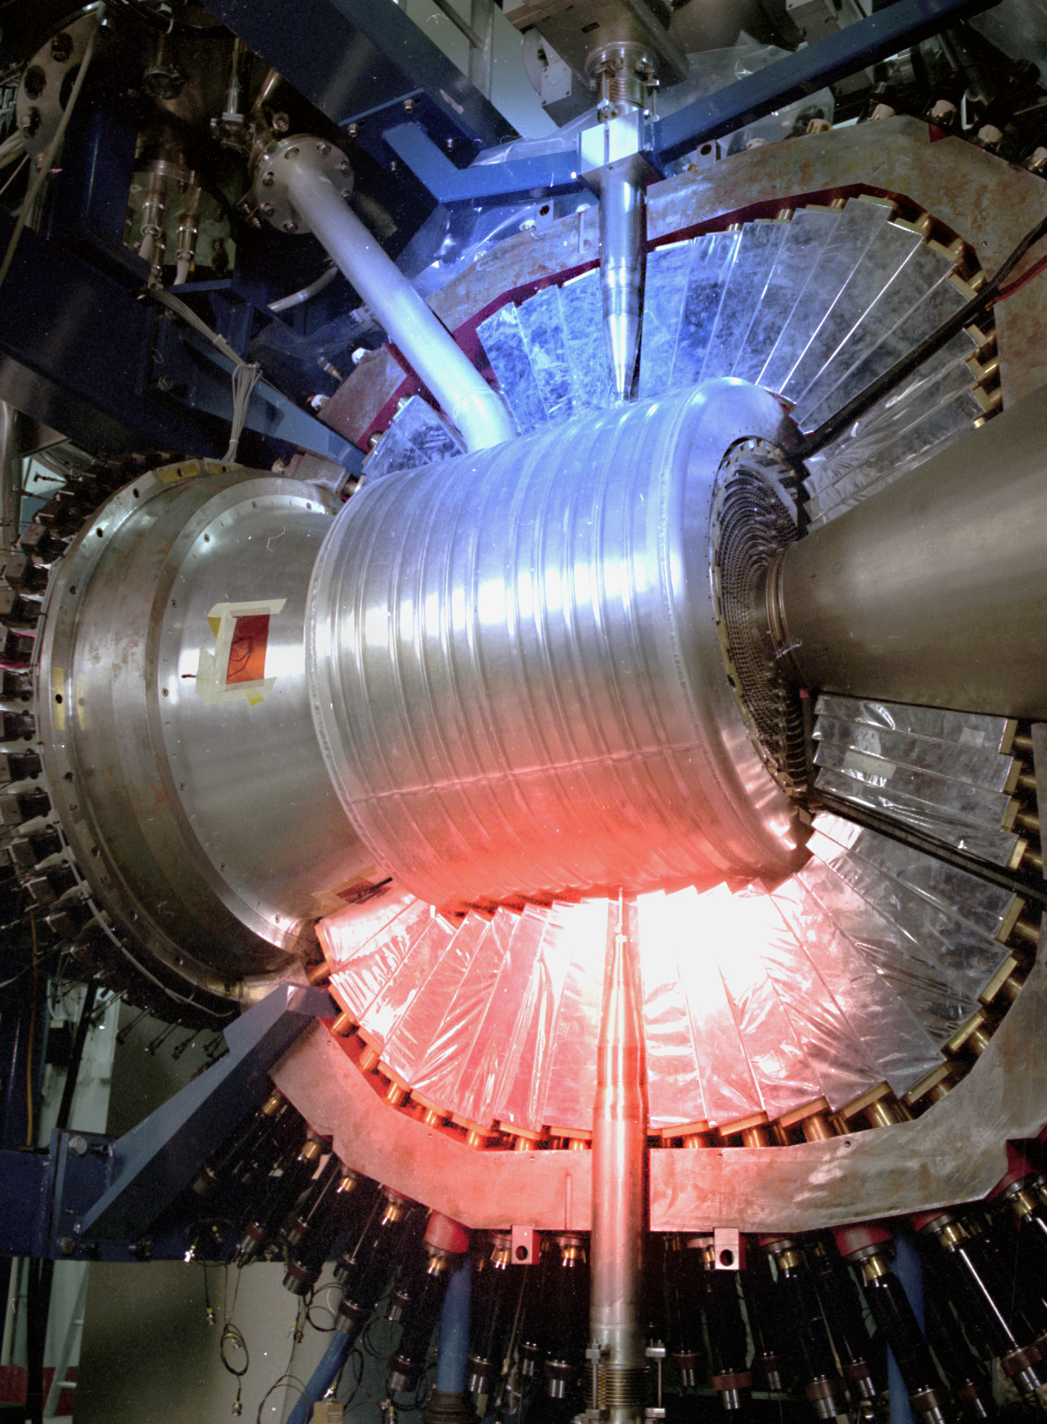
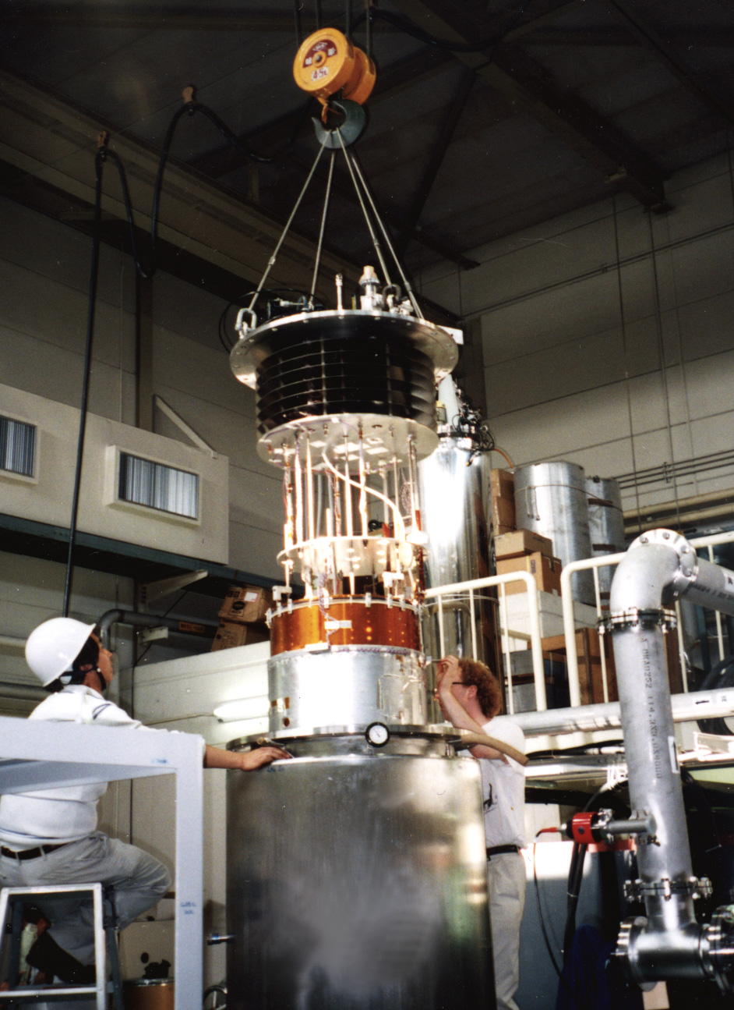
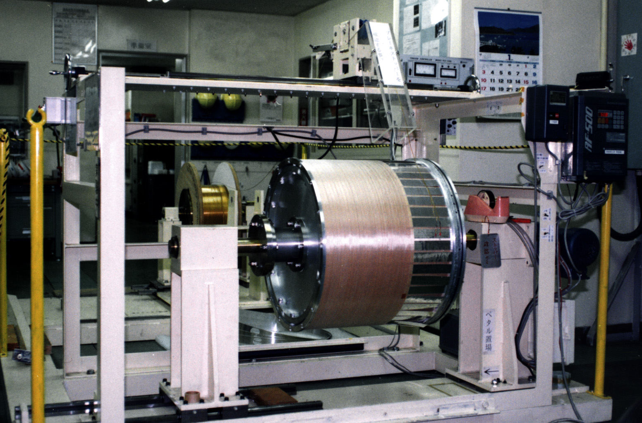
KEK & WASA Superconducting Solenoid
1991-2006 WASA Solenoid
study rare π⁰ and η decays at CELSIUS
  using internal pellet target
KEK contributes ultra-thin solenoid
  1992-1996 construction & test at KEK
2006 move to Jülich (Germany)
2019 move to GSI/FAIR (Germany)
WSCS (1993)
WSCS (1994)
WASA (1999) T. Thörnlund

Slide 4
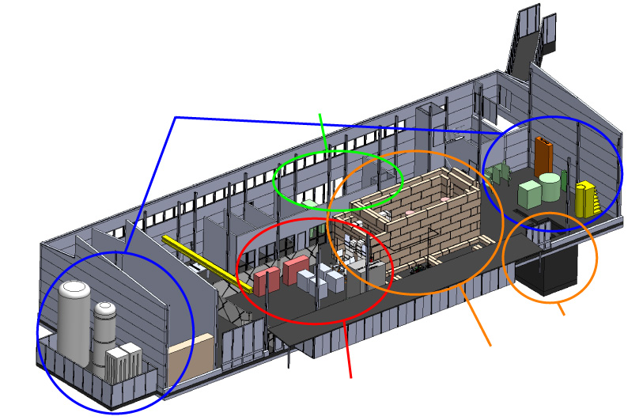
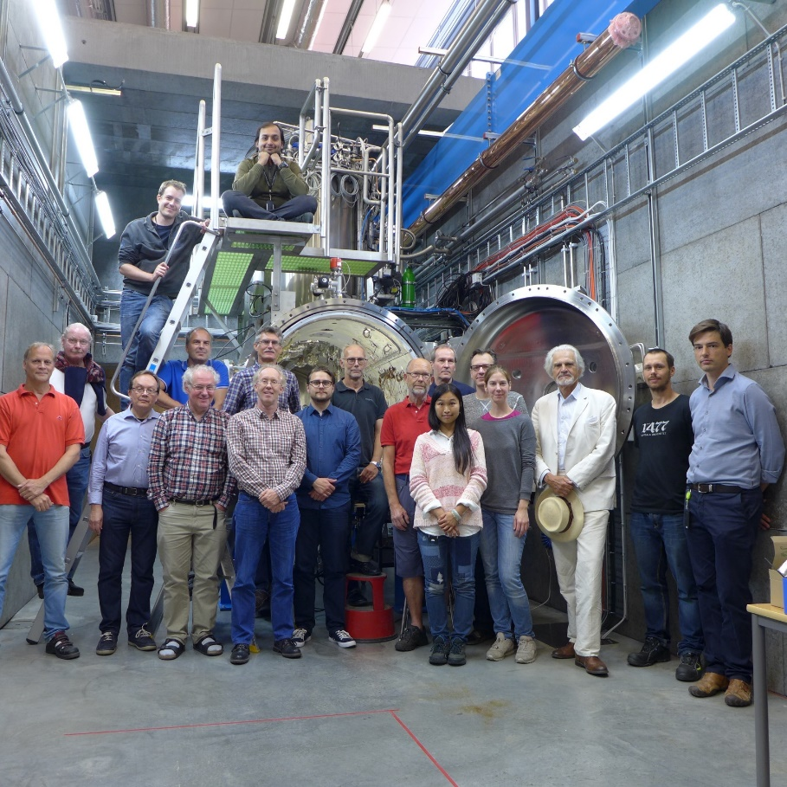
FREIA Laboratory
Facility for Research Instrumentation and Accelerator Development
Funded by
KAWS, Government, Uppsala Univ.
State-of-the-art Equipment
cryogenics
- liquid helium
- liquid nitrogen
control room
- equipment controls
- data acquisition
Competent and motivated staff
collaboration of physics (IFA)
and engineering (Teknikum).
vertical cryostat
3 bunkers
with test stands
horizontal cryostat
radio-frequency (RF) power sources

Slide 5
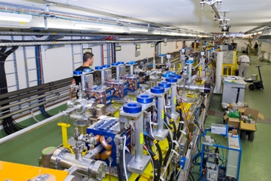
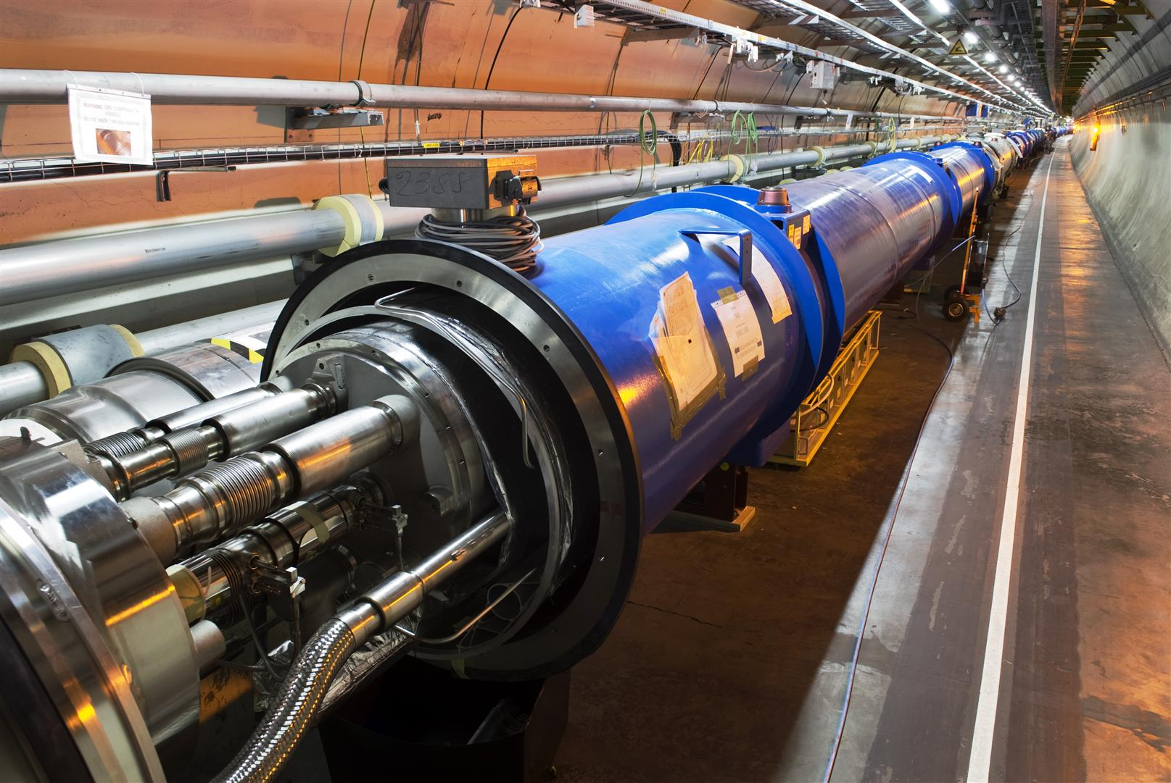
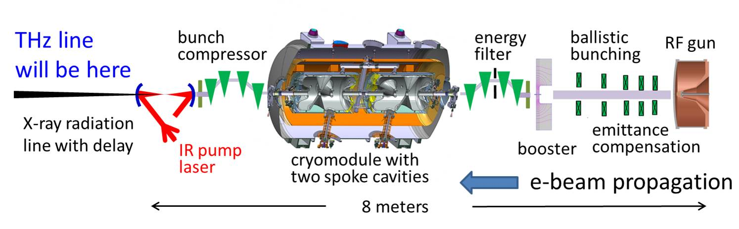
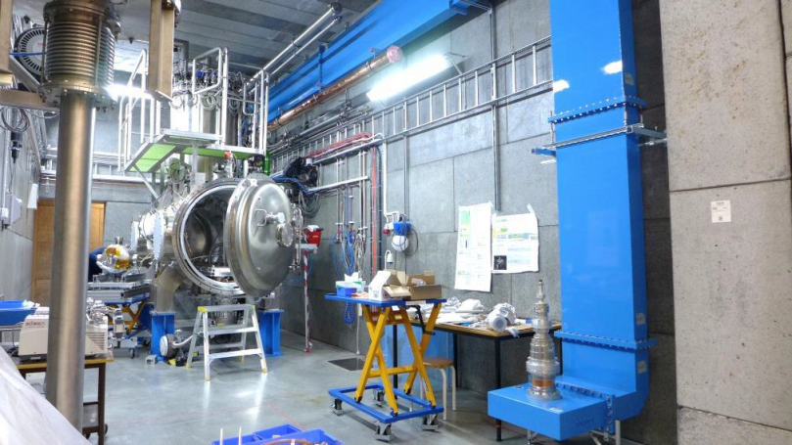
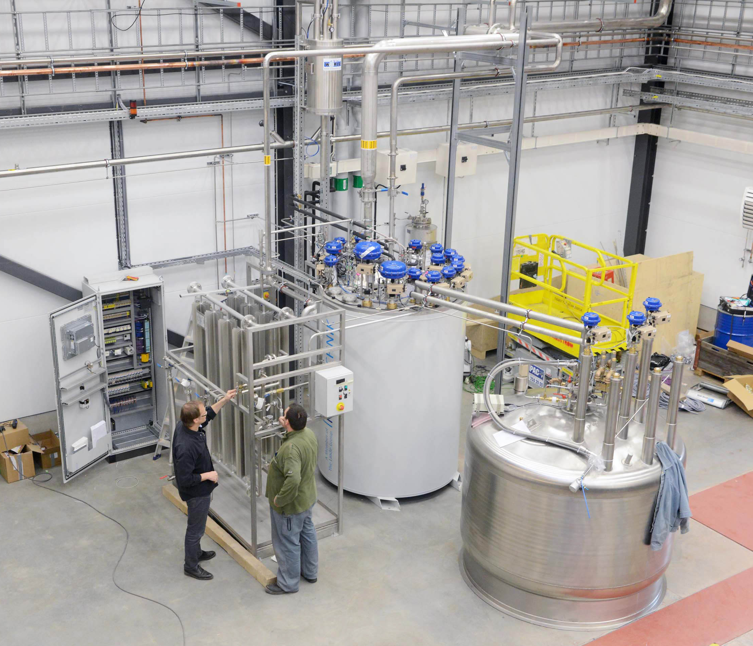
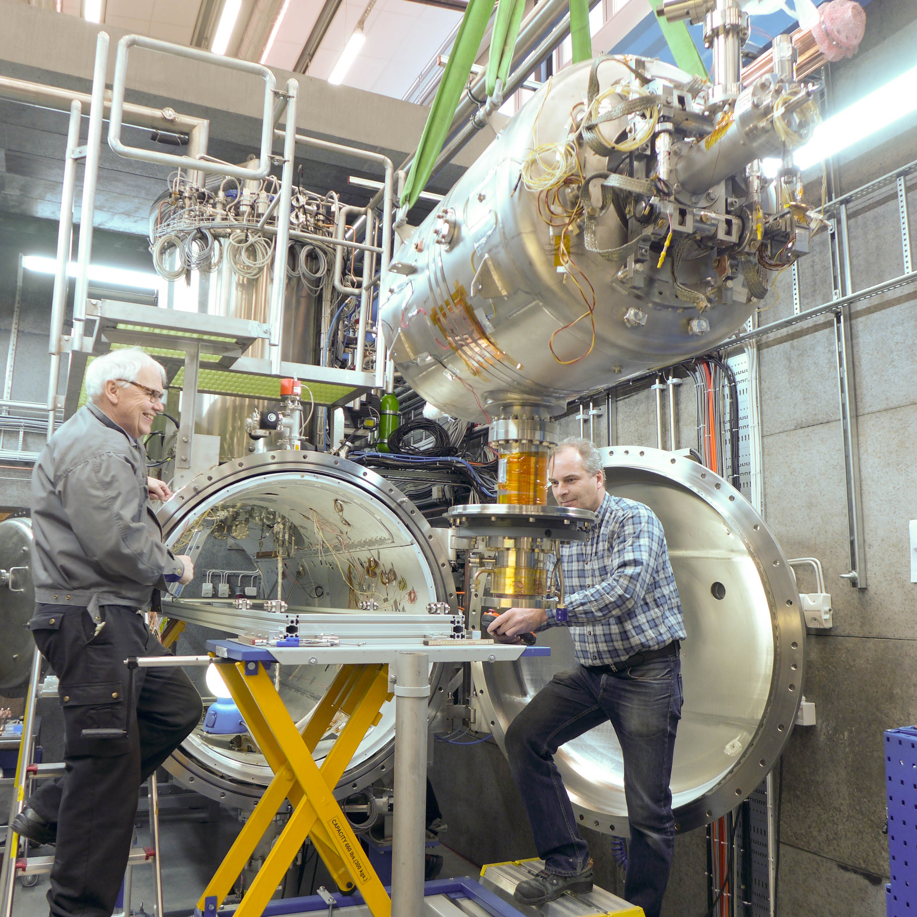
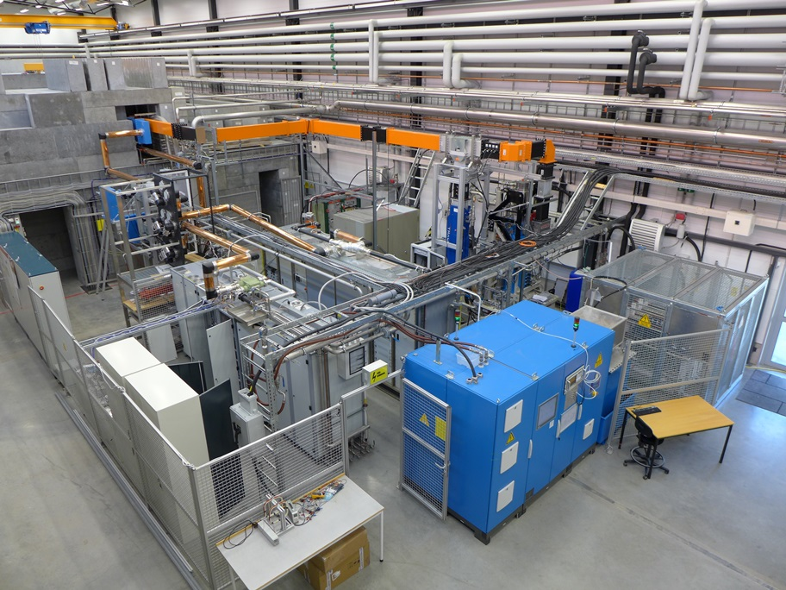
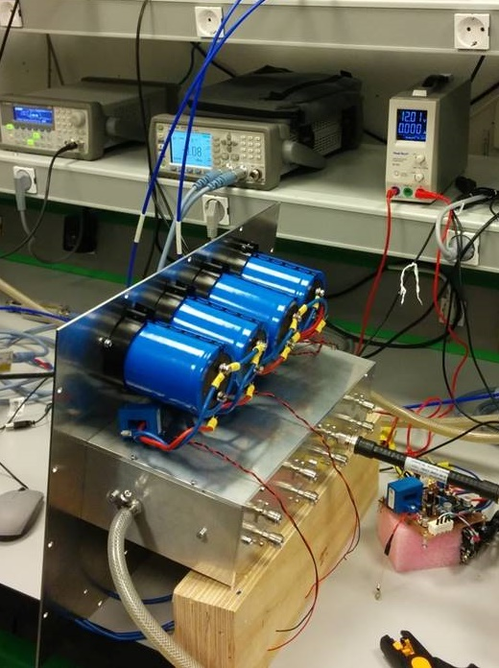
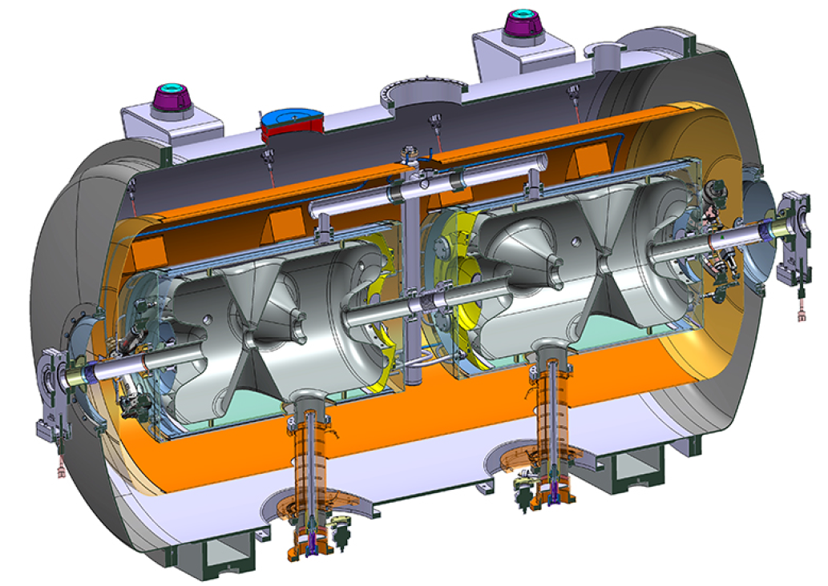
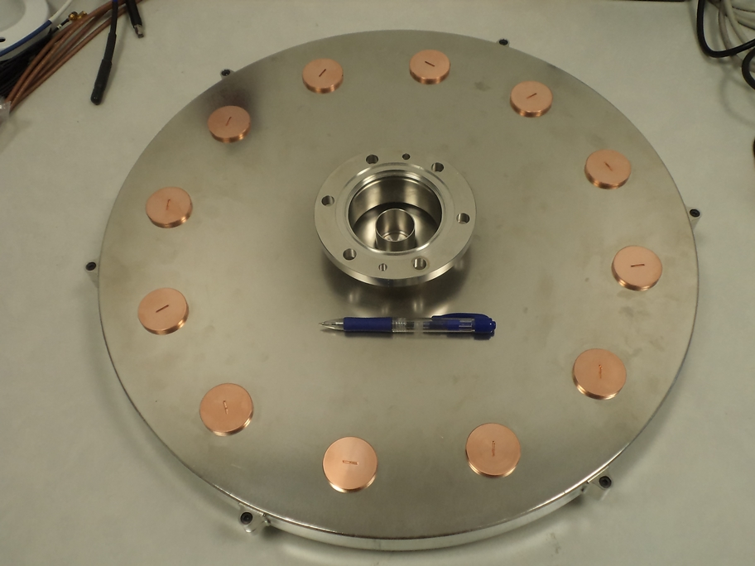
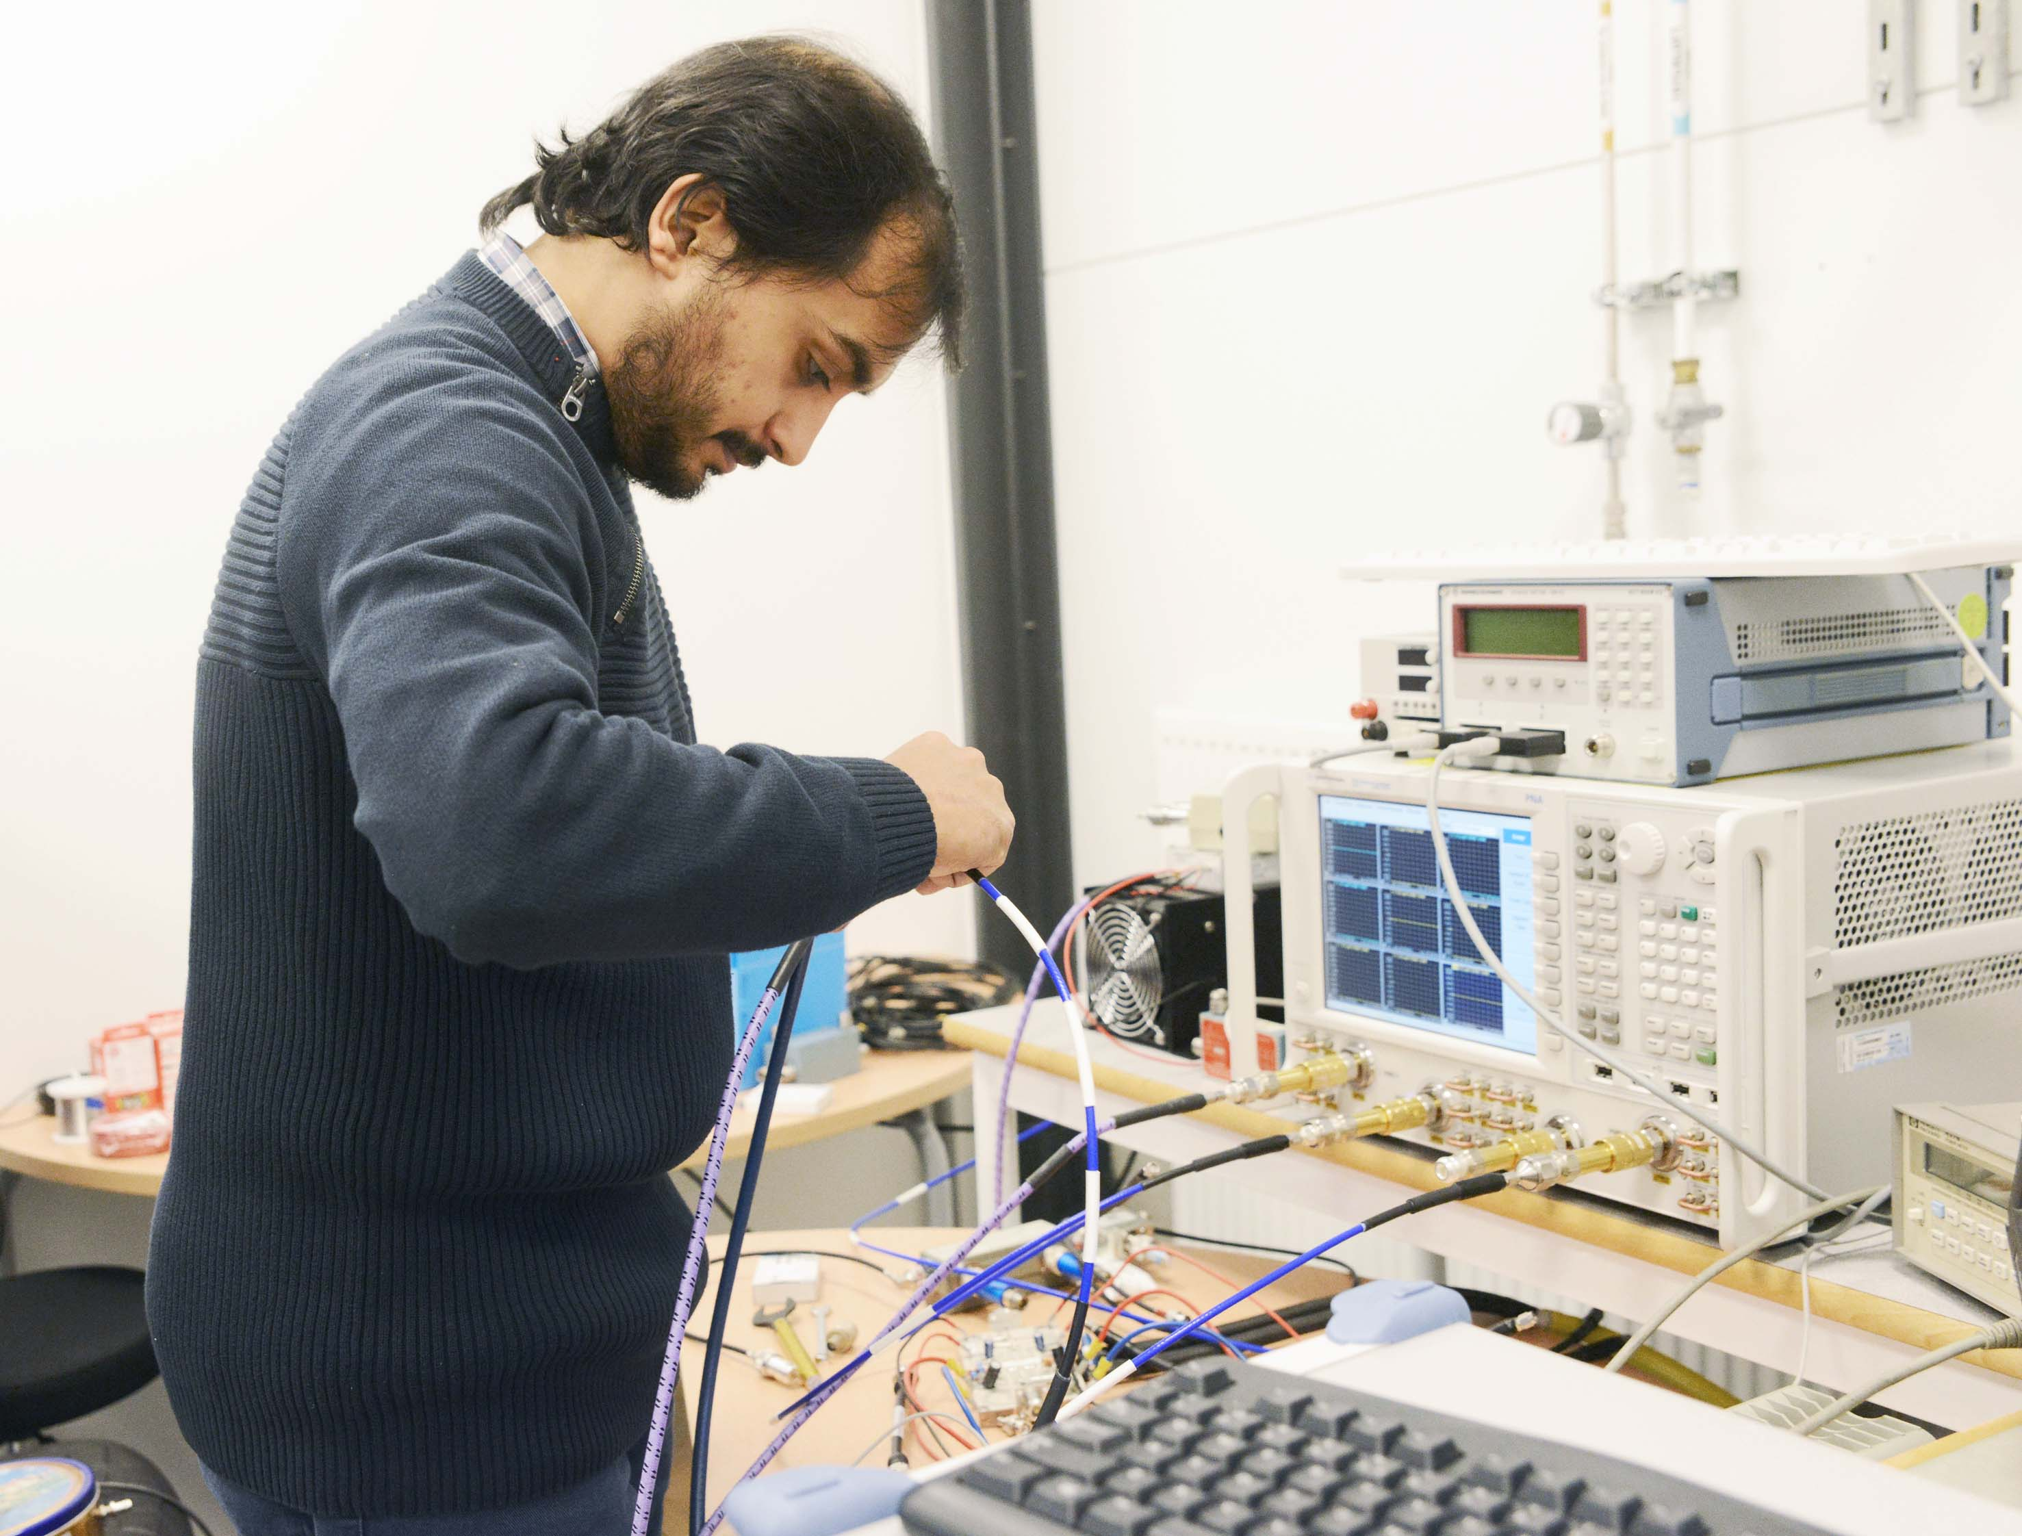
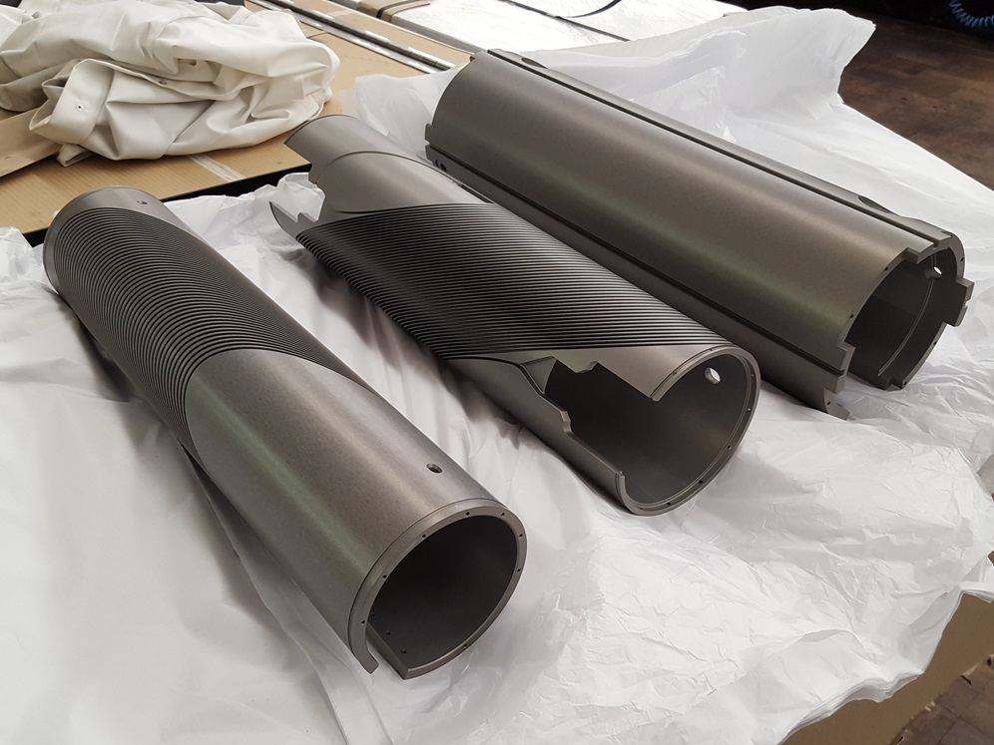
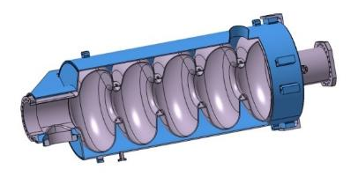
Accelerator Research & Development
Ultra Bright Electron Beams
High Intensity Proton Beams
Accelerator
Physics
Cryogenics & Test Stands
SC Cavities & Magnets
RF Generation & Control
Accelerator
Technology

Slide 6
Overview of Cryogenic Test Stands
cryogenic test stands

Slide 7

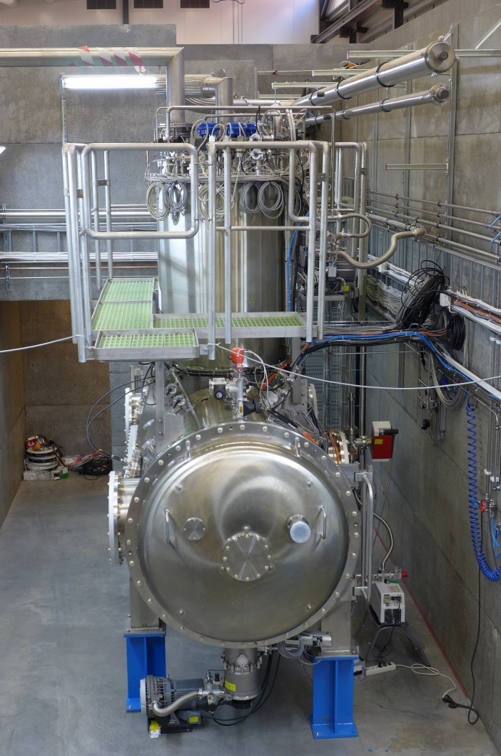
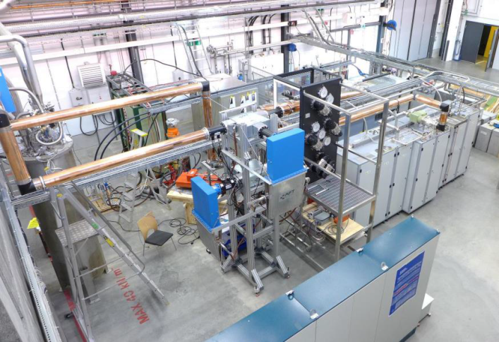
“HNOSS” Horizontal Cryostat
HNOSS = Horizontal Nugget for Operation of Superconducting Systems
Test of superconducting cavities/devices
  3240 x ø1200mm inner volume
  up to two cavities simultaneously,
  each equipped with helium tank,
Low or High power RF testing
  fundamental power coupler (top, bottom, side)
  (cold) tuning system
Operation in the range 1.8 to 4.5K.
Available as ARIES
Trans National Access Facility

Slide 8
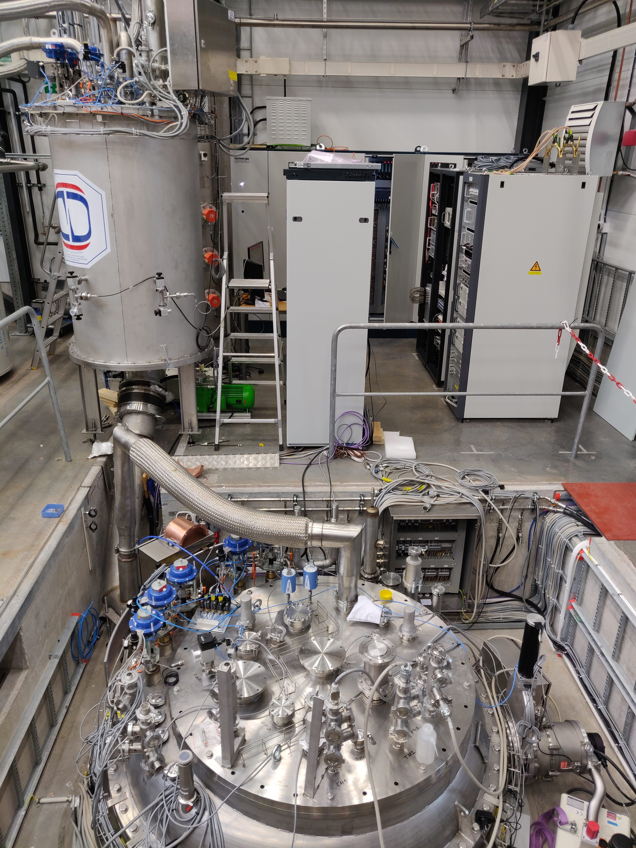
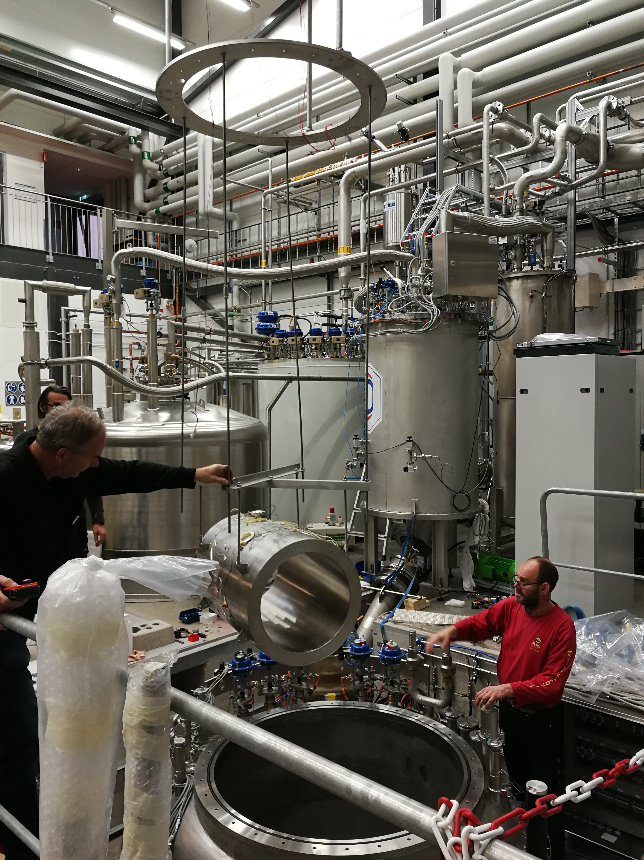
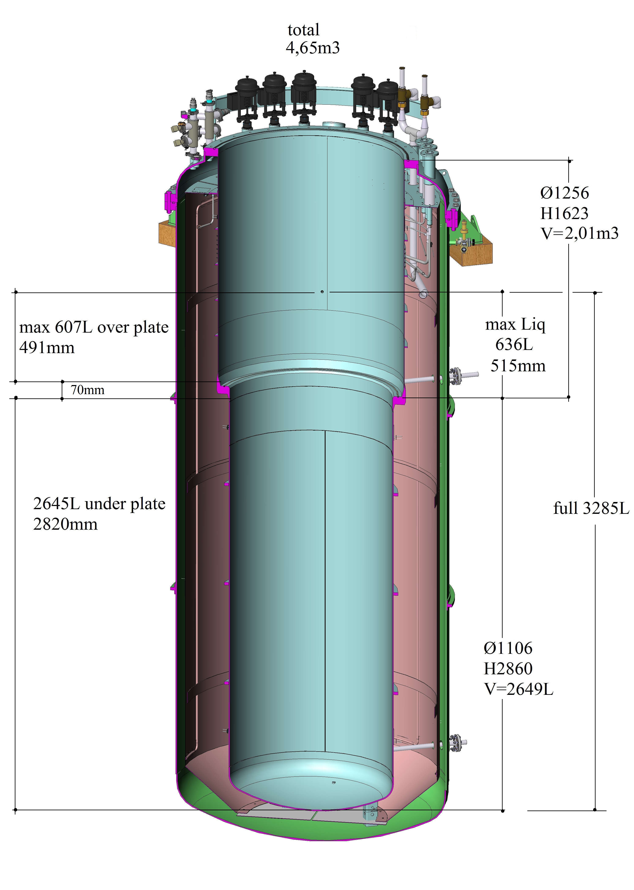
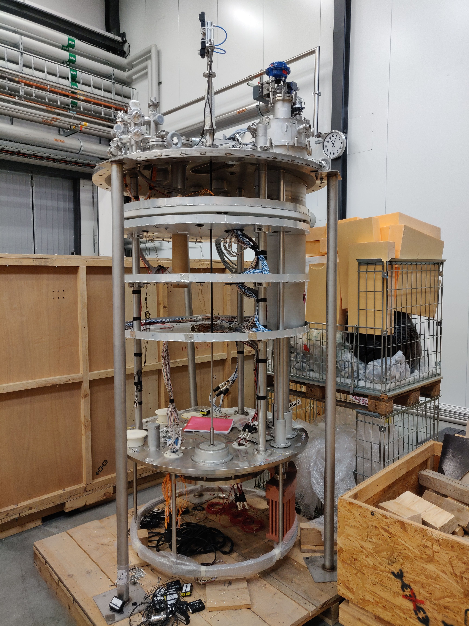
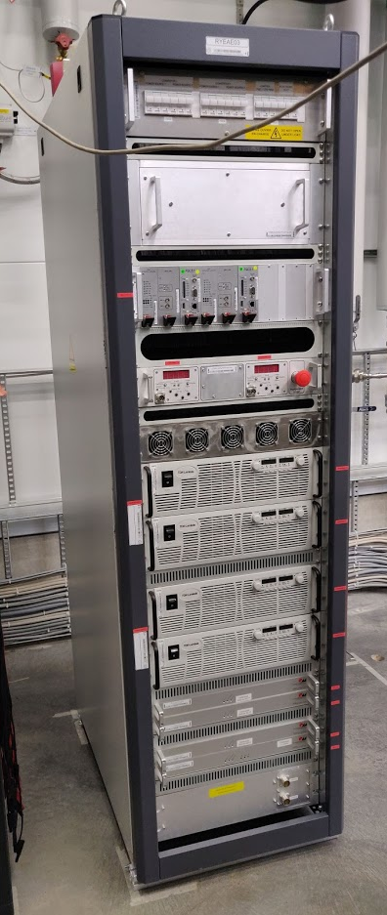
“Gersemi” Vertical Cryostat
Under commissioning
Test of SC cavities & magnets (<350kJ)
  3.2m x ø1.1m total volume
  2.65m x ø1.1m below lambda plate
    design includes joint for lambda plate
Three operation modes
  vacuum; liquid bath; pressurized
  (bath with 2K heat exchanger)
Operation in the range 1.8 to 4.5K
Available as ARIES
Trans National Access Facility
2 x 2000 A

Slide 9
Development of High Power RF Technology
RF Generation & Control

Slide 10

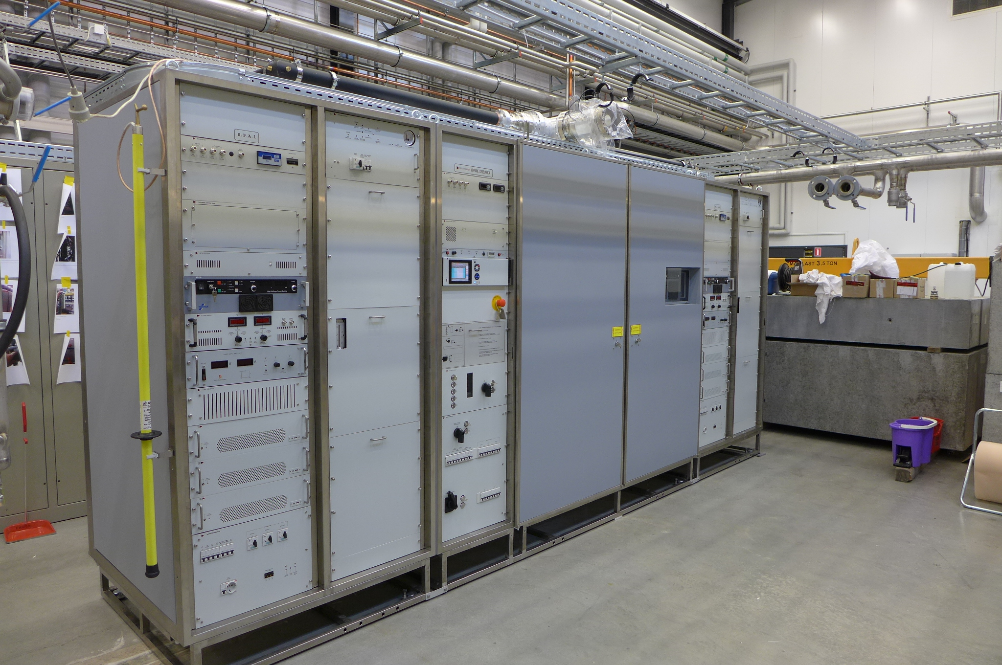
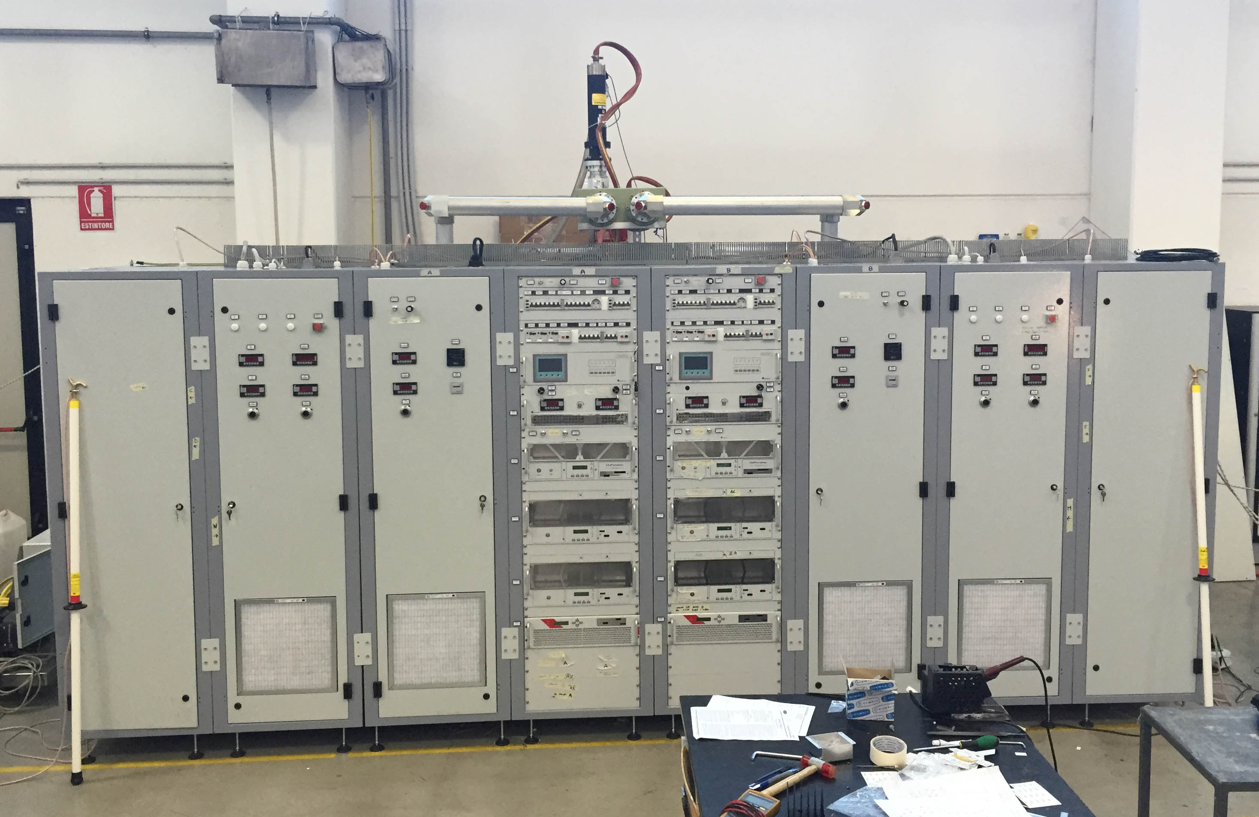
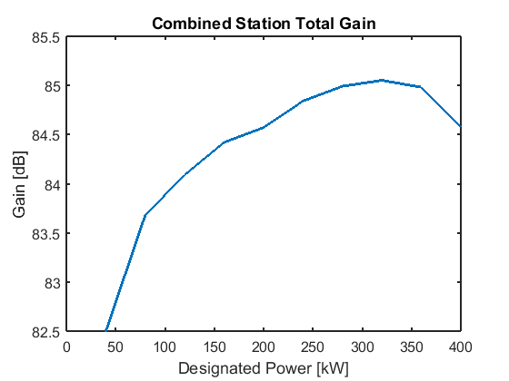
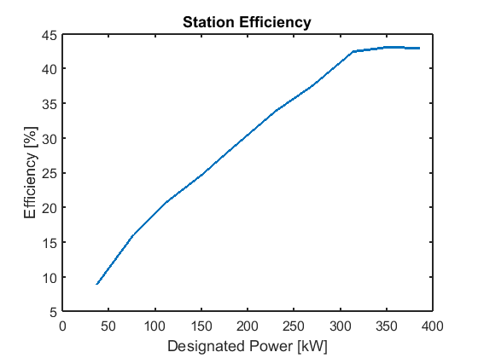
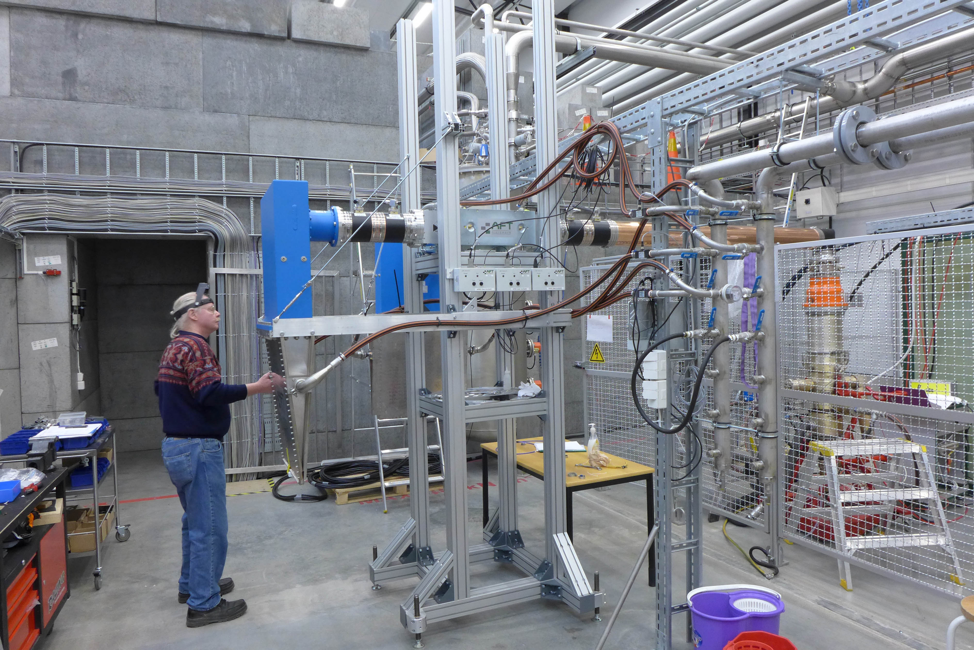
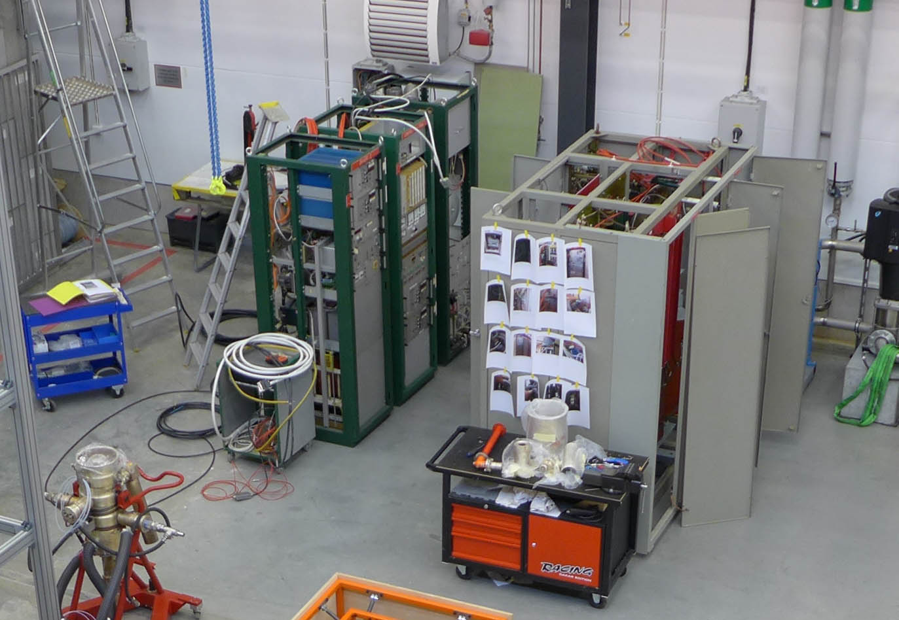
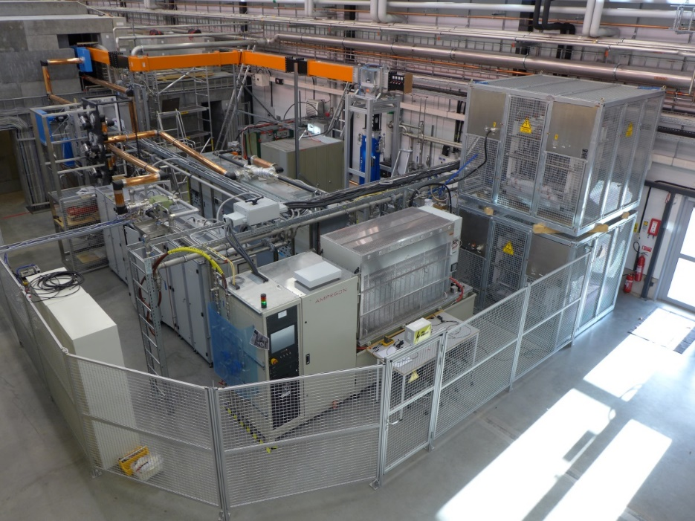
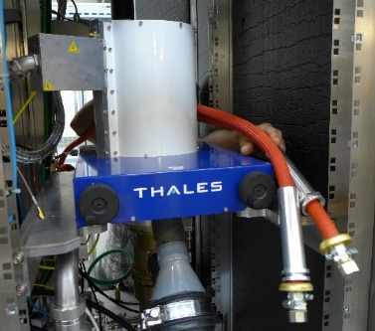
High Power RF Amplifiers
CERN 50 kW CW
400 kW pulsed (352 MHz)
  2 stations, each 2 tetrodes TH595(A)
  3.5 ms, 14-28 Hz
  ESS prototype development
50 kW CW (352/400 MHz)
  single tetrode TH571b
1.2 MW pulsed (704 MHz)
  HV modulator & klystron test for ESS

Slide 11
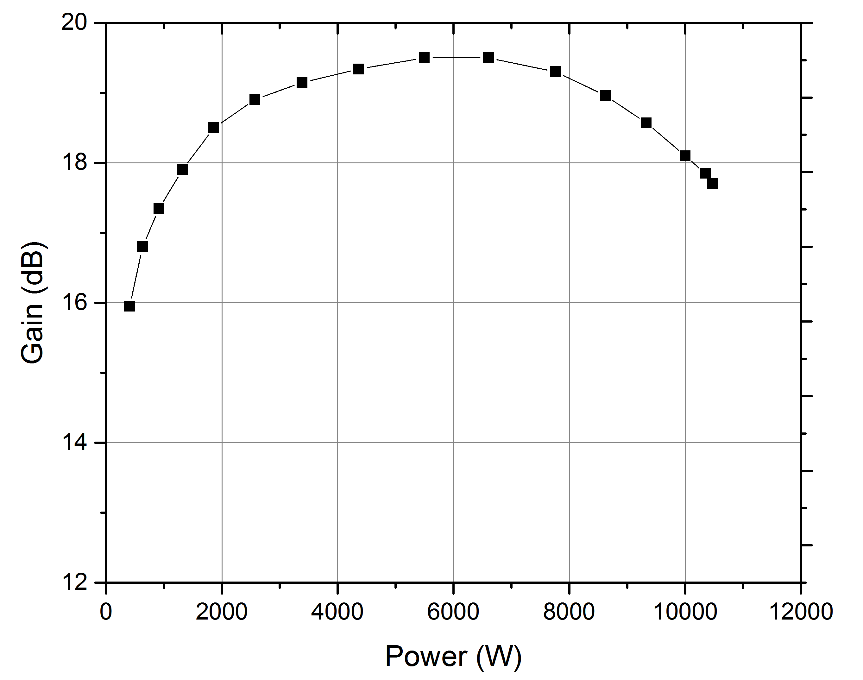
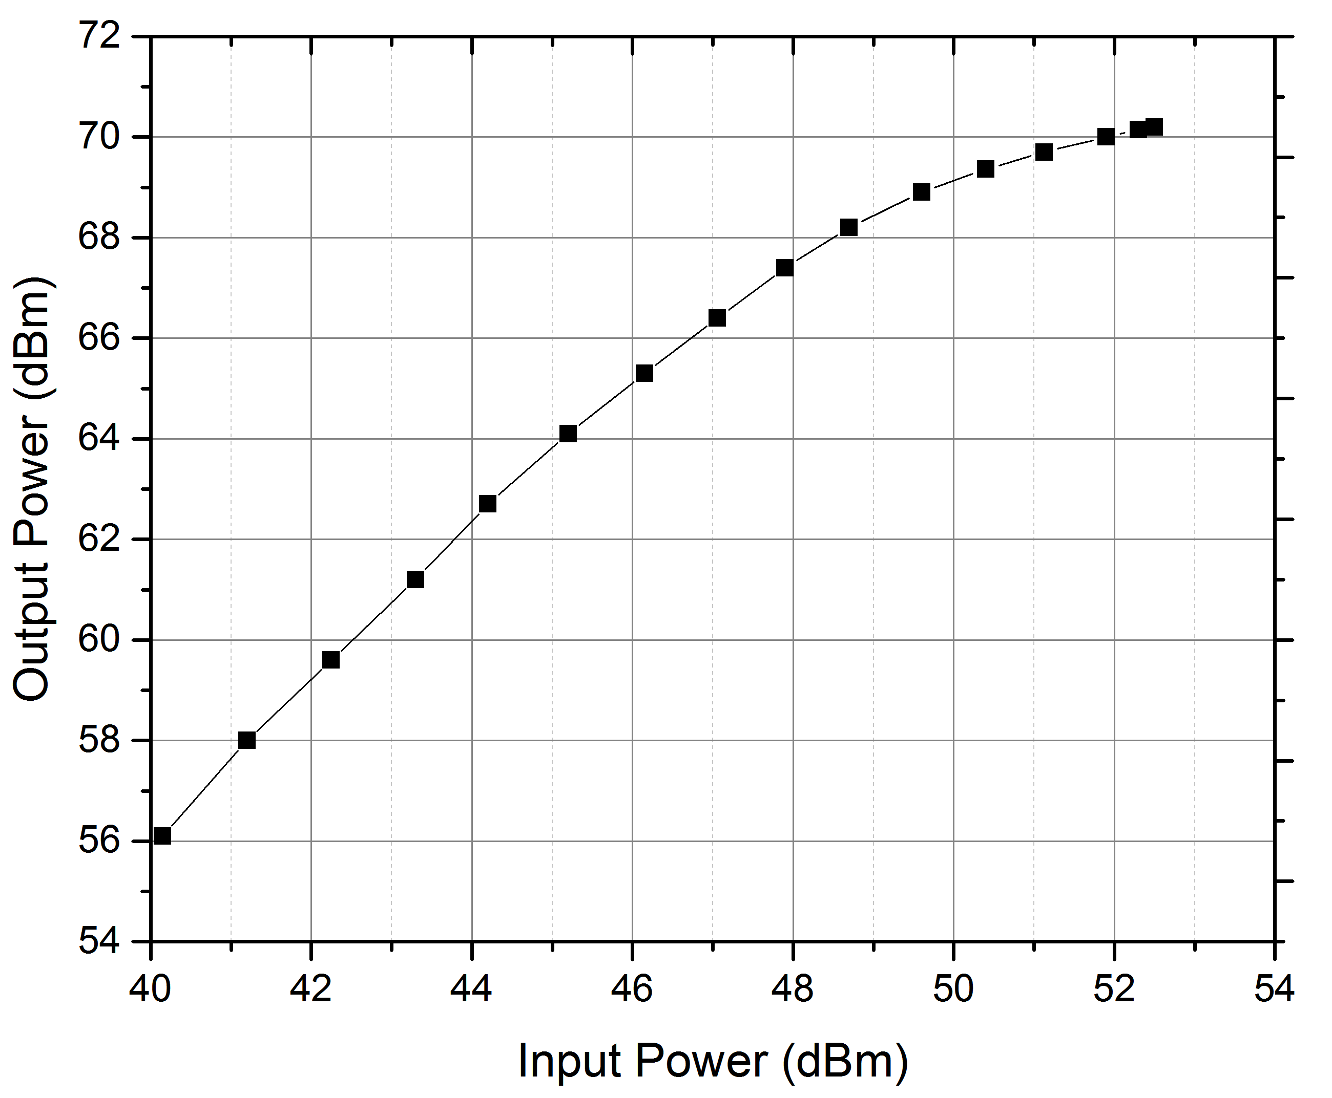
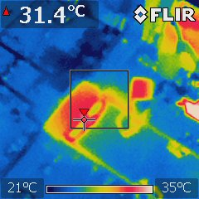
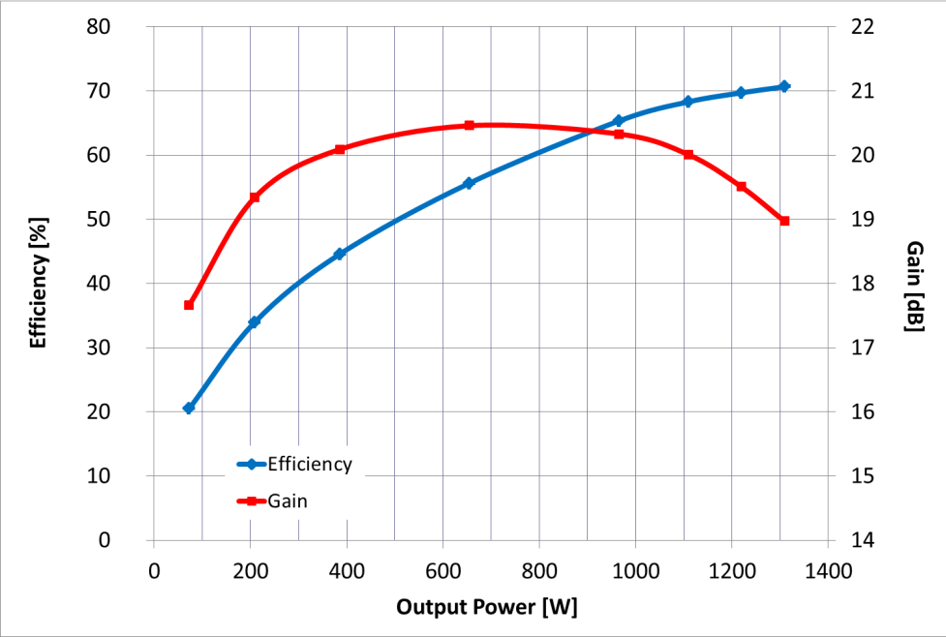
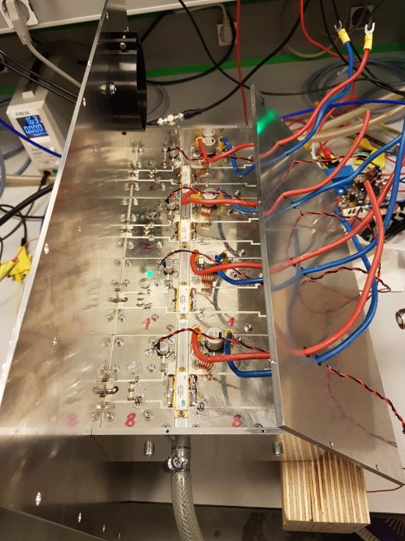
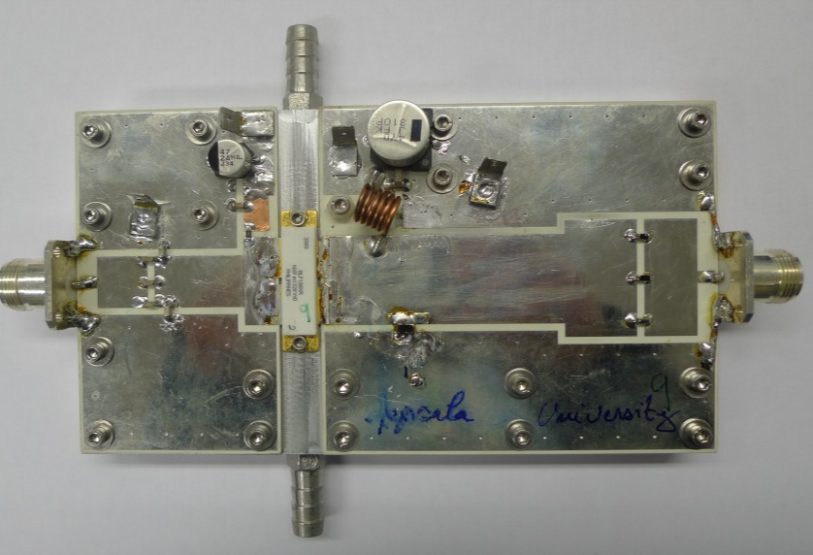
Solid State RF Amplifier
Transistor Amplifier Module
Amplifier Demonstrator
single ended RF power amplifier
based on BLF188XR
1250 W and 70% efficiency
8 modules, 10.5 kW
69% efficiency
  pulsed 14 Hz, 3.5 ms (ESS)
D. Dancila et al.
IOP Conf. Series,
J. Physics Conf. Series
vol. 874, 2017 (012093).
L. Haapala et al. Electronics Letters, vol. 52, (2016) p.1552.

Slide 12
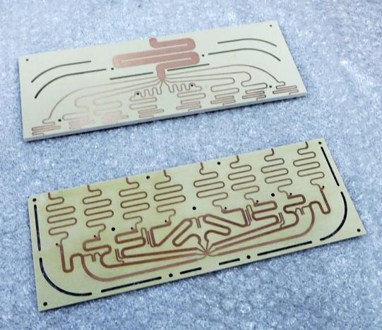
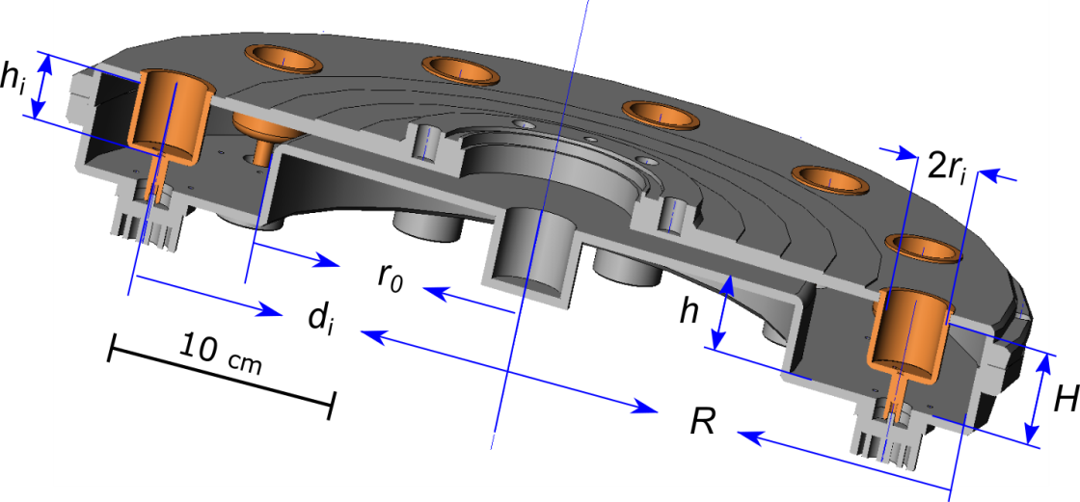
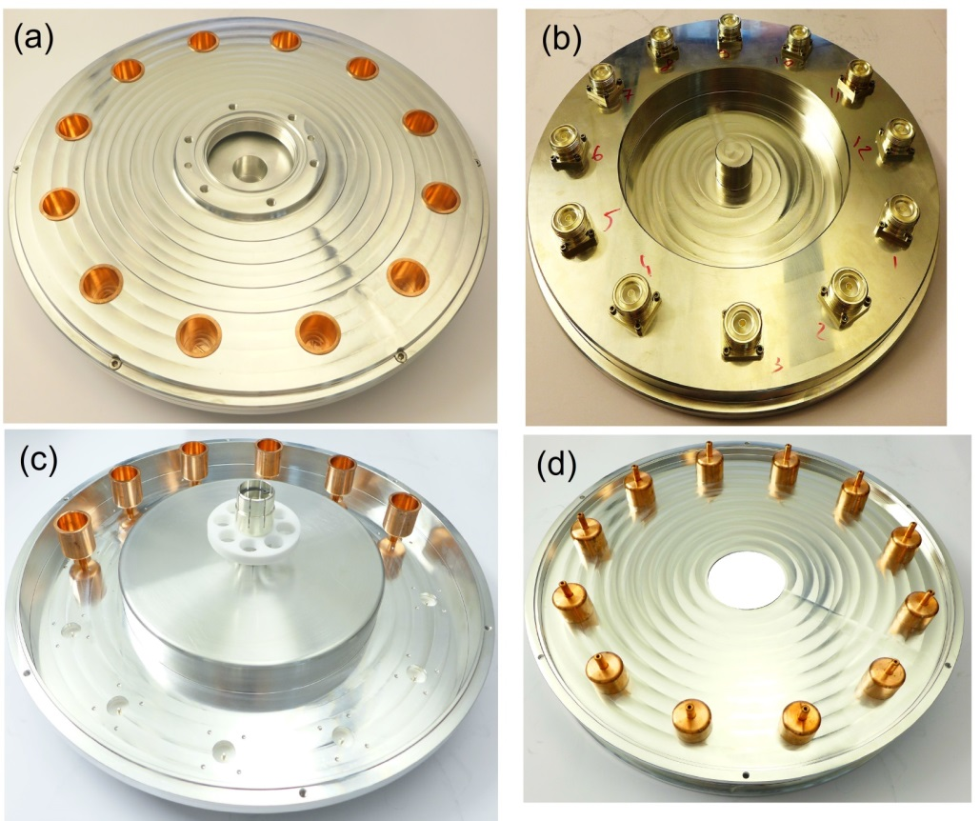
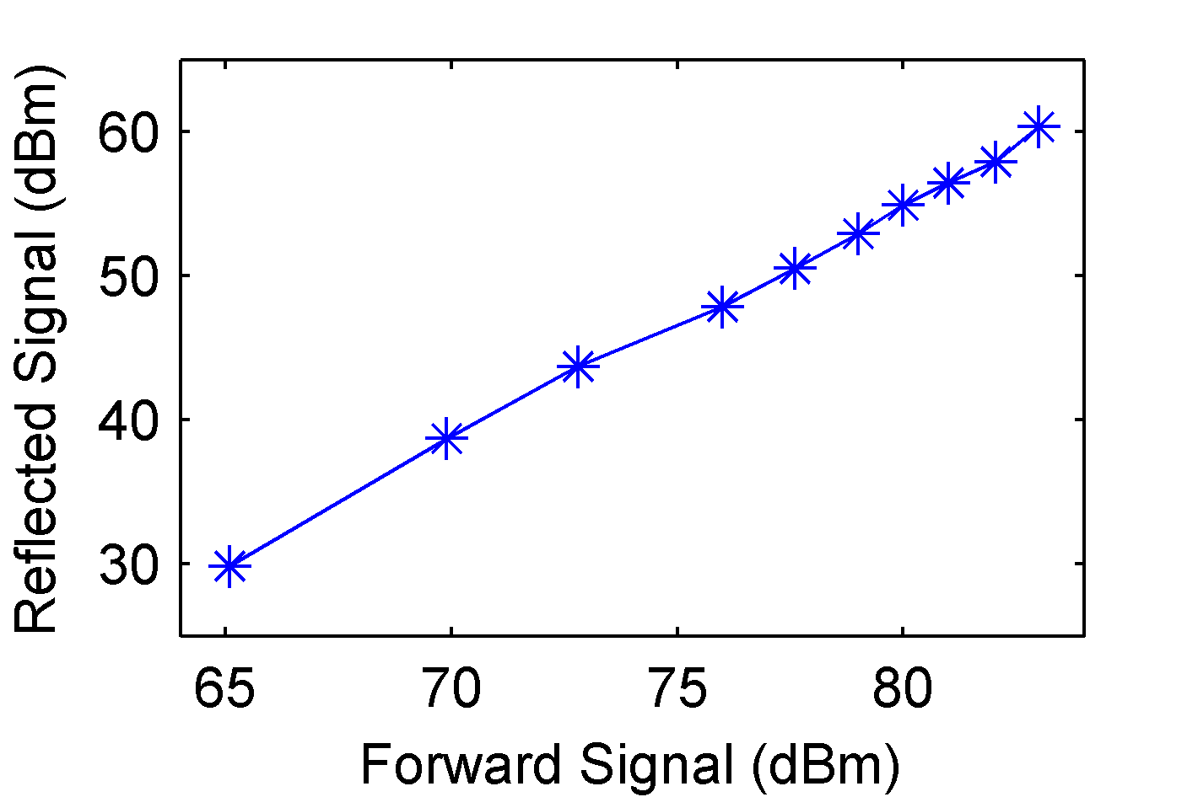
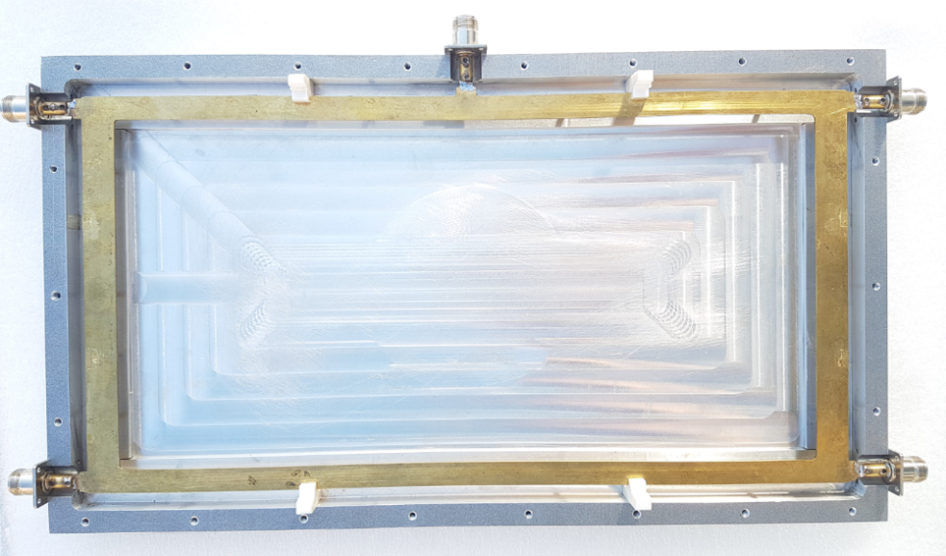
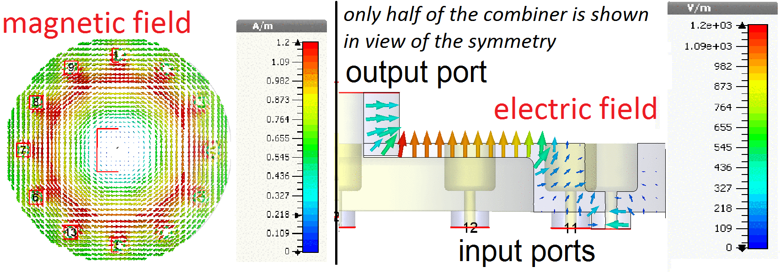
Low-loss Compact Combiners
Compact Cavity Combiner
Compact Planar Combiner
352 MHz 200 kW
  12 input ports
  0.2% insertion loss
352 MHz 10 kW
  8 input ports
  Gysel type
  line coupling
  compensates
  parasitic coupling
352 MHz 20 kW
  2 to 1
    2 ext. loads
  combiner/splitter
  insert.loss 0.1 dB
V. A. Goryashko et al.
IEEE Microwave and wireless components Letts, vol. 28, 2018.
Output RF power
M. Jobs et al. IEEE Trans. Components, Packaging Manufacturing Tech., vol. 8, 2018.
Input RF power
L. Hoang Duc et al. J. of Engineering, 2017.

Slide 13
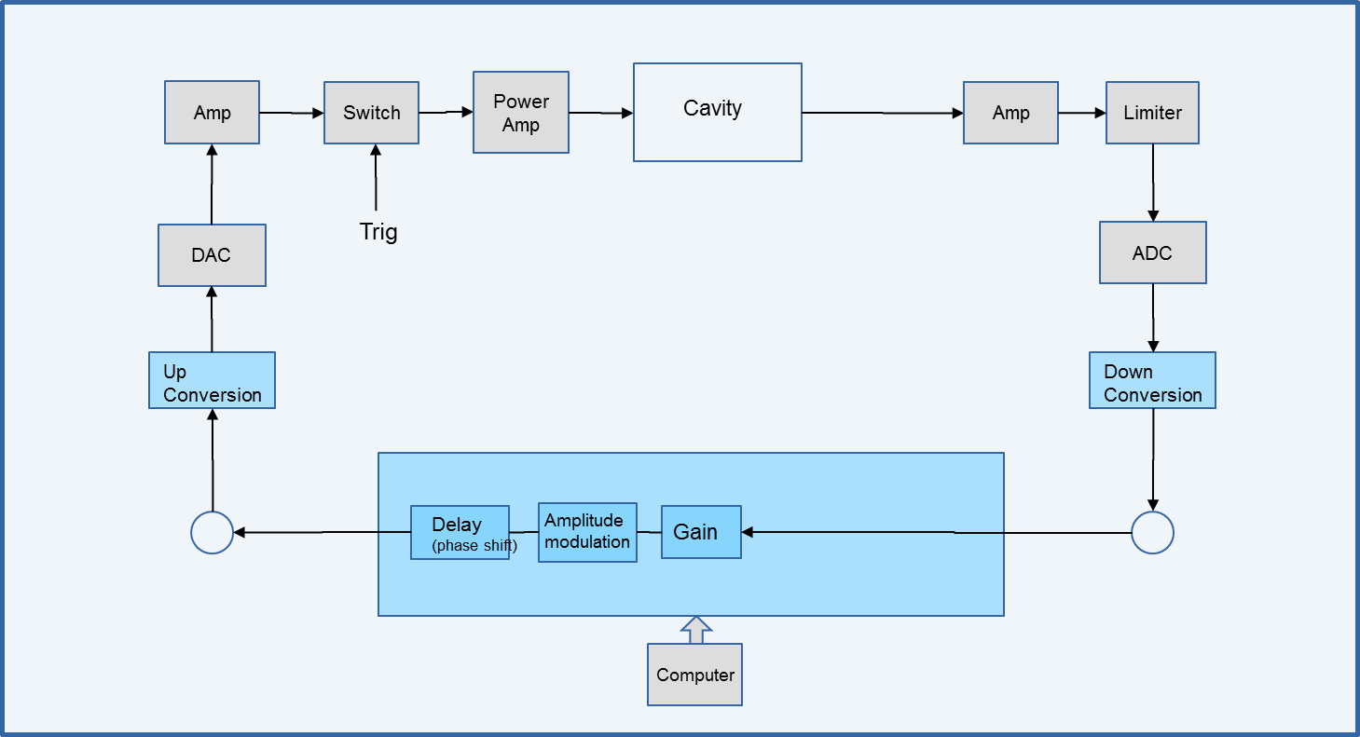
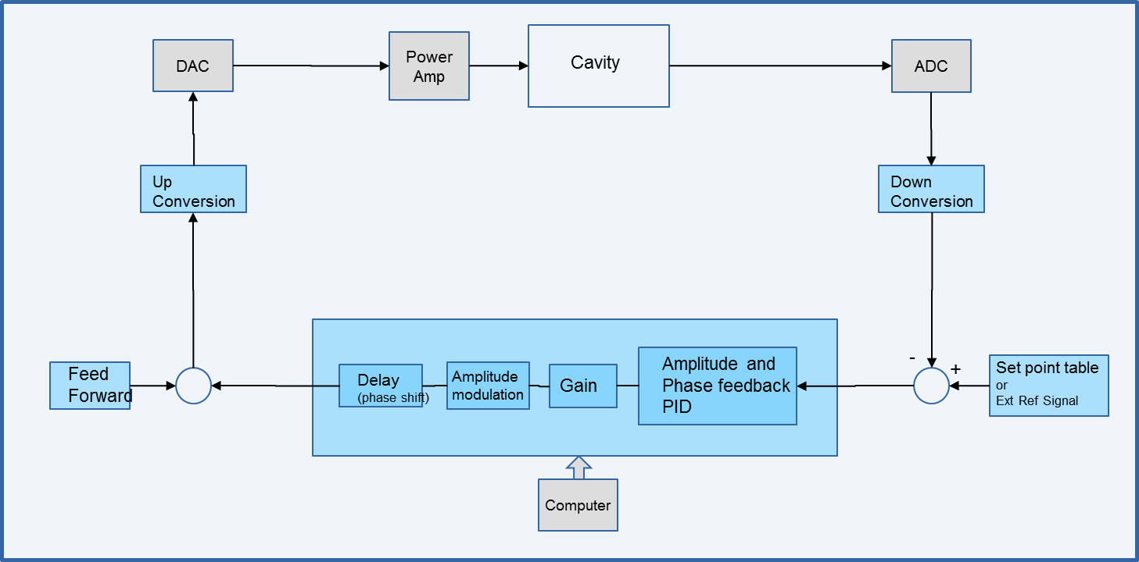

FPGA Based Digital LLRF
Signal Driven
Self-excited Loop
2 ADC inputs at 250 Msps
  (*) analogue bandwidth of 750 MHz
2 DAC outputs at 500 Msps
Digital downconversion to baseband 0 Hz, no analog mixers
  downconverted signal at 10 Msps or 1 Msps, selectable
undersampling to operate at any frequency from 10 to 750 MHz*
CW or
pulsed mode
  switch closes the loop for a duration of 2.86 ms, repetition rate of 14 Hz.
Code in the FPGA

Slide 14
Development of SRF cavities for ESS
Superconducting cavities

Slide 15


ESS Cavities & Cryomodules
Double Spoke Cavity, 352 MHz
Elliptical Cavity, 704 MHz
Prototype cavity
  without and with FPC
  RF conditioning
  Q₀, gradient, fill time,
  Lorentz force detuning, microphonics
  test LLRF, SEL,
  tuner operation
  nominal gradient
Cryomodules
  prototype valve box & cryomodule
  13 series cryomodules
    Oct. 2019 – end 2020 (~6 weeks/CM)
RF stations
  acceptance test of HV modulator for ESS local test stand
  test RF distribution (circulator, load)
Prototype high beta elliptical
  with power coupler and tuner
  RF conditioning
  Q₀, gradient, fill time, heat load
  Lorentz force detuning,
  microphonics
  test LLRF, SEL,
  tuner operation

Slide 16


Spoke Cryomodule Prototype (2019)
Warm RF conditioning
  ~3 days/cavity
  MP bands were consistent with HNOSS test
    strength depends on pulse length,
    1st/2nd conditioning…
Cold RF conditioning
  no coupler activity
  Quench during cavity conditioning at 4 K
    burst disc rupture → thermal cycling
Cavity #2 performance
  multipacting regions similar as prototype
    2-3; 4-5; 7-8 MV/m
  field emission sensitive to tuner motion
  or position (under investigation)
FREIA CAV2 after tuner test (2019)

Slide 17


Spoke Cryomodule Prototype (2019)
Fast tuner performance
  Lorenz force detuning compensation (piezo)
w/o correction
w/ correction
P_{fwd}
P_{ref}
P_{trans}
f_{shift}

Slide 18
Test and Development of SC Magnets for CERN
superconducting magnets

Slide 19



Orbit Correctors for HL-LHC
Test of nested dipole orbit corrector magnets for the High Luminosity upgrade of LHC
  magnet design and construction by CIEMAT (Spain)
  test at FREIA (20 magnets)
Parameter | Unit | Value
Aperture | mm | 150
Magnetic length | m | 1.2
Nominal integrated field | T m | 2.5
Nominal current inner | A | 1625
Nominal current outer | A | 1474
Short sample current at 1.9 K | A
Loadline fraction at 1.9 K
Strand diameter | mm | 0.480
Cu/no_Cu |  | 1.75
Number of turns per layer inner |  | 140
Number of turns per layer outer |  | 191
Nominal strand current density | A/mm²
Nominal superconductor current density | A/mm²
Nominal differential inductance inner | mH | 58.4
Nominal differential inductance outer | mH | 118.8
Nominal stored energy inner | kJ | 87
Nominal stored energy outer | kJ | 150
Maximum hotspot temp | K | 270
MCBXF

Slide 20


Magnet Powering & Quench Monitoring
PLC Slot
Computer
2 x 2000 A
Quench detection system
Computer
Patch panel
Data acquisition
Data acquisition
slot
IGBTs based EE system

Slide 21



CCT Magnet Development
Canted-Cosine-Theta magnet is a dipole based on the superposition of two oppositely skewed solenoids with respect to the bore axis.
  produces a perfect cosθ field,
  is cost effective compared to a conventional SC dipole
    but not the same field strength possibilities
CERN (G. Kirby)
Scanditronix (A. Ahl)

Slide 22



FELs
CLIC
Ultrafast Electron Diffraction
CLIC, Free Electron Lasers, Ultra-fast Electron Diffraction
high brilliance electron beams

Slide 23







RF Breakdown Studies
Models for RF conditioning process
  why the achievable gradient increases?
  why an ultimate limit in conditioning?
  strong dependence on temperature
    not many data available
  agree within range of available data
    but diverge significantly outside that range
  include temperature-dependent terms,
    can be distinguished by dedicated experiments
Dark currents
  No indication of single emitting spot inside cavity
  Broad energy spectrum
Breakdown events
  Good correlation with BD position (from RF)
  Electrons with well defined energies
  Discovered H2+ in "Flashbox" at TBTS
42 MW @ 50ns
34 MW @ 50ns

Slide 24




Cryogenic DC Spark System
Field emission and BDR as a function of temperature
Complement to RF tests
  very high repetition rate, pulsed DC
  simple geometry (large planar electrodes)
  similar high-field behavior in RF and pulsed DC
  allows in depth studies of the fundamental physics of high-fields (e.g. material and surface science)
  possibility to find new and potentially important connections between the high-gradient NC and SC fields.
Electrodes at 30K reached almost 20% higher field gradient than at 300 K.
PRELIMINARY
Field emission at 300K and 30K
starts at higher field at 30 K
OFE-Cu electrodes
50 mm diameter
60 μm gap

Slide 25


Soft X-ray Laser (SXL) at MAX IV
Collaboration: Uppsala, Stockholm, Lund University, KTH & MAX IV
  funding from Wallenberg foundation and universities
Uppsala is involved in
  accelerator (microbunching instability),
  FEL (short-pulse generation),
  optical beamline design.
A. Mak et al “Compact FEL at MAX IV”
J. Synchrotron Rad. (2019) 26.

Slide 26



Attosecond Pulse Generation
high-harmonic generation in gas
High-Harmonic Generation (HHG) sources are facing saturation
Undulator light source is a promising way to the attosecond region
Application submitted to the EU/H2020 program
  12 partners from Germany, Hungary, Italy, UK. Ukraine, Sweden and Japan
Read more in: A. Mak et al 2019 Rep. Prog. Phys. 82 025901

Slide 27



CompactLight
EU funded project to design the next generation compact FEL
Consideration of costs and space: reduce linac length
  opening the way to affordable “Regional Facilities”
Uppsala:
  communication with users, specify science requirements
  definition of FEL system & accelerator/undulator requirements
  design of the soft X-ray FEL and potentially the beamline
  breakdown studies in accelerating structures
A. Mak et al “Science Requirements and Performance Specification for the CompactLight”,
FREIA Report 2019/01.
Preliminary design of the CompactLight FEL.
Courtesy of N. Thompson
Notes:
Echo-Enabled Harmonic Generation (EEHG) is a laser assisted electron beam manipulation scheme designed to produce high-harmonics in the e-beam density distribution for the generation of short-wavelength radiation.

Slide 28

ESS Superconducting Linac
ESS Neutrino Super Beam
HiLumi LHC
European Spallation Source (ESS) and
High Luminosity LHC (CERN)
high brilliance proton beams

Slide 29



ESS Neutrino Super Beam (ESSnuSB)
Doubling the ESS beam power for a second target
  linac duty cycle doubling to 8 % (RF sources, cooling)
    using new H⁻ source
  accumulator ring (~400 m circ.) compress 2.86 ms beam pulse to few µs
    multi-turn injection, stripping H⁻ → H⁺
  2nd target station with magnetic horn (350 kA)
    to deliver ~300 MeV neutrinos
Injection
Extraction
Collimation
RF

Slide 30




ESSnuSB Accumulator Ring
Incoming beam from the linac:
Losses due to Lorentz stripping < 0.1 W/m ⇒
Maximum magnetic field in transfer line 0.15 T
for neutrons
for neutrinos
4 x 640 µs
p
p
Accumulator ring
lattice and optics
28 Hz
28 Hz
28 Hz
Switchyard
H⁻
p
distributes the compressed beam pulses over four separate targets
After accumulation:
1.35 kHz
2.23E14 protons per pulse
4 x 1.2 µs
384 m circumference
481 injected turns
H⁻ stripping at injection
14 Hz

Slide 31
Summary
Uppsala University & FREIA Laboratory actively developing accelerator and instrumentation technology
Technology Development
NC and SC RF cavities
SC magnets
RF power generation
LLRF and controls
Physics Research
high brilliance beams
superconducting RF
RF breakdown
Academic Teaching

