Slide 1
DFHX
Summary assembly sequence at CERN
R. Betemps / P. Schneider / F. Pillon / D. Ochoa
2020.05.13

Slide 2
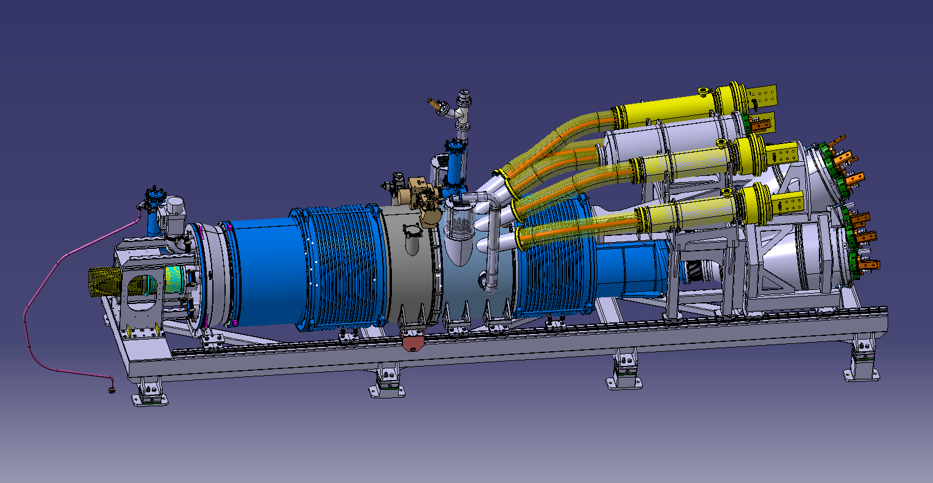
Final DFHX Unit

Slide 3
Assembling the link, and the cable

Slide 4
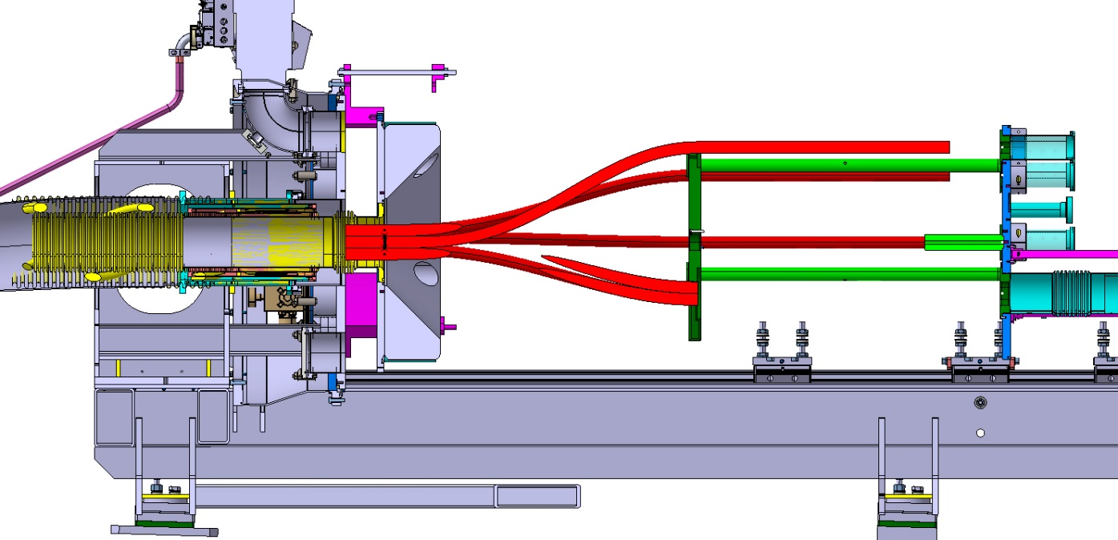
Assembling of the shuffling module 1

Slide 5
Add cryo-line and safety-line and IFS

Slide 6
Add vacuum “barriere” chamber

Slide 7
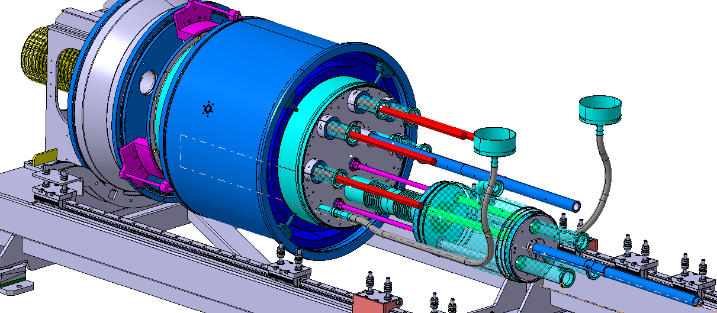
Assembling of the shuffling module 2

Slide 8
Add bellow and intermediary chamber

Slide 9
And the “currents leads” chamber

Slide 10
Put in place the 2kA Current lead module

Slide 11
Splice first module

Slide 12
Splice seconde module

Slide 13
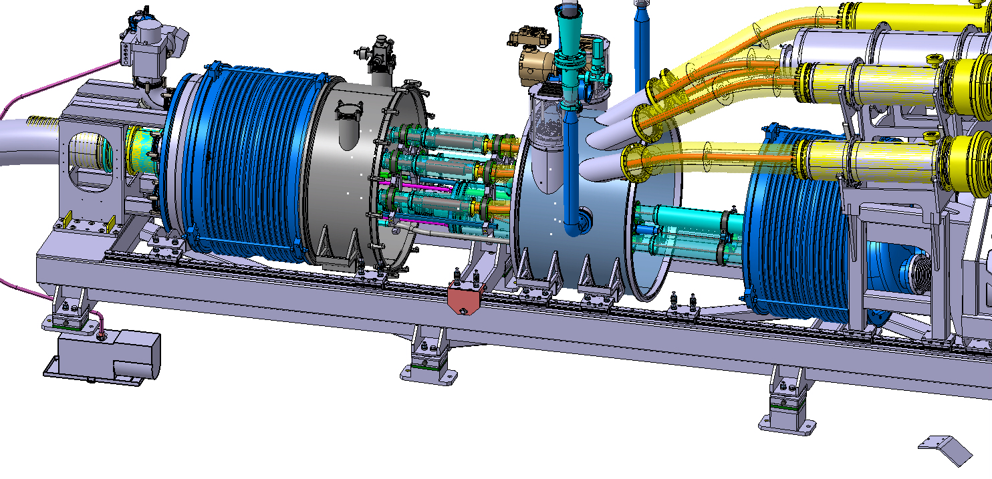
Close the splice chamber

Slide 14
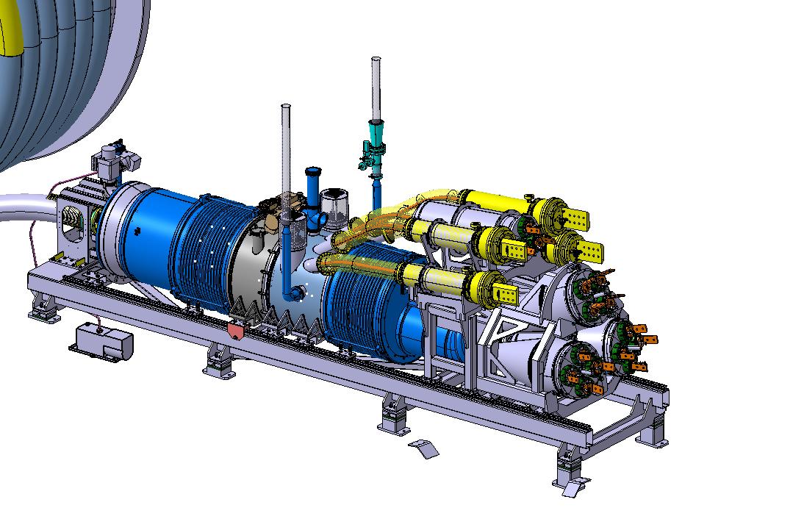
Close the vacuum chambers

