Slide 1
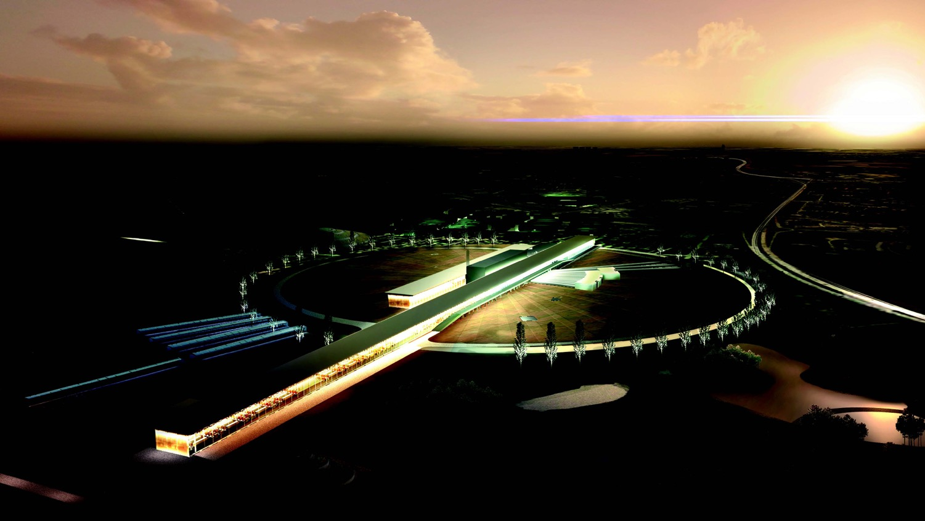

Status of ESSνSB and plans for future
Marcos Dracos
IPHC-Strasbourg

Slide 2
European Spallation Source as Neutrino Facility for CP violation observation
(2nd Oscillation maximum)
ν_{μ}→ν_{e}

Slide 3
2nd Oscillation max. coverage
2nd oscillation max.
well covered by the ESS neutrino spectrum
ν_{μ}→ν_{e}
1st oscillation max.

Slide 4
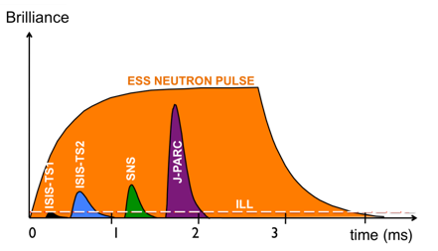
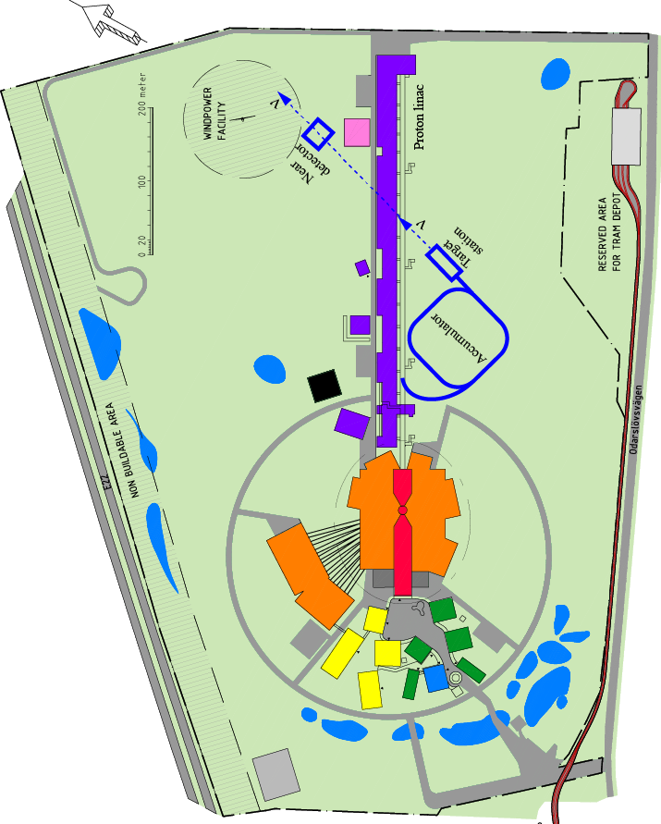
How to add a neutrino facility on top of the neutron one?
The neutron program must not be affected and if possible synergetic modifications.
Linac modifications: double the rate (14 Hz → 28 Hz), from 4% duty cycle to 8%.
Accumulator (C~400 m) needed to compress to few μs the 2.86 ms proton pulses, affordable by the magnetic horn (350 kA, power consumption, Joule effect)
  H⁻ source (instead of protons),
  space charge problems to be solved.
~300 MeV neutrinos.
Target station (studied in EUROν).
Underground detector (studied in LAGUNA).
Short pulses (~μs) will also allow DAR experiments (as those proposed for SNS) using the neutron target.

Slide 5
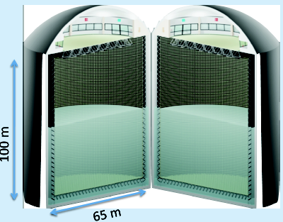
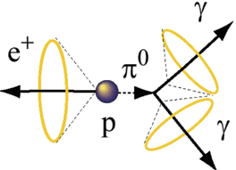
Can we go to the 2nd oscillation maximum using our proton beam?
Yes, if we place our far detector at around 500 km from the neutrino source.
MEMPHYS like Cherenkov detector
(MEgaton Mass PHYSics studied by LAGUNA)
(arXiv: hep-ex/0607026)
Neutrino Oscillations
Proton decay
Astroparticles
Understand the gravitational collapsing: galactic SN ν
  Supernovae "relics"
Solar Neutrinos
Atmospheric Neutrinos
500 kt fiducial volume (~20xSuperK)
Readout: ~240k 8” PMTs
30% optical coverage
New 20" PMTs with higher QE and cheaper (see JUNO), the detection efficiency will improve the detector performance keeping the price constant, not yet taken into account.

Slide 6
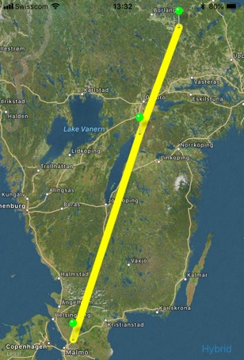
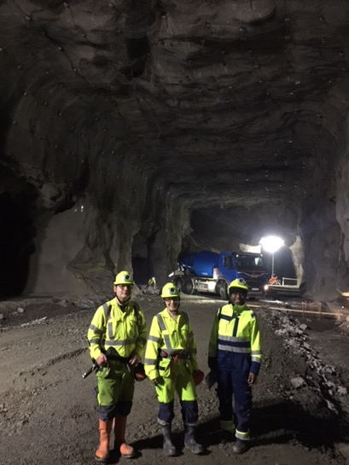
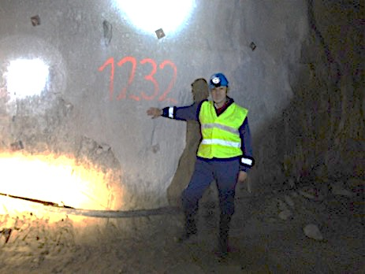
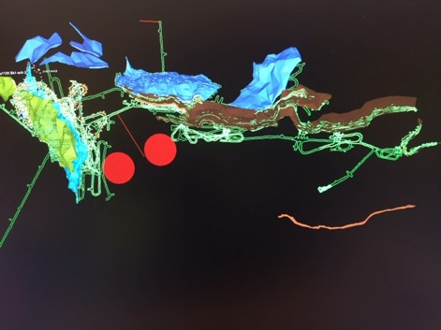
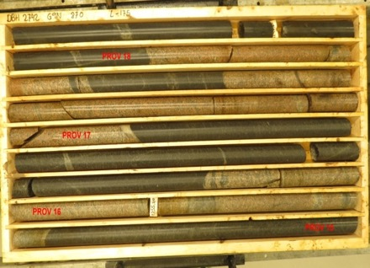
Candidate active mines
Garpenberg mine
  Distance from ESS Lund 540 km
  Depth 1200 m
  Truck access tunnel
Zinkgruvan mine
  Distance from ESS Lund 360 km
  Depth 1500 m
  Truck access tunnel
Garpenberg
(540 km)
Zinkgruvan
Zinkgruvan
(360 km)
Lund
possible location of MEMPHYS in
Zinkgruvan mine
Garpenberg
Granite drill cores

Slide 7
Physics Performance
540 km
little dependence on mass hierarchy,
δ_{CP} coverage at 5 σ C.L. up to 60%,
δ_{CP} accuracy down to 6° at 0° and 180° (absence of CPV for these two values),
not yet fully optimized facility,
5/10% systematic errors on signal/background.
5/5 yrs

Slide 8
The Linac modifications and operation
H⁻ source options
Into linac
P
_{H}⁻
_{H}⁻
_{H}⁻
_{H}⁻
P
_{H}⁻
_{H}⁻
_{H}⁻
_{H}⁻
14 Hz
100 µs
0.65 ms
Into ring
H⁻
H⁻
H⁻
H⁻
H⁻
H⁻
H⁻
H⁻
14 Hz
~1.4 kHz
~1 µs
~0.75 ms
Into horn
_{H}⁻
_{H}⁻
_{H}⁻
_{H}⁻
_{H}⁻
_{H}⁻
_{H}⁻
_{H}⁻
14 Hz
Horn 1
Horn 4
Horn 2
Horn 3

Slide 9
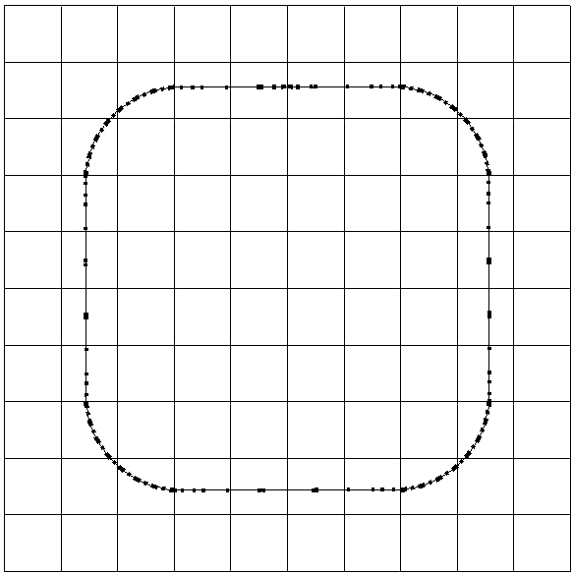
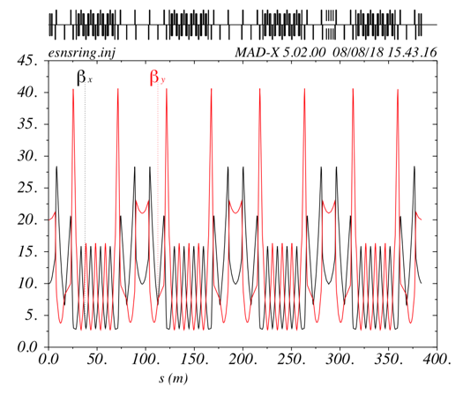
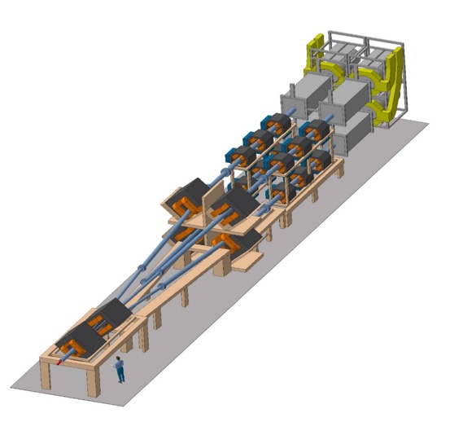
The Accumulator
lattice development
injection
4 superperiods
RF
extraction
FODO cells
H⁻ stripping
collimation
Dispersion-free straight sections
Switchyard
compression of the linac pulses from 3 ms to ~1.4 μs

Slide 10
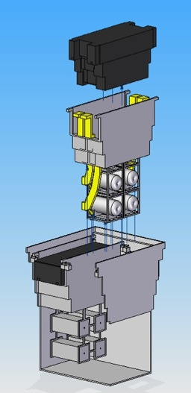
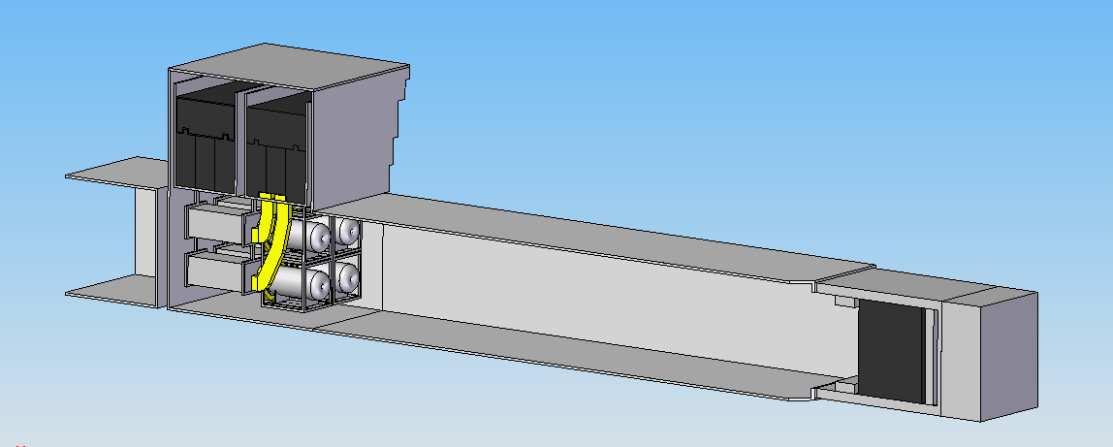
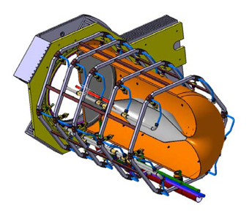
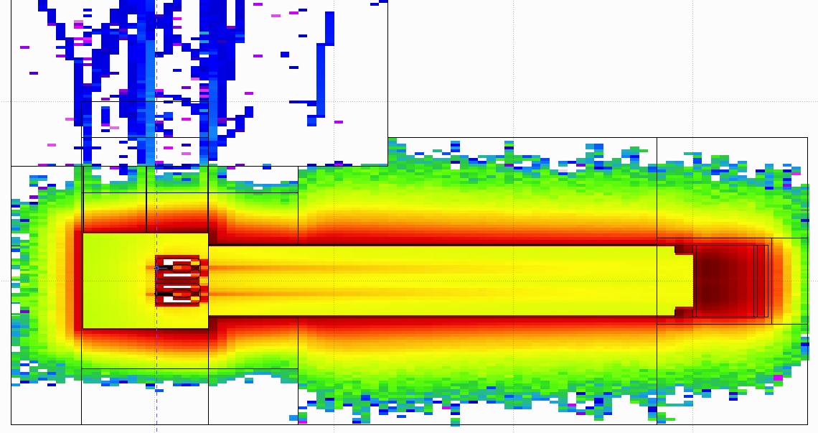
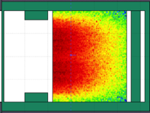
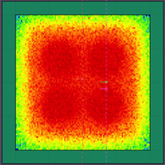
General Layout of the target station
Shield Blocks
Horn Support Module
8 m concrete
Split Proton Beam
Horns and Targets
Collimators
Decay Volume
(He, 4x4x25 m³)
Neutrino Beam Direction
Beam Dump

Slide 11
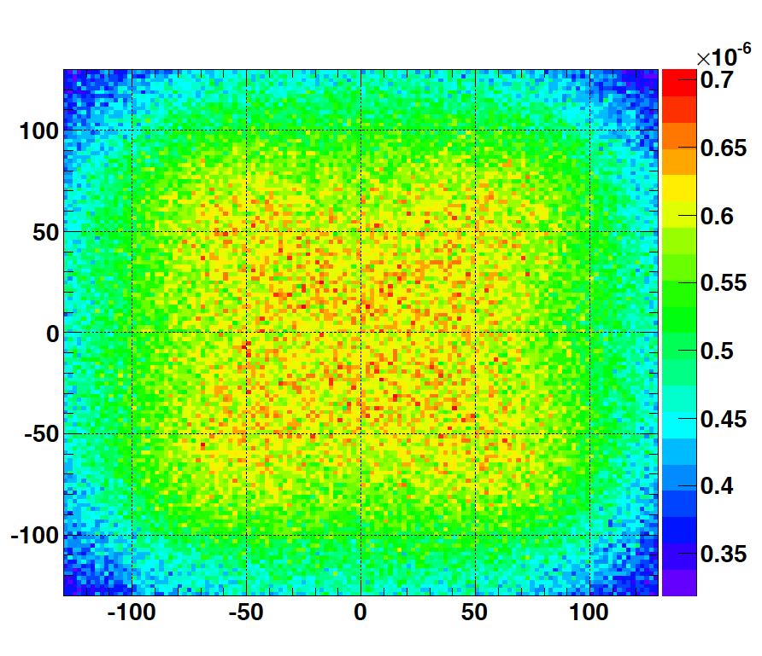
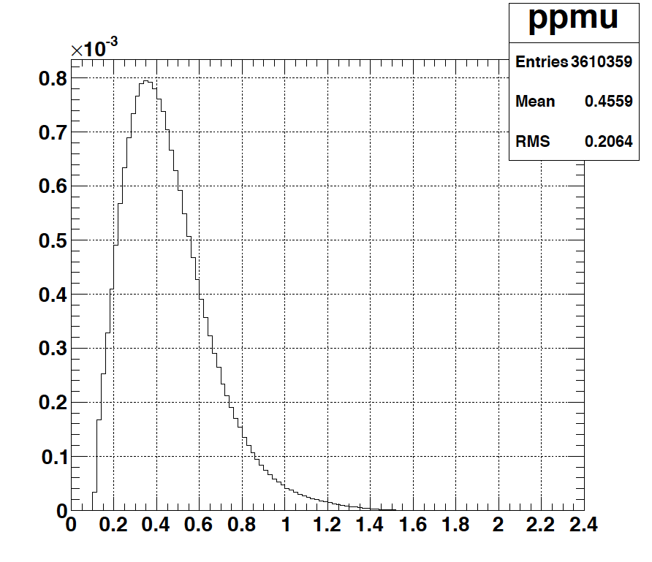
Muons at the level of the beam dump
2.7x10²³ p.o.t/year
y (cm)
muons at the level of the beam dump
(per proton)
more than 4x10²⁰ μ/year from ESSS compared to 10¹⁴ μ used by all experiments up to now (10¹⁸ μ for COMET in the future).
4.2x10²⁰ μ/year
(16.3x10²⁰ for 4 m²)
x (cm)
10⁻³
4.1x10²⁰ μ/year
input beam for future 6D μ cooling experiments (for muon collider),
low energy nuSTORM,
Neutrino Factory,
Muon Collider.
muons/proton
<E_{μ}>~0.46 GeV
<L_{μ}>~2.9 km

Slide 12

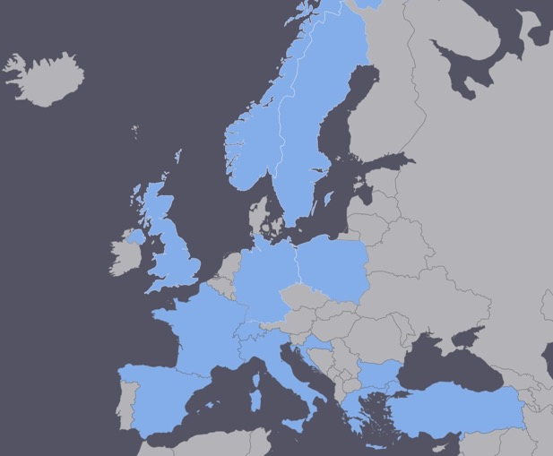
EuroNuNet
COST application for networking: CA15139 (2016-2020)
  EuroNuNet : Combining forces for a novel European facility for neutrino-antineutrino symmetry violation discovery (http://www.cost.eu/COST_Actions/ca/CA15139)
The members are countries which signed the Action MoU
Finished
  Major goals of EuroNuNet:
    to aggregate the community of neutrino physics in Europe to study a neutrino long baseline concept in a spirit of inclusiveness,
    to impact the priority list of High Energy Physics policy makers and of funding agencies to this new approach to the experimental discovery of leptonic CP violation.
  13 participating countries
http://euronunet.in2p3.fr/

Slide 13
ESSνSB at the European level
A H2020 EU Design Study (Call INFRADEV-01-2017)
Title of Proposal: Discovery and measurement of leptonic CP violation using an intensive neutrino Super Beam generated with the exceptionally powerful ESS linear accelerator
Duration: 4 years
Total cost: 4.7 M€
Requested budget: 3 M€
15 participating institutes from
11 European countries including CERN and ESS
6 Work Packages
Approved end of August 2017: 2018-2021 → CDR end of 2021
ESSνSB
BENE (2004-2008)
ISS (2005-2007)
EUROν (2008-2012)
LAGUNA (2008-2010)
LAGUNA-LBNO (2010-2014)
COST Action CA15139 (2015-2019)

Slide 14
H2020 ESSνSB
Now 3rd year
  Very good progress done on all WP
  Up to now all deliverables ready on time
  Small delays due to the pandemic
CDR by end of 2021
After:
  R&D on well identified sectors (e.g. ion stripping, hadronic collector, pulse generator, near detector,…)
  Design Study for some remaining items (e.g., common accumulator between ESSnuSB and NF/MC, muon extraction at the level of the beam dump for nuSTORM, near detector, underground lab, …)

Slide 15
ESSνSB and the future
Input from ESSνSB to the 2020 update of the European Strategy for Particle Physics
  Briefing Book of the European Strategy for Particle Physics published in January and available at https://arxiv.org/abs/1910.11775:
  “ …ESS could be an important test-bed for R&D on new intense neutrino beams along the road towards a Neutrino Factory. Indeed a Neutrino Factory, where the neutrinos are produced in the decay of muons in a storage ring, would be the natural next-to-next step for long-baseline experiments beyond DUNE and Hyper-Kamiokande. It would be a unique facility to reach a precision of 6◦ on the measurement of δ_{CP}.”
Still waiting for the conclusions…
EU calls (Horizon Europe)
  INFRADEV-1 →
    INFRADEV-2 (ESFRI, preparatory phase) →
      INFRADEV-3 (ESFRI, world-class RI) →
        INFRADEV-4 (ESFRI, fast track to implementation of RI)
ERC
  Synergy Grants
large gap

Slide 16
ESSνSB and (R&D) synergies
Super Beam
nuSTORM
+Decay At Rest and Coherent scat.
(with short pulses)
Neutrino Factory
Muon Collider

Slide 17
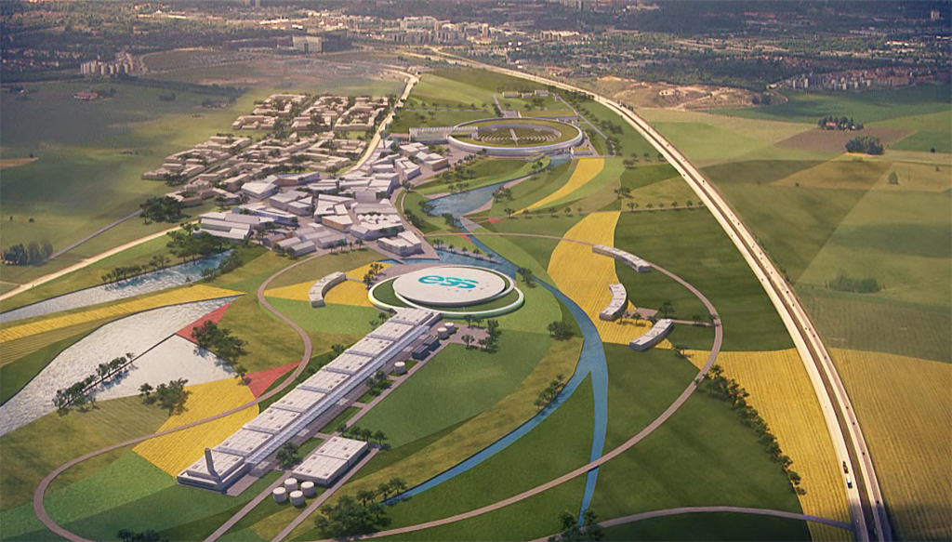
Backup

Slide 18
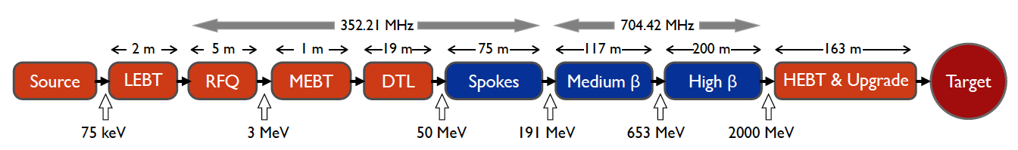
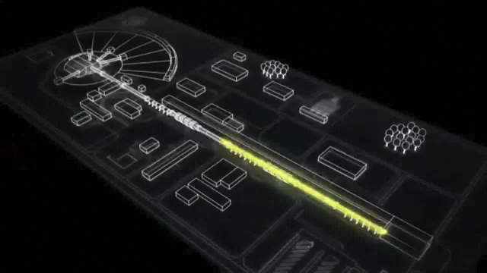
ESS proton linac
empty space for energy upgrades
The ESS will be a copious source of spallation neutrons.
5 MW average beam power.
125 MW peak power.
14 Hz repetition rate (2.86 ms pulse duration, 10¹⁵ protons).
Duty cycle 4%.
2.0 GeV protons
  up to 3.5 GeV with linac upgrades
>2.7x10²³ p.o.t/year.
8
x10¹⁴
ESS 5 MW
2015 design
7
λ = 1.5 Å
6
5
Brightness (n/cm²/s/sr/Å)
4
3
ESS 5 MW
2012 design (TDR)
2
UK TS2
32 kW
SNS
1-2 MW
JPARC
0.3-1 MW
1
UK TS1
128 kW
ILL 57 MW
0
time (ms)
1
2
3
4

Slide 19
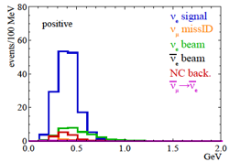
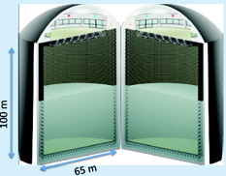
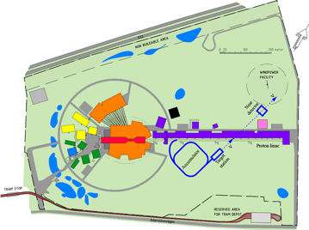
Possible ESSνSB schedule (optimistic?)
(2nd generation neutrino Super Beam)
2021: End of ESSνSB Design Study, CDR and preliminary costing
2012: inception of the project
2016-2019: beginning of COST Action EuroNuNet
2018: beginning of ESSνSB Design Study (EU-H2020)
2022-2025: Preparatory Phase, TDR
2025-2028: Preconstruction Phase, International Agreement
2028-2034: Construction of the facility and detectors, including commissioning
2035-: Data taking
Nucl. Phys. B 885 (2014) 127

Slide 20
ESSνSB and synergies

Slide 21
Design Study ESSνSB
(2018-2021)
More information on:
http://essnusb.eu/
CDR end of 2021
partners: IHEP, BNL, SCK•CEN, SNS, PSI, RAL

Slide 22
Synergy Grants
Who can apply?
A group of two to maximum four Principal Investigators (PIs)
  of which one will be designated as the corresponding PI (cPI)
  working together and bringing different skills and resources to tackle ambitious research problems.
No specific eligibility criteria regarding the academic training are foreseen for ERC Synergy Grants.
PIs must present an early achievement track-record or a ten-year track-record, whichever is most appropriate.
Proposals will be evaluated on the sole criterion of scientific excellence which, in the case the ERC Synergy Grants, takes on the additional meaning of outstanding intrinsic synergetic effect.

Slide 23
Synergy Grants
What proposals are eligible?
Criteria
  Applications can be made in any field of research.
  'bottom-up' basis without predetermined priorities.
  Applications must demonstrate that the proposed research cannot be carried out by a single PI working alone.
Location
  Research must be conducted by all PIs in a public or private research organisation(known as a Host Institution, HI).
  It could be the HI where the applicant already works, or any other HI established in one of the EU Member or Associated Countries.
  one Principal Investigator per Synergy Grant group at any one time can be hosted or engaged by an institution outside of the EU or Associated Countries.
Host Institution
  Applications must be submitted by a minimum of two to a maximum of four Principal Investigators (PI), with one of the PIs acting as corresponding PI (cPI). The cPI will act as a contact point of behalf of the group.
  PIs can apply within the same HI or through different HIs. At submission stage, all Host Institutions must provide the host support letter for their Principal Investigator(s).
  The ERC Synergy Grant is awarded to the cHI that engages and hosts the cPI for at least the duration of the grant, and to any other HI that engages and hosts other PIs participating in the project.
Team
  ERC Synergy grants support projects carried out by a group of two to four individual researchers who can employ researchers of any nationality as team members.

Slide 24
Synergy Grants
How much?
Synergy Grants can be up to a maximum of € 10 million for a period of 6 years (pro rata for projects of shorter duration).
However an addition € 4 million can be requested in the proposal in total to cover:
  eligible 'start-up' costs for Principal Investigators moving to the EU or an Associated Country from elsewhere as a consequence of receiving an ERC grant and/or
  the purchase of major equipment and/or
  access to large facilities.
An ERC grant can cover up to 100% of the total eligible direct costs of the research plus a contribution of 25% of the total eligible costs towards indirect costs.

