Slide 1
Pion target and focussing in a axially symmetric B field
Liquid metal target is immersed in high field solenoid (20 T)
  Proton beam is oriented with about 20° with respect to axis
  Particles with p_{t} < 0.25 GeV/c are trapped (about ½ of all)
  Pions decay into muons
  Focussing both signs of particles
The MERIT/CERN experiment has successfully injected a Hg-jet into a 15-T solenoid
Pions/muons drifting as a function of c τ
Z = 1 m
GeV/c ->
c τ
Z = 58 m
GeV/c ->
.
c τ

Slide 2
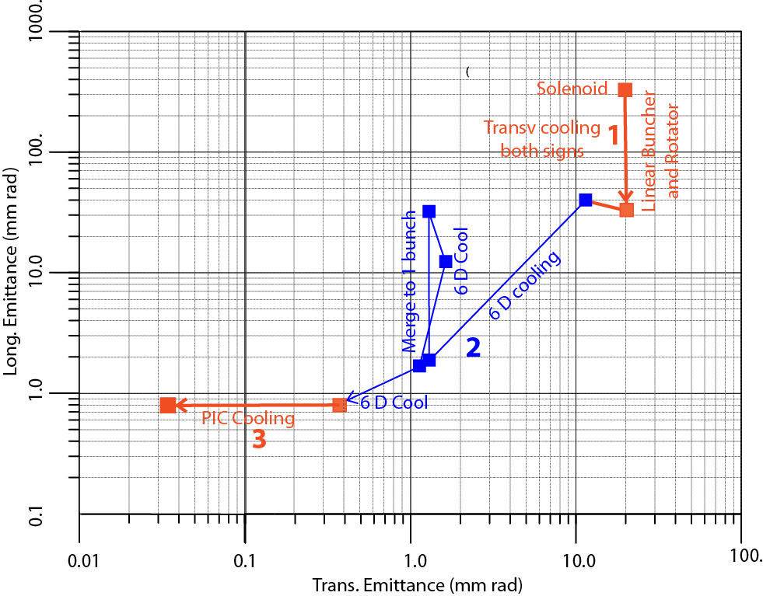
The cooling process
Three successive steps are required in order to bring the cooling process at very low energies, after capture and bunching + rotation.
Linear transverse cooling of both signs and small Δp increase.
Ring cooling in 6D with B brings the μ+ and μ- to a reasonable size Merging and cooling to single bunches
Parametric Resonance Cooling (PIC), where the elliptical motion in x-x' phase space has become hyperbolic.
(

Slide 3
1.-The initial linear beam transport
Initially, there is a small spread in time, but a very large spread in energy. The target is followed by a drift space, where a strong correlation develops between time and energy.
p
Drift
Buncher
Rotator
Accelerator
π→μ
Strings of both signs are accumulated since half-way between each of the stable RF phases for one sign there is a stable phase for the opposite sign.

Slide 4
2.- The 6-D cooling
The linear initial muon processing facilitates the further subsequent injection in a cooling ring.
Protons are removed by an absorber and two cooling rings separate the charges. A wedge absorber is placed such that high momenta pass through more material than low momenta, so that all three dimensions can be cooled.
The initial several bunches of each sign can be initially cooled and later, at an intermediate stage, bunch rotated and each accumulated in one bunch which is extracted at the end of the cooling process.
The wedge has a central thickness of 28 cm, a total wedge opening angle of 100º and is rotated 30º from the vertical to match the maximum of the dispersion.
R. Palmer et al. arXiv:physics/0504098 v1, 2005

Slide 5
3.- PIC, the Parametric Resonance Cooling
Combining ionization cooling with parametric resonances is expected to lead to muon with much smaller transverse sizes.
A linear magnetic transport channel has been designed by Ya.S. Derbenev et al where a half integer resonance is induced such that the normal elliptical motion of particles in x-x' phase space becomes hyperbolic, with particles moving to smaller x and larger x' at the channel focal points.
Thin absorbers placed at the focal points of the channel then cool the angular divergence by the usual ionization cooling.
LEFT ordinary oscillations
RIGHT hyperbolic motion
induced by perturbations near an (one half integer) resonance of the betatron frequency.
x x’ = const
V. S. Morozov et al, AIP 1507, 843 (2012);

Slide 6
Details of PIC
Without damping, the beam dynamics is not stable because the beam envelope grows with every period. Energy absorbers at the focal points stabilize the beam through the ionization cooling.
The longitudinal emittance is maintained constant tapering the absorbers and placing them at points of appropriate dispersion, vertical β and two horizontal β’σ.
. Comparison of cooling factors (ratio of initial to final 6D emittance) with and without the PIC condition vs number of cells: about 10x gain
10 x

Slide 7
Comments on the cooling process
A conventional muon cooling ring should present no unexpected behaviour and good agreement between calculations and experiment is expected both transversely and longitudinally
The novel Parametric Resonance Cooling (PIC) involving instead the balance between a strong resonance growth and ionization cooling may involve significant and unexpected conditions which are hard to predict.
Therefore the experimental demonstration of the cooling must be concentrated on such a resonant behaviour.
On the other hand the success of the novel Parametric Resonance Cooling may be a premise for an optimal luminosity, since the expected Higgs rate is proportional to the inverse of the transverse emittance,
However PIC may expect up to one order of magnitude decrement in the transverse emittance.

