Slide 1
Intense muon beams for Higgs studies
The ESSµSB project is based on the production, accumulation and cooling for a future facility of intense muon beams to study the Higgs related scalar sector.
A practical μ+ −μ− Higgs factory as a next facility consists of
a high-intensity H⁻ source feeding p-compressor rings;
a p–π −μ decay channel at a optimal muon momentum compression to about 220 MeV/c;
a robust μ± ionization–cooling system, compressing the bunches in 6D;
a fast recirculating LINAC acceleration system to bring muons to the required energy where collisions are recorded;.
a L ≈ 10³² cm⁻² s⁻¹ μ⁺−μ⁻ collider ring at the Higgs mass and a L ≈ 10³⁴ cm⁻² s⁻¹ μ⁺−μ⁻ collider in the sub-TeV range.
The large ESS proton intensity is directly related to the relatively short muon lifetime

Slide 2
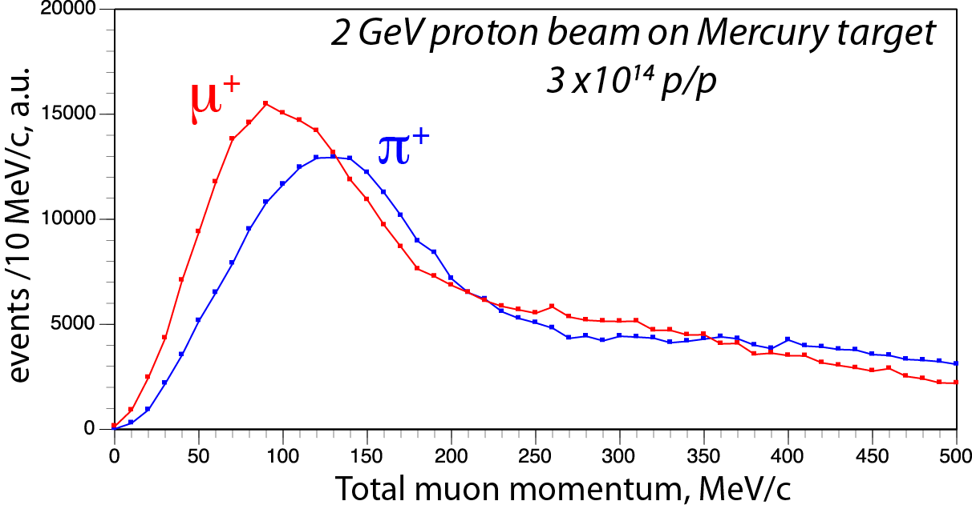
ESS production at 2.0 GeV
A GEANT4 simulation has been used for charged pion and kaon in a mercury target at the kinetic energy of 2.0 GeV.
The 3.3 x 10¹⁴ p/pulse generate 3.85 x 10¹³ π+/pulse and 2.64 x 10¹³ π-/pulse in the forward direction with respect to the beam and a transverse momentum at production < 250 MeV/c. The peak of the momentum distributions is at about 120 MeV/c.
.
The π are decaying with a mean lifetime of ct = 7.8 m, corresponding to path of 8.94 m at the most probable momentum of 160 MeV/c
The µ have ct = 659.1 m, and the longer decay length of 1370 m at 220 MeV/c

Slide 3
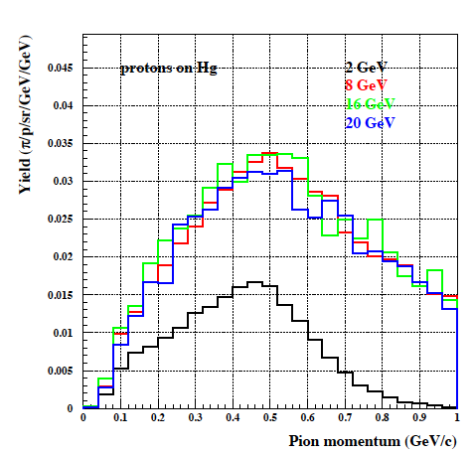
The proton rings
The rate of the ESS- LINAC may be doubled to 28 Hz.
Two proton rings of 35 m radius, the “Accumulator” collects the LINAC pulse and the “Compressor” steers the bunch to 1.5 ns.
The beam transfer from the LINAC to the Accumulator is performed by a multi-turn injection of negative [p+2e-] ions, stripped at the entrance of the Accumulator ring, either with a thin absorbing carbon foil or of an appropriate LASER beam.
The pion spectrum produced by a given “proton power” (the number of protons inversely proportional to its energy) is nearly independent of proton kinetic energy between 8 and 20 GeV and a only a factor two lower for 2 GeV.
Yield (π/p/sr/GeV/GeV)
P. Sala: prediction
Pion momentum 300 MeV/c

Slide 4
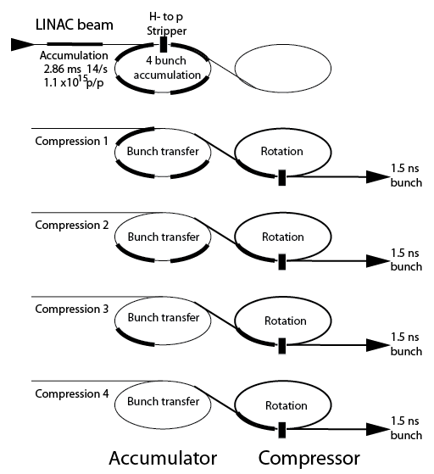
Accumilator and compressor rings for H-
In order to make use of a 5 MWatt/pulse from the ESS and the requirement of 1.5 ns long proton pulses, 2 coupled rings (Accumulator and Compressor) may subdivide the beam pulse into four pulses and operate the secondary beam at 4 x 14 = 56 Hz and a 17.8 ms bunch rate.
Rings have 35 m radius, wth 4 pulses of 120 ns each separated by 50 ns.

