Slide 1
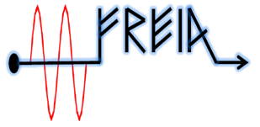
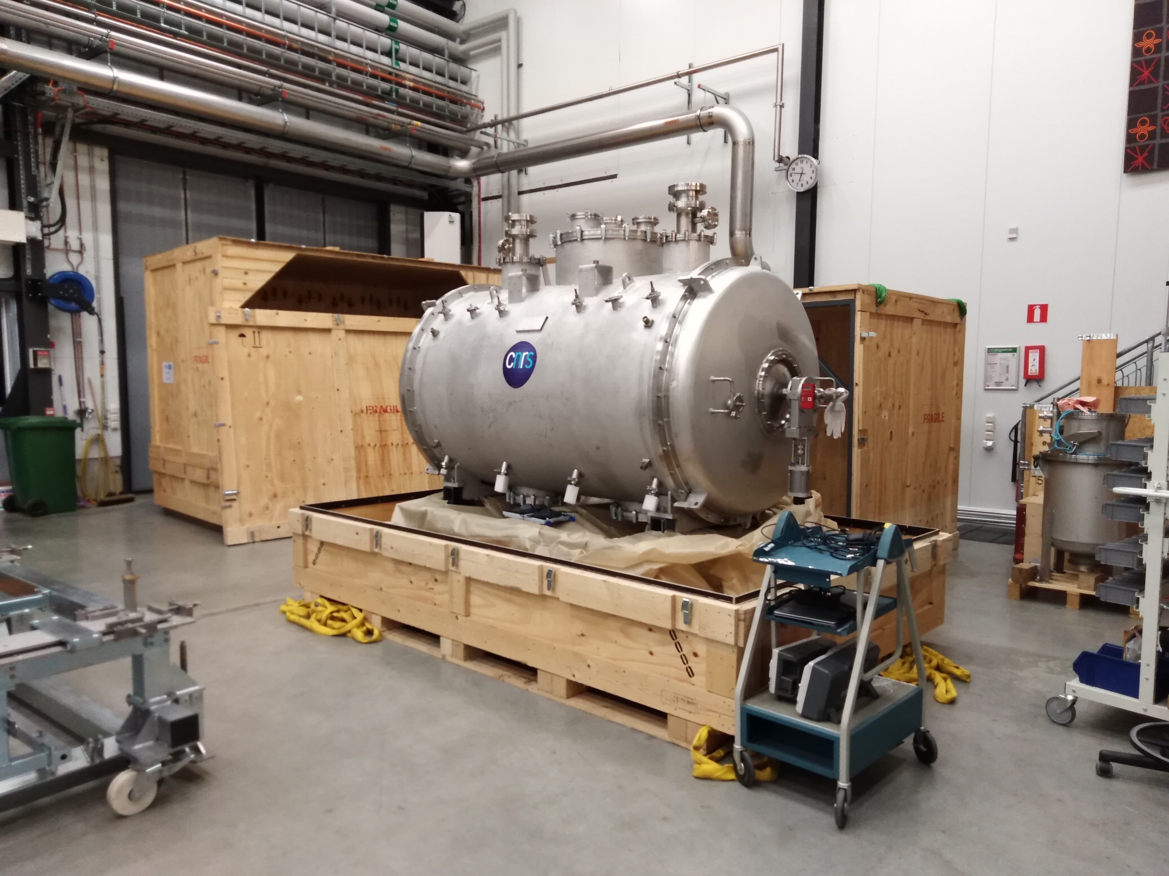
Arrival of Series CM
The cryomodule has arrived FREIA
In-coming inspection/test has been implemented

Slide 2
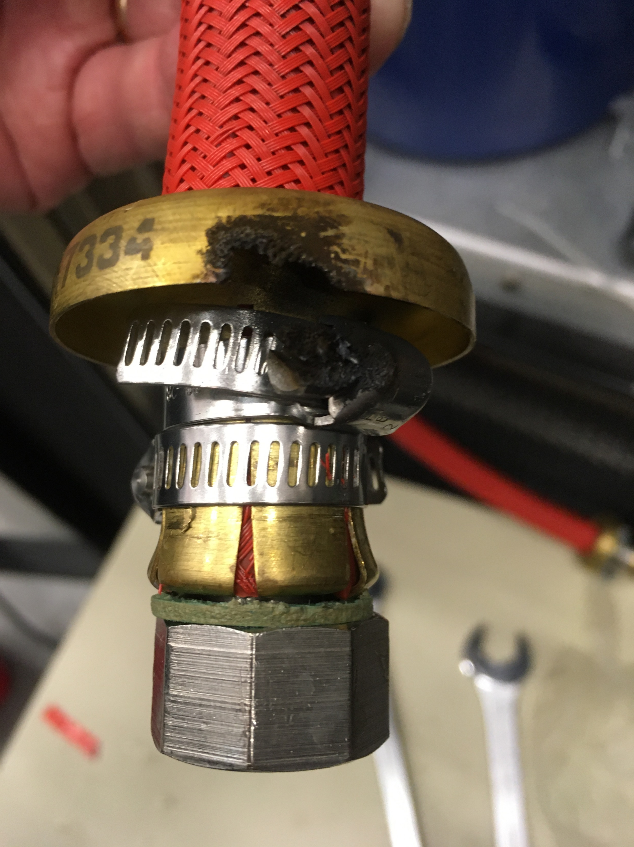
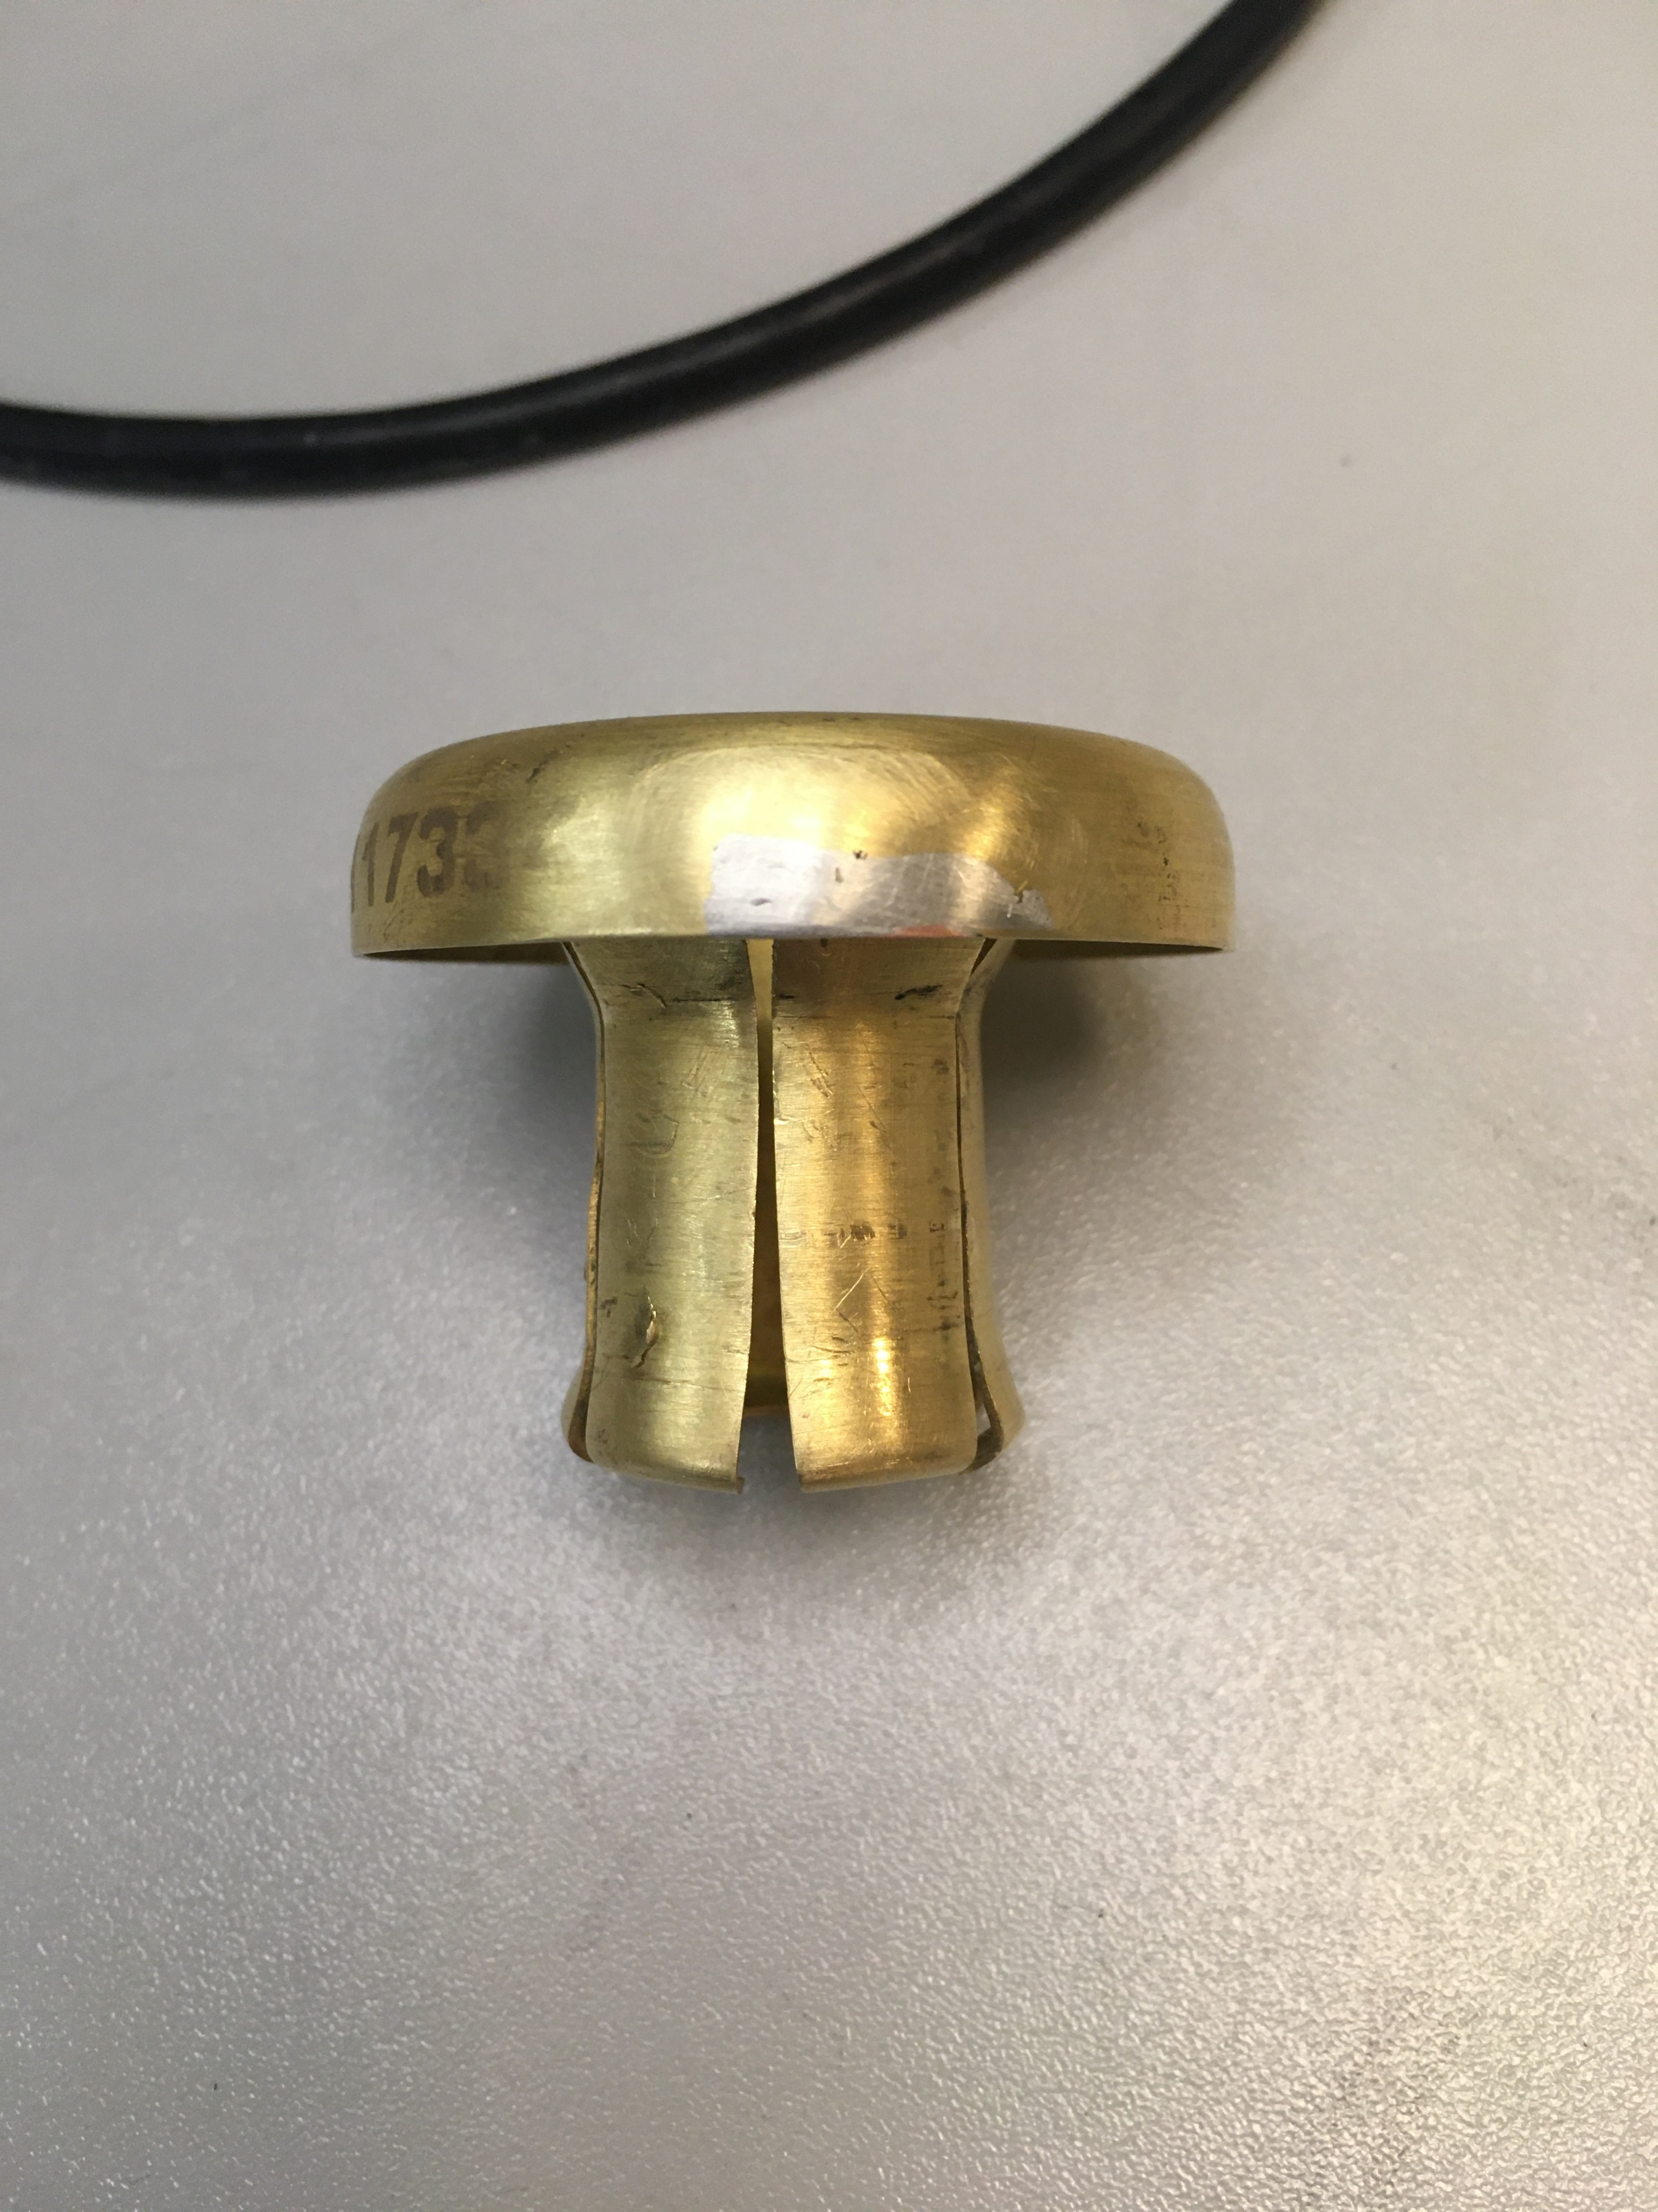
System state
Hardware:
Electrosys
Change anode power cable and anticorona ring
Second pumping carts
Functionality has been verified
R&S oscilloscope
Has been shipped back for repairing
Receive shock sensor from ESS
Software:
LLRF upgrade
Test with both chains of LLRFs and RF stations simultaneously
Consider to increase statute monitor of each tetrode tubes in the FPC conditioning program (for the sake of tubes)

Slide 3
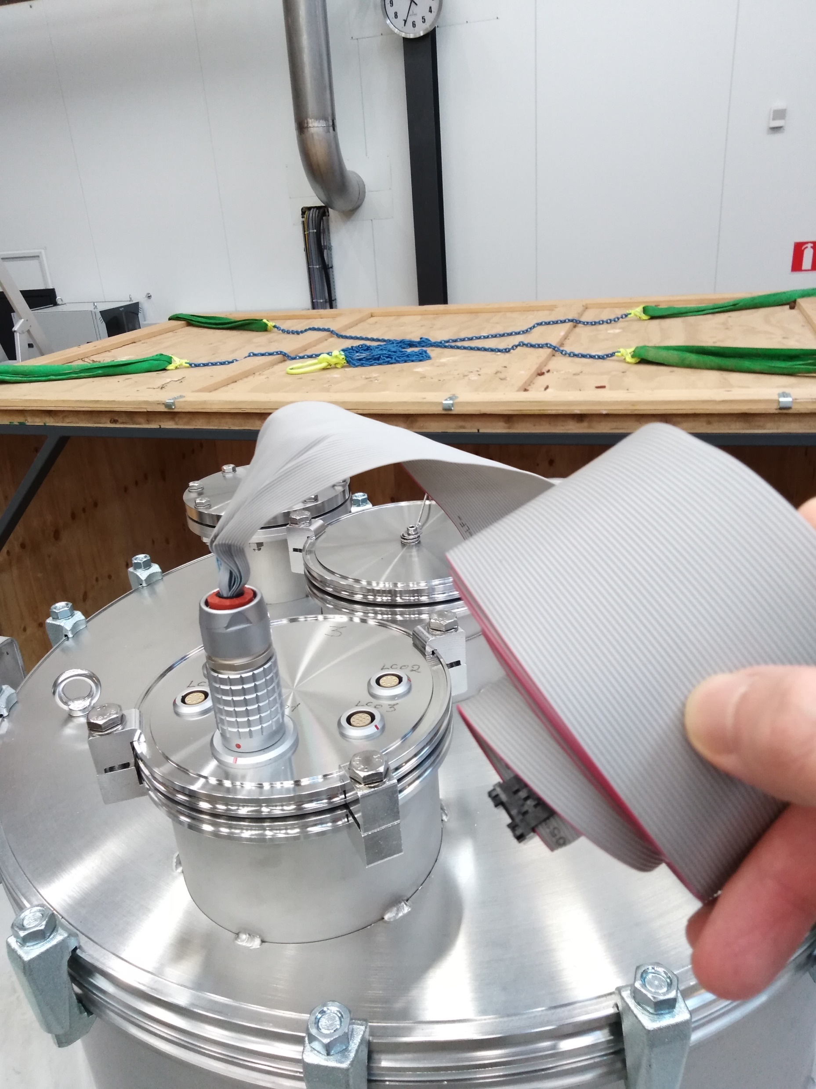
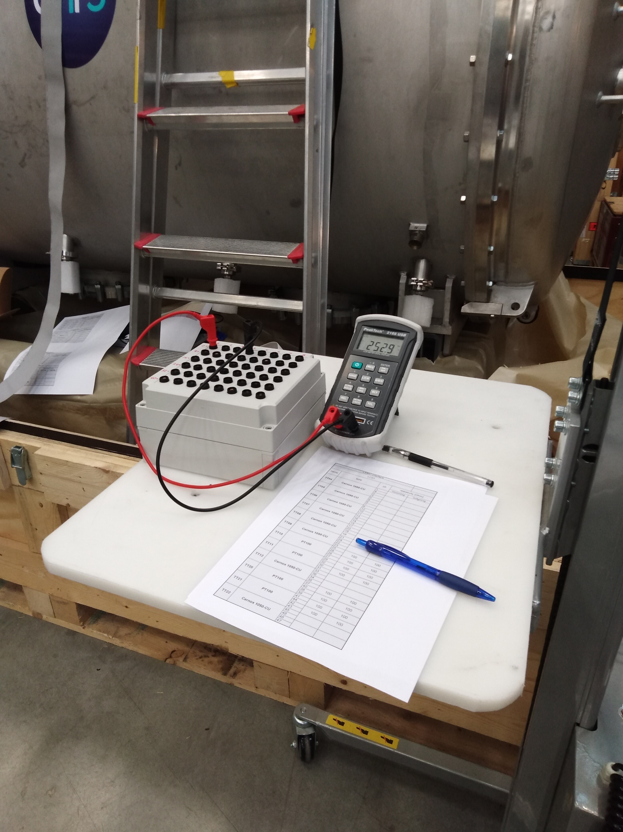
Incoming test for Series CM (I)
Beam vacuum 9.3E-3 mbar
electric continuity check went well
In-coming data has been documented
Comparison with Orsay’s out-going data?
mounting arc detectors and e-pickup

Slide 4
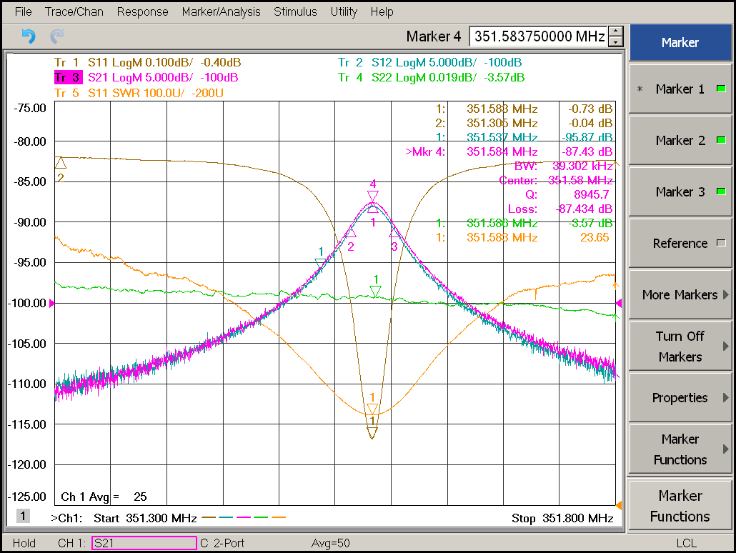
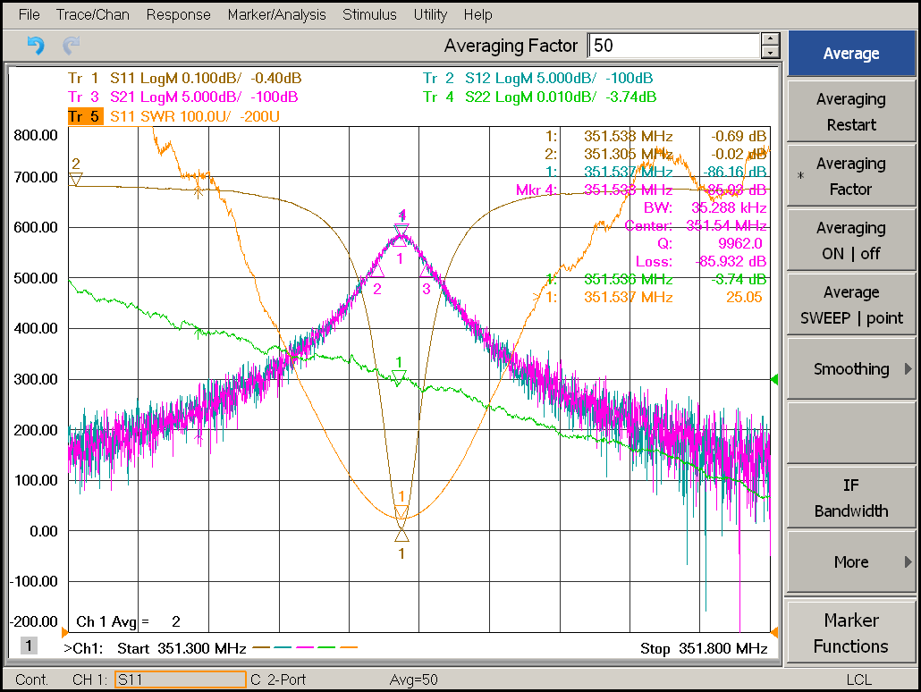
Incoming test for Series CM (II)
Adapter for cavity measurement through FPC
Cavity | Qext for FPC (room T) | Qext for FPC (2K)
Cavity IN | 2.2E5 (SWR)
 | 2.34E5 (S11)
Cavity OUT | 2.59E5 (SWR)
 | 2.68 (S11)
Cavity1 (Romea) | 2.1E5 | 1.8E5
Cavity2 (Giulietta) | 2.3E5 | 1.85E5
Cav in
Cav out
Temperature of cavity (body) | Cavity status | Insulation status | Cavity in (MHz) | cavity out (MHz) | Comment (Giulietta)
300 K | vacuum | atmospheric pressure | 351.584 | 351.538 | 351.59

Slide 5
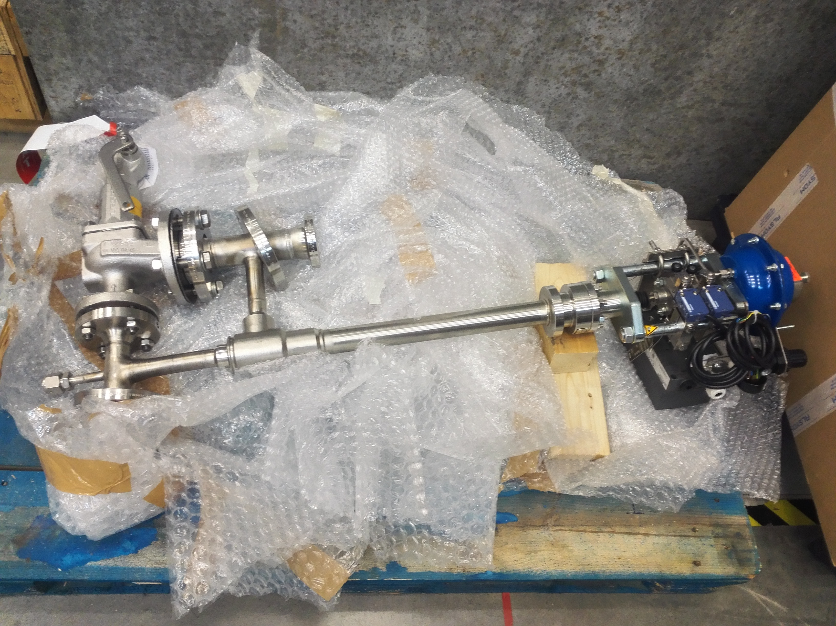
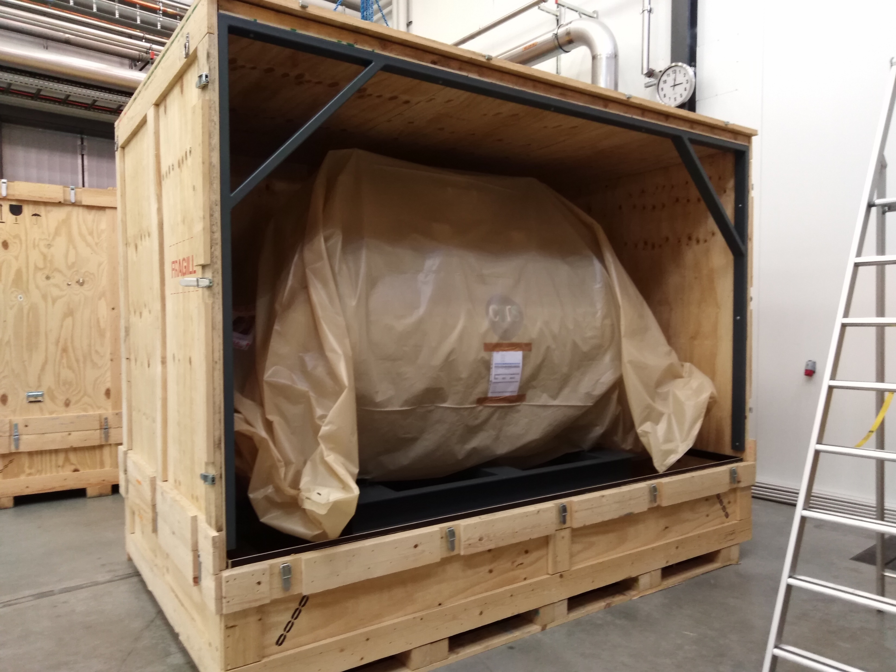
questions
Control valve?
Modify the wooden box for series CM?
Acceptance Criteria of cavity vacuum at warm? 1E-2 mbar?

Slide 6
External helping
1 operator for cryogenics during cold test (from Philipp Arnold)
1 technician for installation work, from 2nd cryomodule (this technician should learn in Uppsala how to redo in Lund)
Any other requests: vacuum, high power RF, ...?
Due to Covid this has to be authorized at the highest level.

Slide 7
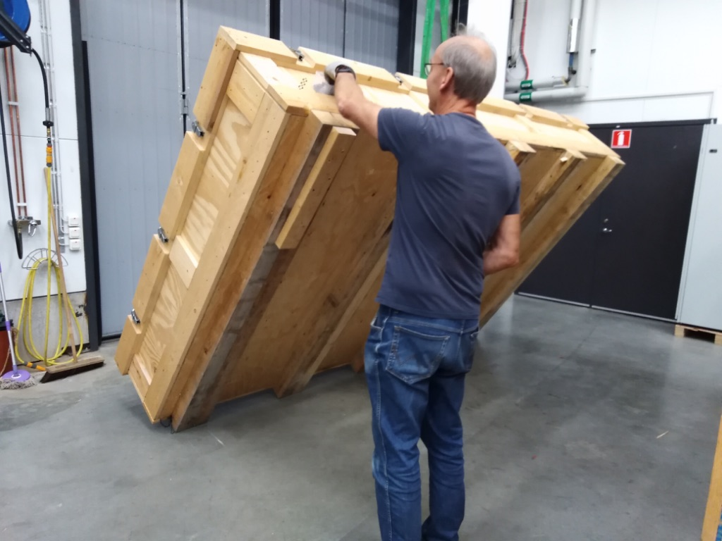
Prepare of shipping Prototype CM
Modification of the prototype box
Will pack the prototype
Mount the shock sensor

Slide 8
To do list
Before CM arrival:
number | item | Person in charge | status
1 | Get back and install G1 power supply for Electrosys | Rolf, Tord | close
2 | Test DB and Electrosys station to full power | Rolf, Tord, Han, Michael | close
2 | Ask for shock senor reader preparation, test box, documentation | Roger | close
3 | Tuner control software validation | Kjell | close
4 | Dismount of doorknob | Lars | close
5 | Validation of vacuum pumping cart | Lars | close
6 | Overall check with the LLRF/software | Han, Tor, Kjell | close
7 | Cryogenic procedure | Lars, Esat | On going
8 | Test documentation | Han | close
9 | Documentation for TRR | Roger, Han | close
10 | Factory calibration of key devices (VNA) Repair of R&S oscilloscope | Tor | On going

Slide 9
To do list
After CM arrival:
Working package | number | item | Person in charge | Status
In-coming test | 1 | Readout information of shock sensor and vacuum | Akira, Han | close
 | 2 | Visual checking of CM | Han, Akira | close
 | 3 | Cavity frequency at room temperature | Han | close
 | 4 | Sensor/cable continuity (test box) | Akira | close
System Installation | 5 | install cavity vacuum pump group on one side | Lars | opening
 | 6 | FPC and doorknob installation |  | opening
 | 7 | move cryomodule into bunker |  | opening
 | 8 | install cryogenics connection |  | opening
 | 9 | install cavity vacuum pump group on other side |  | opening
 | 10 | install insulation vacuum pumps |  | opening
Signal calibration | 11 | Calibration of the pressure sensors/MKS | Konrad | opening
Prototype CM | 12 | Shipping back to ESS |  | On going

