Slide 1
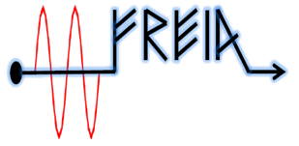
To do list
After CM arrival:
Working package | number | item | Person in charge | Status
In-coming test | 1 | Readout information of shock sensor and vacuum | Akira, Han | close
 | 2 | Visual checking of CM | Han, Akira | close
 | 3 | Cavity frequency at room temperature | Han | close
 | 4 | Sensor/cable continuity (test box) | Akira | close
System Installation | 5 | install cavity vacuum pump group on one side | Lars | opening
 | 6 | FPC and doorknob installation |  | close
 | 7 | move cryomodule into bunker |  | close
 | 8 | install cryogenics connection |  | close
 | 9 | install cavity vacuum pump group on other side |  | opening
 | 10 | install insulation vacuum pumps |  | close
Signal calibration | 11 | Calibration of the pressure sensors/MKS | Konrad | On going
cabling | 12 | Connect all cables to the interconnection box | Akira, Han | opening
Prototype CM | 13 | Shipping back to ESS |  | close

Slide 2
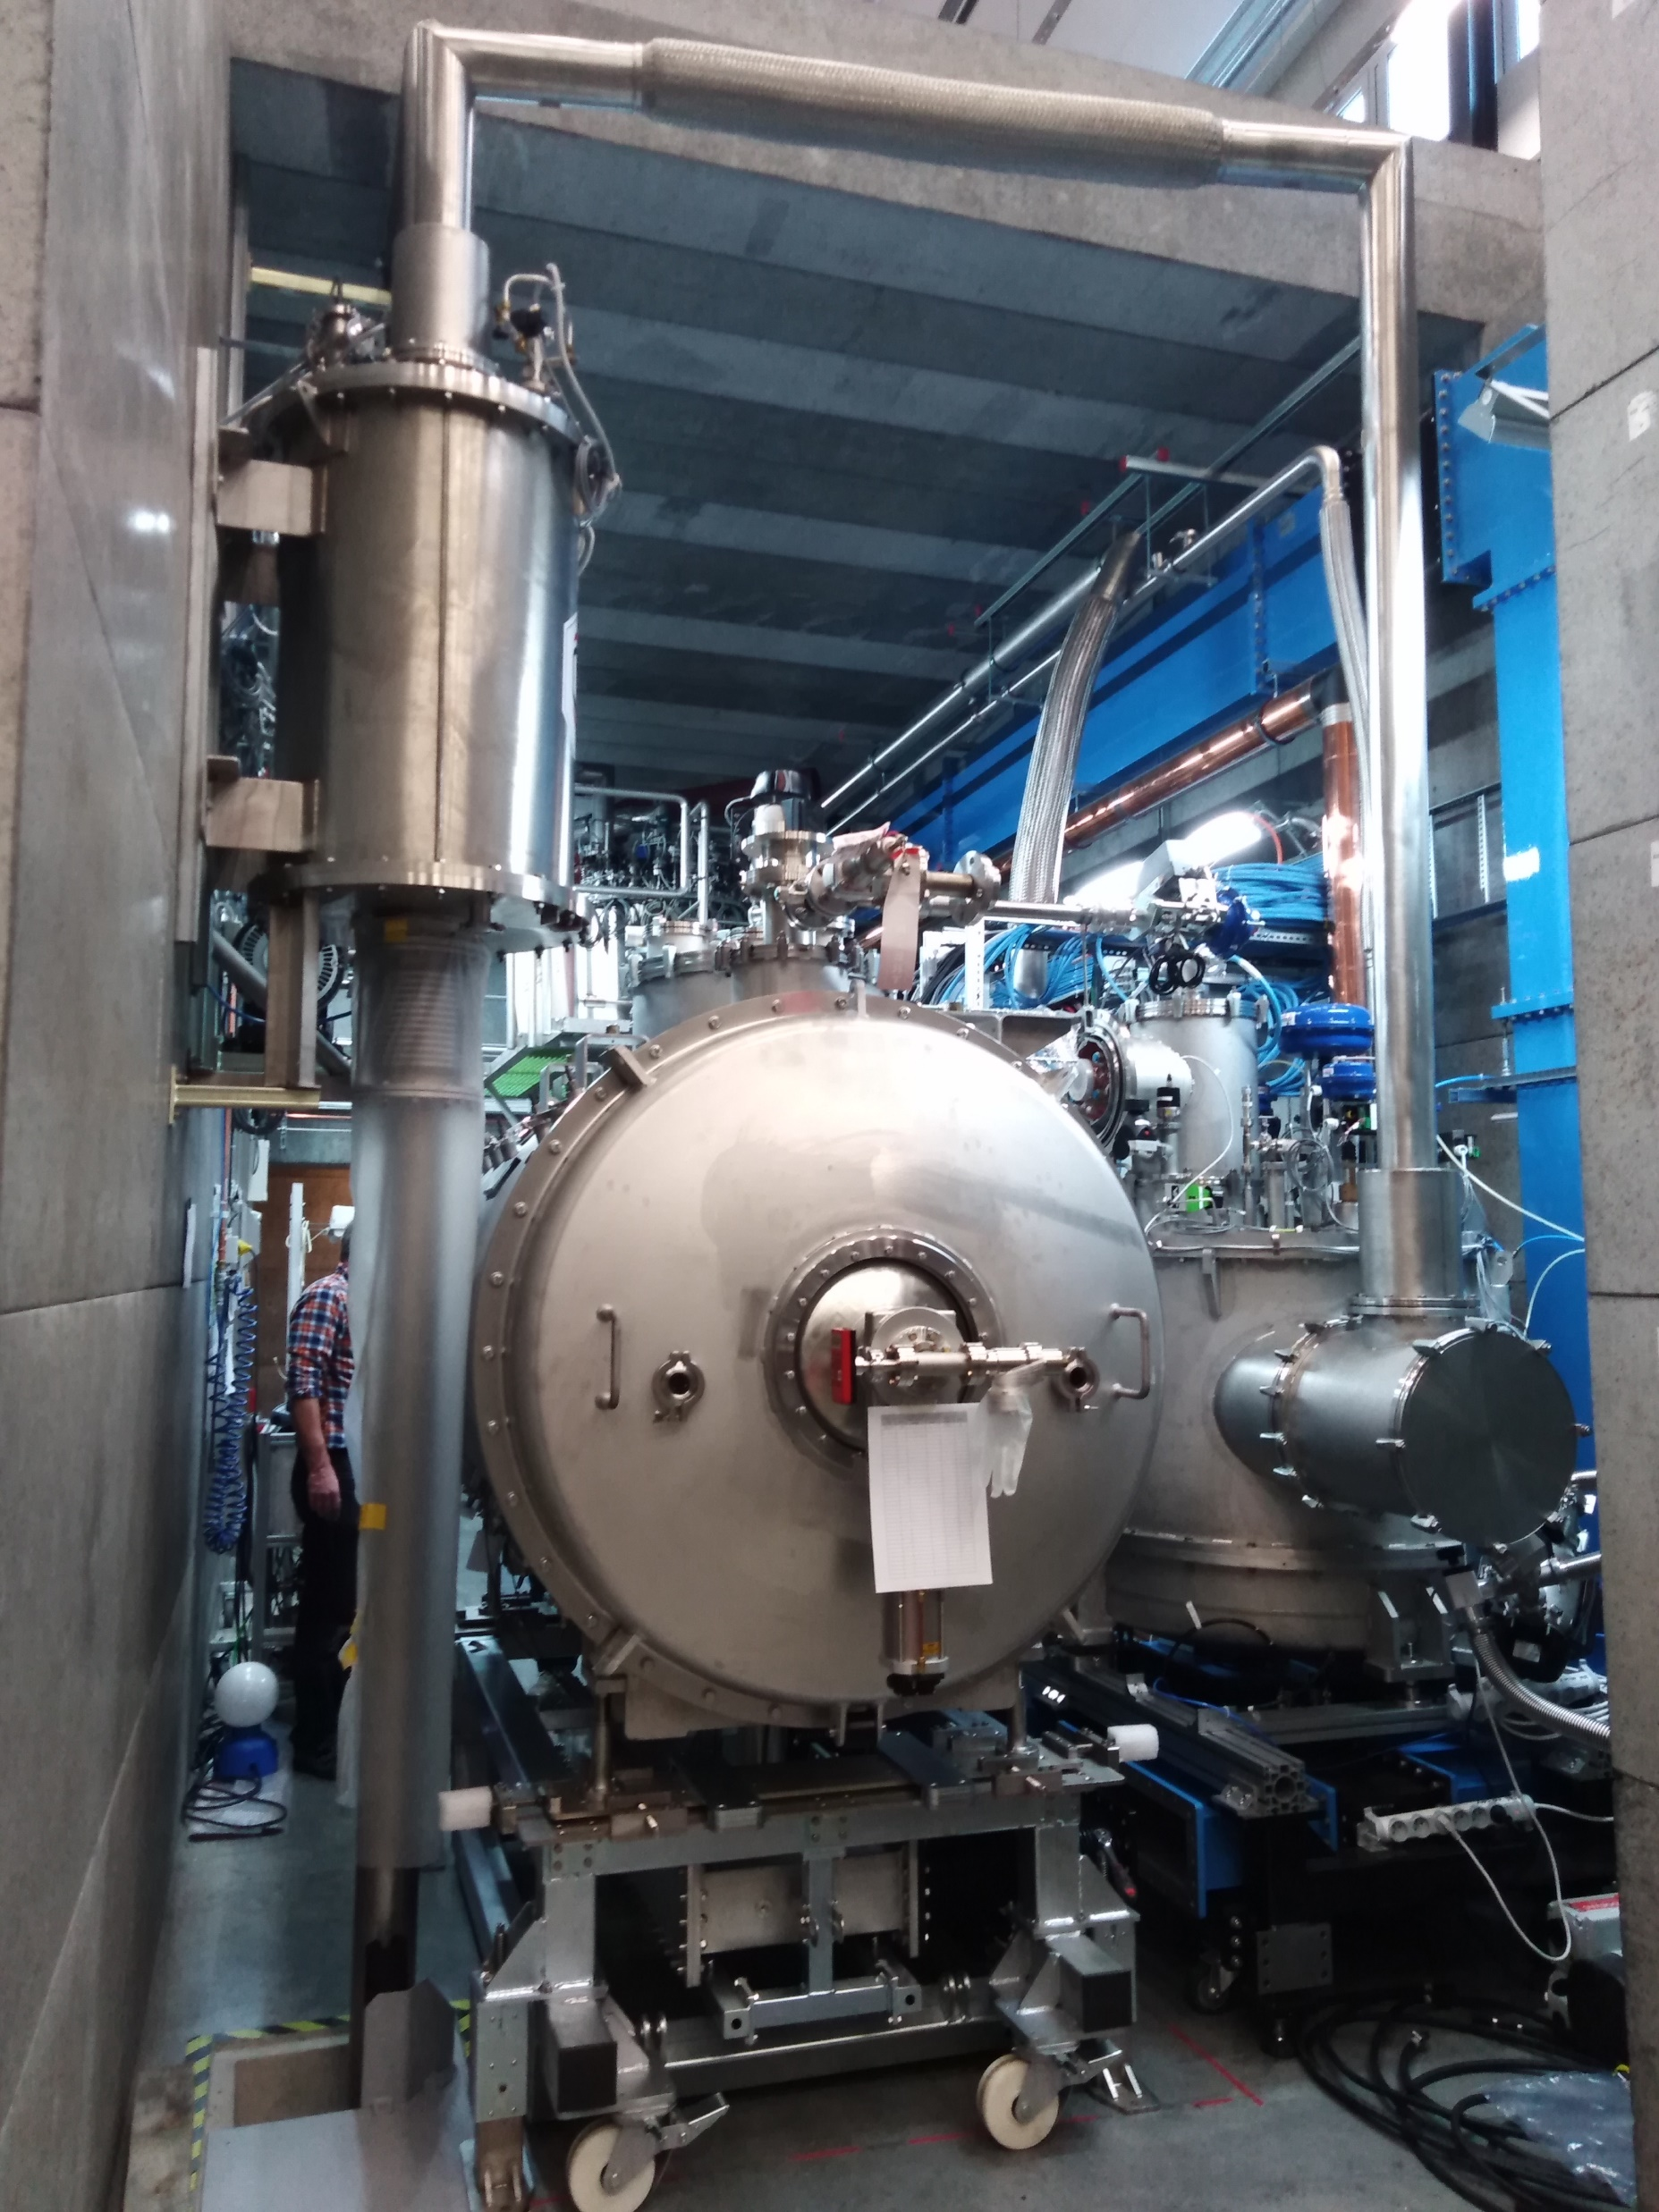
Series CM
Installation of the CM
Doorknob
cryogenics connection
Need extra magnetic solenoid valve for the cryogenic valve functioning
Will connect the beam vacuum pump
Will connect all electronic cables to interconnection box
Calibration of pressure sensor/gauge readout (MKS)
Will re-test with Orsay’s test box

Slide 3
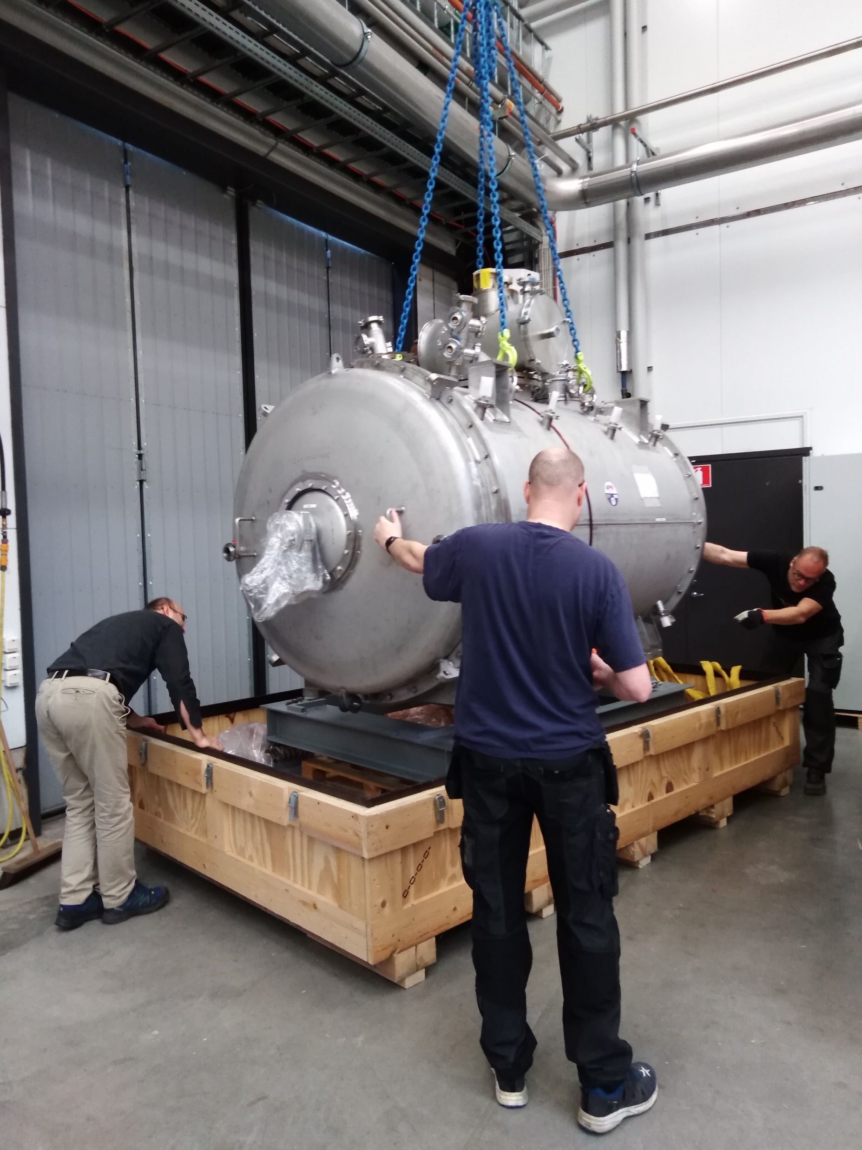
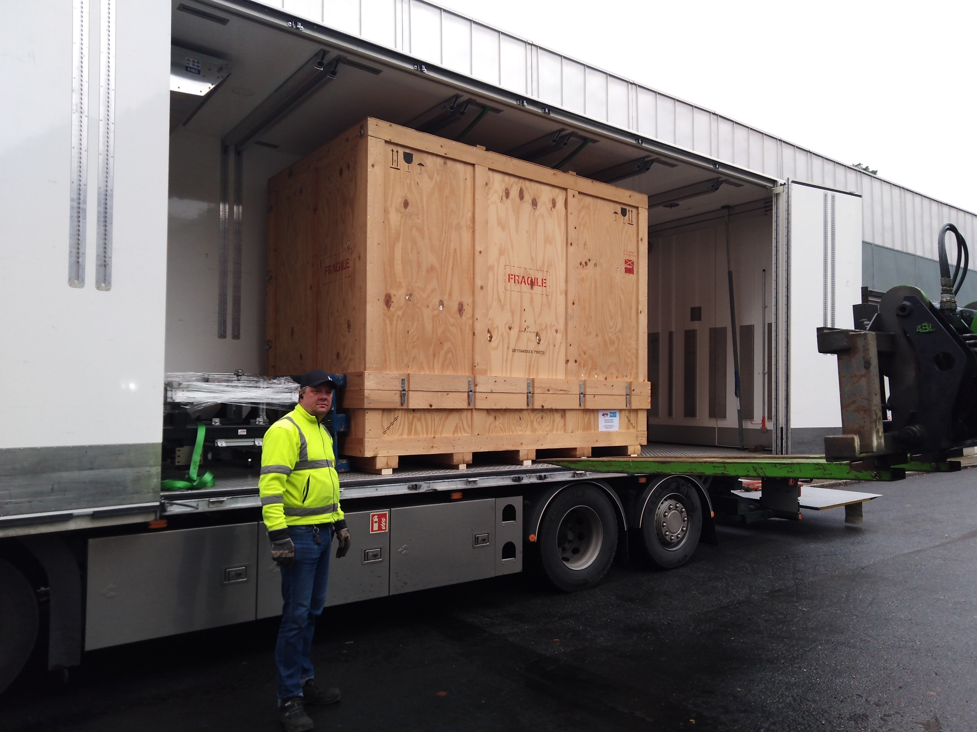
Delivery of Prototype CM
Prototype CM and its frame support have been delivered to ESS

Slide 4
System state
Hardware:
RF stations
Standby mode
RF distribution
Connect to CM by the end of this week
Shock sensor from Orsay
Shipped back to Orsay
Test box
Receive from Orsay
Software:
LLRF
Test with both chains of LLRFs and RF stations simultaneously
PID test of both chains simultaneously(on load)

Slide 5
Preliminary time plan
Test item | time | comment
CM installation | 26th-30th Oct.
Install cavity vacuum pump group | 2nd Nov.
FPC warm conditioning | 3nd-6th Nov. | 1) Simultaneously 2) Could be prolonged depended on the progressing
CM cooldown | 9th-11th Nov. | Based on the prototype experience
FPC cold conditioning | 12th -13th Nov. | Simultaneously
Cavity tuning | 16th -17th Nov. | CTS measurement
Cavity conditioning (on resonance) | 18th -20th Nov. | Open loop
Heat load/Q measurement |  | 1)Each cavity 2) PID
Long-term stability | 23rd Nov.
Piezo compensation | 24th – 27th Nov. | First CM only
Warm up | 28th Nov.

