Slide 1
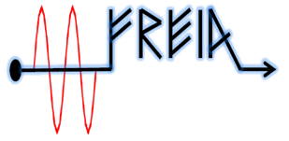
To do list
After CM arrival:
Working package | number | item | Person in charge | Status
In-coming test | 1 | Readout information of shock sensor and vacuum | Akira, Han | close
 | 2 | Visual checking of CM | Han, Akira | close
 | 3 | Cavity frequency at room temperature | Han | close
 | 4 | Sensor/cable continuity (test box) | Akira | close
System Installation | 5 | install cavity vacuum pump group on one side | Lars | close
 | 6 | FPC and doorknob installation |  | close
 | 7 | move cryomodule into bunker |  | close
 | 8 | install cryogenics connection |  | close
 | 9 | install cavity vacuum pump group on other side |  | close
 | 10 | install insulation vacuum pumps |  | close
Signal calibration | 11 | Calibration of the pressure sensors/MKS | Konrad | close
cabling | 12 | Connect all cables to the interconnection box | Akira, Han | close
Prototype CM | 13 | Shipping back to ESS |  | close

Slide 2
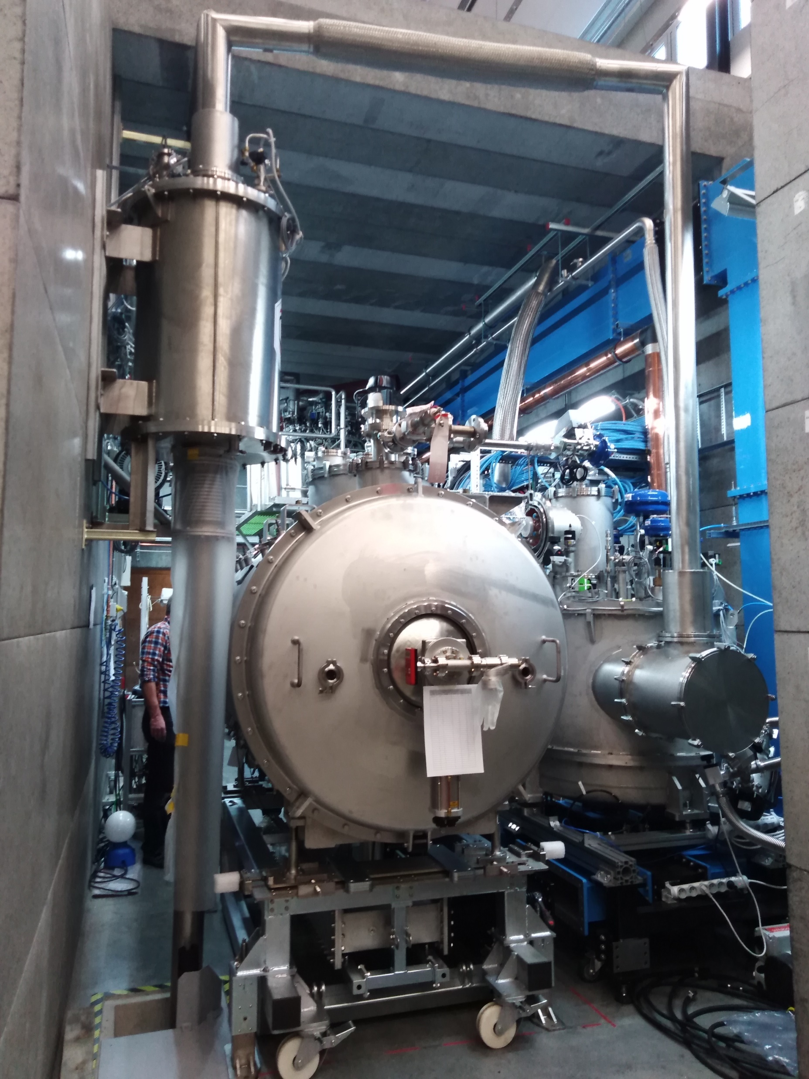
Series CM
Re-test with Orsay’s test box
Confirm that one temperature sensor (TT12) is dead.
Closer the bunker
Install water cooling system for FPC
Interlock system checking
Start first FPC warm conditioning simultaneously

Slide 3
Coupler conditioning
Conditioning program>
Use arc detector and e- pick up .
Frequency using for off resonance conditioning at warm: 353 MHz
Auto-conditioning 24/7
Parameter | value
Loop control time (s) | 1
Pulse repeat rate (Hz) | 14
Vacuum upper limit (mbar) | 5e-6
Vacuum lower limit (mbar) | 1e-6
Initial pulse length (µs) | 20
pulse length step | 50 µs, 100µs, 250µs,500 µs, 1ms, 2 ms,3.5ms
Vacuum hardware interlock (mbar) | 1e-5
e- pickup interlock (mA) | 2
Main Parameters of Spoke FPC Conditioning
3

Slide 4
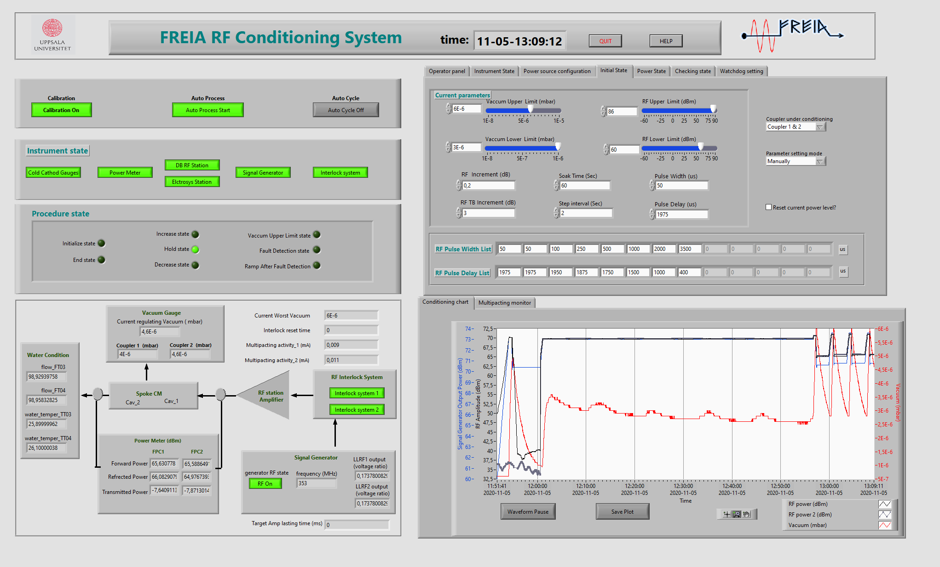

Slide 5
Preliminary time plan
Test item | time | comment
CM installation | 26th-30th Oct.
Preparation | 2nd – 4th Nov. | Install cavity vacuum pump group /water cooling system
FPC warm conditioning | 5nd-13th Nov. | 1) Simultaneously 2) Could be prolonged depended on the progressing
CM cooldown | 16th-18th Nov. | Based on the prototype experience
FPC cold conditioning | 19th -20th Nov. | Simultaneously
Cavity tuning | 23rd -24th Nov. | CTS measurement
Cavity conditioning (on resonance) | 25th -27th Nov. | Open loop
Heat load/Q measurement |  | 1)Each cavity 2) PID
Long-term stability | 30th Nov.
Piezo compensation | 1st – 3rd Dec. | First CM only
Warm up | 4th Dec.

Slide 6
Shift for CM test
Operation related to FPC conditioning: Auto-conditioning 24/7
Operation related to cavity RF test at cold : only during working hour
Two shifts are need? From 8 a.m. to 8 p.m. ?
8 a.m. to 4 p.m?
1 p.m. to 8 p.m?
On call?
Each shift need at least :
RF expert × 1
LLRF expert × 1
High power station expert × 1
Cryogenic operator × 1
Preference for the shift?

