Slide 1


SAC meeting on Ångström FEL
Beam dynamics
09 November 2020
Kévin Pepitone – Zoltán Tibai

Slide 2

Outline
Accelerate the beam up to 3 MeV
Focusing and bucking coils
Accelerate the beam up to 10 MeV
RF gun cavity
Focusing coil
Cavity
Cavity
CST
CST
Cavity
GPT
MATLAB
ASTRA
GPT
e- diffraction
ASTRA
GPT
ASTRA
GPT
ASTRA GPT
Generate the distribution at
100 fs
Adapt to ASTRA and create the reference particle
Grating at
190 cm
4f-imaging
Slit at
265 cm
Next presentation
Emittance exchange
Zoltan
Tibai

Slide 3
Layout and fields

Slide 4
Layout
Dipole
Solenoid
Grating
Slit
9
10
z (m)
0
1
2
3
4
5
6
7
8
RF gun
325 MHz
Accelerator module
1.3 GHz
Accelerator module
1.3 GHz
Deflector
Accelerator

Slide 5
Layout
9
10
z (m)
0
1
2
3
4
5
6
7
8

Slide 6
Layout - Fields
9
10
z (m)
0
1
2
3
4
5
6
7
8

Slide 7
Layout - Fields
35 MV/m
17 MV/m
13 MV/m

Slide 8
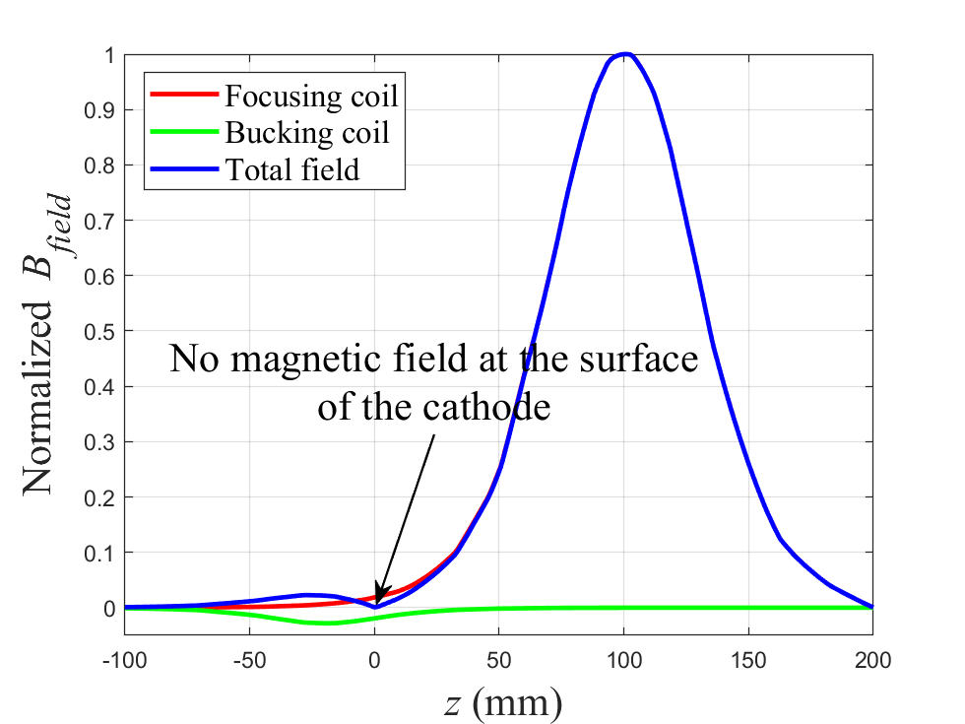
Solenoids
Parameter | Focusing coil | Bucking coil
Inner diameter | 60 mm | 60 mm
Outer diameter | 102 mm | 102 mm
Thickness | 51.7 mm | 22 mm
Nb of turns | 1055 | 25

Slide 9
Cathode – Electron distibution

Slide 10
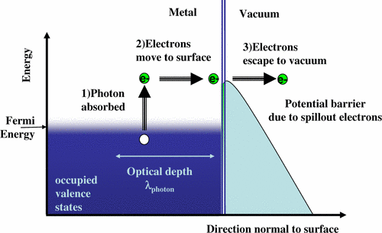



Photoemission
Fermi-Dirac probability function:
$$n\left(E\right)=g_{C}\left(E\right)f\left(E\right) \sim \sqrt{E}\frac{1}{1+e^{\frac{E−E_{F}}{k_{B}T}}}$$
Parameters:
$$T=300 K$$
$$E_{photon}=4.71 eV$$
$$φ_{eff}=4.46 eV$$
$$E_{F}=7 eV$$
D. H. Dowell, J. F. Schmerge DOI: 10.1103/PhysRevSTAB.12.074201

Slide 11
Electron distribution
Parameters: $r_{xy}=54 μm,τ=30 fs, Q=160 fC, B_{z}=0.075 T$
MATLAB
Photoemission
E- Distrib.
GPT
MATLAB
Generate the distribution
at 100 fs
Adapt to ASTRA and create the reference particle

Slide 12
Grating

Slide 13
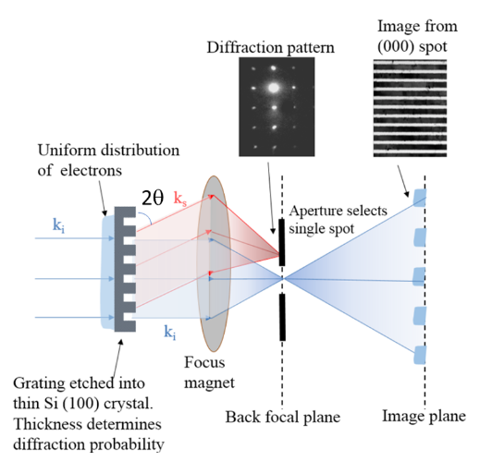

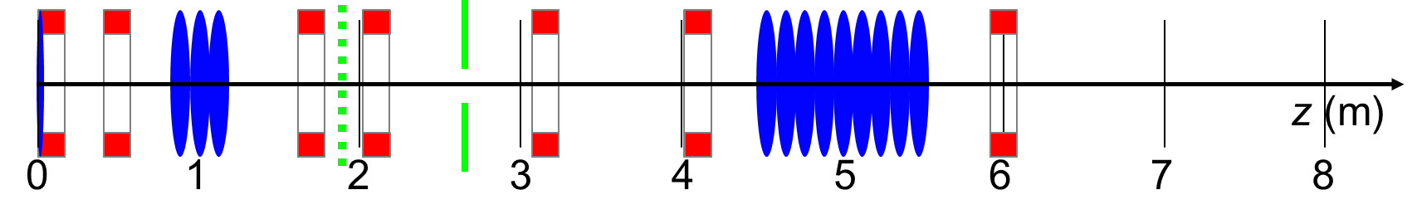
Electron diffraction and 4f-imaging
Theory
Simulation
Peter
Salen
Grating
z (m)
1.8
2
MATLAB
Kick in y depending on the position of the electron and period of 43%-57% (0th order-1st order)
2θ = 1.1 mrad
W.S. Graves arXiv:1906.01525
Note that for the simulations the grating is 25.8-34.2 μm

Slide 14
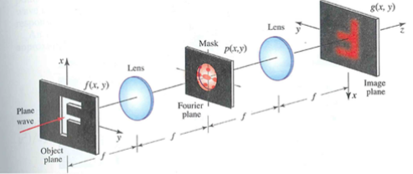
Electron diffraction and 4f-imaging
Theory
Simulation
Peter
Salen
Grating
Slit
Lens
Lens
d
d
z (m)
2
3
Textbook: Fundamentals of Photonics - B.E.A. Saleh & M.C. Teich
Object plane
1.9 m
Fourier plane
2.65 m
Virtual image plane
3.4 m
Fourier transform
Inverse Fourier transform

Slide 15
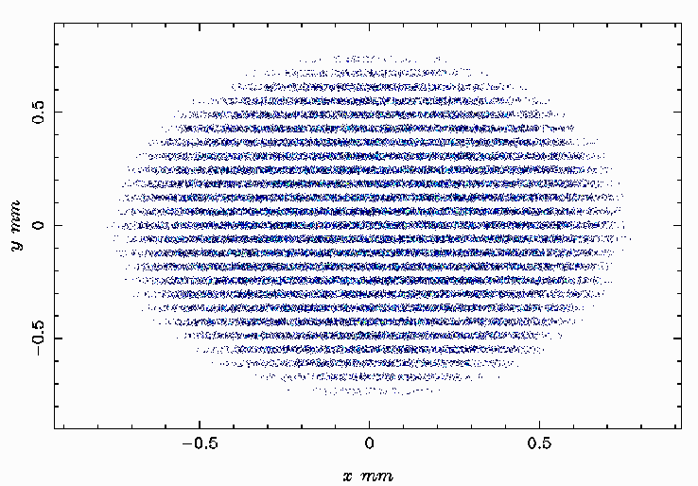
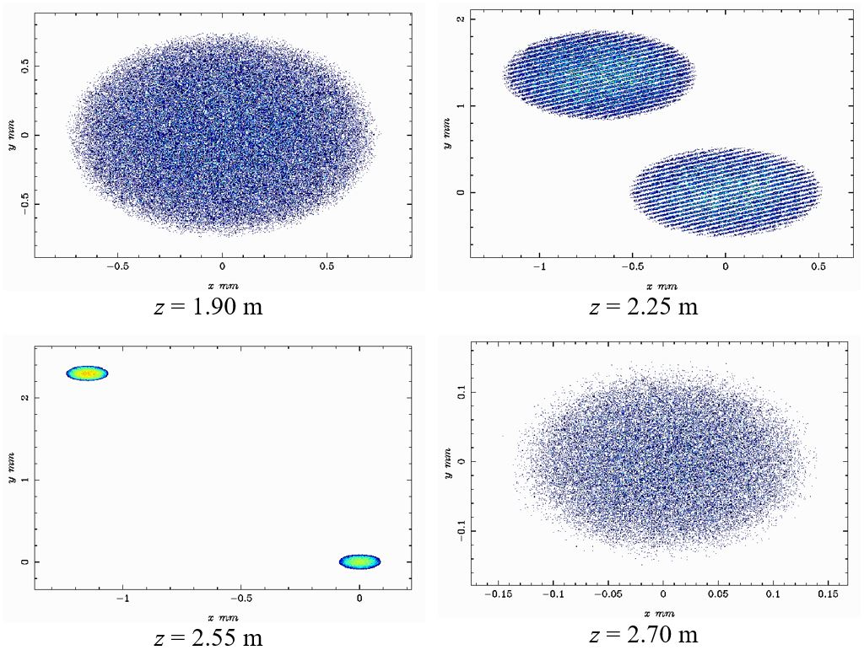
Simulations – e- beam
z (m)
0
1
2
3
4
5
6
7
8

Slide 16
GPT and ASTRA simulation results

Slide 17
Simulations – energy
z (m)
0
1
2
3
4
5
6
7
8

Slide 18
Simulations – energy spread
z (m)
0
1
2
3
4
5
6
7
8

Slide 19
Simulations – beam size
z (m)
0
1
2
3
4
5
6
7
8

Slide 20
Simulations - emittance
z (m)
0
1
2
3
4
5
6
7
8

Slide 21
Simulations – beam divergence
z (m)
0
1
2
3
4
5
6
7
8
ASTRA: p_{x}/p_{z}
GPT: β_{x}

Slide 22
Thank you for your attention

