Slide 1
FREIA Laboratory
Facility for Research Instrumentation and Accelerator Development
Department of Physics and Astronomy
Overview of
Infrastructure and Resources
Roger Ruber
for the FREIA Team
Uppsala, 10 November 2020
SAC meeting on Ångström FEL

Slide 2

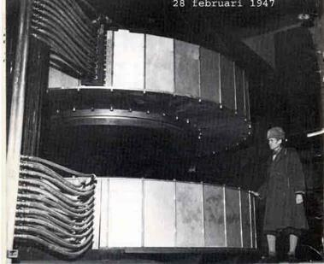
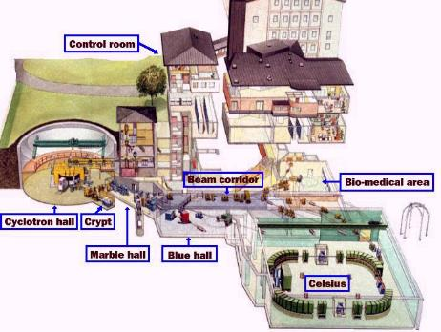
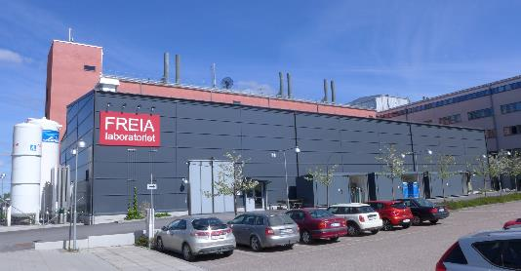
Uppsala Accelerator History
1477: Uppsala University, oldest in Scandinavia
25'000 students, 7'000 staff
historical profiles: Linné, Rudbeck, Celsius, Ångström, Svedberg
1940's: The(odore) Svedberg builds a cyclotron
Gustaf Werner synchro-cyclotron (1947 - 2016)
  nuclear physics & oncology
CELSIUS ring (1984 - 2005)
  nuclear & particle physics
2000's: External projects
CTF3/CLIC (since 2005)
FLASH/XFEL (since 2006)
ESS (since 2009)
2010's: New ventures
FREIA laboratory (est. 2011)
Skandion clinic (est. 2015)

Slide 3
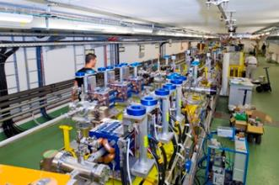
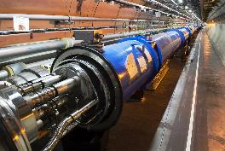
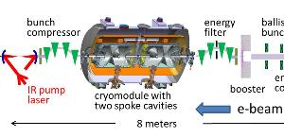
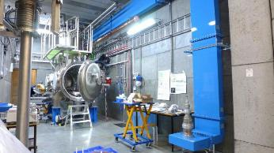
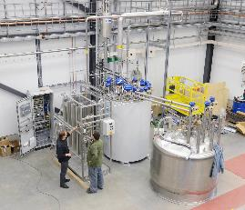
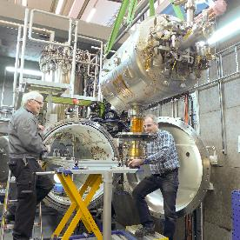
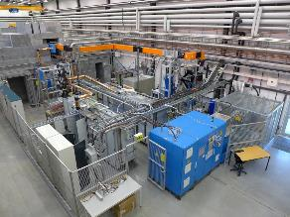
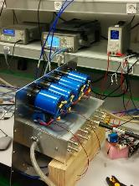
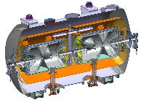
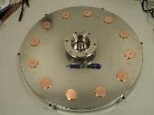
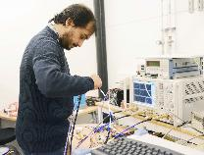
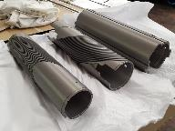
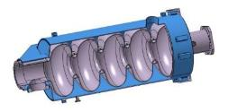
Accelerator Research & Development
Ultra Bright Electron Beams
High Intensity Proton Beams
Accelerator
Physics
Cryogenics & Test Stands
SC Cavities & Magnets
RF Generation & Control
Accelerator
Technology

Slide 4
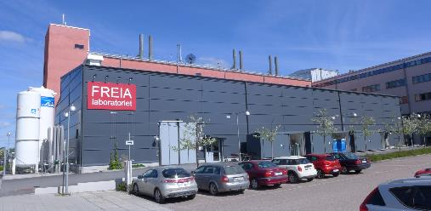
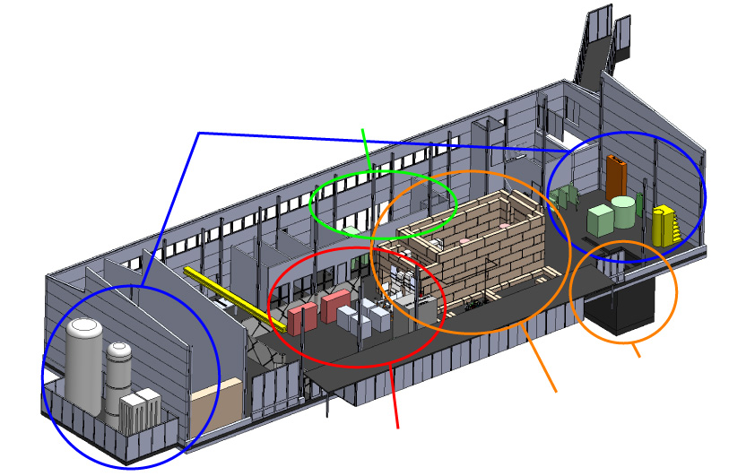
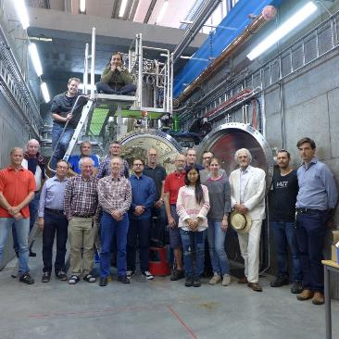
FREIA Laboratory
Facility for Research Instrumentation and Accelerator Development
Funded by
KAWS, Government, Uppsala Univ.
State-of-the-art Equipment
cryogenics
- liquid helium
- liquid nitrogen
control room
- equipment controls
- data acquisition
Competent and motivated staff
collaboration of physics (IFA)
and engineering (Teknikum).
vertical cryostat
3 bunkers
with test stands
horizontal cryostat
radio-frequency (RF) power sources

Slide 5
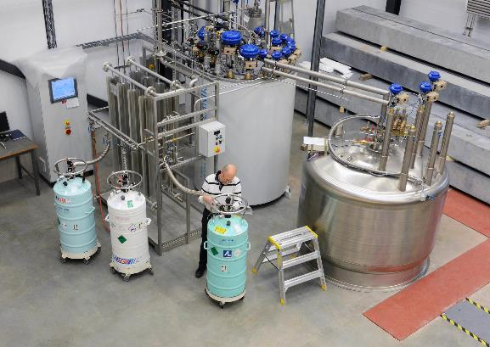
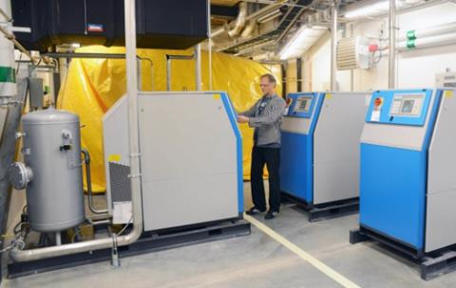
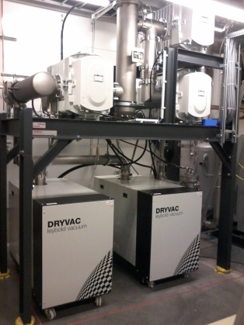
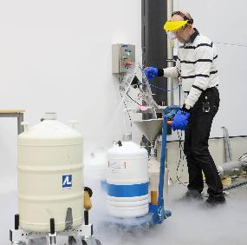
Cryogenics
Helium liquefaction
  150 l/h at 4.5K (LN2 pre-cooling)
  2000 l LHe dewar/buffer, 3+1 outlets
  cryostats connected in closed loop
Gas recovery
  100 m³ gasbag
  3x 25 m³/h compressor
  10 m³ 200 bar storage
2K Pumping
  ~3.2 g/s at 10 mbar
  ~4.3 g/s at 15 mbar
  110(90)W at 2.0(1.8)K
Liquid nitrogen
  20 m³ LN2 tank
Helium gas recovery system
Sub-atmospheric pumping station

Slide 6

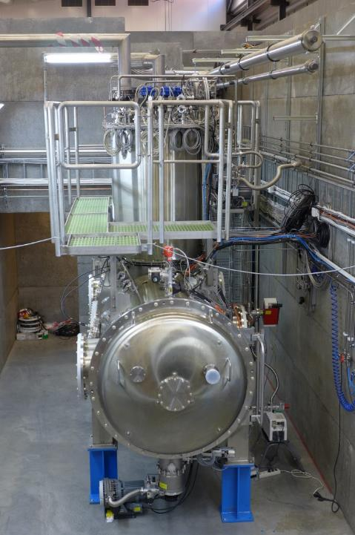
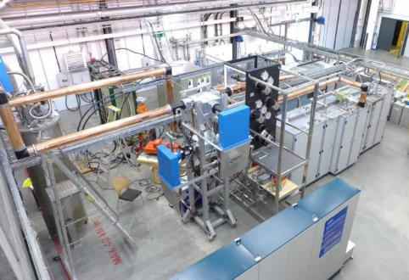

“Hnoss” Horizontal Cryostat
Nordic mythology: Hnoss is one of Freia’s daughters
Test of superconducting cavities/devices
  3240 x ø1200mm inner volume
  up to two cavities simultaneously,
  each equipped with helium tank,
Low or High power RF testing
  fundamental power coupler (top, bottom, side)
  (cold) tuning system
Operation in the range 1.8 to 4.5K.
Available as ARIES
Trans National Access Facility
cern.ch/aries

Slide 7
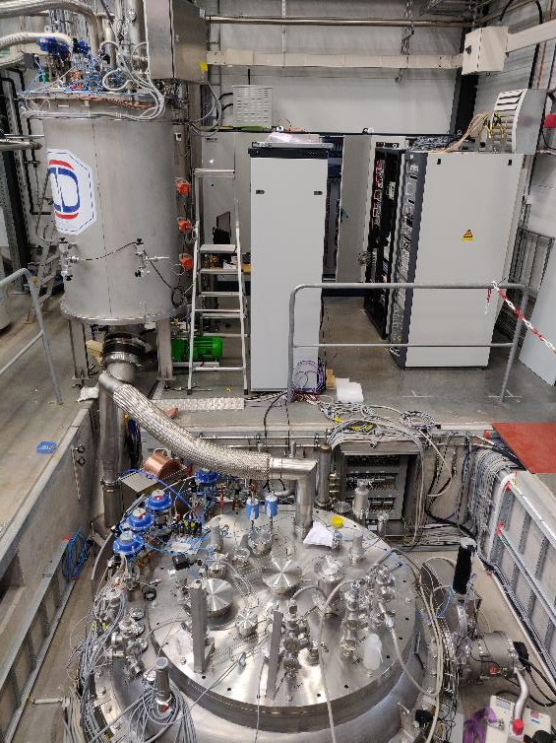
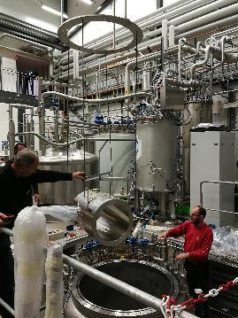
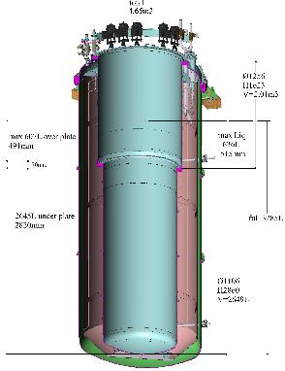
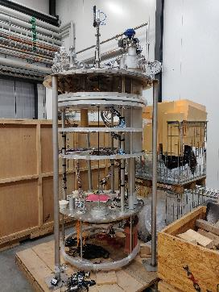
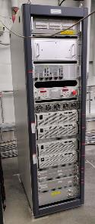
“Gersemi” Vertical Cryostat
Nordic mythology: Gersemi is one of Freia’s daughters
Test of SC cavities & magnets (<350kJ)
  3.2m x ø1.1m total volume
  2.65m x ø1.1m below lambda plate
    design includes joint for lambda plate
Three operation modes
  vacuum; liquid bath; pressurized
  (bath with 2K heat exchanger)
Operation in the range 1.8 to 4.5K
Available as ARIES
Trans National Access Facility
cern.ch/aries
2 x 2000 A

Slide 8
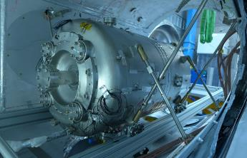
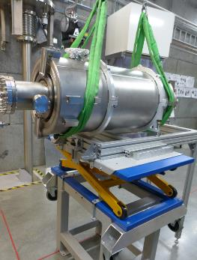
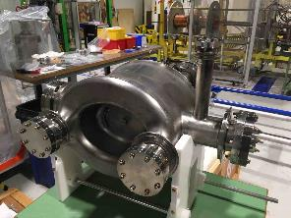
SRF Cavities Testing
ESS Double-spoke, 352 MHz
ESS Elliptical, 704 MHz
Prototype cavity
  test without and with power coupler
  RF conditioning
  Q₀, gradient, fill time,
  Lorentz force detuning, microphonics
  test LLRF, SEL,
  tuner operation
  nominal gradient
HL-LHC Crab, 400 MHz
  prototype cavity, w/o He jacket
  double quarter wave (DQW)
  first cavity test in vertical cryostat
    successfully completed 8-Oct!
RF stations
  acceptance test of HV modulator for ESS local test stand
  test RF distribution (circulator, load)
Prototype high beta elliptical
  with power coupler and tuner
  RF conditioning
  Q₀, gradient, fill time, heat load
  Lorentz force detuning,
  microphonics
  test LLRF, SEL,
  tuner operation
H. Li et al,
NIM A927 (2019) 63
H. Li et al,
LINAC 2018, THOP066

Slide 9
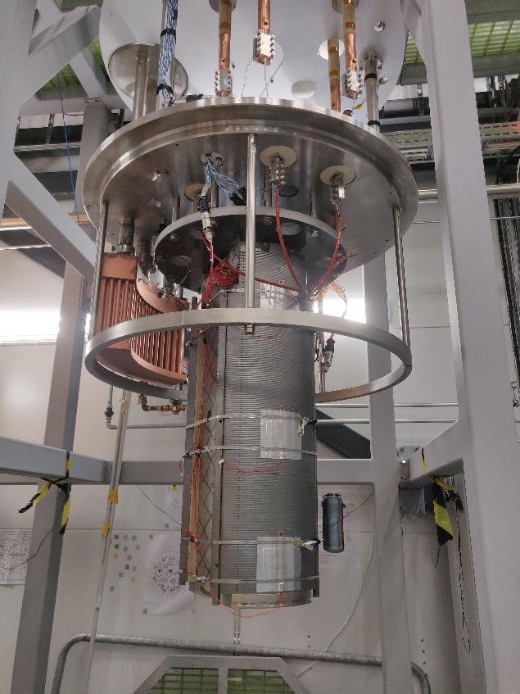
SC Magnet Testing
Preparing to commission Gersemi with a superconducting magnet
Operation with “magnet insert”
  lambda plate to separate 2K pressurized helium from 4K helium
  heat exchanger with sub-atmospheric 2K helium to cool the pressurized 2K helium

Slide 10

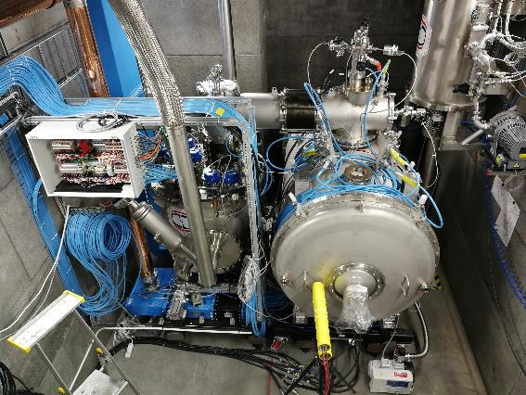
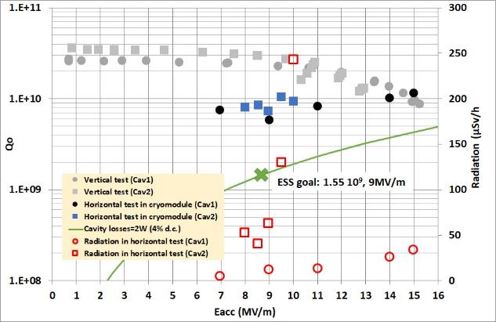
Cryomodule Testing
ESS Prototype cryomodule (2019)
  RF conditioning
    ~3 days/cavity at warm
    MP bands were consistent with HNOSS test
      strength depends on pulse length,
      1st/2nd conditioning…
    no activity at cold
  Cavity performance
    multipacting regions similar as test
    in Hnoss:
      2-3; 4-5; 7-8 MV/m
    Q0 higher than ESS goal
    frequency sensitivity 28 Hz/mbar
ESS Series cryomodules (2020-2022)
  13 cryomodules, 1st arrived 19-Oct
  6-8 weeks turn-over time
H. Li et al,
FREIA Report 2019/08
urn:nbn:se:uu:diva-409815

Slide 11
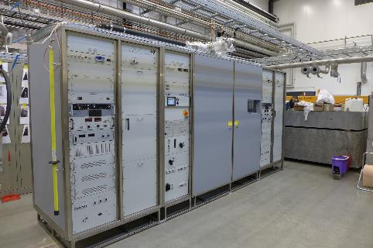
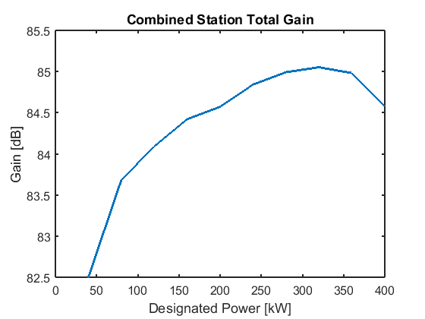
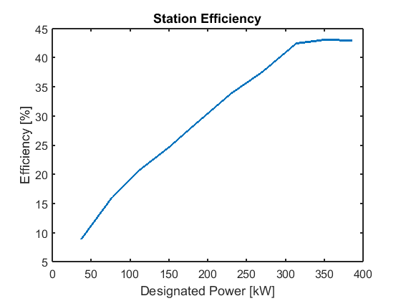
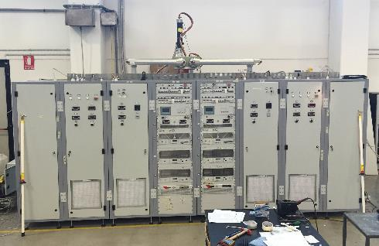
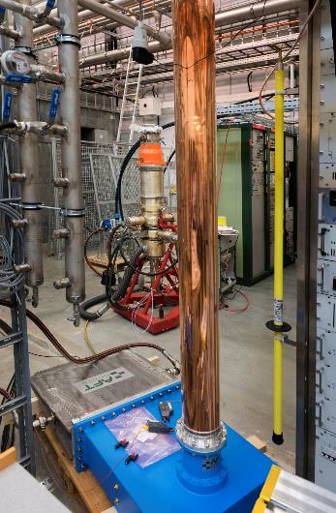
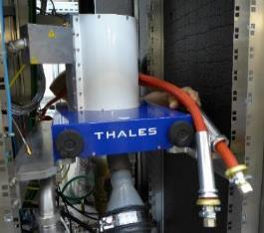
High Power RF Amplifiers
400 kW pulsed (352 MHz)
  2 stations, each 2 tetrodes TH595(A)
  3.5 ms, 14-28 Hz
  developed for ESS project

Slide 12
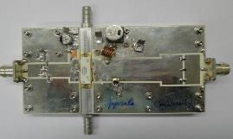
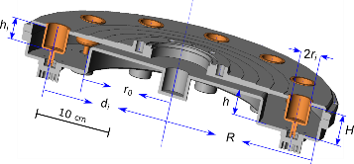
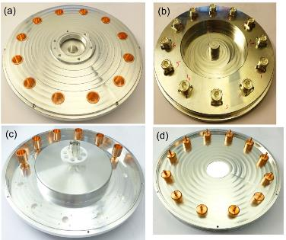
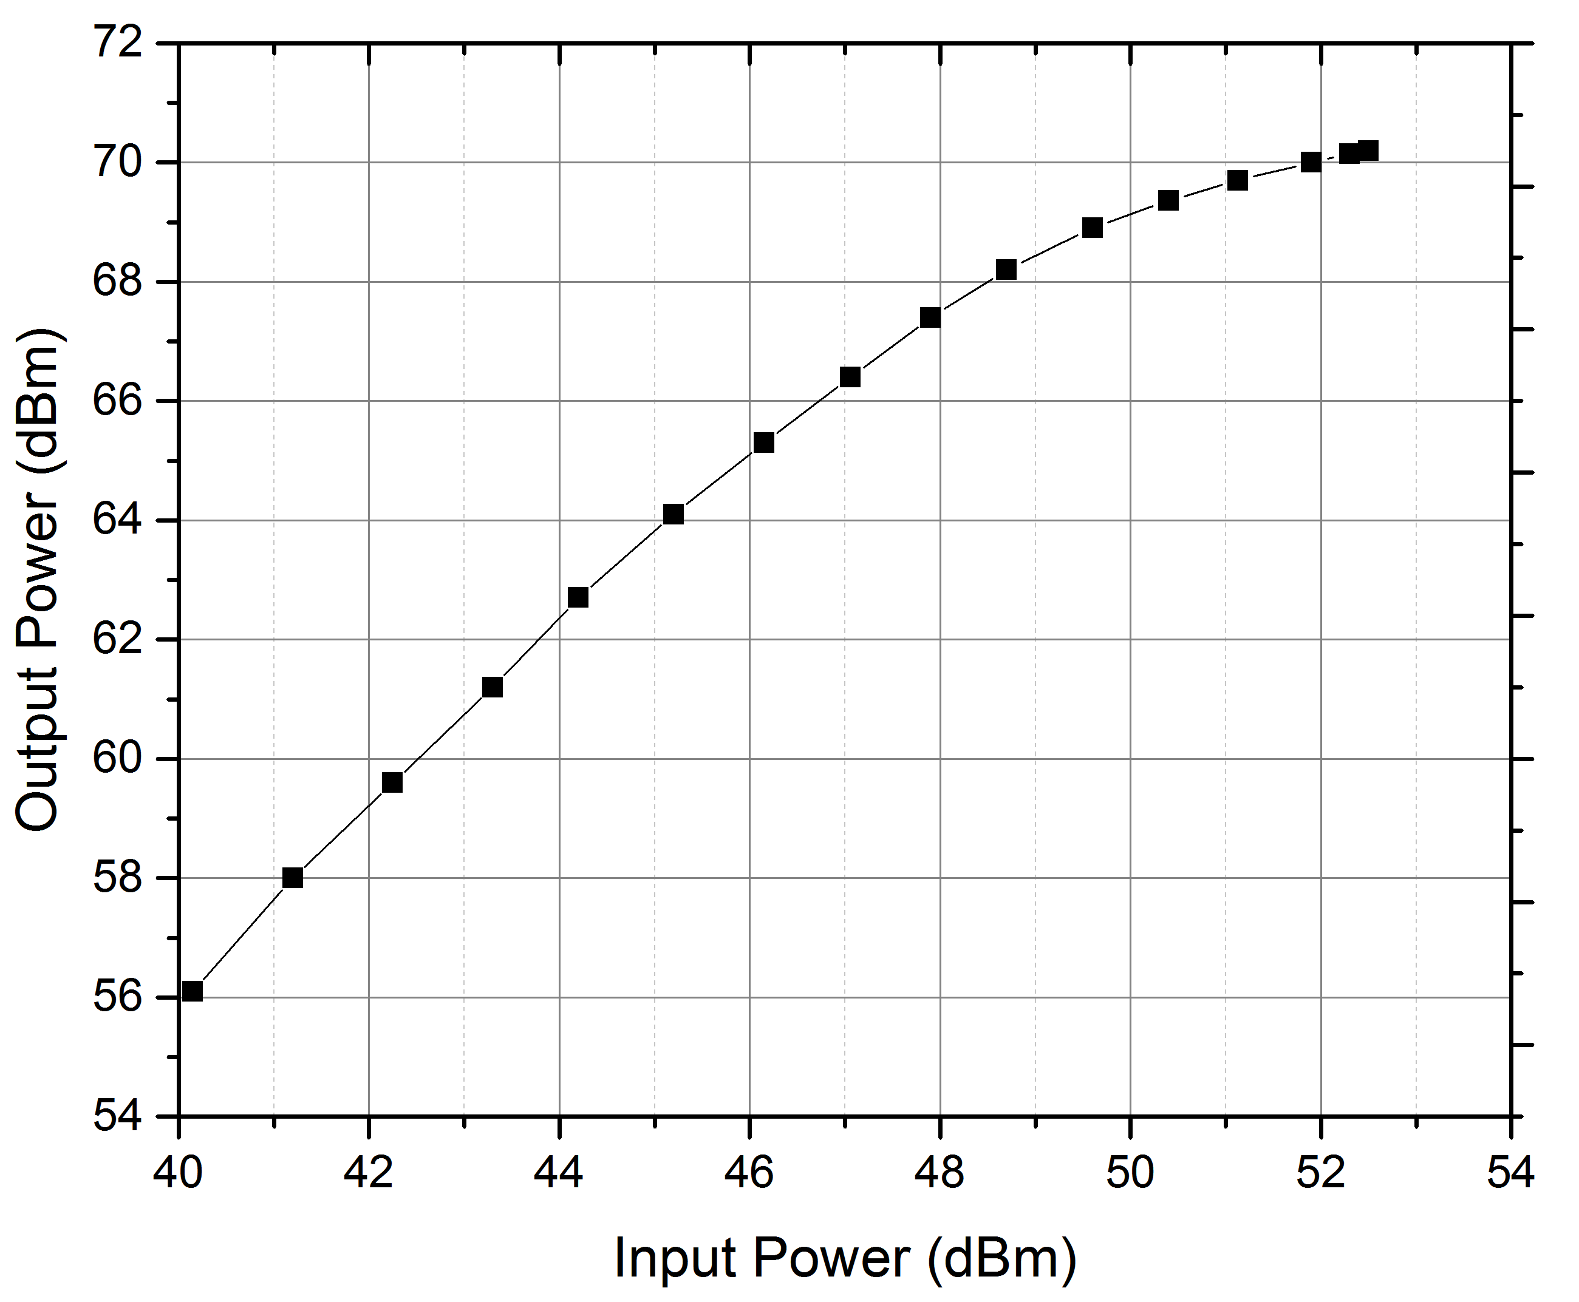

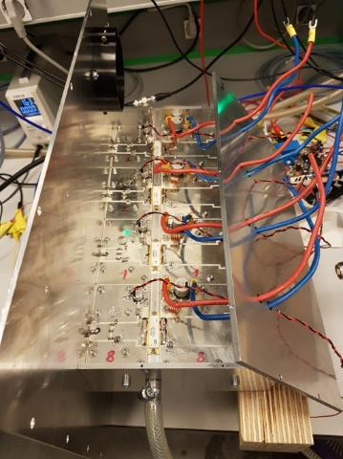
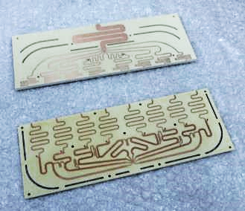
RF Amplifier R&D
Transistor Amplifiers 352 MHz
Compact Combiners 352 MHz
8 modules, 10.5 kW
69% efficiency
  pulsed 14 Hz, 3.5 ms
Cavity combiner
  200 kW, 12 input ports
  0.2% insertion loss
Planar Gysel combiner
  10 kW, 8 inputs
  line coupling
  compensates
  parasitic coupling
Output RF power
Input RF power
V. A. Goryashko et al.
IEEE Microwave and wireless components Letts, vol. 28, 2018.
L. Hoang Duc et al.
Rev. Sci. Instr. Vol. 90,
2019 (104707).
M. Jobs et al. IEEE Trans. Components, Packaging Manufacturing Tech., vol. 8, 2018.

Slide 13
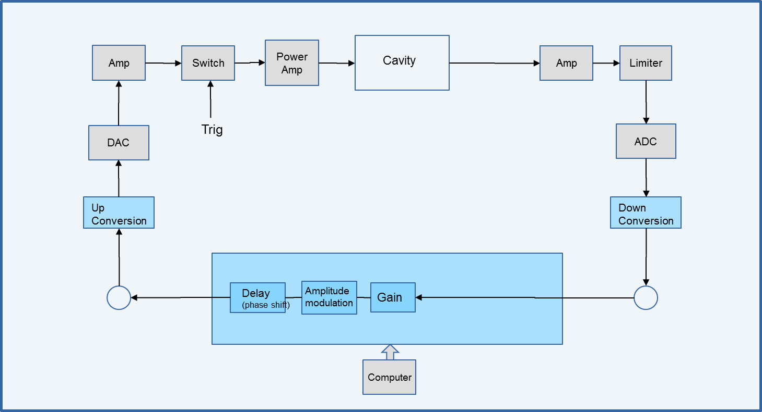
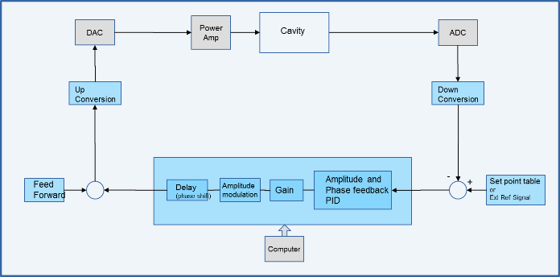

Digital LLRF Development
Signal Driven
Self-excited Loop
2 ADC inputs at 250 Msps
  (*) analogue bandwidth of 750 MHz
2 DAC outputs at 500 Msps
Digital downconversion to baseband 0 Hz, no analog mixers
  downconverted signal at 10 Msps or 1 Msps, selectable
undersampling to operate at any frequency from 10 to 750 MHz*
CW or
pulsed mode
  switch closes the loop for a duration of 2.86 ms, repetition rate of 14 Hz.
Code in the FPGA

Slide 14




Cryogenic DC Spark System
Field emission and BDR as a function of temperature
Complement to RF tests
  very high repetition rate, pulsed DC
  simple geometry (large planar electrodes)
  similar high-field behavior in RF and pulsed DC
  allows in depth studies of the fundamental physics of high-fields (e.g. material and surface science)
  possibility to find new and potentially important connections between the high-gradient NC and SC fields.
Electrodes at 30K reached almost 20% higher field gradient than at 300 K.
PRELIMINARY
Field emission at 300K and 30K
starts at higher field at 30 K
OFE-Cu electrodes
50 mm diameter
60 μm gap

Slide 15


Establishing a New Laser Lab
Existing
  800 nm laser from Eng. Dept.
  used for THz experiments
  (higher harmonic at 270 nm)
Acquire
  100 kV DC photo-gun (Cu-cath.)
  280 nm laser / amplifier (tbd)
  pulse picker for laser
Hire
  laser expert
Total area: 39 m²
  8.28 m x 4.73 m
  RF lab: 3.48 x 4.73 = 16.5 m²
  El. lab: 2.28 x 4.73 = 10.8 m² (x2)
“clean” room
cryoDC spark
3D printer
Electronics lab storage
RF lab
mechanics workshop
control room
Laser Lab

Slide 16
Personnel Resources
About 30 staff and 4 PhD student
  3 professor/lecturer (instrumentation, accelerators, electronics/RF)
    ongoing recruitment: Associate Professor in Physics with specialisation in Photon and Charged Particle Beams
  13 researcher/post-doctoral
  15 engineer/technician
Core competence areas
  accelerators
  beam lines and end stations
  instruments and methods
  engineering for accelerators and instruments
  coordination and project management
Moderate or lack of competence
  lasers and photo cathodes
  decided last week to open a recruitment process

Slide 17

Summary
Uppsala University & FREIA Laboratory actively developing accelerator and instrumentation technology
Technology Development
SRF cavities
SC magnets
RF power generation
LLRF and controls
Physics Research
high brilliance beams
superconducting RF
RF breakdown
Academic Teaching
accelerators and photonics

