Slide 1
ESS spoke CM02
weekly meeting
20201102
Han Li

Slide 2
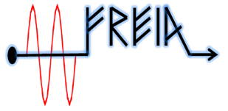
Coupler conditioning
Conditioning program>
Use arc detector and e- pick up .
Frequency using for off resonance conditioning at warm: 353 MHz
Auto-conditioning 24/7
Criteria for FPC conditioning ready : outgassing lower than 3 E-7 mbar (vacuum baseline 1E-7 mbar)
Parameter | value
Loop control time (s) | 1
Pulse repeat rate (Hz) | 14
Vacuum upper limit (mbar) | 5e-6
Vacuum lower limit (mbar) | 1e-6
Initial pulse length (µs) | 50
pulse length step | 50 µs, 100µs, 250µs,500 µs, 1ms, 2 ms,3.5ms
Vacuum hardware interlock (mbar) | 1e-5
e- pickup interlock (mA) | 2
Main Parameters of Spoke FPC Conditioning
2

Slide 3
Coupler conditioning conclusion
FPC1 & 2 | Warm
Real time [h] | 120
Intervention | 2
Up time [h] | 89.5
Down time [h] | 30.5
Two FPCs are conditioned simultaneously with two pumping carts
Three MP bands: 70 dBm (10kW), 74 dBm and 76 dBm (40kW)
CM comparison:
Total conditioning timing is about 4 weeks (real time), can be improved to 7 days (based on live time) or even 3 days if conditioning two couplers simultaneously
2nd CM FPC warm conditioning last about 4 days, is consistent with prototype estimation

Slide 4
Investigation of downtimes
Major bottleneck: Stable operation of two RF stations

Slide 5
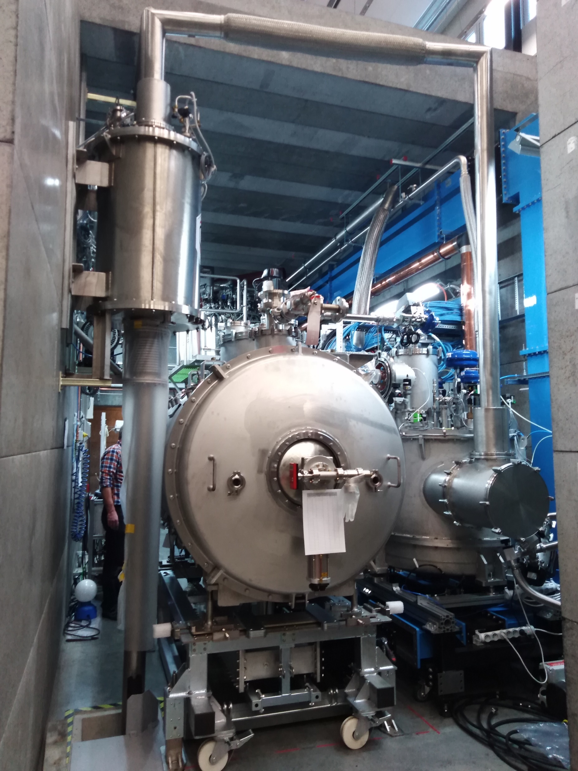
Cool down
Control valve for safety
VB insolation vacuum
LN cooldown start from Wednesday
LHe cooldown to 4 K

Slide 6
Preliminary time plan
Test item | time | comment
CM installation | 26th-30th Oct.
Preparation | 2nd – 4th Nov. | Install cavity vacuum pump group /water cooling system
FPC warm conditioning | 5nd-10th Nov. | 1) Simultaneously 2) Could be prolonged depended on the progressing
CM cooldown to 4 K | 11th-12th Nov.
FPC cold conditioning | 13th Nov. | Simultaneously
CM cooldown to 2 K | 16th Nov.
Cavity tuning | 17th Nov. | CTS measurement
Cavity conditioning (on resonance) | 18th -20th Nov. | Open loop
Heat load/Q measurement |  | 1)Each cavity 2) PID
Long-term stability | 23rd Nov.
Piezo compensation | 24th – 27th Nov. | First CM only
Warm up | 28th Nov.

Slide 7
Shift for CM test
Operation related to FPC conditioning: Auto-conditioning 24/7
Operation related to cavity RF test at cold : only during working hour
Working group | Candidate | Preference working shift
 |  | Morning shift (8 a.m. to 4 p.m.) | Afternoon shift (1 p.m. to 8 p.m.) | Possible for on-call?
RF test | Han Li |  | √ | √
 | Akira Miyazaki
LLRF | Konrad Gajewski |  |  | √
 | Kjell E. I. Fransson
 | Tor Lofnes
High power station | Rolf Wedberg |  |  | √
 | Mykhailo Zhovner
 | Tord Peterson
Cryogenic | Lars Hermansson
 | Esat Pehlivan | √

