Slide 1
ESS spoke CM02
weekly meeting
20201119
Han Li

Slide 2
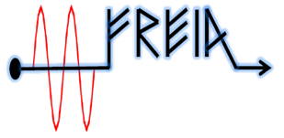
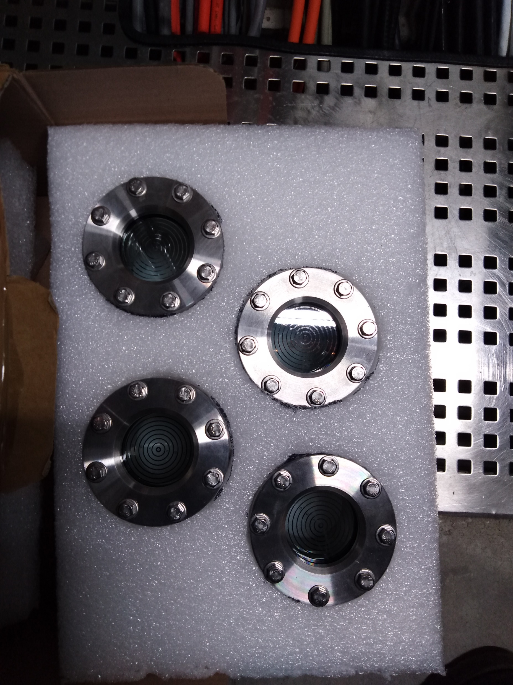
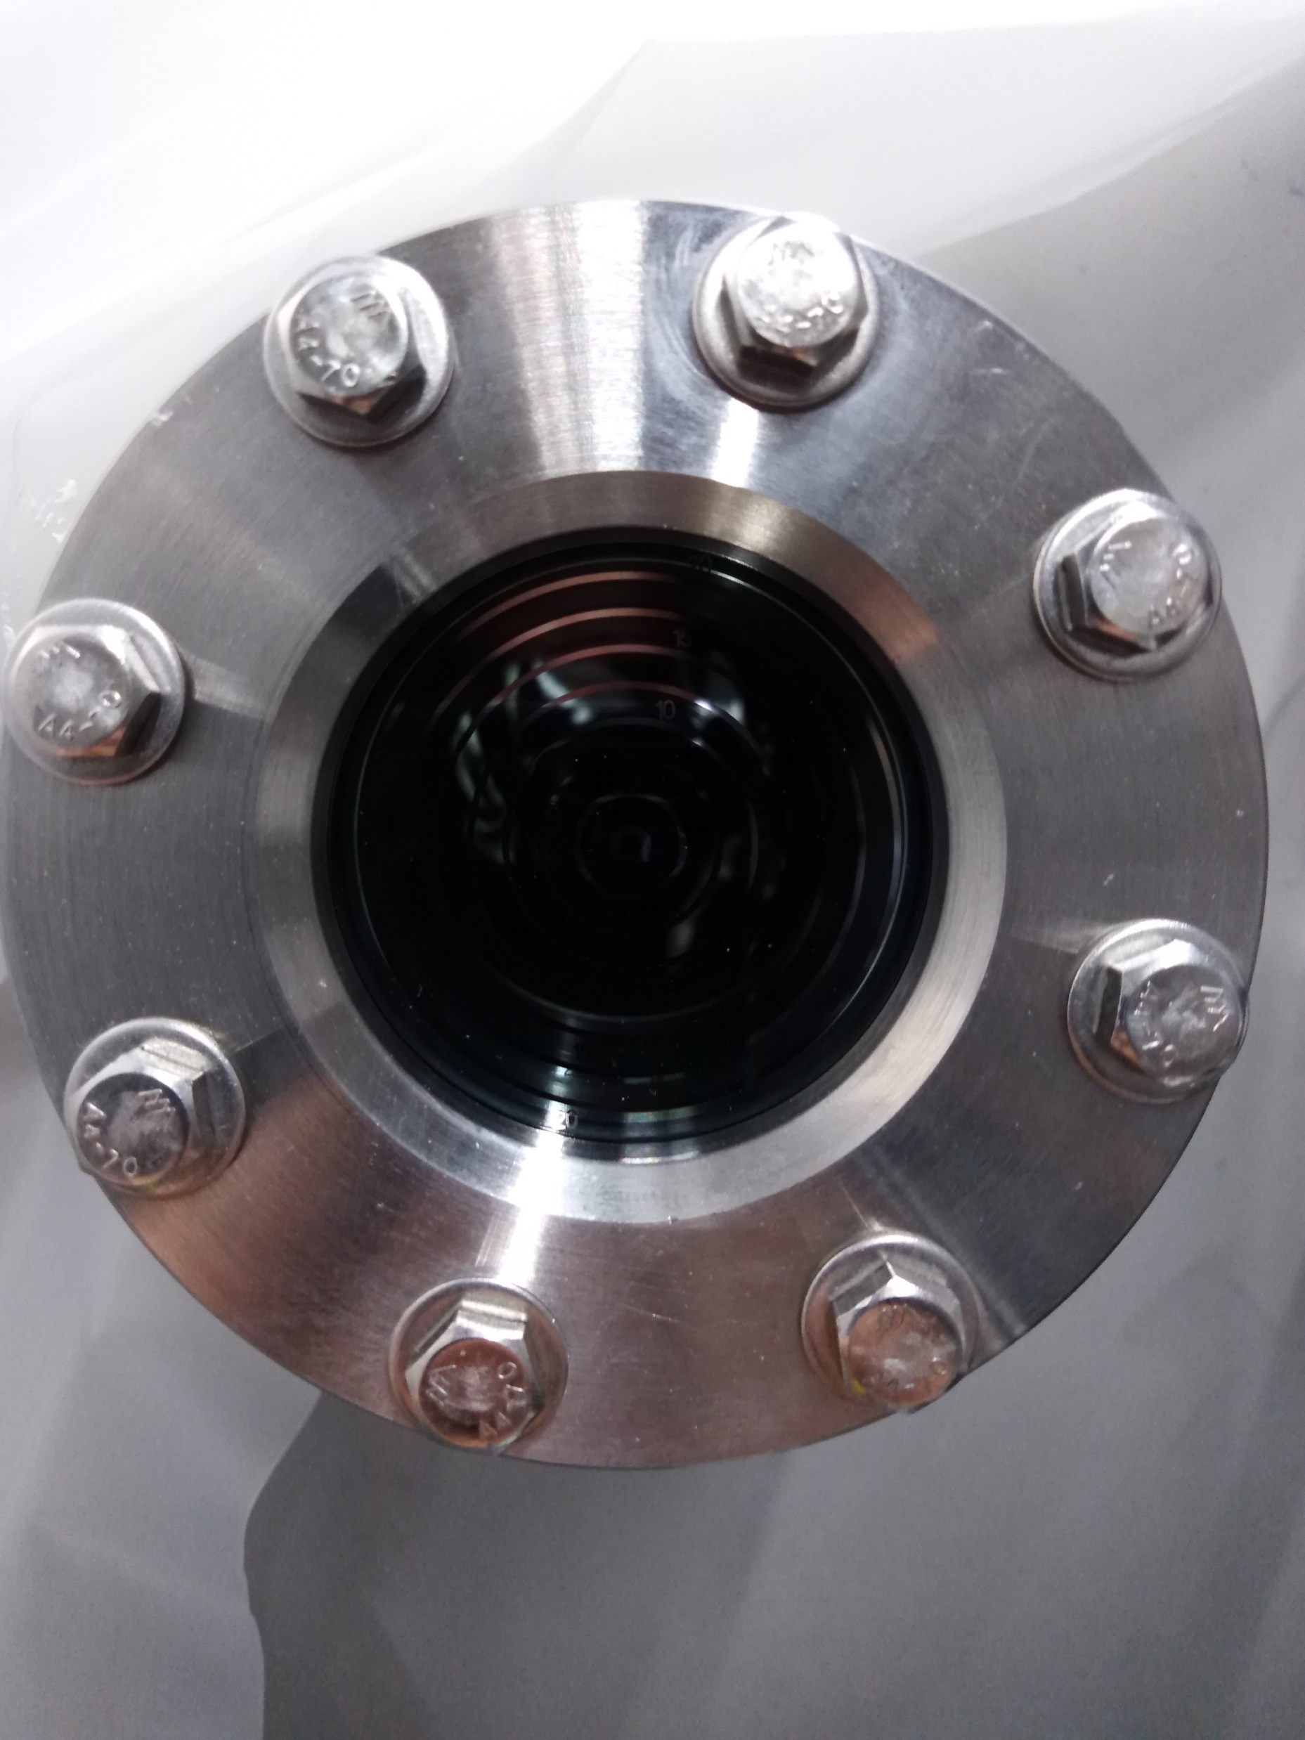
CM status
Warm up from about 140 K to room temperature took about 4 days ( from 13th -16th Nov.)
Window change (17th Nov.)
LN cooldown start from Wednesday (18th Nov.)
LHe cooldown to 4 K

Slide 3
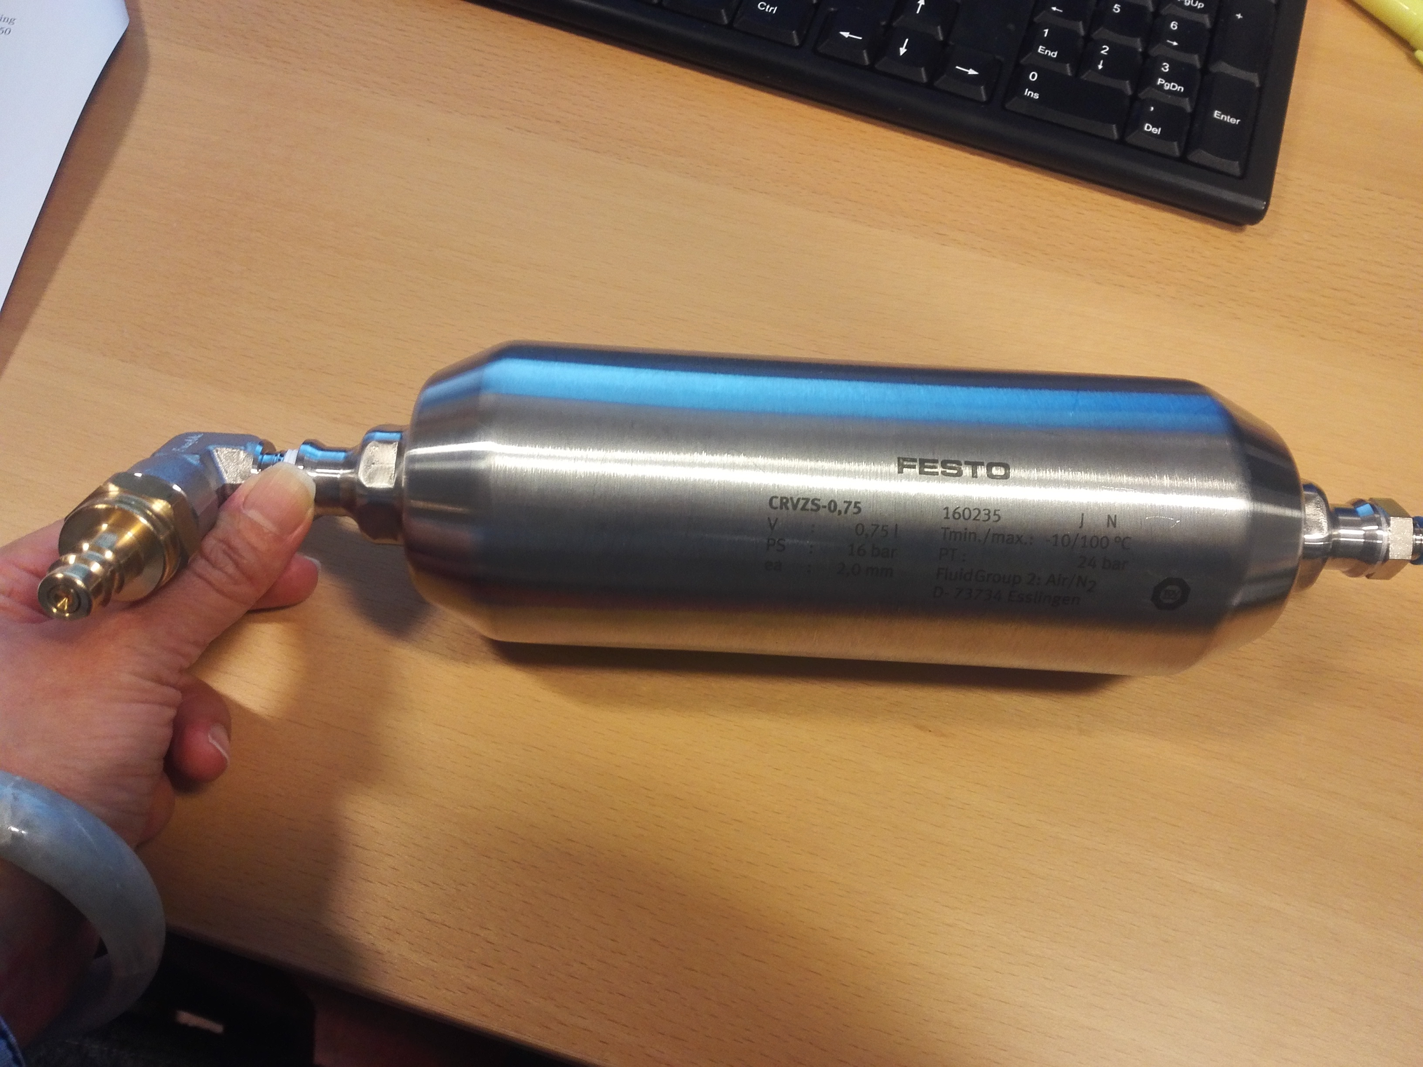
Issue
Vacuum gauge for insolation vacuum
Pumping cart 14 failure (FESTO compressed air reservoir )--fixed
Electrosys RF station failure (G1 power supply)--fixed

Slide 4
Preliminary time plan
Test item | time | comment
CM installation | 26th-30th Oct.
Preparation | 2nd – 4th Nov. | Install cavity vacuum pump group /water cooling system
FPC warm conditioning | 5nd-10th Nov. | 1) Simultaneously 2) Could be prolonged depended on the progressing
Window change | 12th -17th Nov.
CM cooldown to 4 K | 18th-19th Nov.
FPC cold conditioning | 20th Nov. | Simultaneously
CM cooldown to 2 K | 16th Nov.
Cavity tuning | 23rd Nov. | CTS measurement
Cavity conditioning (on resonance) | 24th -27th Nov. | Open loop
 |  | 1)Each cavity 2) PID
Heat load/Q measurement |  | 1)Each cavity 2) PID
Long-term stability | 30th Nov.
Piezo compensation | 1st – 4th Dec.. | First CM only
Warm up | 5th Dec.

Slide 5
Shift for CM test
Operation related to FPC conditioning: Auto-conditioning 24/7
Operation related to cavity RF test at cold : only during working hour
Shift is only during RF on period
Working group | Candidate | Preference working shift
 |  | Morning shift (8 a.m. to 4 p.m.) | Afternoon shift (1 p.m. to 8 p.m.) | Possible for on-call?
RF test | Han Li |  | √ | √
 | Akira Miyazaki | √ |  | √
LLRF | Konrad Gajewski |  |  | √
 | Kjell E. I. Fransson | √ |  | √
 | Tor Lofnes
High power station | Rolf Wedberg |  |  | √
 | Mykhailo Zhovner | √
 | Tord Peterson |  | √ | √
Cryogenic | Lars Hermansson |  | √ | √
 | Esat Pehlivan | √

