Slide 1
ESS CM02 weekly meeting
Akira Miyazaki
Dec 16th 2020

Slide 2
Contents
Static heat load
  Vapor flow measurement: mystery between 4K and 2K line
  LHe level decrease measurement: mystery on 6cm offset from the CAD model
Piezo test results continued (CTS2)
Disengage system (CTS1)
  Surprised at swapped EH10 and EH02
Warming up finished
Dismounting progress
Nonconformity of wirings confirmed
  Improve in-coming test at the reception

Slide 3
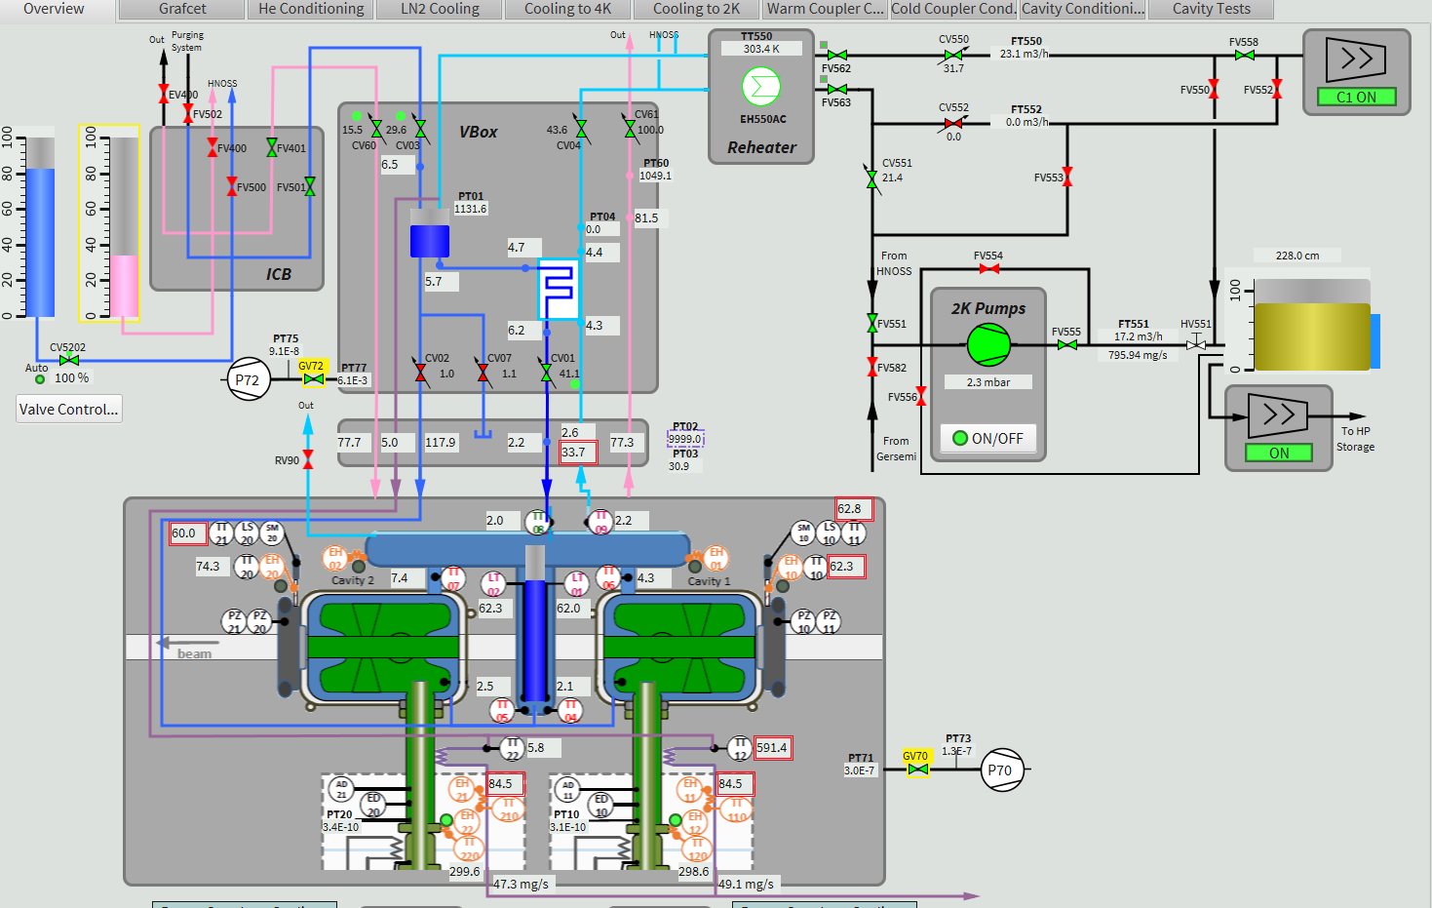
Static heat load from vapor flow
Fix CV03
Manually control CV551
Close inlet JT CV01
Read GHe exhaust FT551
From 2K: 1.07W x FT551 [m³/h]
Strangely, we observed interference from 4K line whose valve CV03 regulation became mad when CV01 is closed
In principle, 4K line and 2K line are separated, but why interfered?
With CV03 fixed, statistical uncertainty of heat load estimate from FT551 is 0.5W but systematic uncertainty due to CV551 control was higher

Slide 4
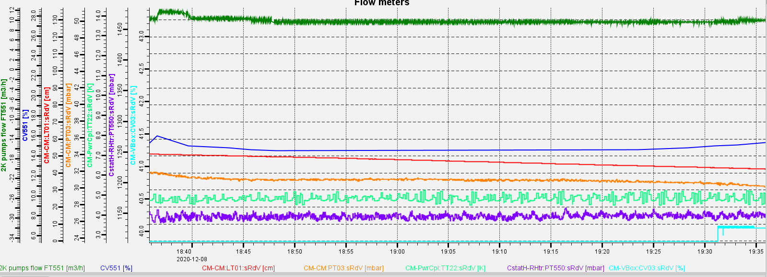
Example of vapor flow
CV03 (4K line) under regulation
Fix CV03 at 40%
FT551 = 9.5 m³/h
→ 10.2 W ☺
FT551 = 5-19 m³/h
→ 7.5-20 W ☹
CM Pressure variation
LHe Level drop
We found the working point but why 4K and 2K lines interfere?
  Via supercritical GHe line that cool down the coupler? → No because the real heat load cannot be 20W by decrease coupler cooling
  CV01 (JT valve 2K inlet) may not be fully closed ??
  Any other possibilities?

Slide 5
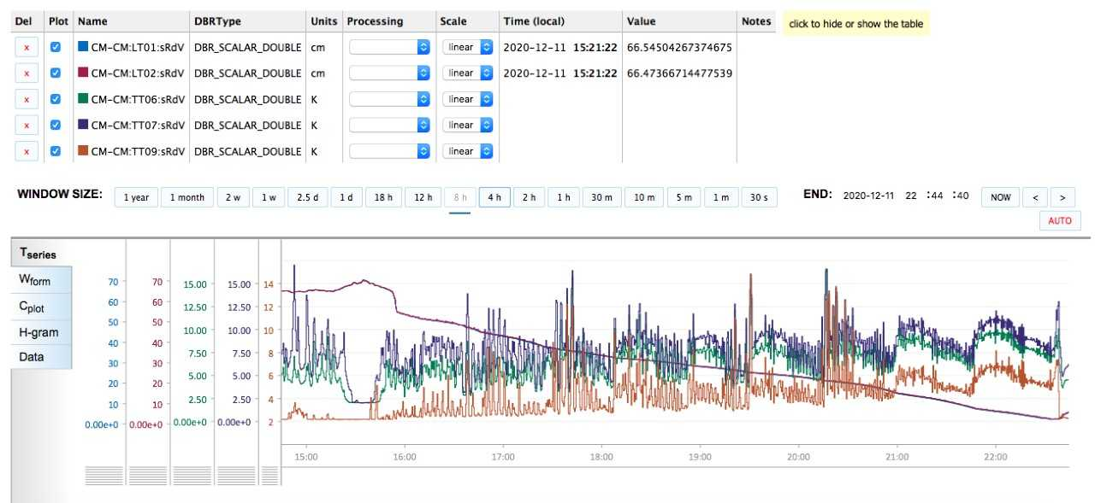
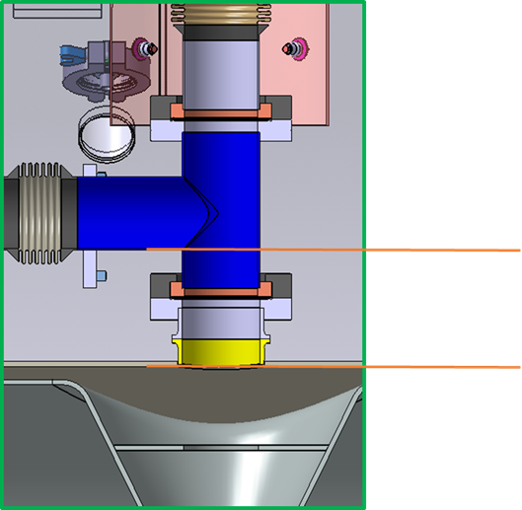
Static heat load from LHe level decrease
Thanks to Patxi!
64cm
55cm
Patxi estimated static heat load of 10.9-11.5W (which conversion coefficient?)
LHe level 55-64 cm is 30cm² cylinder
Remaining question: the LHe seems in 6cm offset from the design
LM510 setting
  Active length 74 cm
  Continuous mode
  Boosted mode: smart
What is the cause?

Slide 6
Piezo test in CTS2 1/2
Test on Nov 25
Test on Dec 08
Double checked by Woitech’s dynamics piezo control
We gained tuning range in PZ21 in this new experiment
The difference between PZ20 and PZ21 was “as expected” according to the previous meeting
??? We checked the wirings between these two dates. No loose connections were found in piezo lines.

Slide 7
Piezo test in CTS2 2/2: PZ20+PZ21 simultaneous
750 Hz in unipolar
1kHz in bipolar

Slide 8
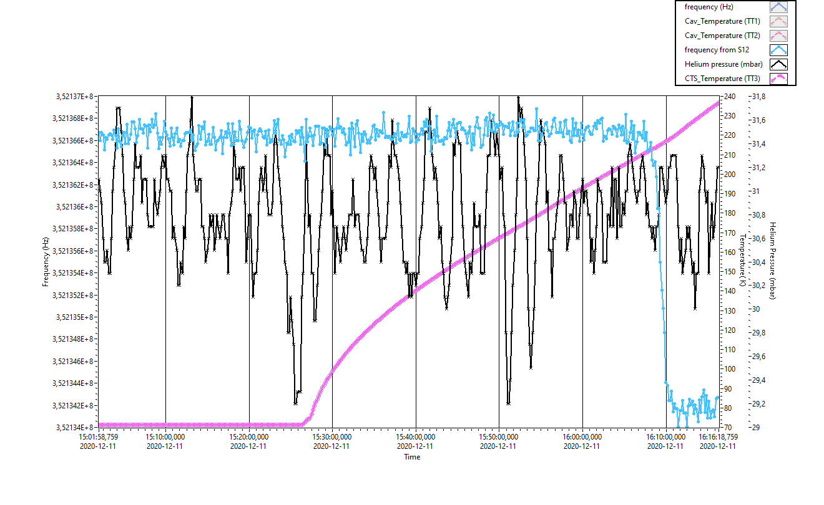
Disengage CTS1
Disengage system temperature
Frequency drop
→ disengagement

Slide 9
Surprise: heaters were swapped!

Slide 10
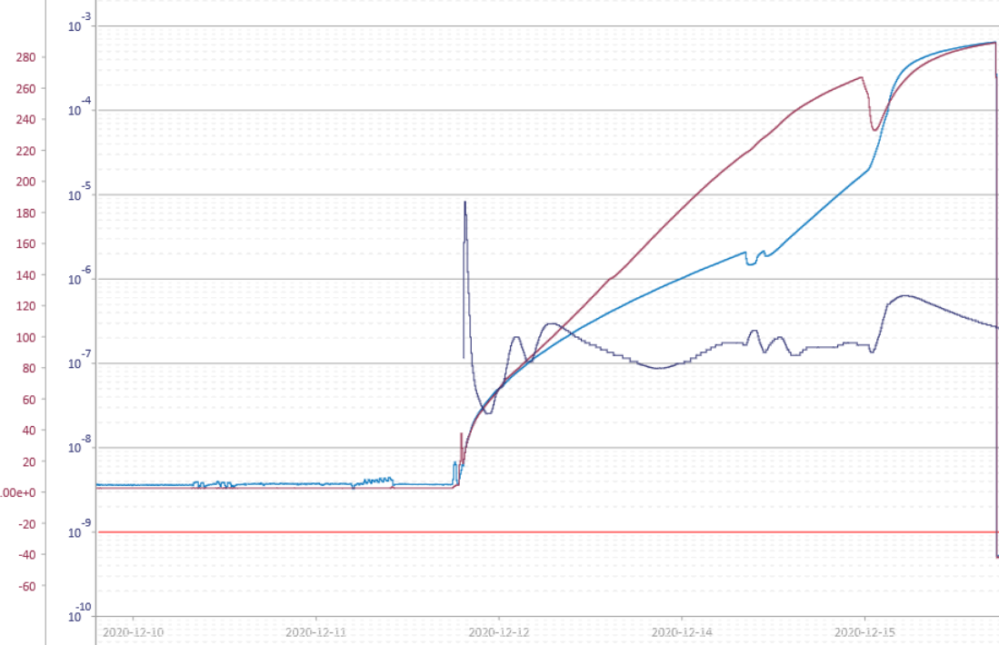
Warming up finished within 4 days
TT06 top of the cavity
Open angle valves
Bottom of 2K He tank
Break insulation vacuum by dry N2
Beam vacuum
Warm He gas flow to He circuit
Saturday morning
Wednesday morning

Slide 11
Dismounting process on Dec 16th
All the cables, water pipes, compressed airs, optical fibers
Unscrewed bellows waveguide
Disconnected the aiming windows for cavity alignment and connect transport supports
Disconnect two pumping stations
½ days with 4 people (bunker was open during warming up)
Today: disconnect the jumper and move the CM out of the bunker
Doorknob dismounting & safety valve dismounting → tomorrow or next week (depending on Johan)

Slide 12
Wiring issues inside CM (confirmed at LEMO feedthroughs)
CM02-LC01
CM02-LC02
CM02-LC07
design | pin | reality
TT10 | 25 | 29
 | 26 | 30
 | 27 | 31
 | 28 | 32
TT11 | 29 | 25
 | 30 | 26
 | 31 | 27
 | 32 | 28
TT20 | 37 | 41
 | 38 | 42
 | 39 | 43
 | 40 | 44
TT21 | 41 | 37
 | 42 | 38
 | 43 | 39
 | 44 | 40
design | pin | reality
EH01 | 1 | 1
 | 2 | 2
EH02 | 3 | 5
 | 4 | 6
EH10 | 5 | 3
 | 6 | 4
EH11 | 7 | 7
 | 8 | 8
Design | pin | Signal | reality | Signal
LT01 | 1 | V+ | 1 | V+
 | 2 | I+ | 2 | I+
 | 3 | I- | 3 | I-
 | 4 | V- | 4 | V-
LT02 | 5 | V+ | 6 | I+
 | 6 | I+ | 5 | V+
 | 7 | I- | 7 | I-
 | 8 | V- | 8 | V-
We need to improve the qualification of wiring before cooling down
So far, we have checked only the electric continuity and was not careful about swapping the sensors, wires, and polarities
For heaters, energize EH01 and EH02 for a while to see the response of TT10, 11, 20, 21
For level gauges, we can profit from the asymmetry
  Between V+ & I+ must be 10 Ohm
  Between V- & I- must be 5 Ohm
  Between V+ & I- must be 370 Ohm
  Between I+ & V- must be 375 Ohm

Slide 13
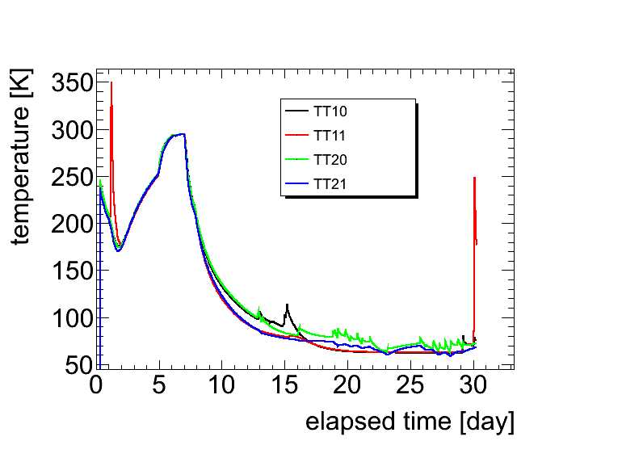
Swapped heater → accidental overheating
Accidentally reached >350K
Disengage CTS1 on purpose max T < 300K
We switched on EH01 and EH02 to accelerate the unexpected warming up on Nov 12 to replace the windows for alignment
No temperature sensors around these two heaters in LHe tank so that we were blind and gave up soon
Unfortunately, this EH02 was in reality EH10 placed on the CTS1’s disengage system
We realized this issue only at the very end of the test when we used the disengage system
The disengage system of CTS1 was accidentally warmed up before all the tests at cold
This might explain the malfunctioning of CTS1
Decided to quickly warm up the CM to replace the windows for cavity alignment campaign

Slide 14
Planning
The goal is to move the present cryomodule into the transport box before the arrival of the next cryomodule
  The shock sensors must be connected beforehand
  Outgoing test as well
  It seems feasible maybe next week if necessary
What is the delay anticipated now to make CM04 ready?
Minor but important points
  Is it possible to install pt100 at the ceramic window at Orsay?
  Last time, we removed them from the prototype and Jean spent long time to install them to CM02
  We are not confident if we can remove/install such fragile things every time in a very limited time
How do we deal with the safety valve RV90 and pressure gauges PT02 & PT03?

