Slide 1
ESS spoke CM04
weekly meeting
20210114
Han Li

Slide 2
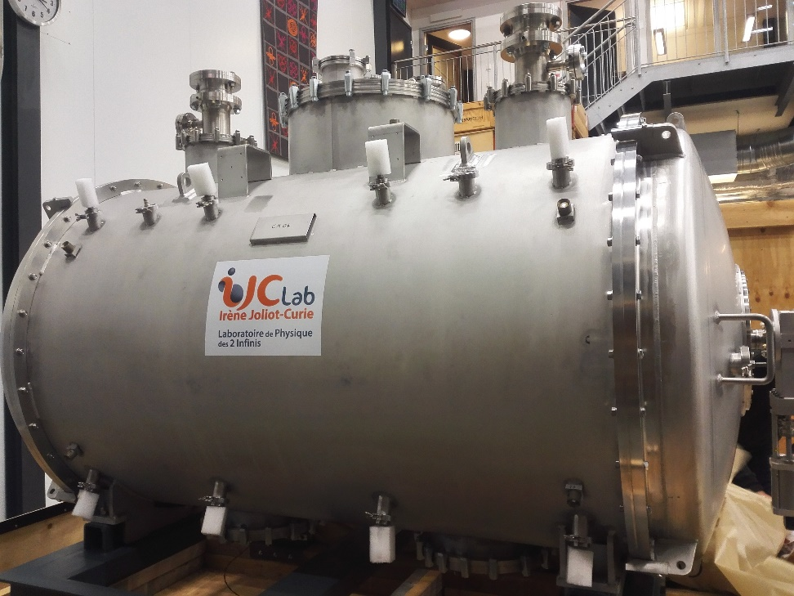
CM status
CM arrival (11th Jan)
CM incoming test
CM installation
Test plan

Slide 3
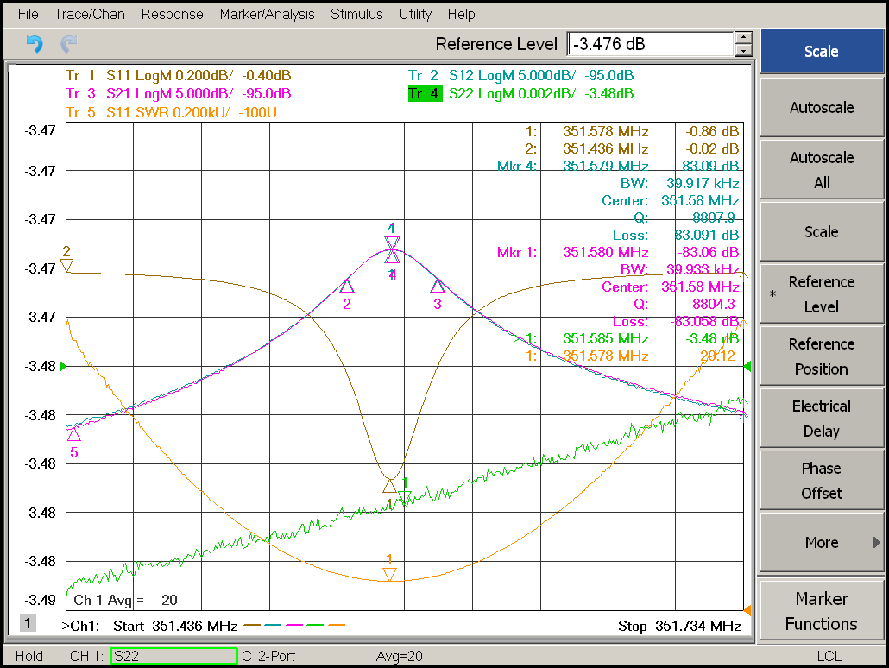
CM incoming test
Cav_IN
Cav_OUT
 | Orsay outgoing test |  | UU incoming
Cavity location | Cavity IN | Cavity OUT | Cavity IN | Cavity OUT
Cavity | DSPK10 | DSPK17 | DSPK10 | DSPK17
cavity vacuum (mbar) | 1,50E-03 | 1,50E-03 | 4,90E-03 | 4,90E-03
Frequency (MHz) | 351,554 | 351,564 | 351,580 | 351,580
Qloaded | 8890 | 8778 | 8871 | 8804
Qext (@ 300K) | 2,22E+05 | 1,84E+05 | 2,17E+05 | 1,91E+05

Slide 4
CM incoming test
No shot record during the transportation
Electronical continuity has done

Slide 5
Malfunctional sensor

Slide 6
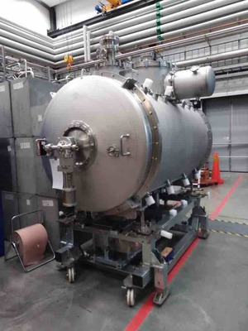
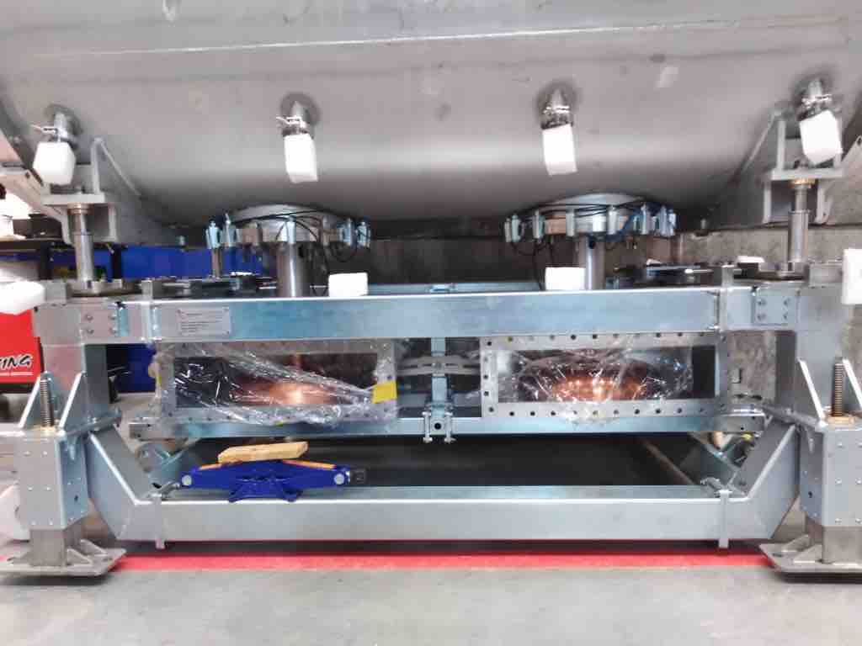
CM04 installation
Hardware:
Doorknob √
Sensors and gauges: arc detector, electron pickup √
Safety valve mounting √
Pressure gauge mounting √
Turbo-pump mounting for insulation vacuum √
Waveguide bellows mounting √
Window replacement to the aiming windows for the laser alignment
Cryogenic jumper
Do we need to test with the new jumper together with every new CM?
RF stations
Will power on the RF stations next week and should be ready before FPC conditioning

Slide 7
Preliminary time plan
Test item | time | comment
Arrival, unpacking, initial inspection | 11th-12th Jan.
CM installation | 13th-15th Jan.
CM alignment measurement | 18th-20th Jan.
FPC warm conditioning | 21th-24th Jan. | 1) Simultaneously 2) Could be prolonged depended on the progressing
CM cooldown to 4 K | 25th Jan.
CM cooldown to 2 K | 26th Jan.
FPC cold conditioning | 27th Jan. | Simultaneously
Cavity conditioning (on resonance) | 28th-29th Jan. | Open loop
CTS test | 1st-2nd Feb. | CTS measurement
Heat load/Q measurement | 3rd -4thFeb. | 1)Each cavity 2) PID
Warm up | 5th -9th Feb.
CM alignment measurement | 10th Jan.
Disconnect, packing, shipment | 11th -17th Feb.

Slide 8
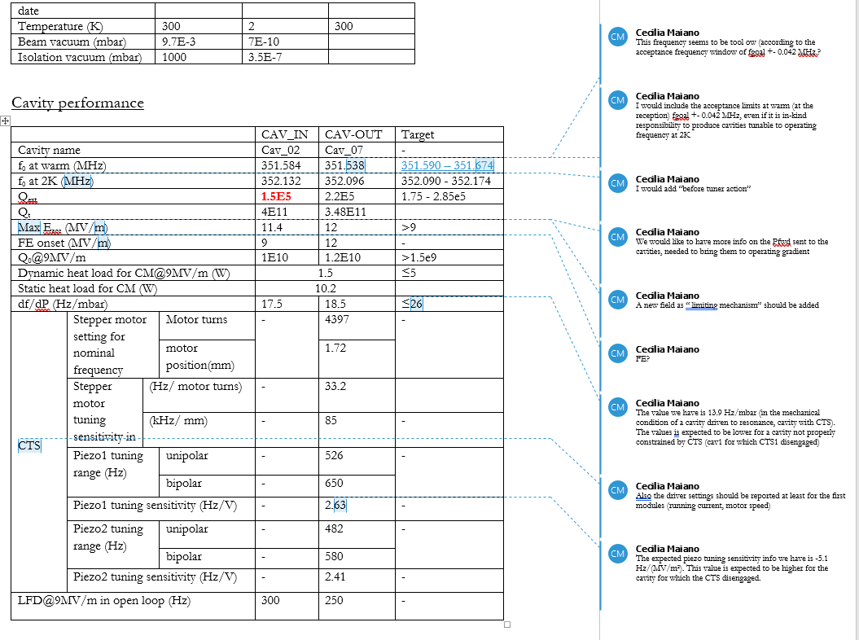

Slide 9
