Slide 1
ESS spoke CM04
weekly meeting
20210121
Han Li

Slide 2
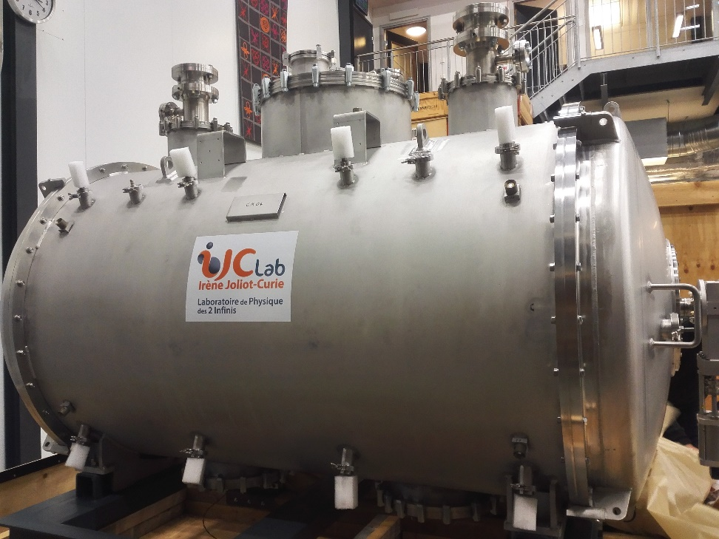
CM status
CM installation
CM alignment measurement
Test plan

Slide 3
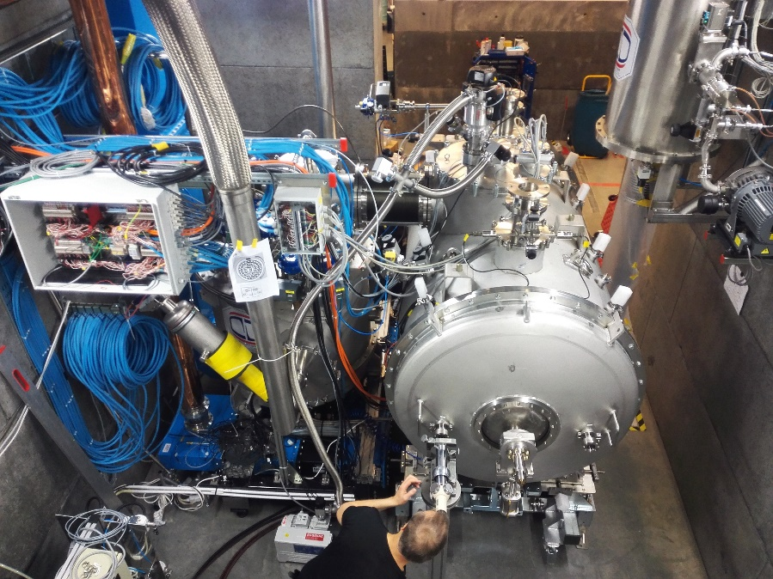
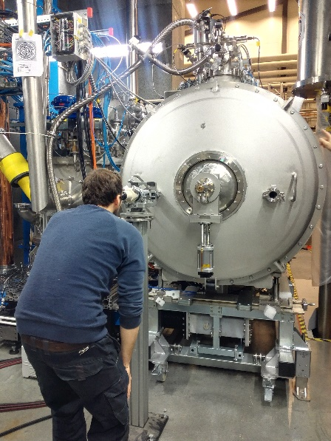
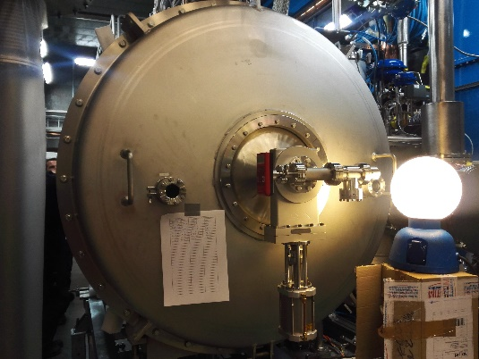
CM04 installation
Hardware:
Doorknob √
Sensors and gauges: arc detector, electron pickup √
Safety valve mounting √
Pressure gauge mounting √
Turbo-pump mounting for insulation vacuum √
Waveguide bellows mounting √
Cryogenic jumper √
CM alignment checking without insulation vacuum√
CM alignment checking with insulation vacuum
Beam vacuum pumping cart connection
FPC water cooling pipe connection
Cabling: arc, e-pickup, lemo connector…
Close buncker

Slide 4
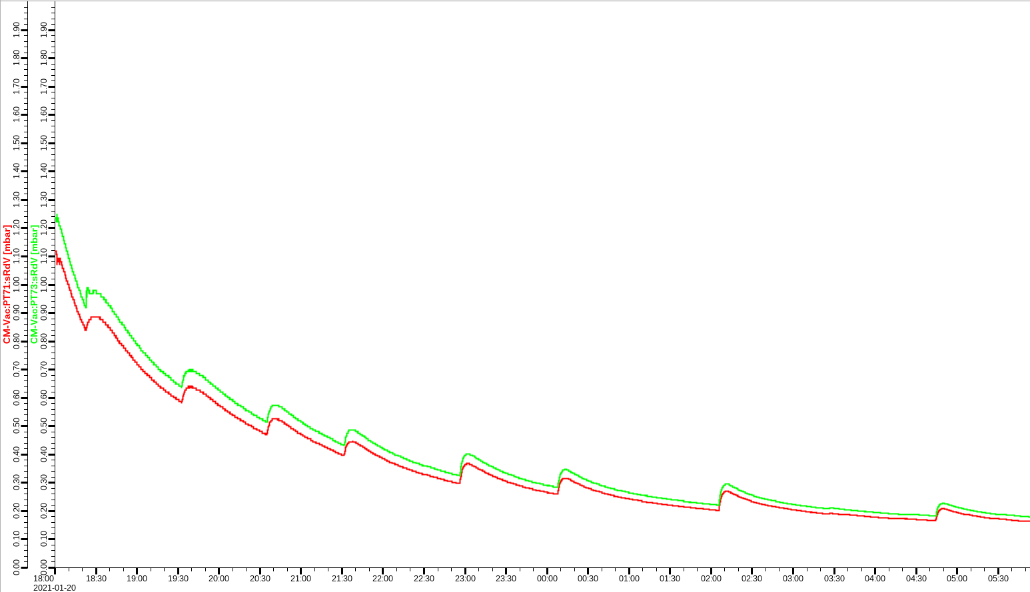
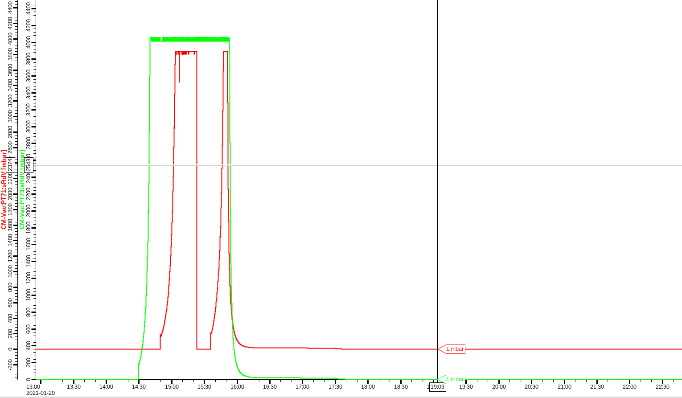
Insulation Vacuum
After 5 hours, insulation vacuum still around 1 mbar
Strange curve of insulation vacuum during overnight pumping
Suspect a leak for the insulation vacuum

Slide 5
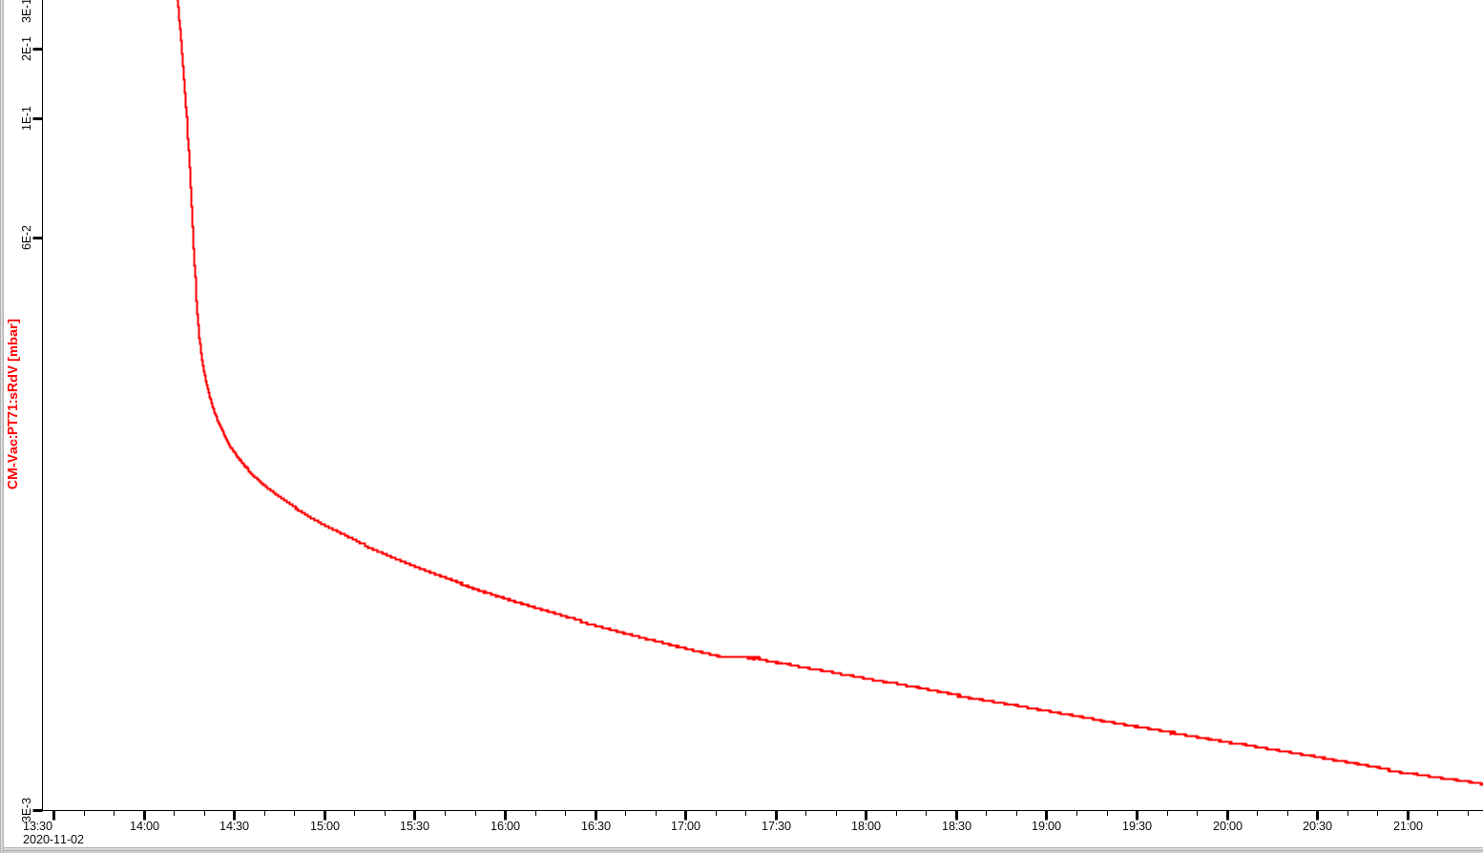
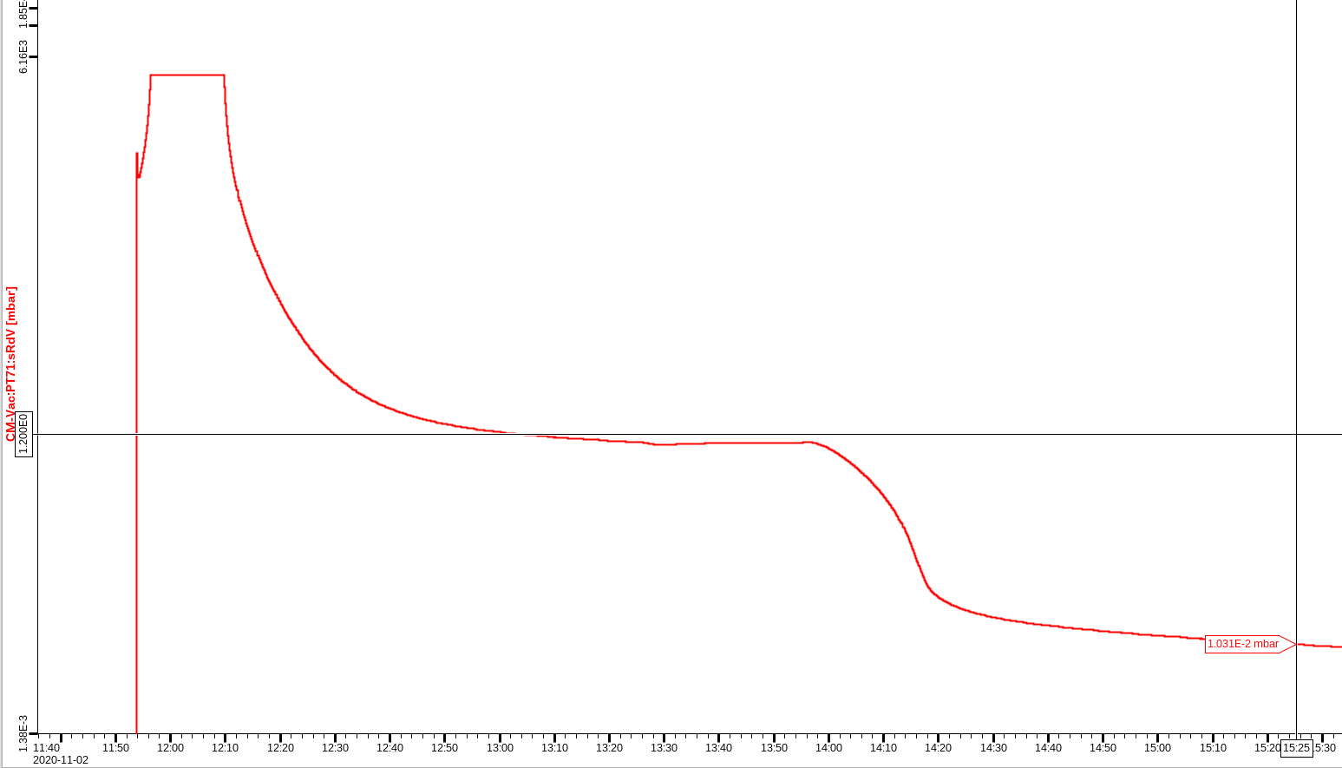
In the case of CM02 insulation vacuum:
About 2,5 hours down to 1e-1 mbar

Slide 6
FPC conditioning preparation
RF stations:
Both RF test stations has test on load
DB maximum 360kW output
section B has higher gain than section A
Esys maximum 370kW output
Software:
Interlock has been checked
Only one pumping cart will be connected the CM:
To check if it is necessary to have two pumping
Try to avoid risk of contamination
The second pumping cart will be standby

Slide 7
priority
Beam vacuum
FPC water cooling installation
Sensors connection
Start FPC warm conditioning
Take advantage of weekend conditioning
Insulation vacuum is not necessary for FPC warm conditioning
Make it next Monday?

Slide 8
Preliminary time plan
Test item | time | comment
Arrival, unpacking, initial inspection | 11th-12th Jan.
CM installation | 13th-15th Jan.
CM alignment measurement | 18th-21th Jan.
FPC warm conditioning | 23th-26th Jan. ? | 1) Simultaneously 2) Could be prolonged depended on the progressing
CM cooldown to 4 K | 27th Jan.
CM cooldown to 2 K | 28th Jan.
FPC cold conditioning | 29th Jan. | Simultaneously
CTS test | 1st-2nd Feb. | CTS measurement
Cavity conditioning (on resonance) | 3rd -4thFeb. | Open loop
Heat load/Q measurement | 5th Feb. | 1)Each cavity 2) PID
CM alignment measurement | 9th Jan.
Warm up | 10th -15th Feb.
Disconnect, packing, shipment | 16th -19th Feb.

