Slide 1

CCT Superconducting Magnets
05 feb 2021
Kévin Pepitone

Slide 2

Outline
CCT magnet
  Definition and history
  Mathematical model
  Analytical simulations
  Numerical simulations
  3D simulations
  Future

Slide 3
CCT Magnets: Definition
What is a CCT magnet ?
Often called double-helix coils or tilted coils, the Canted-Cosine-Theta (CCT) coils are made of two concentric modulated helical coils having a winding shift of π and inverse currents.
Canted-Cosine-Theta magnet is based on the superposition of two oppositely skewed solenoids with respect to the bore axis
Configuration proposed in the 60’s by D.I. Meyer and that will be used for first time for high-energy physics particle accelerator
D.I. Meyer, R. Flasck, “A new configuration for a dipole magnet for use in high energy physics applications,” Nucl. Instrum. Methods, Vol. 80, Issue 2, 1970

Slide 4




CCT Magnets: Definition – Mathematical model
Consider the an ideal infinitely long, tightly wound, tilted solenoids and a particle focusing spot small compared with the dimensions of the coils.
The magnetic flux density per unit current (or transfer function) can be defined by:
I
B_{z}
$$α$$
z
y
$$χ_{y}=\frac{μ_{0}}{2d}\cos{α}$$
B₁
B_{y}
$$χ_{z}=\frac{μ_{0}}{2d}\sin{α}$$
Each turn of the coil can be well approximated as an ellipse tilted at an angle α with respect to the axis of the coil.
d is the wire effective diameter
$μ_{0}=4π {10}^{−7}$T m/A magnetic constant
J. Alonso, et al., J. Magn. Reson., Vol. 235, pp. 32-41, 2013

Slide 5



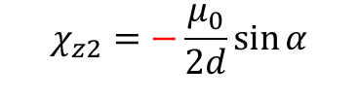

CCT Magnets: Definition – Mathematical model
I
Consider the two ideal infinitely long, tightly wound, tilted solenoids and a particle focusing spot small compared with the dimensions of the coils.
The magnetic flux density per unit current (or transfer function) can be defined by:
I
α
B_{z}
α
-B_{z}
B_{z}
z
I
z
y
y
B₁
$$χ_{y1}=\frac{μ_{0}}{2d}\cos{α}$$
$$χ_{y2}=\frac{μ_{0}}{2d}\cos{α}$$
B₂
B₁
B_{y}
B_{y}
B_{y}
$B_{y}=B_{Dipole}=$ $\frac{μ_{0}I}{d}\cos{α}$
$$χ_{z1}=\frac{μ_{0}}{2d}\sin{α}$$
$$χ_{z2}=−\frac{μ_{0}}{2d}\sin{α}$$
d is the wire effective diameter
$μ_{0}=4π {10}^{−7}$T m/A magnetic constant
J. Alonso, et al., J. Magn. Reson., Vol. 235, pp. 32-41, 2013

Slide 6
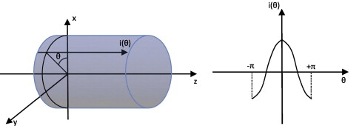



CCT Magnets: Definition – Mathematical model
The ideal current distribution on an infinitely long conductive cylinder, for producing the best homogeneity of a transverse magnetic field inside the cylinder, is:
$$i\left(θ\right)=I\cos{θ}$$
The axial current density of a CCT coil can be described is:
Constant canceled by the second coil
$$J_{z}=J_{z}\left(θ\right)+J_{z}^{sol}=\frac{I\cos{θ}}{hd\tan{α}}+\frac{I}{2πad\tan{α}}$$
Proportional to θ
The current density of the CCT magnet is:
h is the pitch of the winding
$J_{z}^{CCT}=2J_{z}\left(θ\right) \sim \cos{θ}$
θ is the azimuthal angle around the cylinder
A. Akhmeteli, et al., IEEE Trans. Appl. Supercond., pp. 1439-1443, 2005

Slide 7
CCT Magnets: Advantages
Perfect field:
  As “true” a cosine-theta current density distribution
  Field quality over the straight section without optimization required
Low conductor stress:
  Structure intercepts Lorentz-Forces, reduced coil stress by an order of magnitude
  No need for pre-stress
Cost-effective:
  All poles inclusive just like solenoids, inherently a 3D structure
  Small number of components
  10 drawings instead of 100, so fewer components and less tooling to assemble
  Coil assembly not needed (all poles are wound together around a single bore)
  Compatibility between NbTi, Nb₃Sn and HTS
But requires about 50% more conductor than normal sector coils
more cost effective to manufacture than a comparable classical cosine-theta magnet with ribbon wire

Slide 8
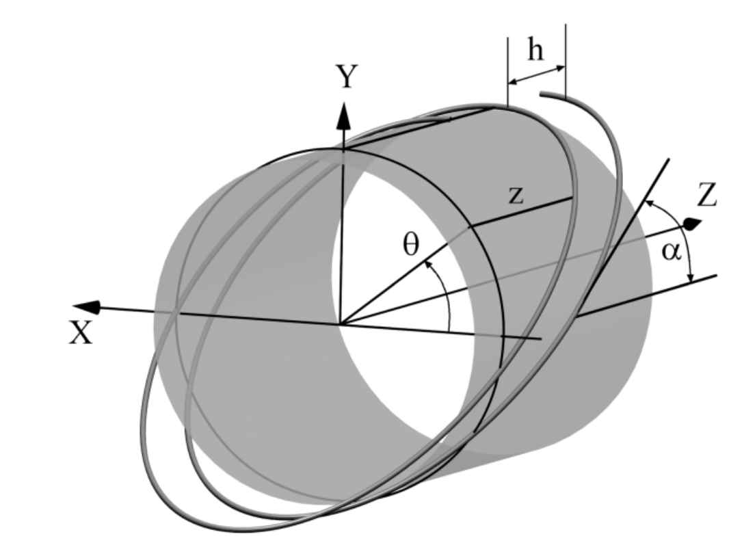
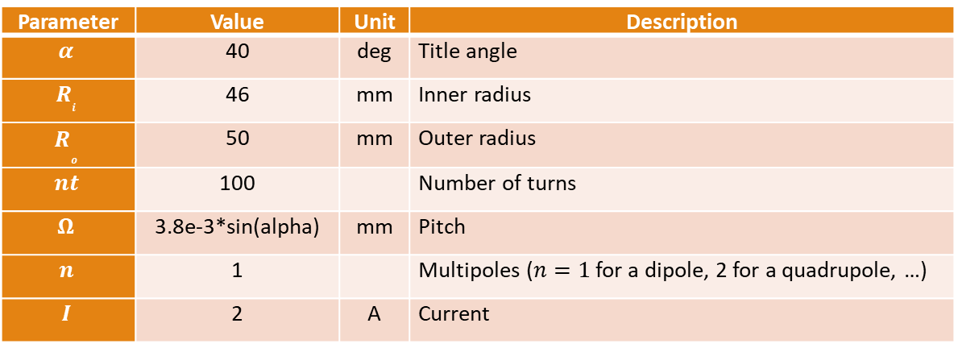
Simulation: Analytic model in 1D and 2D MATLAB
A tool developed by Loic Quéval can be used to pre-design a CCT magnet. This MATLAB script analytically and numerical calculates the magnetic field generated by a modulated double helical coil (double helix coil, canted-cosine-theta coil).
Parameter | Value | Unit | Description
$$α$$ | 40 | deg | Title angle
$$R_{i}$$ | 46 | mm | Inner radius
$$R­_{o}$$ | 50 | mm | Outer radius
$$nt$$ | 100 |  | Number of turns
$$Ω$$ | 3.8e-3*sin(alpha) | mm | Pitch
$$n$$ | 1 |  | Multipoles ($n=1$ for a dipole, 2 for a quadrupole, …)
$$I$$ | 2 | A | Current
θ is the azimuthal angle around the cylinder
L. Quéval, R. Gottkehaskamp, "Analytical field calculation of modulated double helical coils," IEEE Trans. Appl. Supercond, vol. 25, no. 6, p. 4901307, 2015.

Slide 9
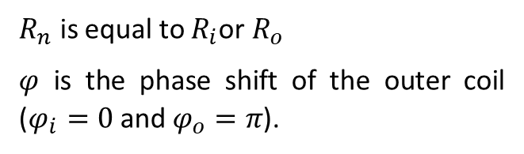

Simulation: Analytic model in 1D and 2D MATLAB
Equations used for the magnetic field calculations are the following in cylindrical coordinates $(ρ, θ, z)$.
$$B_{ρ}=\left\{\begin{aligned}−μ_{0}\frac{I}{Ω}\frac{R_{n}}{2\tan\left(α\right)}\frac{n}{R_{n}}{\left(\frac{ρ}{R_{n}}\right)}^{n−1}\sin\left(nθ+φ\right), ρ<R_{n} \\ −μ_{0}\frac{I}{Ω}\frac{R_{n}}{2\tan\left(α\right)}\frac{n}{R_{n}}{\left(\frac{ρ}{R_{n}}\right)}^{n+1}\sin\left(nθ+φ\right), ρ>R_{n}\end{aligned}\right.$$
$$B_{θ}=\left\{\begin{aligned}−μ_{0}\frac{I}{Ω}\frac{R_{n}}{2\tan\left(α\right)}\frac{n}{R_{n}}{\left(\frac{ρ}{R_{n}}\right)}^{n−1}\cos\left(nθ+φ\right), ρ<R_{n} \\ μ_{0}\frac{I}{Ω}\frac{R_{n}}{2\tan\left(α\right)}\frac{n}{R_{n}}{\left(\frac{ρ}{R_{n}}\right)}^{n+1}\cos\left(nθ+φ\right)+ μ_{0}\frac{I}{2πρ}, ρ>R_{n}\end{aligned}\right.$$
$$B_{z}=\left\{\begin{aligned}μ_{0}\frac{I}{Ω}, ρ<R_{n} \\ 0, ρ>R_{n}\end{aligned}\right.$$
$R_{n}$ is equal to $R_{i}$or $R_{o}$
$φ$ is the phase shift of the outer coil ($φ_{i}=0$and $φ_{o}=π$).
L. Quéval, R. Gottkehaskamp, "Analytical field calculation of modulated double helical coils," IEEE Trans. Appl. Supercond, vol. 25, no. 6, p. 4901307, 2015.

Slide 10
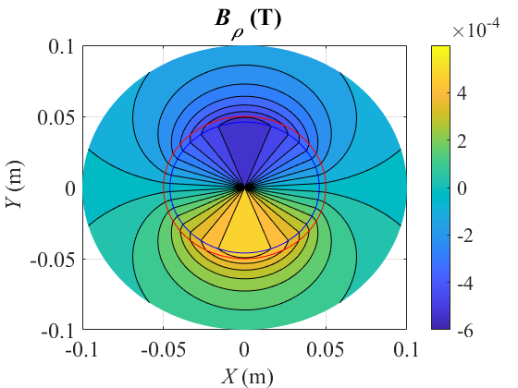
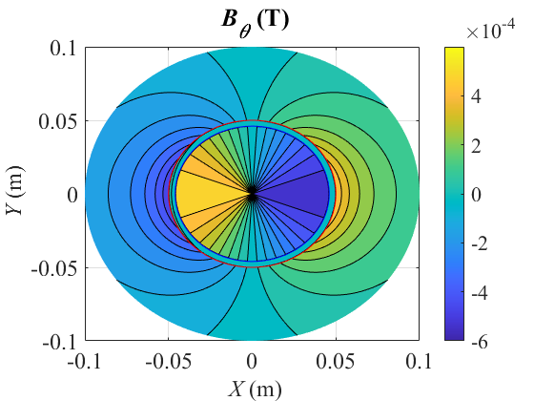
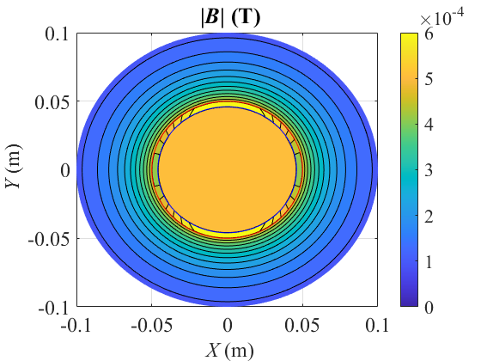
Simulation: Analytic model in 1D and 2D MATLAB

Slide 11
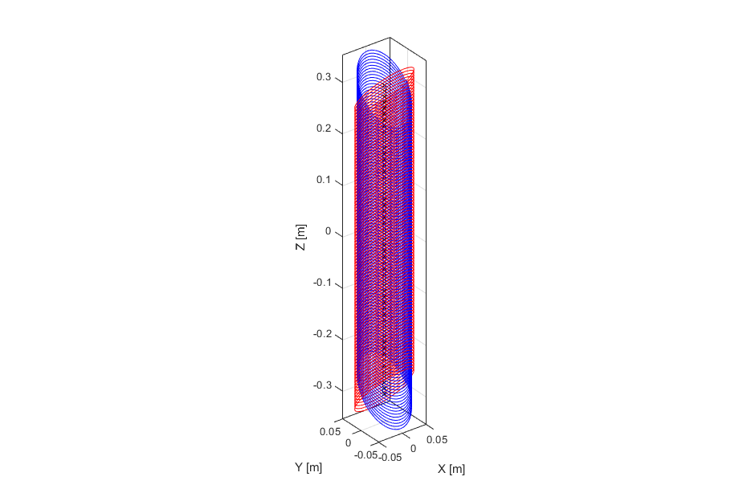
Simulation: Numerical model in 1D and 2D MATLAB
After calculations of the Biot-Savart law we obtain can numerically calculate the CCT magnet in 1D and 2D. 1D results are given at 45° and 2D results have a discretization of 1°.
M. N. Wilson, Superconducting magnets, Oxford: Clarendon Press, 1983.

Slide 12
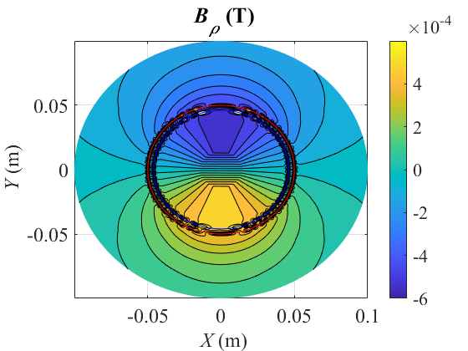
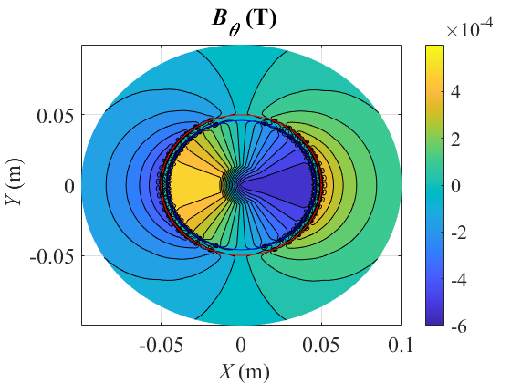
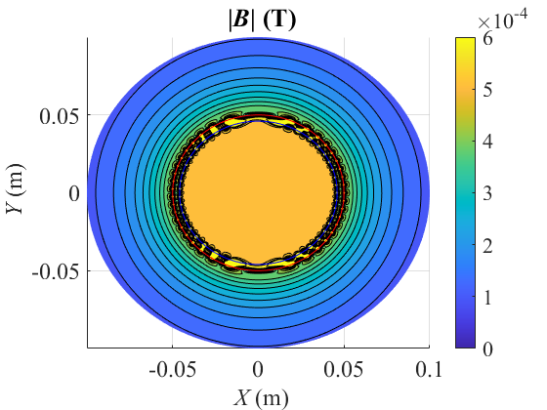
Simulation: Numerical model in 1D and 2D MATLAB

Slide 13
Simulations: Fields with MATLAB

Slide 14
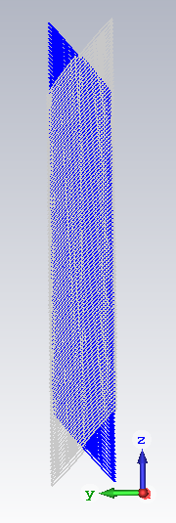
Simulation: 3D with CST
3D simulations of the magnet can be performed, quite easily, using CST

Slide 15
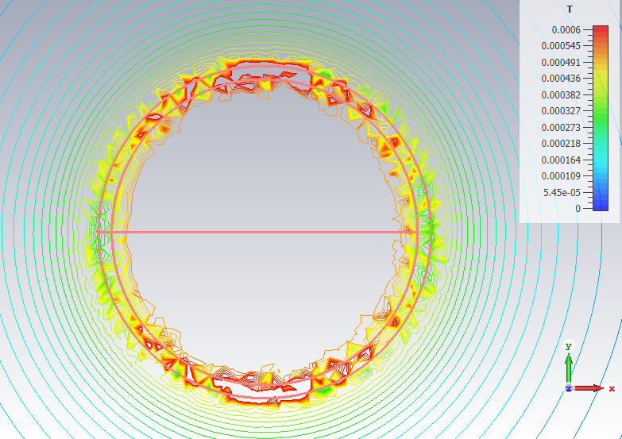
Simulation: 3D with CST

Slide 16
Future
Model using a CAD software to produce a step file
3Dprinting prototype. A company in Karlstad has a printer which is 300mm in diameter and 600mm in height
First print in PLA
Then Accura 25 if we want to cool it down
https://tractus3d.com/products/t1250/

